Slide 1
Arm | MeeGo | Linaro | Android
Organization | Linux Foundation auspices | UK non-profit | Industry consortium
Membership | No formal membership | Core, Club, Community | Unclear
Planning/gover-nance process | Open (?) meetings on IRC | Board, TSGs meet in private | Private meetings of members
License | LGPL | “in line” with upstreams | Apache v2
Corporate participants | 16 (more or less) inc. Intel, TI, Nokia?, AMD, Fujitsu, Renesas | 6 “commercial”: ARM, Freescale, IBM, Samsung, ST Ericsson, TI | “over 80,” esp. Mentor in embedded
Supported architectures | Atom (x86) and ARMv7-A, MIPS in progress | ARMv7: Cortex A8, A9, & A15 | ARMv7-A, ARMv5, PowerPC, x86, MIPS
Shipping products | WeTab, IndaMixx, Amino STB | Not yet | legion

Slide 2
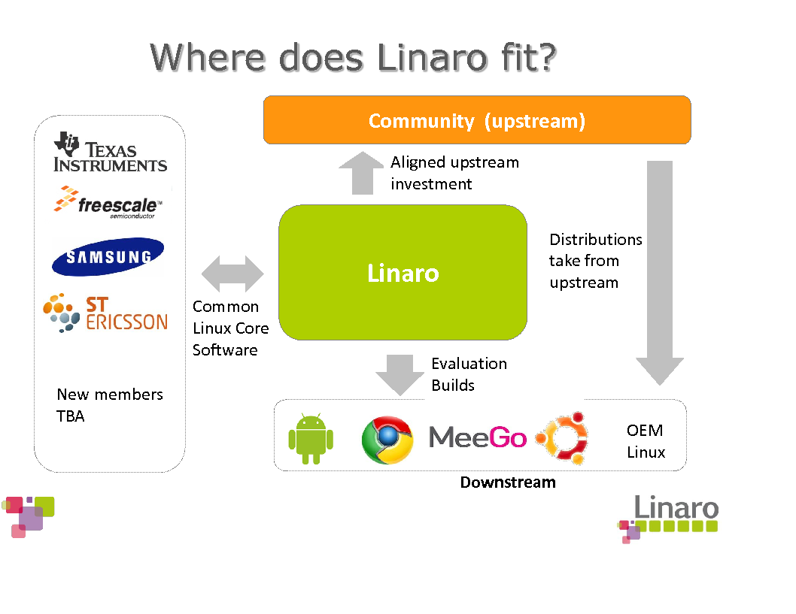

Slide 3
References
http://meego.com/about/governance
http://www.linaro.org/how-linaro-works/
http://www.openhandsetalliance.com/oha_faq.html
http://www.linaro.org/assets/LinaroSummaryQ111.pdf
http://developer.android.com/sdk/ndk/overview.html

