Slide 1



How to get involved: community projects
NOBDy wiki:
http://nobdy.wikia.com/wiki/Nobdy_Wiki
OBDGPSLogger: http://icculus.org/obdgpslogger/
LibOBD:
http://libobd.wikia.com/wiki/Libobd_Wiki
OBDref: https://github.com/canurabus/obdref
Mp3car: http://www.mp3car.com/

Slide 2
How to get involved: corporate-backed FLOSS
OpenXC: http://openxcplatform.com/
Ubuntu IVI Remix: http://linux.softpedia.com/progDownload/Ubuntu-IVI-Remix-Download-78078.html
Renault R-Link (Android): http://www.renault.com/en/innovation/plaisir-et-confort/pages/r-link.aspx
Bosch-ETAS Busmaster: https://github.com/rbei-etas/busmaster

Slide 3
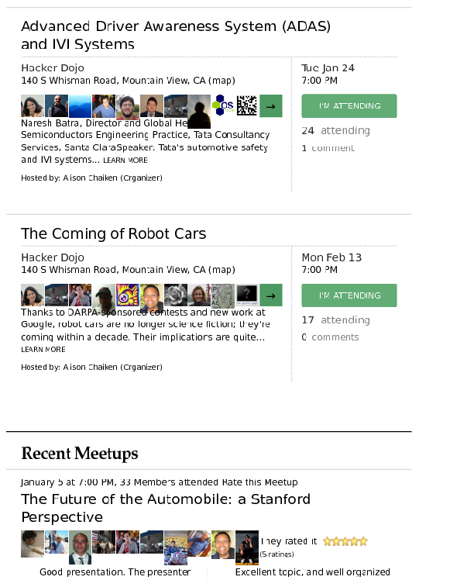

Silicon Valley Automotive Open Source Meetup http://www.meetup.com/Silicon-Valley-Automotive-Open-Source/
Completely
free!

Slide 4
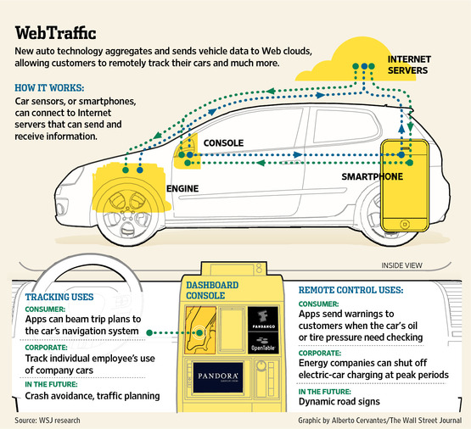
Back-end “cloud programming” in IVI

Slide 5
Features of nOBDy
Based on Qt toolkit and QML (Qt Modelling Language) – Booths 24 (Qt) and 67 (ICS)
TCP, Bluetooth, D-Bus support
Websocket/HTML5 browser interface based on JQuery Mobile
Provides communications interface to CAN (Controller Area Network) vehicle data bus
GPLv2, source on gitorious
Based on libobd, OBDGPSLogger, obdref and gpsd projects
Available as .deb and (soon) RPM packages

Slide 6
nOBDy's stack
Your Qt, QML or Javascript application here!
nOBDy plugin framework
QML
JQuery
HTML5
Qt
OpenLayers
OBDGPSLogger
OpenStreetMap
gpsd
libobd
Linux kernel and device drivers
New plugins that talk TCP can be written in any language.

Slide 7
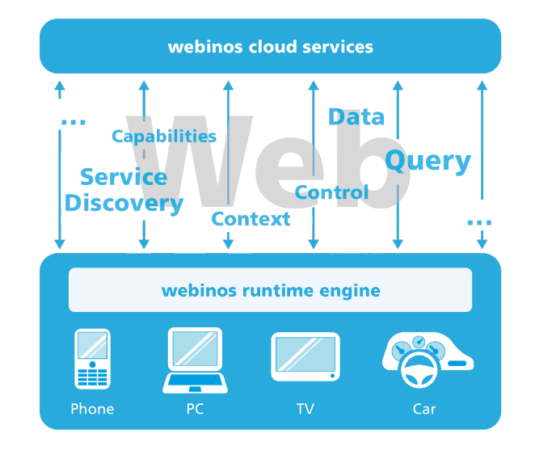
E.U.'s webinos project
http://dev.webinos.org

Slide 8

OpenXC Platform: Android and Arduino
http://openxcplatform.com/
Status: limited pre-release to selected developers

Slide 9
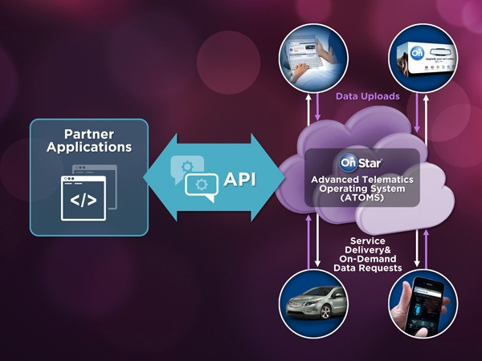
Cadillac User Experience based on MontaVista
Status: SDK expected, Spring 2012

Slide 10
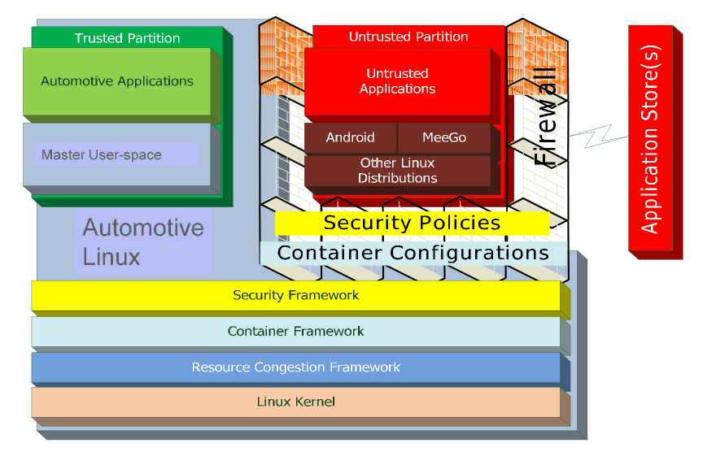
MontaVista's Automotive Linux stack
Courtesy Iisko Lappalainen, MontaVista, Embedded Linux Conf Europe 2011

Slide 11
OBDGPSLogger: Real-time Vehicle Diagnostics
http://icculus.org/obdgpslogger/

Slide 12
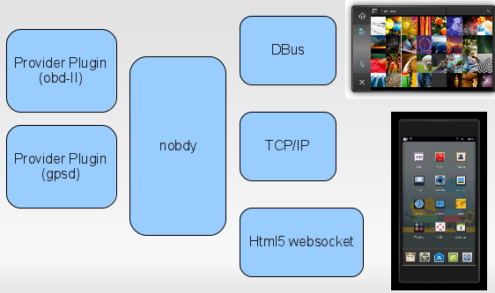
nOBDy is a GPL'ed plugin framework akin to gstreamer or pulseaudio
Plugin
framework
subscriber or
provider
Provider Plugin
(obdsim)
Subscriber plugin

Slide 13
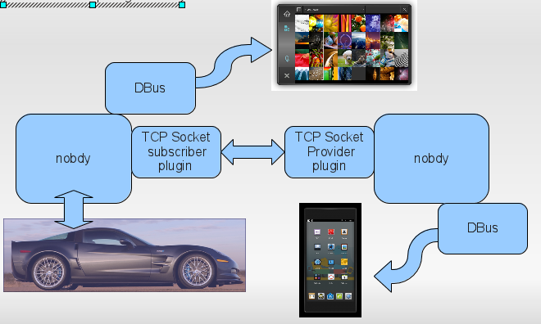
Use cases for nOBDy plugin framework

Slide 14
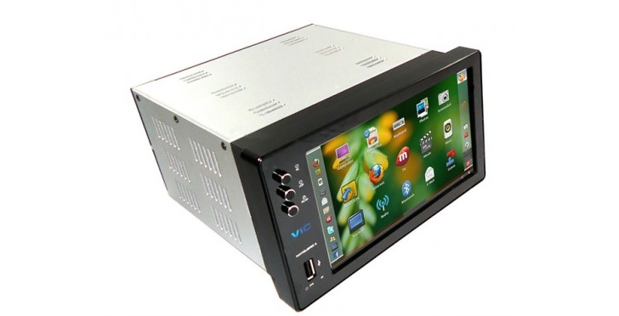
Ubuntu IVI Remix, released 12/2011
http://news.softpedia.com/news/Ubuntu-IVI-Remix-Beta-2-Officially-Released-242300.shtml
https://oem-share.canonical.com/share/ivi-remix/release-beta2-dec2011/

Slide 15
Bosch-ETAS CAN simulation tool
https://github.com/rbei-etas/busmaster

