Slide 1
Vehicular Networks
Alison Chaiken
alison@she-devel.com
Presented to the UCSC Extension course
“Networking Fundamentals"
Aug 9, 2021

Slide 2
Vehicular Networks
Common in automated systems and robotics:
Precision Timing Protocol (IEEE 1588), to sync clocks of hosts
Time-Sensitive Networking (IEEE 802.1 and 1722), to prioritize critical messages
  CAN or Internet payload
CV2X and DSRC wireless (not 802.11)
Controller Area Network

Slide 3
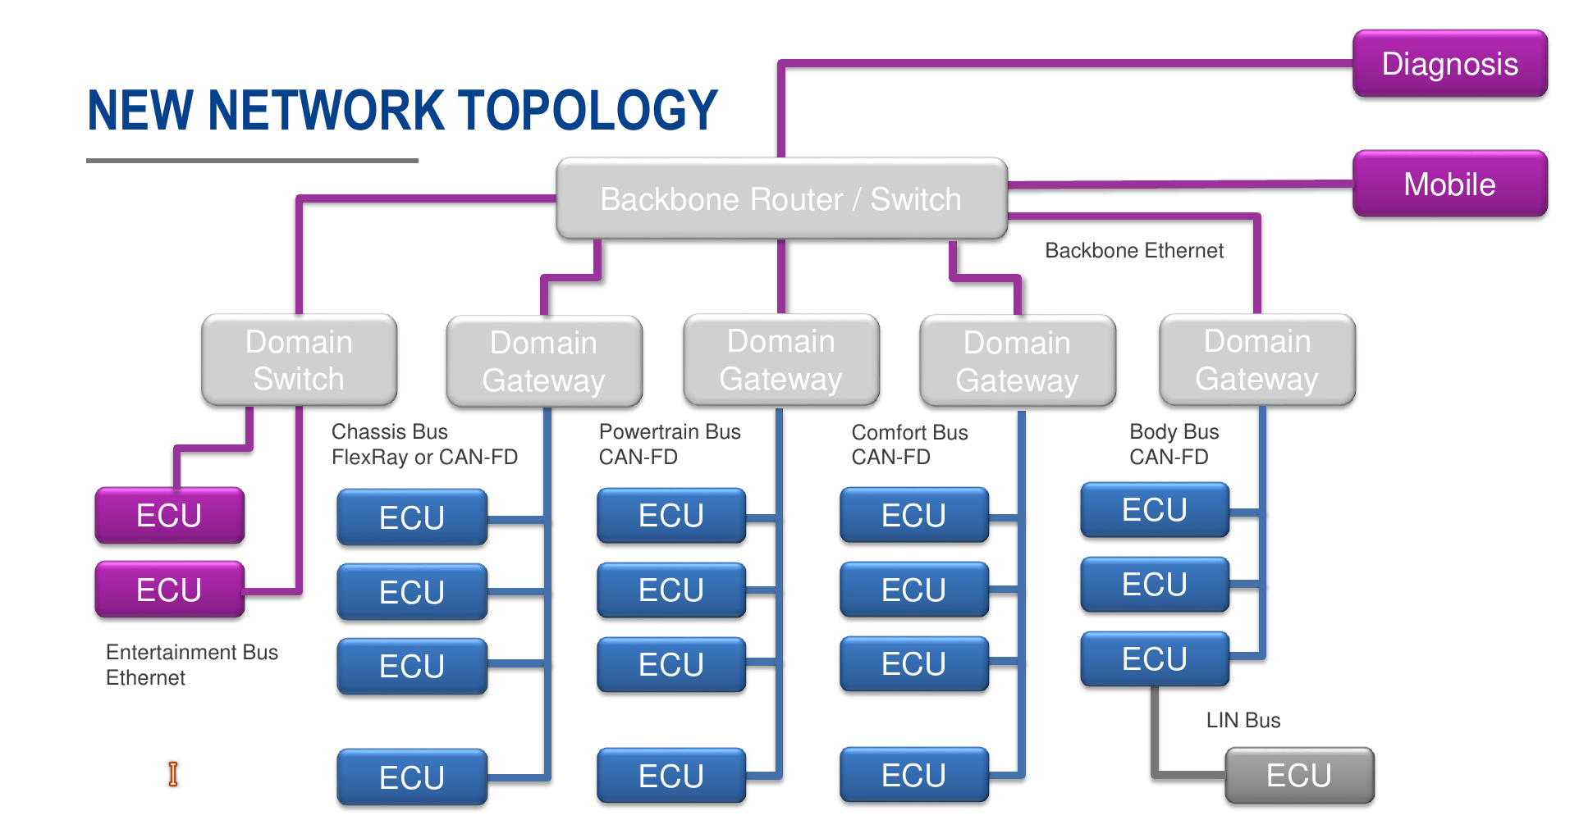
Renesas Network for Modern Autos
entrance
facilities
external
gateways/firewalls
Each vehicle is an Autonomous System.

Slide 4
Motivation: Vehicular Subnetworks
Different bus speeds and cabling.
Different security domains.
  Problem: interconnection of various domains.
  Example: driver displays with brake and music-player info.
CAN gateways interconnect subnetworks.

Slide 5
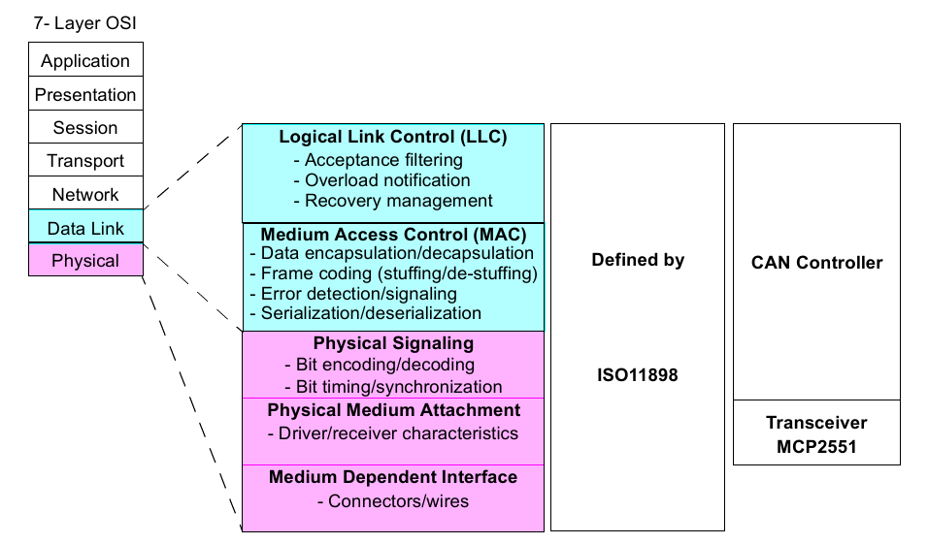
Courtesy Microchip

Slide 6
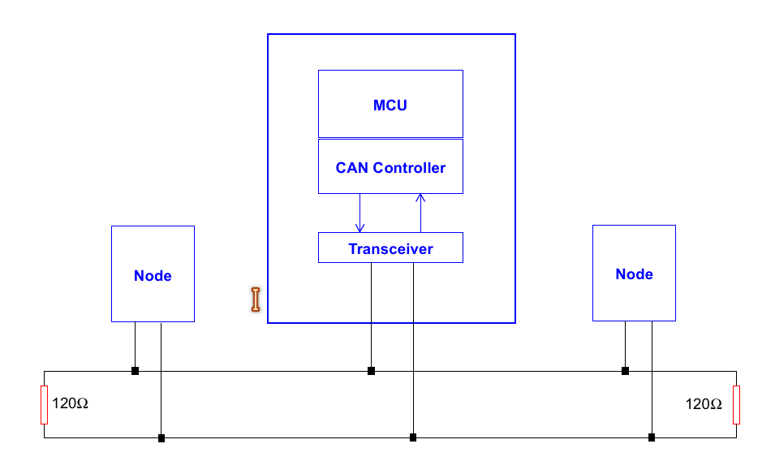
Courtesy Microchip
Sensor or actuator

Slide 7
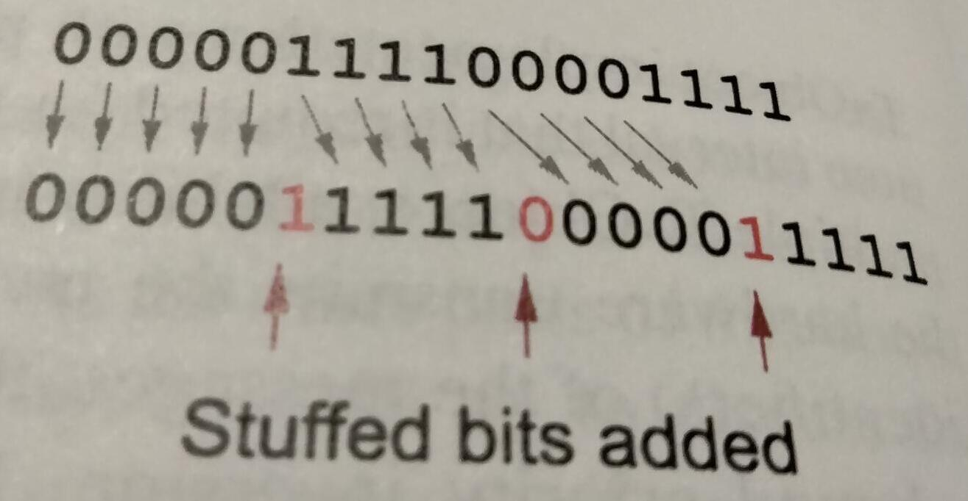
CAN Clock
Clock is derived from data “bit stuffing.”
From Understanding and Using the Controller Area Network Communication Protocol

Slide 8
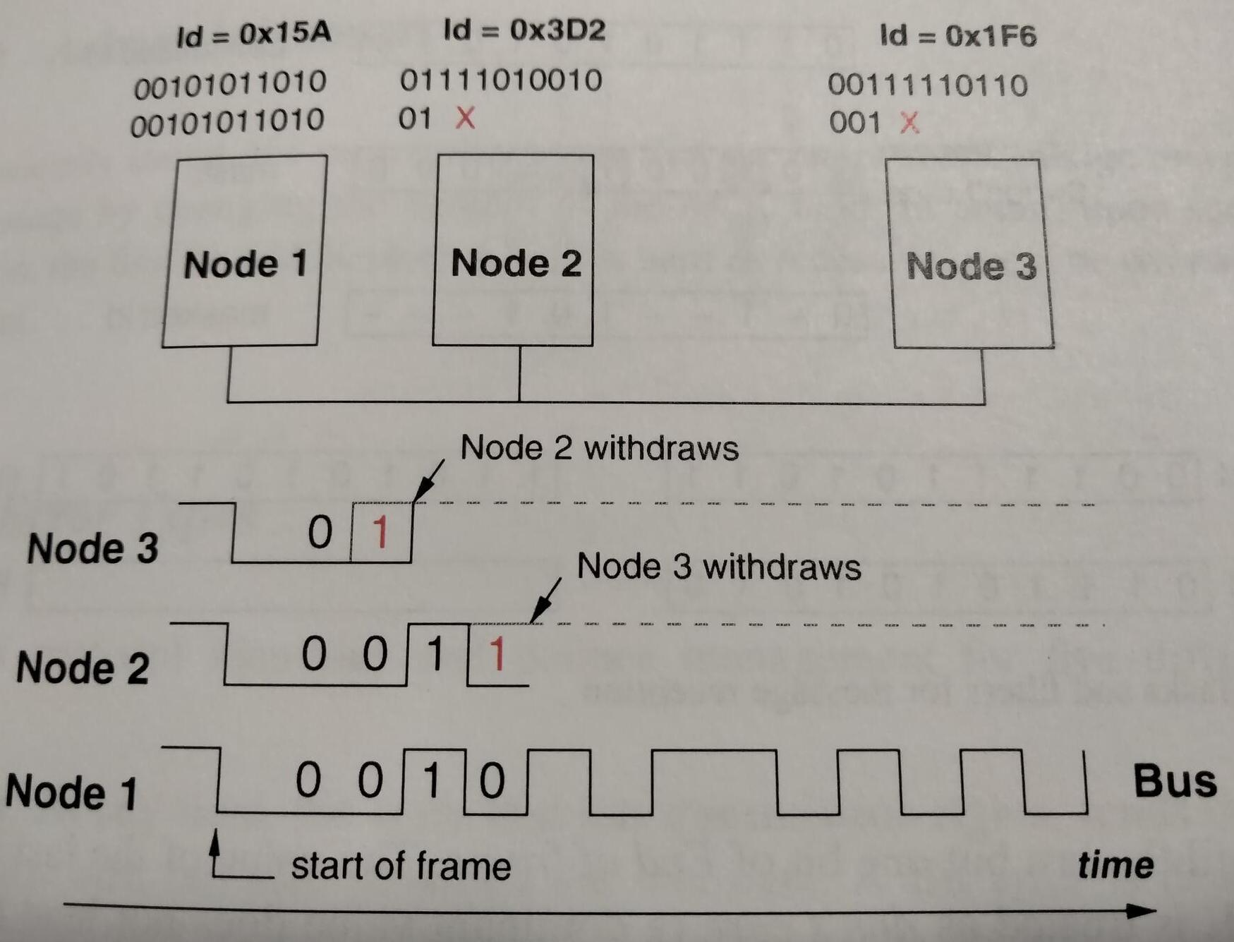
Bus Arbitration: CSMA/Collision Resolution
From Understanding and Using the Controller Area Network Communication Protocol

Slide 9
CAN Data Frame Basics
11- or 29-bit ID determined by “claiming” procedure.
Messages are acknowledged (like WiFi).
Protocol supports Remote Request and Error frames.
Classic CAN: 8B MTU, up to 1 Mb/s.
CAN FD: 64B MTU, up to 5 Mb/s.
All messages are broadcast: connectionless.
HW filters determine which messages an ECU (electronic control unit) processes.

Slide 10
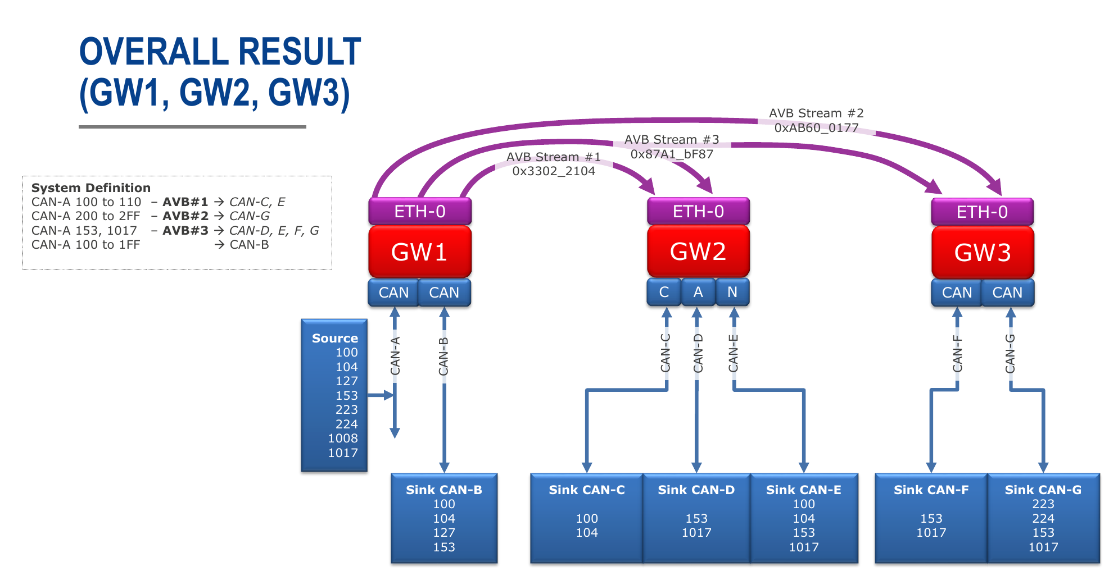
Renesas Gateway Routing: static packet filtering
AVB = audio-video bridging (IEEE 1722)
CAN IDs

Slide 11
Summary
Like Ethernet and IP, is old but evergreen.
Differs from TCP/IP at every protocol layer.
CAN classic and CAN FD are PHY and Link Layer protos.
High layers have many standards and vendors.
Wide application in vehicles, robotics, industrial applications, agriculture . . .

Slide 12
#!/bin/bash
set -e
set -u
echo "****Existing networks before VCAN addition****"
ip link show
echo "***********************************************"
echo ""
# tell Linux about virtual CAN nodes: necessary one time
#sudo ip link add type vcan
sudo ip link add dev vcan0 type vcan
sudo ip link set up vcan0
echo "****Networks after VCAN addition****"
ip link show
echo "***********************************************"
echo ""
#!/bin/bash
set -e
set -u
count=$(ip link show | grep vcan | wc -l)
echo "Removing ${count} vcan devices"
echo ""
while (( --count > -1 )); do
echo "removing vcan${count}"
sudo ip link del dev vcan${count}
echo ""
done
echo "****Removed vcan devices:****"
ip addr list
echo "***********************************************"
Then $ cangen -n 5 -m

Slide 13
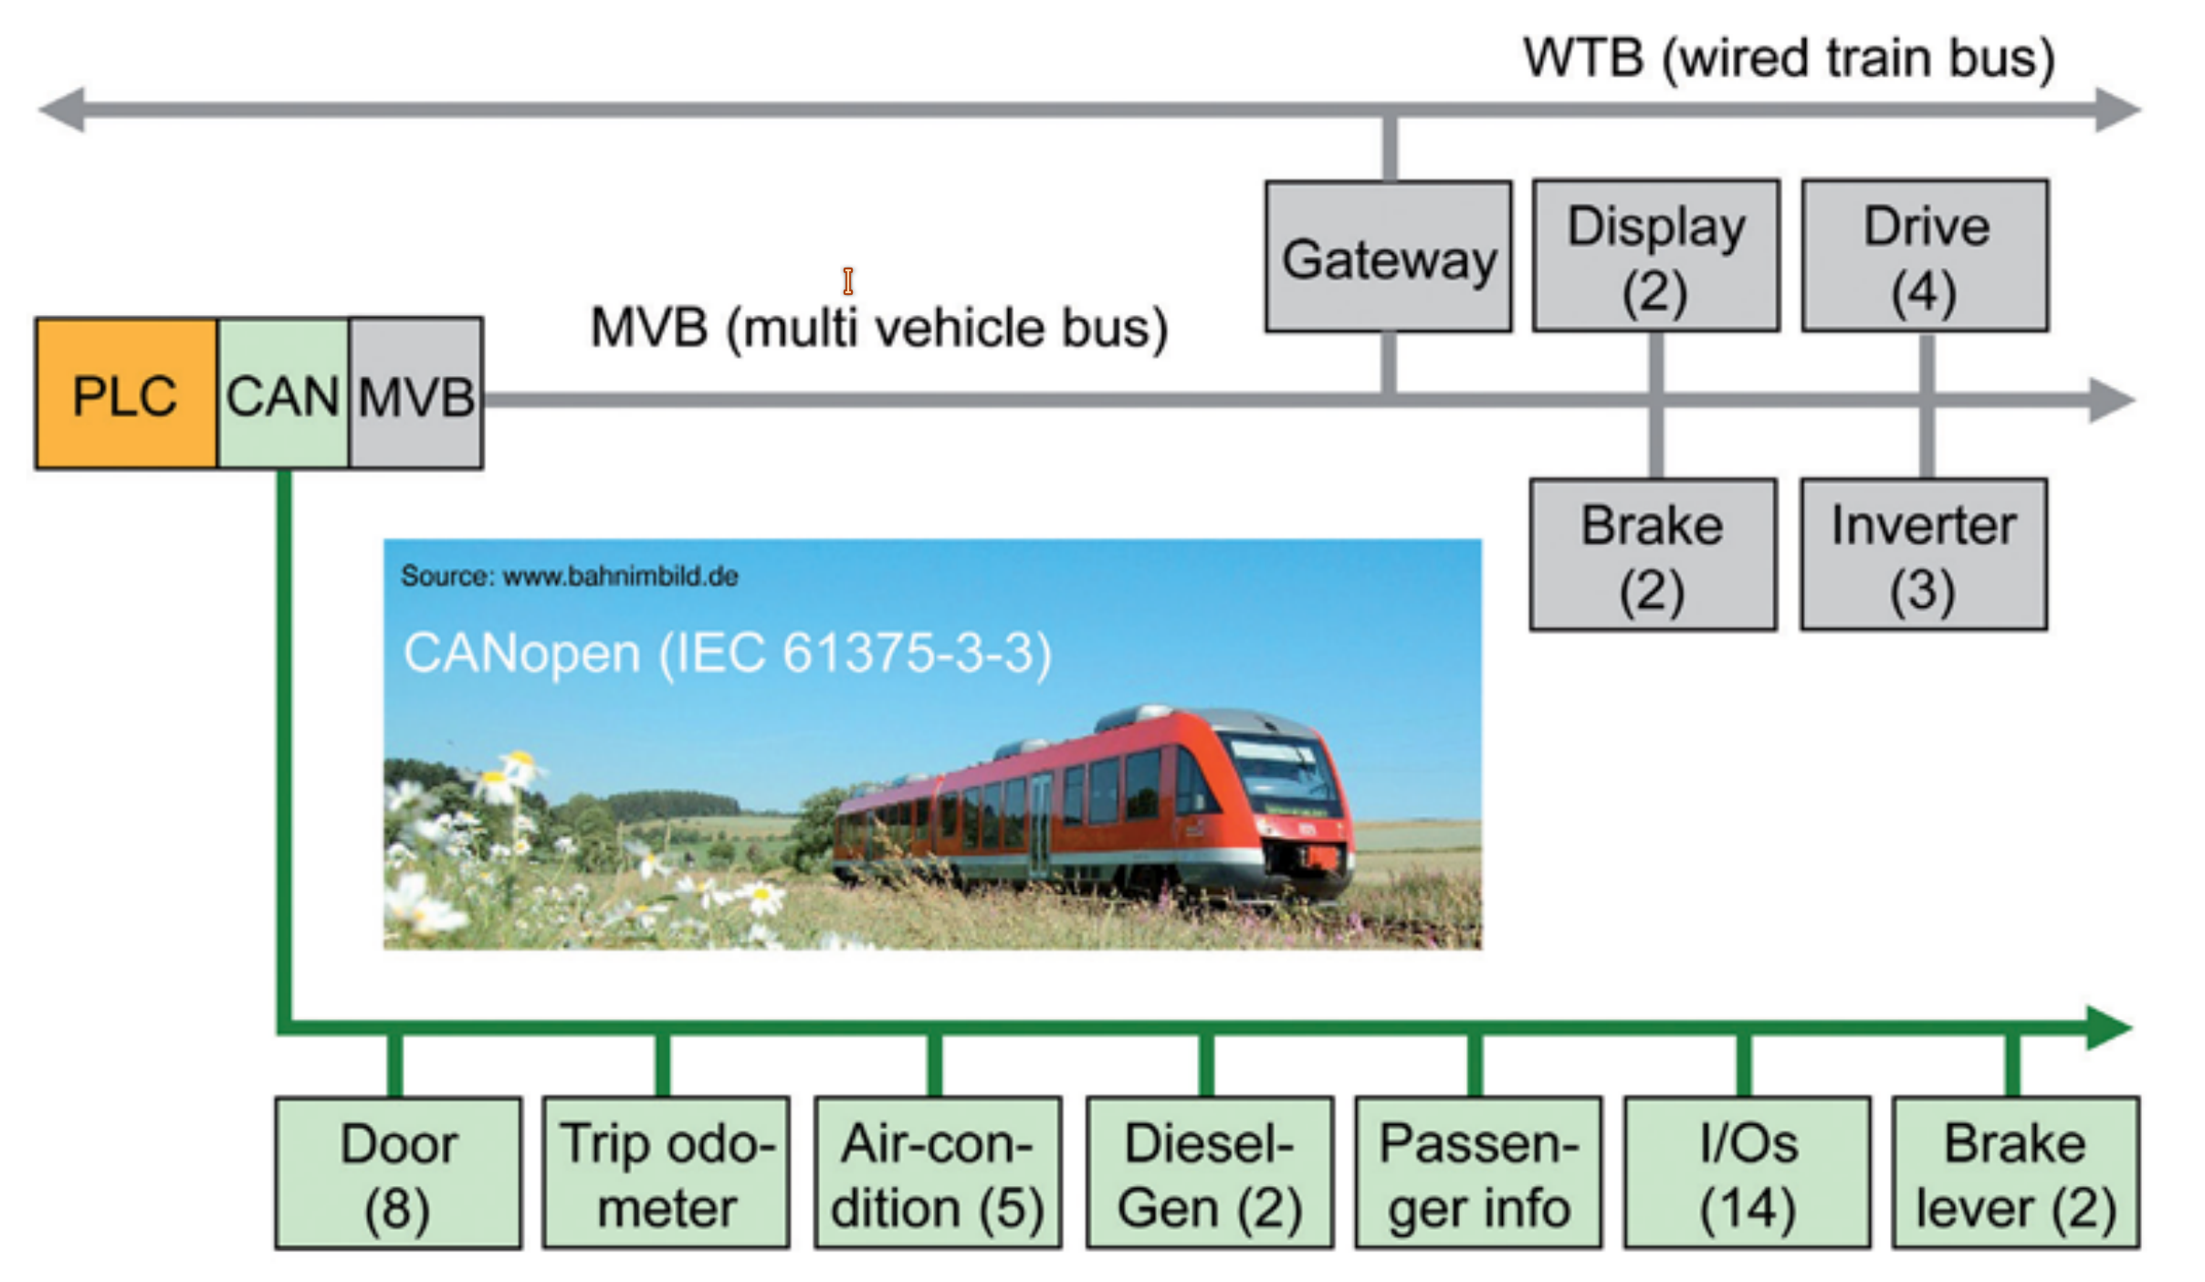
Example: railroad control system

Slide 14
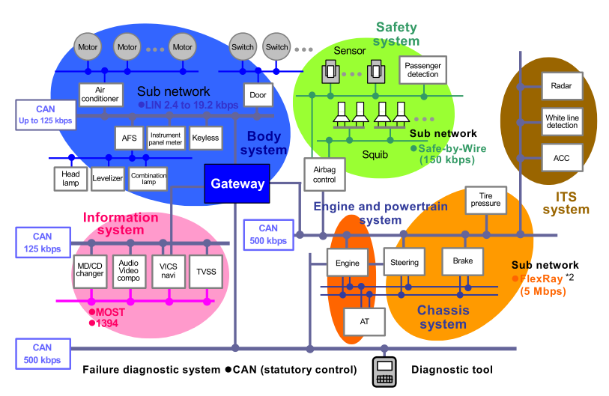

Older image of passenger vehicle network
Cameras and LIDARS:
TSN
TSN

Slide 15
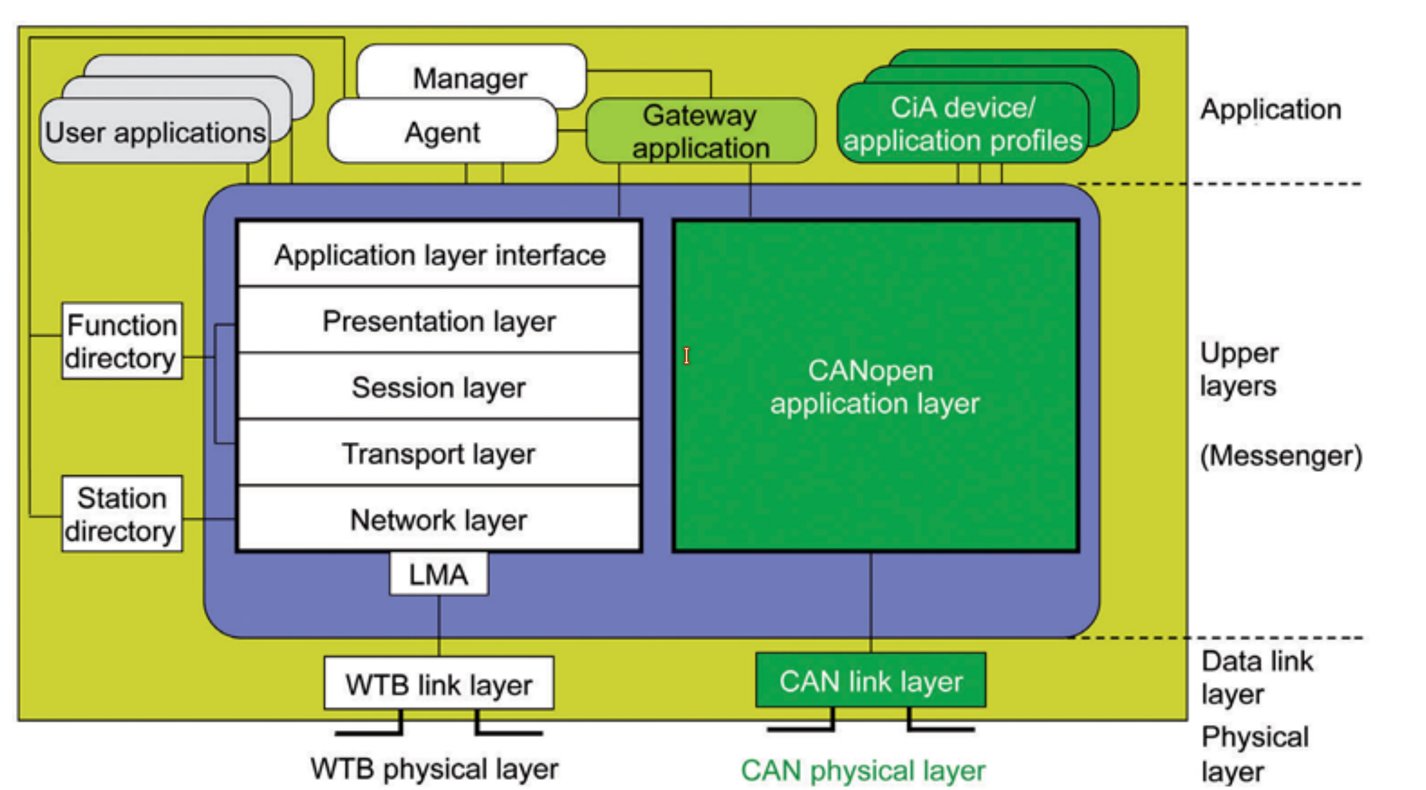
CANopen and ISO-TP provide higher levels
Example: railroad gateway

