Slide 1

Linux: the first second
Alison Chaiken
alison@she-devel.com
January 25, 2018
All code for demos
Related blog post at opensource.com

Slide 2

Fast boot: US gov't requires reverse-video in 2s
Panic Concern ensues among automakers shipping Linux.

Slide 3
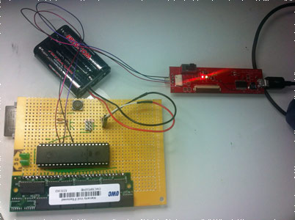
Slow boot: Linux boot on 8-bit AVR
“uARM is certainly no speed demon. It takes about 2 hours to boot to bash prompt”.
System:
8-bit micro,
external storage,
external RAM,
32-bit ARMv5 emulation.

Slide 4
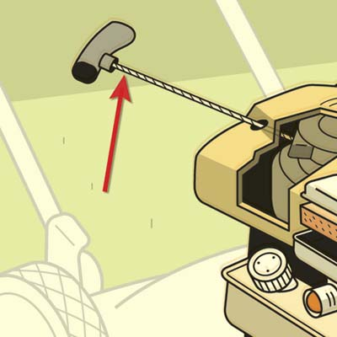
How Linux starts
What precisely does “off” mean?
Fun with bootloaders
ACPI vs DTB
The kernel as PID 0
How does PID 1 start?
What is an initrd?
http://spartakirada.com/lawnmower-pullcord/

Slide 5
bootloader
(u-boot,
GRUB)
head_64.S
start of
zImage
Boot ROM in CPU
“Kernel startup
entry point”
Decompress
cpu_idle
main.c
start_kernel()
rest_init()
kernel/smp.c
Boot
secondary
cores
spawn
2nd thread
smp_init()
kernel_init
do_initcalls()
arch/arm/kernel/smp.c
secondary_start_kernel()
start
userspace
probe
devices
init
device drivers
Notes:
verify_cpu() and secondary_start_kernel are head_64.S, line 223:
#ifdef CONFIG_HOTPLUG_CPU
/*
* Boot CPU0 entry point. It's called from play_dead(). Everything has been set
* up already except stack. We just set up stack here. Then call
* start_secondary() via .Ljump_to_C_code.
*/
ENTRY(start_cpu0)
movq initial_stack(%rip), %rsp
jmp .Ljump_to_C_code
ENDPROC(start_cpu0)
#endif
/* Both SMP bootup and ACPI suspend change these variables */
__REFDATA
.balign 8
GLOBAL(initial_code)
.quad x86_64_start_kernel

Slide 6

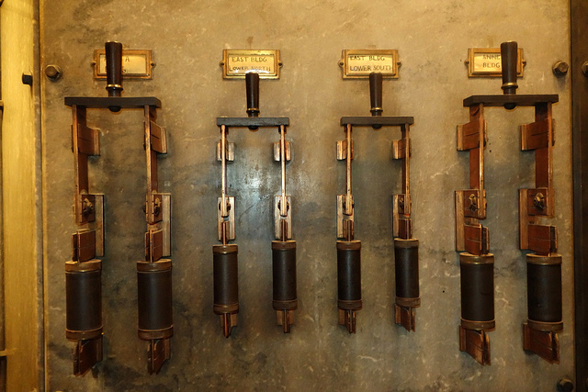
Applying power
https://www.flickr.com/photos/nicknormal/11939558655/in/album-72157644792628117/

Slide 7
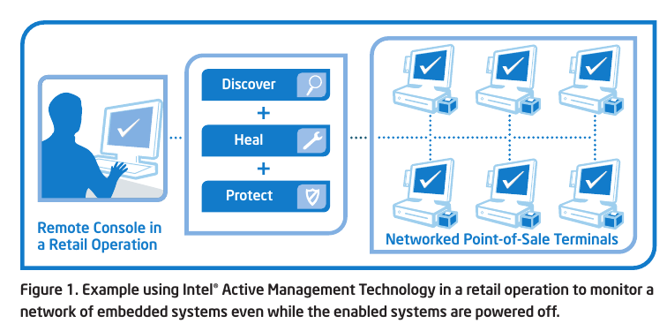
x86_64: Never genuinely off
Source: Intel
IPMI: run from Baseboard Management Controller
AMT: run from Platform Controller Hub

Slide 8
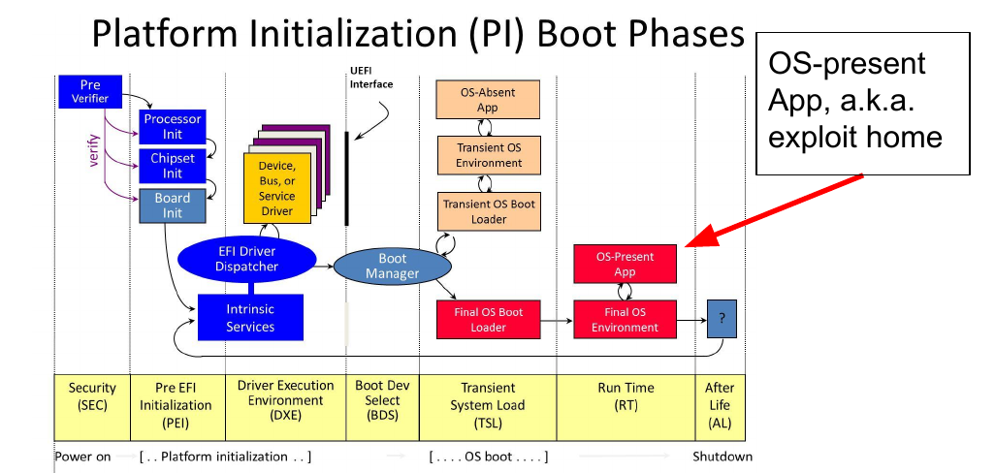
{
GRUB (x86)
or
u-boot (ARM)
on PCH
on CPU
Source: Minnich et al., ELCE2017
Notes:
For people who thought that the systemd project was not ambitious enough.
The IME running on the PCH is more or less a 'shim bootloader' that runs before the main one (e.g. GRUB or u-boot).
me_cleaner project removes most of IME but not SMM that runs on PCH.

Slide 9
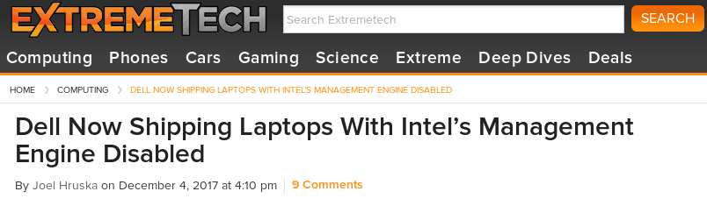
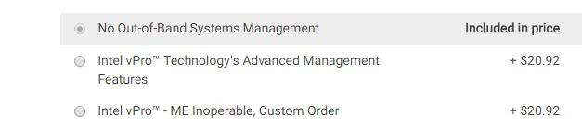
Purism, System76, Dell turn AMT off
Source: ExtremeTech, December 2017

Slide 10
ARM Bootloader:
u-boot

Slide 11
Fun with u-boot's sandbox
(demo placeholder)
How-to:
  make ARCH=sandbox defconfig
  make
  ./u-boot
Even more fun:
  make_test_disk.sh
  file test.raw; gdisk -l test.raw
  ./u-boot
  host bind 0 test.raw
  printenv
  gpt read host 0
  fatls host 0:1
  fdt addr $fdt_addr_
  fdt header

Slide 12
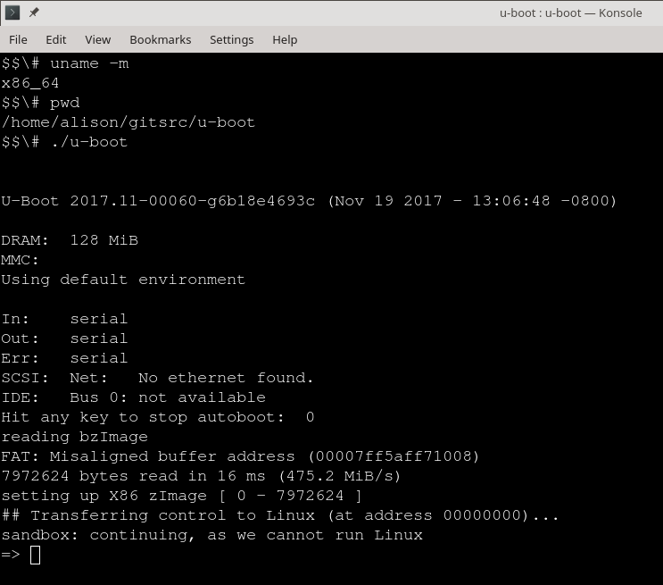
demo placeholder
Notes:
You can run u-boot under host GDB.
You can run u-boot in CI testing.
U-Boot passes pointers to the DTB and initrd to the kernel before it jumps into kernel code.

Slide 13
bootloader
(u-boot,
GRUB)
head_64.S
start of
zImage
Boot ROM in CPU
“Kernel startup
entry point”
Decompress
Pass cmdline +
device-tree or ACPI
How the system reaches the kernel initialization stage
Notes:
verify_cpu() and secondary_start_kernel are head_64.S, line 223:
#ifdef CONFIG_HOTPLUG_CPU
/*
* Boot CPU0 entry point. It's called from play_dead(). Everything has been set
* up already except stack. We just set up stack here. Then call
* start_secondary() via .Ljump_to_C_code.
*/
ENTRY(start_cpu0)
movq initial_stack(%rip), %rsp
jmp .Ljump_to_C_code
ENDPROC(start_cpu0)
#endif
/* Both SMP bootup and ACPI suspend change these variables */
__REFDATA
.balign 8
GLOBAL(initial_code)
.quad x86_64_start_kernel

Slide 14


Kernel's “address book”: ACPI or Device-tree
ACPI tables in SPI-NOR flash.
At boot:
'dmesg | grep DT'
Examine:
'acpidump | grep Windows'
Get source: run iasl to extract
Modify: boot-time 'BIOS' menu.
device-tree in /boot.
At boot:
each driver reads the DTB.
Examine:
'strings /boot/foo.dtb'
Get source: from kernel
Modify: edit source, run dtc,
copy to /boot.
Notes:
The DTB or ACPI data are akin to the environmentpassed in by execve().
They are the kernel's “address book” for the HW.

Slide 15
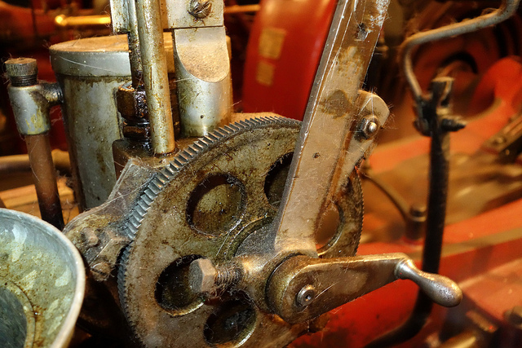
Starting up
the kernel
https://www.flickr.com/photos/nicknormal/11939856433/in/album-72157644792628117/
Notes:
Show this on previous slide to introduce topic of device-tree and kernel loading. Note that the middle command could be initrd.
=> printenv custom_bootcmd
custom_bootcmd=host bind 0 test.raw;setenv bootfile bzImage;load host 0:1 ${kernel_addr_r} ${bootfile};load host 0:1 ${fdt_addr_r} u-boot.dtb;bootz ${kernel_addr_r} - ${fdt_addr_r}

Slide 16

The kernel is an ELF binary
Extract vmlinux from vmlinuz:
  <path-to-kernel-source>/scripts/extract-vmlinux \
  /boot/vmlinuz-$(uname -r) > vmlinux
vmlinux is a regular ELF binary:
  file vmlinux; file /bin/ls
  readelf -e vmlinux; readelf -e /bin/ls
https://flic.kr/p/6xuhiK

Slide 17
?
?
?
Quiz:
How do ELF binaries start?
?
?
?
?
?
Notes:
a) main()
b) execv
c) bash
d) ld.so
Where do argc and argv come from?

Slide 18
?
?
?
Quiz:
Where do argc and argv
come from?
?
?
?
?
?
Notes:
strace /bin/ls /var /tmp 2>&1 | head
Better without '-v'.

Slide 19
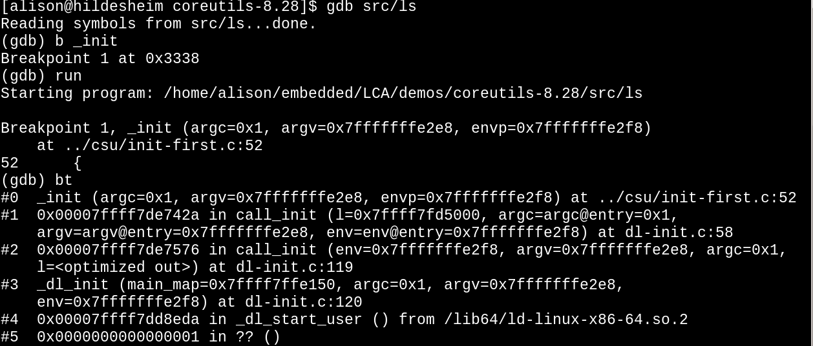
Inspecting the start of ls with GDB
demo placeholder
Notes:
[alison@hildesheim cross-test]$ file showBits
showBits: ELF 32-bit LSB executable, ARM, EABI5 version 1 (SYSV), dynamically linked, interpreter /lib/ld-linux-armhf.so.3, for GNU/Linux 3.2.0, BuildID[sha1]=09f3b20e5fd4ca6480df28aa4909ad5082c4031c, with debug_info, not stripped
[alison@hildesheim cross-test]$ ./showBits
/lib/ld-linux-armhf.so.3: No such file or directory
[alison@hildesheim cross-test]$ gdb showBits_x86
Reading symbols from showBits_x86...done.
(gdb) b __libc_start_main
Function "__libc_start_main" not defined.
Make breakpoint pending on future shared library load? (y or [n]) y
Breakpoint 1 (__libc_start_main) pending.
(gdb) run
Starting program: /home/alison/embedded/LCA/demos/cross-test/showBits_x86
Breakpoint 1, __libc_start_main (main=0x555555554808 <main>, argc=0x1,
argv=0x7fffffffe248, init=0x555555554850 <__libc_csu_init>,
fini=0x5555555548c0 <__libc_csu_fini>, rtld_fini=0x7ffff7de99e0 <_dl_fini>,
stack_end=0x7fffffffe238) at ../csu/libc-start.c:133
133 {
[alison@hildesheim cross-test]$ ls -l ../csu
lrwxrwxrwx 1 alison alison 29 Jan 6 14:41 ../csu -> /usr/src/glibc/glibc-2.25/csu/
Linaro provides an unstripped version of ld-linux-armhf.so, but Debian offers no unstripped ld-linux-x86_64.so.

Slide 20
Examining ELF binary start with GDB
(results depend on toolchain and libc)
Compile your C program with '-ggdb'.
gdb <some-binary-executable>
set backtrace past-main on
set backtrace past-entry on
Type 'run'
frame 1; list
Type 'info files'
Find 'Entry point'.
Type 'l *(hex address)'
Type 'l 1,80'
Type 'info functions' or 'info sources'
demo placeholder
Notes:
apt-get install glibc-source
ln -s /usr/src/glibc/glibc-2.25/sysdeps ../port/sysdeps

Slide 21
The kernel as PID 0
Userspace processes need to start need:
  stack,
  heap,
  STD* file descriptors
  environment
glibc and libgcc allocate these resources.
  Source is in start.S (ARM) and libc-start.c.
Corresponding kernel resources provided via inline ASM.
  Reads cmdline, device-tree or ACPI.

Slide 22
Examining ARM32 kernel start with GDB
(demo placeholder)
Type 'file vmlinux'. (If zImage, extract with linux/scripts/extract-vmlinux).
Type:
arm-linux-gnueabihf-gdb vmlinux
Type:
info files
Find 'Entry point'.
Type:
l *(hex address)
Type
  l 1,80

Slide 23
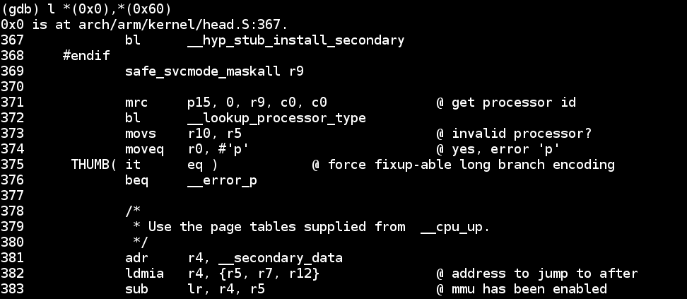
What's in ARM's head.S?
Type 'file vmlinux.o'
Try 'arm-linux-gnueabihf-gdb vmlinux.o'
Type 'info files'
Type 'l *(0x0)' <---- actually works!
demo placeholder
Kernel starts in head.S,
not start.S.

Slide 24
Examining x86_64 kernel with GDB
(demo placeholder)
Type 'file vmlinux'. (If zImage, extract with linux/scripts/extract-vmlinux).
Type:
gdb vmlinux
Type:
info files
Find '.init.text'.
Type:
l *(hex address)
Type
  l 200,290
Notes:
line 241 of head_64.S has
.quad x86_64_start_kernel

Slide 25
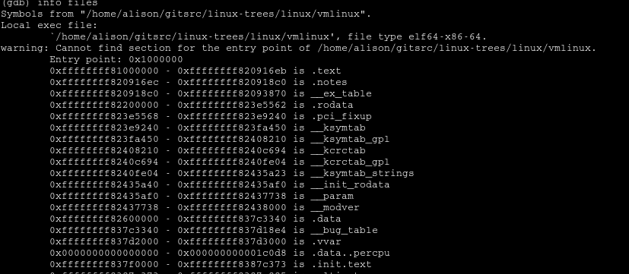
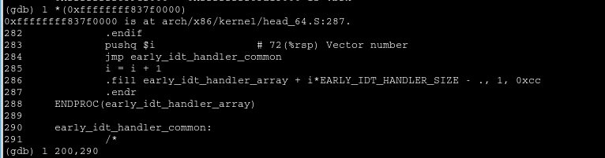
What's in x86_64 head_64.S?
demo placeholder

Slide 26
The kernel's main() function
start_kernel() {:
  boot_cpu_init();
  setup_arch(&command_line);
  page_alloc_init();
  pr_notice("Kernel command line: );
  mm_init();
  sched_init();
  init_IRQ();
  init_timers(); timekeeping_init();
  console_init();
  rest_init();
}
“Activate the first processor.”
process the device-tree
setup page tables
and start virtual memory
All timestamps before
are [0.000000]
start userspace
All on
one core!
Notes:
This part of boot is a lot like an RTOS: it is synchronous and single-threaded.
system_state=SYSTEM_BOOTING until rest_init.

Slide 27
bootloader
(u-boot,
GRUB)
head_64.S
start of
zImage
Boot ROM in CPU
“Kernel startup
entry point”
Decompress
main.c
start_kernel()
cpu_idle
rest_init()
spawn
2nd thread
kernel_init
Finish core kernel bringup
Notes:
When the second thread is launched, system_state changes to SYSTEM_SCHEDULING from SYSTEM_BOOTING.

Slide 28
bootloader
(u-boot,
GRUB)
head_64.S
start of
zImage
Boot ROM in CPU
“Kernel startup
entry point”
Decompress
cpu_idle
main.c
start_kernel()
rest_init()
spawn
2nd thread
kernel/smp.c
Boot
secondary
cores
smp_init()
kernel_init
arch/arm/kernel/smp.c
secondary_start_kernel()
Bring up symmetric
multiprocessing (SMP)
Notes:
verify_cpu() and secondary_start_kernel are head_64.S, line 223:
#ifdef CONFIG_HOTPLUG_CPU
/*
* Boot CPU0 entry point. It's called from play_dead(). Everything has been set
* up already except stack. We just set up stack here. Then call
* start_secondary() via .Ljump_to_C_code.
*/
ENTRY(start_cpu0)
movq initial_stack(%rip), %rsp
jmp .Ljump_to_C_code
ENDPROC(start_cpu0)
#endif
/* Both SMP bootup and ACPI suspend change these variables */
__REFDATA
.balign 8
GLOBAL(initial_code)
.quad x86_64_start_kernel

Slide 29

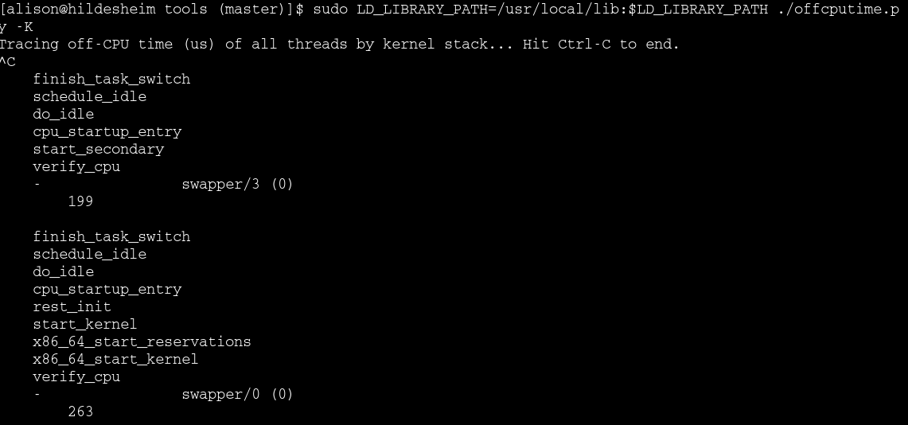
Kernel boot via BCC
Stack for 2nd core
demo placeholder
Stack for CPU0
x86_64_start_kernel: head_64.S
Notes:
This program shows stack traces that were blocked, and the total duration they were blocked. It works by tracing when threads block and when they return to CPU, measuring both the time they were blocked (aka the "off-CPU time") and the blocked stack trace and the task name. This data is summarized in kernel by summing the blocked time by unique stack trace and task name.

Slide 30
bootloader
(u-boot,
GRUB)
head_64.S
start of
zImage
Boot ROM in CPU
“Kernel startup
entry point”
Decompress
main.c
start_kernel()
cpu_idle
rest_init()
spawn
2nd thread
kernel/smp.c
Boot
secondary
cores
smp_init()
kernel_init
do_initcalls()
arch/arm/kernel/smp.c
secondary_start_kernel()
Bring up devices, filesystems . . .
probe
devices
device drivers
Notes:
verify_cpu() and secondary_start_kernel are head_64.S, line 223:
#ifdef CONFIG_HOTPLUG_CPU
/*
* Boot CPU0 entry point. It's called from play_dead(). Everything has been set
* up already except stack. We just set up stack here. Then call
* start_secondary() via .Ljump_to_C_code.
*/
ENTRY(start_cpu0)
movq initial_stack(%rip), %rsp
jmp .Ljump_to_C_code
ENDPROC(start_cpu0)
#endif
/* Both SMP bootup and ACPI suspend change these variables */
__REFDATA
.balign 8
GLOBAL(initial_code)
.quad x86_64_start_kernel

Slide 31
bootloader
(u-boot,
GRUB)
head_64.S
start of
zImage
Boot ROM in CPU
“Kernel startup
entry point”
Decompress
cpu_idle
main.c
start_kernel()
Finally, userspace.
rest_init()
spawn
2nd thread
kernel/smp.c
Boot
secondary
cores
smp_init()
kernel_init
do_initcalls()
arch/arm/kernel/smp.c
secondary_start_kernel()
start
userspace
probe
devices
init
device drivers
Notes:
verify_cpu() and secondary_start_kernel are head_64.S, line 223:
#ifdef CONFIG_HOTPLUG_CPU
/*
* Boot CPU0 entry point. It's called from play_dead(). Everything has been set
* up already except stack. We just set up stack here. Then call
* start_secondary() via .Ljump_to_C_code.
*/
ENTRY(start_cpu0)
movq initial_stack(%rip), %rsp
jmp .Ljump_to_C_code
ENDPROC(start_cpu0)
#endif
/* Both SMP bootup and ACPI suspend change these variables */
__REFDATA
.balign 8
GLOBAL(initial_code)
.quad x86_64_start_kernel

Slide 32
bootloader
(u-boot,
GRUB)
head_64.S
start of
zImage
Boot ROM in CPU
“Kernel startup
entry point”
Decompress
cpu_idle
main.c
start_kernel()
rest_init()
spawn
2nd thread
kernel/smp.c
Boot
secondary
cores
smp_init()
kernel_init
do_initcalls()
arch/arm/kernel/smp.c
secondary_start_kernel()
start
userspace
probe
devices
init
device drivers
Notes:
verify_cpu() and secondary_start_kernel are head_64.S, line 223:
#ifdef CONFIG_HOTPLUG_CPU
/*
* Boot CPU0 entry point. It's called from play_dead(). Everything has been set
* up already except stack. We just set up stack here. Then call
* start_secondary() via .Ljump_to_C_code.
*/
ENTRY(start_cpu0)
movq initial_stack(%rip), %rsp
jmp .Ljump_to_C_code
ENDPROC(start_cpu0)
#endif
/* Both SMP bootup and ACPI suspend change these variables */
__REFDATA
.balign 8
GLOBAL(initial_code)
.quad x86_64_start_kernel

Slide 33
Summary
Practicing with u-boot sandbox is comparatively relaxing.
Viewing the kernel as ELF helps to understand early boot.
Several processors and SW components participate in boot.
Until the scheduler and SMP start, the boot process is relatively simple.

Slide 34
Acknowledgements
Big thanks to Joel Fernandes and Akkana Peck for suggestions.
Shout-out to Linaro for making ARM so much easier than x86.

Slide 35
Major References
Embedded Linux Primer by Chris Hallinan and Essential Linux Device Drivers by Sreekrishnan Venkateswaran (books)
Booting ARM Linux by Russell King and THE LINUX/x86 BOOT PROTOCOL (Documentation/)
Program startup process in userspace at linux-insides blog, Michael Kerrisk's TLPI (book)
Matthew Garrett's comprehensive series on UEFI
Status of Intel Management Engine on various laptops (Coreboot) and servers (FSF)
Nov, 2017 Intel Management Engine exploits and vulnerability detection tool
All about ACPI talk by Darren Hart, ELCE 2013, Arch Wiki on hacking ACPI tables
'apt-get install debian-kernel-handbook'; GDB docs chapter 8

Slide 36

Cold-boot may become rare
Source: Micron
Specs:
ArsTechnica
AKA,
'Optane'
by Intel
Non-volatile RAM  suspend even for brief inactivity.
Minimal diff between 'suspend' and 'hibernate'?
Linux drivers: Matthew Wilcox, XIP DAX

Slide 37

About Initrds

Slide 38
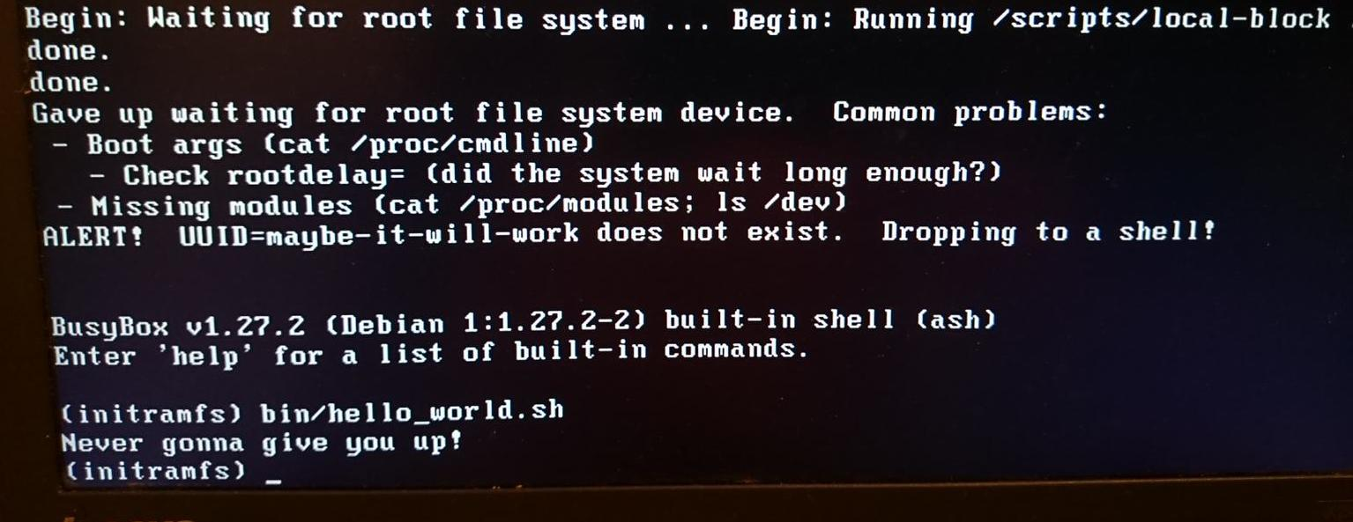
Booting into Rescue Shell

Slide 39
What is an initrd anyway?
'init ramdisk' = filesystem that is loaded into memory by the kernel before the rootfs mounts.
Why?
  To provide a 'rescue shell' in case rootfs doesn't mount.
  To provide modules that don't fit in zImage.
  To provide a safe environment to run agressive tests.
  To facilitate software updates on devices with limited storage.

Slide 40
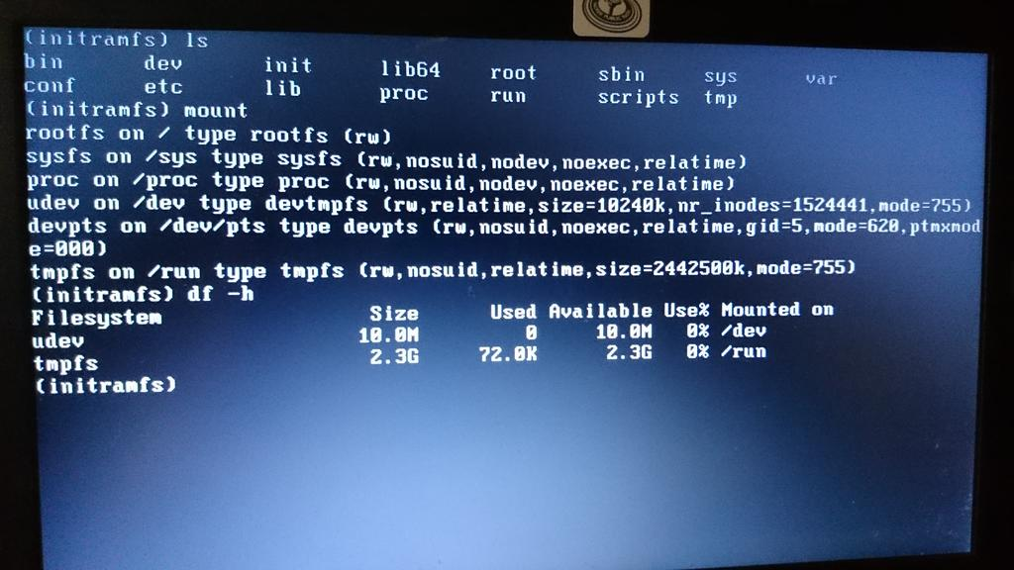
Exploring initramfs

Slide 41
What's in an initrd and why?
Boot into the rescue shell by providing a broken cmdline in /boot/grub/grub.cfg
  Type 'ls'
Or try 'lsinitramfs /boot/$(uname -r)'
initrd is a gzipped cpio archive:
  cp /boot/initrd-$(uname -r) /tmp/initrd.gz
  gunzip /tmp/initrd.gz
  cpio -t < /tmp/initrd

Slide 42
OMG! My life is over! (rescue shell tips)
Inhale on a 4-count, then exhale on a 10-count.
Oh no! 'help' scrolls pages of unreadable crap!
Relax your jaw. Make circles with your neck.
Read 'man busybox'.
'help | grep' works in busybox.
Look in /bin and /sbin. There's fsck!!
You have sed and vi (but not emacs ;-( )
Type 'reboot -f' or 'exit' when you are bored.

Slide 43
How to create your own initrd
Unpack one that already works with gunzip and 'cpio -i'
Copy in your binary.
Use gen_initramfs.h from kernel source tree:
  scripts/gen_initramfs_list.sh -o <archive> <path to source>
Run 'lsinitramfs <archive>' to check the result.
cp <archive> /boot; edit /boot/grub/grub.cfg
CAUTION: your system boots fine, right? You're crazy to mess with the bootloader, you moron.
Run grub-script-check.

Slide 44
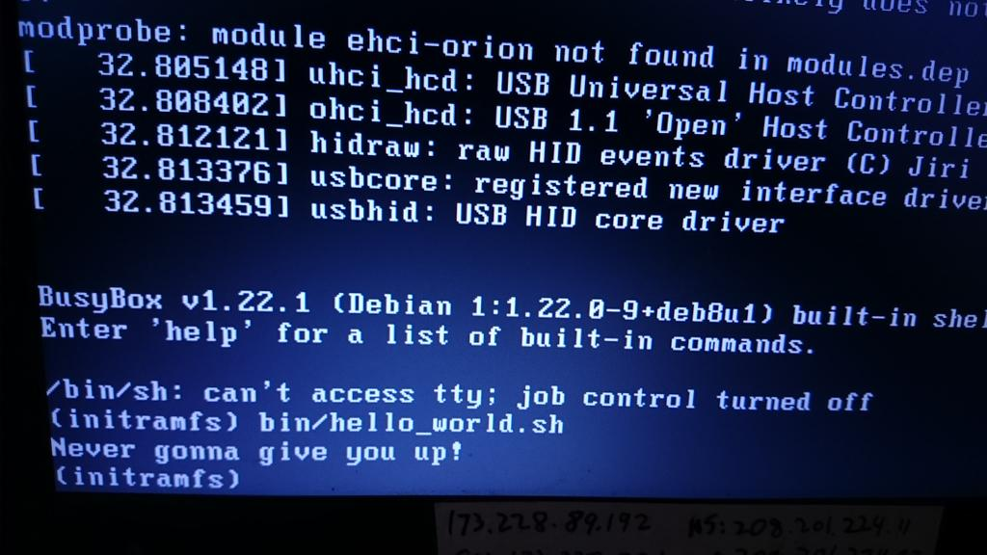
The magnificent result!

Slide 45
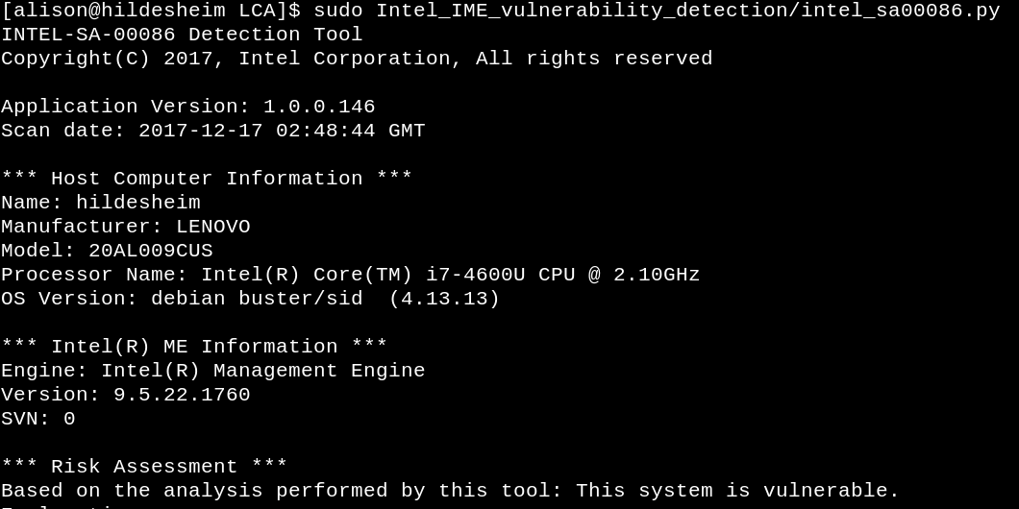
The Lenovo laptop on which the slides were created has known IME vulnerabilities described by unpatched CVEs. This has nothing to do with Meltdown and Spectre.

Slide 46
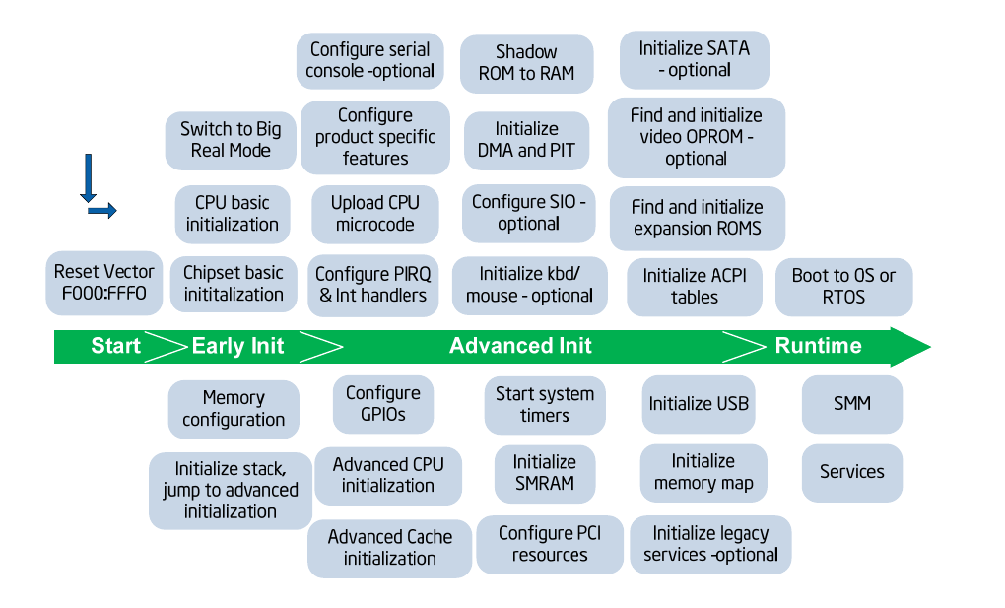
Bootloaders according to Intel
Read
device-tree
(ARM)

Slide 47
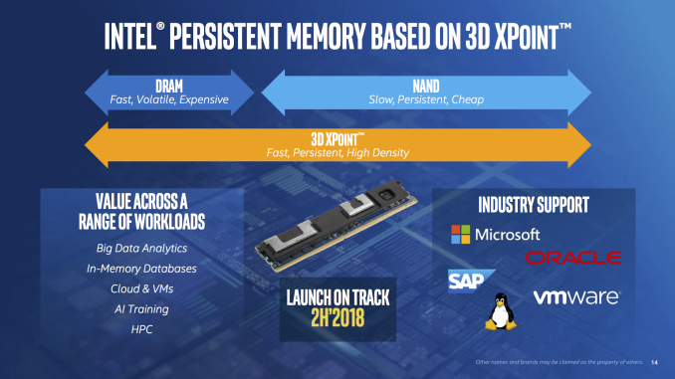
Coming soon to a system near you
Source:
Anandtech

Slide 48
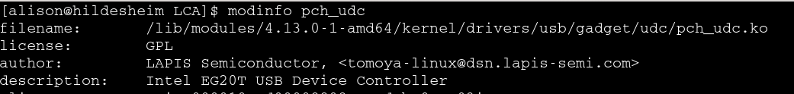
Investigating your laptop's PCH
Try:
  lsmod | grep pch
Try:
  find /lib/modules/$(uname -r)/ -name “*pch*”
Then (for example):
EG20T = Intel Topcliff PCH

Slide 49
Why bootloaders have two parts
ARM: “SPL”, “XLoader” or “MLO” in addition to u-boot.img.
Problem: DRAM controller must be initialized.
Solution: load into SRAM ('OCRAM' in i.MX6, 'l2ram' for TI).
  Why this works: SRAM (and pNOR) are mapped memory.
Problem: SRAM is little! (256K on i.MX6, 2 MB on DRA7x).
Solution: start with a tiny SPL.

Slide 50
Warm vs. power-on reset
 | Clears memory? Restarts clocks? | Pros | Cons | Examples
Power-on Reset | Yes, then reads boot-mode pins. | Won't fail. | Slightly slower. | Plug-in device
Warm Reset | DDR set to 'self-refresh', then reset clocks and jump to stored address. | Faster; retains 'reset reason' and RAM data. | Can fail. | 'reboot'; watchdog; JTAG

Slide 51
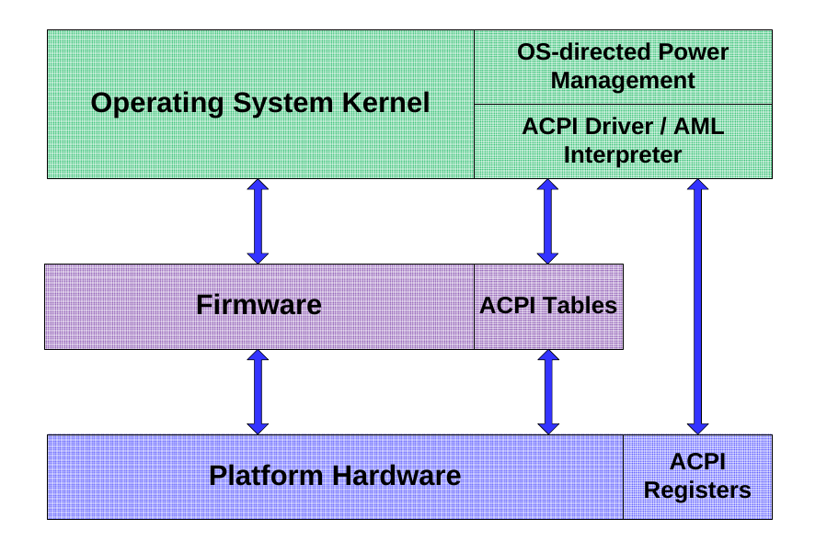
Advanced Configuration and Power Interface
Source: Intel

Slide 52
do_bootm_states = u-boot state machine
bootm.c<common>
BootROM
(internal EEPROM)
***
bootm_start()
bootm_find_os()
bootm_load_os()
bootm_os_get_boot_func()
No
boot_selected_os
resume?
Yes
bootm.c<lib>
do_bootm_linux()
“Main Entry point for arm
bootm implementation”
Read Reset
Controller registers
bootm_jump_linux()
Jump to
stored image
Das U-boot

Slide 53
Where do messages originate?
u-boot
misc.c
in zImage
header
from kernel
proper
[ 54.590327] Starting kernel ...
[ 54.593459]
Uncompressing Linux... done, booting the kernel.
Linux version 3.0.35-2508-g54750ff (gcc version 4.6.3 #1 SMP PREEMPT
CPU: ARMv7 Processor [412fc09a] revision 10 (ARMv7), cr=10c53c7d
CPU: VIPT nonaliasing data cache, VIPT aliasing instruction cache
Machine: Freescale i.MX 6Quad/DualLite/Solo Sabre-SD Board
Memory policy: ECC disabled, Data cache writealloc
CPU identified as i.MX6Q, silicon rev 1.1
PERCPU: Embedded 7 pages/cpu @8c008000 s5440 r8192 d15040 u32768
Built 1 zonelists in Zone order, mobility grouping on. Total pages: 227328
Kernel command line: console=ttymxc1,115200 ip=dhcp rootwait root=/dev/nfs nfsroot=172.17.0.1:/tftpboot/alison/mx6q/fsl-mx6,v3,tcp
}
from CPU
from kernel
passed from u-boot

Slide 54
Getting more detailed kernel messages at boot
Remove 'quiet' from the kernel command line.
How to keep 'quiet' from coming back:
  edit /etc/grub.d/10_linux and add:
  export GRUB_DISABLE_SUBMENU=y
  export GRUB_CMDLINE_LINUX_DEFAULT=""
CAUTION: your system boots fine, right? You're crazy to mess with the bootloader, you moron.
Always run 'grub-script-check /boot/grub/grub.cfg' afterwards.

Slide 55
Learning more with systemd-bootchart
Make sure kernel is compiled with CONFIG_SCHEDSTATS=y.
'apt-get install systemd-bootchart'
Interrupt grub by typing 'e'
Append 'init=/lib/systemd/systemd-bootchart' to the line that starts with 'linux'
After boot, open the SVG image in /run/log/ with a browser.

Slide 56

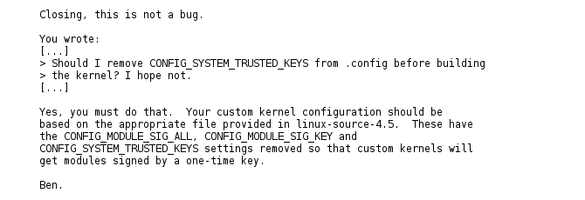
A change in compiling your own kernel

Slide 57
Appendix: running QEMU
#!/bin/bash
ROOTDIR=/home/alison/ISOs
HDNAME=debian-testing
VERSION=4.9.5
# Load kernel via GRUB; console shows in QEMU window.
#qemu-system-x86_64 -machine accel=kvm -name ${HDNAME} -boot c -drive file=${ROOTDIR}/${HDNAME}.raw,format=raw -m 4096 -smp cpus=1 -net nic,model=e1000 -net user,hostfwd=tcp:127.0.0.1:6666-:22 -localtime -serial stdio
# Load kernel from external file; console shows in xterm; GRUB doesn't run.
qemu-system-x86_64 -machine accel=kvm -name ${HDNAME} -initrd /home/alison/embedded/SCALE2017/kernel/initrd.img-${VERSION} -kernel /home/alison/embedded/SCALE2017/kernel/vmlinuz-${VERSION} -boot c -drive file=${ROOTDIR}/${HDNAME}.raw,format=raw -m 4096 -smp cpus=1 -net nic,model=e1000 -net user,hostfwd=tcp:127.0.0.1:6666-:22 -localtime -serial stdio -append "console=ttyAMA0 console=ttyS0 root=UUID=8e6a1c7e-b3c4-4a37-8e21-56a137c9dded ro"

Slide 58
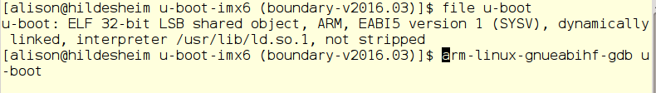
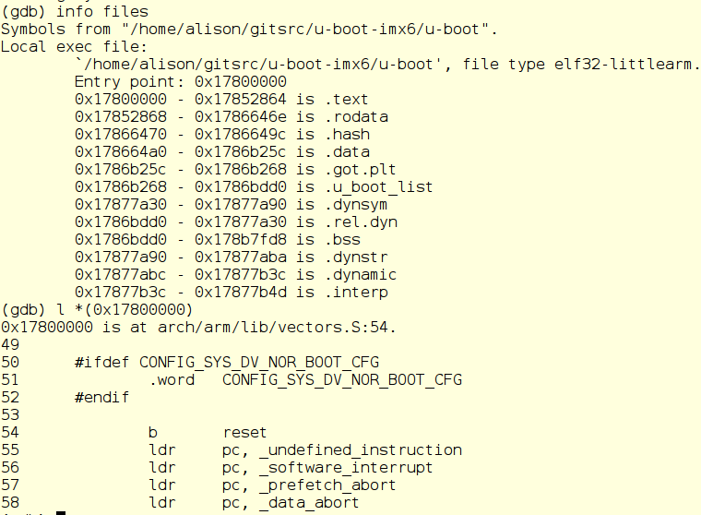
Finding u-boot start with GDB

Slide 59
The ARM bootloader
Read fundamental configuration from fuses, switches and GPIOs.
Then, for ARM:
1. Setup and initialise the RAM.
2. Initialise one serial port.
3. Detect the machine type.
4. Setup the kernel tagged list. device-tree
5. Load initramfs.
6. Call the kernel image.
Code in the SPL: board_init_f() and jump_to_image_linux()

Slide 60
Image, zImage, uImage, vmlinux, vmlinuz?
Image is the raw executable.
zImage is compressed version of Image with prepended uncompression instructions in ASM.
uImage is a zImage with a u-boot header.
vmlinux is ELF executable containing Image in .text section.
vmlinuz is a stripped version of vmlinux.

Slide 61
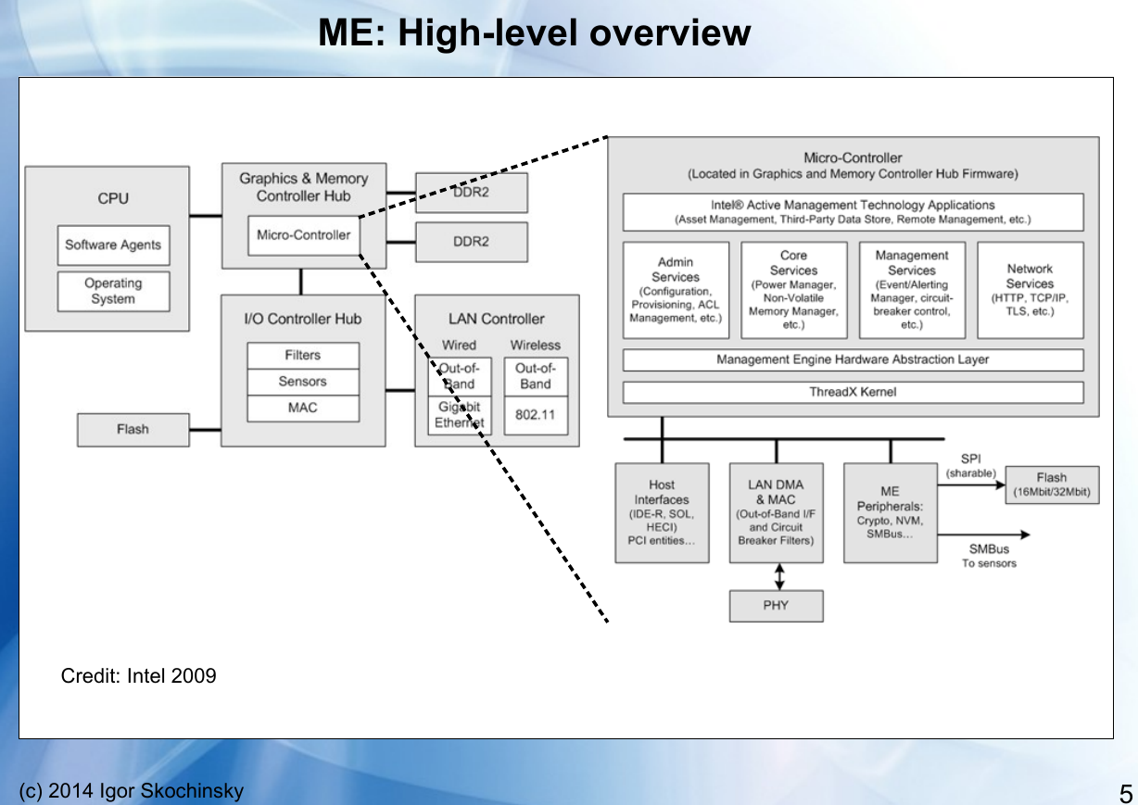
Older x86 had ARC processor as
GMCH instead of PCH.
Source: https://recon.cx/2014/slides/Recon%202014%20Skochinsky.pdf

