Slide 1

Linux: the first second
Alison Chaiken
alison@she-devel.com
March 3, 2017

Slide 2
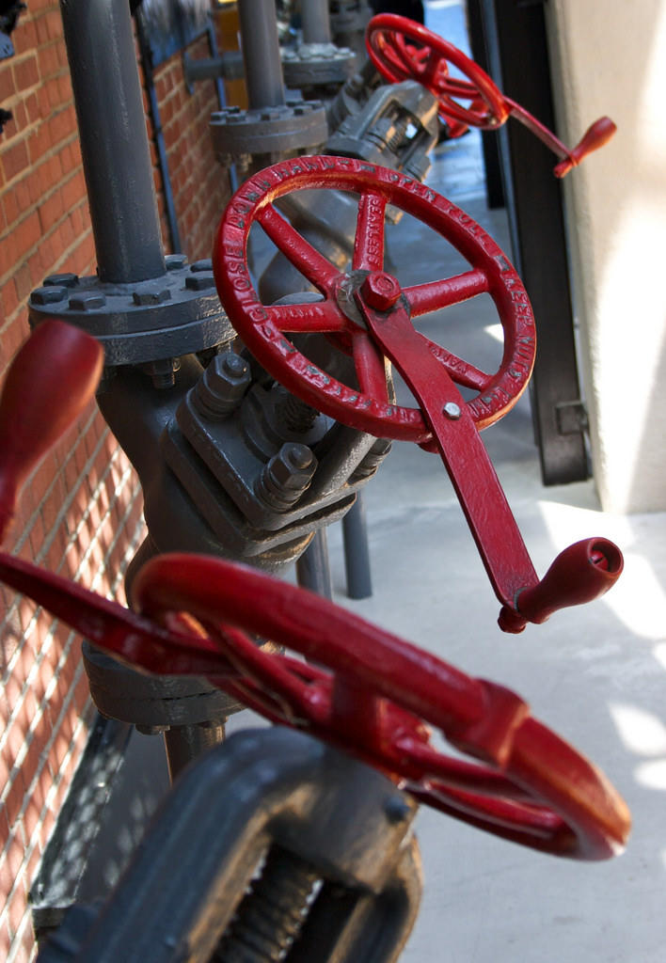
How Linux starts
What precisely does “off” mean?
Why does my bootloader have two binaries?
ACPI vs DTB
When does the kernel first spawn a second thread?
What is an initrd?
How does PID 1 start?
Out-of-bounds: systemd; SecureBoot; fastboot
https://flic.kr/p/6h96xg

Slide 3

THE FOLLOWING CONTENT MAY BE TOO DISTURBING FOR SOME VIEWERS
-- you will witness a kernel panic and
a boot failure;
-- a NULL pointer will be dereferenced
¼ successfully!

Slide 4

Applying power

Slide 5
Warm vs. power-on reset
 | Clears memory? Restarts clocks? | Pros | Cons | Examples
Power-on Reset | Yes, then reads boot-mode pins. | Won't fail. | Slightly slower. | Plug-in device
Warm Reset | DDR set to 'self-refresh', then reset clocks and jump to stored address. | Faster; retains 'reset reason' and RAM data. | Can fail. | 'reboot'; watchdog; JTAG

Slide 6
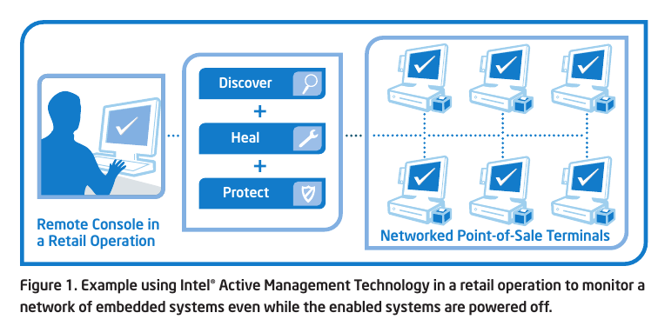
x86_64: Never genuinely off
Source: Intel
IPMI: run from Baseboard Management Controller
AMT: run from Graphics and Memory Controller Hub

Slide 7
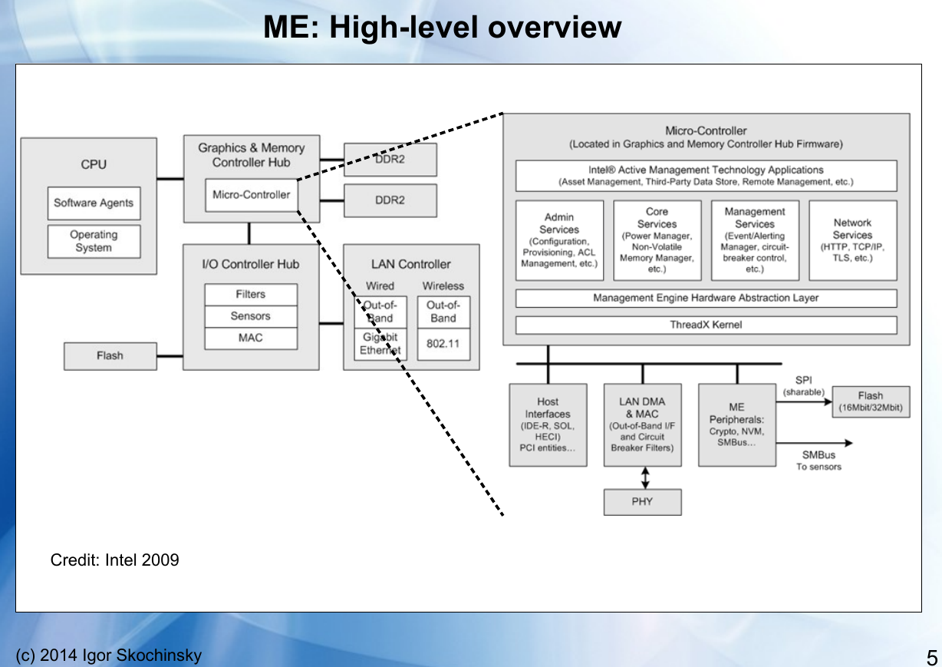
Source: https://recon.cx/2014/slides/Recon%202014%20Skochinsky.pdf

Slide 8
Bootloaders:
x86 and u-boot

Slide 9
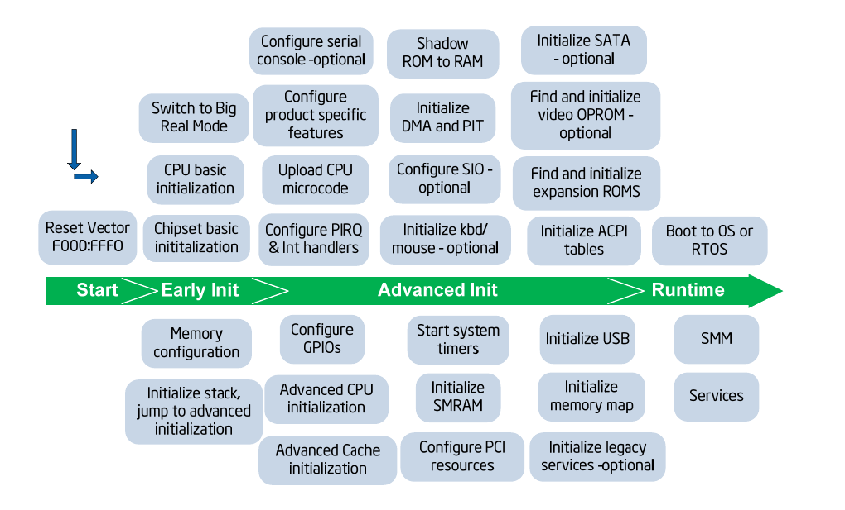
Bootloaders according to Intel
Read
device-tree
(ARM)

Slide 10
'Shim' bootloader » 'Early Init'
ARM: “SPL”, “XLoader” or “MLO” in addition to u-boot.img.
“Software program loader” separates CPU-specific code.
Problem: DRAM controller must be initialized.
Solution: load into SRAM ('OCRAM' in i.MX6, 'l2ram' for TI).
  Why this works: SRAM (and pNOR) are mapped memory.
Problem: SRAM is little! (256K on i.MX6, 2 MB on DRA7x).
Solution: start with a tiny SPL.

Slide 11
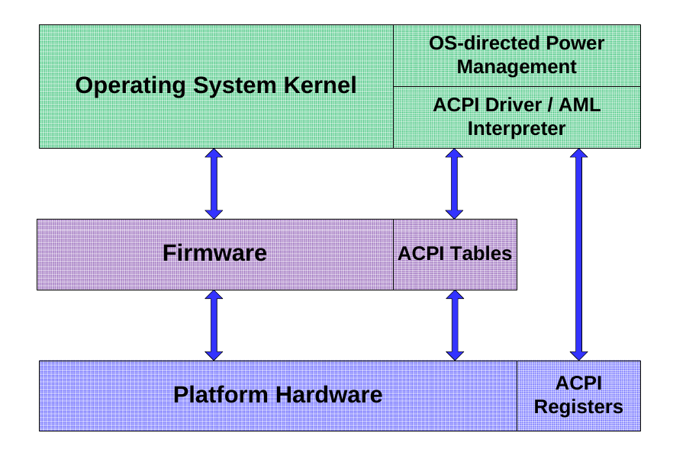
Advanced Configuration and Power Interface
Source: Intel
Entertainment: 'sudo acpidump | grep Windows'

Slide 12
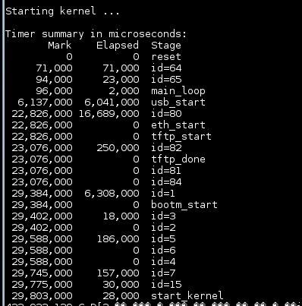
Getting more detailed u-boot messages
U-boot config:
# Boot timing
CONFIG_BOOTSTAGE=y
CONFIG_BOOTSTAGE_REPORT=y
CONFIG_BOOTSTAGE_FDT=y
***
/* Exiting U-Boot, entering OS */

Slide 13
Interpretation of bootstages
enum bootstage_id {
BOOTSTAGE_ID_START = 0,
BOOTSTAGE_ID_CHECK_MAGIC, /* Checking image magic */
BOOTSTAGE_ID_CHECK_HEADER, /* Checking image header */
BOOTSTAGE_ID_CHECK_CHECKSUM, /* Checking image checksum */
BOOTSTAGE_ID_CHECK_ARCH, /* Checking architecture */
BOOTSTAGE_ID_CHECK_IMAGETYPE = 5,/* Checking image type */
BOOTSTAGE_ID_DECOMP_IMAGE, /* Decompressing image */
BOOTSTAGE_ID_KERNEL_LOADED, /* Kernel has been loaded */
BOOTSTAGE_ID_DECOMP_UNIMPL = 7, /* Odd decompression algorithm */
BOOTSTAGE_ID_RUN_OS = 15, /* Exiting U-Boot, entering OS */
/* Boot stages related to loading a kernel from an network device */
BOOTSTAGE_ID_NET_CHECKSUM = 60,
BOOTSTAGE_ID_NET_ETH_START = 64,
BOOTSTAGE_ID_NET_ETH_INIT,
BOOTSTAGE_ID_NET_START = 80,
BOOTSTAGE_ID_NET_NETLOOP_OK,
};

Slide 14

Passing info from Kernel to Bootloader
U-boot can pass info in registers or in kernel cmdline.
Most arches pass “Reset cause” to bootloader.
mtdoops and ramoops save backtraces in persistent stores specified by device-tree.

Slide 15
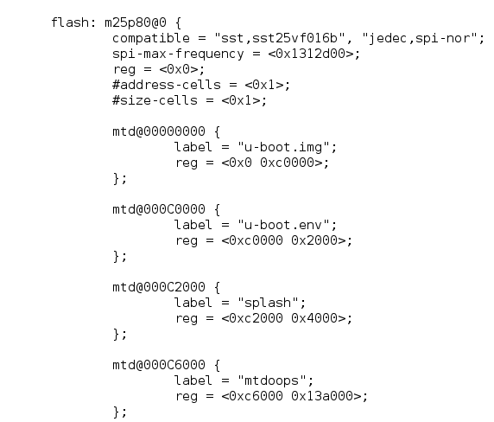
mtdoops in ARMv7 Device-tree

Slide 16

The coming revolution in non-volatile storage
Source: Micron
Specs:
ArsTechnica
AKA,
'Optane'
by Intel
1 Gb non-volatile memory  suspend even for brief inactivity.
POR will become a rare event.
Profound security implications.
Linux drivers: Matthew Wilcox, XIP DAX

Slide 17
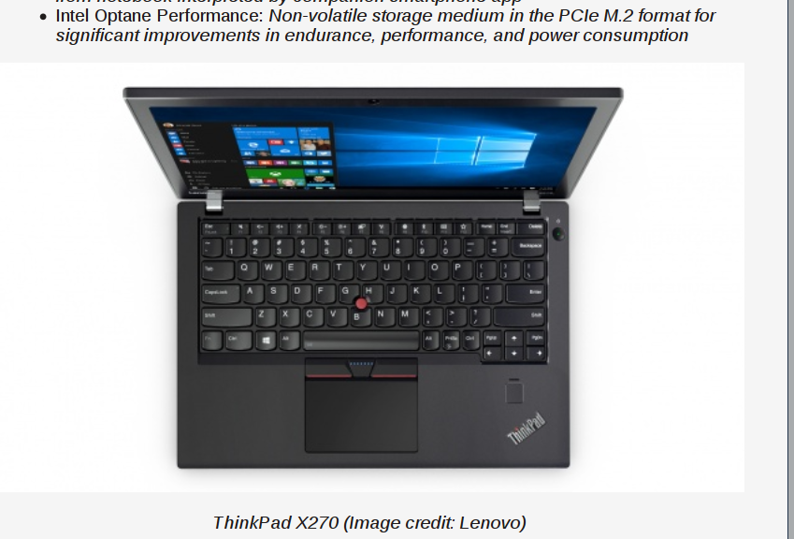
Coming soon to a system near you
Source:
PCPER

Slide 18
Starting up
the kernel

Slide 19

The kernel is an ELF binary
vmlinux is a regular ELF binary.
  readelf -e vmlinux
Extract vmlinux from vmlinuz:
  <path-to-kernel-source>/scripts/extract-vmlinux \
  /boot/vmlinuz-$(uname -r) > vmlinux
https://flic.kr/p/6xuhiK

Slide 20
?
?
?
Quiz:
How do ELF binaries start?
?
?
?
?
?

Slide 21
Examining ELF binary start with GDB
(results depend on toolchain)
Compile your C program with '-ggdb'.
gdb <some-binary-executable>
Type 'info files'
Look for 'Entry point'.
x86_64:
  Type 'b *(hex address)'
  Type 'run'
  Type 'info functions'
ARM:
  Type 'l *(hex address)'
  Type 'l 1,80'
  Type 'info functions' or 'info sources'

Slide 22
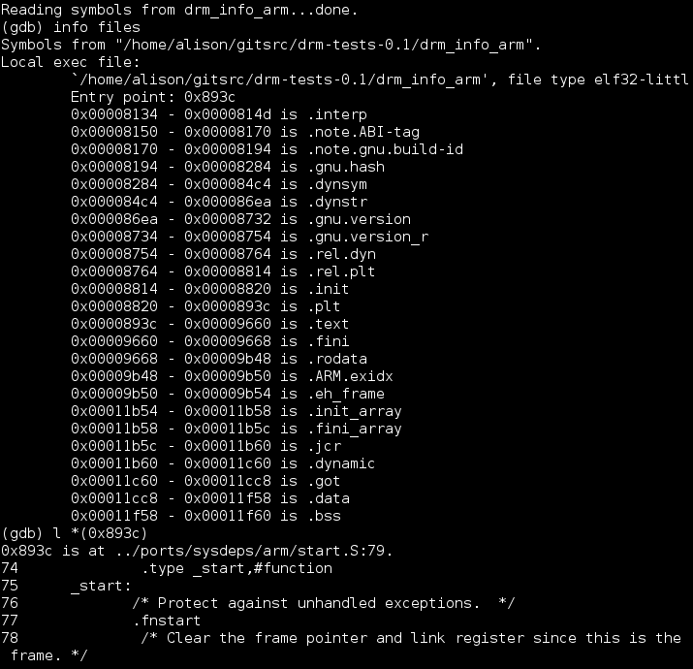

Slide 23
The kernel as PID 0
Userspace processes need a stack, a heap, STD* file descriptors and an environment to start.
An ASM constructor “ctor” from crti.o, crtn.o and crt1.0 provided by libgcc allocates these resources.
Source is start.S.
Corresponding kernel resources are provided via inline ASM.

Slide 24
Examining kernel start with GDB
Type 'file vmlinux'. (If zImage, extract with linux/scripts/extract-vmlinux).
Type:
gdb vmlinux
Type:
info files
Find 'Entry point'.
Type:
l *(hex address)
Type
  l 1,80

Slide 25
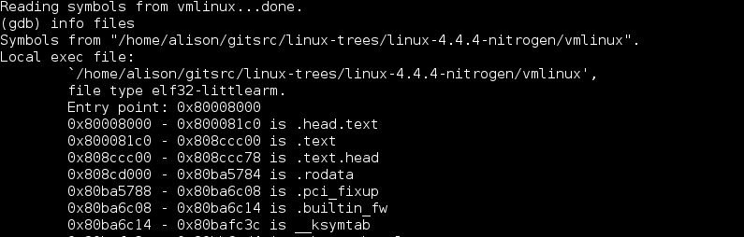
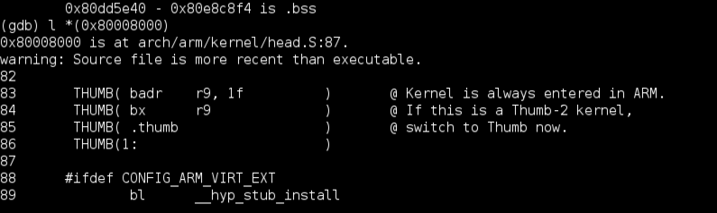
Kernel starts in head.S,
not start.S.

Slide 26
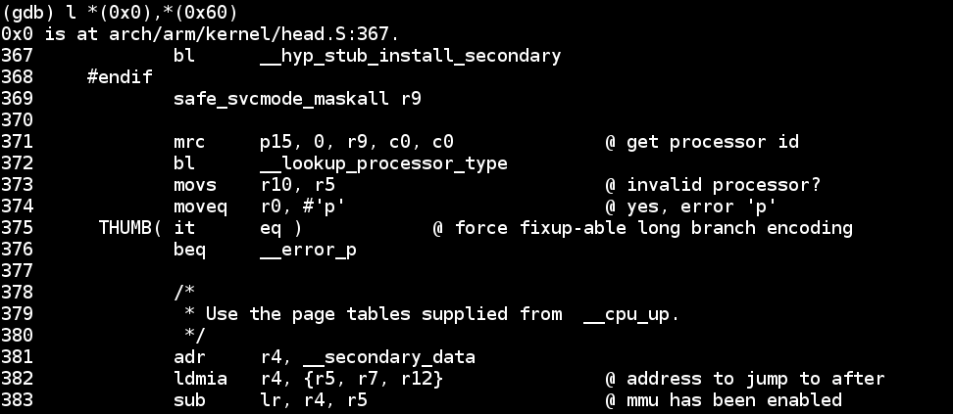
What's in head.S?
Type 'file vmlinux.o'
Try 'arm-linux-gnueabihf-gdb vmlinux.o'
Type 'info files'
Type 'l *(0x0)' <---- actually works!

Slide 27
The kernel's main() function: highlights of start_kernel()
start_kernel() {:
  boot_cpu_init();
  page_address_init();
  setup_arch(&command_line);
  page_alloc_init();
  pr_notice("Kernel command line: );
  parse_args("Booting kernel", command_line);
  mm_init();
  sched_init();
  init_IRQ();
  init_timers(); timekeeping_init();
  rest_init();
}
“Activate the first processor.”
process the device-tree
setup page tables
and start virtual memory
All timestamps before
are [0.000000]
start userspace

Slide 28
About Initrds

Slide 29
What is an initrd anyway?
'init ramdisk' = filesystem that is loaded into memory by the kernel before the rootfs mounts.
Why?
  To provide a 'rescue shell' in case rootfs doesn't mount.
  To provide modules that don't fit in zImage.
  To provide a safe environment to run agressive tests.
  To facilitate software updates on devices with limited storage.

Slide 30
What's in an initrd and why?
Boot into the rescue shell by providing a broken cmdline in /boot/grub/grub.cfg
  Type 'ls'
Or try 'lsinitramfs /boot/$(uname -r)'
initrd is a gzipped cpio archive:
  cp /boot/initrd-$(uname -r) /tmp/initrd.gz
  gunzip /tmp/initrd.gz
  cpio -t < /tmp/initrd

Slide 31
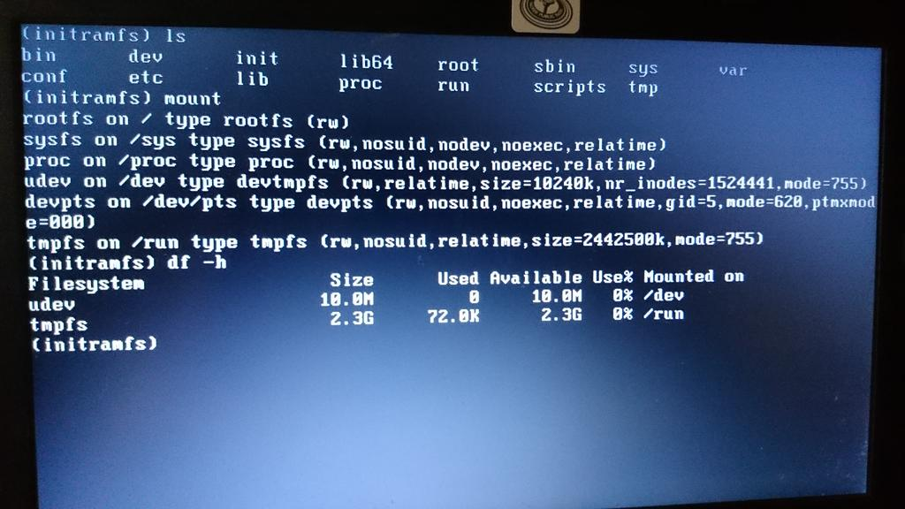
Exploring initramfs

Slide 32
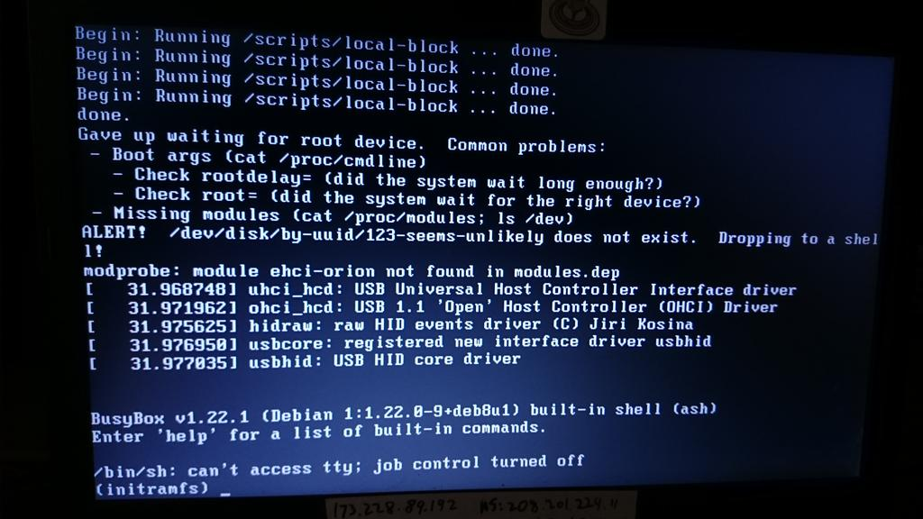
Booting into Rescue Shell
/scripts/local-block is the function local_block() inside initramfs /scripts/local

Slide 33
OMG! My life is over! (rescue shell tips)
Inhale on a 4-count, then exhale on a 10-count.
Oh no! 'help' scrolls pages of unreadable crap!
Relax your jaw. Make circles with your neck.
Read 'man busybox'.
'help | grep' works in busybox.
Look in /bin and /sbin. There's fsck!!
You have sed and vi (but not emacs ;-( )
Type 'reboot -f' when you are bored.

Slide 34
Hibernation and Suspension

Slide 35
{Hibernate, Suspend} == Freeze
Suspend: save state to memory.
Hibernate: save state to disk (swap).
Main code is in kernel/freezer.c.
Freezing of processes preserves state, protects filesystems.
Each core must save its state separately.
To watch, append no_console_suspend to bootargs.

Slide 36
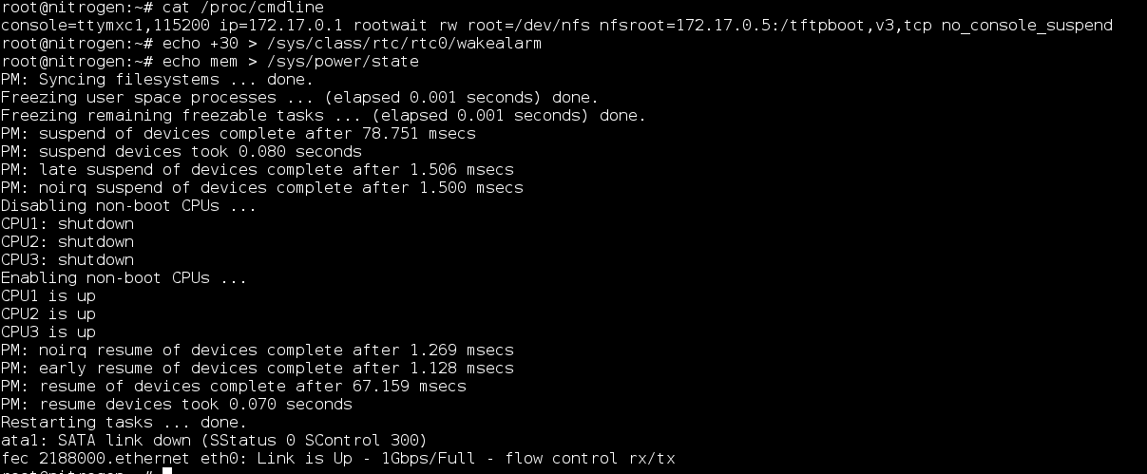
How to suspend from CLI
no_console_suspend in bootargs gives debug output.

Slide 37
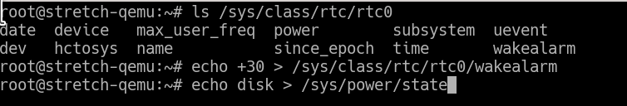
How to Hibernate from CLI
Only works for devices with swap space.

Slide 38
Summary
u-boot's CONFIG_BOOTSTAGES, acpidump and systemd-bootchart provide details about boot.
Practicing with QEMU is entertaining and low-risk.
Examine your kernel with GDB and binutils.
ARM and x86 boot processes are quite distinct.
High-speed non-volatile memory is about to have a massive impact on Linux.

Slide 39
Major References
Embedded Linux Primer by Chris Hallinan (book)
Booting ARM Linux by Russell King and THE LINUX/x86 BOOT PROTOCOL (Documentation/)
Program startup process in userspace at linux-insides blog
Matthew Garrett's comprehensive series on UEFI
Status of Intel Management Engine on various laptops (Coreboot) and servers (FSF)
All about ACPI talk by Darren Hart, ELCE 2013
Arch Wiki on hacking ACPI tables

Slide 40
do_bootm_states = u-boot state machine
bootm.c<common>
BootROM
(internal EEPROM)
***
bootm_start()
bootm_find_os()
bootm_load_os()
bootm_os_get_boot_func()
No
boot_selected_os
resume?
Yes
bootm.c<lib>
do_bootm_linux()
“Main Entry point for arm
bootm implementation”
Read Reset
Controller registers
bootm_jump_linux()
Jump to
stored image
Das U-boot

Slide 41
Shim bootloader
(Xloader, MLO, etc.)
Boot ROM in CPU
bootloader (u-boot, GRUB, etc.)
head.S
“Kernel startup entry point”
Decompress
the
kernel
start of zImage
head-common.S
main.c
start_kernel()
arch/arm/kernel/smp.c
secondary_start_kernel()
do_initcalls()
kernel_init
Boot
secondary
cores
kernel/smp.c
smp_init()
udev
init
cpu_idle
kernel/smpboot.c
idle_threads_init()
start
userspace
spawn
2nd thread

Slide 42
How to create your own initrd
Unpack one that already works with gunzip and 'cpio -i'
Copy in your binary.
Use gen_initramfs.h from kernel source tree:
  scripts/gen_initramfs_list.sh -o <archive> <path to source>
Run 'lsinitramfs <archive>' to check the result.
cp <archive> /boot; edit /boot/grub/grub.cfg
CAUTION: your system boots fine, right? You're crazy to mess with the bootloader, you moron.
Run grub-script-check.

Slide 43
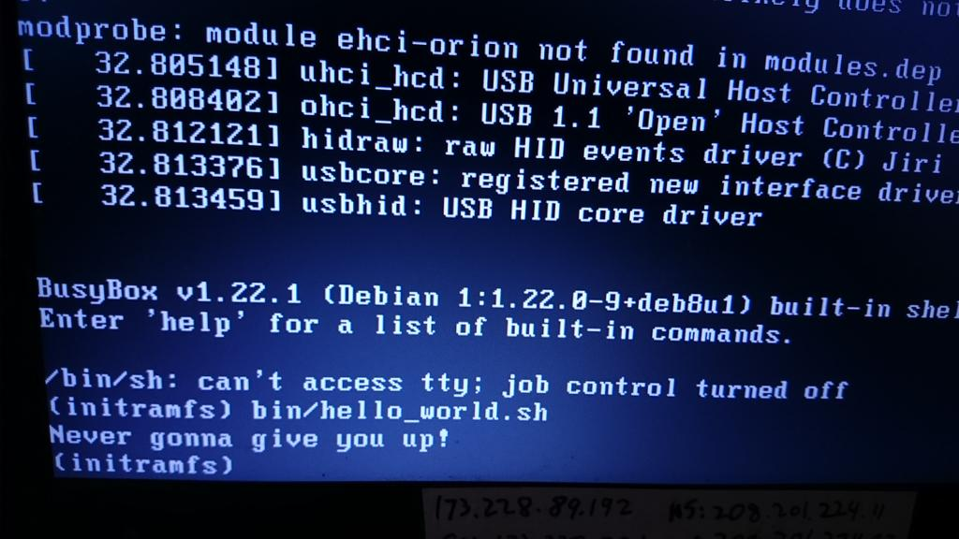
The magnificent result!

Slide 44
Getting more detailed kernel messages at boot
Remove 'quiet' from the kernel command line.
How to keep 'quiet' from coming back:
  edit /etc/grub.d/10_linux and add:
  export GRUB_DISABLE_SUBMENU=y
  export GRUB_CMDLINE_LINUX_DEFAULT=""
CAUTION: your system boots fine, right? You're crazy to mess with the bootloader, you moron.
Always run 'grub-script-check /boot/grub/grub.cfg' afterwards.

Slide 45
Learning more with systemd-bootchart
Make sure kernel is compiled with CONFIG_SCHEDSTATS=y.
'apt-get install systemd-bootchart'
Interrupt grub by typing 'e'
Append 'init=/lib/systemd/systemd-bootchart' to the line that starts with 'linux'
After boot, open the SVG image in /run/log/ with a browser.

Slide 46

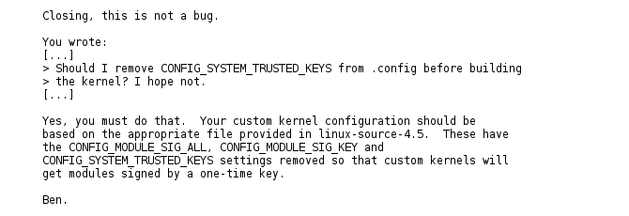
A change in compiling your own kernel

Slide 47
Appendix: running QEMU
#!/bin/bash
ROOTDIR=/home/alison/ISOs
HDNAME=debian-testing
VERSION=4.9.5
# Load kernel via GRUB; console shows in QEMU window.
#qemu-system-x86_64 -machine accel=kvm -name ${HDNAME} -boot c -drive file=${ROOTDIR}/${HDNAME}.raw,format=raw -m 4096 -smp cpus=1 -net nic,model=e1000 -net user,hostfwd=tcp:127.0.0.1:6666-:22 -localtime -serial stdio
# Load kernel from external file; console shows in xterm; GRUB doesn't run.
qemu-system-x86_64 -machine accel=kvm -name ${HDNAME} -initrd /home/alison/embedded/SCALE2017/kernel/initrd.img-${VERSION} -kernel /home/alison/embedded/SCALE2017/kernel/vmlinuz-${VERSION} -boot c -drive file=${ROOTDIR}/${HDNAME}.raw,format=raw -m 4096 -smp cpus=1 -net nic,model=e1000 -net user,hostfwd=tcp:127.0.0.1:6666-:22 -localtime -serial stdio -append "console=ttyAMA0 console=ttyS0 root=UUID=8e6a1c7e-b3c4-4a37-8e21-56a137c9dded ro"

Slide 48
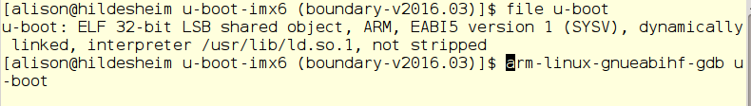
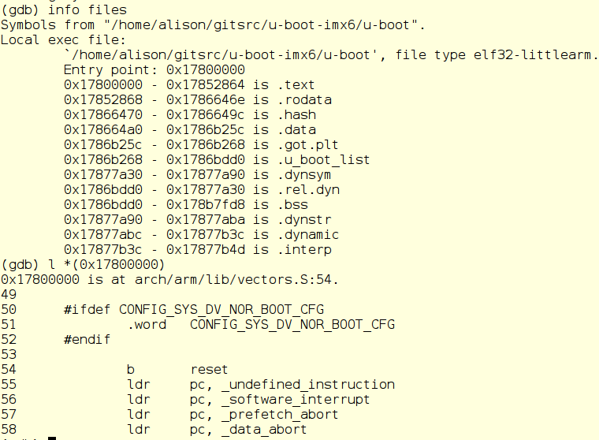
Finding u-boot start with GDB

Slide 49
The ARM bootloader
Read fundamental configuration from fuses, switches and GPIOs.
Then, for ARM:
1. Setup and initialise the RAM.
2. Initialise one serial port.
3. Detect the machine type.
4. Setup the kernel tagged list. device-tree
5. Load initramfs.
6. Call the kernel image.
Code in the SPL: board_init_f() and jump_to_image_linux()

Slide 50
Where do messages originate?
u-boot
misc.c
in zImage
header
from kernel
proper
[ 54.590327] Starting kernel ...
[ 54.593459]
Uncompressing Linux... done, booting the kernel.
Linux version 3.0.35-2508-g54750ff (gcc version 4.6.3 #1 SMP PREEMPT
CPU: ARMv7 Processor [412fc09a] revision 10 (ARMv7), cr=10c53c7d
CPU: VIPT nonaliasing data cache, VIPT aliasing instruction cache
Machine: Freescale i.MX 6Quad/DualLite/Solo Sabre-SD Board
Memory policy: ECC disabled, Data cache writealloc
CPU identified as i.MX6Q, silicon rev 1.1
PERCPU: Embedded 7 pages/cpu @8c008000 s5440 r8192 d15040 u32768
Built 1 zonelists in Zone order, mobility grouping on. Total pages: 227328
Kernel command line: console=ttymxc1,115200 ip=dhcp rootwait root=/dev/nfs nfsroot=172.17.0.1:/tftpboot/alison/mx6q/fsl-mx6,v3,tcp
}
from CPU
from kernel
passed from u-boot

Slide 51
Image, zImage, uImage, vmlinux, vmlinuz?
Image is the raw executable.
zImage is compressed version of Image with prepended uncompression instructions in ASM.
uImage is a zImage with a u-boot header.
vmlinux is ELF executable containing Image in .text section.
vmlinuz is a stripped version of vmlinux.

