Slide 1
Virtual filesystems: why we need them and how they work
Alison Chaiken
Peloton Technology
alison@she-devel.com
March 9, 2019

Slide 2
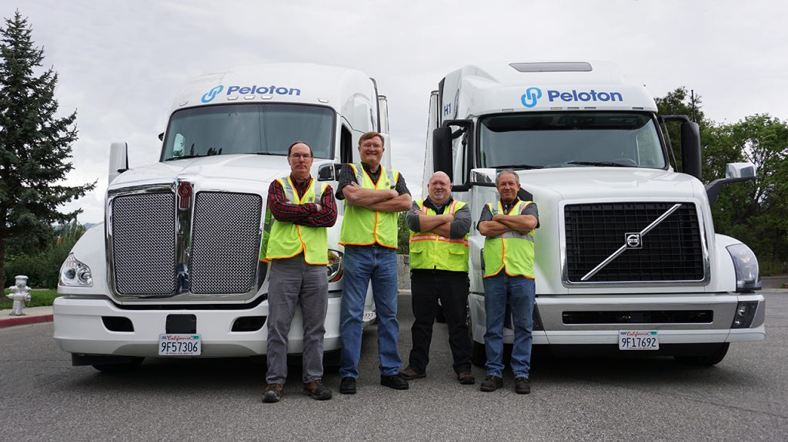
My coworkers with our product
We're hiring.

Slide 3

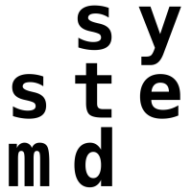

Agenda
Filesystems and VFS
/proc and /sys
Monitoring with eBPF and bcc
About bind mounts and namespaces
containers and ro-rootfs
live-media boots
Notes:
explain what bind mounts and namespaces are

Slide 4
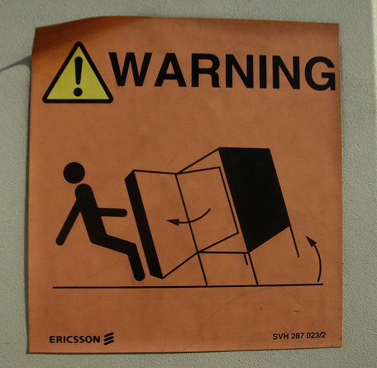
Does your system work now?
Do you really want to mess with it?

Slide 5

What is a filesystem?

Slide 6
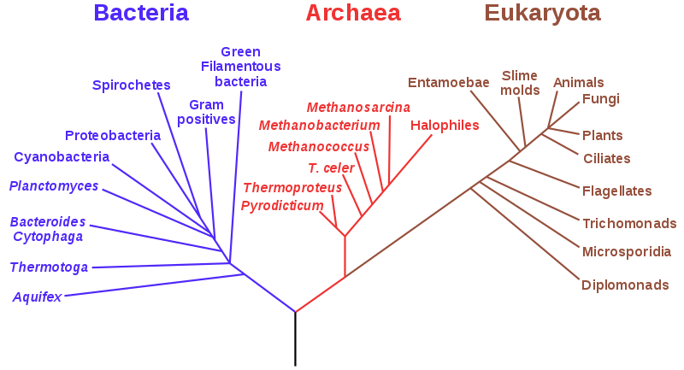
What is a filesystem?
Robert Love: “A filesystem is a hierarchical storage of data adhering to a specific structure.”
Does the image depict a filesystem?

Slide 7
Linux's definition of a filesystem
A filesystem must define the system calls:
struct file_operations {
…
ssize_t (*read) (struct file *, char __user *, size_t, loff_t *);
ssize_t (*write) (struct file *, const char __user *, size_t, loff_t *);
int (*open) (struct inode *, struct file *);
…
}

Slide 8
What are virtual filesystems?

Slide 9
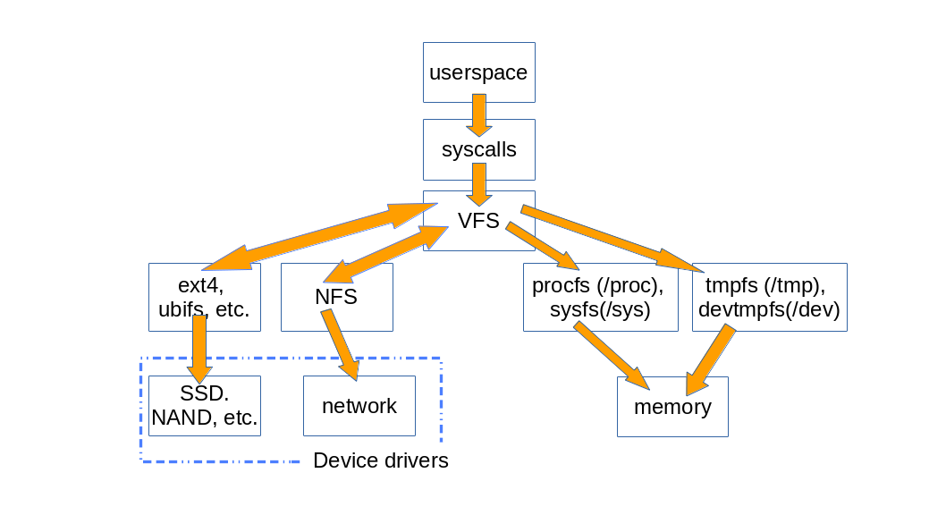
How VFS are used
userspace
kernel
hardware
Storage-backed filesystems
Pseudofilesystems
Notes:
Memory-backed FS are pseudo-filesystems in kernel parlance.
When a file is copied from NFS to disk, the system call open() is resolved by the VFS, which uses NFS' read() method to cp the file data into the VFS internal data structures, from whence they are copied then into the data structures of the FS implementation, which calls the device driver to store the data.
The fact that VFS resolve permissions and paths before passing requests to FS implementations is crucial to understanding how namespaces and security of binds and overlays works.

Slide 10
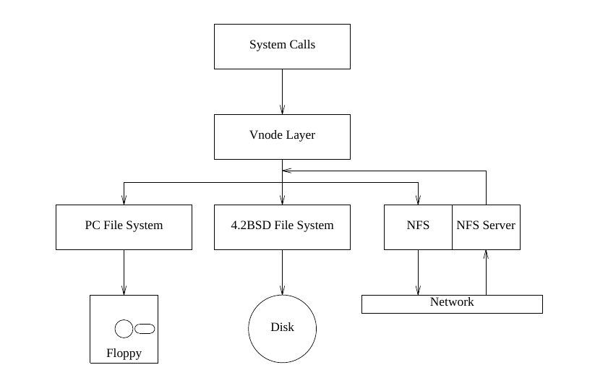
S. R. Kleiman and Sun Microsystems,
”Vnodes: An Architecture for Multiple File System Types”,
in Proc. USENIX, Summer 1986.

Slide 11
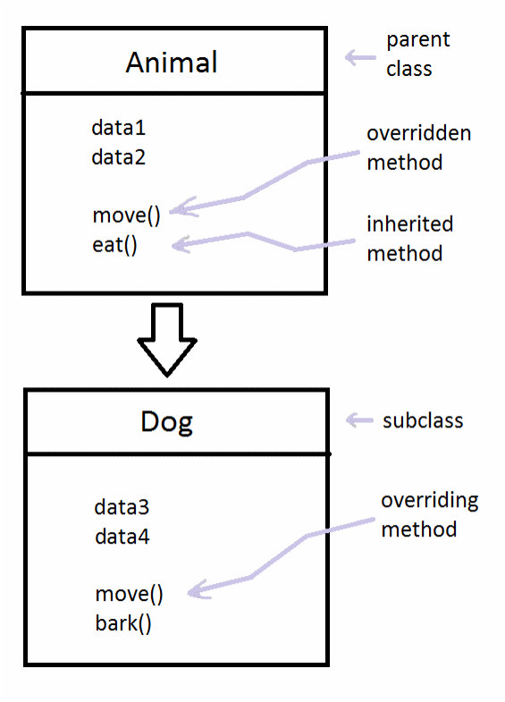
VFS are an abstract interface that specific FS's implement
VFS
.open = NULL;
.read = NULL;
.write = NULL;
.rmdir = simple_rmdir();
.link = simple_link(); …
stubs
https://commons.wikimedia.org/w/index.php?curid=64193508
ext4, fuse …
open(), read(), write()
.rmdir = my_rmdir();
.link() = simple_link();
mandatory
optional
overrides

Slide 12
Typical file_operations
struct file_operations ext4_file_operations = {
.llseek = ext4_llseek,
.read_iter = ext4_file_read_iter,
.write_iter = ext4_file_write_iter,
.unlocked_ioctl = ext4_ioctl,
.mmap = ext4_file_mmap,
.mmap_supported_flags =
MAP_SYNC,
.open = ext4_file_open,
.release = ext4_release_file,
.fsync = ext4_sync_file,
.get_unmapped_area =
thp_get_unmapped_area,
.splice_read =
generic_file_splice_read,
.splice_write =
iter_file_splice_write,
.fallocate = ext4_fallocate,
};

Slide 13
VFS Basics
The VFS methods are defined in the kernel's fs/*c source files.
Subdirectories of fs/ contain specific FS implementations.
VFS resolve paths and permissions before calling into FS methods.
A great example of code reuse! Unless …

Slide 14
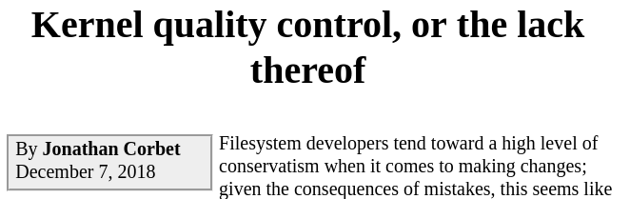
“Resources limits were not respected, users could overwrite a setuid file without resetting the setuid bits, time stamps would not be updated . . . affected all filesystems offering those features and needed to be fixed at the VFS level.”
Link to article

Slide 15
/proc and /sys

Slide 16
The observation that motivated the talk
Try this:
  $ stat /proc/cpuinfo
  $ stat /sys/power/state
  $ file /proc/cpuinfo
  $ file /sys/power/state
Why are the results so different?
?
?
?
?
?
?
?
?
?
?
?
?
?

Slide 17
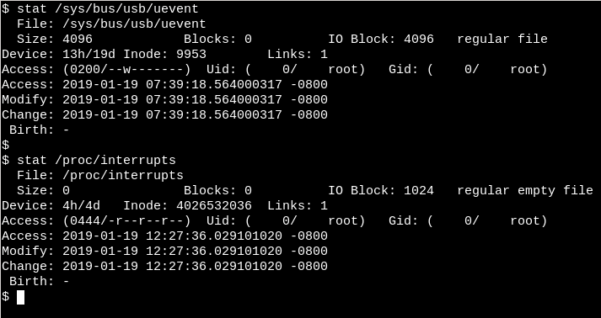
Sysfs
System boot
Procfs
Now

Slide 18
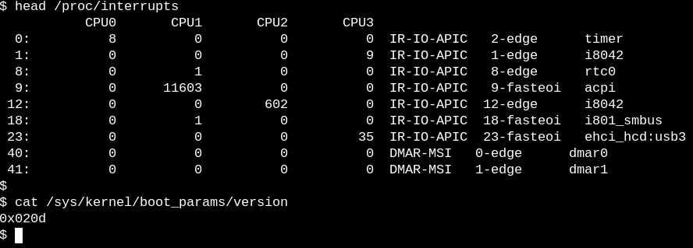
/procfs has tables; /sys has single params

Slide 19
state of kernel itself is visible via procfs
/proc/<PID> directories contain per-process stats.
The 'sysctl' interface manipulates /proc/sys:
  $ 'sysctl -a' lists system memory, network tunables
procfs files are 'seq files' whose contents are generated dynamically.

Slide 20
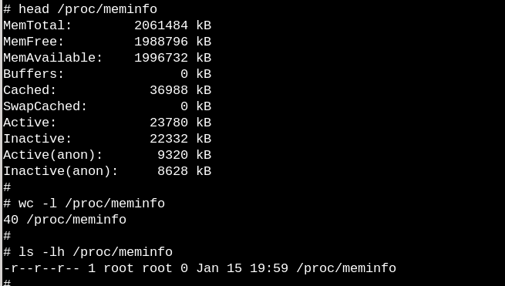
/proc files: empty or no?

Slide 21
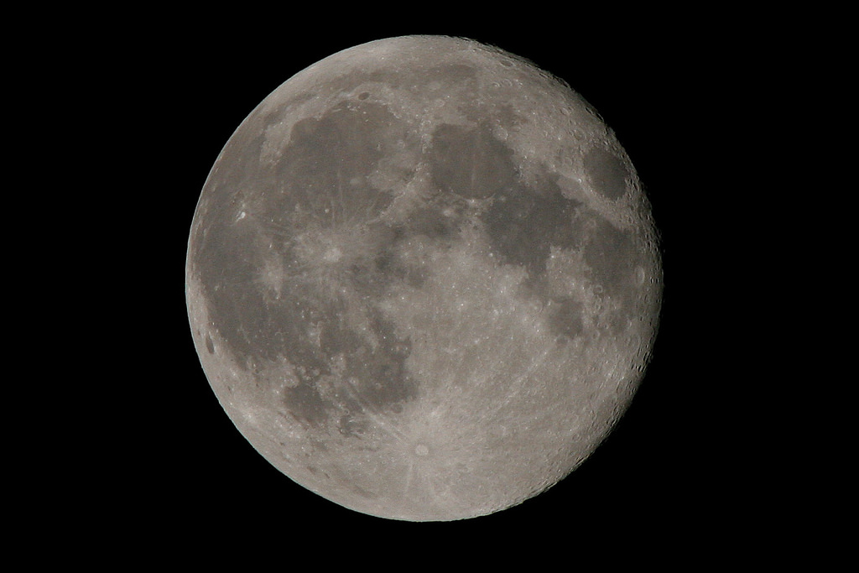

The contents of procfs appear when summoned
Copyright 2006 Koen Kooi, all rights reserved

Slide 22
"It is a fundamental quantum doctrine that a measurement does not reveal a pre-existing value of the measured property." -- David Mermin

Slide 23
sysfs is how the kernel reacts to events
sysfs:
  publishes events to userspace about appearance and disappearance of devices, FS, power, modules …
  allows these objects to be configured.
  includes the kernel's famous stable ABI.
In sysfs lies the userspace that one MUST NOT BREAK!

Slide 24

Watch USB stick insertion with eBPF and bcc
git clone git@github.com:iovisor/bcc.git
trace.py source
Use tplist.py to discover kprobes and userspace
probes that trace.py can watch.
Notes:
kworker serivces a workqueue.

Slide 25
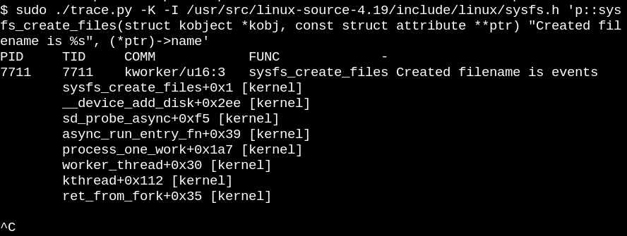
Illustrating the full power of bcc-tools
Watch the same sysfs_create_files() function,
get more details.
Notes:
$ cat /sys/devices/pci0000:00/0000:00:14.0/usb1/1-2/1-2.2/1-2.2:1.0/host3/target3:0:0/3:0:0:0/block/sdb/events
media_change
/usr/src/linux-source-4.19/block/genhd.c
static const char *disk_events_strs[] = {
[ilog2(DISK_EVENT_MEDIA_CHANGE)] = "media_change",
[ilog2(DISK_EVENT_EJECT_REQUEST)] = "eject_request",
};

Slide 26
The source code tells you what programs can do; eBPF/bcc-tools tell you what they actually do.
 | Kernel | User space | easy to use | Minimal performance hit
ftrace | X |  |  | ?
strace |  | X | X
bcc/eBPF | X | X | X | X

Slide 27
Bind mounts
and
mount namespaces

Slide 28
symlinks, chroots, binds and overlays
Symlinking a file or directory provides no security, and is static.
chroot / is dynamic, but provides no /proc, /sys, /dev.
Bind-mounting a file or directory over another:
  provides dynamic, secure, granular reference to dir/file at another path;
  useful for containers and IoT devices.
Overlaying a filesystem over another:
  provides a union of the FS at one path with the FS at another;
  useful for live media boots.
Notes:
A bind is like a reference: it is not a copy or a link, but the actual same thing.

Slide 29
Bind mount
tmpfs
Demo
FS A
/home/newstuff
/home/oldstuff
storage media
FS B
/home/oldstuff
/home/secretstuff
=
bound
view
/home/newstuff
/home/oldstuff
Files at path B inherit
permissions from FS A.

Slide 30
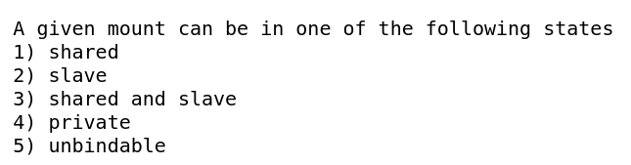
Bind-mount flags control visibility of mount events, not files
prevent
loops
Host
Host
Host
Container
Container
Container
Shared
Shared
(mirror)
Slave
(my mounts are private)
Private
(default)
From Documentation/filesystems/sharedsubtree.txt.

Slide 31
Namespaces are magic that enables containers
chroot, the old 'container', had minimal security.
Container security is implemented (in part) via namespaces.
Each container can have a different view of the system's files.
See an overview with mountinfo files.
Info about fields is in Documentation/filesystems/proc.txt.

Slide 32
Example: containers

Slide 33
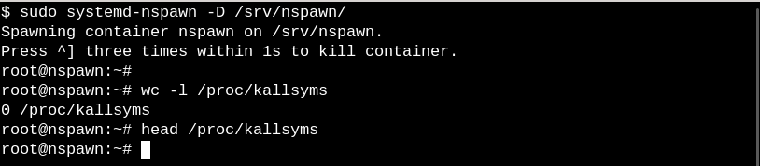
Start a simple container
systemd-nspawn is a container manager akin to runc
or lxc.

Slide 34
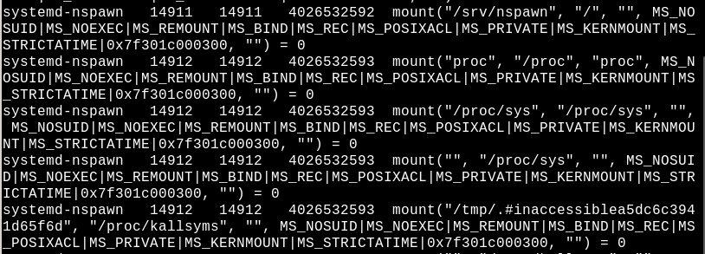
Watch container bind mounts with BCC
Intentional hiding of kernel symbols
Private mounts:
invisible to parent
Notes:
sudo ~/gitsrc/bcc/tools/mountsnoop.py | tee /tmp/mountsnoop.txt

Slide 35
read-only root filesystems

Slide 36

Read-only rootfs: a critical tool for embedded
Motivation:
Safely yank device power.
rootfs does not get full.
Malware cannot modify /usr/, /etc, keys . . .
Device problems reported from the field reproduce.
Forces separation of application data and binaries.
https://tinyurl.com/y7t2k7ma

Slide 37
read-only rootfs challenges
/var must be mounted separately from /.
Programs that modify $HOME at runtime: gstreamer, openssh-client …
rootfs builders must
  pre-populate these files, or
  bind- or overlay-mount them from other paths.
Not a bug but a feature!

Slide 38
Overlayfs
tmpfs
upper
/etc/passwd
/home/newstuff
storage media
lower
/etc/passwd
/home/oldstuff
=
overlaid
view
/etc/passwd
/home/oldstuff
/home/newstuff

Slide 39
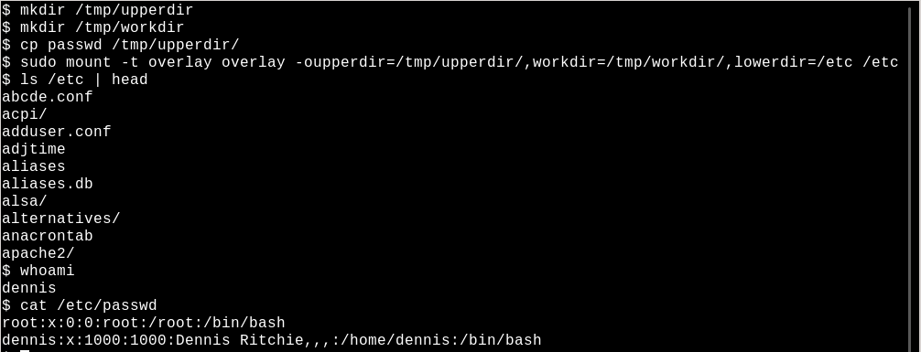
Replace /etc/passwd inside a container

Slide 40
Summary
VFS are one of Linux' core components.
/proc, /sys and most on-HW FS are based on VFS.
Bind-mounts and mount NS enable containers and ro-rootfs.
bcc-tools and eBPF are remarkably powerful and easy to use.

Slide 41
Acknowledgements
Much thanks to
Akkana Peck, Michael Eager
and Sarah Newman for comments and corrections.
Ballroom H at 6 PM:
“Accidentally accessible”

Slide 42

References
About kobjects, seq files and sysfs: Appendix C,Essential Device Drivers by S. Venkateswaran
About “everything is a file”: chapters 2, 4, 13, Linux Kernel Development by Robert Love
Excellent mount namespaces article by Michael Kerrisk
Excellent “Object-oriented design patterns in the kernel” article series by Neil Brown
“BPF in the Kernel” series by Matt Fleming

Slide 43
Example: Live CD

Slide 44
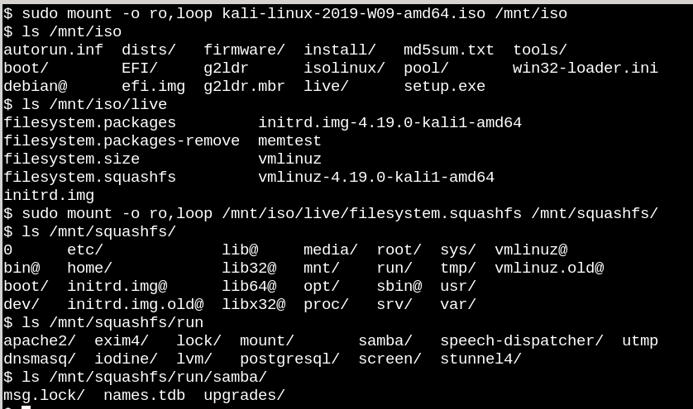
Prepopulated /run directory on Kali Linux LiveCD

Slide 45
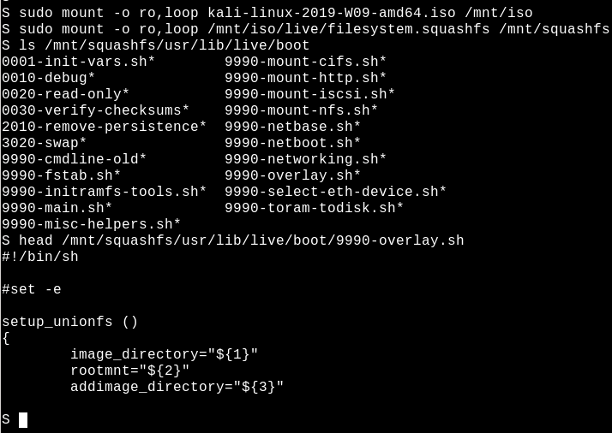
Kali Linux relies on overlayfs

Slide 46
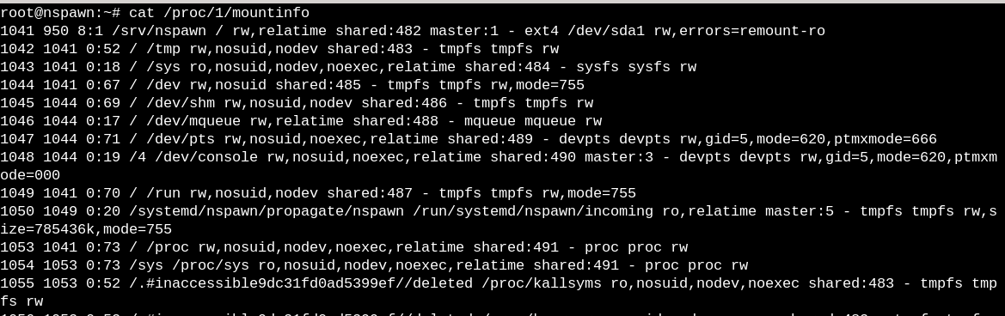
Info from /proc/<PID>/mountinfo about shared mounts

Slide 47
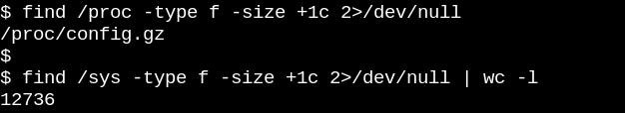
sysfs vs procfs sizes
/sys files are 1 page of memory and contain 1 string/ number.
/procfs files often 'contain' a table of data.

Slide 48
Overlayfs mounts
Overlay mounts are like bind mounts, but changes in the upper directory obscure those in the lower directory.
A file in /tmp/upper can appear to replace files in /home on storage media.
Notes:
mkdir /tmp/upper
mkdir /tmp/workdir
cp ~/embedded/SCALE2019/passwd /tmp/upper
sudo mount -t overlay overlay -oupperdir=/tmp/upper,workdir=/tmp/workdir,lowerdir=/etc /etc
whoami
On console,
umount overlay

Slide 49
Bind mounts
Bind mounts make an existing file or directory appear at a new path.
  Changes to the directory appear in both places.
  A file in /tmp can appear to be in $HOME in addition to files that are in $HOME on storage media.

Slide 50
Subtle but important win with ro-rootfs
A ro-rootfs forces better application design
via separation of data and binaries.

Slide 51
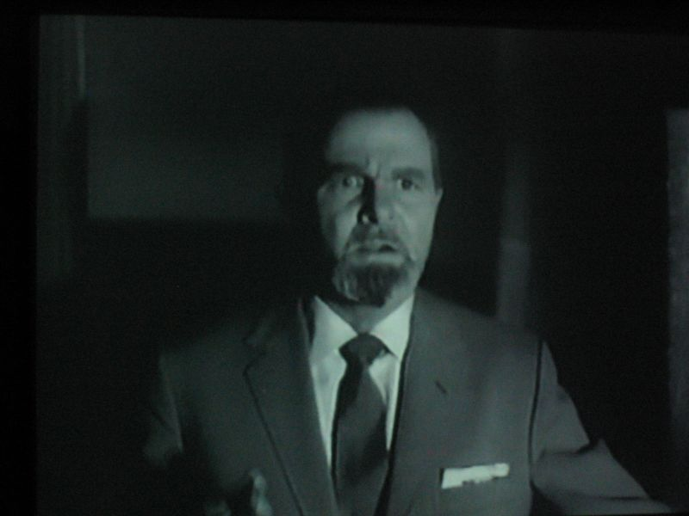
A systems administration tip!
Try this:
  $ findmnt /tmp
Is /tmp on /dev/sdx? on /dev/hdx?
Fix by editing /etc/fstab!
https://tinyurl.com/ybomxyfo
Keep a copy of /etc/fstab on a bootable USB stick.
Make sure that fstab ends with a newline!

Slide 52
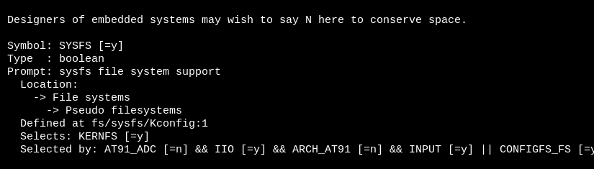
Turning off sysfs?
Keyboard and mouse

Slide 53
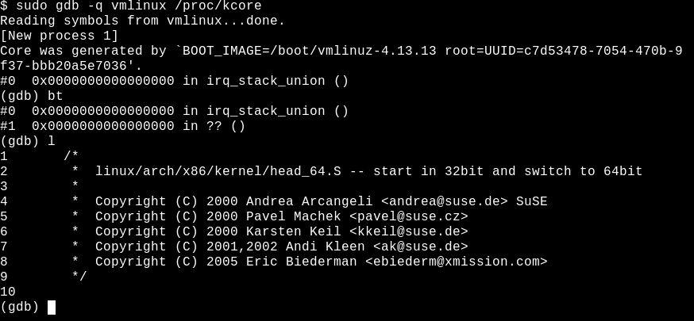
A few oddities: /proc/kcore

