Slide 1
Getting Around to It: Deferred Work in Linux Kernel
Alison Chaiken
alison@she-devel.com
https://github.com/chaiken/SCALE2024
These slides: http://she-devel.com/ChaikenSCALE2024.pdf

Slide 2
Categories of Deferred Work
Tasks delayed due to resource unavailability
Tasks performed by callbacks in response to an event

Slide 3



“Upload tax
documents!”
http://tinyurl.com/4hdbcnhk
Empty litterbox
Do tax stuff.

Slide 4
Performers of Deferred Work
Softirqs (bottom halves)
Kworkers (workqueues)
Waitqueues
Notes:
Tasklets, kworkers and softirqs are mechanisms to defer work which *could* be performed immediately.
Waitqueues pend on a condition variable:
‘A "wait queue" in the Linux kernel is a data structure to manage threads that are waiting for some condition to become true; they are the normal means by which threads block (or "sleep") in kernel space.’

Slide 5
What Happens when Task Deferral Goes Wrong
Tasks are deferred too long:
  RCU stalls.
  Heavy network traffic unacceptably delays applications.
Deferred work disrupts latency-sensitive applications:
  kworkers or ksoftirqd hog cores.
  kworker watchdog timer fires.

Slide 6

softirqs and workqueues have been inscrutable
http://tinyurl.com/36wh4ssn
Notes:
Why is ksoftirqd or a kworker hogging the CPU?
Why is the task in some workqueue so slow to run?

Slide 7

softirqs

Slide 8

Softirqs types in order of priority
HI: DMA, PCI
TIMER
NET_TX and NET_RX
BLOCK: assess status of requests
IRQ_POLL: NAPI for storage
TASKLET: crypto, drivers
SCHED: rebalance scheduling domains
HRTIMER
RCU: read-copy-update memory mgmt
http://tinyurl.com/yrhsk9d7
Notes:
Having a softirq run right after a hard IRQ sounds great. Why isn’t it?

Slide 9
Softirqs: as popular as death
“Softirqs are often a pain to deal with”
“People fight hard through this big softirq lock . . .
“Softirq processing . . . prevents the scheduler to control it . . . heuristics people have added to ‘control’ this is disgusting”

Slide 10
The “disgusting” heuristics
/*
* These limits have been established via experimentation.
* The two things to balance is latency against fairness -
* we want to handle softirqs as soon as possible, but they
* should not be able to lock up the box.
*/
#define MAX_SOFTIRQ_TIME msecs_to_jiffies(2)
#define MAX_SOFTIRQ_RESTART 10
Notes:
In an idea world, the scheduler would manage the softirq actions as individual threads based on scheduling policies rather than arbitrary numbers.
Numbers are unchanged since 2013.
/*
* We restart softirq processing for at most MAX_SOFTIRQ_RESTART times,
* but break the loop if need_resched() is set or after 2 ms.
* The MAX_SOFTIRQ_TIME provides a nice upper bound in most cases, but in
* certain cases, such as stop_machine(), jiffies may cease to
* increment and so we need the MAX_SOFTIRQ_RESTART limit as
* well to make sure we eventually return from this method.
*
* These limits have been established via experimentation.
* The two things to balance is latency against fairness -
* we want to handle softirqs as soon as possible, but they
* should not be able to lock up the box.
*/

Slide 11

Problem: softirqs do not run concurrently
hard IRQ
softirq is
already
running on
this cpu?
Y
e
s
No
wait for
ksoftirqd
__do_softirq();
Notes:
Going directly to __do_softirq() is the “piggyback.”
Why are softirqs like BKL? They don’t run concurrently with one another, so they block each other.
Since they are outside of scheduler control (running after hard IRQ or when softirqs are enabled via local_bh_enable()), they have unpredictable and hard-to-control effects on latency.
Culprit functions: local_bh_disable() and spin_lock_disable(), which calls local_bh_disable().
Can raise ksoftirqd priority, but raise priority of ALL softirqs.

Slide 12
bcc’s stackcount can make softirqs visible (demo)
$ sudo /usr/sbin/stackcount-bpfcc __do_softirq -D 10
Tracing 1 functions for "__do_softirq"... Hit Ctrl-C to end.
__do_softirq
do_softirq.part.0
__local_bh_enable_ip
iwl_pcie_irq_rx_msix_handler
irq_thread_fn
irq_thread
kthread
ret_from_fork
ret_from_fork_asm
109
__do_softirq
__irq_exit_rcu
common_interrupt
asm_common_interrupt
cpuidle_enter_state
cpuidle_enter
do_idle
cpu_startup_entry
start_secondary
secondary_startup_64_no_verify
204

Slide 13
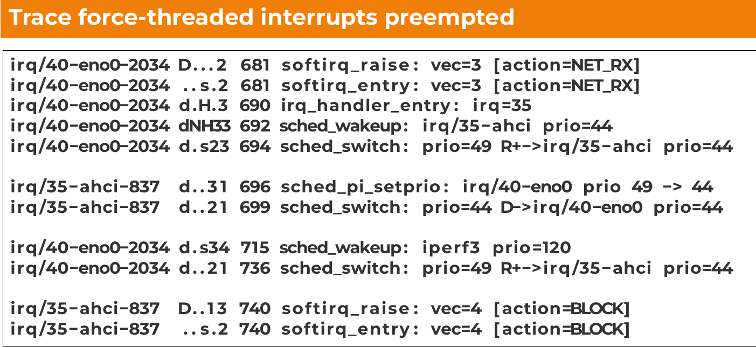
RT Problem: local_bh_disable() defeats PI
SATA hardirq
Here the BLOCK softirq should run but must wait.
The NET_RX softirq is done, so now run BLOCK softirq.
S. Siewior, Linux Plumbers 2023 slides, video, LKML
Notes:
When sched_switch() chooses irq/40-eno0 on line 699, it’s actually switching to the NET_RX softirq, which is running in the context of the hard IRQ that raised it.
PI does result in the priority of the NET_RX softirq being raised so that it can local_bh_enable() and allow BLOCK softirq to run, but NET_RX must run first, possibly for a long time.

Slide 14
Timeline: incrementally improving softirqs
threaded
NAPI
local_lock_nested_bh()
RCU_NOCB_CPU
TIMER_SOFTINTERRUPTIBLE
v3.8
v5.12
proposed, v6.5
v3.12.54-rt74
v4.1-rt
v4.1-rt
v5.0-rt
v5.16-rt
v4.1-rt
v6.9
ktimersoftd
(RT only)
ktimersd
(RT only)
tasklets --> wq
Notes:
The goal of all efforts is to make the work currently done by ksoftirqd visible to the scheduler and configurable by userspace (taskset, chrt).
TIMER_SOFTINTERRUPTIBLE immediately ran into lockup problems when tested in RT kernels, and did not proceed further. Doesn’t move timer softirq into a thread, but makes it preemptible by other softirqs.
threaded NAPI can run alongside Receive Packet Steering (RPS) or Receive Flow Steering (RFS). These direct traffic, but do not move work out of ksoftirqd.
“kthread is more configurable than workqueue,
and we could leverage existing tuning tools for threads, like taskset, chrt, etc to tune scheduling class and cpu set, etc.”
kernel/softirq.c is copyright 1992.

Slide 15

Progress with Softirqs is Slow
~250 call-sites for local_bh_disable(), the “Big Softirq Lock.”
RCU, network and timers (RT) softirqs are runnable in kthreads, but with context-switch penalty.
Improvements to tasklets coming in 6.9.
credit Estel@deviantart
Notes:
Networking maintainers don’t like the additional complexity associated with local_lock_bh_nested().
Siewior’s LPC talk demonstrated that high-priority IRQs get the “piggyback” with the associated softirq following them.

Slide 16
workqueues

Slide 17
Bound (per-CPU) workqueues
high-priority bound wqs
worker_pool on core 0
kworker/0:0
kworker/0:1
work_function1
work_function0
work_function0
work_function1
work_function2
work_function3
kworker/1:1H
kworker/1:3H
work_function2
high-prio worker_pool on core 1
kworker attributes match pools.
A given pool will service diverse workqueues.

Slide 18
kworker naming
bound cpu
kworker/6:3H
kworker id High-prio?
unbound pool id
kworker/u114:3
kworker id
Created: at boot
Per-CPU: yes
Fixed # pools: yes
Fixed workers/pool: no
Can migrate: no
Persistent, CPU-intensive
Created: at boot and dynamic
Per-CPU: no
Fixed # pools: no
Fixed workers/pool: no
Can migrate: yes
Notes:
https://lore.kernel.org/all/ZBlJJBR7dH4%2FkIWD@slm.duckdns.org/
“Use cases that generate extreme amount of IOs do
depend on the ability to fan out IO related work items across multiple CPUs, especially if the IOs coincide with network activities.”

Slide 19
BUG: workqueue lockup - pool cpus=1 node=0 flags=0x0 nice=0 stuck for 207s!
pool 112: cpus=0-55 flags=0x4 nice=0 hung=0s workers=4 idle: 44535
workqueue ixgbe: flags=0xe000a
pwq 112: cpus=0-55 flags=0x4 nice=0 active=1/1 refcnt=4
in-flight: 18005:ixgbe_service_task
workqueue ext4-rsv-conversion: flags=0x2000a
pwq 112: cpus=0-55 flags=0x4 nice=0 active=1/1 refcnt=14
in-flight: 53379:ext4_end_io_rsv_work
inactive: ext4_end_io_rsv_work, ext4_end_io_rsv_work
workqueue my-deadlocking-driver: flags=0xa000a
pwq 112: cpus=0-55 flags=0x4 nice=0 active=1/1 refcnt=4
in-flight: 39998:deadlocking_work_fn
RT 5.15 kernel
Notes:
WHAT TO DO? SET PRIORITY? PIN TO CORE?
Like ksoftirqd, kworkers may execute a variety of unrelated tasks.
“ * Stall may be caused by various bugs - missing WQ_MEM_RECLAIM, illegal
* flush dependency, a concurrency managed work item which stays RUNNING
* indefinitely. Workqueue stalls can be very difficult to debug as the
* usual warning mechanisms don't trigger and internal workqueue state is
* largely opaque.
*
* Workqueue watchdog monitors all worker pools periodically and dumps
* state if some pools failed to make forward progress for a while where
* forward progress is defined as the first item on ->worklist changing.”
Only the 0xa last digit of the wq flags matches = UNBOUND+RECLAIM.

Slide 20
Kernel Thread Pinnability (demo, Github)
$ classify_process_affinity | grep -e ^k
kworker/6:1H-events_highpri: unpinnable
kworker/6:2-mm_percpu_wq: unpinnable
kworker/7:0H-events_highpri: unpinnable
kworker/7:2-mm_percpu_wq: unpinnable
kworker/u16:0-events_unbound: unpinnable
kworker/u17:0-rb_allocator: unpinnable
kcompactd0: pinnable.
kdevtmpfs: pinnable.
khugepaged: pinnable.
khungtaskd: pinnable.
kintegrityd: unpinnable
How it works
struct task->flags & PF_NO_SETAFFINITY
$ cat /proc/93/stat
93 (irq/27-aerdrv) S 2 0 0 0 -1 2129984 0 0 0 0 0 0 0 0 -51 0 1 0 88 0 0 18446744073709551615 0 0 0 0 0 0 0 2147483647 0 0 0 0 17 5 50 1 0 0 0 0 0 0 0 0
Notes:
Even the unbound kworkers which are not per-CPU threadsare not pinnable.
taskset and chrt cannot set attributes of workqueues; they are specially managed kthreads.

Slide 21
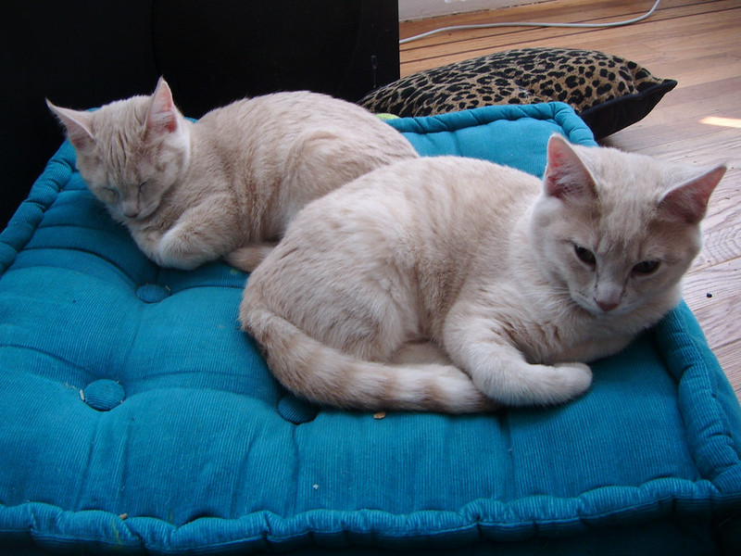
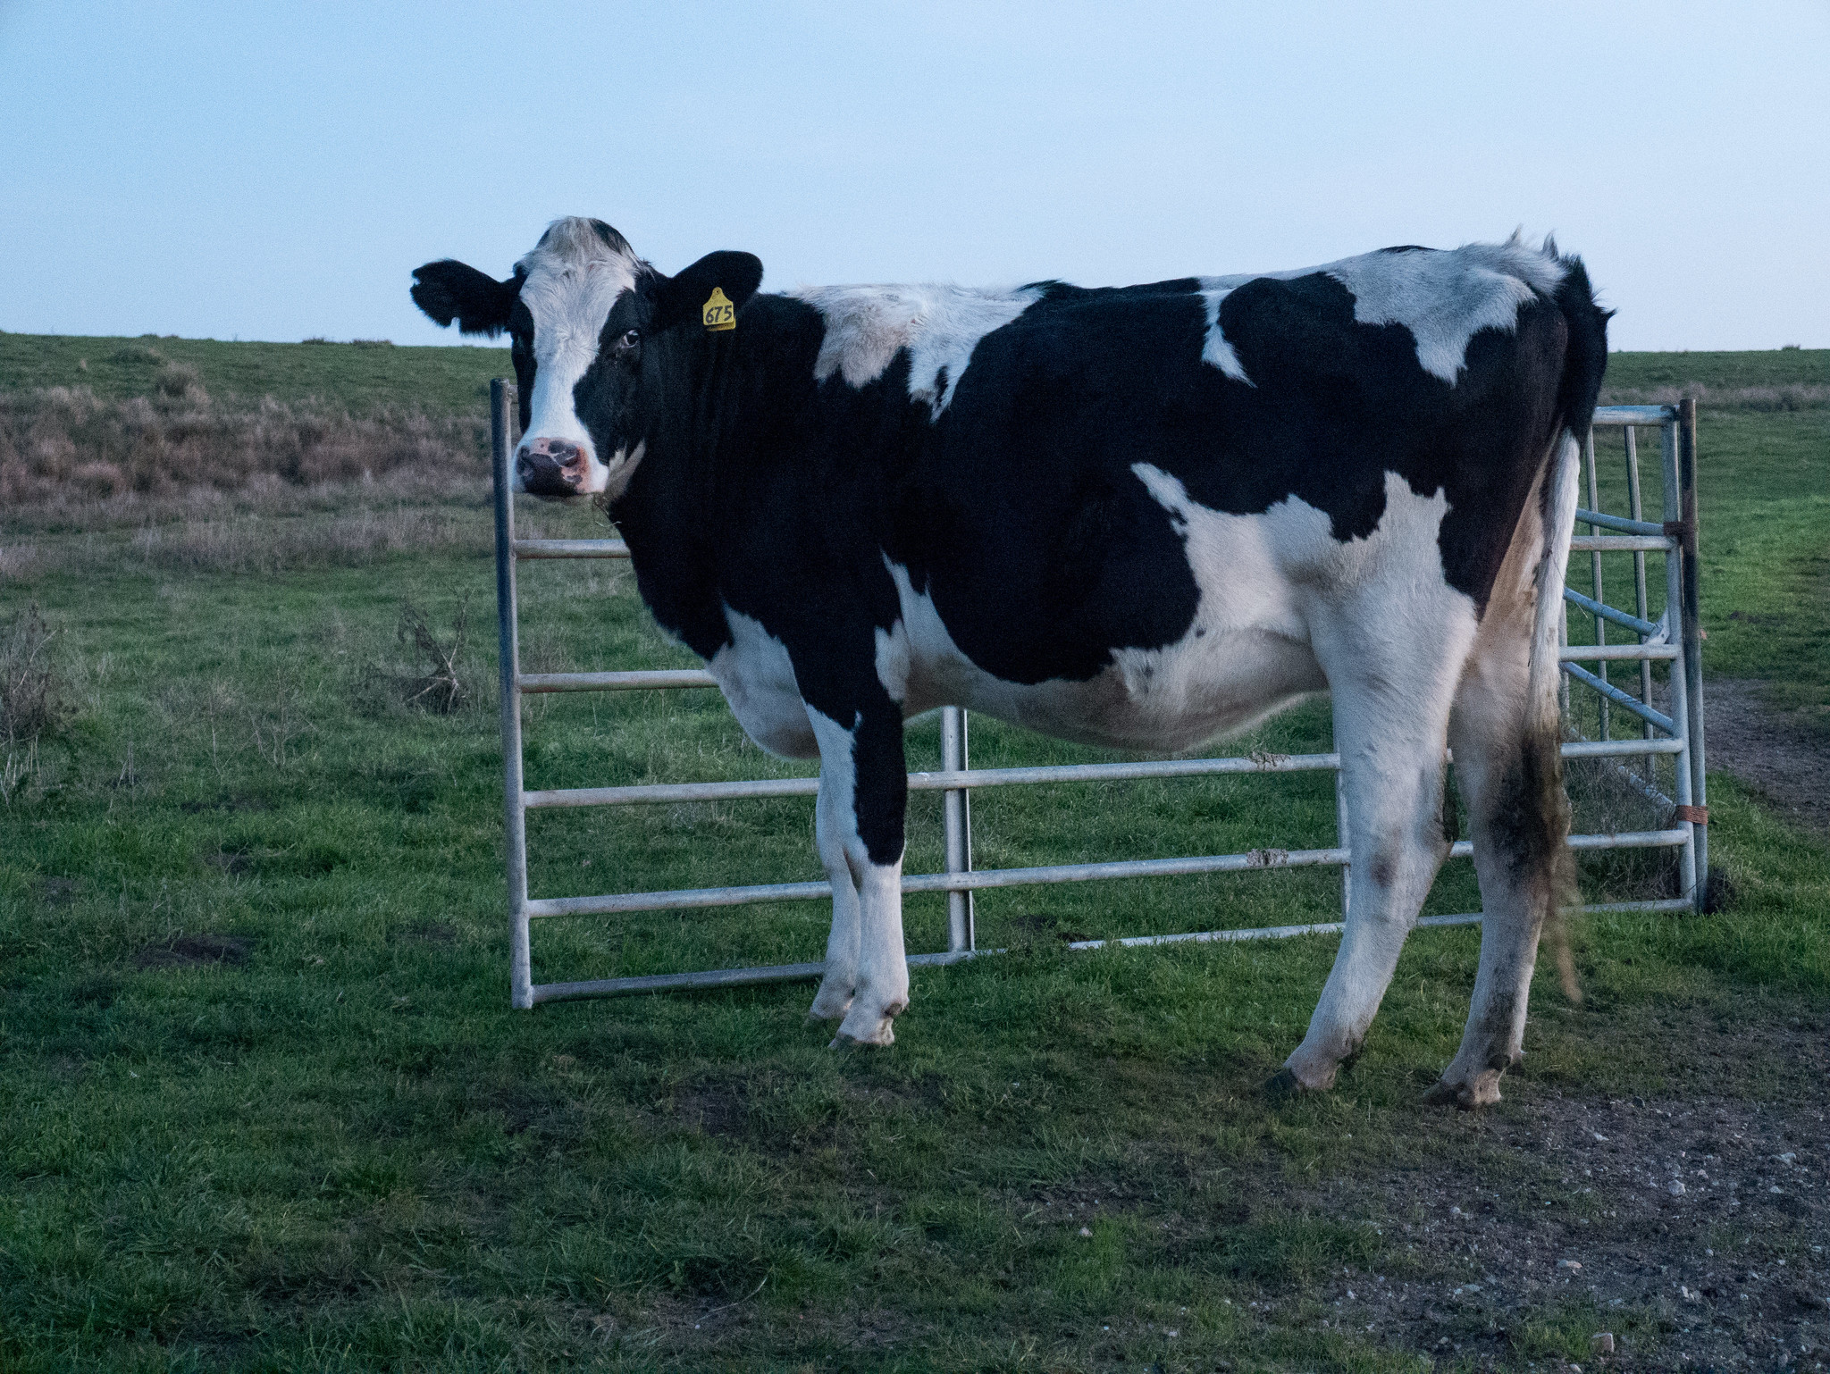
Configure workqueues rather than kworkers
https://tinyurl.com/mtvucy4k
https://tinyurl.com/252h7ctt
Workqueues
Kworkers
taskset and chrt manage the wrong thing.
Notes:
Non-consecutive numbering of kworkers is a sign of their volatility.

Slide 22
how to set workqueue affinity (demo)
[alison@bitscream SCALE2024 (main)]$ sudo ./workqueue-affinity_demo.sh
0. Demo will not work before v6.7.
Kernel version 6.7-amd64
1. Workqueues which are configurable from sysfs:
$ ls /sys/devices/virtual/workqueue
blkcg_punt_bio nvme-delete-wq nvme-wq raid5wq scsi_tmf_1 scsi_tmf_3 scsi_tmf_5 scsi_tmf_7 writeback
cpumask nvme-reset-wq power scsi_tmf_0 scsi_tmf_2 scsi_tmf_4 scsi_tmf_6 uevent
2. Consider tunable parameters for nvme-delete-wq:
$ ls /sys/devices/virtual/nvme-delete-wq
affinity_scope affinity_strict cpumask max_active nice per_cpu power subsystem uevent
4. Default nice value of unbound nvme-delete-wq workqueue:
$ cat /sys/devices/virtual/workqueue/nvme-delete-wq/nice
0
5. Determine in which workqueue pools nvme-delete-wq runs by default
Workqueue CPU -> pool
=====================
[ workqueue \ type CPU 0 1 2 3 4 5 6 7 dfl]
$ drgn tools/workqueue/wq_dump.py | grep nvme-delete-wq
nvme-delete-wq unbound 66 66 66 66 66 66 66 66 66 66 66 66 66 66 66 66 66 66 66 66 66 66 66 66 66 66 66 66 66 66 66 66 66
6. Set nice to -4
$ echo -4 > /sys/devices/virtual/workqueue/nvme-delete-wq/nice
7. In which workqueue pools does nvme-delete-wq run NOW?
$ drgn tools/workqueue/wq_dump.py | grep nvme-delete-wq
Workqueue CPU -> pool
=====================
[ workqueue \ type CPU 0 1 2 3 4 5 6 7 dfl]
nvme-delete-wq unbound 65 65 65 65 65 65 65 65 65 65 65 65 65 65 65 65 65 65 65 65 65 65 65 65 65 65 65 65 65 65 65 65 65
9. What are the properties of pool 65?
$ drgn tools/workqueue/wq_dump.py | grep 'pool[65]'
pool[65] ref= 33 nice= -4 idle/workers= 1/ 1 cpus=00000015 pod_cpus=00000015
8. What else runs in workqueue pool 65?
$ drgn tools/workqueue/wq_dump.py | grep 65
pool[65] ref= 33 nice= -4 idle/workers= 1/ 1 cpus=00000015 pod_cpus=00000015
nvme-delete-wq unbound 65 65 65 65 65 65 65 65 65 65 65 65 65 65 65 65 65 65 65 65 65 65 65 65 65 65 65 65 65 65 65 65 65
Notes:
Until 6.6, pool_ids for workqueue were visible in sysfs.

Slide 23
Configuration Applies to Work, not Executors
1. Workqueues appear in /sys/devices/virtual.
2. Workqueues have a “nice” value and cpu affinity.
3. Unbound workqueues can migrate, not kworkers.
Notes:
$ ls /sys/devices/virtual/workqueue/writeback/
affinity_scope affinity_strict cpumask max_active nice per_cpu power/ subsystem@ uevent
Shows high PIDs of kworkers:
$ ps ax | grep work | cut -f 1 -d ‘ ‘
One manages workqueues rather than kworkers since it’s often not clear what work a kworker performs, and since kworkers come and go.
Unbound workqueues migrate when they wake up on another core.

Slide 24
Workqueue March of Progress
6.5
affinity scope;
automatic CPU_INTENSIVE;
wq_monitor.py
CPU_INTENSIVE_REPORT
proposed, 6.9
replace tasklets;
system-wide max_active
6.6 (LTS)
wq_dump.py;
rescuers renamed
6.7
unbound use per-CPU
6.8
isolcpus-aware
wqlat.py*
Notes:
Threshold for automatic CPU_INTENSIVE is 5 ms.
CPU_INTENSIVE workqueues don’t block others; they can run independently.

Slide 25
Conclusions
softirqs
Can run in atomic context.
Heroic efforts.
Limited progress.
Limited observability.
Run in process context.
Manage work, not kworkers!
Improved observability.
More configurable.
Improved performance.
workqueues

Slide 26
Acknowledgements
Big thanks to Sarah Newman for her suggestions.

Slide 27
References
“IRQs: the Hard, the Soft, the Threaded and the Preemptible,” from 2016: video, slides
“Unblocking the softirq lock for PREEMPT_RT” by S. Siewior from 2023: video (starts at 2:16), slides
bpftrace scripts and shell scripts to run them at Github
classify_process_affinity at Github
Comparison by Wei Wang of kthreads, workqueues and softirqs
LWN, of course!

Slide 28
Helpful kernel configuration
IKHEADERS=y
DEBUG_KERNEL=y
DEBUG_INFO=y
DEBUG_INFO_DWARF_TOOLCHAIN_DEFAULT=y
DEBUG_INFO_BTF=y
DEBUG_INFO_BTF_MODULES=y
PAHOLE_HAS_SPLIT_BTF=y
WQ_CPU_INTENSIVE_REPORT=y
FUNCTION_ERROR_INJECTION=y
BPF_KPROBE_OVERRIDE=y
WQ_WATCHDOG=y

Slide 29
Helpful kernel cmdline parameters
General:
nohz_full
isolcpus
Softirqs:
rcu_nocbs
rcu_nocb_poll
rcutree.use_softirq
workqueue.unbound_cpus
workqueue.watchdog_thresh
workqueue.cpu_intensive_thresh_us
workqueue.power_efficient
workqueue.default_affinity_scope
Relevant sysfs attributes
Workqueues:
/sys/module/workqueue/parameters/*
/sys/devices/virtual/workqueue/*
NET_RX softirqs:
$(find /sys -name threaded)
Other softirqs:
/sys/module/kernel/rcu*
/sys/module/srcu*
/sys/module/rcupdate*
/sys/module/rcutree/*

Slide 30
Helpful software
/usr/bin/pahole
drgn + wq_monitor.py or wq_dump.py
bpfcc-tools package or bcc --> wq_lat.py
bpftrace

Slide 31
Understanding Tasklet Softirqs
Tasklets are event callbacks which:
  don’t block (no memory allocation, no I/O);
  have predictable execution time.
Heavy users include graphics, keyboard, USB:
Spy on tasklets:
$ sudo bpftrace -e 'tracepoint:irq:tasklet_entry { printf("%s\n", ksym(args->func)); }'

Slide 32
Yet more workqueue-monitoring tools
Additional drgn-base kernel tool:
linux/tools/workqueue/wq_monitor.py
$ sudo ~/gitsrc/SCALE2024/run-wq_monitor.sh
New libbpf tool:
$ sudo python3 ~/gitsrc/bcc/tools/wqlat.py

Slide 33
Demo Board
Boundary Devices Nitrogen 8MQ running v2022.04 U-Boot and the 6.1-BSP kernel and with patches to support tools/workqueue/wq_monitor backported.
Userspace is Boundary Devices’ Debian image.
Board is netbooted following simple advice.

Slide 34
New CPU_INTENSIVE_REPORT Feature
Dying USB hub:
workqueue: hub_event hogged CPU for >10000us 4 times, consider switching to WQ_UNBOUND
workqueue: set_brightness_delayed hogged CPU for 10000us 4 times, consider switching to WQ_UNBOUND
6.5 kernel

Slide 35
Intentional Workqueue Throttling
Subject: block: limit request dispatch loop duration
Date: Tue, 5 Apr 2022
From: Shin'ichiro Kawasaki <shinichiro.kawasaki@wdc.com>
When IO requests are made continuously and the target block device
handles requests faster than request arrival, the request dispatch loop
keeps on repeating to dispatch the arriving requests very long time,
more than a minute. Since the loop runs as a workqueue worker task, the
very long loop duration triggers workqueue watchdog timeout and BUG [1].
To avoid the very long loop duration, break the loop periodically. When
opportunity to dispatch requests still exists, check need_resched(). If
need_resched() returns true, the dispatch loop already consumed its time
slice, then reschedule the dispatch work and break the loop. With heavy
IO load, need_resched() does not return true for 20~30 seconds. To cover
such case, check time spent in the dispatch loop with jiffies. If more
than 1 second is spent, reschedule the dispatch work and break the loop.

Slide 36
Rescue kworkers
Run when attempt to start more kworkers fails due to ENOMEM.
Each WQ_MEM_RECLAIM has a rescuer kworker which responds to “maydays.”
pre-6.6 called slub_flushwq, inet_frag_wq, etc.
Now called kworker/R*
System Workqueues
Initialized early in boot.
Named “kworker/*events*”.
Used internally by workqueue management.
Also console, tty.
Notes:
In 6.1, rescuer->task = kthread_create(rescuer_thread, rescuer, "%s", wq->name);
In 6.7, rescuer->task = kthread_create(rescuer_thread, rescuer, "kworker/R-%s", wq->name);
/*
* Rescue workers are used only on emergencies and shared by
* all cpus. Give MIN_NICE.
*/
RESCUER_NICE_LEVEL = MIN_NICE,
HIGHPRI_NICE_LEVEL = MIN_NICE,
enum pool_workqueue_stats {
PWQ_STAT_STARTED, /* work items started execution */
PWQ_STAT_COMPLETED, /* work items completed execution */
PWQ_STAT_CPU_TIME, /* total CPU time consumed */
PWQ_STAT_CPU_INTENSIVE, /* wq_cpu_intensive_thresh_us violations */
PWQ_STAT_CM_WAKEUP, /* concurrency-management worker wakeups */
PWQ_STAT_REPATRIATED, /* unbound workers brought back into scope */
PWQ_STAT_MAYDAY, /* maydays to rescuer */
PWQ_STAT_RESCUED, /* linked work items executed by rescuer */
};

Slide 37
 | Triggered by hard IRQ? | Directly invocable? | Long duration? | Pinnable to cores?
softirqs | Y | N, callback | Y | N
tasklets | Y | N, callback | N | N
workqueues | N | N, queue_work() | Y | Y via sysfs, not taskset

Slide 38
taskset cannot pin workqueues
$ sudo taskset -pc 3 8 [kworker/0:0H-events_highpri]
pid 8's current affinity list: 0
taskset: affinity cannot be set due to PF_NO_SETAFFINITY flag set
taskset: failed to set pid 8's affinity: Invalid argument
$ sudo taskset -pc 3 913283 [kworker/u17:0-rb_allocator]
pid 913283's current affinity list: 0-7
taskset: affinity cannot be set due to PF_NO_SETAFFINITY flag set
taskset: failed to set pid 913283's affinity: Invalid argument

Slide 39
Unbound Workqueues
Why:
try to start execution of work items as soon as possible;
CPU-intensive workloads can be better managed by the system scheduler.
But:
kworkers can change tasks quickly since there is no context switch.
kthreads in contrast must wait on the scheduler.

Slide 40
no-threaded-NAPI demo
ARM64$ sudo find /sys/ -name threaded
/sys/devices/platform/soc@0/30800000.bus/30be0000.ethernet/net/eth0/threaded
ARM64$ ps ax | grep napi
ARM64$ top
PID USER PR NI VIRT RES SHR S %CPU %MEM TIME+ COMM
1608 debian 20 0 10096 3432 2772 R 11.1 0.2 0:00.04 top
laptop$ netperf -H 10.0.0.2 -t TCP_RR -r 4096 -- -o max_latency,mean_latency
ARM64$ sudo softirqs-bpfcc
Tracing soft irq event time... Hit Ctrl-C to end.
^C
SOFTIRQ TOTAL_usecs
[ . . .]
net_rx 1010045

Slide 41
with-threaded-NAPI demo
ARM64$ sudo bash -c 'echo 0 > /sys/devices/platform/soc@0/30800000.bus/30be0000.ethernet/net/eth0/threaded'
ARM64$ ps ax | grep napi
1038 ? S 0:00 [napi/eth0-257]
ARM64$ top
PID USER PR NI VIRT RES SHR S %CPU %MEM TIME+ COMM
1448 root 20 0 0 0 0 S 5.6 0.0 0:01.82 napi/eth0-257
laptop$ netperf -H 10.0.0.2 -t TCP_RR -r 4096 -- -o max_latency,mean_latency
ARM64$ sudo softirqs-bpfcc
Tracing soft irq event time... Hit Ctrl-C to end.
^C
SOFTIRQ TOTAL_usecs
[ . . .]
net_rx 33925

Slide 42

softirqs are
“quicksand code”
https://upload.wikimedia.org/wikipedia/commons/b/ba/Quicksand_warning.jpg

