Slide 1
IRQs: the Hard, the Soft, the Threaded and the Preemptible
Alison Chaiken
Latest version of these slides
alison@she-devel.com
Embedded Linux Conference Europe
Oct 11, 2016
Example code
Version 2, actually presented live

Slide 2
Thursday October 13, 2016 15:30:
Debugging Methodologies for Realtime Issues
Joel Fernandes, Google
this same room
Knocking at Your Back Door (or How Dealing with Modern Interrupt Architectures can Affect Your Sanity)
Marc Zyngier, ARM Ltd
Hall Berlin A

Slide 3
Agenda
Why do IRQs exist?
About kinds of hard-IRQ handlers
About softirqs and tasklets
Differences in IRQ handling between RT and non-RT kernels
Studying IRQ behavior via kprobes, event tracing, mpstat and eBPF
Detailed example: when does NAPI take over for eth IRQs?
“Kunst nicht lehrbar ist. Sie müssen wieder in der Werkstatt aufgehen.” -- Walter Gropius

Slide 4
Sample questions to be answered
What's all stuff in /proc/interrupts anyway?
What are IPIs and NMIs?
Why are atomic operations expensive for ARM?
Why are differences between mainline and RT for softirqs?
What is 'current' task while in softirq?
What function is running inside the threaded IRQs?
When do we switch from individual hard IRQ processing to NAPI?

Slide 5

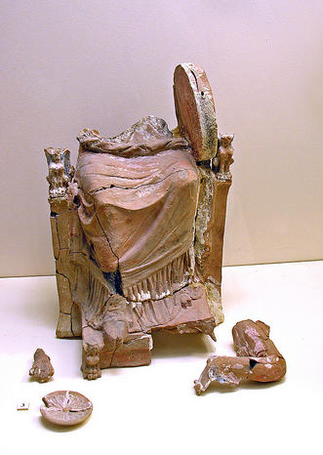

Interrupt handling: a brief pictorial summary
one full life, http://tinyurl.com/j25lal5
Dennis Jarvis, http://tinyurl.com/jmkw23h
Top half: the hard IRQ
Bottom half: the soft IRQ

Slide 6
Why do we need interrupts at all?
IRQs allow devices to notify the kernel that they require maintenance.
Alternatives include
  polling (servicing devices at a pre-configured interval);
  traditional IPC to user-space drivers.
Even a single-threaded RTOS or a bootloader needs a system timer.

Slide 7
Interrupts in Das U-boot
For ARM, minimal IRQ support:
  clear exceptions and reset timer (e.g., arch/arm/lib/interrupts_64.c or arch/arm/cpu/armv8/exceptions.S)
For x86, interrupts are serviced via a stack-push followed by a jump (arch/x86/cpu/interrupts.c)
  PCI has full-service interrupt handling (arch/x86/cpu/irq.c)

Slide 8
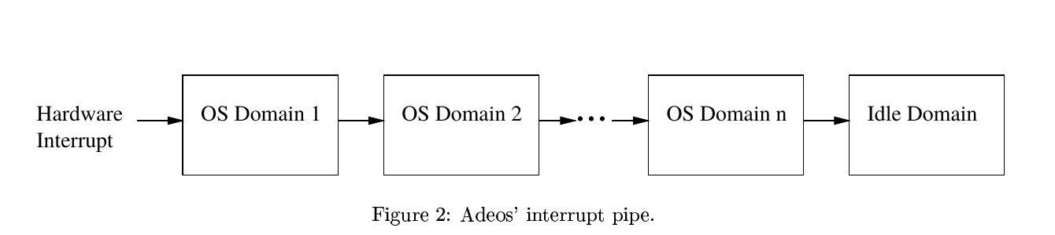
Interrupts in RTOS: Xenomai/ADEOS IPIPE
From Adeos website, covered by GFDL

Slide 9

Zoology of IRQs
Hard versus soft
Level- vs. edge-triggered, simple, fast EOI
or per-CPU
Local vs. global; System vs. device
Maskable vs. non-maskable
Shared or not; chained or not
Multiple interrupt controllers per SOC
By BirdBeaksA.svg: L. Shyamalderivative work: Leptictidium (talk) - BirdBeaksA.svg, CC BY-SA 2.5, https://commons.wikimedia.org/w/index.php?curid=6626434
'cat /proc/interrupts' or 'mpstat -A'

Slide 10
ARM IPIs, from arch/arm/kernel/smp.c
void handle_IPI(int ipinr, struct pt_regs *regs)
switch (ipinr) {
case IPI_TIMER:
tick_receive_broadcast();
case IPI_RESCHEDULE:
scheduler_ipi();
case IPI_CALL_FUNC:
generic_smp_call_function_interrupt();
case IPI_CPU_STOP:
ipi_cpu_stop(cpu);
case IPI_IRQ_WORK:
irq_work_run();
case IPI_COMPLETION:
ipi_complete(cpu);
}
Handlers are in kernel/sched/core.c
$ # cat /proc/interrupts, look at bottom

Slide 11

What is an NMI?
SKIP
A 'non-maskable' interrupt is related to:
  HW problem: parity error, bus error, watchdog timer expiration . . .
  also used by perf
/* non-maskable interrupt control */
#define NMICR_NMIF 0x0001 /* NMI pin interrupt flag */
#define NMICR_WDIF 0x0002 /* watchdog timer overflow */
#define NMICR_ABUSERR 0x0008 /* async bus error flag */
From arch/arm/mn10300/include/asm/intctl-regs.h
By John Jewell - Fenix, CC BY 2.0, https://commons.wikimedia.org/w/index.php?curid=49332041

Slide 12
How IRQ masking works
SKIP
only current core
arch/arm/include/asm/irqflags.h:
#define arch_local_irq_enable arch_local_irq_enable
static inline void arch_local_irq_enable(void)
{ asm volatile(
"cpsie i @ arch_local_irq_enable"
::: "memory", "cc"); }
arch/arm64/include/asm/irqflags.h:
static inline void arch_local_irq_enable(void)
{ asm volatile(
"msr daifclr, #2 // arch_local_irq_enable"
::: "memory"); }
arch/x86/include/asm/irqflags.h:
static inline notrace void arch_local_irq_enable(void)
{ native_irq_enable(); }
static inline void native_irq_enable(void)
{ asm volatile("sti": : :"memory"); }
“change processor state”

Slide 13
x86's Infamous System Management Interrupt
SMI jumps out of kernel into System Management Mode
  controlled by System Management Engine (Skochinsky)
Identified as security vulnerability by Invisible Things Lab
Not directly visible to Linux
Traceable via hw_lat detector (sort of)
[RFC][PATCH 1/3] tracing: Added hardware latency tracer, Aug 4
From: "Steven Rostedt (Red Hat)" <rostedt@goodmis.org>
The hardware latency tracer has been in the PREEMPT_RT patch for some time. It is used to detect possible SMIs or any other hardware interruptions that
the kernel is unaware of. Note, NMIs may also be detected, but that may be
good to note as well.

Slide 14
ARM's Fast Interrupt reQuest
An NMI with optimized handling due to dedicated registers.
Underutilized by Linux drivers.
Serves as the basis for Android's fiq_debugger.

Slide 15
IRQ 'Domains' Correspond to Different INTC's
SKIP
CONFIG_IRQ_DOMAIN_DEBUG:
This option will show the mapping relationship between hardware irq
numbers and Linux irq numbers. The mapping is exposed via debugfs
in the file "irq_domain_mapping".
Note:
There are a lot more IRQs than in /proc/interrupts.
There are more IRQs in /proc/interrupts than in 'ps axl | grep irq'.
Some IRQs are not used.
Some are processor-reserved and not kernel-managed.

Slide 16
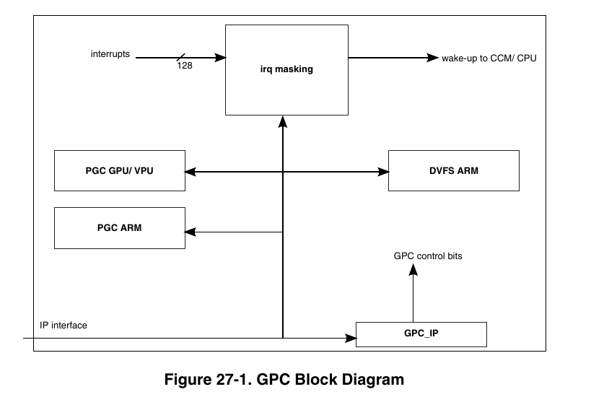
Example: i.MX6 General Power Controller
Unmasked IRQs can wakeup sleeping power domains.

Slide 17
Threaded IRQs in RT kernel
ps axl | grep irq
with both RT and non-RT kernels.
Handling IRQs as kernel threads allows priority and CPU affinity to be managed individually.
IRQ handlers running in threads can themselves be interrupted.

Slide 18
?
?
?
Quiz: What we will see with 'ps axl | grep irq' for non-RT kernels?
Why?
?
?
?
?
?

Slide 19
What function do threaded IRQs run?
/* request_threaded_irq - allocate an interrupt line
* @handler: Function to be called when the IRQ occurs.
* Primary handler for threaded interrupts
* If NULL and thread_fn != NULL the default
* primary handler is installed
*
* @thread_fn: Function called from the irq handler thread
* If NULL, no irq thread is created
*/
Even in mainline, request_irq() = requested_threaded_irq()
with NULL thread_fn.
EXAMPLE

Slide 20
CASE 0
indirect invocation of request_threaded_irq()
request_irq(handler) request_threaded_irq(handler, NULL)
Result:
-- irq_default_primary_handler() runs in interrupt context.
-- All it does is wake up the thread.
-- Then handler runs in irq/<name> thread.
CASE 1
direct invocation of request_threaded_irq()
Result:
-- handler runs in interrupt context.
-- thread_fn runs in irq/<name> thread.
irq_setup_forced_threading()

Slide 21
Threaded IRQs in RT, mainline and mainline with “threadirqs” boot param
RT: all hard-IRQ handlers that don't set IRQF_NOTHREAD run in threads.
Mainline: only those hard-IRQ handlers whose registration requests explicitly call request_threaded_irq() run in threads.
Mainline with threadirqs kernel cmdline: like RT, but CPU affinity of IRQ threads cannot be set.
genirq: Force interrupt thread on RT
genirq: Do not invoke the affinity callback via a workqueue on RT

Slide 22
Shared interrupts: mmc driver
Check 'ps axl | grep irq | grep mmc':
  1 0 122 2 -51 0 - S ? 0:00 [irq/16-mmc0]
  1 0 123 2 -50 0 - S ? 0:00 [irq/16-s-mmc0]
'cat /proc/interrupts': mmc and ehci-hcd share an IRQ line
16: 204 IR-IO-APIC 16-fasteoi mmc0,ehci_hcd:usb3
drivers/mmc/host/sdhci.c:
ret = request_threaded_irq(host->irq, sdhci_irq, sdhci_thread_irq, IRQF_SHARED, mmc_hostname(mmc), host);
handler
thread_fn

Slide 23
Why are atomic operations more expensive (ARM)?
arch/arm/include/asm/atomic.h:
static inline void atomic_##op(int i, atomic_t *v) \
{ raw_local_irq_save(flags); \
v->counter c_op i; \
raw_local_irq_restore(flags); }
include/linux/irqflags.h:
#define raw_local_irq_save(flags) \
do { flags = arch_local_irq_save(); } while (0)
arch/arm/include/asm/atomic.h:
/* Save the current interrupt enable state & disable IRQs */
static inline unsigned long arch_local_irq_save(void) { . . . }

Slide 24
Introduction to softirqs
Tasklet interface
Raised by devices
Kernel housekeeping
In kernel/softirq.c:
IRQ_POLL since 4.4
const char * const softirq_to_name[NR_SOFTIRQS] = {
"HI", "TIMER", "NET_TX", "NET_RX", "BLOCK", "BLOCK_IOPOLL",
"TASKLET", "SCHED", "HRTIMER", "RCU"
};
Gone since 4.1
In ksoftirqd, softirqs are serviced in the listed order.

Slide 25
What are tasklets?
const char * const softirq_to_name[NR_SOFTIRQS] = {
"HI", "TIMER", "NET_TX", "NET_RX", "BLOCK", "BLOCK_IOPOLL",
"TASKLET", "SCHED", "HRTIMER", "RCU"
};
Tasklets perform deferred work not handled by other softirqs.
Examples: crypto, USB, DMA, keyboard . . .
More latency-sensitive drivers (sound, PCI) are part of tasklet_hi_vec.
Any driver can create a tasklet.
tasklet_hi_schedule() or tasklet_schedule() are called directly by ISR.

Slide 26
SKIP
[alison@sid ~]$ sudo mpstat -I SCPU
Linux 4.1.0-rt17+ (sid) 05/29/2016 _x86_64_ (4 CPU)
CPU HI/s TIMER/s NET_TX/s NET_RX/s BLOCK/s TASKLET/s SCHED/s HRTIMER/s RCU/s
0 0.03 249.84 0.00 0.11 19.96 0.43 238.75 0.68 0.00
1 0.01 249.81 0.38 1.00 38.25 1.98 236.69 0.53 0.00
2 0.02 249.72 0.19 0.11 53.34 3.83 233.94 1.44 0.00
3 0.59 249.72 0.01 2.05 19.34 2.63 234.04 1.72 0.00
Linux 4.6.0+ (sid) 05/29/2016 _x86_64_ (4 CPU)
CPU HI/s TIMER/s NET_TX/s NET_RX/s BLOCK/s TASKLET/s SCHED/s HRTIMER/s RCU/s
0 0.26 16.13 0.20 0.33 40.90 0.73 9.18 0.00 19.04
1 0.00 9.45 0.00 1.31 14.38 0.61 7.85 0.00 17.88
2 0.01 15.38 0.00 0.20 0.08 0.29 13.21 0.00 16.24
3 0.00 9.77 0.00 0.05 0.15 0.00 8.50 0.00 15.32
Linux 4.1.18-rt17-00028-g8da2a20 (vpc23) 06/04/16 _armv7l_ (2 CPU)
CPU HI/s TIMER/s NET_TX/s NET_RX/s BLOCK/s TASKLET/s SCHED/s HRTIMER/s RCU/s
0 0.00 999.72 0.18 9.54 0.00 89.29 191.69 261.06 0.00
1 0.00 999.35 0.00 16.81 0.00 15.13 126.75 260.89 0.00
Linux 4.7.0 (nitrogen6x) 07/31/16 _armv7l_ (4 CPU)
CPU HI/s TIMER/s NET_TX/s NET_RX/s BLOCK/s TASKLET/s SCHED/s HRTIMER/s RCU/s
0 0.00 2.84 0.50 40.69 0.00 0.38 2.78 0.00 3.03
1 0.00 89.00 0.00 0.00 0.00 0.00 0.64 0.00 46.22
2 0.00 16.59 0.00 0.00 0.00 0.00 0.23 0.00 3.05
3 0.00 10.22 0.00 0.00 0.00 0.00 0.25 0.00 1.45

Slide 27

Two paths by which softirqs run
system management thread
CASE 1
(right)
CASE 0
(left)
Hard-IRQ handler
system management thread
raises softirq
raises softirq
local_bh_enable()
run_ksoftirqd()
do_current_softirqs() (RT) or
__do_softirq()
__do_softirq()
exhausts timeslice?
Related demo and sample code

Slide 28
Case 0: Run softirqs at exit of a hard-IRQ handler
RT (4.6.2-rt5)
non-RT (4.6.2)
local_bh_enable();
local_bh_enable();
__local_bh_enable();
do_softirq();
do_current_softirqs();
__do_softirq();
while (current->softirqs_raised) {
i = __ffs(current->softirqs_raised);
do_single_softirq(i);
}
handle_pending_softirqs();
handle_softirq();
while ((softirq_bit = ffs(pending)))
handle_softirq();
Run softirqs raised
in the current context.
Run all pending softirqs up to MAX_IRQ_RESTART.
EXAMPLE

Slide 29
Case 1: Scheduler runs the rest from ksoftirqd
RT (4.6.2-rt5)
non-RT (4.6.2)
run_ksoftirqd();
run_ksoftirqd();
do_softirq();
do_current_softirqs()
[ where current == ksoftirqd ]
__do_softirq();
h = softirq_vec;
while ((softirq_bit = ffs(pending))) {
h += softirq_bit - 1;
h->action(h);
}

Slide 30
RT vs Mainline: entering softirq handler
SKIP
4.7 mainline:
[11661.191187] e1000e_poll+0x126/0xa70 [e1000e]
[11661.191197] net_rx_action+0x52e/0xcd0
[11661.191206] __do_softirq+0x15c/0x5ce
[11661.191215] irq_exit+0xa3/0xd0
[11661.191222] do_IRQ+0x62/0x110
[11661.191230] common_interrupt+0x82/0x82
kick off soft IRQ
}
hard-IRQ handler
4.6.2-rt5:
[ 6937.393805] e1000e_poll+0x126/0xa70 [e1000e]
[ 6937.393808] check_preemption_disabled+0xab/0x240
[ 6937.393815] net_rx_action+0x53e/0xc90
[ 6937.393824] do_current_softirqs+0x488/0xc30
[ 6937.393831] do_current_softirqs+0x5/0xc30
[ 6937.393836] __local_bh_enable+0xf2/0x1a0
[ 6937.393840] irq_forced_thread_fn+0x91/0x140
[ 6937.393845] irq_thread+0x170/0x310
[ 6937.393848] irq_finalize_oneshot.part.6+0x4f0/0x4f0
[ 6937.393853] irq_forced_thread_fn+0x140/0x140
[ 6937.393857] irq_thread_check_affinity+0xa0/0xa0
[ 6937.393862] kthread+0x12b/0x1b0
}
kick-off softIRQ
}
hard-IRQ handler

Slide 31
Summary of softirq execution paths
Case 0: Behavior of local_bh_enable() differs significantly between RT and mainline kernel.
Case 1: Behavior of ksoftirqd itself is mostly the same (note discussion of ktimersoftd below).

Slide 32
What is 'current'?
include/asm-generic/current.h:
#define get_current() (current_thread_info()->task)
#define current get_current()
arch/arm/include/asm/thread_info.h:
static inline struct thread_info *current_thread_info(void)
{ return (struct thread_info *) (current_stack_pointer & ~(THREAD_SIZE - 1));
}
arch/x86/include/asm/thread_info.h:
static inline struct thread_info *current_thread_info(void)
{ return (struct thread_info *)(current_top_of_stack() - THREAD_SIZE);}
In do_current_softirqs(), current is the threaded IRQ task.

Slide 33
What is 'current'? part 2
SKIP
arch/arm/include/asm/thread_info.h:
/*
* how to get the current stack pointer in C
*/
register unsigned long current_stack_pointer asm ("sp");
arch/x86/include/asm/thread_info.h:
static inline unsigned long current_stack_pointer(void)
{
unsigned long sp;
#ifdef CONFIG_X86_64
asm("mov %%rsp,%0" : "=g" (sp));
#else
asm("mov %%esp,%0" : "=g" (sp));
#endif
return sp;
}

Slide 34
?
?
?
Q.: When do
system-management softirqs get to run?
?
?
?
?
?

Slide 35
Introducing systemd-irqd!!†
†As suggested by Dave Anders

Slide 36
Do timers, scheduler, RCU ever run as part of do_current_softirqs?
Examples:
-- every jiffy,
raise_softirq_irqoff(HRTIMER_SOFTIRQ);
-- scheduler_ipi() for NOHZ calls
raise_softirq_irqoff(SCHED_SOFTIRQ);
-- rcu_bh_qs() calls
raise_softirq(RCU_SOFTIRQ);
These run when ksoftirqd is current.

Slide 37
Demo: kprobe on do_current_softirqs() for RT kernel
At Github
Counts calls to do_current_softirqs() from ksoftirqd and from a hard-IRQ hander.
Tested on 4.4.4-rt11 with Boundary Devices' Nitrogen i.MX6.
Output showing what task of 'current_thread' is:
[ 52.841425] task->comm is ksoftirqd/1
[ 70.051424] task->comm is ksoftirqd/1
[ 70.171421] task->comm is ksoftirqd/1
[ 105.981424] task->comm is ksoftirqd/1
[ 165.260476] task->comm is irq/43-2188000.
[ 165.261406] task->comm is ksoftirqd/1
[ 225.321529] task->comm is irq/43-2188000.
explanation

Slide 38
Softirqs can be pre-empted with PREEMPT_RT
include/linux/sched.h:
struct task_struct {
#ifdef CONFIG_PREEMPT_RT_BASE
struct rcu_head put_rcu;
int softirq_nestcnt;
unsigned int softirqs_raised;
#endif
};

Slide 39
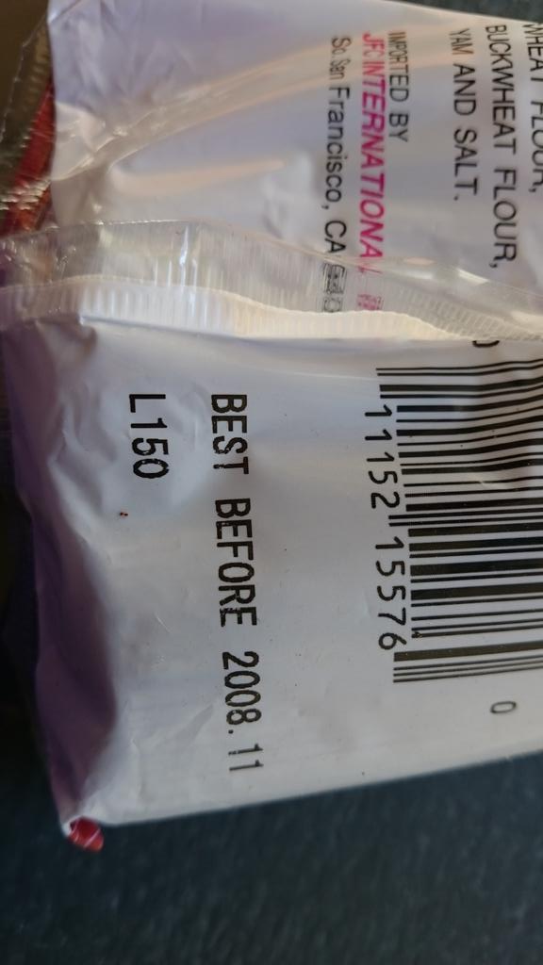
RT-Linux headache: 'softirq starvation'
“sched: RT throttling activated” or
“INFO: rcu_sched detected stalls on CPUs”
ksoftirqd scarcely gets to run.
Events that are triggered by timer interrupt won't happen.
Example: main event loop in userspace did not run due to missed timer ticks.
Reference: “Understanding a Real-Time System” by Rostedt, slides and video

Slide 40
(partial) RT solution: ktimersoftd
Author: Sebastian Andrzej Siewior <bigeasy@linutronix.de>
Date: Wed Jan 20 2016 +0100
softirq: split timer softirqs out of ksoftirqd
With enough networking load it is possible that the system never goes idle and schedules ksoftirqd and everything else with a higher priority. One of the tasks left behind is one of RCU's threads and so we see stalls and eventually run out of memory. This patch moves the TIMER and HRTIMER softirqs out of the `ksoftirqd` thread into its own `ktimersoftd`. The former can now run SCHED_OTHER (same as mainline) and the latter at SCHED_FIFO due to the wakeups. [ . . . ]

Slide 41


Slide 42

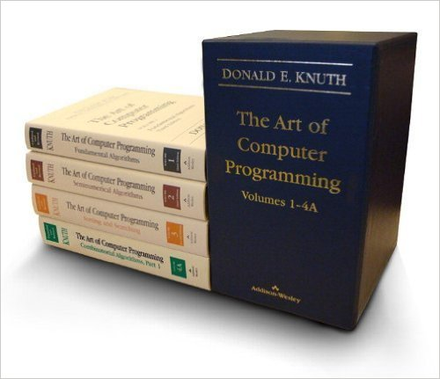
ftrace produces a copious amount of output

Slide 43

Investigating IRQs with eBPF: bcc
BCC - Tools for BPF-based Linux analysis
tools/ and examples/ illustrate interfaces to kprobes and uprobes.
BCC tools are:
  a convenient way to study arbitrary infrequent events dynamically;
  based on dynamic code insertion using Clang Rewriter JIT;
  lightweight due to in-kernel data storage.

Slide 44
eBPF, IOvisor and IRQs: limitations
JIT compiler is currently available for the x86-64, arm64, and s390 architectures.
No stack traces unless CONFIG_FRAME_POINTER=y
Requires recent kernel, LLVM and Clang
bcc/src/cc/export/helpers.h:
#ifdef __powerpc__
[ . . . ]
#elif defined(__x86_64__)
[ . . . ]
#else
#error "bcc does not support this platform yet"
#endif

Slide 45
bcc tips
SKIP
Kernel source must be present on the host where the probe runs.
/lib/modules/$(uname -r)/build/include/generated must exist.
To switch between kernel branches and continue quickly using bcc:
  run 'mrproper; make config; make'
  'make' need only to populate include/generated in kernel source before bcc again becomes available.
  'make headers_install' as non-root user

Slide 46
Get latest version of clang by compiling from source
(or from Debian Sid)
SKIP
$ git clone http://llvm.org/git/llvm.git
$ cd llvm/tools
$ git clone --depth 1 http://llvm.org/git/clang.git
$ cd ..; mkdir build; cd build
$ cmake .. -DLLVM_TARGETS_TO_BUILD="BPF;X86"
$ make -j $(getconf _NPROCESSORS_ONLN)
from samples/bpf/README.rst

Slide 47


Example: NAPI: changing the bottom half
By McSmit - Own work, CC BY-SA 3.0
Di O. Quincel - Opera propria, CC BY-SA 4.0

Slide 48
Quick NAPI refresher
net/core/dev.c in RT
The problem:
“High-speed networking can create thousands of interrupts per second, all of which tell the system something it already knew: it has lots of packets to process.”
The solution:
“Interrupt mitigation . . . NAPI allows drivers to run with (some) interrupts disabled during times of high traffic, with a corresponding decrease in system load.”
The implementation:
Poll the driver and drop packets without processing in the NIC if the polling frequency necessitates.

Slide 49
Example: i.MX6 FEC RGMII NAPI turn-on
== irq_forced_thread_fn() for irq/43
static irqreturn_t fec_enet_interrupt(int irq, void *dev_id)
[ . . . ]
if ((fep->work_tx || fep->work_rx) && fep->link) {
if (napi_schedule_prep(&fep->napi)) {
/* Disable the NAPI interrupts */
writel(FEC_ENET_MII, fep->hwp + FEC_IMASK);
__napi_schedule(&fep->napi);
}
}
Back to threaded IRQs

Slide 50
Example: i.MX6 FEC RGMII NAPI turn-off
static int fec_enet_rx_napi(struct napi_struct *napi, int budget){
[ . . . ]
pkts = fec_enet_rx(ndev, budget);
if (pkts < budget) {
napi_complete(napi);
writel(FEC_DEFAULT_IMASK, fep->hwp + FEC_IMASK);
}
}
netif_napi_add(ndev, &fep->napi, fec_enet_rx_napi, NAPI_POLL_WEIGHT);
Interrupts are re-enabled when budget is not consumed.

Slide 51
Using existing tracepoints
function_graph tracing causes a lot of overhead.
How about napi_poll tracer in /sys/kernel/debug/events/napi?
  Fires constantly with any network traffic.
  Displays no obvious change in behavior when eth IRQ is disabled and polling starts.

Slide 52
The Much Easier Way:
BCC on x86_64 with
4.6.2-rt5 and Clang-3.8

Slide 53
Handlind Eth IRQs in ksoftirqd on x86_64, but NAPI?
root $ ./stackcount.py e1000_receive_skb
Tracing 1 functions for "e1000_receive_skb"
^C
e1000_receive_skb
e1000e_poll
net_rx_action
do_current_softirqs
run_ksoftirqd
smpboot_thread_fn
kthread
ret_from_fork
1
4.6.2-rt5
e1000_receive_skb
e1000e_poll
net_rx_action
do_current_softirqs
__local_bh_enable
irq_forced_thread_fn
irq_thread
kthread
ret_from_fork
26469
COUNTS
running from ksoftirqd, not from hard IRQ handler.
Normal behavior: packet handler runs immediately after eth IRQ, in its context.

Slide 54
Switch to NAPI on x86_64
[alison@sid]$ sudo modprobe kp_ksoft eth_irq_procid=1
[ ] __raise_softirq_irqoff_ksoft: 582 hits
[ ] kprobe at ffffffff81100920 unregistered
[alison@sid]$ sudo ./stacksnoop.py __raise_softirq_irqoff_ksoft
144.803096056 __raise_softirq_irqoff_ksoft
ffffffff81100921 __raise_softirq_irqoff_ksoft
ffffffff810feda9 do_current_softirqs
ffffffff810ffeae run_ksoftirqd
ffffffff8114d255 smpboot_thread_fn
ffffffff81144a99 kthread
ffffffff8205ed82 ret_from_fork

Slide 55
Same Experiment, but non-RT 4.6.2
SKIP
Most frequent:
e1000_receive_skb
e1000e_poll
net_rx_action
__softirqentry_text_start
irq_exit
do_IRQ
ret_from_intr
cpuidle_enter
call_cpuidle
cpu_startup_entry
start_secondary
1016045
Run in ksoftirqd:
e1000_receive_skb
e1000e_poll
net_rx_action
__softirqentry_text_start
run_ksoftirqd
smpboot_thread_fn
kthread
ret_from_fork
1162
At least 70 other call stacks observed in a few seconds.

Slide 56
Due to handle_pending_softirqs(), any hard IRQ can run before a given softirq (non-RT 4.6.2)
e1000_receive_skb
e1000e_poll
net_rx_action
__softirqentry_text_start
irq_exit
do_IRQ
ret_from_intr
pipe_write
__vfs_write
vfs_write
sys_write
entry_SYSCALL_64_fastpath
357
e1000_receive_skb
e1000e_poll
net_rx_action
__softirqentry_text_start
irq_exit
do_IRQ
ret_from_intr
__alloc_pages_nodemask
alloc_pages_vma
handle_pte_fault
handle_mm_fault
__do_page_fault
do_page_fault
page_fault
366

Slide 57
Same Experiment, but 4.6.2 with 'threadirqs' boot param
e1000_receive_skb
e1000e_poll
net_rx_action
__softirqentry_text_start
do_softirq_own_stack
do_softirq.part.16
__local_bh_enable_ip
irq_forced_thread_fn
irq_thread
kthread
ret_from_fork
569174
With 'threadirqs' cmdline parameter at boot.
Note:
no do_current_softirqs()

Slide 58
Investigation on ARM: kprobe with 4.6.2-rt5

Slide 59
Documentation/kprobes.txt
“In general, you can install a probe
anywhere in the kernel.
In particular, you can probe interrupt handlers.”
Takeaway: not limited to existing tracepoints!

Slide 60
Not quite anywhere
root@nitrogen6x:~# insmod 4.6.2/kp_raise_softirq_irqoff.ko
[ 1749.935955] Planted kprobe at 8012c1b4
[ 1749.936088] Internal error: Oops - undefined instruction: 0 [#1] PREEMPT SMP ARM
[ 1749.936109] Modules linked in: kp_raise_softirq_irqoff(+)
[ 1749.936116] CPU: 0 PID: 0 Comm: swapper/0 Not tainted 4.6.2
[ 1749.936119] Hardware name: Freescale i.MX6 Quad/DualLite
[ 1749.936131] PC is at __raise_softirq_irqoff+0x0/0xf0
[ 1749.936144] LR is at __napi_schedule+0x5c/0x7c
[ 1749.936766] Kernel panic - not syncing: Fatal exception in interrupt
Mainline stable 4.6.2

Slide 61
Adapt samples/kprobes/kprobe_example.c
code at Github
/* For each probe you need to allocate a kprobe structure */
static struct kprobe kp = {
.symbol_name = "__raise_softirq_irqoff_ksoft",
};
/* kprobe post_handler: called after the probed instruction is executed */
static void handler_post(struct kprobe *p, struct pt_regs *regs,unsigned long flags)
{
unsigned id = smp_processor_id();
/* change id to that where the eth IRQ is pinned */
if (id == 0) { pr_info("Switched to ethernet NAPI.\n");
pr_info("post_handler: p->addr = 0x%p, pc = 0x%lx,"
" lr = 0x%lx, cpsr = 0x%lx\n",
p->addr, regs->ARM_pc, regs->ARM_lr, regs->ARM_cpsr); }
}
in net/core/dev.c

Slide 62
Watching net_rx_action() switch to NAPI
alison@laptop:~# make ARCH=arm CROSS_COMPILE=arm-linux-gnueabi- samples/kprobes/ modules
root@nitrogen6x:~# modprobe kp_ksoft.ko eth_proc_id=1
root@nitrogen6x:~# dmesg | tail
[ 6548.644584] Planted kprobe at 8003344
root@nitrogen6x:~# dmesg | grep post_handler
root@nitrogen6x:~#
. . . . . Start DOS attack . . . Wait 15 seconds . . . .
root@nitrogen6x:~# dmesg | tail
[ 6548.644584] Planted kprobe at 80033440
[ 6617.858101] pre_handler: p->addr = 0x80033440, pc = 0x80033444, lr = 0x80605ff0, cpsr = 0x20070193
[ 6617.858104] Switched to ethernet NAPI.

Slide 63
Another example of output
Insert/remove two probes during packet storm:
root@nitrogen6x:~# modprobe -r kp_ksoft
[ 232.471922] __raise_softirq_irqoff_ksoft: 14 hits
[ 232.471922] kprobe at 80033440 unregistered
root@nitrogen6x:~# modprobe -r kp_napi_complete
[ 287.225318] napi_complete_done: 1893005 hits
[ 287.262011] kprobe at 80605cc0 unregistered

Slide 64
Counting activation of two softirq execution paths
static struct kprobe kp = {
.symbol_name = "do_current_softirqs",
};
if (raised == NET_RX_SOFTIRQ) {
ti = current_thread_info();
task = ti->task;
if (chatty)
pr_debug("task->comm is %s\n", task->comm);
if (strstr(task->comm, "ksoftirq"))
p->ksoftirqd_count++;
if (strstr(task->comm, "irq/"))
p->local_bh_enable_count++;
}
show you the codez
previously included results
store counters in
struct kprobe{}
modprobe kp_do_current_softirqs chatty=1

Slide 65
Summary
IRQ handling involves a 'hard', fast part or 'top half' and a 'soft', slower part or 'bottom half.'
Hard IRQs include arch-dependent system features plus software-generated IPIs.
Soft IRQs may run directly after the hard IRQ that raises them, or at a later time in ksoftirqd.
Threaded, preemptible IRQs are a salient feature of RT Linux.
The management of IRQs, as illustrated by NAPI's response to DOS, remains challenging.
If you can use bcc and eBPF, you should be!

Slide 66
Acknowledgements
Thanks to Sebastian Siewor, Brenden Blanco, Brendan Gregg, Steven Rostedt and Dave Anders for advice and inspiration.
Special thanks to Joel Fernandes and Sarah Newman for detailed feedback on an earlier version.

Slide 67
Useful Resources
NAPI docs
Documentation/kernel-per-CPU-kthreads
Documentation/DocBook/genericirq.pdf
Brendan Gregg's blog
Tasklets and softirqs discussion at KLDP wiki
#iovisor at OFTC IRC
Alexei Starovoitov's 2015 LLVM Microconf slides

Slide 68
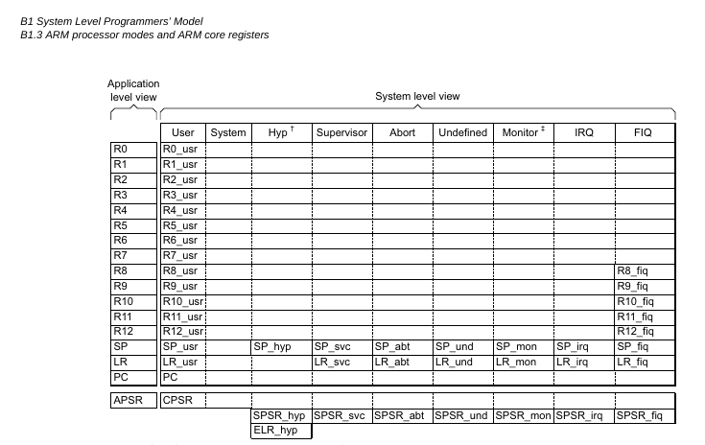
ARMv7 Core Registers

Slide 69
Softirqs that don't run in context of hard-IRQ handlers run “on behalf of ksoftirqd”
static inline void ksoftirqd_set_sched_params(unsigned int cpu)
{
/* Take over all but timer pending softirqs when starting */
local_irq_disable();
current->softirqs_raised = local_softirq_pending() & ~TIMER_SOFTIRQS;
local_irq_enable();
}
static struct smp_hotplug_thread softirq_threads = {
.store = &ksoftirqd,
.setup = ksoftirqd_set_sched_params,
.thread_should_run = ksoftirqd_should_run,
.thread_fn = run_ksoftirqd,
.thread_comm = "ksoftirqd/%u",
};

Slide 70
Compare output to source with GDB
[alison@hildesheim linux-4.4.4 (trace_napi)]$ arm-linux-gnueabihf-gdb vmlinux
(gdb) p *(__raise_softirq_irqoff_ksoft)
$1 = {void (unsigned int)} 0x80033440 <__raise_softirq_irqoff_ksoft>
(gdb) l *(0x80605ff0)
0x80605ff0 is in net_rx_action (net/core/dev.c:4968).
4963 list_splice_tail(&repoll, &list);
4964 list_splice(&list, &sd->poll_list);
4965 if (!list_empty(&sd->poll_list))
4966 __raise_softirq_irqoff_ksoft(NET_RX_SOFTIRQ);
4967
4968 net_rps_action_and_irq_enable(sd);
4969 }

