Slide 1

Addressing the hard problems of automotive Linux: networking and IPC
Alison Chaiken
Mentor Embedded Software
Fremont CA USA
alison_chaiken@mentor.com
February 21, 2013

Slide 2

Outline
Status of Linux in automotive
GENIVI and AF_BUS IPC
V2V and V2I networking
New stakeholders for Linux
Summary

Slide 3
Housekeeping: IVI Jargon
“OEM”: a car manufacturer
“Tier 1”: a vendor who sells directly to OEMs
“Tier 2”: a vendor to Tier 1s, who bundle components
“ECU”: electronic control unit, 32- or 16-bit MCU running an RTOS
“AUTOSAR”: ECU protocol incl. design methodology
“ADAS”: advanced driver assistance system

Slide 4




Linux won:
  on servers and on handsets.
Linux lost:
  on desktops.
Linux could lose in automotive:
  QNX and Windows have the largest automotive base.
  QNX has fast IPC and works well on smaller MCUs.
  Most car CPUs run proprietary RTOSes.

Slide 5
Current Public Status of Automotive Linux
OEM | Confirmed Operating system
Fiat-Chrysler Blue&Me (500, Delta), Kia Uvo | Microsoft Windows Embedded Automotive
Ford (all?) | MyTouch/Sync-Microsoft (OpenXC-Android)
General Motors/Cadillac User Experience | Linux
Geely (China); Hawtai (China) | Linux: Moblin (MeeGo-Tizen precursor)
Renault R-Link | Android
Jaguar Land-Rover | Tizen (Linux)
Honda (Accord, Odyssey, Pilot), Audi (A8L, Q5, A6), BMW (7-series and M models), Chrysler, Daewoo, GM (OnStar), Hyundai, Land Rover, Porsche, Saab (9-3), Renault (SM7), Mercedes (S- and C-class) | QNX
Linux Foundation members: Toyota, Pelagicore, Symbio, Tieto
GENIVI Alliance: 160+ members including 11 “OEMs”

Slide 6

GENIVI Alliance
Goals:
  reduce lock-in by Tier 1 vendors.
  reduce cost and TTM of new models.
Methods:
  Promote code reuse via standard interfaces.
  Grow the size of contributor community.
  Focus on middleware: not a distro.
Projects with released code: Audio Manager, IVI Layer Management, Diagnostic Log and Trace, AF_BUS D-Bus Optimization, LXCBENCH; more on the way.
Mailing lists and #genivi on FreeNode.

Slide 7
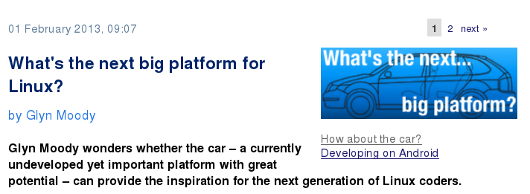
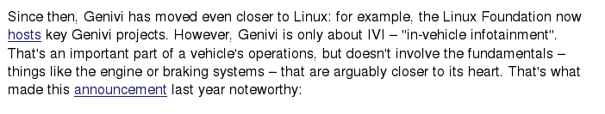
TRUE:
FALSE:
http://www.h-online.com/open/features/What-s-the-next-big-platform-for-Linux-1794404.html

Slide 8
The strange case
of
AF_BUS

Slide 9
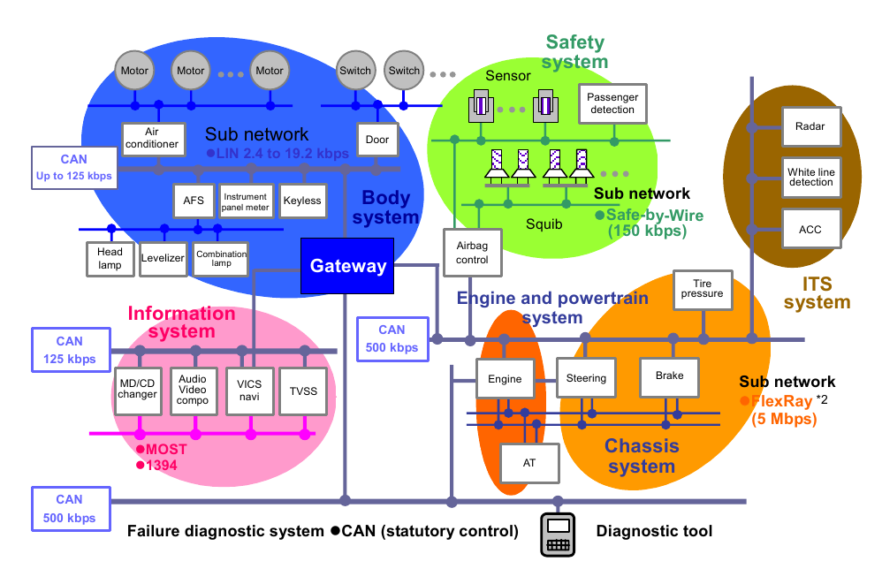
Mixture of time-critical and best-effort networks
Copyright Renesas, “Introduction to CAN”, with permission.

Slide 10
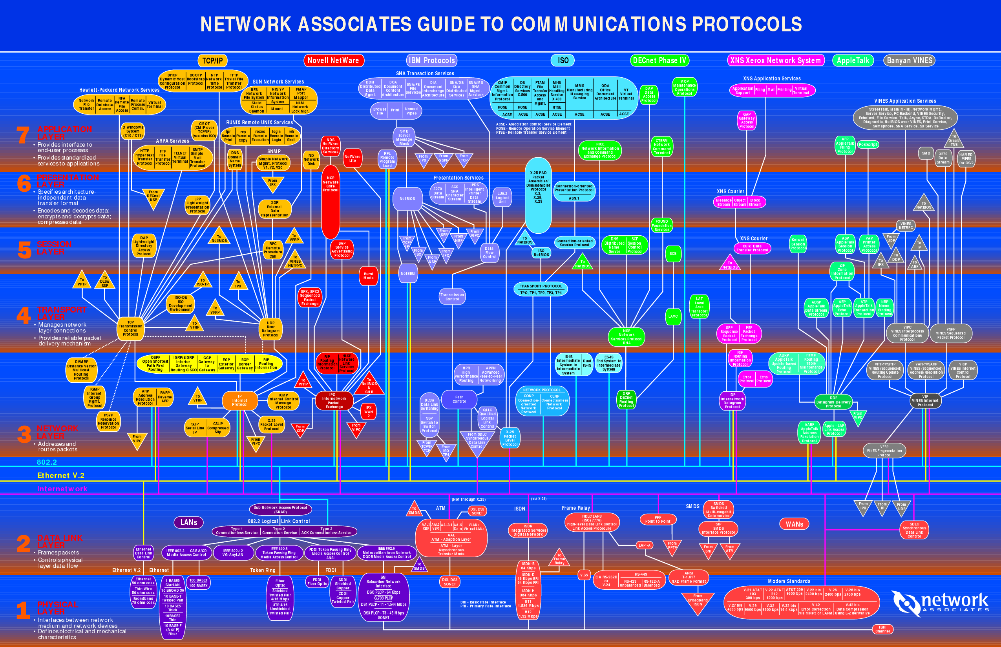
Anyone reminded of this Babel?

Slide 11
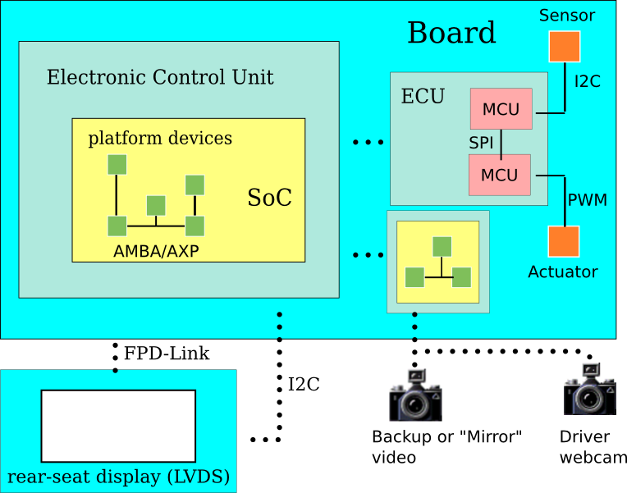
Diverse IPC mechanisms, Legacy Protocols
TCP/IP?
UDP/IP?
RemoteProc?
D-Bus?
or maybe
FlexRay
EthernetAVB
EtherCAT
J1939 . . .

Slide 12
Challenges to Standards for Linux IPC
“IP is the narrow waist of the Internet” BUT
TCP/UDP, even IP headers are too large for AUTOSAR.
  6LoWPAN header compression offers a solution?
Event-driven and timer-based traffic coexist on same network.
  Will asynchronous networking provide QoS?
AudioManager, LayerManager, AF_BUS define policies to enable whole-system-level interrupts and priorities.

Slide 13
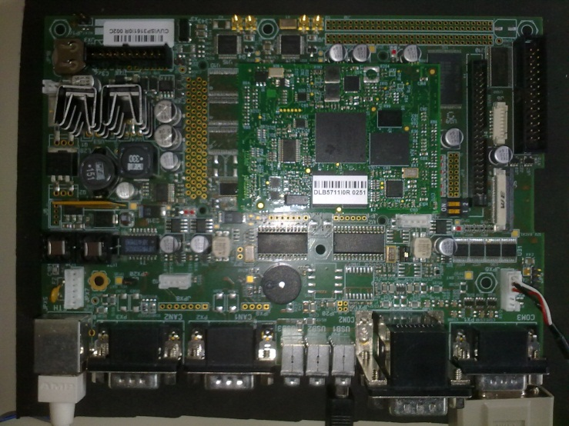
CAN-Ethernet Gateway Demo
From “SAE J 1939 Over Real Time Ethernet: The Future of
Heavy Duty Vehicle Networks,” Ruggeri et al., Imamoter, 2012
UDP Socket
ARM Cortex A8
Linux Ångström v 2.6.28
Stack “SocketCAN”
Can and Ethernet on chip
CAN-E'net bridge
CAN to UDP Thread
UDP to CAN Thread
CAN Controller
Two independent threads.
Uses socket paradigm as an abstraction to transparently copy messages on different physical layers

Slide 14
GENIVI meets kernel: AF_BUS
Problem: D-Bus scales poorly, is resource-intensive and slow.
Recent history of contention around IPC: binder in 2009
AF_BUS is created by Collabora with GENIVI-funding.
Implements a new socket interface based on AF_UNIX but with multicast capability.
Rejected from mainline with rationale that IP sockets can provide needed performance.
  Real-time IPC guarantees possible with IP?
AF_BUS subsequently merged in LTSI kernel 3.4.21.

Slide 15

Feb 2013: Gnome Hackfest
New in-kernel D-Bus-based IPC is broached.
  Will support Binder userspace API as well as D-Bus.
  And others (0MQ, RabbitMQ, etc.)?
Endorsed by D-Bus (Pennington) and kernel (GKH) contributors.
Victory for GENIVI: in-kernel D-Bus optimization is coming!
Not viewed that way by everyone . . .
brcmsmac vs. b43 (Broadcom) redux?

Slide 16
Automotive
networking
background
– extravehicular

Slide 17
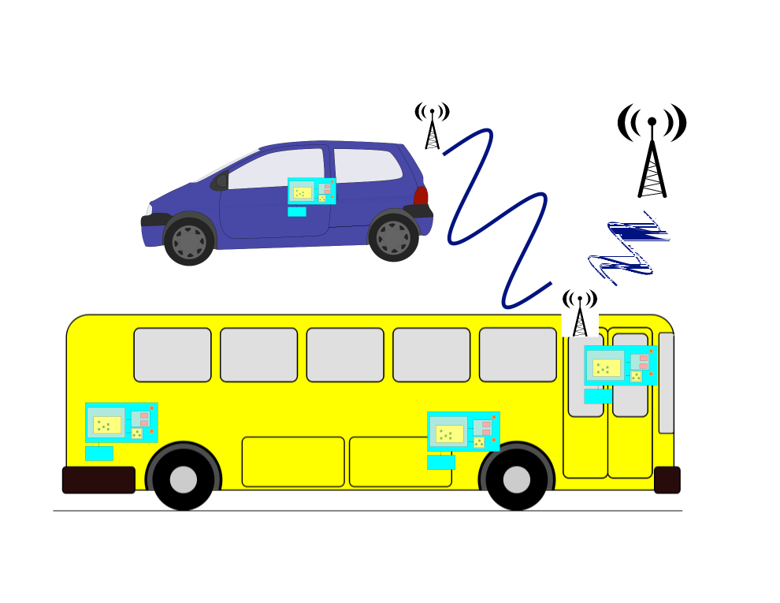
Vehicles are a “network of networks”
V2V
V2I

Slide 18
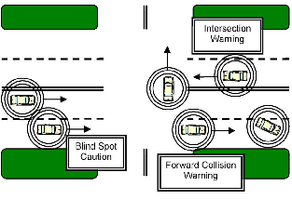
IEEE: DSRC and Basic Safety Message
J.B. Kenney,
Toyota ITC,
Proc. IEEE 99,
2011.
Collision avoidance is primary motivation.
USDoT had RFC on PKE for V2X in 2012.
How to issue revocable keys w/o trackability?

Slide 19
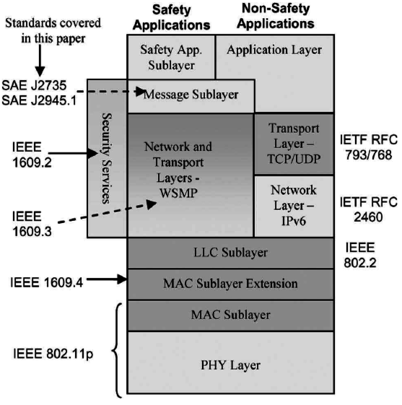
802.11p & 1609: DSRC, WAVE and WSMP
802.11p has dedicated spectrum at 5.9 GHz.
Unlike other 802.11, no BSS.
New protocols, e.g. DNS Geocasting.
New use cases, e.g. mobile routers
VIN == MAC? or is VIN private?
Jouni Malinen, 2012 Linux Wireless
Summit, "Not yet implemented."
J.B. Kenney,
Toyota ITC,
Proc. IEEE 99,
2011.

Slide 20
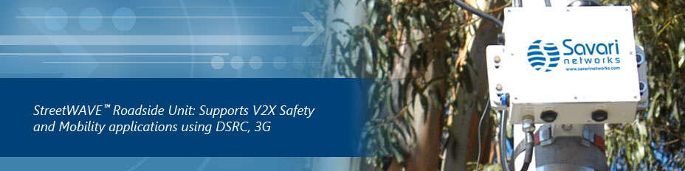
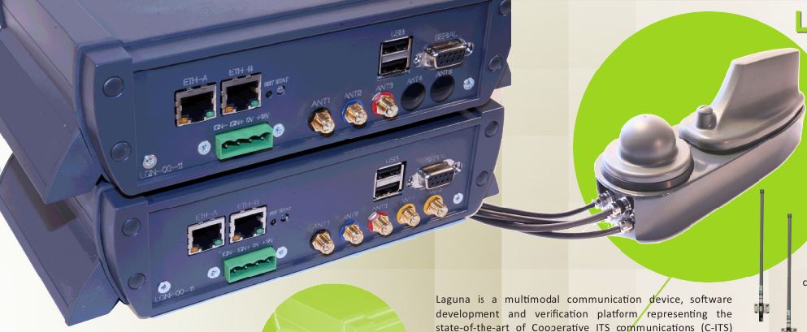
802.11p V2X routers
Linux-based
BSD-based?
Commsignia

Slide 21

Automotive Grade Linux
Initiated September 2012.
An installable distro like Android (unlike GENIVI).
Development in open (unlike Android or GENIVI).
No CLA, but no GPLv3 (like Android and GENIVI).
Mailing lists available but very quiet.
So far, based entirely on Tizen.

Slide 22







Open source has new allies
+

Slide 23
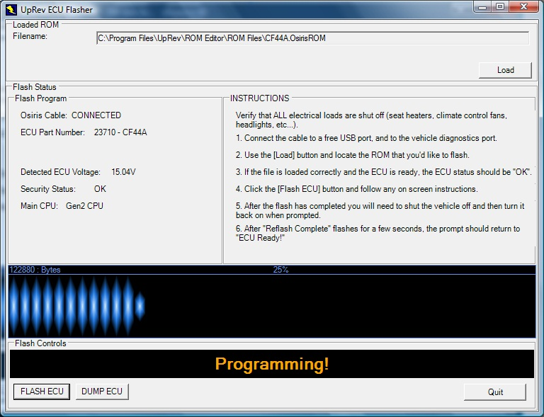
Reflashing the ECUs: uprev.com

Slide 24
Conclusions
Hardest problem of automotive Linux is cultural.
The Linux community and kernel devs and “Tier n” software creators need to work together.
  Make accomodation for mutual benefit, as with Android.
Kernel quality standards must be maintained
BUT
OEMs need to ship reliable, safe cars every year.
Drivers, transit planners, insurance companies, home mechanics are stakeholders, too.

Slide 25
Related automotive presentation
John Mehaffey, Mentor Graphics,
Security Best Practices for Embedded Systems
Friday at 3:15 in Cyril Magnin
Special thanks
Massimiliano Ruggeri of Imamoter, John Kenney of Toyota,
Ravi Puvvala of Savari Networks, Christie Dudley of Santa Clara
University Law School, Mentor Embedded and GENIVI colleagues

Slide 26
Resources
GENIVI open-source projects, mailing lists, #genivi IRC
Automotive Grade Linux
ITSSv6, CALM, Imamoter, ETSI, ISO C-ITS
SAE, IEEE, AUTOSAR, ISO, IETF, W3C standards
IETF-ITS mailing list; Telematics News and Telematics Update, Wired Autopia
Reverse-engineering legions: scantool.net, mp3car.com, diyefi.org, Team Wikispeed, righttorepair.org
LWN and H-Online (as always!)

Slide 27
Early backup video and v4l2
NHTSA proposed a requirement for annotated, composited backup video 2s after boot.
  Announced for 12/2012: nothing yet.
Likely solution for fast-boot: a dedicated camera ECU or CPU.
  What network architecture optimizes BW, cost and reliability?
Jaguar Land-Rover: 8 cameras in new ADAS systems.
Cameras will also be used for gesture recognition.
  Now possible with specialized IP cores (Samplify et al.).

Slide 28
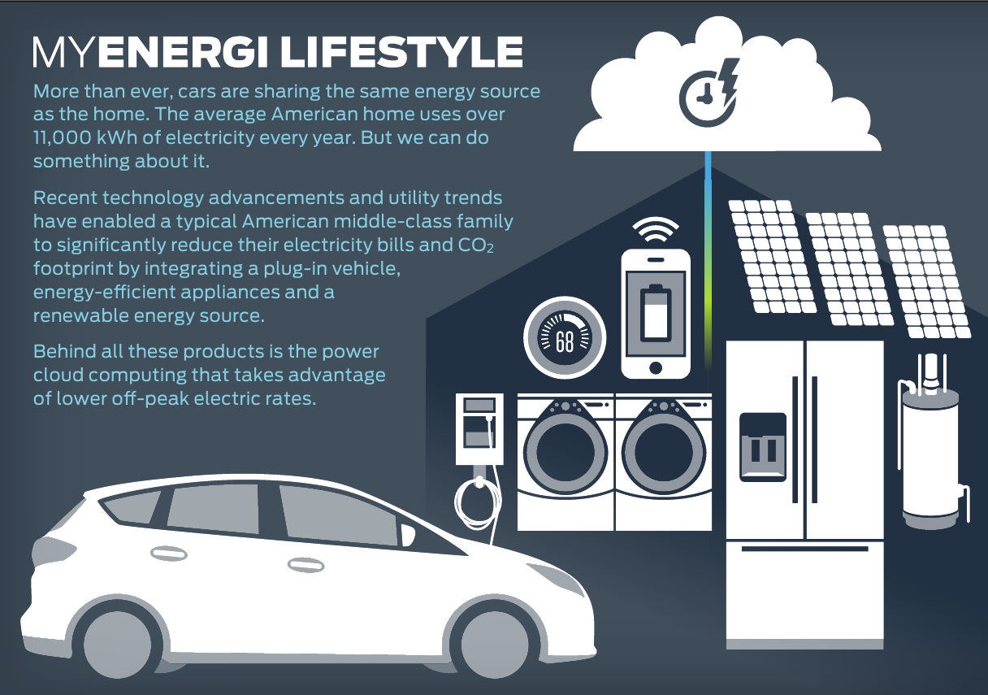
Cars talk on the Internet of Things

Slide 29
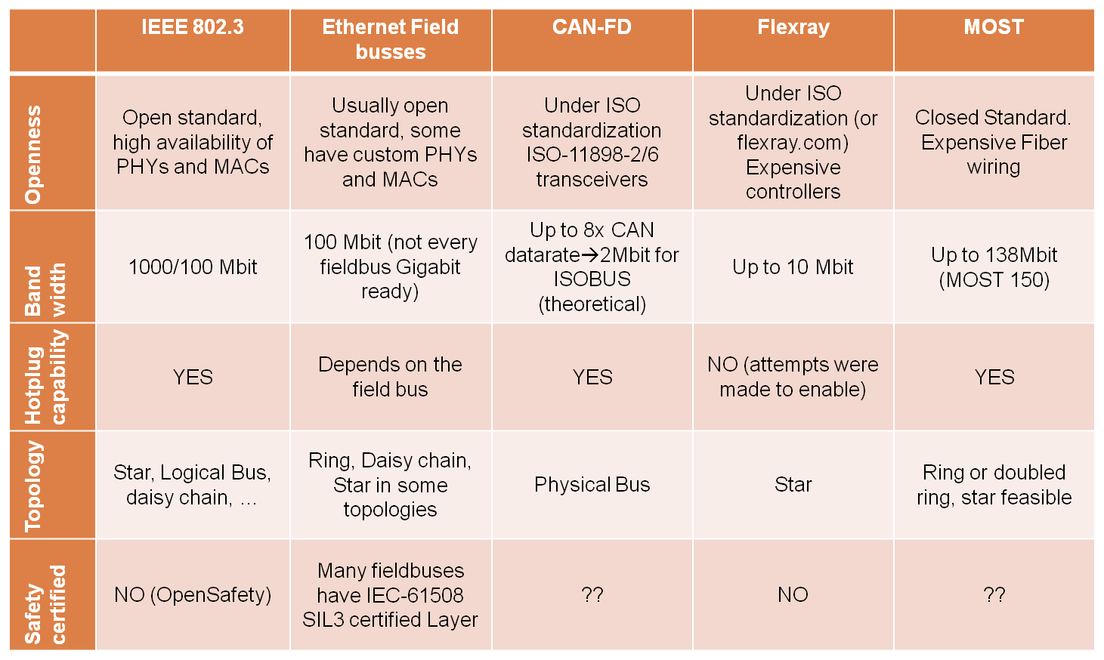
High-Bandwidth feasible buses overview
From “SAE J 1939 Over Real Time Ethernet: The Future of
Heavy Duty Vehicle Networks,” Ruggeri et al., Imamoter

Slide 30
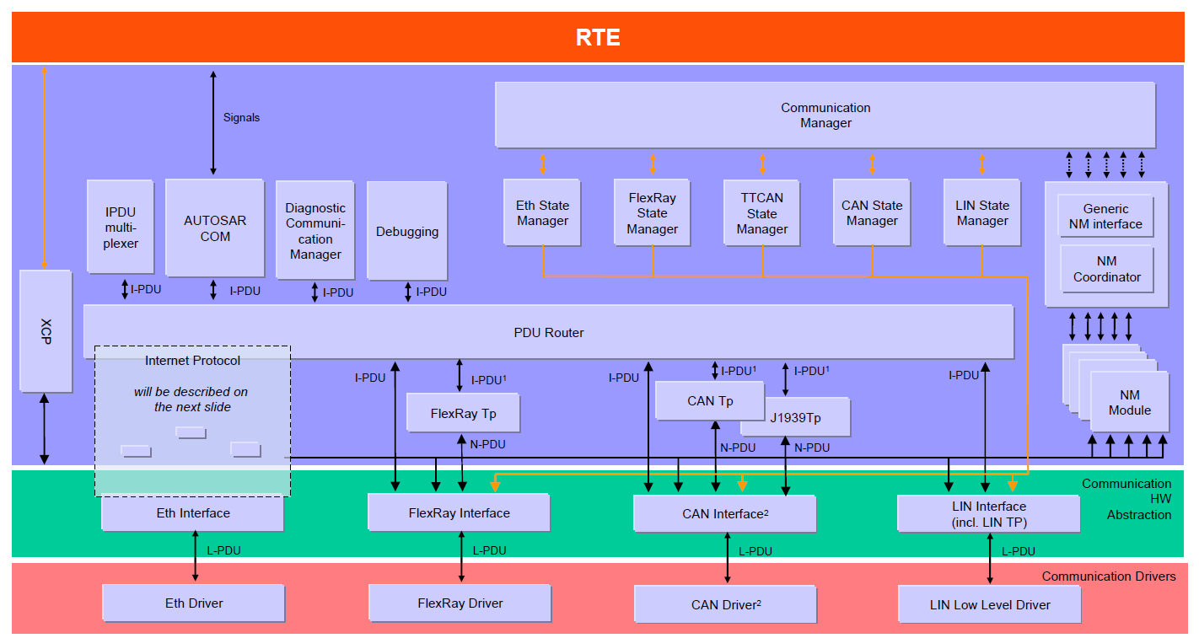
Another view of automotive networks
courtesy AUTOSAR

Slide 31
SPI used as communication stack
Application Layer
Impact:
SPI interface module needed
Runtime Environment (RTE)
Basic Software (BSW)
SPI
SPI
PWM
MCU 1
Sensor ECU
SPI
Actuator
Ext FlexRay transc.
Application Layer
FlexRay
Runtime Environment (RTE)
PWM - Control
Basic Software (BSW)
AUTOSAR or other OS
(e.g. Genivi)
DO
SPI
Digital - Enable
MCU 2
Note:
two or more MCUs
ECU
Courtesy of AUTOSAR Consortium

Slide 32
Phasing in autonomous operation
Prediction: in U.S., incentives to buy cars with V2X radios.
  Usage-based insurance motivates driver acceptance.
Prediction: congestion pricing everywhere all the time.
  Drivers get discounts for travelling off-peak.
Prediction: stop signs and traffic lights disappear.
Optimization at the whole transport-system level is enabled by vehicles talking on the Internet of Things.
  Pollution, energy usage and travel times can be jointly managed

Slide 33
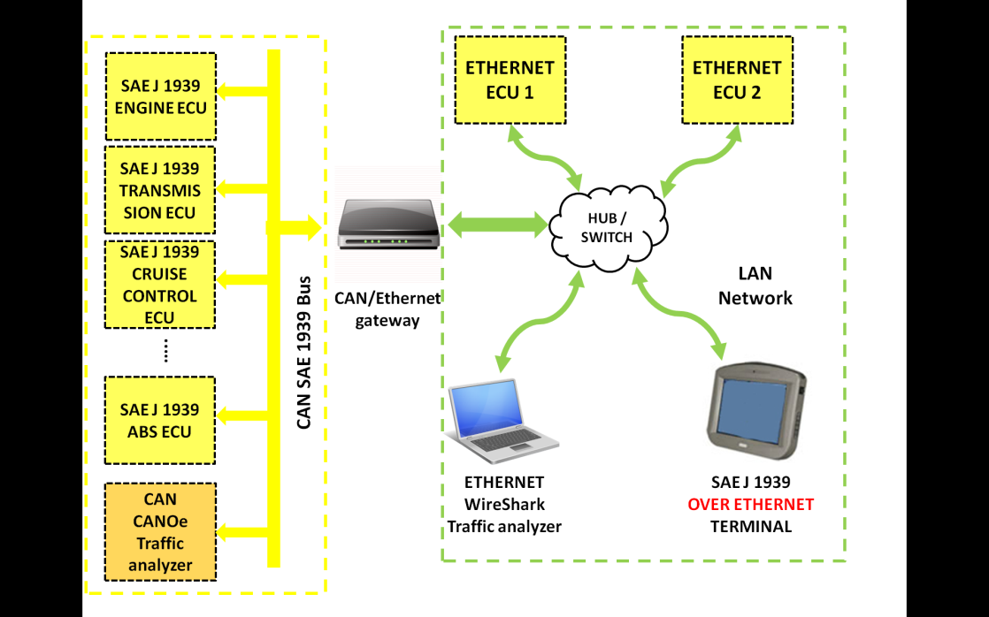
CAN-Ethernet Gateway Demo
From “SAE J 1939 Over Real Time Ethernet: The Future of
Heavy Duty Vehicle Networks,” Ruggeri et al., Imamoter, 2012

