Slide 1
Developing Automotive Linux
Alison Chaiken
alison@she-devel.com
February 4, 2015
Hyperlinks in blue.

Slide 2
Who's using Linux in cars?

Slide 3
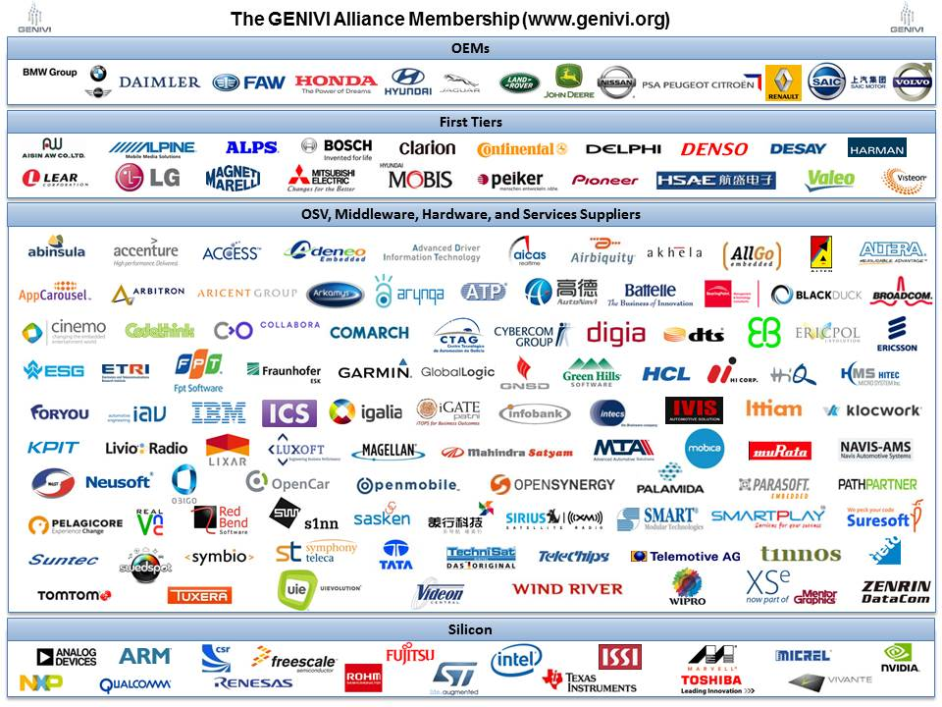

Slide 4
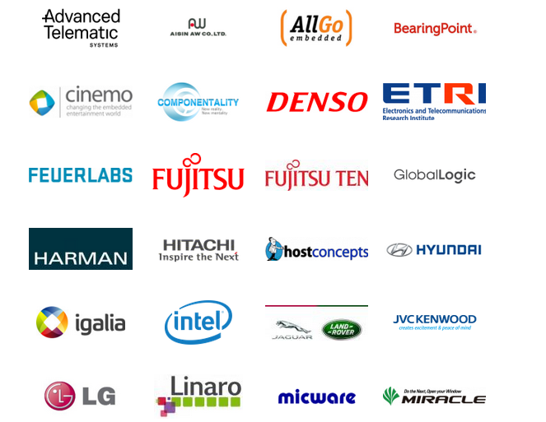
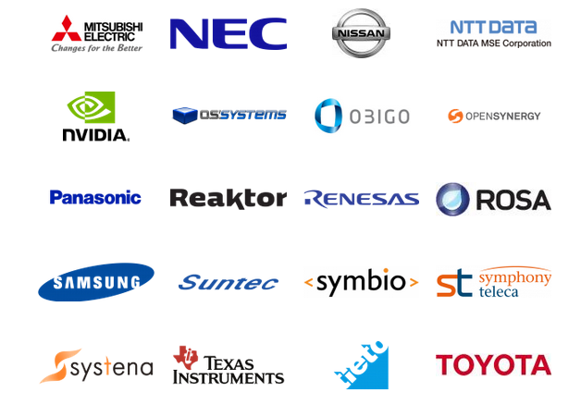
Automotive Grade Linux participants

Slide 5
Current Public Status of Automotive Linux
OEM | Confirmed Operating system
Fiat-Chrysler Blue&Me (500, Delta), Kia Uvo | Microsoft Windows Embedded Automotive
Ford (pre-2016) | MyTouch/Sync-Microsoft; OpenXC-Android
General Motors, Tesla, Volvo, Geely, BMW (2016+), Infiniti (Q50) | GENIVI Linux
Renault R-Link | native Android Linux
Jaguar Land-Rover, Toyota | Tizen/Automotive Grade Linux
Honda (older Accord, Odyssey, Pilot), Audi (A8L, Q5, A6), BMW (older 7-series and M models), Chrysler, Daewoo, GM (OnStar), Hyundai, Porsche, Renault (SM7), Mercedes (S- and C-class), Ford (2016+) | QNX
Oversimplified: each vehicle runs more than one OS.

Slide 6
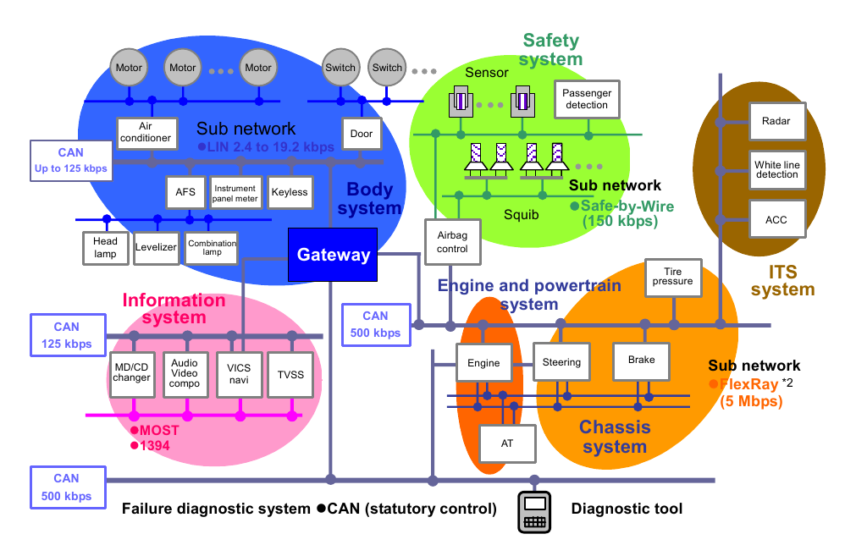
Automotive computing mixes mission-critical and “infotainment”
Copyright Renesas, “Introduction to CAN”, with permission.
Microcontrollers typically run AUTOSAR rather than general-purpose OS.

Slide 7




Automotive OS Outlook
?
Market share
Native Android
Year

Slide 8
How is Android deployed on automotive platforms?

Slide 9
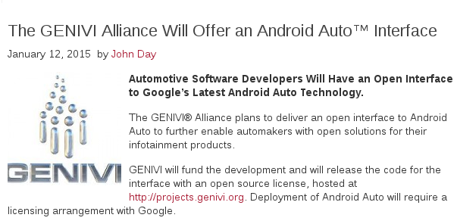

Slide 10
Common automotive Android deployments
Apps
App
App
LINUX
Android
LINUX
RTOS
Android
Apps
Apps
Mem
vDev
Mem
Dev
Mem
Dev
Mem
vDev
Mem
Dev
vCPU
vCPU
vCPU
vCPU
vCPU
vCPU
vCPU
Hypervisor
LXC
CPU
CPU
CPU
CPU
CPU
CPU
Devices
Memory
Devices
Memory
Memory
Based on a slide by Felix Baum, Mentor Graphics.

Slide 11
Linux containers and hypervisors
LXC is
  similar to BSD jails and Solaris zones.
  the basis for widely popular Docker.
LXC requires guests to share a Linux kernel but not platform SW.
Hypervisor guests can run different kernels .
Hypervisor securely manages interguest comms and device access.

Slide 12
Alternative developer-friendly ways to get started with automotive Android

Slide 13
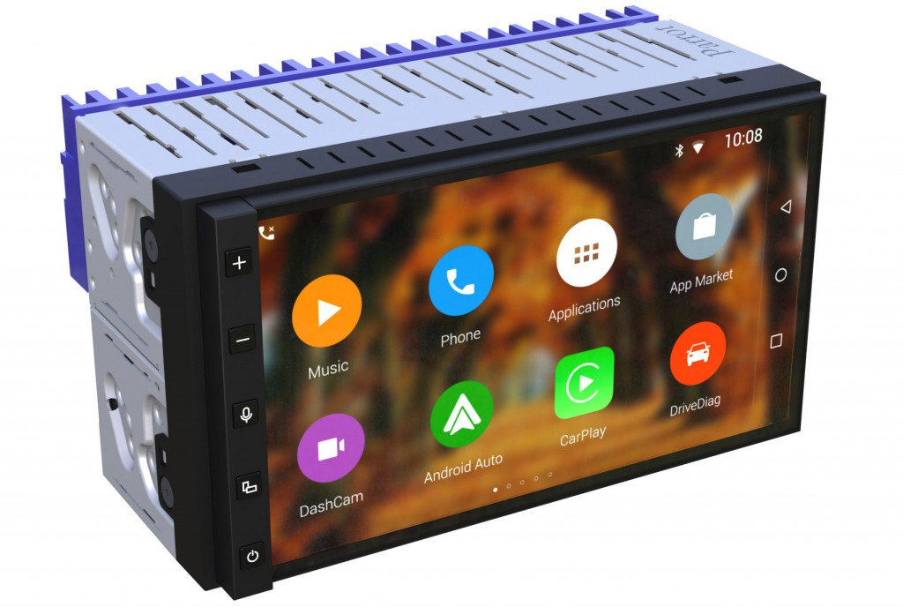
CES 2015: Parrot RNB6 aftermarket Android head unit
Parrot RNB6 (project code name) is an exceptional Android 2-DIN Infotainment Navigation System.
Developed with safety in mind, this revolutionary head-unit leverages Parrot’s extensive expertise in
head-unit conception, voice recognition, Android operating system (Lollipop 5.0) and wireless technology
to offer a smarter, safer and more innovative driving experience.

Slide 14
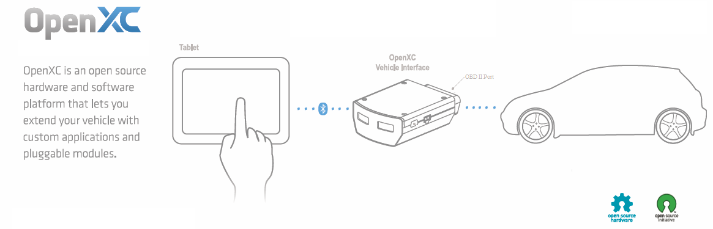
OpenXC Platform
Includes encrypted proprietary vehicle data from Ford and Chrysler.

Slide 15
Resources
GENIVI (mailing lists, package downloads)
Automotive Grade Linux(mailing lists, images, downloads)
Baserock (free installable images)
Android in LXC container how-to
OpenXC platform (github, hardware for purchase)
More automotive software slides
Mentor Embedded automotive solutions

Slide 16
Summary
Android Auto (and Apple CarPlay) are must-haves for automakers.
Android deployment takes a variety of forms.
Android will not boot “on the metal” in most vehicles.
Android and Linux still struggle against incumbent QNX.

Slide 17
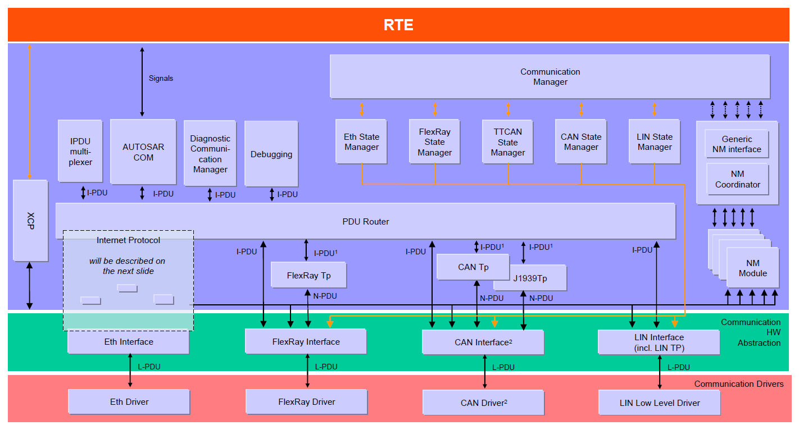
Another view of automotive networks
courtesy AUTOSAR

