Slide 1

Addressing the hard problems of automotive Linux: networking and IPC
Alison Chaiken
Mentor Embedded Software
Fremont CA USA
alison_chaiken@mentor.com
April 2, 2013
Volcano ·
AUTOSAR

Slide 2

Outline
Status of Linux in automotive
Automotive InterProcess Comms (Intranet)
V2V and V2I networking (Ravi)
Summary

Slide 3
Current Public Status of Automotive Linux
Carmaker | Confirmed Operating system
Fiat-Chrysler Blue&Me, Kia Uvo | Microsoft Windows Embedded Automotive
Ford (all?) | Microsoft MyTouch/Sync (+ OpenXC Android dongle and SmartPhoneLink)
General Motors “Cadillac User Experience” | Linux
Geely (China); Hawtai (China) | Linux: Moblin (MeeGo-Tizen precursor)
Renault R-Link | native Android
Jaguar Land-Rover, Tata, Toyota | Tizen (GNU/Linux)
Honda (Accord, Odyssey, Pilot), Audi (A8L, Q5, A6), BMW (7-series and M models), Chrysler, Daewoo, GM (OnStar), Hyundai, Land Rover, Porsche, Saab (9-3), Renault (SM7), Mercedes (S- and C-class) | QNX
Linux Foundation members: Toyota, Pelagicore, Symbio, Tieto
GENIVI Alliance: 160+ members including 11 automakers

Slide 4

GENIVI Alliance
Goals:
  reduce lock-in by suppliers.
  reduce cost and TTM of new models.
Methods:
  Promote code reuse and attract outside contributors.
  Focus on middleware: not a distro.
Mailing lists and #genivi on FreeNode.
10 projects with released code including AUTOSAR (Diagnostic Log and Trace) and IPC (AF_BUS D-Bus Optimization)

Slide 5
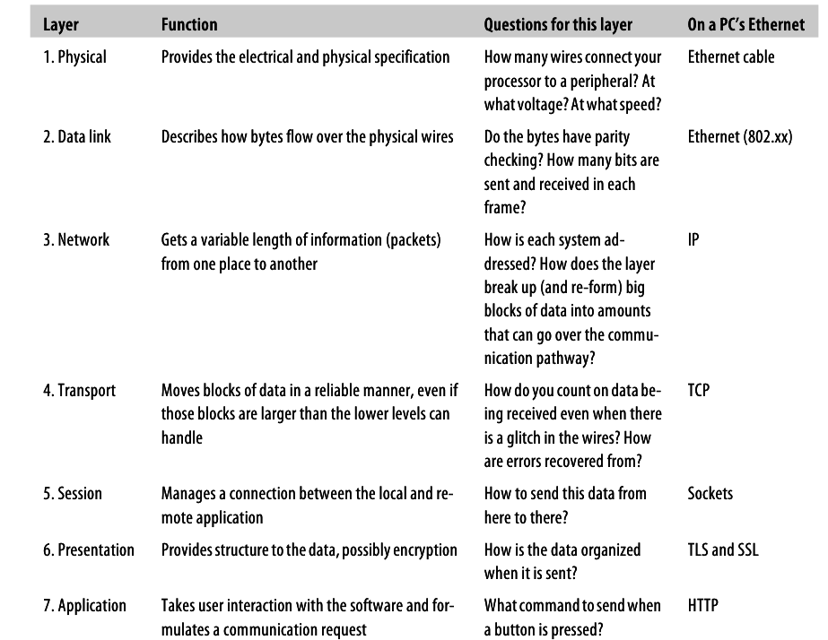
OSI Networking Stack
From
Making Embedded Systems
by Elecia White, with permission

Slide 6
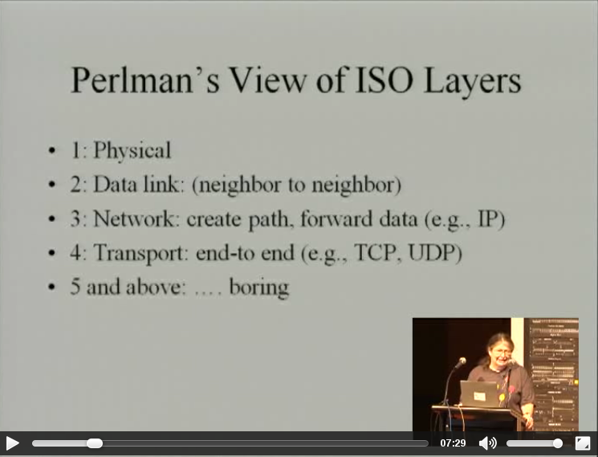
From LCA 2013

Slide 7
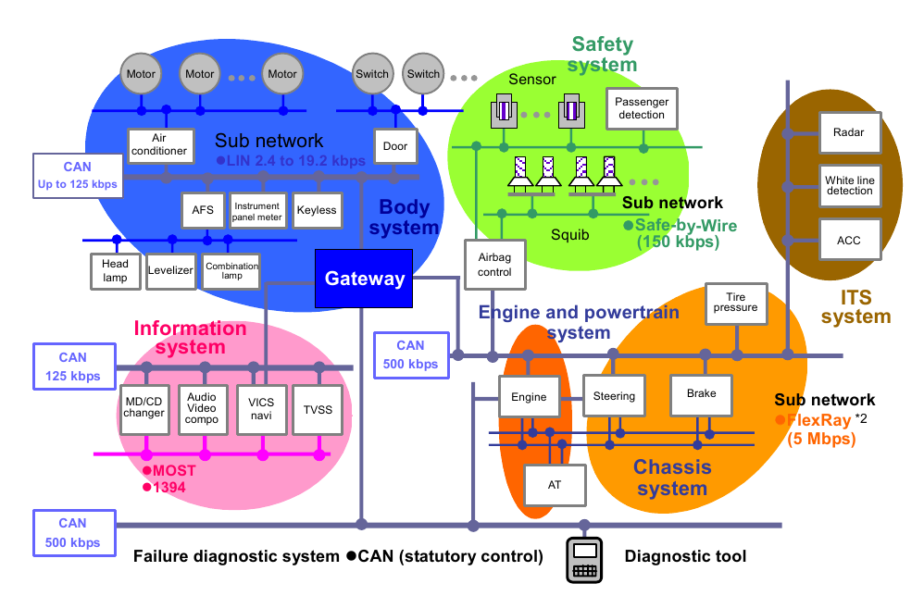
Mixture of time-critical and best-effort networks
RTOS
RTOS
Linux?
Linux?
RTOS
Copyright Renesas, “Introduction to CAN”, with permission.

Slide 8
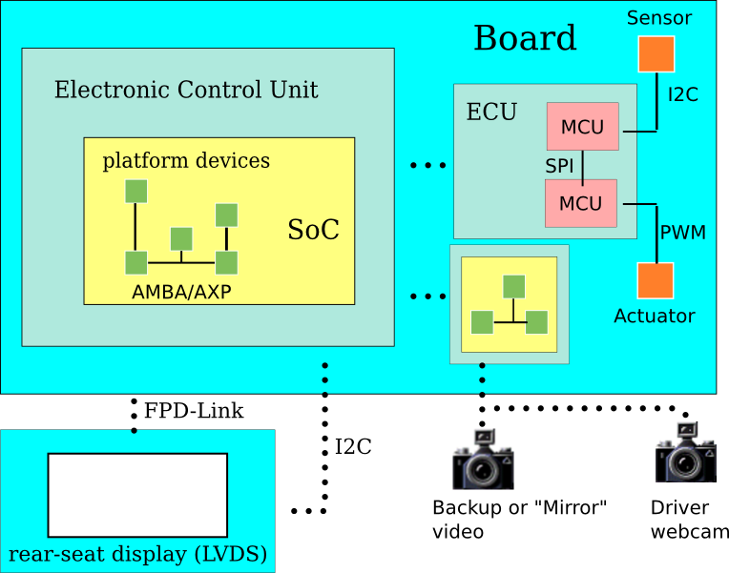
Diverse IPC mechanisms, Legacy Protocols
TCP/IP?
UDP/IP?
RemoteProc?
D-Bus?
RTOS
Linux?
or maybe
FlexRay
EthernetAVB
EtherCAT
J1939 . . .

Slide 9
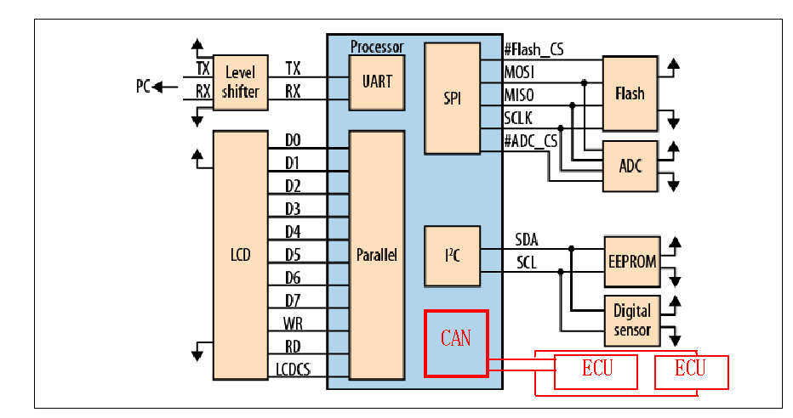
Controller Area Network is 2-wire serial like I2C
Adapted frrom
Making Embedded Systems
by Elecia White, with permission
AUTOSAR comms

Slide 10
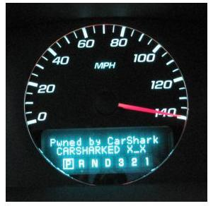
CAN Bus has security problems at Data Link Layer
Remote wireless exploit
against stock vehicle:
U. Wash. and UCSD collaboration
CAN will (eventually) phase out.
Linux security (SELinux, LXC,
cgroups) offer limited help.

Slide 11
Challenges for Linux InterProcess Communication
New for Linux: systems like cruise control incorporate both safety-critical and driver-facing components.
Event-driven and timer-based traffic coexist on same network.
  Will asynchronous networking provide QoS?
“IP is the narrow waist of the Internet” BUT
  TCP/UDP, even IP headers are too large for AUTOSAR.
  Header compression (6LoWPAN) offers a solution?
Many SAE, IETF, IEEE standards lack Linux support.

Slide 12
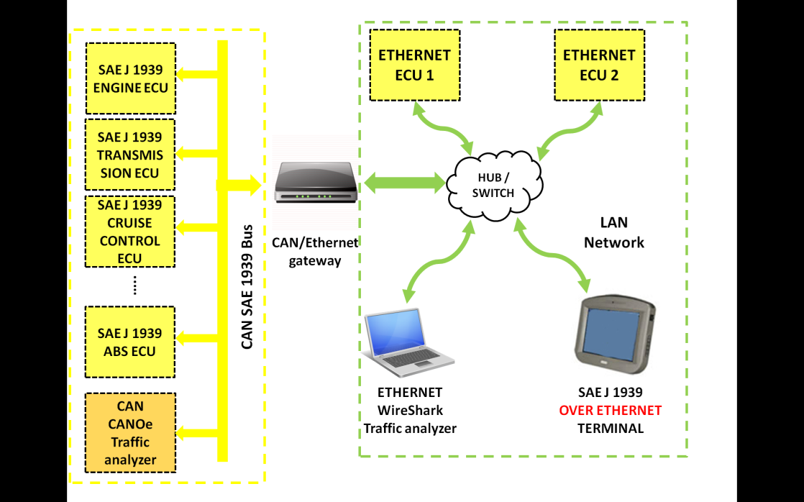
Linux (Ångstrom) CAN-Ethernet Gateway
From “SAE J 1939 Over Real Time Ethernet: The Future of
Heavy Duty Vehicle Networks,” Ruggeri et al., Imamoter, 2012

Slide 13
Conclusions
Linux ships in a small fraction of vehicles.
Growing rapidly, helped by GENIVI.
Problem: integration of legacy and modern networks.
Security, safety and reliability remain a challenge.
Headed incrementally towards autonomous vehicles:
  much work left to do.
  field is expanding rapidly.

Slide 14
Resources
GENIVI open-source projects, mailing lists, #genivi IRC
Making Embedded Systems by Elecia White
IETF-ITS mailing list, Telematics News, Wired Autopia
autosec.org and Ruggeri SAE paper
LWN and H-Online (as always!)
Mentor's AUTOSAR and Embedded Linux platforms

Slide 15
Automotive
extravehicular
networking:
Ravi Puvvala,
Savari Networks

Slide 16
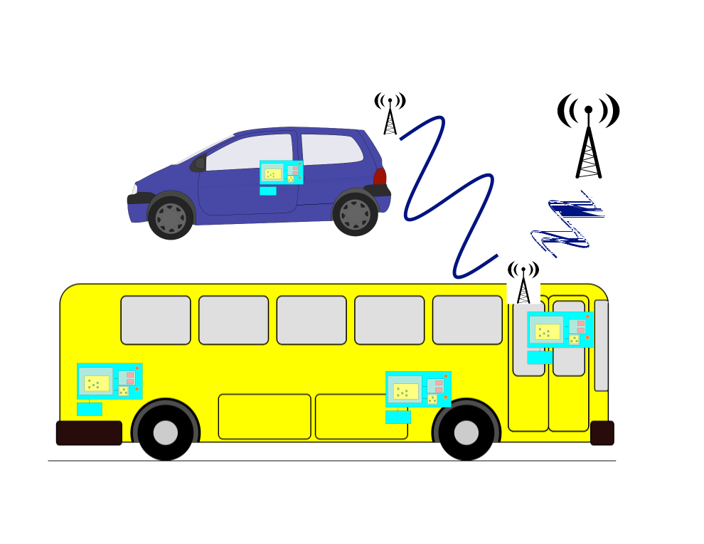
Vehicles are a “network of networks”
V2V
V2I

Slide 17
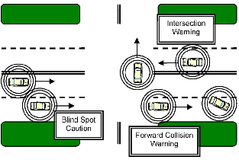
IEEE: DSRC and Basic Safety Message
J.B. Kenney,
Toyota ITC,
Proc. IEEE 99,
2011.
Collision avoidance is primary motivation.
USDoT had RFC on PKE for V2X in 2012.
How to issue revocable keys w/o trackability?

Slide 18
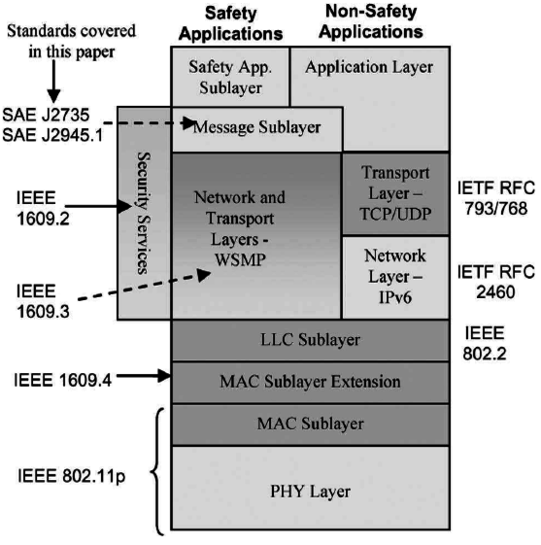
802.11p & 1609: DSRC, WAVE and WSMP
802.11p has dedicated spectrum at 5.9 GHz.
Unlike other 802.11, no BSS.
New protocols, e.g. DNS Geocasting.
New use cases, e.g. mobile routers
VIN == MAC? or is VIN private?
Jouni Malinen, 2012 Linux Wireless
Summit, "Not yet implemented."
J.B. Kenney,
Toyota ITC,
Proc. IEEE 99,
2011.

Slide 19
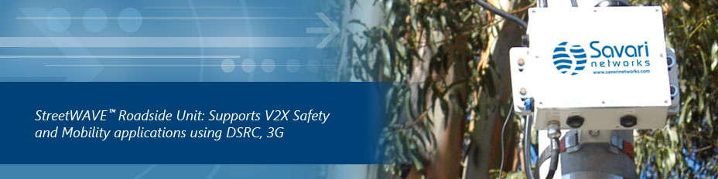
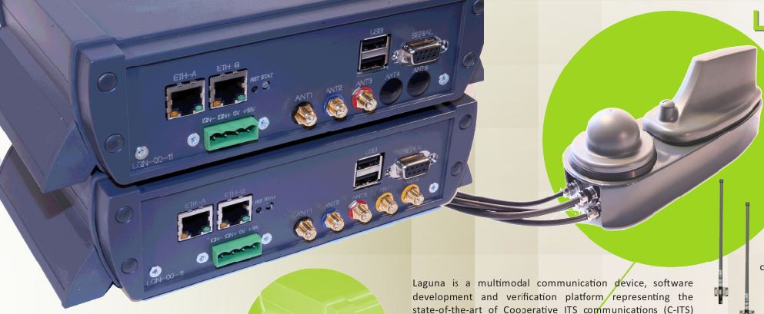
802.11p V2X routers
Linux-based
BSD-based?
Commsignia

Slide 20
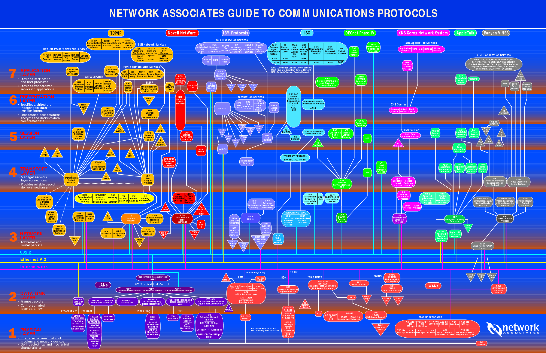
Anyone reminded of this Babel?

Slide 21
Housekeeping: IVI Jargon
“OEM”: a car manufacturer
“Tier 1”: a vendor who sells directly to OEMs
“Tier 2”: a vendor to Tier 1s, who bundle components
“ECU”: electronic control unit, 32- or 16-bit MCU running an RTOS
“AUTOSAR”: ECU protocol incl. design methodology
“ADAS”: advanced driver assistance system

Slide 22




Linux won:
  on servers and on handsets.
Linux lost:
  on desktops.
Linux could lose in automotive:
  QNX and Windows have the largest automotive base.
  QNX has fast IPC and works well on smaller MCUs.
  Most car CPUs run proprietary RTOSes.

Slide 23
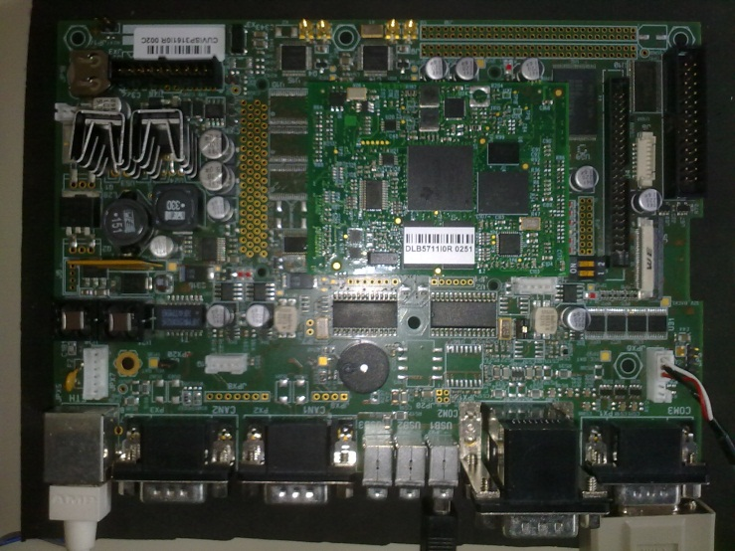
CAN-Ethernet Gateway Demo
From “SAE J 1939 Over Real Time Ethernet: The Future of
Heavy Duty Vehicle Networks,” Ruggeri et al., Imamoter, 2012
UDP Socket
ARM Cortex A8
Linux Ångström v 2.6.28
Stack “SocketCAN”
Can and Ethernet on chip
CAN-E'net bridge
CAN to UDP Thread
UDP to CAN Thread
CAN Controller
Two independent threads.
Uses socket paradigm as an abstraction to transparently copy messages on different physical layers

Slide 24
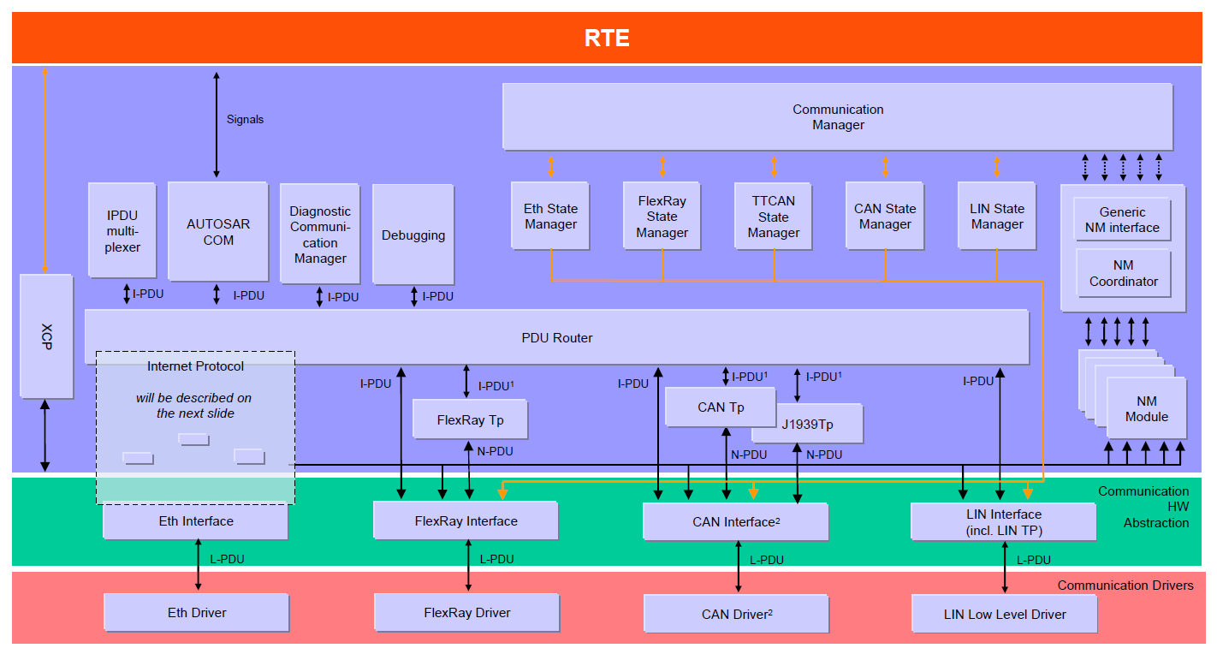
Another view of automotive networks
courtesy AUTOSAR

Slide 25
SPI used as communication stack
Application Layer
Impact:
SPI interface module needed
Runtime Environment (RTE)
Basic Software (BSW)
SPI
SPI
PWM
MCU 1
Sensor ECU
SPI
Actuator
Ext FlexRay transc.
Application Layer
FlexRay
Runtime Environment (RTE)
PWM - Control
Basic Software (BSW)
AUTOSAR or other OS
(e.g. Genivi)
DO
SPI
Digital - Enable
MCU 2
Note:
two or more MCUs
ECU
Courtesy of AUTOSAR Consortium

Slide 26
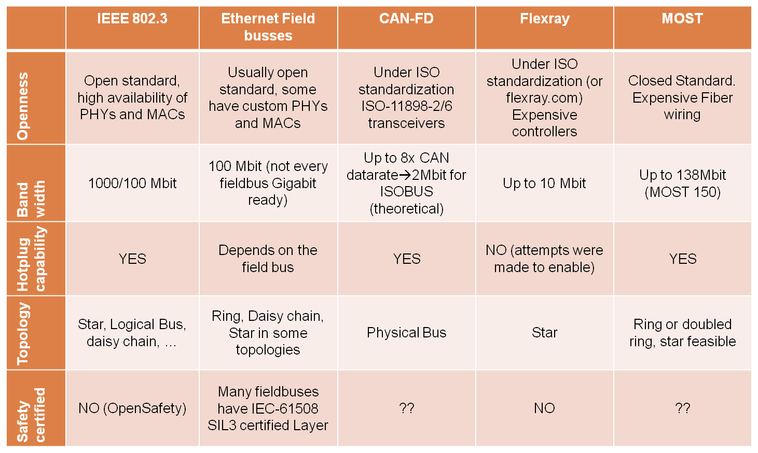
High-Bandwidth feasible buses overview
From “SAE J 1939 Over Real Time Ethernet: The Future of
Heavy Duty Vehicle Networks,” Ruggeri et al., Imamoter

Slide 27
GENIVI meets kernel: AF_BUS
Problem: D-Bus scales poorly, is resource-intensive and slow.
Recent history of contention around IPC: binder in 2009
AF_BUS is created by Collabora with GENIVI-funding.
Implements a new socket interface based on AF_UNIX but with multicast capability.
Rejected from mainline with rationale that IP sockets can provide needed performance.
  Real-time IPC guarantees possible with IP?
AF_BUS subsequently merged in LTSI kernel 3.4.21.

Slide 28
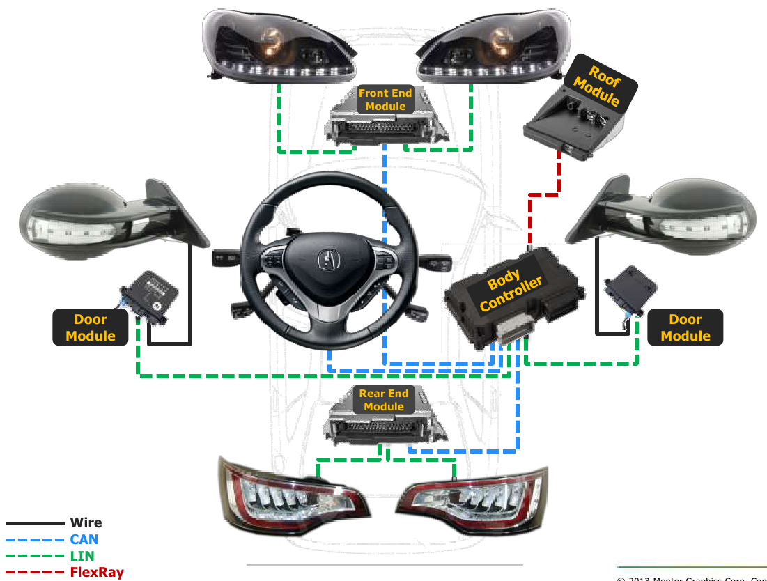
Automotive Architecture (H.-J. Mantsch, Mentor Automotive Networking)

Slide 29

Feb 2013: Gnome Hackfest
New in-kernel D-Bus-based IPC is broached.
  Will support Binder userspace API as well as D-Bus.
  And others (0MQ, RabbitMQ, etc.)?
Endorsed by D-Bus (Pennington) and kernel (GKH) contributors.
Victory for GENIVI: in-kernel D-Bus optimization is coming!
Not viewed that way by everyone . . .
brcmsmac vs. b43 (Broadcom) redux?

