Slide 1
Not breaking userspace: the evolving Linux ABI
Alison Chaiken
Southern California Linux Expo 2022
alison@she-devel.com
Slides: http://she-devel.com/Chaiken_LinuxABI.pdf
Blue text indicates hyperlinks.

Slide 2

Why do kernel upgrades make users nervous?

Slide 3
Contents
What is an ABI and what is Linux’s?
Why does it matter?
  64-bit time (Y2038)
  Priority inversions and robotics
  Writing and maintaining log monitors
  Mounting old filesystems
  Mixing BPF programs and udev rules
How to avoid ABI breaks
Summary

Slide 4
What is an Application Binary Interface?
Library headers and documentation are the API.
For C programs in general:
  return types of functions;
  parameter lists of functions;
  layout of structs
  meaning, range or ordering of enums.
Lack of “name mangling” in C is a problem.

Slide 5

ABI Guarantees are a Contract
Linux kernel
userspace
(ELF)
compiler
libc (syscalls)

Slide 6

The Linux Kernel Warranty

Slide 7
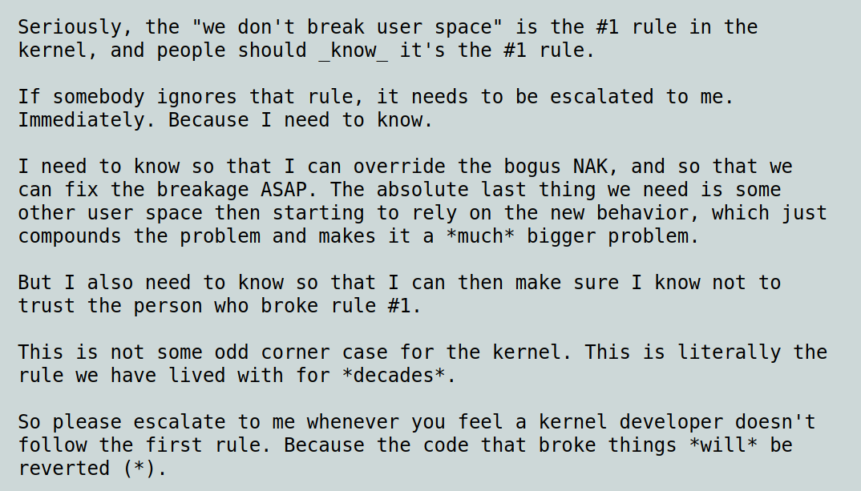

Slide 8
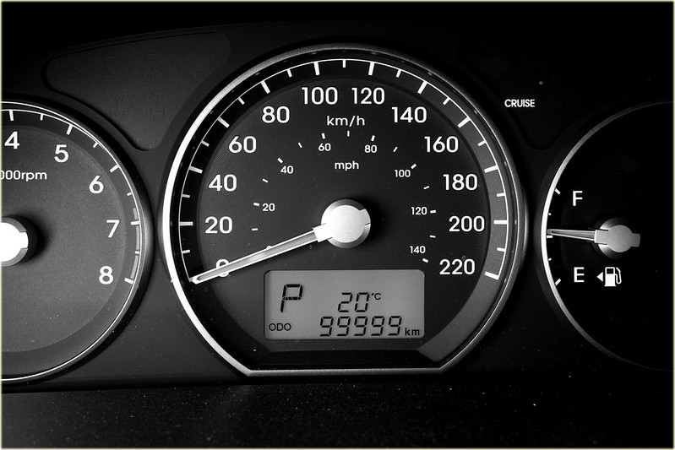
Y2038 and 64-bit time
tinyurl.com/mw94ktpw

Slide 9
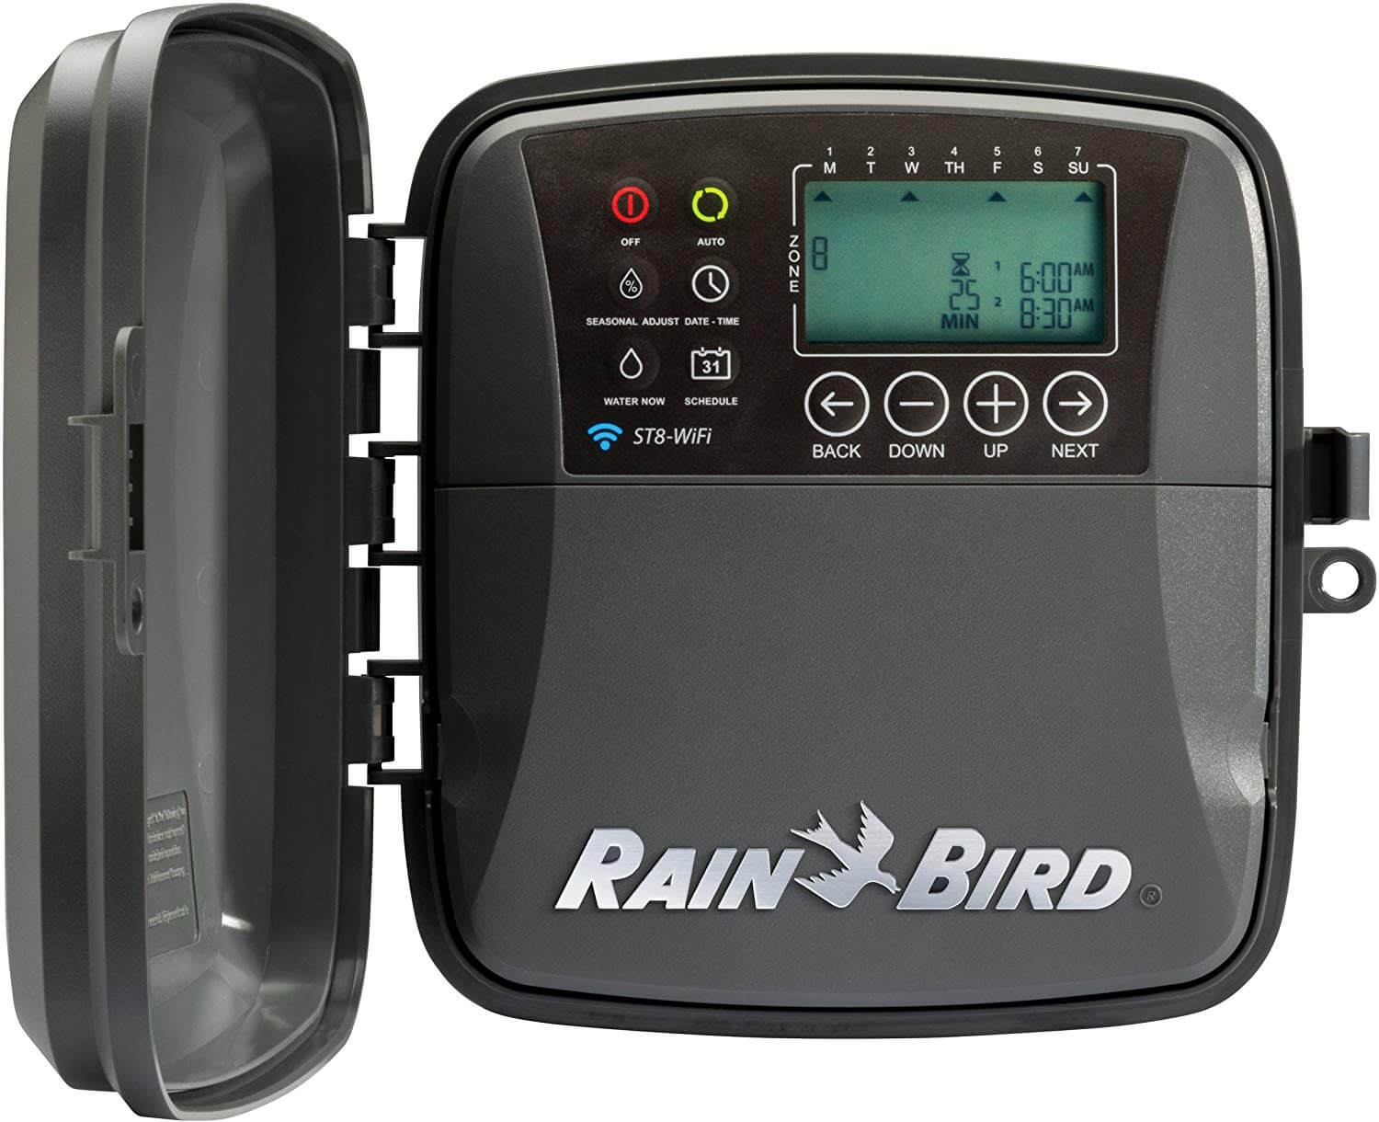

32-bit IoT devices have a long service life
Disclaimer: these devices may not run Linux, or be 64-bit, or already updated.

Slide 10
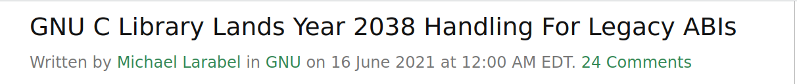
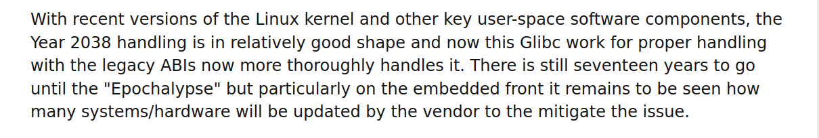



Good News: Kernel and Glibc are ready!

Slide 11
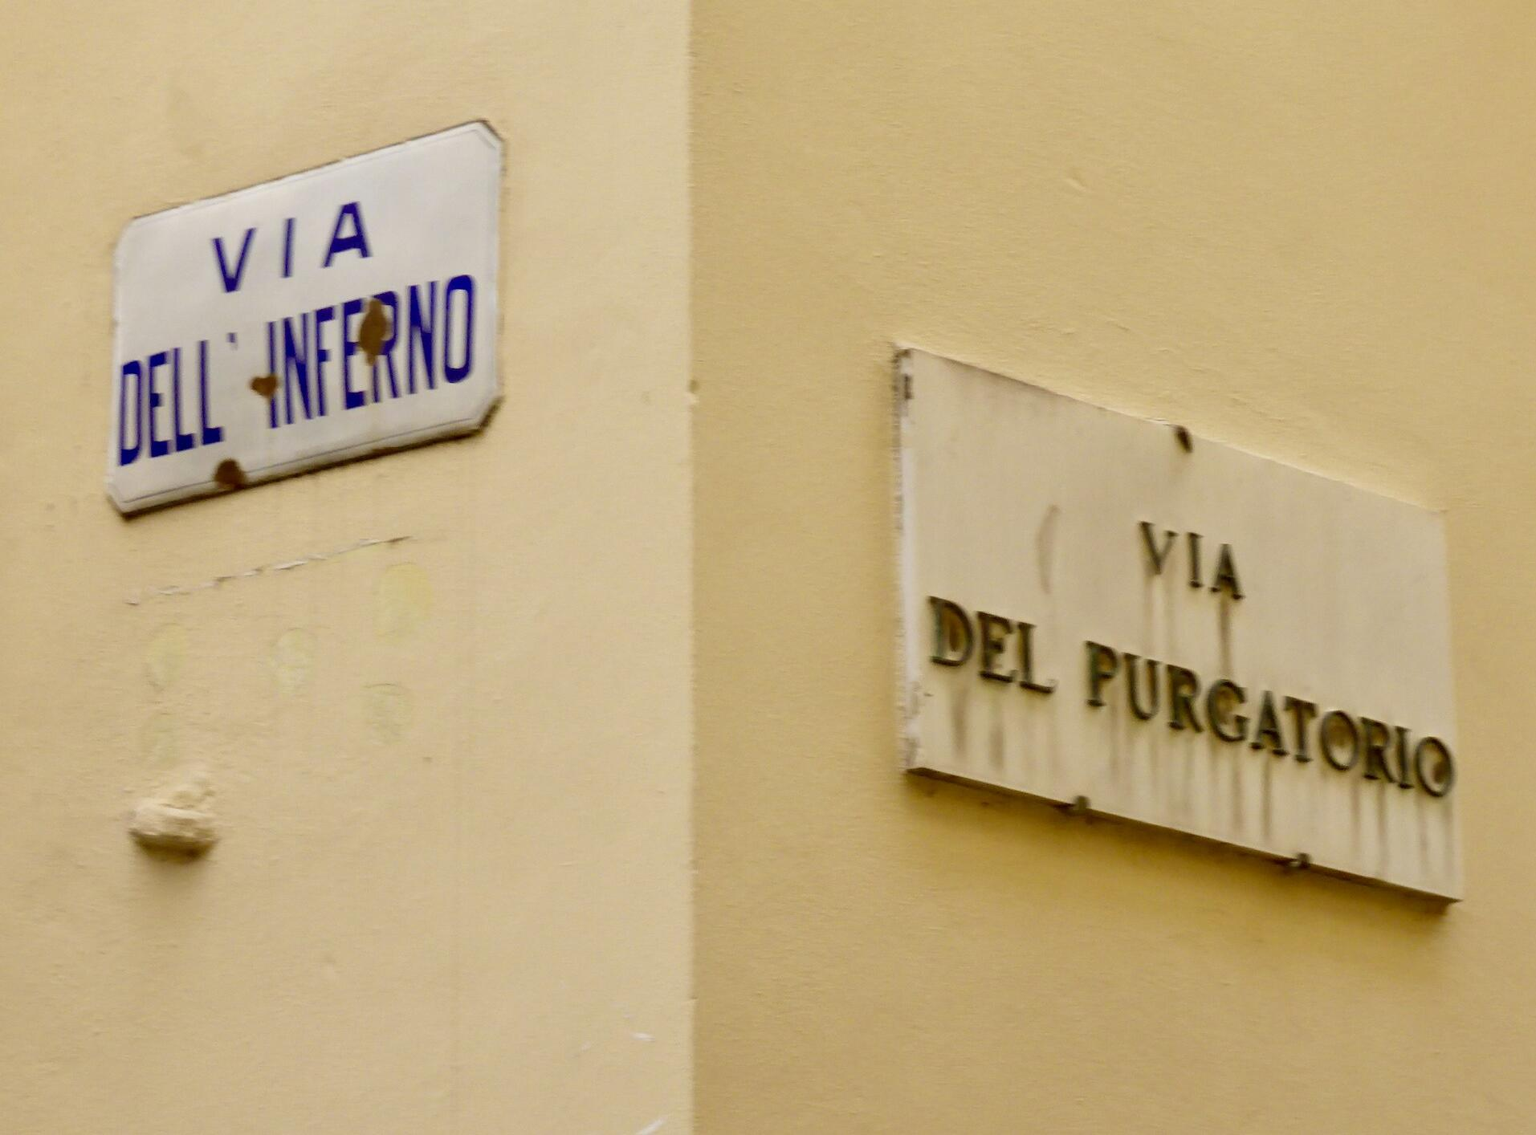
Two bad choices for distros with 32-bit arches
complete set of 32- and 64-bit-time packages;
OR
distinct 32- and 64-bit-time images: i386 and i386t
https://tinyurl.com/mryr56ee

Slide 12
Servers 1, Robots 0

Slide 13
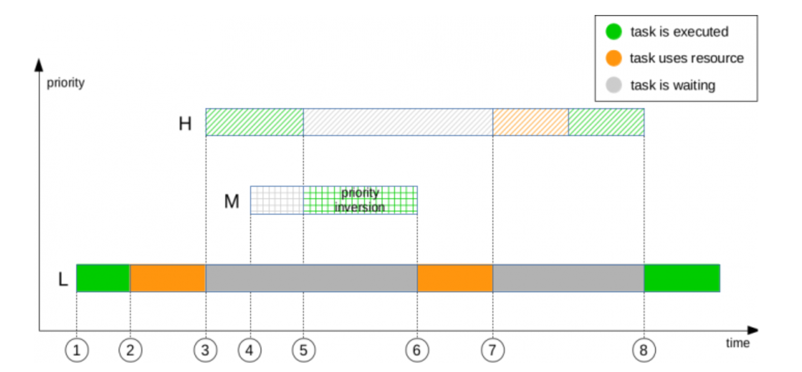
Priority inversion occurs when L-prio thread holds a lock that H-prio thread needs
Hi-prio needs
lock
Priority
Lo-prio takes
lock
Time

Slide 14
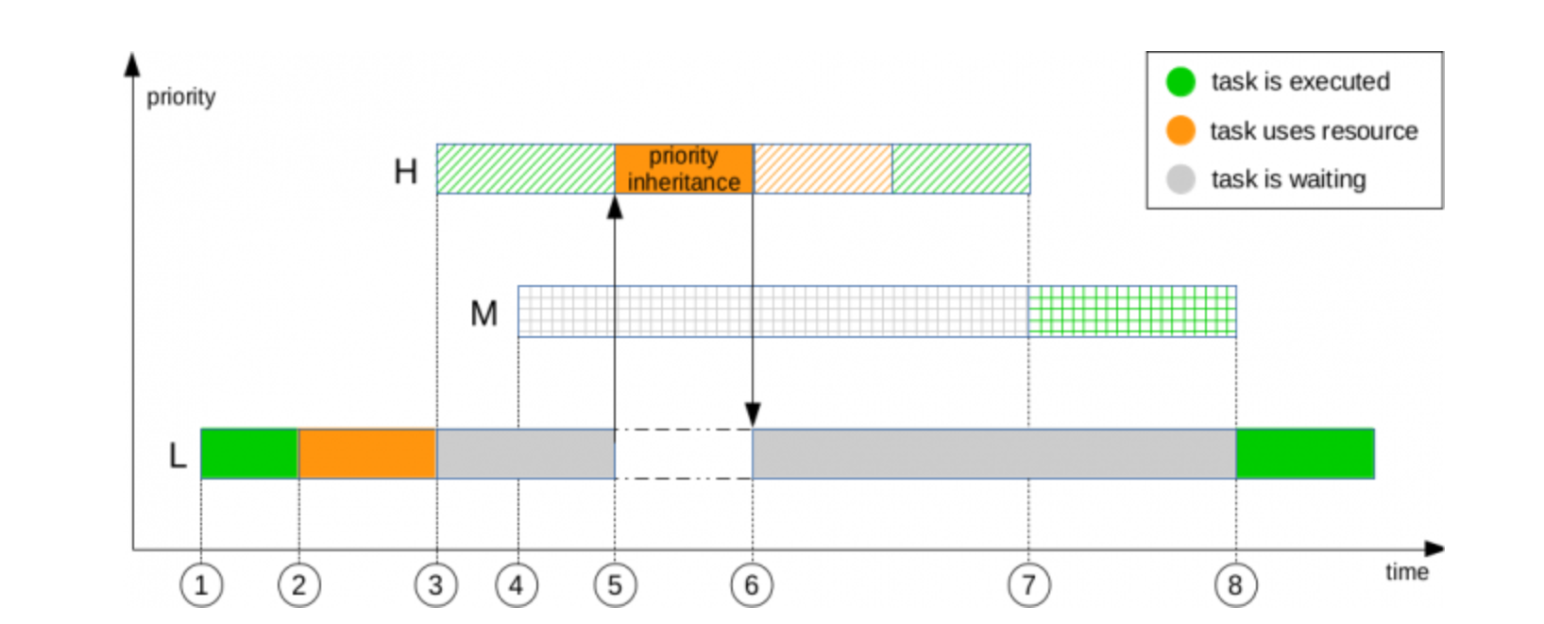
Priority Inheritance in Realtime Kernel Boosts the L-prio thread temporarily
Hi-prio needs
lock
Priority
Lo-prio takes
lock
Time
Vital for userspace tasks as well as kernel!

Slide 15
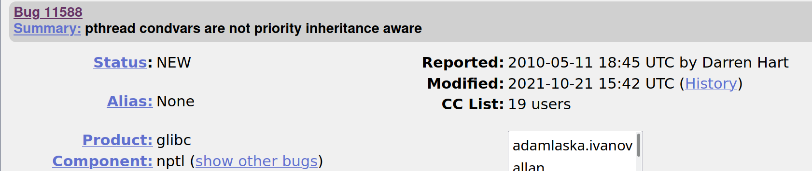
Problem: glibc threads do not support PI
Bug report posted in 2010; still “NEW” in 2022.

Slide 16
Fix Requires an ABI Break
Either:
a syscall must take an additional argument;
-or-
a function arg (the “futex word”) must change from 32- to 64-bit.

Slide 17


Robotics projects need a different pthread library
librtpi
tinyurl.com/2p99dtan, https://tinyurl.com/2rmmmban
glibc
Or an entirely different libc!
musl

Slide 18
What is in the Linux Kernel Stable ABI?
?
Advertised: ELF, /proc, /sys and device-tree.
What about :
?
Devices in /dev?
printk output (dmesg)?
Bootargs (cmdline)?
Module params?
Netlink sockets?
Tracepoints?
Valid BPF programs?
Filesystem metadata?
Meaning of constants in headers?
?
?
?
?
?

Slide 19
Developers are not covered by the Warranty
You broke
my ABI!
sysfs
or
procfs?
Yes!
No
YOU
win!
YOU
lose!
You are a User:
“I want it to just work!”
You are a Developer:
“I want to debug and optimize”.

Slide 20
dmesg, GDB and log monitors

Slide 21
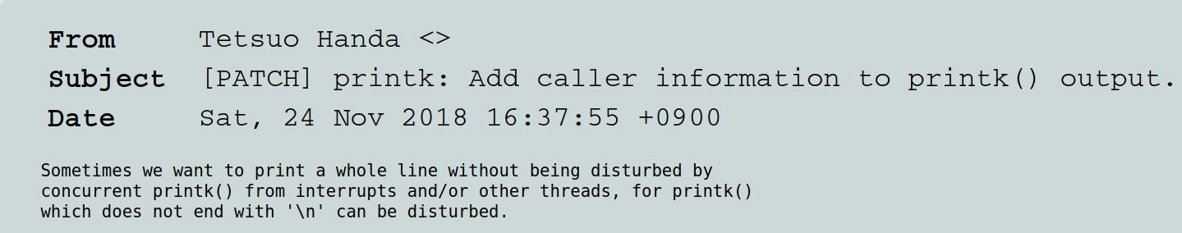
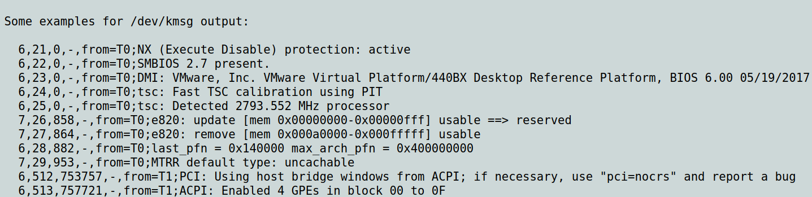
Threading Kernel Log Messages

Slide 22
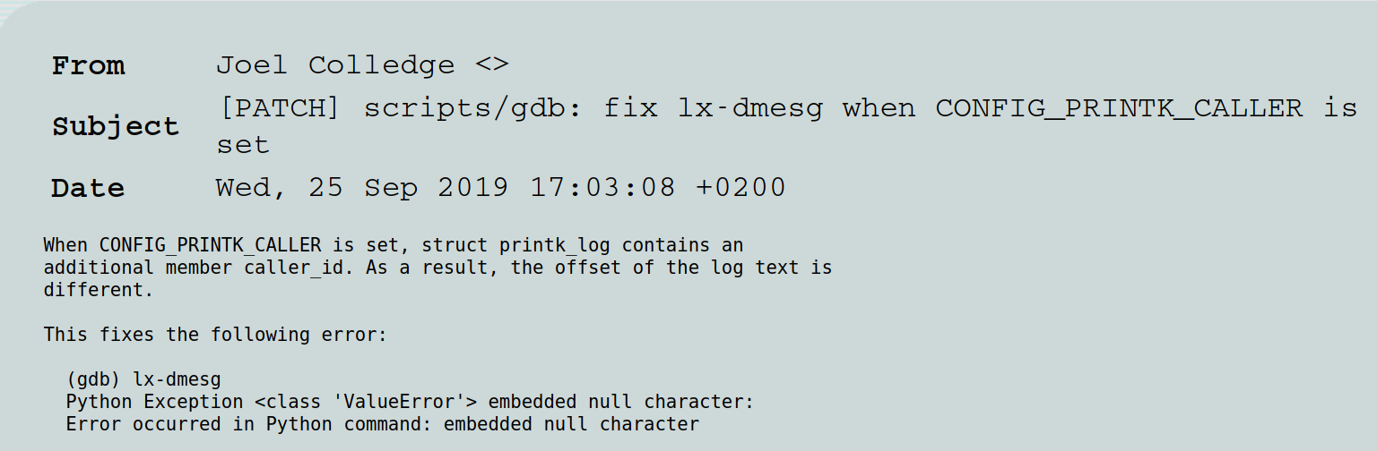
And then fix GDB

Slide 23
You broke
my ABI!
sysfs
or
procfs?
Yes!
No
Yes!
YOU
win!
in-tree
userspace
tool?
No
YOU
lose!

Slide 24
Kernel ABI Stability Checklist
ELF format: yes, /proc: yes, /sys: yes†
Device files in dev? (not /dev/kmsg)
printk output (dmesg)?
Filesystem metadata?
Valid BPF programs?
Tracepoints?
Bootargs (cmdline)?
Module parameters?
†except /sys/kernel/debug, /sys/kernel/btf . . .

Slide 25
Mounting Old Filesystems

Slide 26

Will old filesystems mount with new kernels?
it's not just about "whatever the kernel happens to accept". It should also be, "was it generated using an official version of the userspace tools",
“I was under the impression that mounting existing FSs fell under the scope of the kernel⇔userspace boundary”
Manipulating FS metadata with custom tool relies on
Undefined Behavior.

Slide 27
ABI Contract holds if official userspace tools are used
userspace:
e2fsprogs,
zfsutils, etc.
Linux kernel
libc: mount
What about FS from Windows, iOS, BSD?

Slide 28
Kernel ABI Stability Checklist
ELF format: yes, /proc: yes, /sys: yes†
Device files in dev? (not /dev/kmsg)
printk output (dmesg)?
Filesystem metadata? only with official tools
Valid BPF programs?
Bootargs (cmdline)?
Module parameters?
Tracepoints?
†except /sys/kernel/debug, /sys/kernel/btf . . .

Slide 29
Are BPF Programs
Part of Stable ABI?

Slide 30
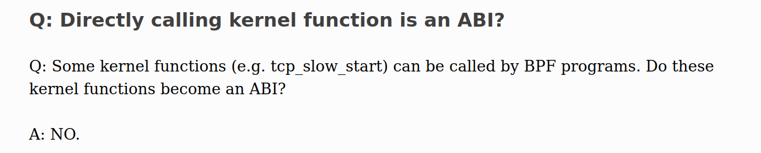
BPF’s ABI Guarantee
Controversy: can an ordinary user tool like a udev
rule depend on a developer tool like bpftrace?

Slide 31

What about Kernel Features on which BPF Programs Rely?
“out-of-tree modules will have the technical debt of changing every time a new kernel release is out, and so should out-of-tree bpf programs.”
Stable ABI is any ‘"user workflow", whether it uses BPF or any other kernel feature’
Photo: https://lwn.net/Articles/899182/
Kernel Summit mailing list
6/16/22
OSS 2022,
6/21/22

Slide 32
Avoiding ABI Breaks

Slide 33
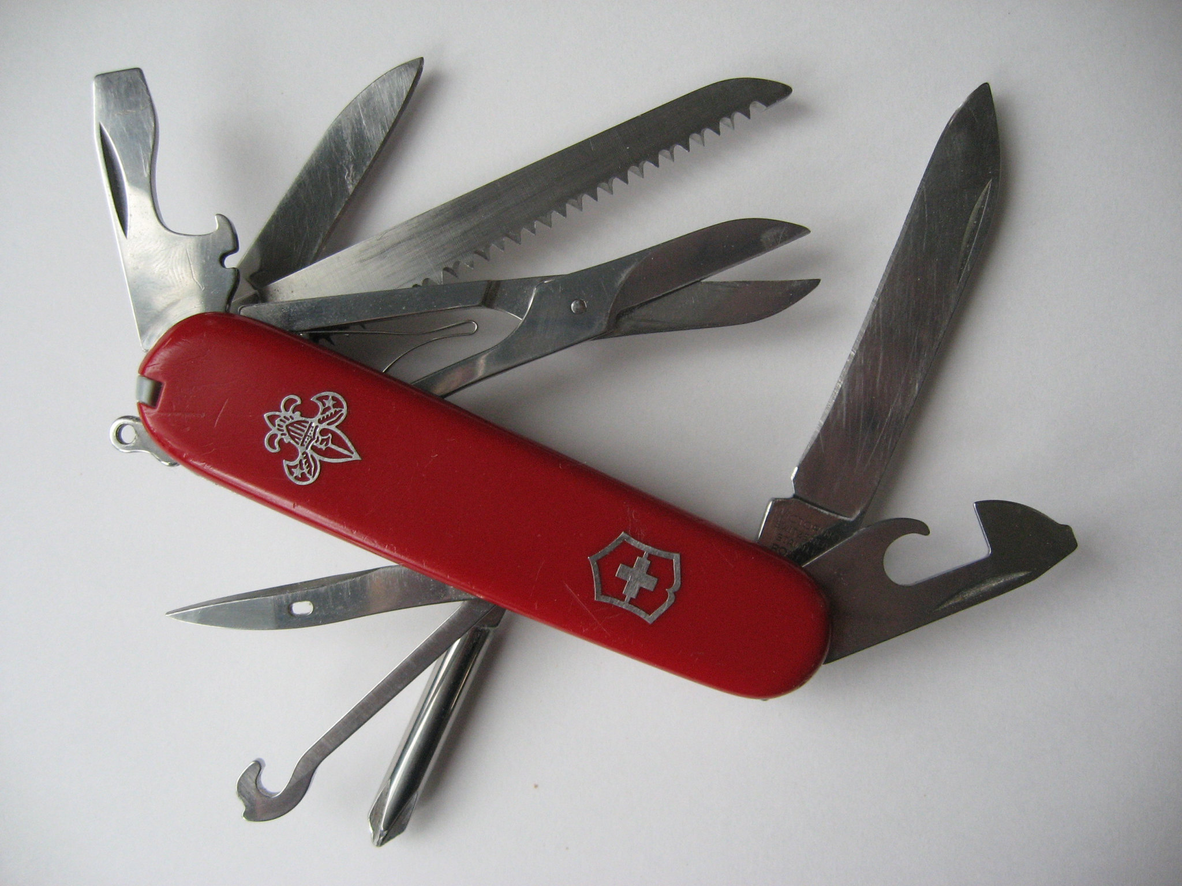
Method 0: generic syscalls
prctl()
https://tinyurl.com/bdd5yeys
ioctl()
int prctl(int option, unsigned long arg2, unsigned long arg3,
unsigned long arg4, unsigned long arg5);
int ioctl(int fd, unsigned long request, ...);

Slide 34
Method 1: Unused Function Parameters
Retain deprecated params: man shmctl
“Reserved for future use” params: man pid_getfd
Bitmasks with unused bits: man statx
Multiple versions of the same syscall: apropos clone
Some unwrapped syscalls have no glibc implementation.

Slide 35

Method 2: avoid procfs and sysfs changes
“I'd just prefer to have
$NEW_FEATURE
under /proc or /sys.”
“This is ABI, you can't walk back on it.”
https://pixabay.com/en/speech-bubble-ellipse-shape-arrow-25917/

Slide 36
Summary
The Linux ABI definition is both fuzzy and controversial.
Some ABI breaks are unavoidable.
Y2038 fix will be painful for distros.
glibc’s thread library NPTL is not suitable for robotics.
Trouble arises when users rely on developer tools.
Think carefully when writing userspace applications!

Slide 37
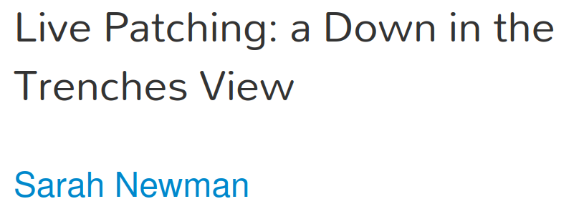
Acknowledgements
Thanks to Akkana Peck and Sarah Newman for their feedback.
Today, Saturday July 30, at 6 PM in this same room!

Slide 38

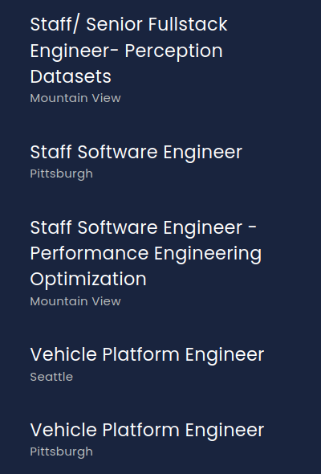
Many full-time-remote Linux jobs with Aurora Innovation (aurora.tech)

Slide 39
Resources
Please support LWN!
“To Save C, We Must Save ABI,” and “Binary Banshees and Digital Daemons,” JeanHeyd Meneide.
“It’s About Time,” Mike Crowe, Overload, 28(156):28-30, April 2020. (about pthreads and condition variables)
Gratian Crisan, librtpi: Conditional Variables for Real-Time Applications, Embedded Linux Conference 2020 presentation
“BPF CO-RE (Compile Once, Run Everywhere),” Andrii Nakryiko’s blog

Slide 40
Changing Meanings
of Names

Slide 41
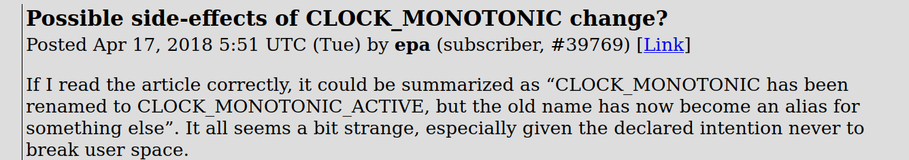
Behavior of Clocks during Suspension
Should CLOCK_MONOTONIC advance when the system is suspended?

Slide 42
Changing the meaning of bootargs
See bootargs with sudo dmesg | grep -i “command line”
Should bootarg A means something different alone than in conjunction with bootarg B?
$ git log -n 1 --grep=consistent – kernel/rcu/tree_nocb.h
Someone preferred the old behavior:
$ git log --oneline -n 1 --grep="option to opt" – kernel/rcu

Slide 43
You broke
my ABI!
sysfs
or
procfs?
Yes!
No
Yes!
YOU
win!
in-tree
userspace
tool?
“official
version
userspace
tools”?
No
YOU
lose!

Slide 44
Trace Events are “stable API”
The list of tracepoints is (mostly) stable.
The format of trace events (the ABI!) changes.
The difference between a tracepoint and trace event is that a tracepoint is the "trace_foo()" in the kernel, whereas the trace event is the data extracted from the tracepoint via the TRACE_EVENT() macro and listed in the format files in the tracefs events directory.

Slide 45
Why kernel tracepoints disappear: optimizing compilers
#linux-rt IRC chat:
<rostedt> I already get people asking me why a function is traced in one kernel, but not the other
<rostedt> and I have to tell them it was because gcc decided to inline it in the other kernel
<rostedt> now we are going to lose tracing, because a function was modified slightly where gcc can do a tail call?
<rostedt> and tail calls are quite common

Slide 46
The libc⇔kernel ABI boundary
/usr/include
/usr/include/linux/
/usr/include/x86_64/asm
/usr/include/x86_64/bits
/usr/include/x86_64/sys
Linux kernel headers from linux-libc-deb
glibc headers from
libc6-dev

Slide 47
BPF Programs and "Compile Once, Run Everywhere"
Problem: BPF programs rely on internal kernel ABI.
Solution: BPF Type Format, with debug info exported to /sys/kernel/btf:
  $ bpftool btf dump file /sys/kernel/btf/battery format c
CO-RE further has LINUX_KERNEL_VERSION and CONFIG_FOO_FEATURE macros to help with more complex changes.

Slide 48
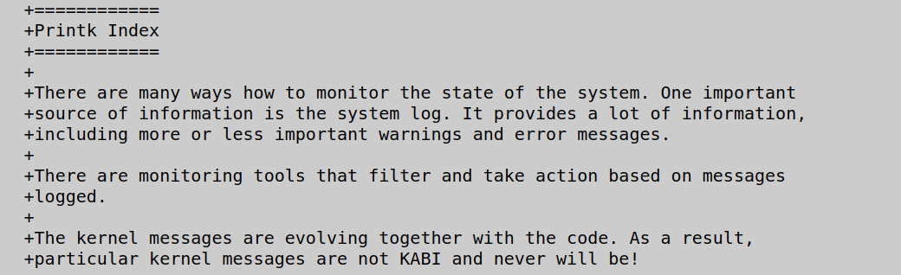
Printk indexing will ease log-monitor maintenance
Solution: export kernel format strings to /sys/kernel/debug for use by log monitors.

Slide 49
Method 3: Export info to sysfs (BTF and printk indexing)
How to access the ABI of the currently running kernel:
$ ls /sys/kernel/btf
$ bpftool btf dump file /sys/kernel/btf/vfat
$ bpftool btf dump file /sys/kernel/btf/battery format c
Not part of stable ABI!

Slide 50
Method 4: JIT Compilation
Works great, but expensive:
  requires kernel headers to be updated along with kernel;
  requires compilation with libclang or libgcc;
  slows startup of applications while JIT runs.

Slide 51
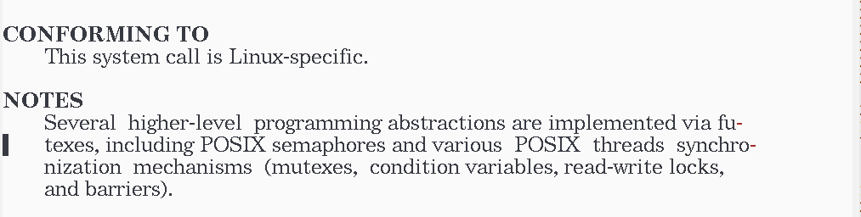
Who ever heard of futexes?

Slide 52

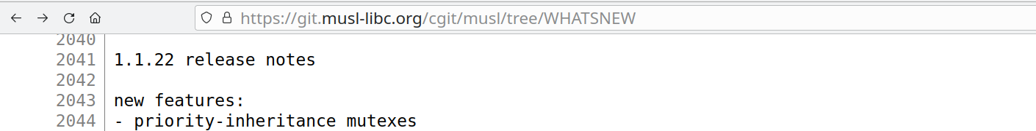
musl has had PI mutexes since 2019

Slide 53
C language lacks features that make ABI stability easier
There are no function overloads or overrides.
  No “name mangling.”
  To safely change a function’s ABI, one must rename it.
“Encapsulation” methods are limited to static keyword.
  No notion of granular privacy.
  Implementation details tend to “leak” from C programs.
Maybe “assembly labels” like __attribute__((alias()) are a path forward?

Slide 54
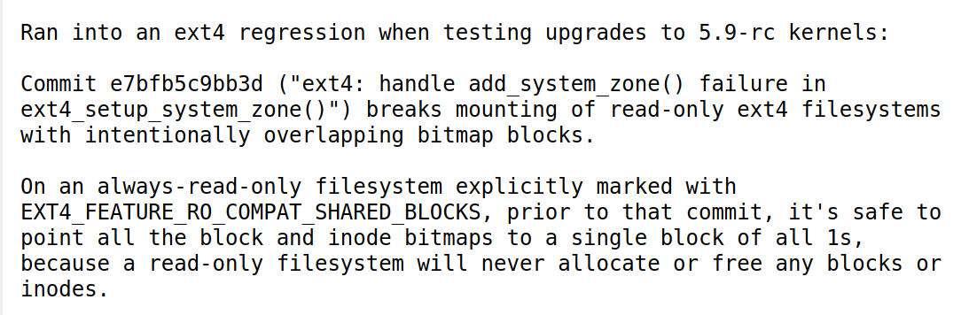
Undefined Behavior with FS Metadata

Slide 55

Backward compatibility is hard
32-bit time
strcpy() &
strdup()
http://stackoverflow.com/questions/28986125/double-curved-shape
i386

Slide 56
Why not just recompile?
Source code is unavailable.
Need to recompile propagates to other libraries/applications.
Proprietary toolchain is too old to support needed features.
Code would need new FDA, ISO262 … certification.
Suppose recompiling is not enough?

Slide 57
ABI-Break Demo
$ git clone https://github.com/chaiken/SCALE2022-demo-code
$ cd SCALE2022-demo-code/C-ABI
$ make right-abi-lib
$ $ make wrong-abi-lib
Makefile main.c
is_negative_64.c
is_negative_128.c

Slide 58
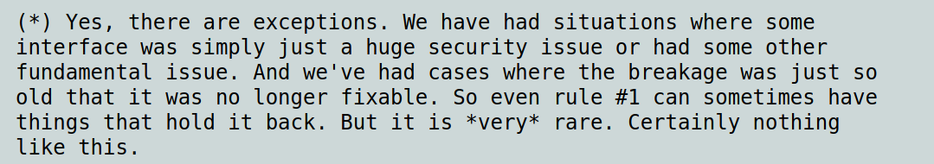
What about the asterix?

Slide 59

How should libc’s respond to kernel ABI Break?
(c) Chris Potter (2012) Title: Scales of Justice - www.flickr.com/photos/86530412@N02/7953227784
Security, Performance, Stability, POSIX: pick 23
(forgetting readability, logical consistency . . . )

Slide 60
Debian and Out-of-Tree Kernel Modules
The kernel ABI
An ABI (Application Binary Interface) is an interface between two software components, considered at the level of register allocation and memory layout. The ABI between the kernel and user-space is generally maintained carefully, and is not a concern here. However, the ABI between the kernel and its modules is not. In order to support out-of-tree modules, the kernel version should be changed when the ABI between the kernel and modules changes.

