Slide 1

Developing Automotive Linux
Alison Chaiken
North Bay Linux Users Group
July 9, 2013
alison@she-devel.com

Slide 2
Who cares? (and Why?)
Crashes cause over 30,000 deaths in U.S. annually.
Intelligent transportation systems are where developers can target global warming, peak oil and energy insecurity.
Phones and tablets are joining PCs in technological maturity.
Connected car business is growing exponentially.

Slide 3
Agenda
Why automotive software matters
Status of Linux in automotive
Show me the code: what's in automotive Linux
Opportunities to get involved

Slide 4
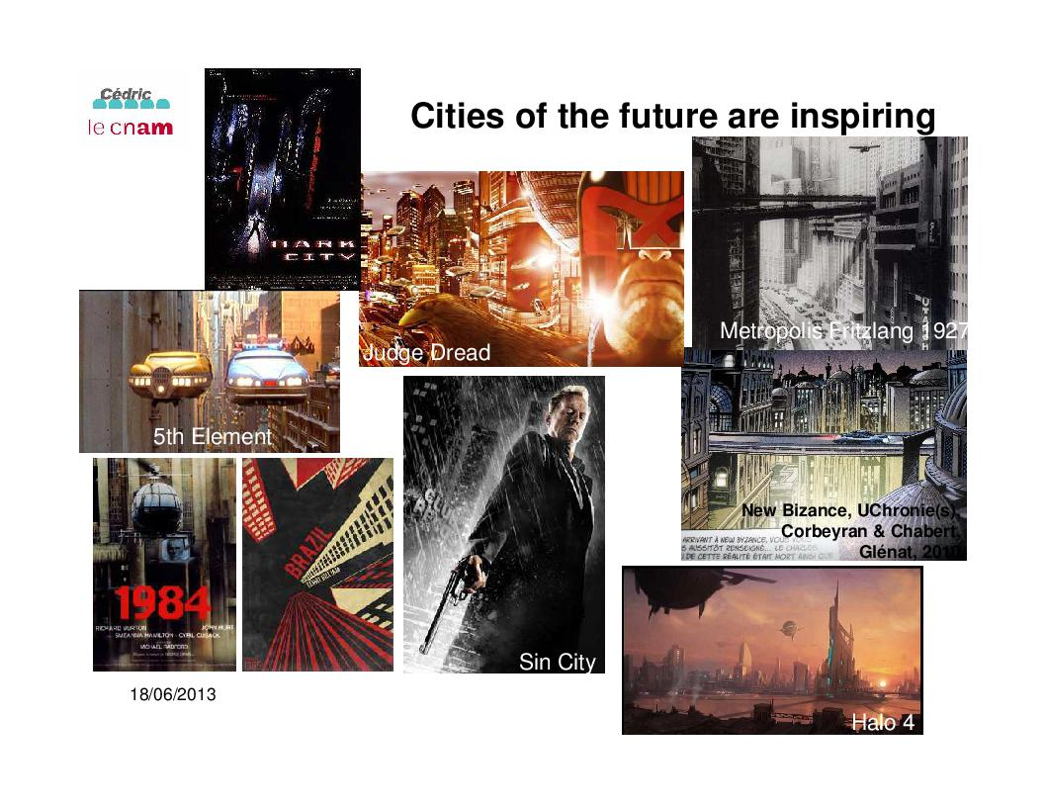
Courtesy Prof. Eric Gressier-Soudan, cnam.fr

Slide 5
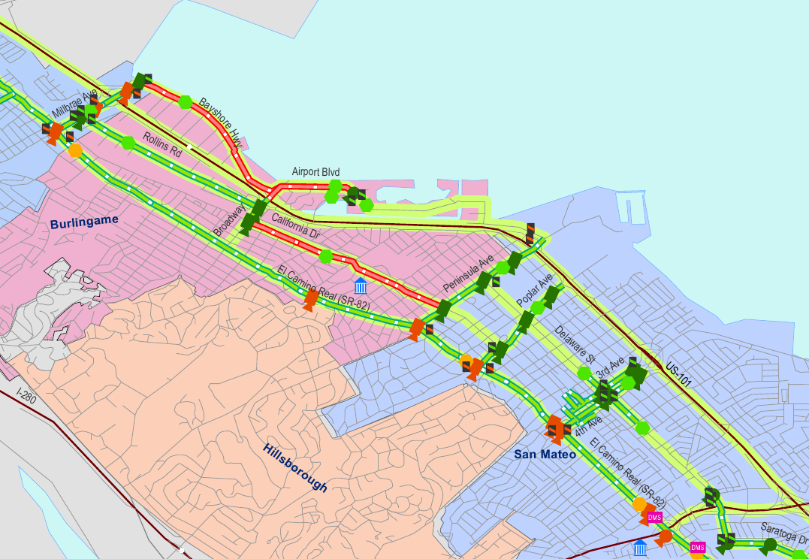
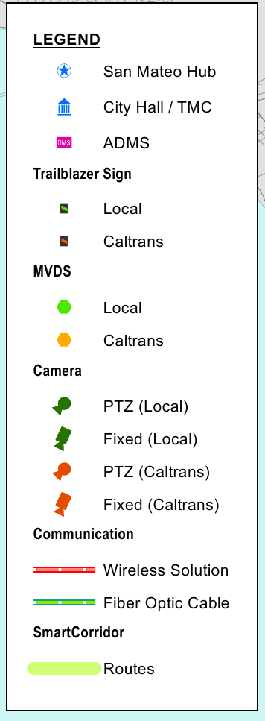
San Mateo Smart Corridor construction is underway

Slide 6
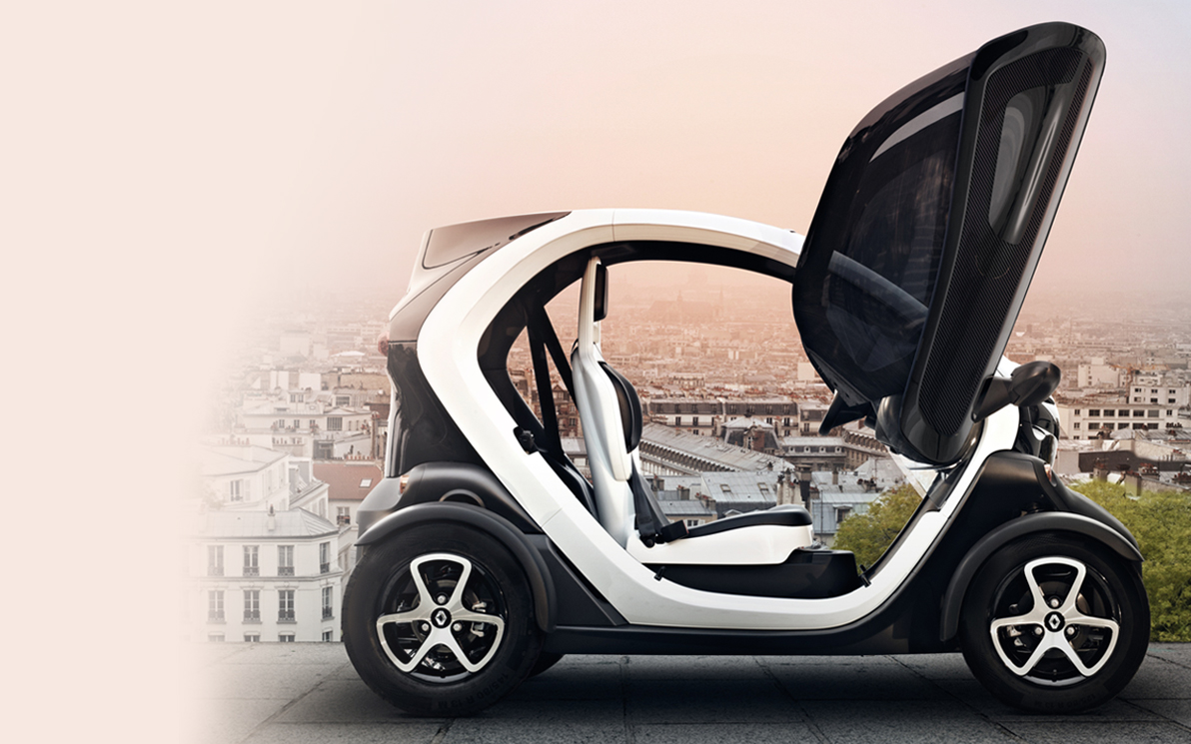
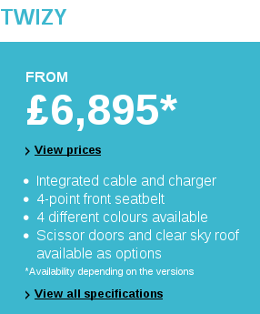

Radically rethought cars are on sale

Slide 7
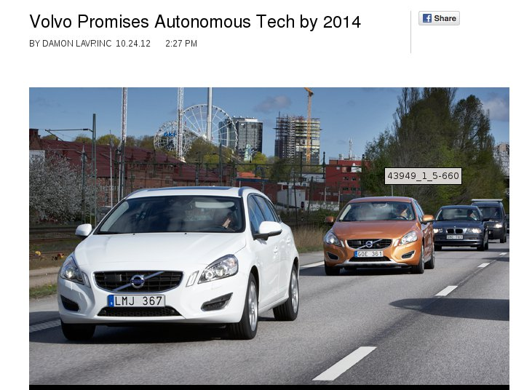
Autonomy is closer than most suspect
From Wired Autopia

Slide 8
Quiz
The most important center of automotive software development is _____________.
T/F: autonomous vehicles won't be legal for many years.
T/F: car companies will never release substantial source code.
The company leading development of autonomous vehicle technology is ______________.
T/F: Asian companies are developing for internal markets only.
The OS with largest install base in cars is _____________.

Slide 9
(Understandable) Misconceptions about Automotive SW
The most important center of automotive software development is Silicon Valley Germany.
Autonomous vehicles will never be legal in the U.S. are legal in Nevada, California and Florida.
Car companies will never release source code have put up repos for automotive software: G.M. , GENIVI , Automotive Grade Linux
Only Google plus Mobileye, Continental, Audi, Volvo, Toyota and Bosch are is serious about autonomous vehicle development.
Chinese and Indian companies are developing for internal markets only now own Volvo, Jaguar Land-Rover and Hummer.

Slide 10
Current Public Status of Automotive Linux
Carmaker | Confirmed Operating system
Fiat-Chrysler Blue&Me, Kia Uvo | Microsoft Windows Embedded Automotive
Ford (all?) | Microsoft MyTouch/Sync (+ OpenXC Android dongle and SmartPhoneLink)
General Motors,Tesla | GNU/Linux
Geely (China); Hawtai (China) | GNU/Linux: Moblin (MeeGo-Tizen precursor)
Renault R-Link | native Android
Jaguar Land-Rover, Tata, Toyota | AGL and Tizen (GNU/Linux)
Honda (Accord, Odyssey, Pilot), Audi (A8L, Q5, A6), BMW (7-series and M models), Chrysler, Daewoo, GM (OnStar), Hyundai, Land Rover, Porsche, Saab (9-3), Renault (SM7), Mercedes (S- and C-class) | QNX
GENIVI Alliance (Linux-based): 160+ members including 11 “OEMs”

Slide 11
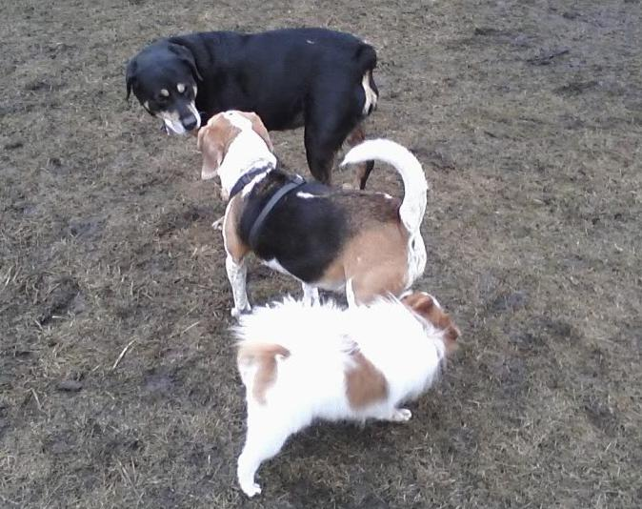
Automakers and Free Software get Acquainted
Automakers
Open source

Slide 12
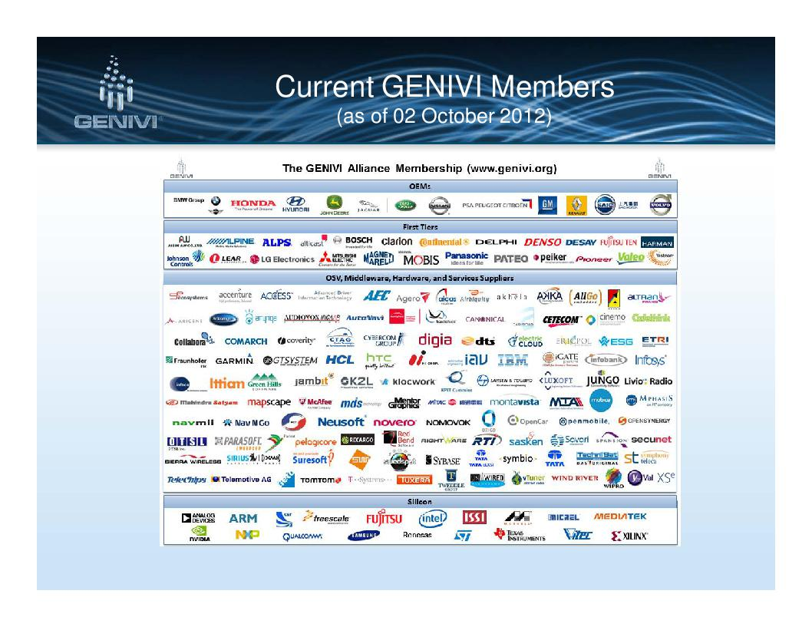
Courtesy Matt Jones, Jaguar Land Rover

Slide 13
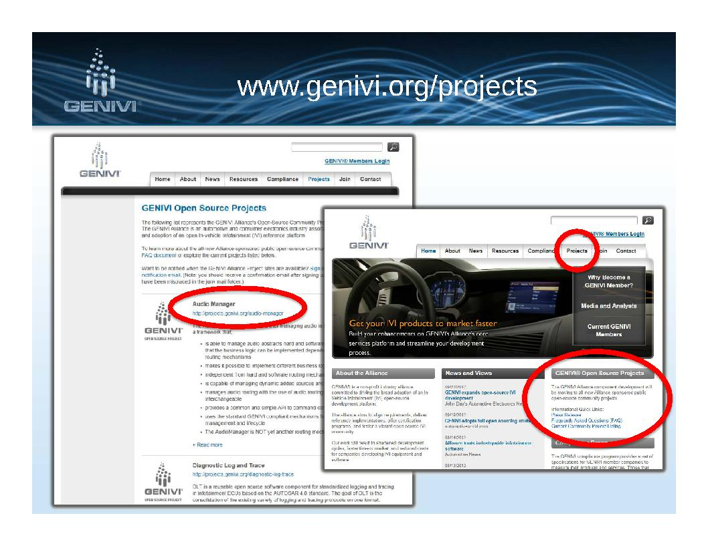
Courtesy Matt Jones, Jaguar Land Rover

Slide 14

Automotive Grade Linux
Initiated September 2012.
An installable distro like Android (unlike GENIVI).
Development in open (unlike Android or GENIVI).
No CLA, but no GPLv3 (like Android and GENIVI).
Mailing lists available but very quiet.
So far, based entirely on Tizen.

Slide 15
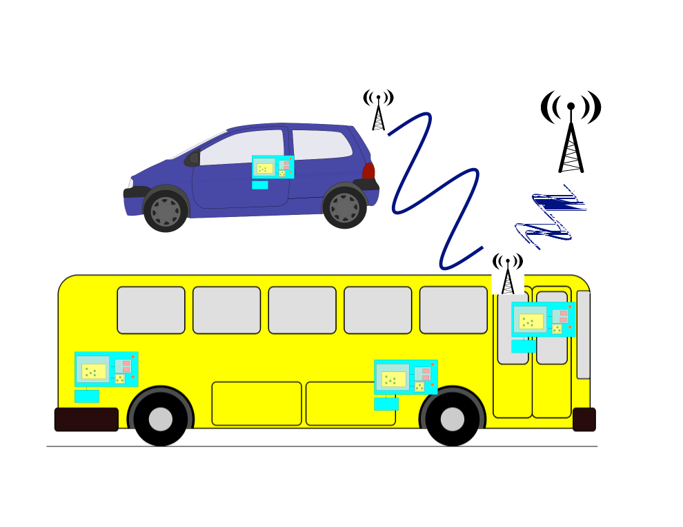
Vehicles are a “network of networks”
V2V
V2I

Slide 16
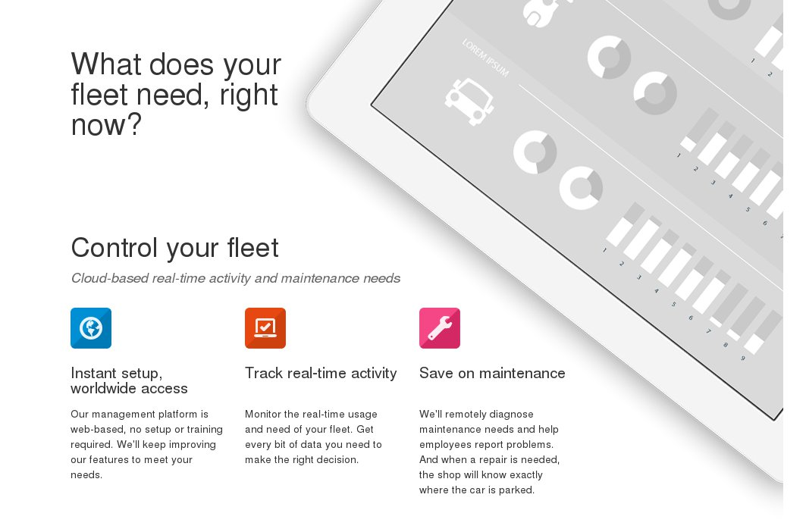
Local Motion: Cloud-based fleet management
What connectivity enables

Slide 17
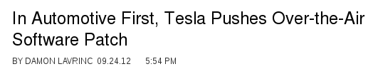
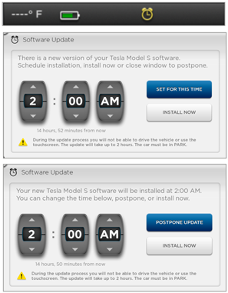
What connectivity enables
Source: Wired Autopia

Slide 18
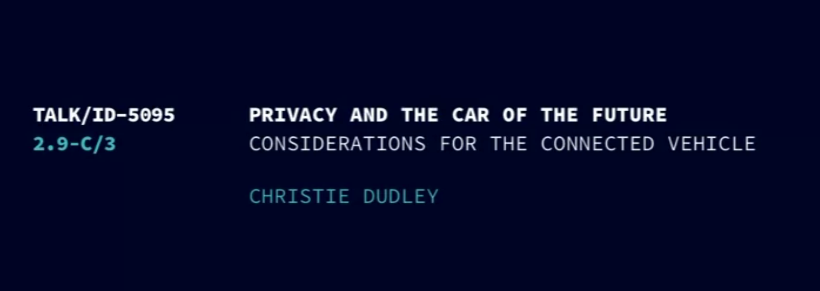
Must watch: Chaos Computer Club 2012 video
Christie Dudley, Santa Clara University Law School
http://tinyurl.com/crbazg9

Slide 19
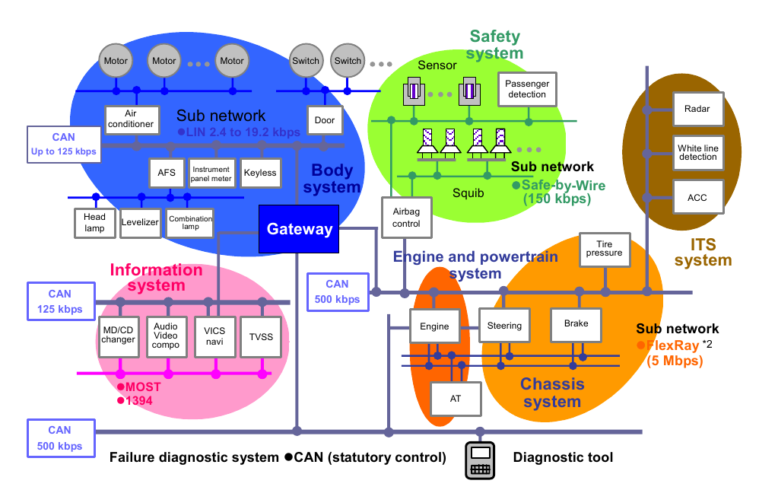
Mixture of time-critical and best-effort networks
Copyright Renesas, “Introduction to CAN”, with permission.

Slide 20
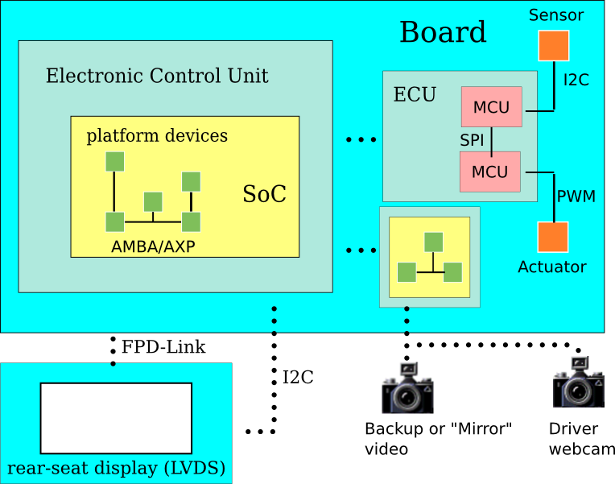
Diverse IPC mechanisms, Legacy Protocols
TCP/IP?
UDP/IP?
RemoteProc?
D-Bus?
or maybe
FlexRay
EthernetAVB
EtherCAT
J1939 . . .

Slide 21
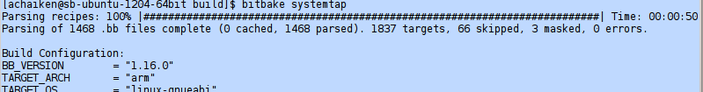
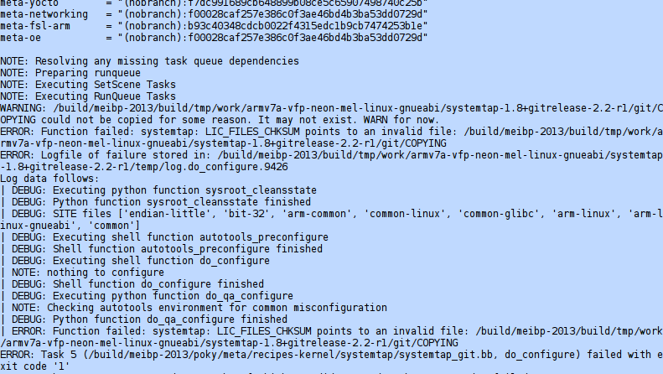
What automotive Linux really looks like!

Slide 22
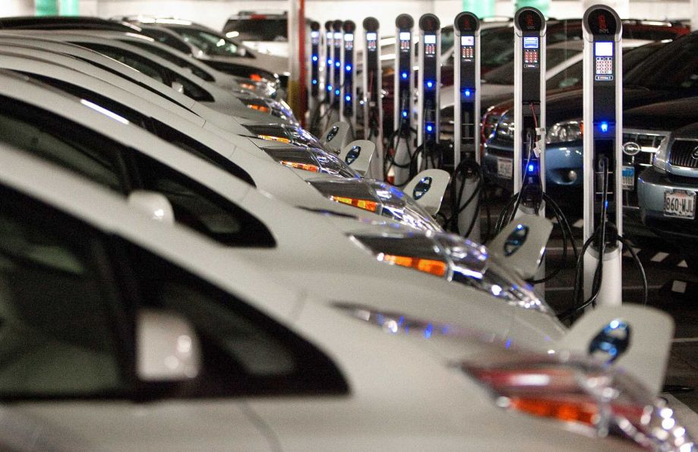
Get Involved: you already know how!
A typical automotive data center
Source: RTKL blog

Slide 23
Resources
IETF-ITS mailing list; Telematics News, Thinking Highways, Wired Autopia
GENIVI open-source projects and Automotive Grade Linux, Tizen-IVI mailing lists
Developer outreach programs: Ford, AGL
SAE and IEEE publications
Car hackers: scantool.net, mp3car.com, diyefi.org, righttorepair.org
#linuxice and #genivi on freenode IRC
LWN and H-Online (as always!)

Slide 24

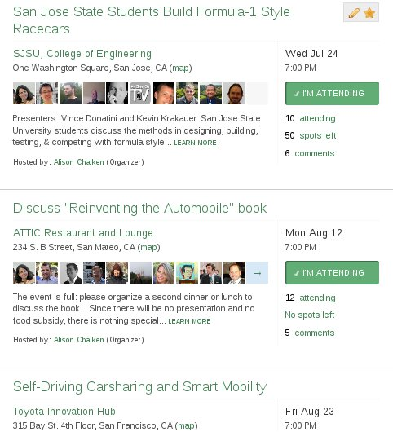
Free and non-commercial monthly meetup group

Slide 25
Conclusion
Automotive software is a boom area for Linux.
Almost any Linux-related skill is pertinent.
Status: technological promise, but legal uncertainty.
Developers can impact urban planning, environment and public safety.

Slide 26

MA “Right to Repair” is now Law
Key provisions of Massachusetts Right to Repair bill law include:
Immediately, car companies are required to make available to independents on “fair and reasonable terms,” the same tools, software, and repair information that they make available to dealers.
By model year 2018 (translates into 2017) manufacturers required to establish web sites or “clouds” that will contain the same information and software that dealers have access to as part of their proprietary tools.
Source: Aaron Lowe, Automotive Aftermarket Industry Association

Slide 27
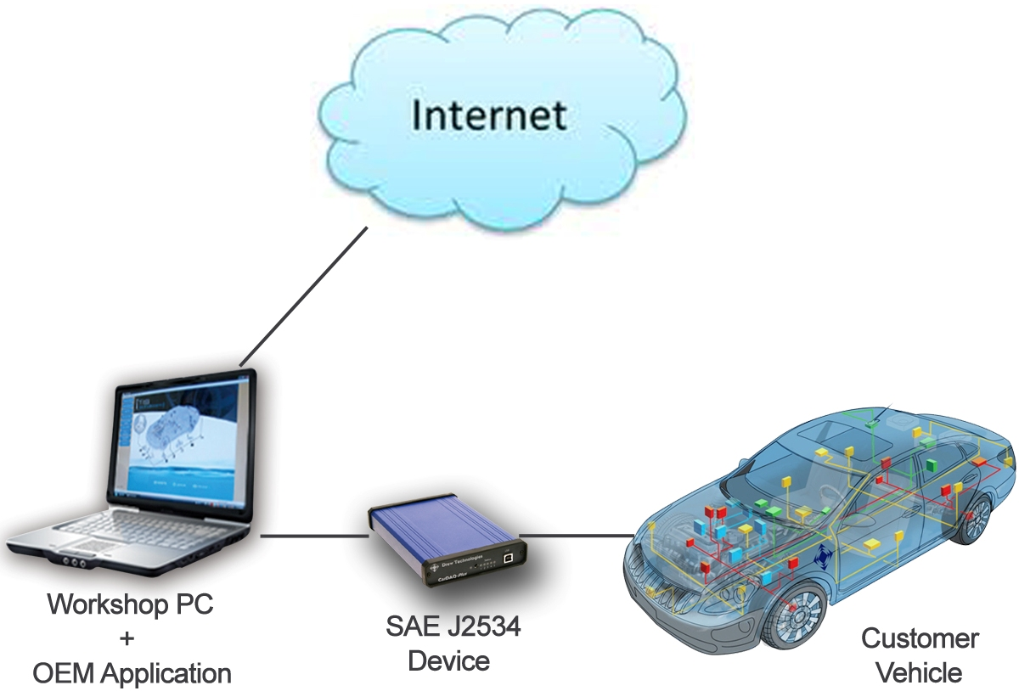
2018 Model Year System
Source: Aaron Lowe, Automotive Aftermarket Industry Association

Slide 28







Free software has new allies
+

Slide 29
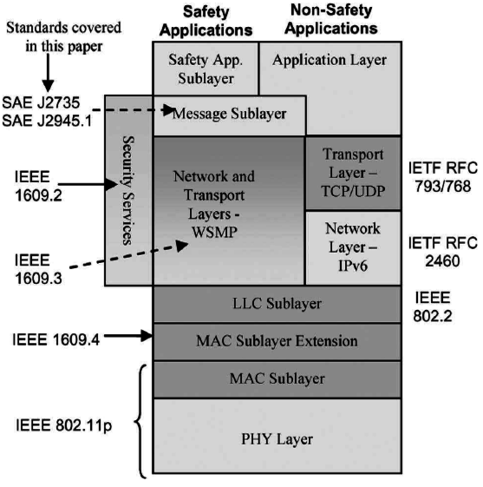
802.11p = Vehicular WiFi
Safety messages via dedicated short-range communication (DSRC) protocol (IEEE 1609)
Allocated spectrum at 5.9 GHz.
New protocols, e.g. DNS Geocasting.
New use cases, e.g. mobile routers
VIN == MAC? or is VIN private?
Field trials underway in Ann Arbor, MI and Germany (simTD)
J.B. Kenney,
Toyota ITC,
Proc. IEEE 99,
2011.

Slide 30




Linux won:
  on servers and on handsets.
Linux lost:
  on desktops.
Linux could lose in automotive:
  QNX and Windows have the largest automotive base.
  QNX has fast IPC and works well on smaller MCUs.
  Most car CPUs run proprietary RTOSes.

