Slide 1
Automotive Linux, Cybersecurity and Transparency
Alison Chaiken
SCALE 14x
alison@she-devel.com
Jan 22, 2016
http://she-devel.com/Chaiken_automotive_cybersecurity.pdf

Slide 2

The Problem(s)
  -- Legacy designs
  -- Unclear privacy situation
  -- DMCA
Approaches to a Solution
  -- PKE
  -- Virtualization
  -- Architecture-based security
  -- Open Source

Slide 3
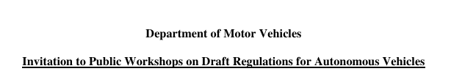
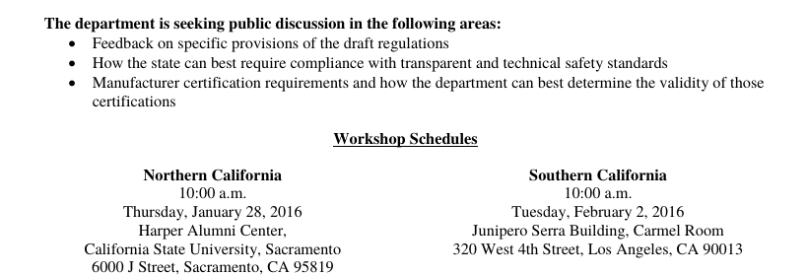
Ready or not, here come new regulations
Caltrans source link

Slide 4
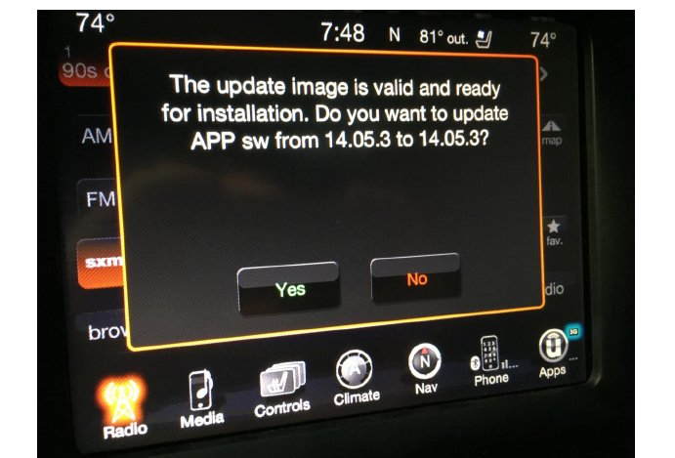
July 2015: Miller and Valasek “state-sponsored” takedown of Jeep
source: http://illmatics.com/Remote%20Car%20Hacking.pdf

Slide 5
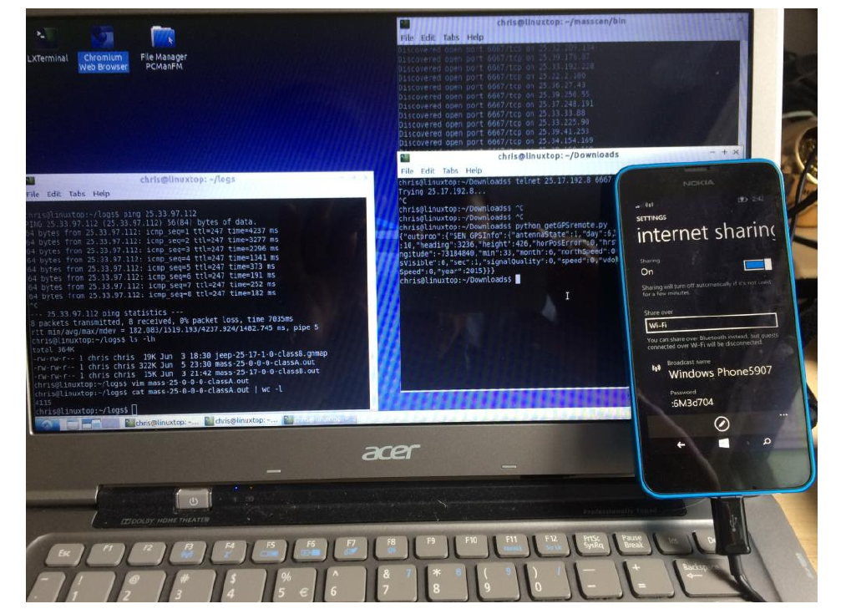
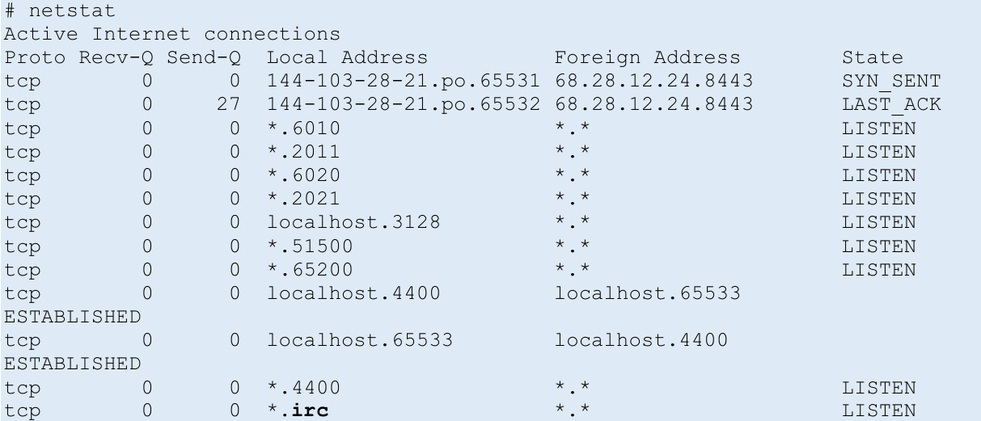
Miller-Valasek: D-Bus service responding to an open 3G port
“To find vulnerable vehicles you just need to scan on
port 6667 from a Sprint device. . . “

Slide 6
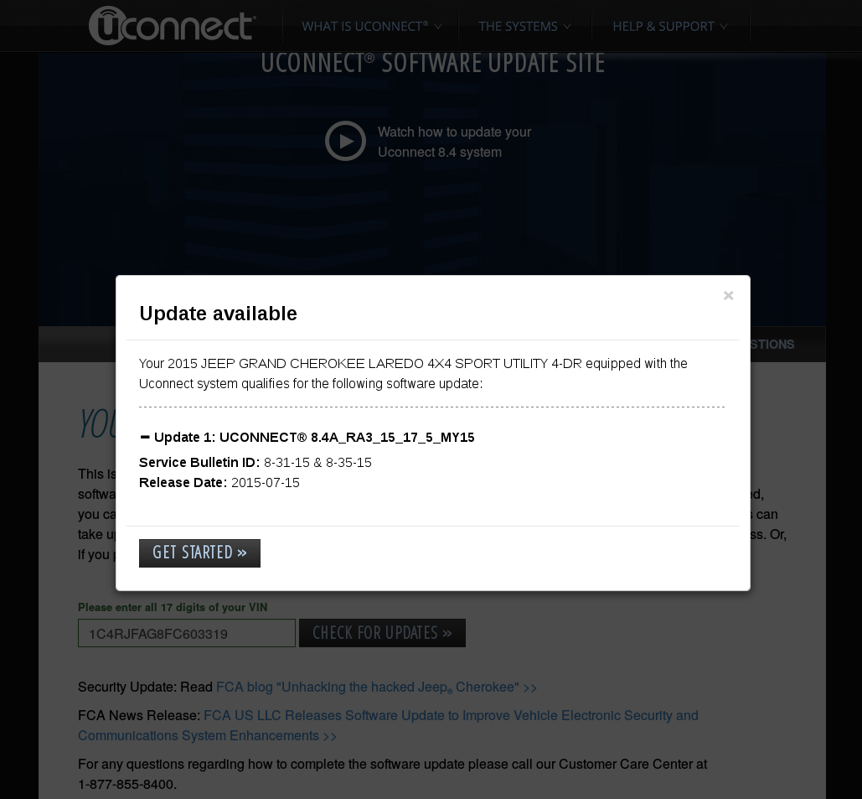
Without Over-the-Air Updates, Jeep is stuck
p0wn-to-own
Dec. 2015 view of Uconnect update

Slide 7
The Jeep was running QNX
QNX is outshipping Linux 6:1 say analysts.
Many automakers plan cars that run Linux:
  GENIVI members: BMW, FAW, CMC, Great Wall, Honda, Hyundai, JLR, Daimler, Nissan, Peugeot-Citroen, Renault, SAIC, Volvo
  AGL members: Toyota, JLR, Mitsubishi, Nissan, Honda, Ford, Mazda,Subaru
So everything's fine, right?

Slide 8
What about . . .
attaching your phone via USB to a rental car?
leaving your car at a repair shop overnight?
How do we . . .
opt out of automakers' data collection?
reset a car for sale to factory defaults?
Should . . .
an unpatched car fail its safety inspection?
law enforcement routinely monitor speed data?

Slide 9
We need societal values to inform
transportation technological decisions
. . . not the other way around!

Slide 10
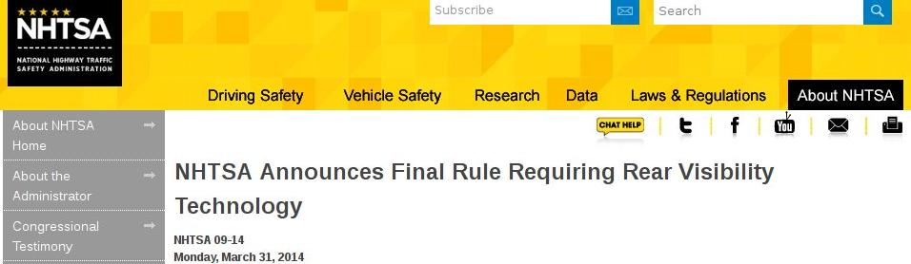
Safety vs. Security Tradeoffs?
2-seconds-to-rear-view-camera NHTSA rule enforces minimum boot time.
Ill-considered regulations can lead to less safety when increased attack surface is factored in.

Slide 11
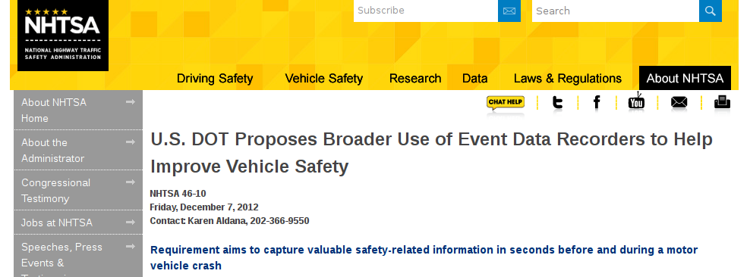
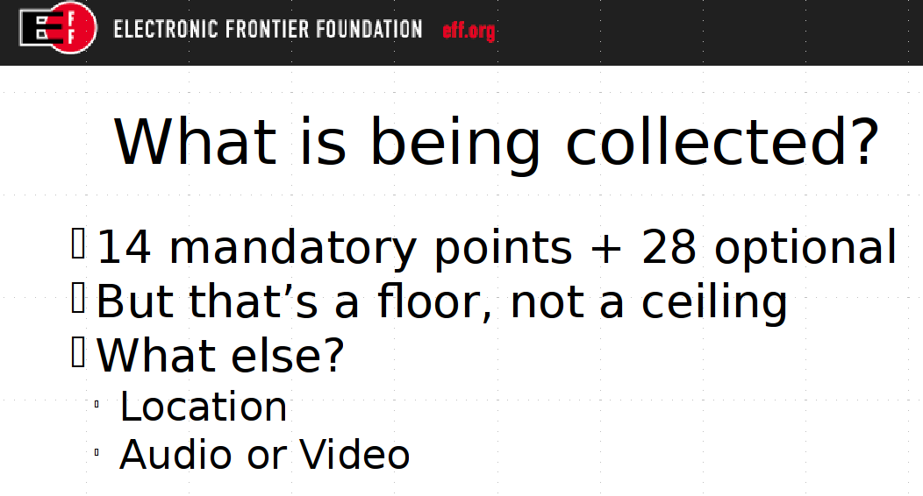
Event Data Recorders: NHTSA decision pending
courtesy
Nate Cardozo,
EFF

Slide 12
The surest approach to security:
avoid being an attractive target

Slide 13
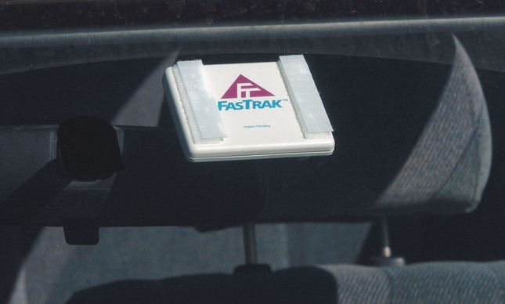
The ONLY way that payment credentials should be stored in a car
Connectivity to car systems: double-stick tape

Slide 14
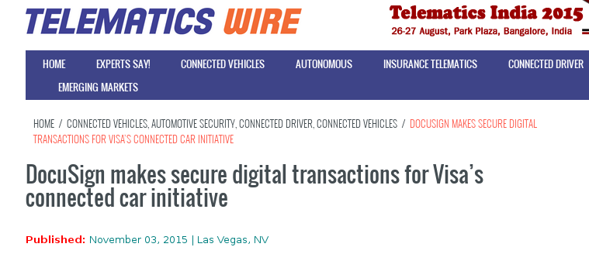
Associating broad payment credentials
with embedded car systems
puts lives in danger.

Slide 15
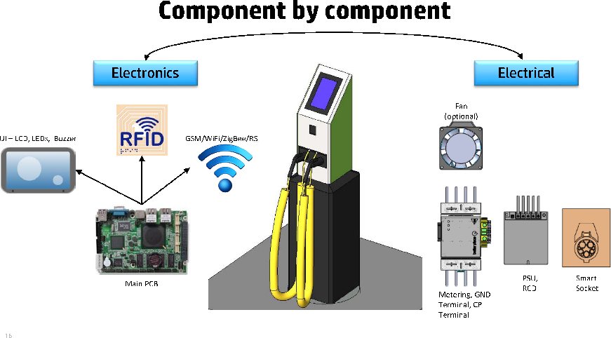
Payment credentials + High Voltage + Connectivity
What could possibly go wrong?
Ozer Shezaf, http://xiom.com/2013/04/13/who_can_hack_a_plug_the_presentation

Slide 16
Security and transparency
approaches

Slide 17
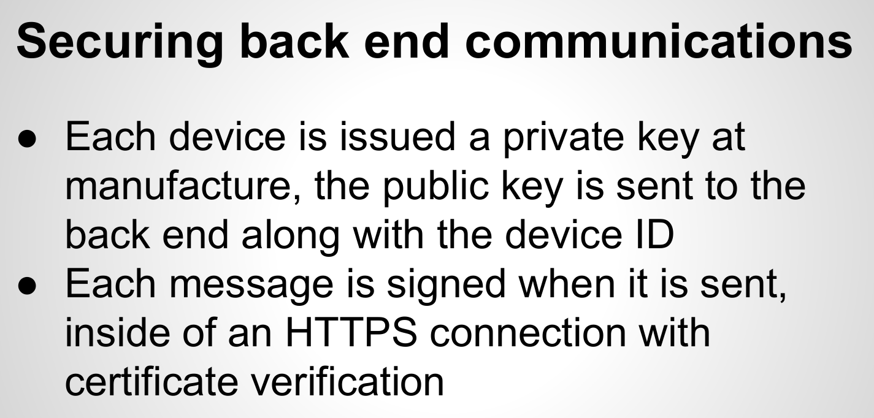
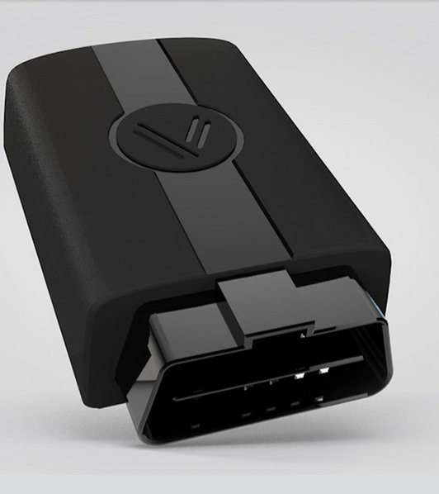
Vinli-Dialexa scan tool architecture

Slide 18
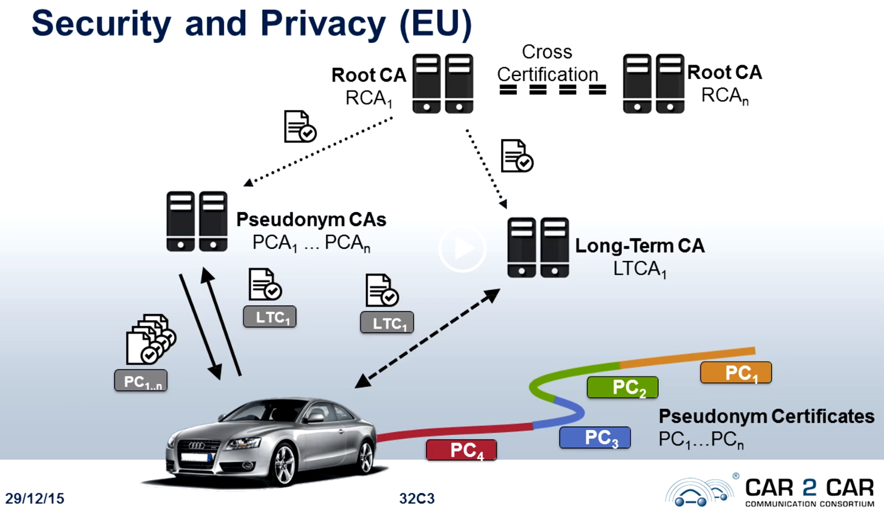
Preserving anonymity with PKE is Challenging
Courtesy B. Lehrmann, 32C3, “Vehicle2Vehicle Communication based on IEEE802.11p”

Slide 19
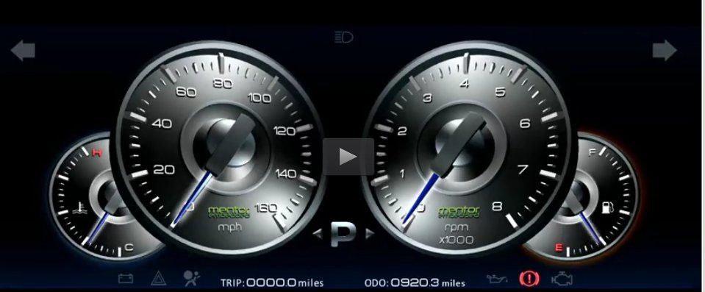

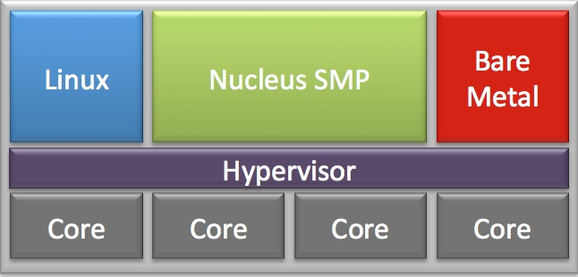
Multiple processor cores with multiple OSes
Driver Assistance,
Navigation, Entertainment
Linux can
be AGL-GENIVI
or Android, or one
core of each
or QNX …
Proprietary or Xen
Courtesy Mentor Automotive

Slide 20
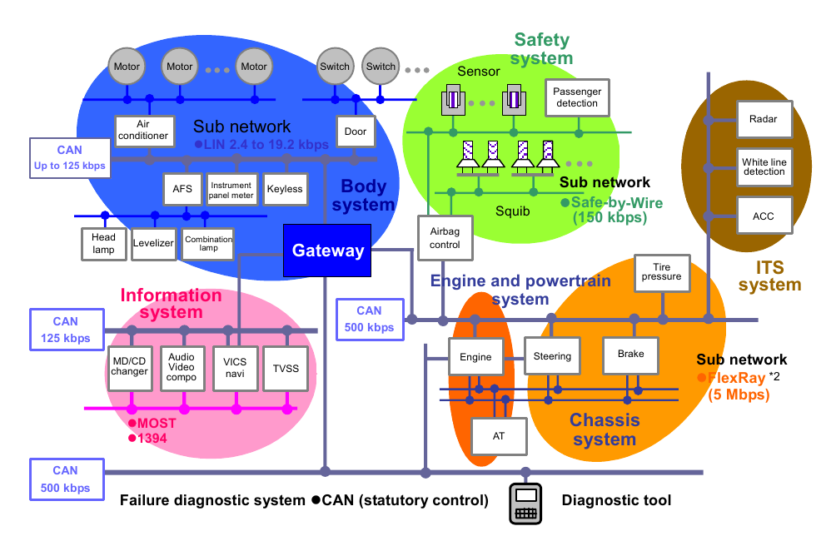
Automotive LAN, 2025
Becomes a
packet-filtering
firewall
EA/V-B
EA/V-B
Copyright Renesas, “Introduction to CAN”, with permission.
Ethernet A/V-B (audio-video bridging) will displace FlexRay and MOST

Slide 21



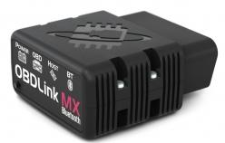
Proposal: scantool connection via DB only
physical
firewall
Single-board server
CAN
500 kbps
Get rid of hard connections to CAN
from passenger cabin.

Slide 22





Linux kernel's watchdog timer guards against intrusion-caused slowdown
/dev/watchdog
int petdog(unsigned interval) {}
Must hit critical time window
Critical application,
normal state
X X
/dev/watchdog
Critical application,
failed state; or simple slowdown
REBOOT

Slide 23
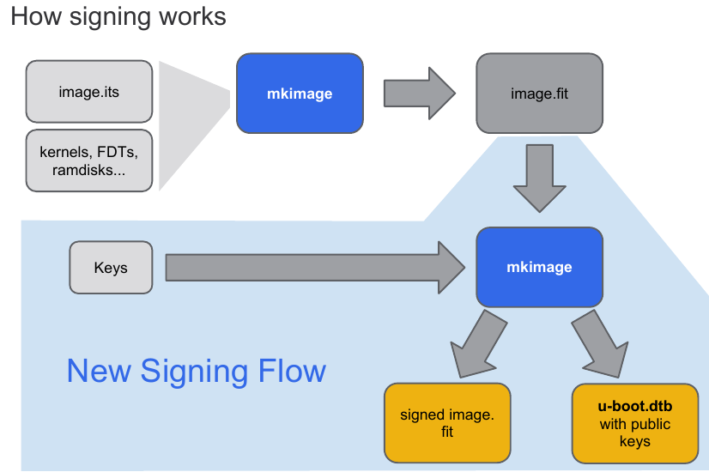
Industry Best Practice: ChromiumOS's Verified Boot
Balances security with software freedom.

Slide 24

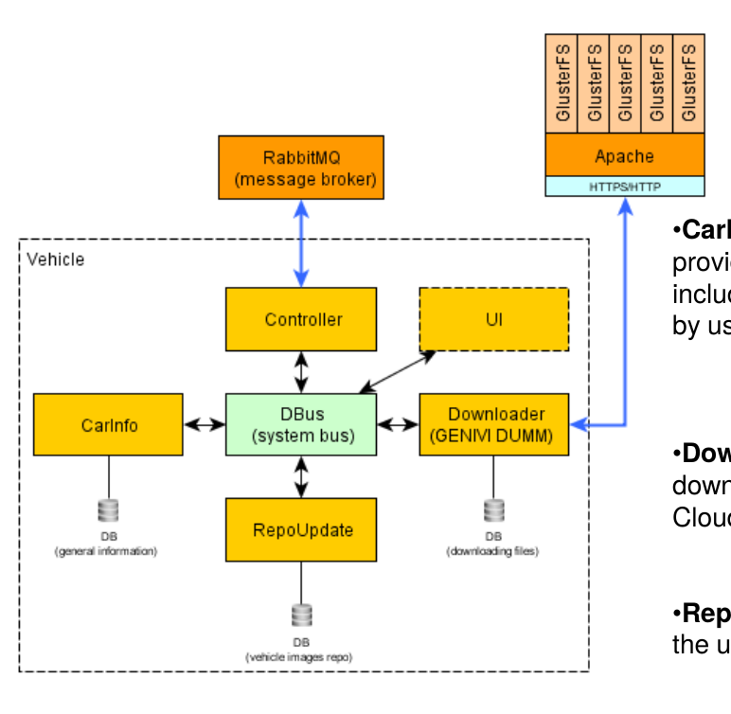
Courtesy
GENIVI
and
Arynga

Slide 25
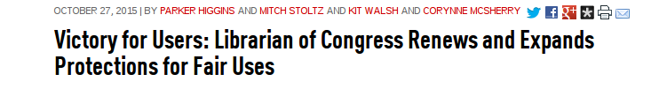
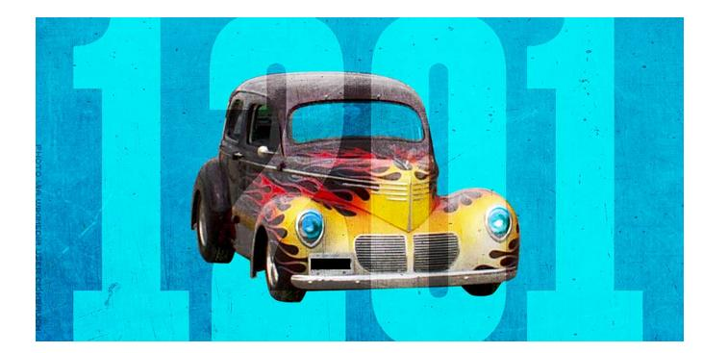
EFF wins automotive DMCA Section 1201 exemption
32c3 2015: F. Domcke reverse-engineers the VW-diesel cheat

Slide 26
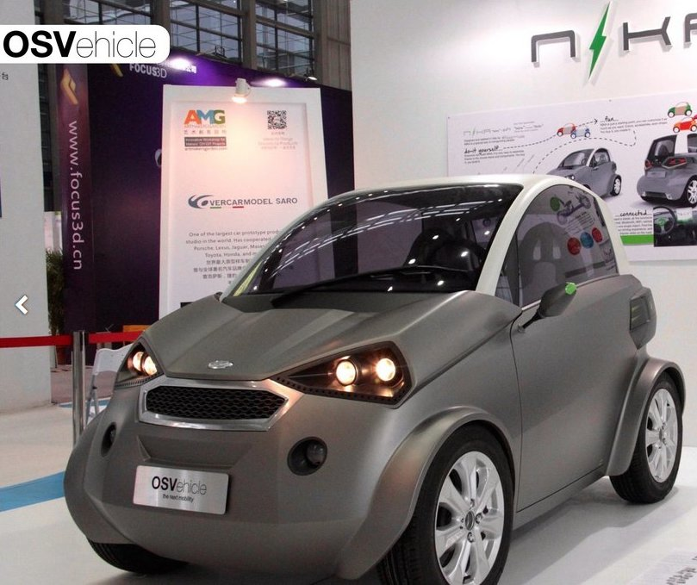
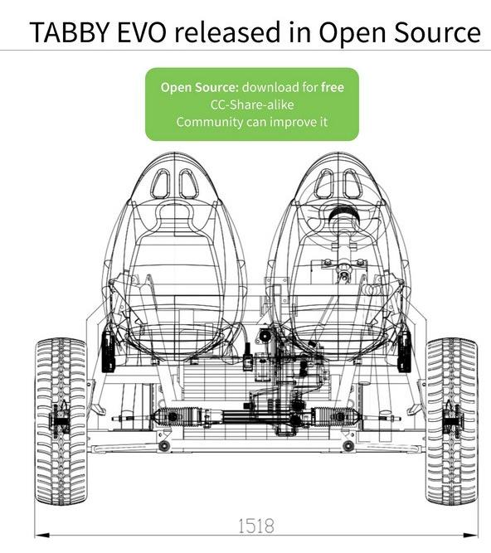
Most exciting development of 2015: OSVehicle

Slide 27
Summary
Adding capability and automation inevitably increases 'attack surface.'
The FCA-Harman-Sprint installation did not follow best practices.
The industry as a whole is moving to OTA.
Considerable open-source activity is underway.
Traditional Linux security considerations apply equally to cars.

Slide 28
References
Smart Automotive special issue of Telematics Wire
Nate Willis, “Linux and the Automotive Security Lab”
“Dieselgate” and V2V communication talks at 32c3 2015
EPIC “Internet of Cars” Congressional testimony, 11/18/2015
“Vehicle Forensics” SchmooCon 2014
“Remote Vehicle Interaction,” AGL meeting, 9/2015
Ethernet A/V-B: Junko Yoshida, EE Times
Automotive Grade Linux and GENIVI
General Motors' kernel source
Freenode #automotive IRC
I Am the Cavalry Five Star Automotive Cyber Safety Framework

Slide 29
Acknowledgements
Thanks to the following people for comments on, contributions to or support of (but not endorsement of) this presentation:
Dan Bartz, Mike Linksvayer, Roni Michaels, Linda Campbell, Charlie Vogelheim, Nate Cardozo, Andre Nakkurth, Julian Palau, Vinli, IBM Enterprise Security

Slide 30
extra slides

Slide 31
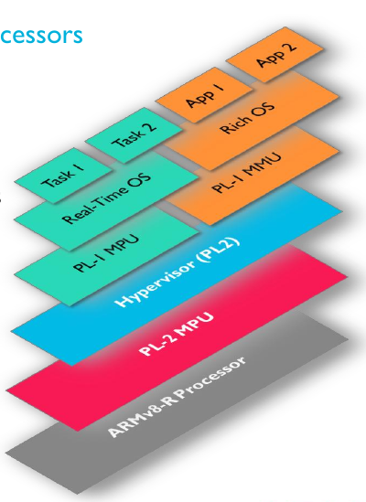
Hardware-level security on a device
x86: TPM, IMA . . .
ARM: Cortex-R, TrustZone
Both ARM and x86 solutions have some Linux driver support
Image courtesy Chris Turner, ARM

Slide 32
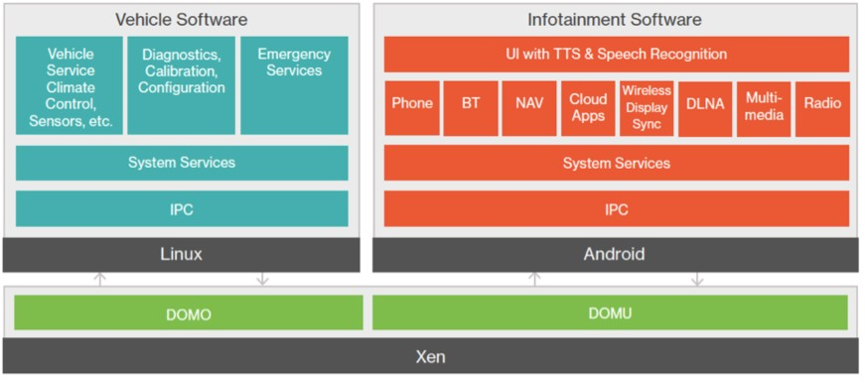
Familiar problems, familiar solutions
DOM0 and DOMU run on different cores of a processor.
Global Logic: http://tinyurl.com/ojnrbr2

Slide 33
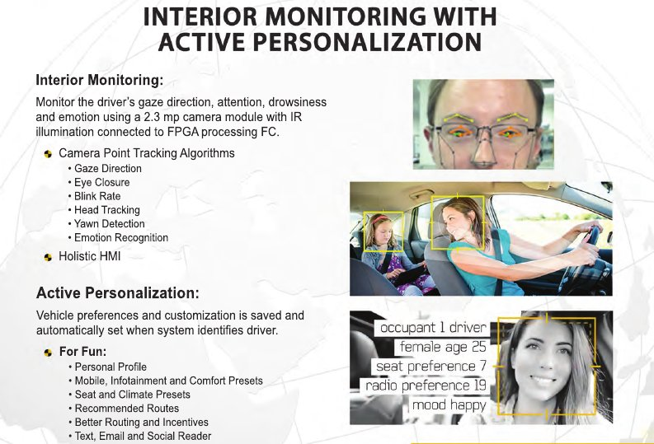
Driver drowsiness detection has great potential, but . . .
Source: Key Safety Systems

Slide 34
Automotive LAN, 2015
Copyright Renesas, “Introduction to CAN”, with permission.
>100 microprocessors on MOST, CAN-FD, LIN, FlexRay networks

Slide 35
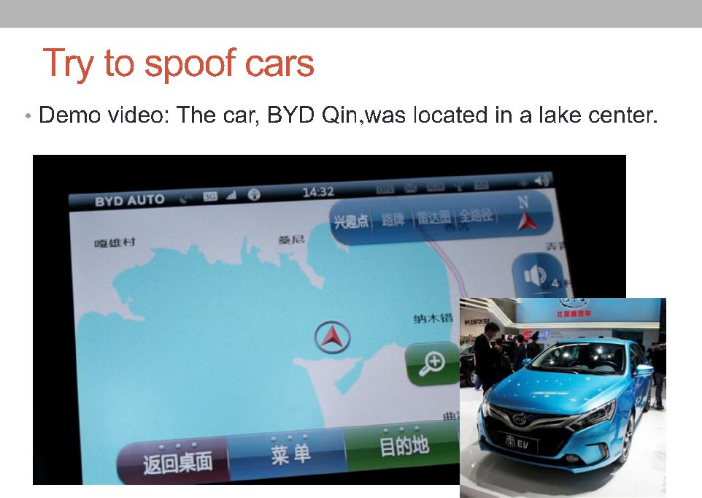
GPS Spoofing: Qihoo at Defcon

Slide 36
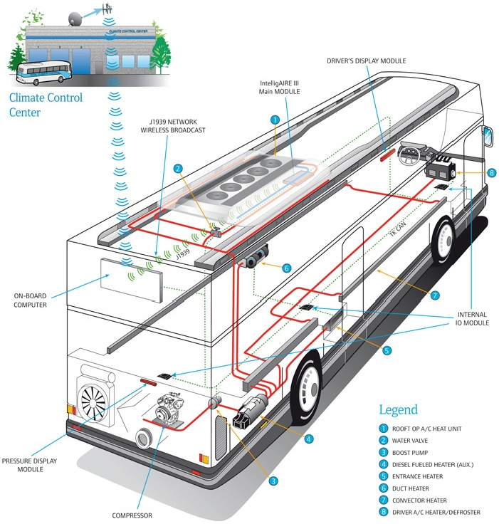
Connectivity may be a bad choice
“Shuttle bus withJ1939 air conditioning,”
Metropolitan Atlanta
Rapid Transit Authority,
http://can-newsletter.org
The “Thermo King Intelligaire III“

Slide 37
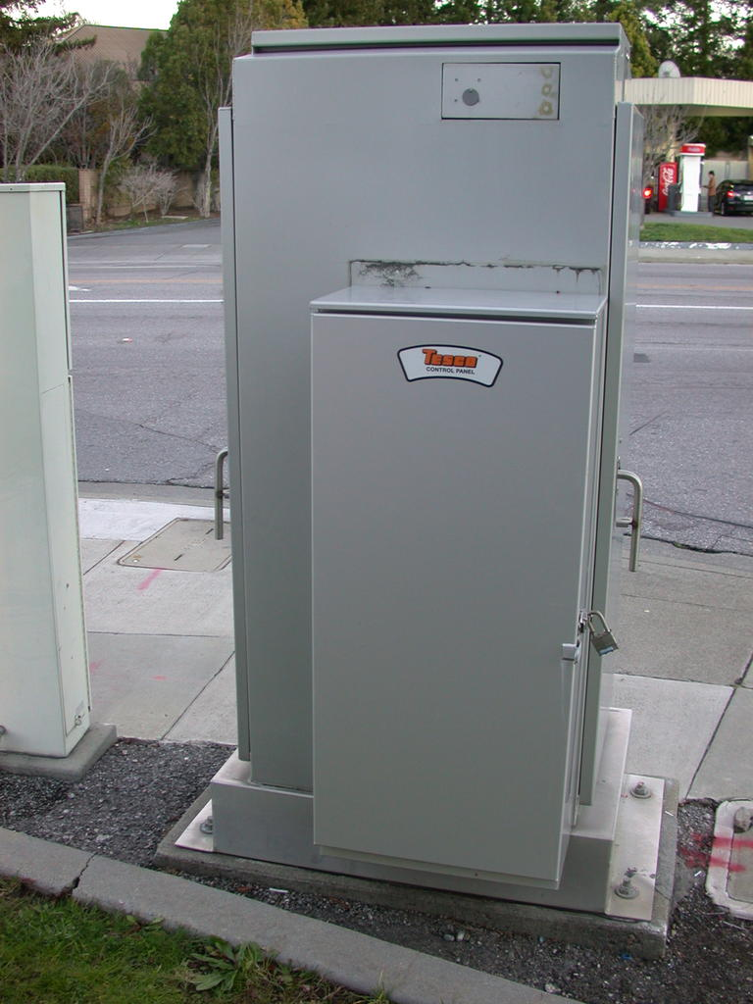
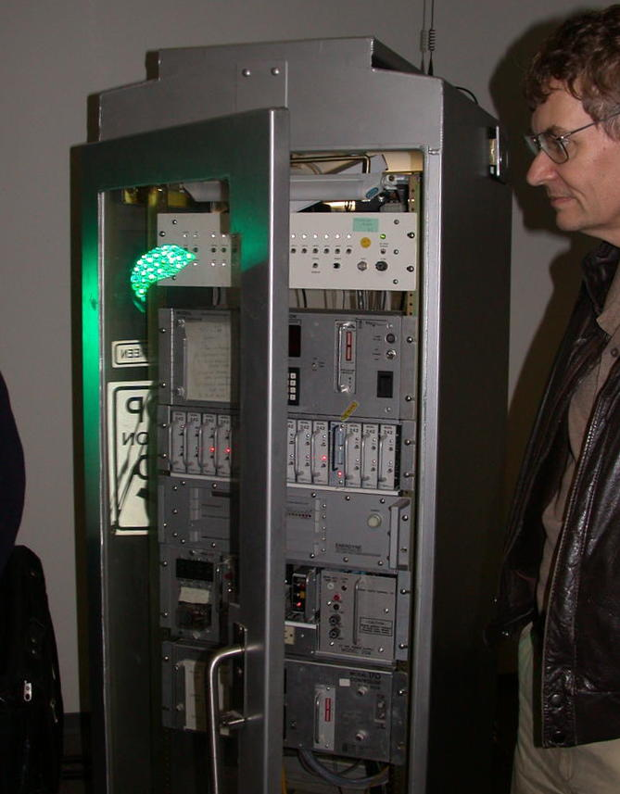
Ambient Insecurity: the Internet of Threats
“Alternative Web browser-based user interface allows remote
programming and status observation”
(Safetran Cobalt brochure)
Background: Thinking Highways

Slide 38
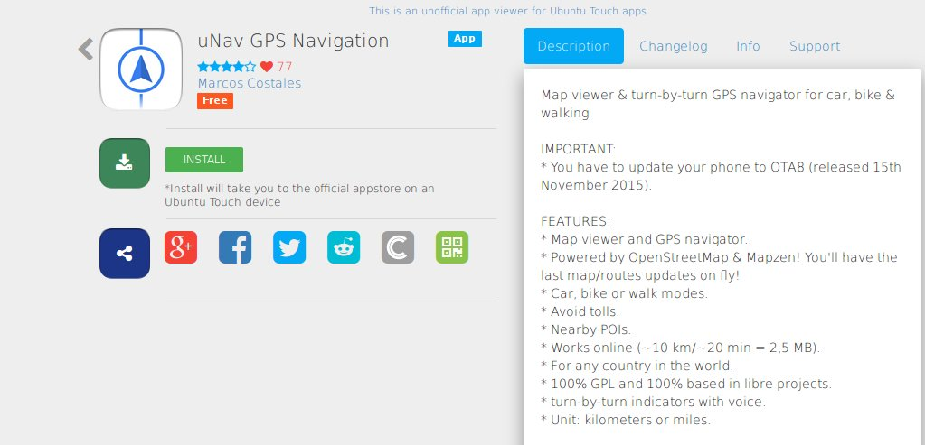
Open Street Map and Ubuntu uNav
H/T Linux Unplugged Episode 115

Slide 39
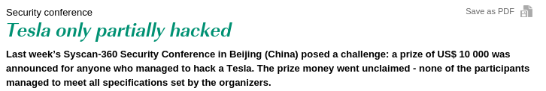
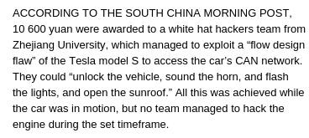
Automotive pen-testing
CAN Industry Association newsletter, July 24, 2014

Slide 40
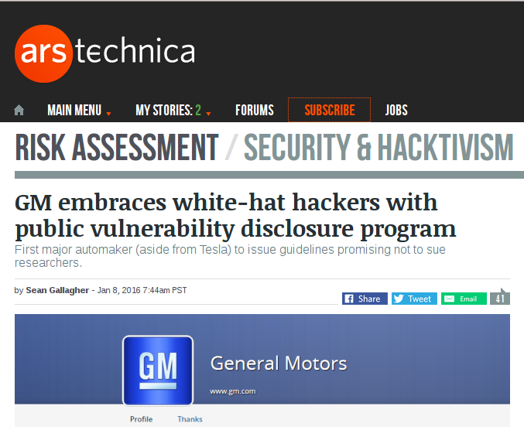

Slide 41
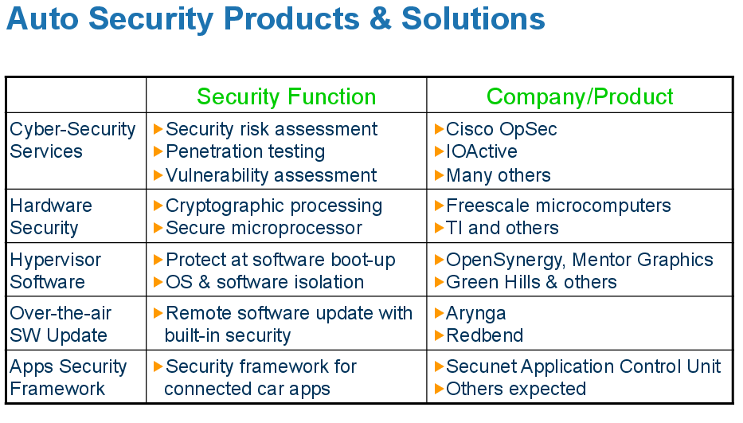
Courtesy of IHS and E. Juliussen

Slide 42
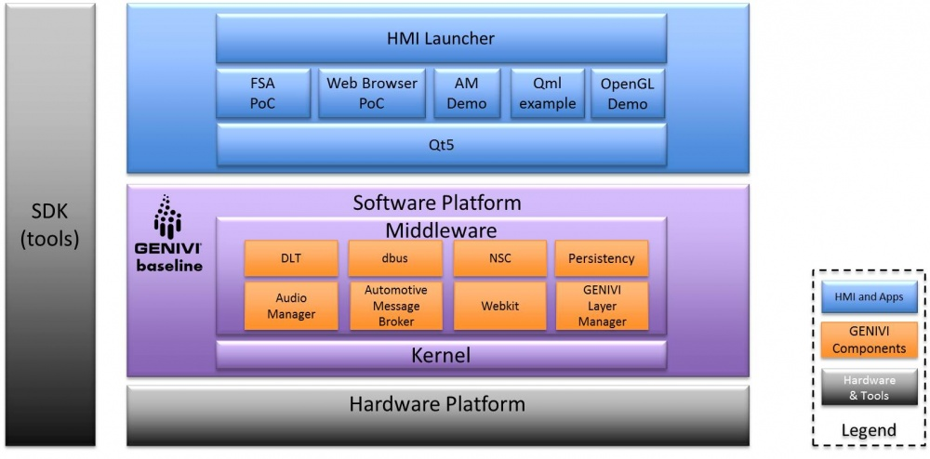
GENIVI Demo Platform
Qemu image plus BSPs for RPi, Minnowboard, Nvidia Jetson and Renesas R-Car

Slide 43
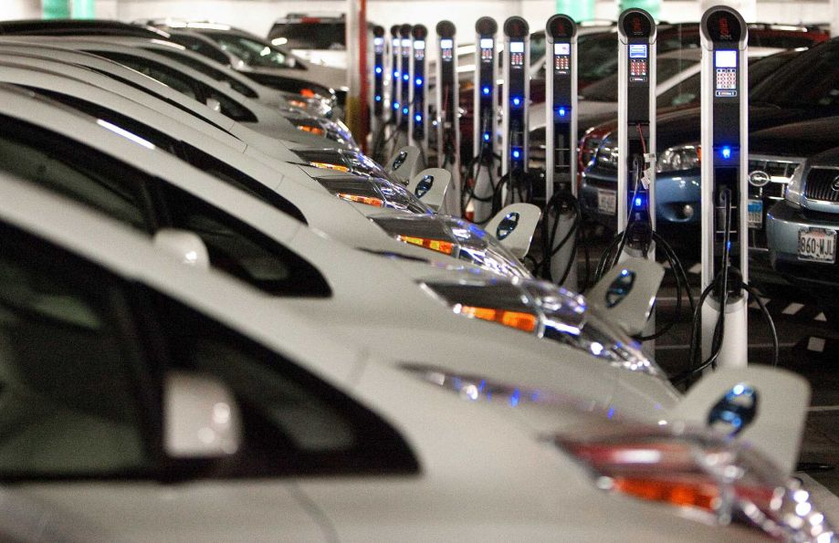
A typical automotive data center
Source: RTKL blog

Slide 44
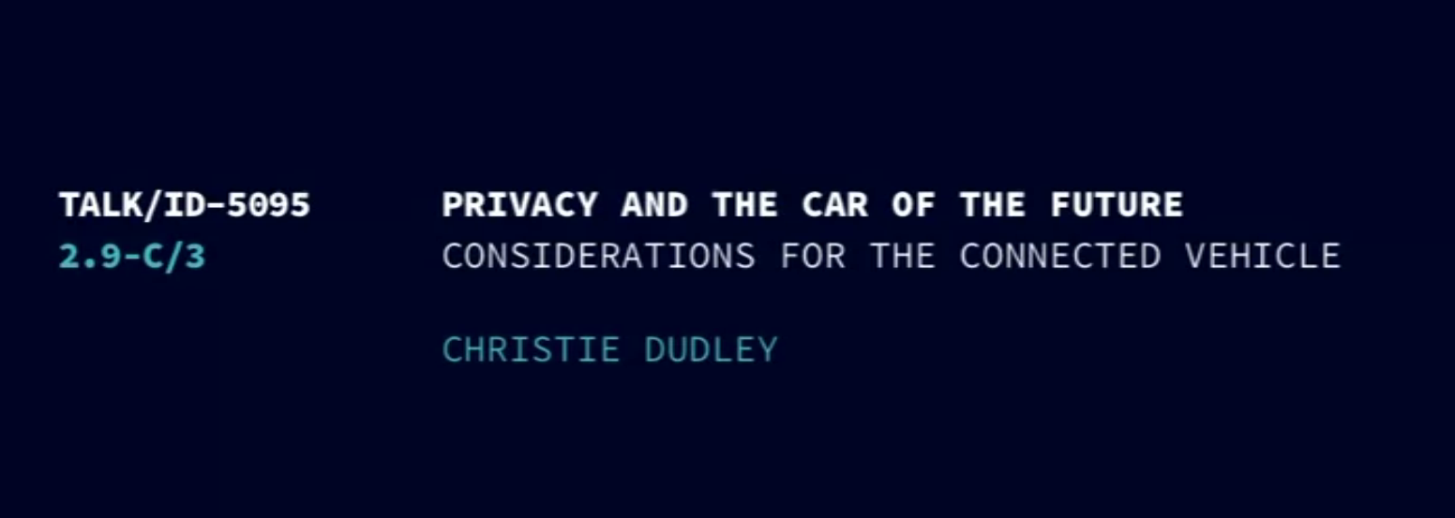
Chaos Computer Club 2012 video
Christie Dudley, Santa Clara University Law School
http://tinyurl.com/crbazg9

