Slide 1

Modeling, Simulation and Testing panel
Alison Chaiken
Peloton Technology
alison@she-devel.com
May 25, 2015

Slide 2
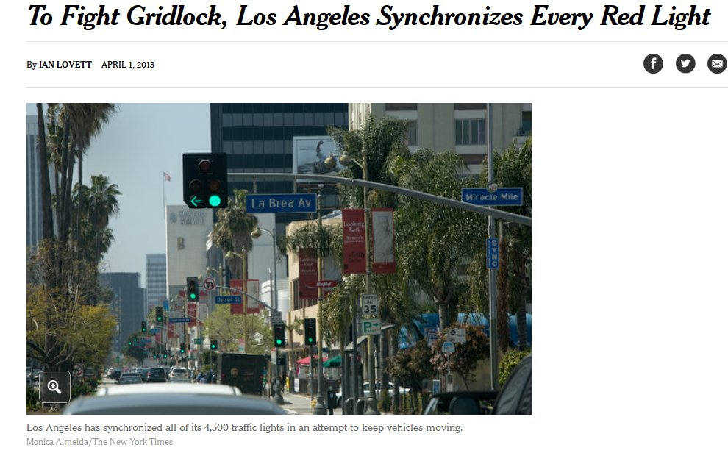
Whole-system optimizations are newly possible

Slide 3
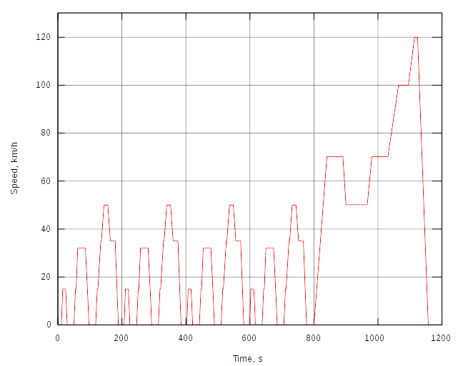
A little-recognized triumph for sophisticated in-car systems
The New European Driving Cycle
By Orzetto - English language Wikipedia, CC-By-SA
“The exhaust emissions scandal ('Dieselgate')” by Felix Domke at CCC32

Slide 4
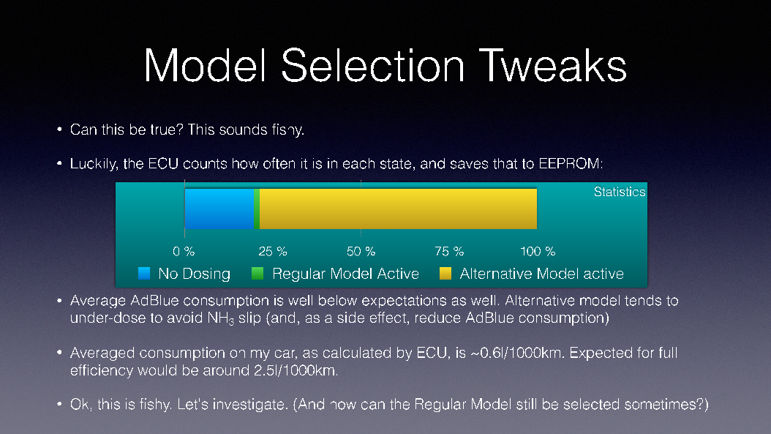
How VW's cheat worked
Courtesy Felix Domke, http://debugmo.de/2015/12/dieselgate/

Slide 5
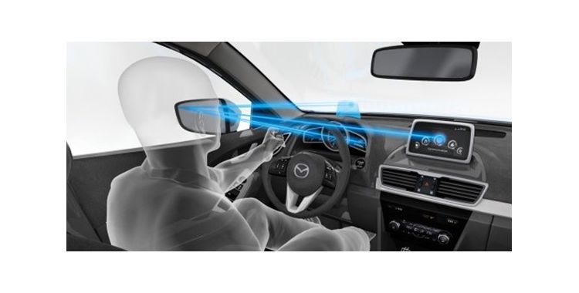
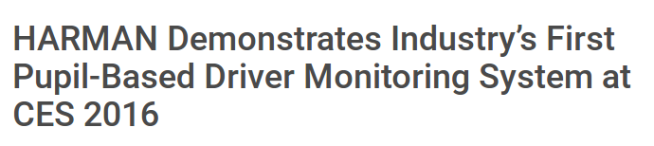
“Human in the loop” will take on new significance

Slide 6
Themes of the panel discussion
Improved, connected GIS
Improved understanding of driver behavior
Better whole-systems approaches to simulation

