Slide 1
Supporting SW Update via u-boot and GPT/EFI
Alison Chaiken
alison@she-devel.com
3/10/2020

Slide 2
Software Update via A/B Image Flipping
A B
A B
A B
kernel
kernel
kernel
/
/
/
/var
/var
/var
Boot Backup
Boot Update
Backup Boot
Software update sequence

Slide 3
How does the bootloader choose A vs. B?
Traditionally, the operating system
writes the bootable image selection
to memory at each shutdown,
then “warm resets.”
When the bootloader runs,
it reads the selection from memory.

Slide 4
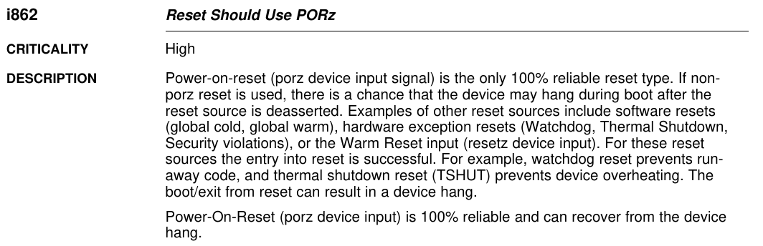
PMIC Errata: no “warm boot” support
Source: TI TDA2x processor errata

Slide 5
Designating boot image w/o warm reset
The information must be written to non-volatile storage: EEPROM, NAND flash, /var partition . . . ?
Design: write all info about partitions into the existing storage device partition table.
EFI partition tables in GPT format support a “name” string.
A boot attempt counter can conveniently be stored there.
2016: u-boot had no support GPT name strings.

Slide 6
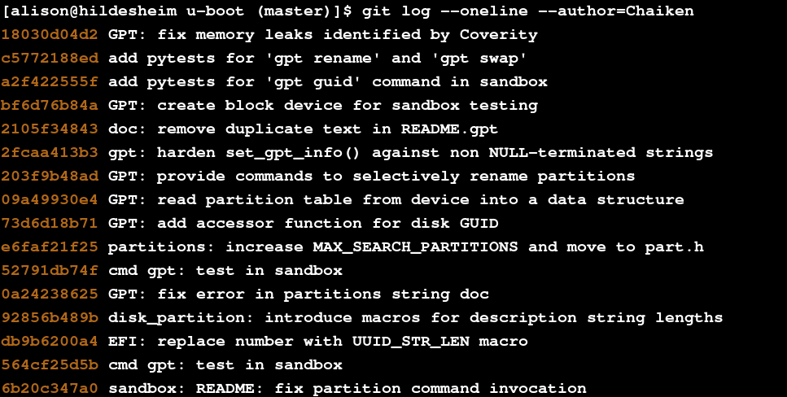
View source code that implements GPT names
git clone git://git.denx.de/u-boot; cd u-boot
git log --author=Chaiken

Slide 7
Demo via u-boot's sandbox
make sandbox_defconfig
make all NO_SDL=1
Follow instructions in doc/README.gpt to make a soft block device.
./u-boot
which produces . . .

Slide 8
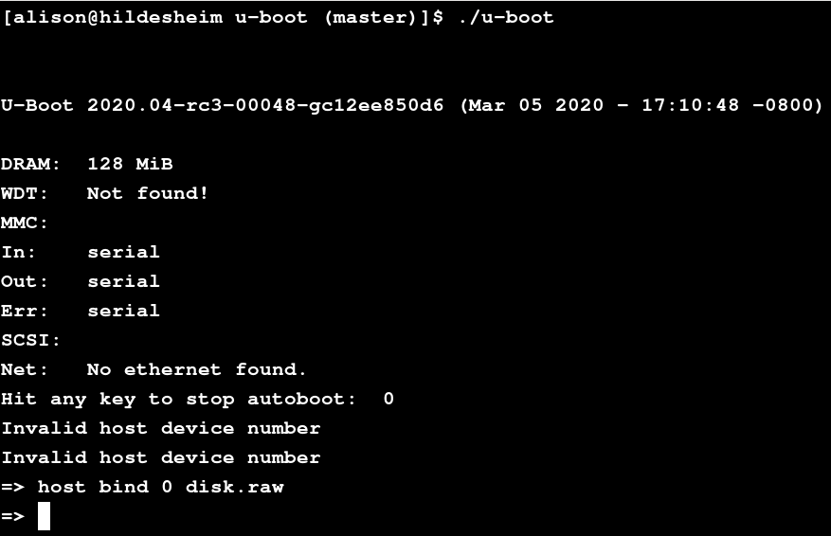

Slide 9
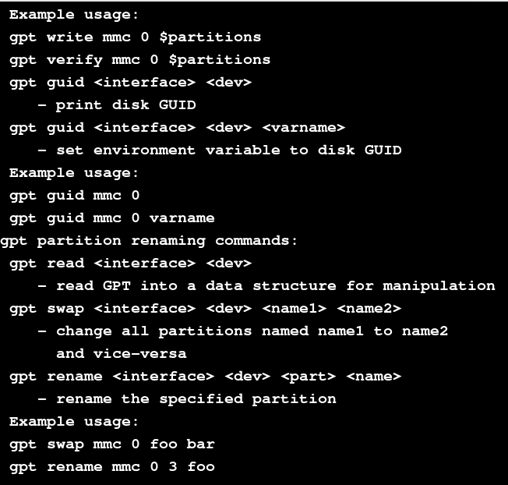

Slide 10
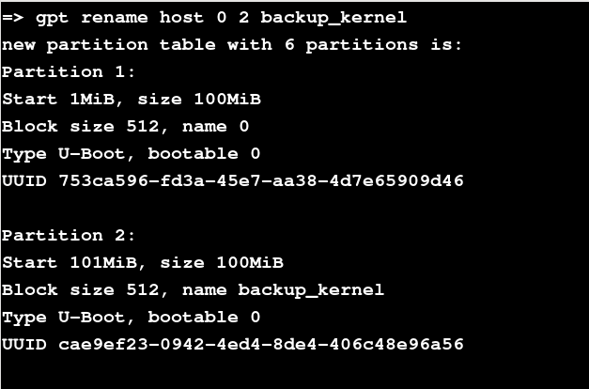
Boot attempt counter

Slide 11
Summary
A/B partition flipping is a conservative strategy when storage capacity allows it.
Traditional flip is accomplished by Linux message in memory to u-boot.
PMIC bug in TI TDA2 prevented message in memory.
Work-around: write the message into the storage partition table.
Contributed the implementation code to upstream u-boot.

