Slide 1
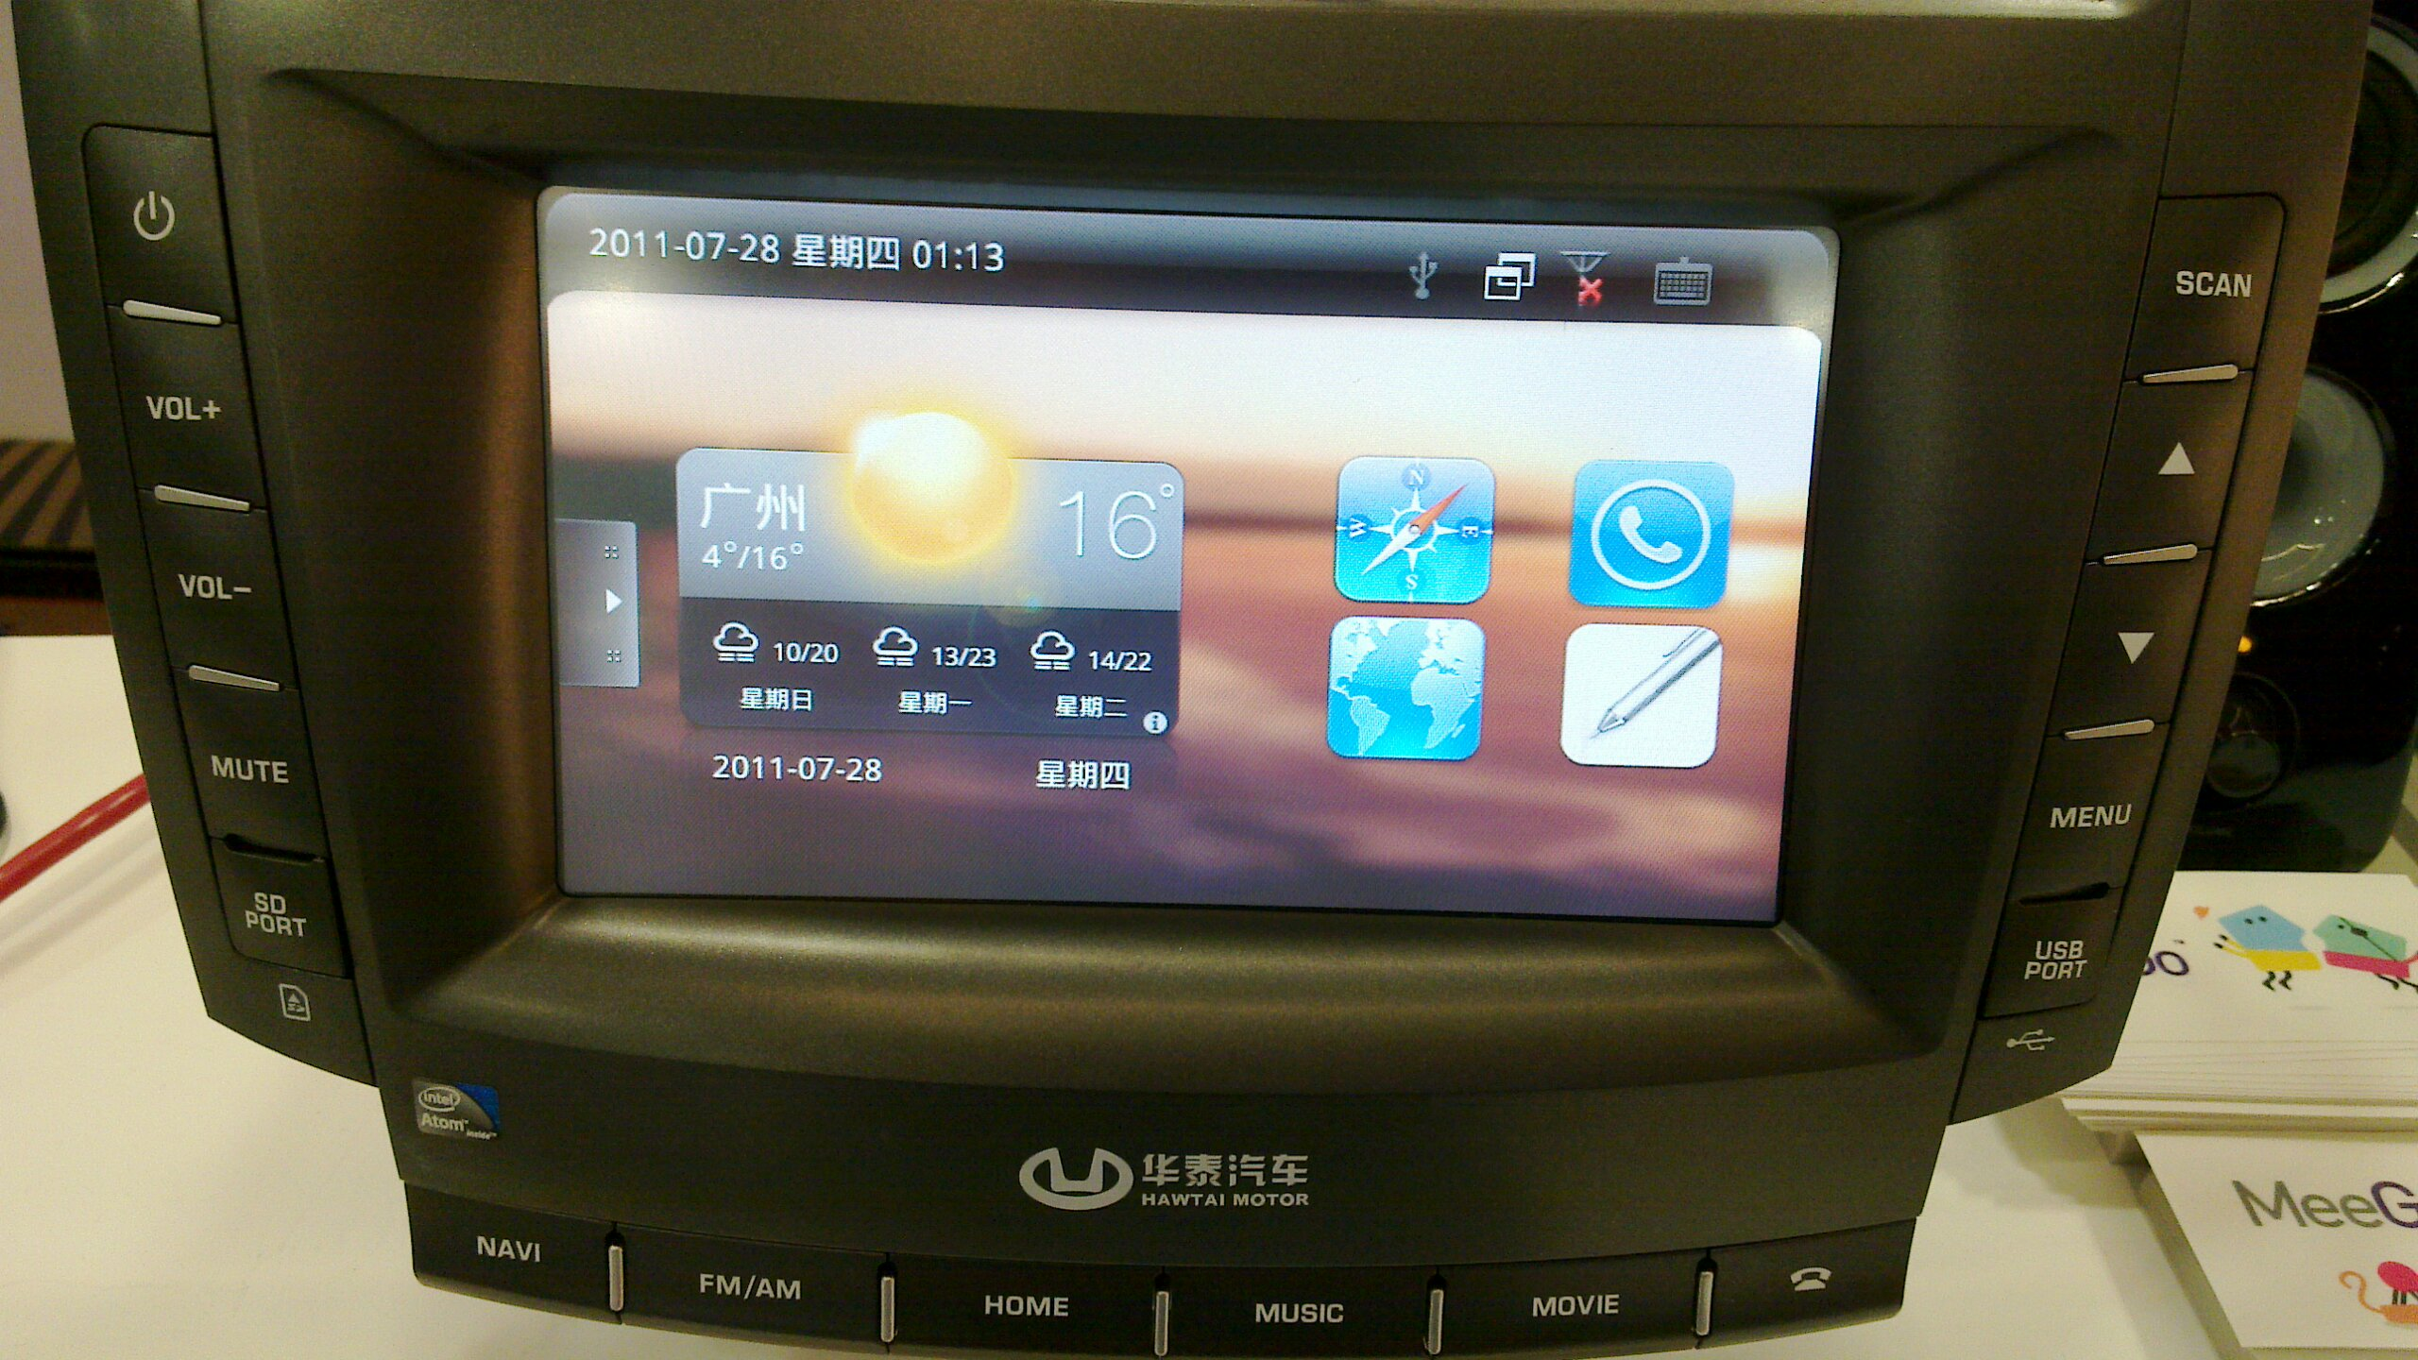
Automotive: new frontier for mobile Linux
Alison Chaiken
alchaiken@gmail.com
http://she-devel.com/

Slide 2
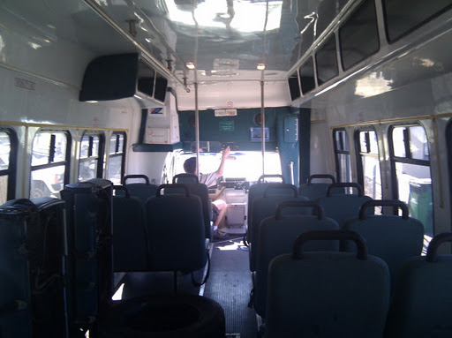
Advertisement: who wants to bus-pool to SCALE?
Katy's shuttle bus

Slide 3
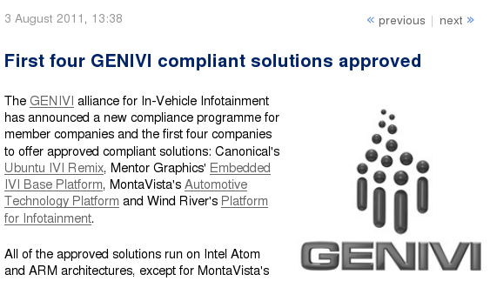
100-Member auto SW alliance endorses Linux
http://www.h-online.com/open/news/item/First-four-GENIVI-compliant-solutions-approved-1317701.html

Slide 4











Bay Area IVI participants
New L.A. factory

Slide 5
Outline
Automotive software systems: IVI
Major IVI projects and platforms
HW platforms for IVI development
nOBDy and ExoPC demos

Slide 6
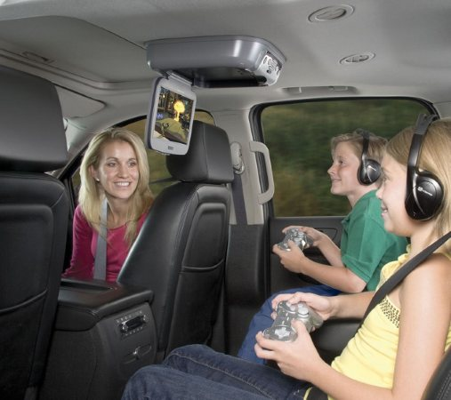
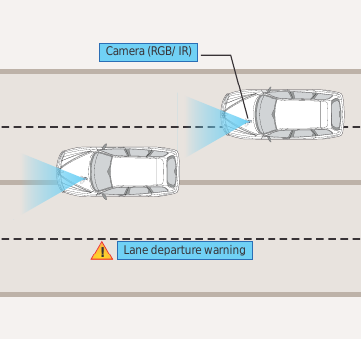
What is “in-vehicle infotainment”?
Courtesy Tata Consultancy Services
What “infotainment” calls to mind
What IVI could be

Slide 7
3 potential novel auto apps
Saving fuel with ad hoc convoys

Slide 8
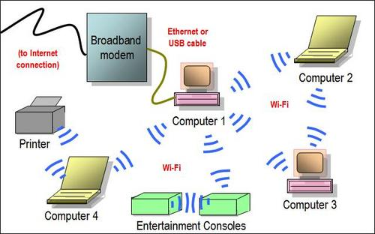
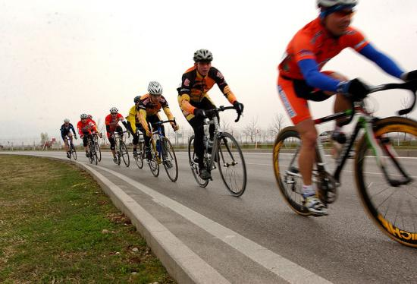
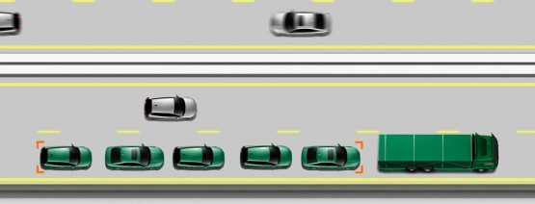
Opportunity: save energy through ad hoc networking
Use this . . .
to save energy . . .
with cars, too: 802.11p WAVE.

Slide 9
3 potential novel auto apps
Saving fuel with ad hoc convoys
Car as mobile data collection platform

Slide 10
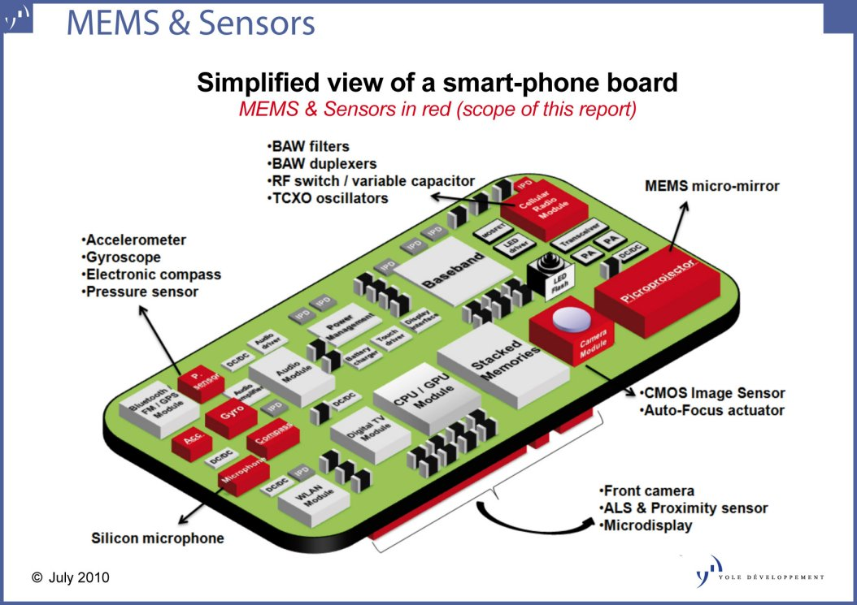
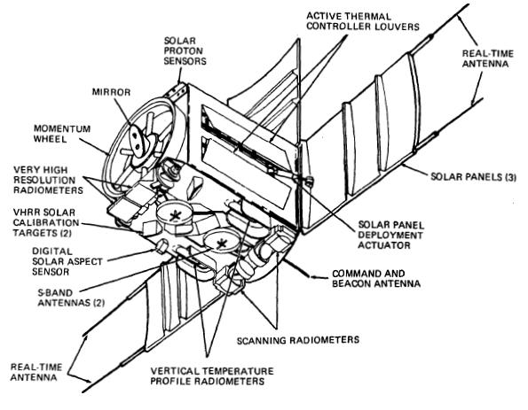
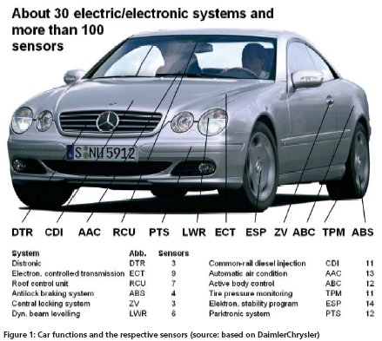
Opportunity: Mobile sensor platform data fusion/mining
Handset
Satellite

Slide 11
3 potential novel auto apps
Saving fuel with ad hoc convoys
Car as mobile data collection platform
Car as giant portable CPU and battery

Slide 12
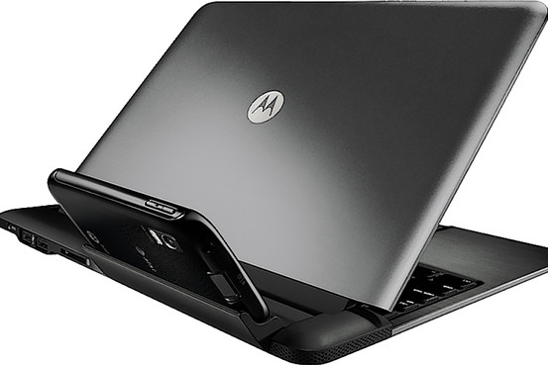
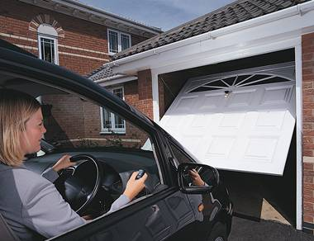
Inserting smarts into big dumb docking stations
Dock the Atrix . . .
. . . or dock the car?
Cars can tether and sync rural businesses and homes?

Slide 13
4 challenges for IVI
Security in a multi-user, mobile, often unattended device

Slide 14
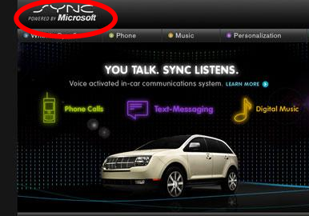
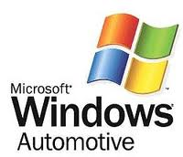
Challenge 1: security
Backseat kids changing nav system's destination . . .
mechanic at body shop installs malware.

Slide 15
4 challenges for IVI
Security in a multi-user, mobile, often unattended device
Safety: not “kill -9” but kill dead!

Slide 16
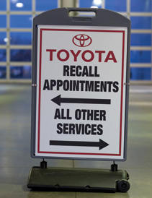
Challenge 2: safety
Driver gets alarms and has read-only access to many parameters.
Prevent entertainment system from hogging resources (incl. Driver!).

Slide 17
4 challenges for IVI
Security in a multi-user, mobile, often unattended device
Safety of a complex system with power to kill
Unique HW: device drivers!?

Slide 18
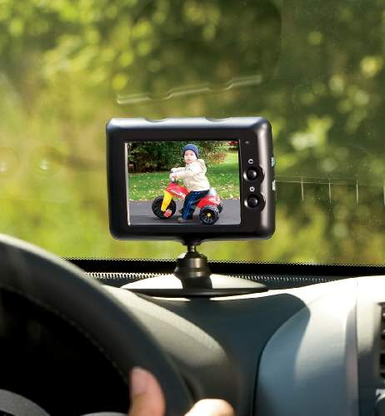
Challenge 3: HW needs
CAN bus, MOST bus, wheel rotation sensors, oil level . .
Not just RT audio, but RT video too!

Slide 19
4 challenges for IVI
Security in a multi-user, mobile, often unattended device
Safety: not “kill -9” but kill dead!
Unique hardware: device drivers?!
Not a phone or desktop: little-understood UI/UX

Slide 20
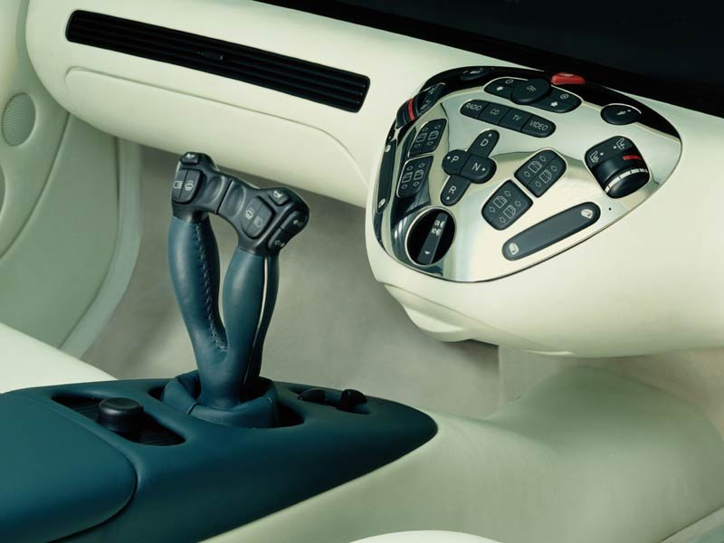
Game-like Controls, Real Cars?
Touchscreen, video gesture, joystick, voice, haptic?
http://funktion.catalystexhibit.com/2009/11/is-our-future-joystuck/

Slide 21
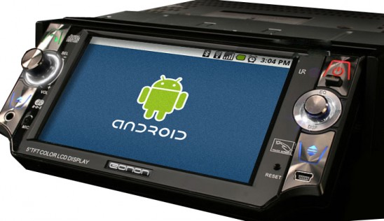
Maybe what we want is Android . . .
from the Open Handset Alliance?

Slide 22
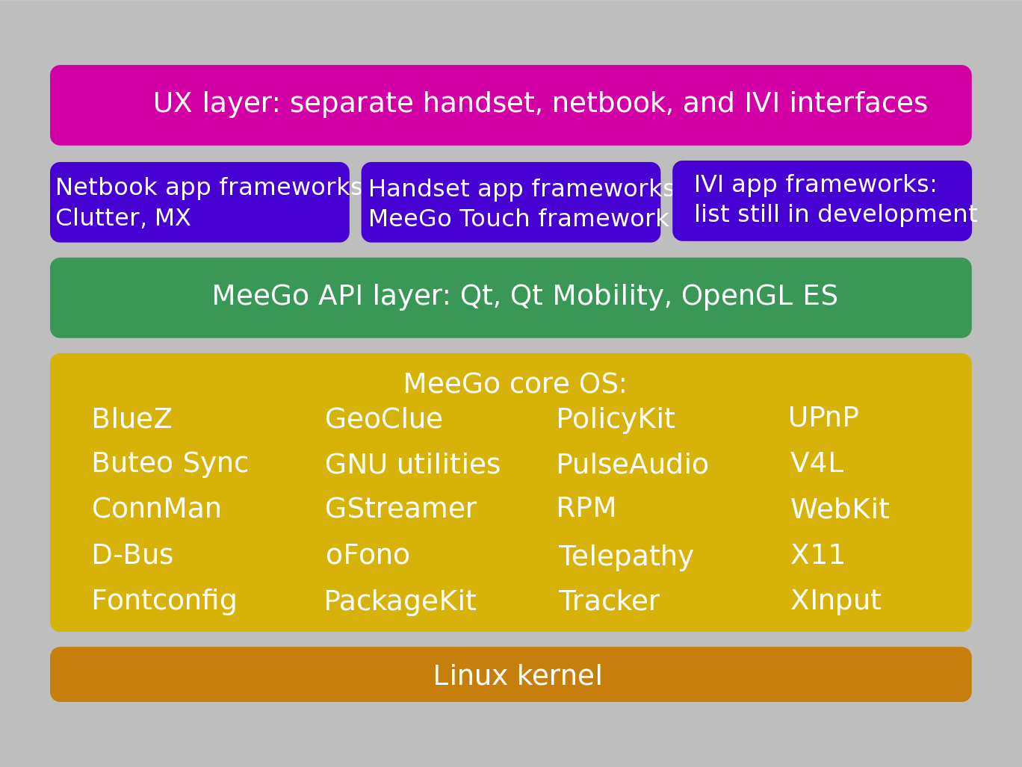
Why consider MeeGo? (or Tizen)?
Courtesy
Nathan P. Willis,
http://tinyurl.com/3m4loer
Closer to traditional GNU/Linux distro than Android.

Slide 23
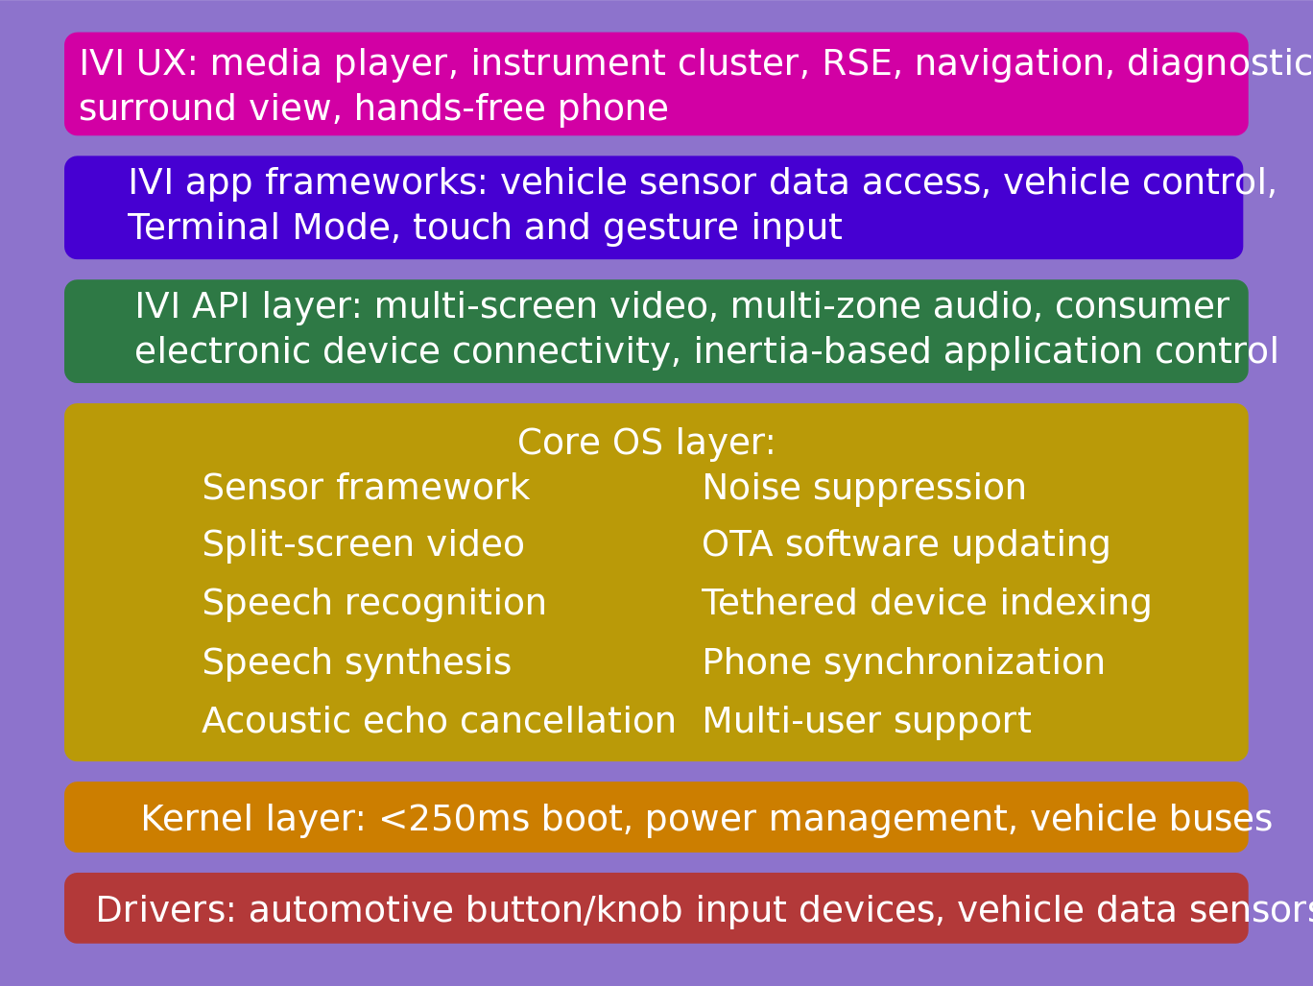
IVI UX Additional Features
Courtesy
Nathan P. Willis,
http://tinyurl.com/3m4loer
Many automotive players, few public announcements.

Slide 24
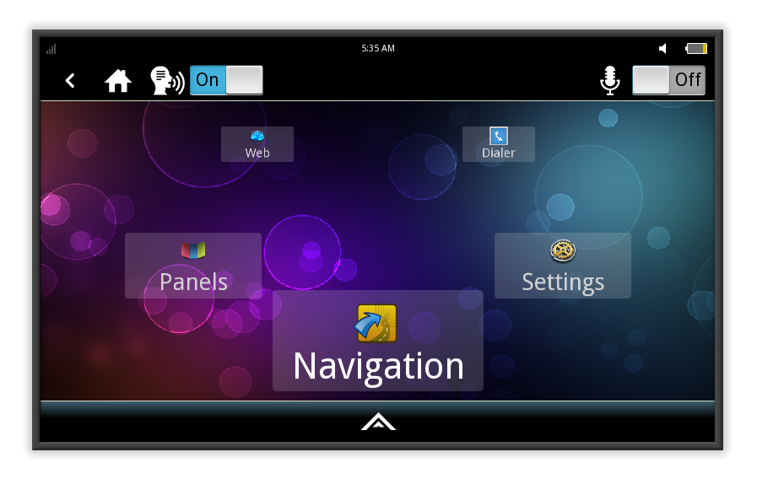
MeeGo IVI 1.2 Home Screen
Intended to be reskinned, not as a shipping product.

Slide 25
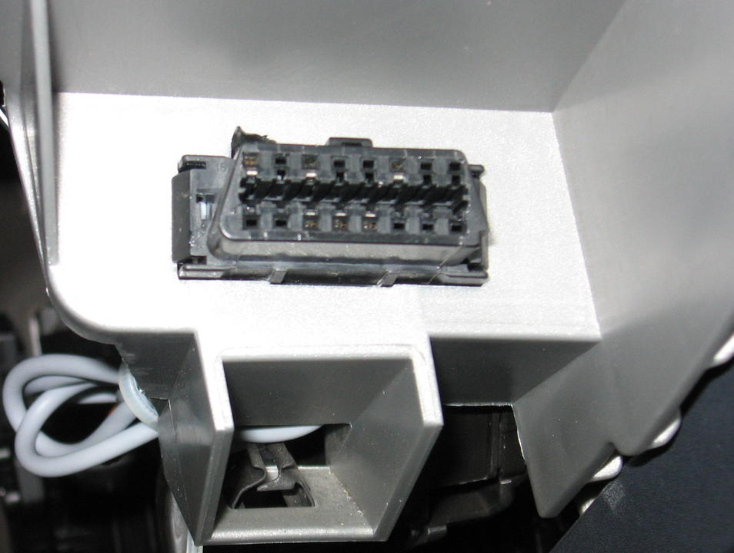
Example: tripzero's nobdy OBDII/CAN scanner
OBD-II connector on left
of steering wheel
Scan tool (USB to OBDII)
available from Amazon, etc.
about $35
GFDL

Slide 26
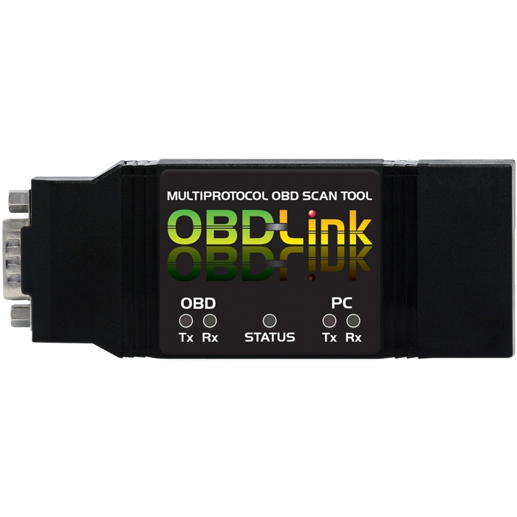
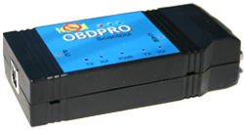
Tripzero: How do I test this in my car?
Elm-compatible scantool
Any tablet/smartphone/laptop that runs meego
http://sf2011.meego.com/program/sessions/vehicle-communications-meego

Slide 27
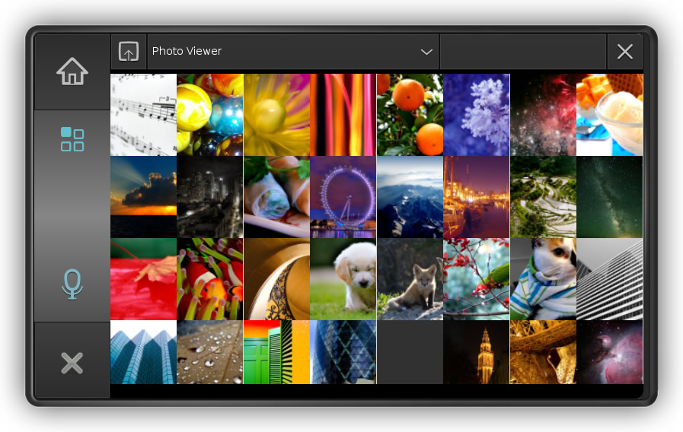
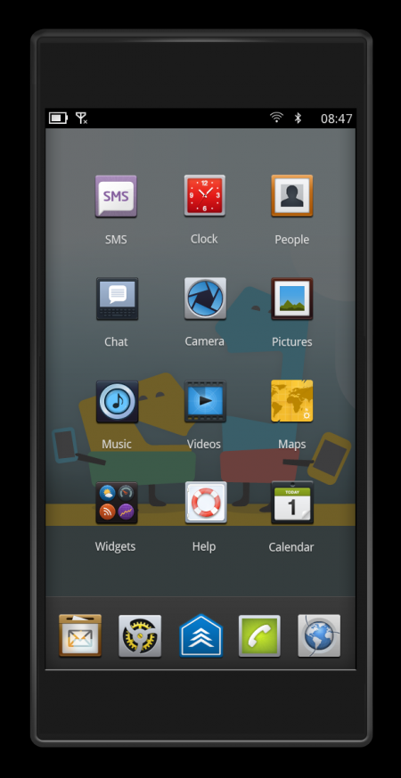
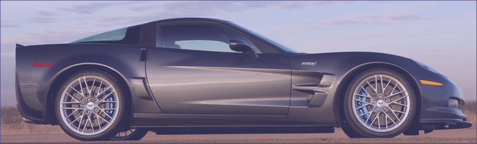
Tripzero: Handset/Tablet + meego ivi
In the near future...
DBus
nobdy
nobdy
Bluetooth
subscriber
plugin
Bluetooth
Provider
plugin
DBus
http://sf2011.meego.com/program/sessions/vehicle-communications-meego

Slide 28
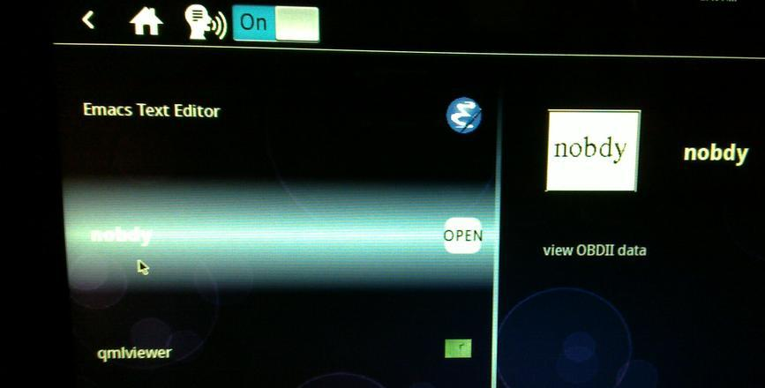
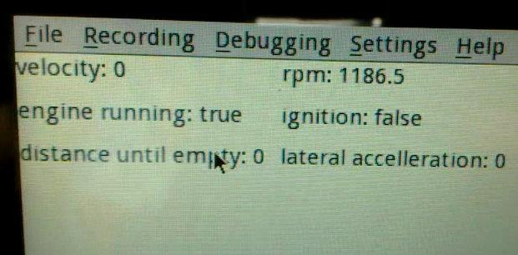
Nobdy on ExoPC
Nobdy in scrollwheel menu
Live data stream via D-bus and qmlviewer

Slide 29
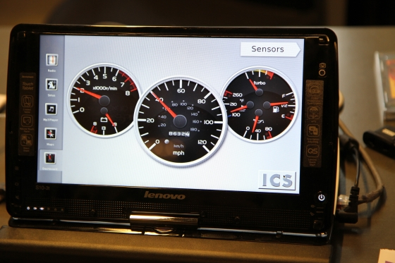
Goal for nOBDy
Open-source ICS IVI demo by Justin Noel

Slide 30
Summary
Linux opportunities at all levels: HW, accessories, embedded, platform, apps, entrepreneurs and big companies.
Finding HW for development remains a problem.
Many local companies are participating =>> jobs.
Prediction: automotive is where Linux will show most growth.

Slide 31
Resources 1: Hardware platforms for IVI
ARM set-top box: Trimslice, $219 with Arch or MeeGo.
ARM board: FreeScale i.MX QuickStart, $149 w/ Ubuntu.
Atom/x86 slate: Ciara ExoPC Vibe, $699 w/ Windows.
Atom/x86 board: Intel Black Sands, $149 w/ reg, Android, Ubuntu or MeeGo.
ARM boards: T.I. BeagleBoard ($149), PandaBoard ($179), Ubuntu or Android.
Multiple displays and controls needed.
Touch, voice, video, joystick, haptic devices and drivers?
GPS dongles, CAN daughter cards . . .

Slide 32
Resources 2
IVI wiki: http://wiki.meego.com/In-vehicle
Official site: http://meego.com/downloads/releases/1.2/meego-v1.2-in-vehicle-infotainment-ivi
Mailing list archive: http://lists.meego.com/pipermail/meego-ivi
Mp3car.com
#linuxice and #meego-ivi IRC on freenode.net
nOBDy: wiki.openice.org/index.php?title=Nobdy
My notes and instructions
  on ExoPC: http://wiki.meego.com/MeeGo_IVI_on_ExoPC
  on Pandaboard: http://wiki.meego.com/Hardware-accelerated_graphics_on_Pandaboard_using_MeeGo

Slide 33
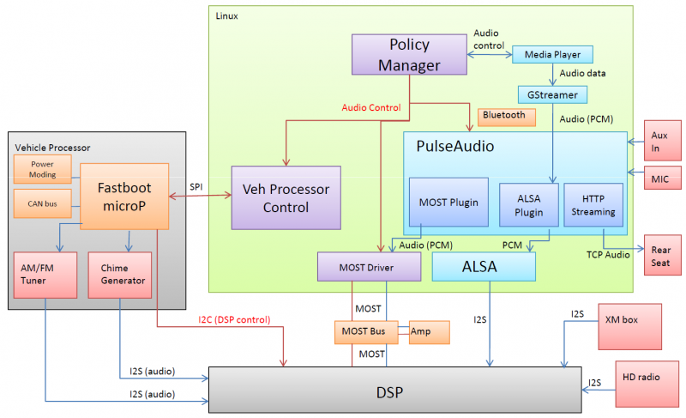
MeeGo IVI Audio Architecture
Courtesy Laci Jalics, Delphi.

Slide 34
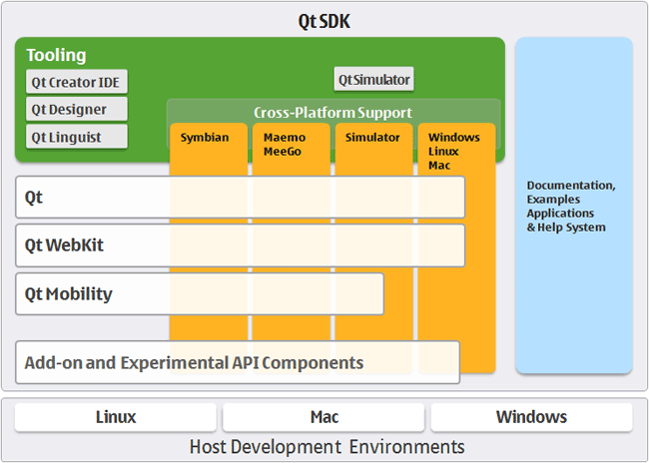
How about MeeGo?
MeeGo = lightweight GNU/Linux with a Qt face.

Slide 35
MeeGo-IVI on Atom and ARM Demo HW
No SW support for HW available to small-medium businesses.
Running IVI on ExoPC requires a mash-up of “Tablet Preview” and IVI UXes.
Meego-ivi repos support EMGD graphics only
  “zypper update” auto-overwrites drivers and X11 SO libraries.
Stopped work on ARM-based Pandaboard due to missing graphics driver.

Slide 36
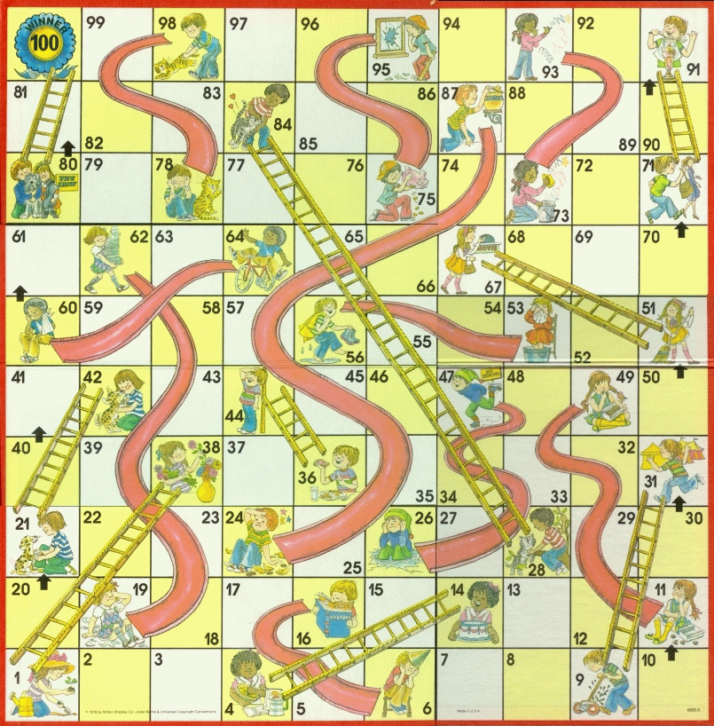
MeeGo Hardware Adaptation Process
Maybe not
that kernel
Update from
wrong repo
Use installer
defaults
Hand-craft
extlinux.conf
Multi-hour
“zypper up”

