Slide 1
Two C++ Tools*
Compiler Explorer and Cpp Insights
Alison Chaiken
alison@she-devel.com
Jan 23, 2020
*with a brief excursion into HW exploits

Slide 2
Overview
Compiler Explorer and Cpp Insights look under the hood of C++ compilation.
  Both kick off a compiler within the browser and show side-by-side source and output.
  Both can be locally hosted.
Compiler Explorer produces assembly output.
Cpp Insights shows the output from the clang parser (specifically AST converted back to C++).

Slide 3
Compiler Explorer Basics
Supports GCC and Clang plus many more.
Multiarch including many ARM flavors.
Arbitrary compiler options are supported.
Settles a lot of arguments about what the compiler actually does.
Has a wiki, FAQ.

Slide 4
CE example: the “Spectre” exploit
Many security holes involving speculation execution by processors disclosed in recent years.
Exploits now exist “in the wild.”
CE illustrates how the “retpoline” fix for C++ indirect branch speculation works.

Slide 5
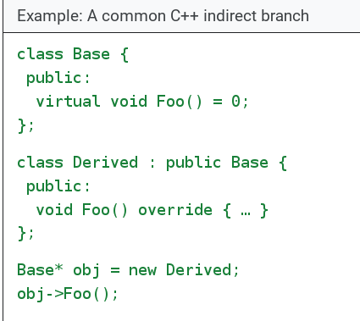
C++ Indirect Branch

Slide 6
The fix: “retpoline”
trampoline: intermediary function that execution bounces off
Takes advantage of the fact that in modern ISAs, “function return is itself an indirect branch. However, unlike other indirect branches, its target may be directly cached for exact future prediction at the point of function call.”[source]
retpoline strategy: make sure that a do-nothing branch keeps the processor busy so that the desirable branch has a chance to look up the correct address.

Slide 7
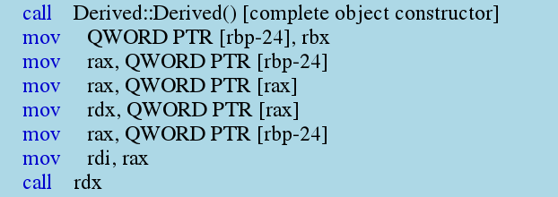
ASM without a retpoline

Slide 8
With GCC and -mindirect-branch=thunk
Demo: -mindirect-branch=thunk
Clear or set this option to see the code
with or w/o the retpoline.

Slide 9
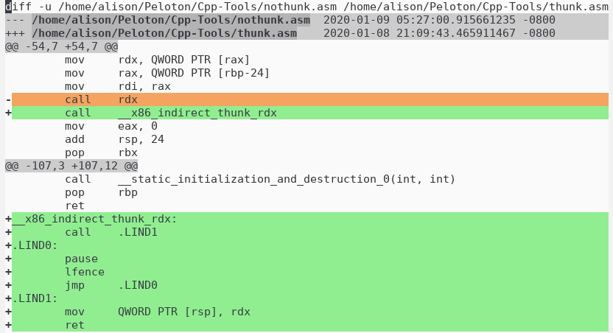
Diff with -mindirect-branch=thunk

Slide 10
Cpp Insights Basics
Clang only.
Support for various C++ versions.

Slide 11
Demo with template and lambda instantiation

Slide 12
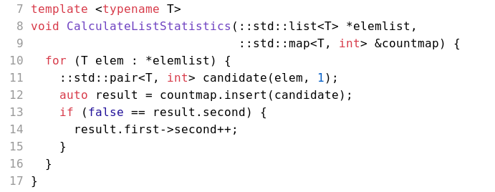
How does the preprocessor resolve auto?
Maybe std::pair<T *, bool> result; ?

Slide 13
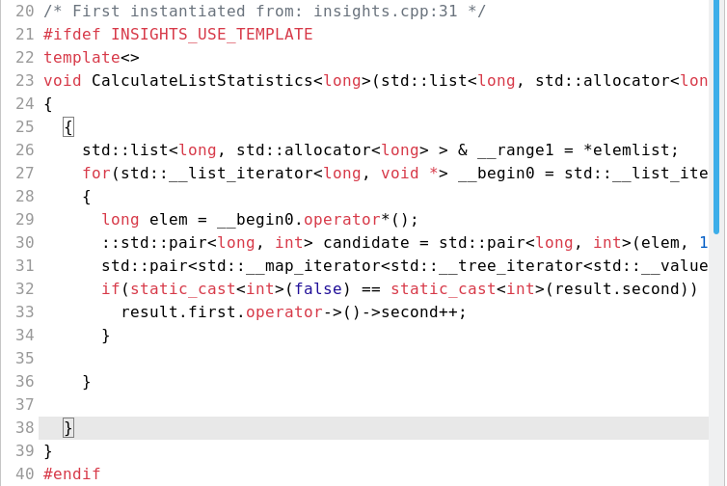

Slide 14
The result of template instantiation
The answer:
std::pair<std::__map_iterator<std::__tree_iterator<std::__value_type<long, int>, std::__tree_node<std::__value_type<long, int>, void *> *, long> >, bool> result

Slide 15
Freestanding Lambda Expressions are Classes
class __lambda_19_16
{
public:
inline long operator()() const
{ return (random() % static_cast<long>((ELEMNUM - 1))); }
using retType_19_16 = auto (*)() -> long;
inline operator retType_19_16 () const noexcept
{ return __invoke; };
private:
static inline long __invoke()
{ return (random() % static_cast<long>((ELEMNUM - 1))); }
};
__lambda_19_16 GetRand = __lambda_19_16(__lambda_19_16{});

Slide 16
Example: macros vs. constexpr
Demo: first CppInsights,
then CompilerExplorer

Slide 17
Comparison: constexpr vs. C-style macro
The input code:
#define CUBE(X) ((X) * (X) * (X))
constexpr Complex cubeme(const Complex &x) { return x * x * x; }

Slide 18
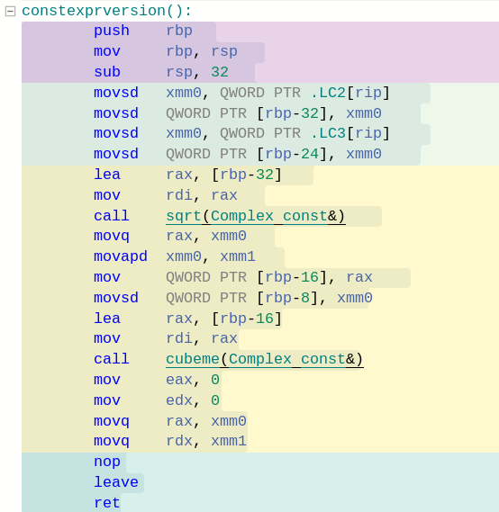
with constexpr
Calls sqrt() and
cubeme() function each 1x.

Slide 19
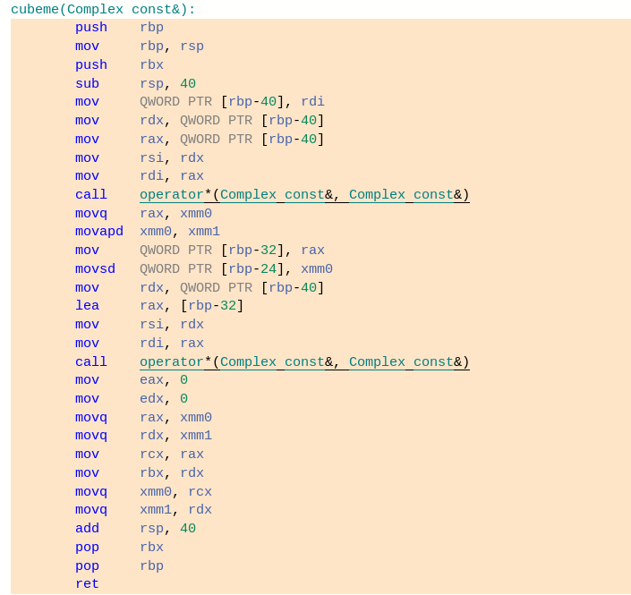
constexpr code calls operator*()
2x, for a total of 1 sqrt() and 2 operator*() calls.

Slide 20
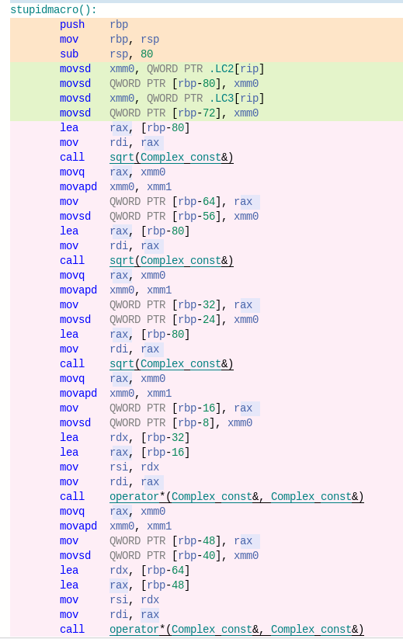
C-macro code calls sqrt() 3x and
operator*() 2x.

Slide 21
Summary
Compiler Explorer and Cpp Insights make differences among compilers, compiler options and arches easier to understand.
Pasting code into them is fast and painless.

