Slide 1
Best practices for long-term support and security of the device-tree
Alison Chaiken
Mentor Embedded Software
October 24, 2013
alison_chaiken@mentor.com

Slide 2
Agenda
How DT complicates updates
Strategies for updates including DTBs
Best practices in creating DTS
Tools to make DT comprehensible to non-experts
Best-practice summary

Slide 3
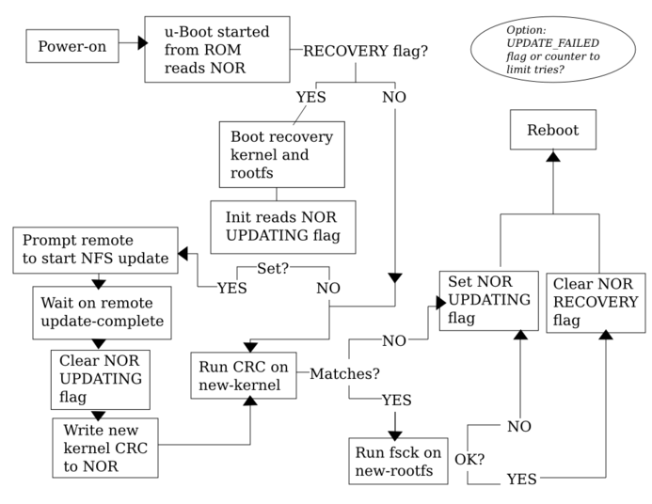
Updates are already tricky without DTB

Slide 4
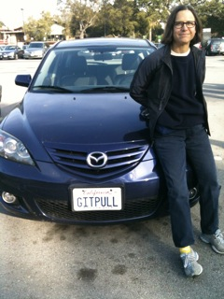
Consider security patch in 2025 for 2015MY car
New kernel needed; will device-tree update be required?
How to match and manage the files?

Slide 5
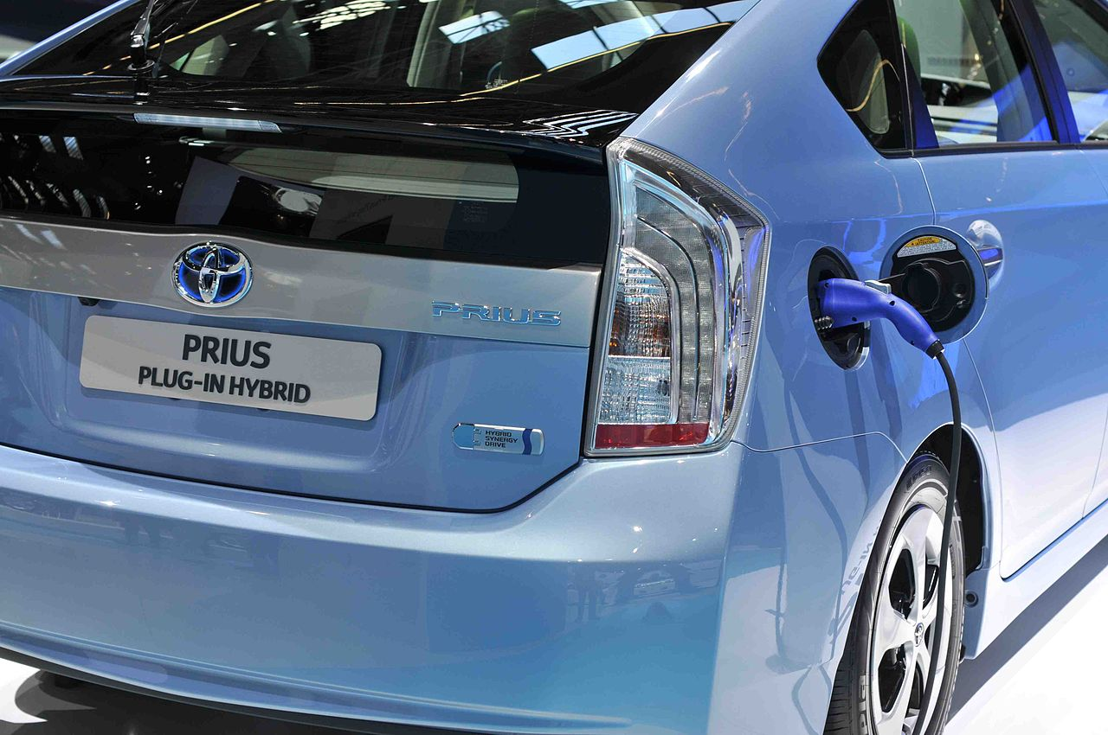
Advocate changing DTB? No, but . . .
Consider battery upgrades: many MCUs.
2013MY: 5-year battery warranty.
DT's are supposed to be HW description.
Lots of configuration already in DT's:
  MTD partition tables; boot device selection; pinmux.
Newer kernels have features old DTs won't support.

Slide 6

Why DTB updates
are hard

Slide 7
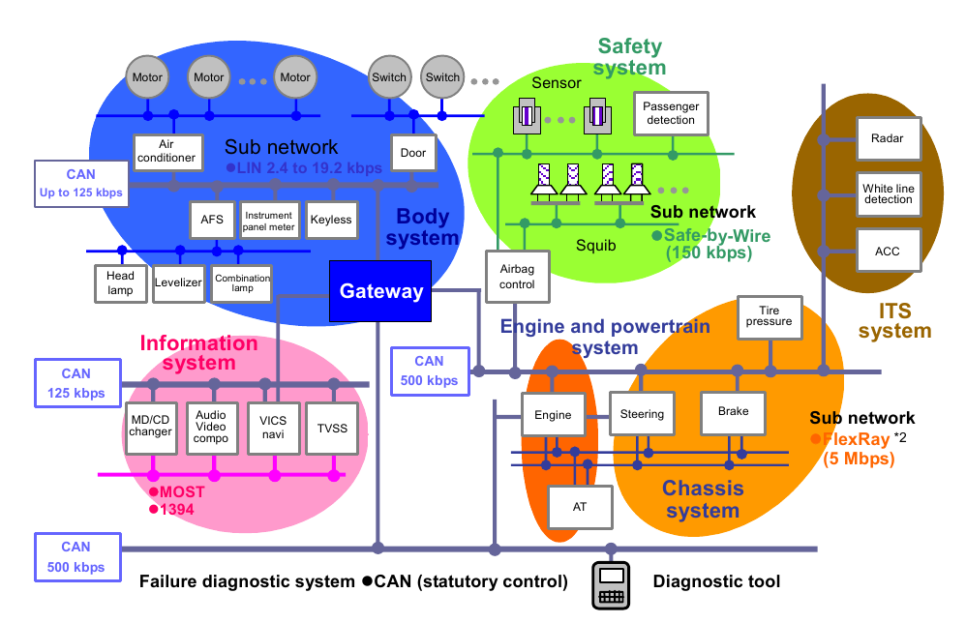
Multiple processors in a LAN may need update
Copyright Renesas, “Introduction to CAN”, with permission.
2014 Mercedes S-Class: 200 MCUs on Ethernet, CAN-FD and LIN.

Slide 8


Careful: DTS and Kconfig must be compatible
Drivers move and CONFIG options change name over time.

Slide 9
Unintentionally changing drivers
Obvious: driver behavior is modified when its DT node is.
Less obvious: Driver behavior changes if clock, pinmux or PS voltage are modified by another driver's DT node.
Koen Kooi:
  “IMPORTANT: booting the existing am335x-bone.dts will blow up the HDMI transceiver after a dozen boots with an uSD card inserted because LDO will be at 3.3V instead of 1.8. MMC support for AM335x still isn't in . . .”

Slide 10
Three possible approaches

Slide 11
Flattened Image Tree addresses LTS problems
.its files record versions of DTS, kernel, misc. files and their CRCs.
Enables OTA with one transferred archive.
ChromeOS “Verified Boot” provides extensions for signed images.
Glass added signing of .itb's to U-boot.
Introduced by Fernandes at ELC2013.
Alternative: record selections in Bitbake recipe or Android-like manifest.

Slide 12
DTS runtime configurability via Overlays
Implements hot-plug for “capes”.
Proposal: use overlays as a DTB update method.
  Not suitable for security improvements or boot devices.
  Similar in spirit to unionfs in Knoppix.
See Pantelis' talk and paper.

Slide 13
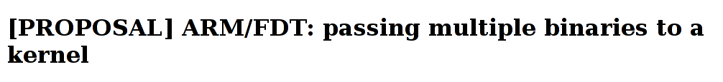
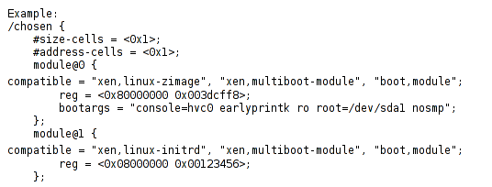
Hypervisors in device-tree
From: Andre Przywara Date: Tue, 03 Sep 2013
Another path to safe updates?

Slide 14
Making DTS more maintainable

Slide 15
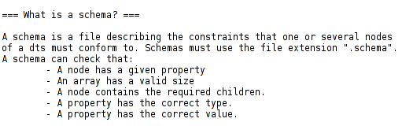

Slide 16
Proposal: explicit inheritance in design
Create schemata matching device classes: board,
cpu, platdev, <arch>
  Each CPU node would validate against cpu.schema,
  each ARM core node against arm.schema,
  each V4L2 camera against v4l2_capture.schema.
Validated DTSI compiled into top-level DTS.
New validator enforces inheritance.

Slide 17
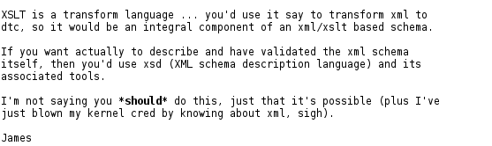
Consider XML for DT schema?
Suggested on LKML by Arend van Spriel
Lots of existing manipulation tools for XML.
Reaction basically favorable:

Slide 18
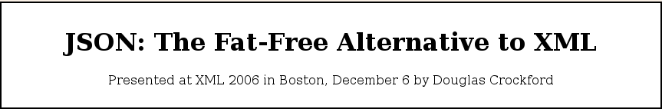
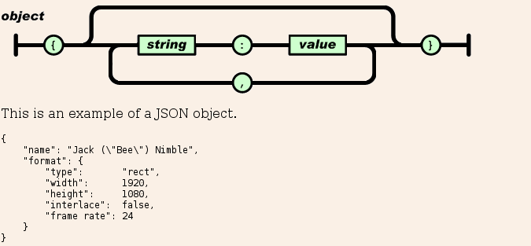
“JSON is a natural representation of data for the C family of programming languages.”
"translated into Chinese, French, German, Italian, Japanese, Korean,
and Spanish. . . . formalized in RFC 4627. . . . support for . . . C, C++, C#, . . . Erlang, Haskell, Java, . . . Lua, Perl, Objective-C, . . . PHP, Python,. . . Ruby, ."

Slide 19
Level separation
Explicit inheritance in nesting of device-trees:
Decisions about shared resources in low-level include files = premature optimization!
Caution with status “okay”, “chosen,” “config-on-boot” and configuration of (power-supply, pinmux and clocks) at “leaf” level.
$ grep okay linux/arch/arm/boot/dts/*dtsi | wc
181 732 11530
$ grep chosen linux/arch/arm/boot/dts/*.dtsi | wc
22 80 1103

Slide 20
Tools: existing and desirable
DTC extensions for schema validation.
Verbose mode for DTC.
Tools to answer the questions:
  “Do my Kconfig and DTS match?”
  “Which of this huge set of DTS files can produce the DTB in the shipping product?”
lshw-like tool to present /proc DT state.
Graphviz/dotty extensions to visualize FDT.
Support for signing DTBs which are not appended.
Put dt.gz in /boot along with other config.gz?

Slide 21
What DTS output does preprocessor produce? makedts for ARM and x86
Advantage over fdtdump: outputs strings as characters, not
ASCII codes.
Invoke with 'makedts <full-path-to-dts-file>' :
#!/bin/bash
DTC_CPP_FLAGS="-E -Wp,-MD,$BASE.pre.tmp -nostdinc /
-Iarch/$SRCARCH/boot/dts -Iarch/$SRCARCH/boot/dts/include /
-undef -D__DTS__ -x assembler-with-cpp"
#run C preprocessor
$CC $DTC_CPP_FLAGS -o $BASE.tmp $1
#run DTC
scripts/dtc/dtc -O dts -o $BASE.out.dts -b 0 -i arch/arm/boot/dts /
-d $BASE.dtc.tmp $BASE.tmp
For x86, script first compiles dtc itself.

Slide 22
Summary: Best practice candidates
Preserving sets of {bootloader configs, DTS sets, Kconfig and kernel sources}
  FIT? BB recipes? Android-style “repo” manifests?
Validation of device-trees:
  Via new schemata and Warren's binding checklist.
  CRC-based via bootloader.
Design of maintainable device-trees via
  Level separation.
  Overlays as update mechanism to failsafe DTB.
  Update into hypervisor domains.

Slide 23
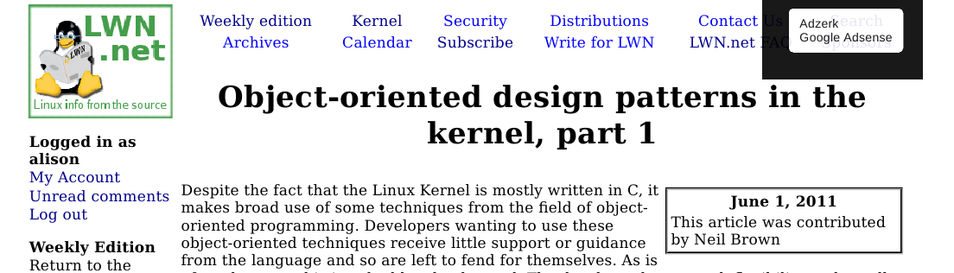
Conclusions
DT = application of agreed best practices to kernel.
Much criticized, but change is hard!

Slide 24
Following slides are extras

Slide 25
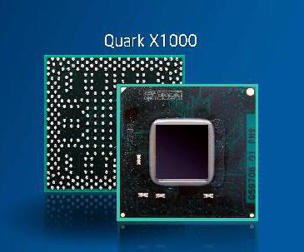

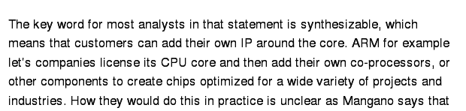
x86 users will want DTS, too
GigaOm, 9/10/2013

Slide 26
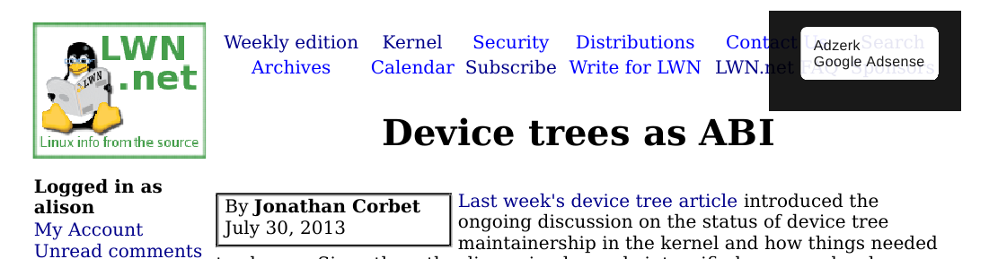
Implications of “Device trees as ABI”
Export all bindings to header file?
Put dt.gz in /boot along with other config files?
Warn about unstable bindings with dtc or require explicit dtc switch to include unstable bindings?

Slide 27
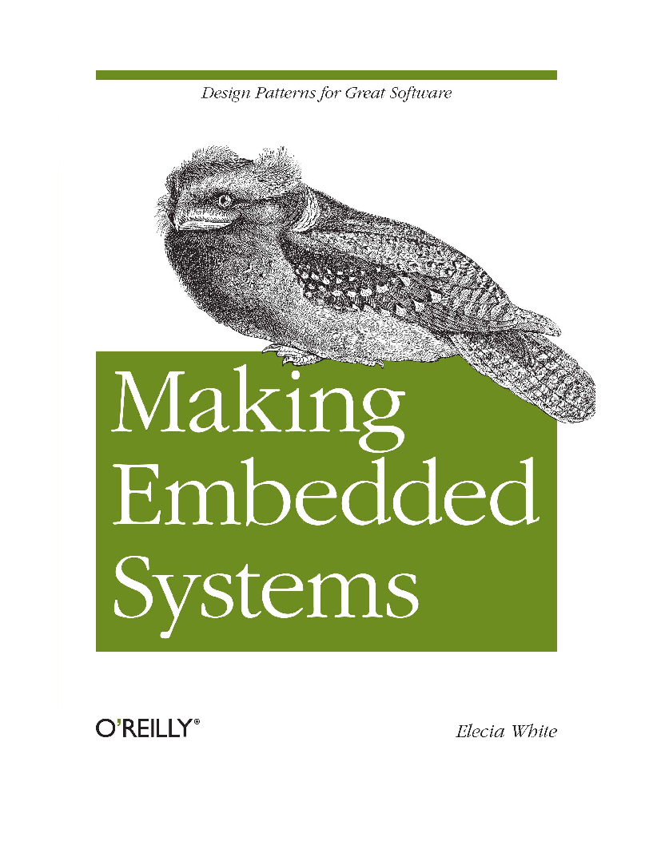
A book about design patterns for embedded

Slide 28
Uncle Bob Martin's 5 Agile Design Principles
Dependency Inversion Principle
Interface Segregation Principle
Liskov Substitution Principle
Open-Closed Principle
Single Responsibility Principle
From 1998, C++ Report, available at objectmentor.com

