Slide 1
Best practices for long-term support and security of the device-tree
Alison Chaiken
Mentor Embedded Software
October 24, 2013
alison_chaiken@mentor.com

Slide 2
Agenda
How DT complicates updates
Strategies for updates including DTBs
Best practices in creating DTS
Tools to make DT comprehensible to non-experts
“Coming attractions”

Slide 3
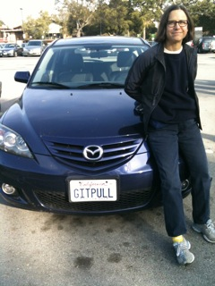
2005 Model Year car is not easily updated
2015MY car will get new kernels;
also updated device-trees?

Slide 4
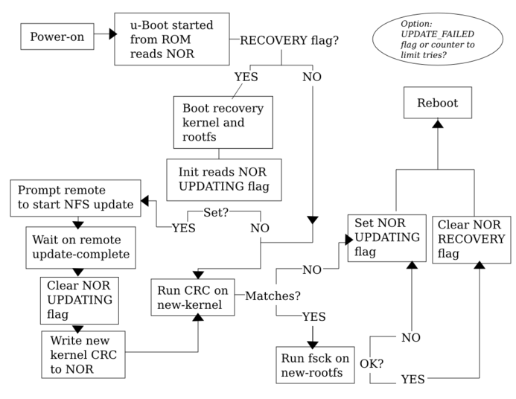
Updates are already tricky without DTB

Slide 5
Consider security patches for Trusted Platform Module
2015MY car in 2025
  one of 30 models that year, now 300 products ago
  different by locality
Needs a new kernel that stops the published exploit.
Does it need a new device-tree too?
  Maybe not if “device-tree is an ABI”?
  But even so, 10 years later?
How to update DTB?
Updated DTB may need new shared-object libs or firmware.
“Range anxiety” means power updates also likely.

Slide 6
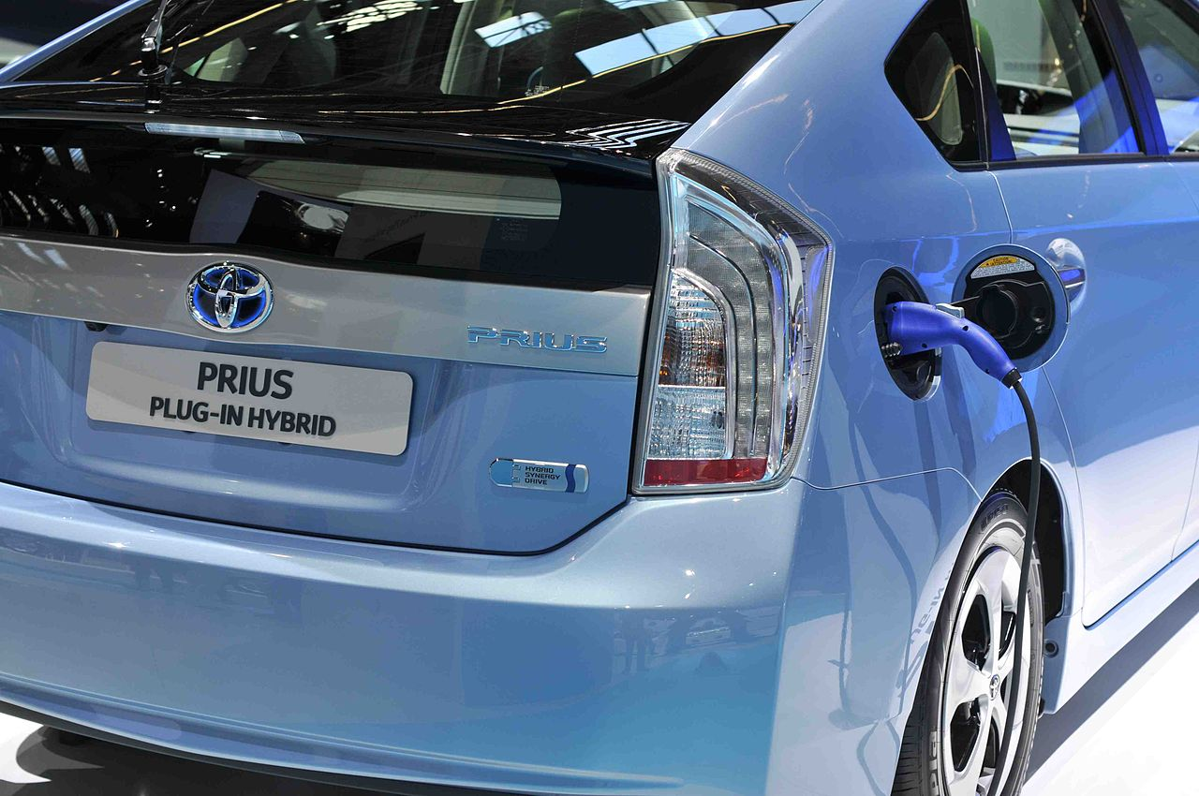
Advocate changing DTB? No, but . . .
Consider battery upgrades:
many MCUs
2013MY: 5-year warranty
DT's are supposed to be HW description
Consider the amount of configuration already in DT's: MTD partition tables; boot device selection; allocation of oversubscribed resources

Slide 7

Why DTB updates
are hard

Slide 8
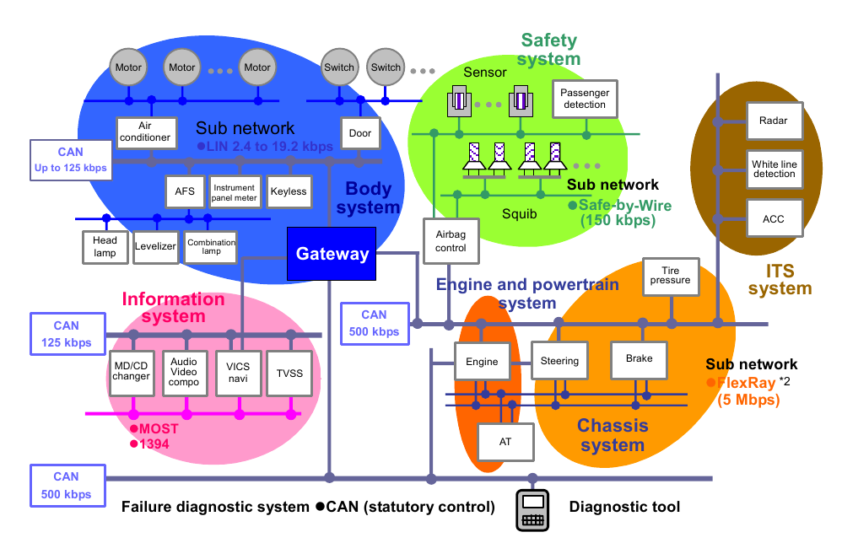
Multiple processors in a LAN may need update
Copyright Renesas, “Introduction to CAN”, with permission.

Slide 9

Careful: DTS and Kconfig must be compatible

Slide 10
Unintentionally changing drivers
Obvious: device driver behavior is modified every time its DT node is.
Not so obvious: A device driver is modified every time its clock, pinmux or power supply voltage are, perhaps by another driver's DT node.
Koen Kooi's example:
  “IMPORTANT: booting the existing am335x-bone.dts will blow up the HDMI transceiver after a dozen boots with an uSD card inserted because LDO will be at 3.3V instead of 1.8. MMC support for AM335x still isn't in . . .”
Scary for long-term support.

Slide 11
Three possible solutions

Slide 12
Fernandes @ ELC2013: Flattened Image Tree
Addresses many of the toughest LTS problems.
.its files record versions of DTS, kernel, misc. files via CRC.
  Alternatively, use Bitbake recipe or Android-like manifest
Enables OTA with one transferred archive.
ChromeOS “Verified Boot” provides extensions for signed images.
ChromeOS' Simon Glass added support for signing to Das U-boot.

Slide 13
DTS runtime configurability via Overlays (P. Antoniou)
Overlays, like udev, implement hot-pluggability.
  Intended for daughter-cards.
Overlay hardware can be added at runtime.
  but only DTB fragments compiled along with dependencies from original DTS.
  A limitation but a security feature, too.
Proposal: use overlays as a method to update DTBs.
  Not suitable for security improvements or boot devices.
  Similar in spirit to unionfs in Knoppix.
See Pantelis' talk and “Beaglebone and the 3.8 Kernel” paper.

Slide 14
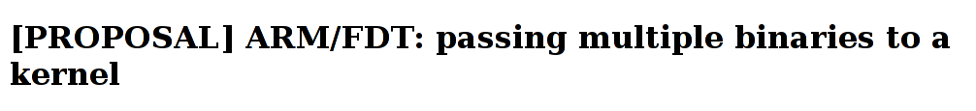
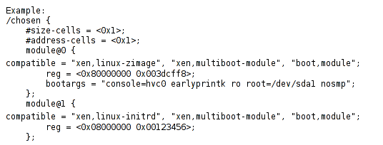
Hypervisors in device-tree
From: Andre Przywara Date: Tue, 03 Sep 2013
Another path to safe updates?

Slide 15
Making DTS more maintainable

Slide 16
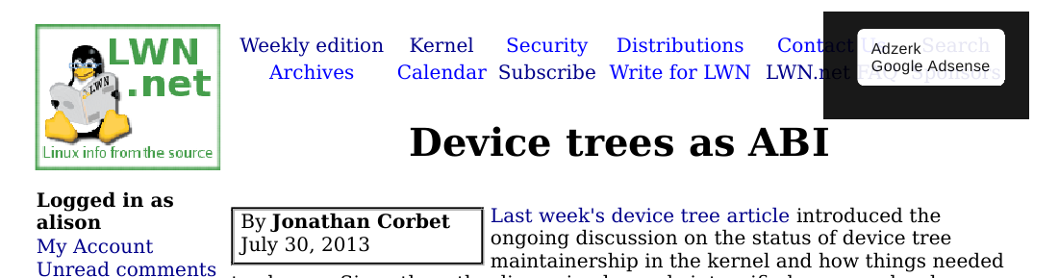
Implications of “Device trees as ABI”
Export all bindings to header file?
Put dt.gz in /boot along with config files?
  Or friendly lshw-like tool to present /proc DT state.
Warn about unstable bindings with dtc or require explicit dtc switch to include unstable bindings?

Slide 17
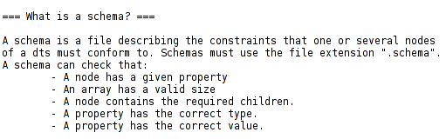

Slide 18
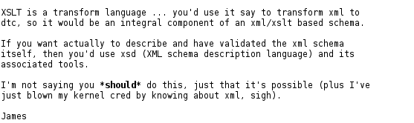
Consider XML for DT schema?
Suggested on LKML by Arend van Spriel
Lots of existing manipulation tools for XML.
Reaction basically favorable:

Slide 19
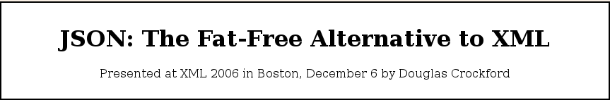
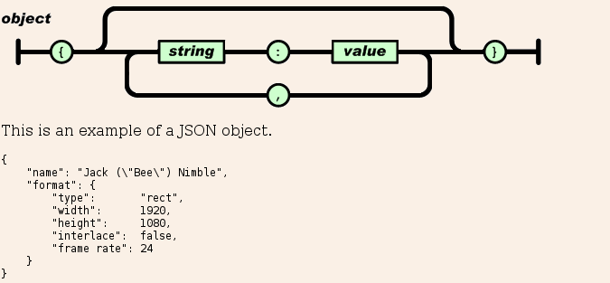
“JSON is a natural representation of data for the C family of programming languages.”
"translated into Chinese, French, German, Italian, Japanese, Korean,
and Spanish. . . . formalized in RFC 4627. . . . support for . . . C, C++, C#, . . . Erlang, Haskell, Java, . . . Lua, Perl, Objective-C, . . . PHP, Python,. . . Ruby, ."

Slide 20
Proposal: explicit inheritance in design
Create board.schema, cpu.schema, platdev.schema, <arch>.schema to represent base classes.
  Each CPU nodewould need to validate against cpu.schema
  each ARM platform against arm.schema,
  each V4L2 camera device node against v4l2_capture.schema
  Et cetera
New DTC validator could enforce the inheritance for in-tree DTS.

Slide 21
Level separation
Explicit inheritance in nesting of device-trees:
Decisions about shared resources in low-level include files = premature optimization!
Caution with status “okay”, “chosen,” “config-on-boot” and configuration of (power-supply, pinmux and clocks) at “leaf” level.
$ grep okay linux/arch/arm/boot/dts/*dtsi | wc
181 732 11530
$ grep chosen linux/arch/arm/boot/dts/*.dtsi | wc
22 80 1103

Slide 22
Tools: existing and desirable
Extensions to DTC to support schemata validation.
Verbose mode for DTC.
Tools to answer the questions:
  “In which DTSI file does a wrong value originate?”
  “Do my Kconfig and DTS selections match?”
  “Which of this huge set of DTS files can produce the DTB in the shipping product?”
Support for signing DTBs which are not appended.
Centralized registry for all “stable” and “staging” bindings.
Graphviz/dotty extensions to visualize FDT.

Slide 23
What DTS output does preprocessor produce? makedts for ARM and x86
Advantage over fdtdump: outputs strings as characters, not
ASCII codes.
Invoke with 'makedts <full-path-to-dts-file>' :
#!/bin/bash
DTC_CPP_FLAGS="-E -Wp,-MD,$BASE.pre.tmp -nostdinc /
-Iarch/$SRCARCH/boot/dts -Iarch/$SRCARCH/boot/dts/include /
-undef -D__DTS__ -x assembler-with-cpp"
#run C preprocessor
$CC $DTC_CPP_FLAGS -o $BASE.tmp $1
#run DTC
scripts/dtc/dtc -O dts -o $BASE.out.dts -b 0 -i arch/arm/boot/dts /
-d $BASE.dtc.tmp $BASE.tmp
For x86, first compile dtc itself.

Slide 24
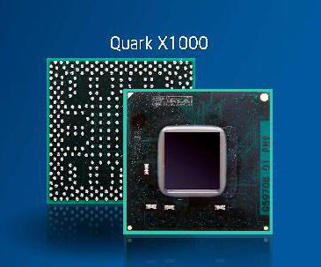
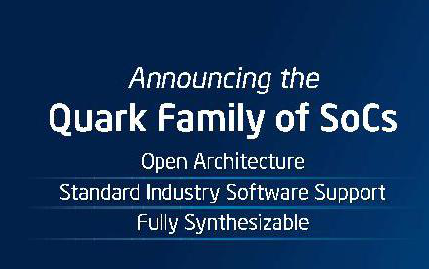
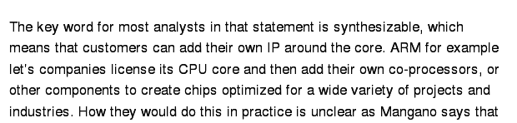
x86 users will want DTS, too
GigaOm, 9/10/2013

Slide 25
Summary: Best practice candidates
Preserving sets of {bootloader configs, DTS sets, Kconfig and kernel sources}
  FIT? BB recipes? Android-style “repo” manifests?
Validation of device-trees:
  DTC-based via new schemas and Warren's binding checklist.
  CRCs via bootloader
Design of maintainable device-trees via
  Level separation
  Overlays and conditionals rather than DTS proliferation.
Preserve failsafe device-tree
  Updates via overlay and into hypervisor domains

Slide 26
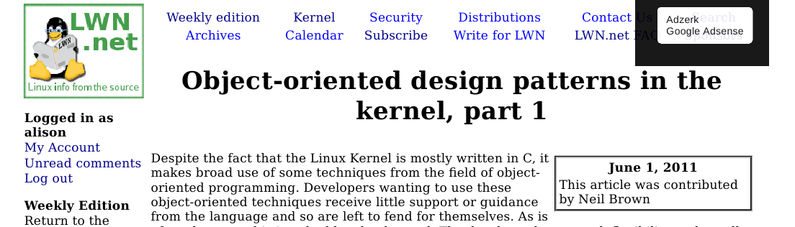
Conclusions
DT represents application of SW best practices to the kernel.
Much criticized, but change is hard!

Slide 27
Following slides are extras

Slide 28
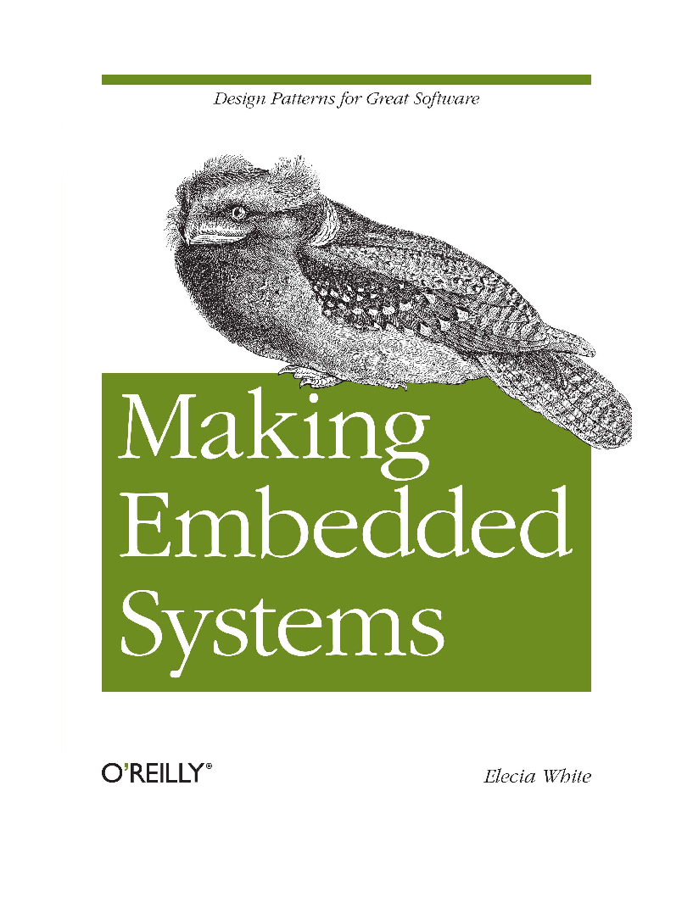
A book about design patterns for embedded

Slide 29
Uncle Bob Martin's 5 Agile Design Principles
Dependency Inversion Principle
Interface Segregation Principle
Liskov Substitution Principle
Open-Closed Principle
Single Responsibility Principle
From 1998, C++ Report, available at objectmentor.com

