Slide 1
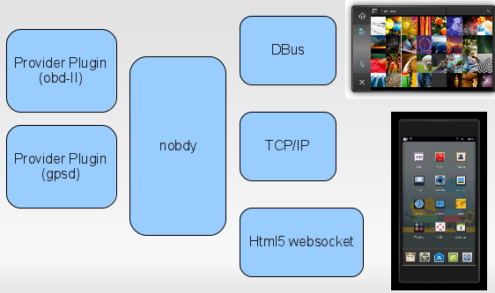
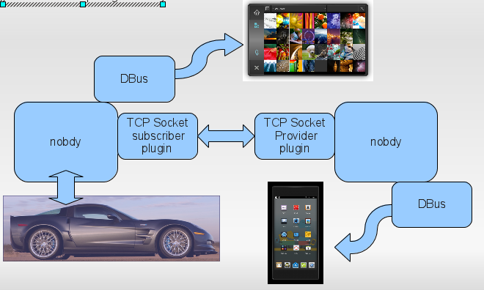





Automotive Open Source Middleware
Extensible plugin framework (nOBDy) + libraries ( libOBD) +
components (OBDGPSLogger) = rapid vehicle SW development
Alison Chaiken (alchaiken@gmail.com, http://she-devel.com/)
for nOBDy, libOBD, OBDref and OBDGPSlogger teams (#linuxice on freenode)
nOBDy = vehicle data abstraction service and multiplexing daemon
obdsim from
obdgpslogger
The closer to metal, the more important source code and standards.
Manufacturer | Confirmed shipping system | Architecture
Fiat-Chrysler Blue&Me (500, Delta), Kia Uvo (Sorento) | Microsoft Windows Embedded Automotive
Ford (all?) | MyTouch/Sync-Microsoft; OpenXC-Android | Cortex A8
General Motors/Cadillac User Experience | MontaVista Linux | ARM11 600 MHz
Geely (China); Hawtai (China) | Linux: Moblin (MeeGo-Tizen precursor) | Atom E6xx
Renault R-Link | Android
Honda (Accord, Odyssey, Pilot), Audi (A8L, Q5, A6), BMW (7-series and M models), Chrysler, Daewoo, GM (OnStar), Hyundai, Land Rover, Porsche, Saab (9-3) Renault (SM7) | QNX
sqlite3 DB
from actual trip
Source: OEM
or OS vendor
website or
press release,
linuxdevices.com,
iSuppli tear-down.
Browser
nOBDy is a plugin framework with language-agnostic API that includes
GPS, D-Bus, tcp and bluetooth plugins and a websocket/HTML5 interface.
OBDII: in U.S. vehicles since 1996. Event Data Recorders: in 2015.
Use cases:
Integrate mileage, speed, performance data with driver's life.
Share via V2V and V2I ad hoc and mesh networking (802.11p, UMTS).
Mine data to improve safety, reduce costs and save time.
nOBDy, libOBD and OBDGPSLogger are GPL'ed deb packages.
ExoPC Atom slate running Ubuntu IVI Remix and featuring the nOBDy
websocket gauges software created by tripzero (Kevron Rees) and making
use of OBDGPSlogger suite's obdsim created by Chunky (Gary Briggs) with
data transport provided by libobd created by malcom2073 (Michael Carpenter).
OBDref
libOBD
nOBDy
OBDGPSlogger
Ubuntu
IVI Remix

