Slide 1
Tuning systemd for Embedded
Alison Chaiken
alison_chaiken@mentor.com
Mar. 23, 2015
Latest version: http://she-devel.com/ELC_systemd.pdf
Auxiliary files: http://she-devel.com/ELC_auxiliary.tar.bz2
Text in blue is hyperlinked.

Slide 2
?
?
?
Quiz:
what is the most widely used
Linux init system?
?
?
?
?
?

Slide 3
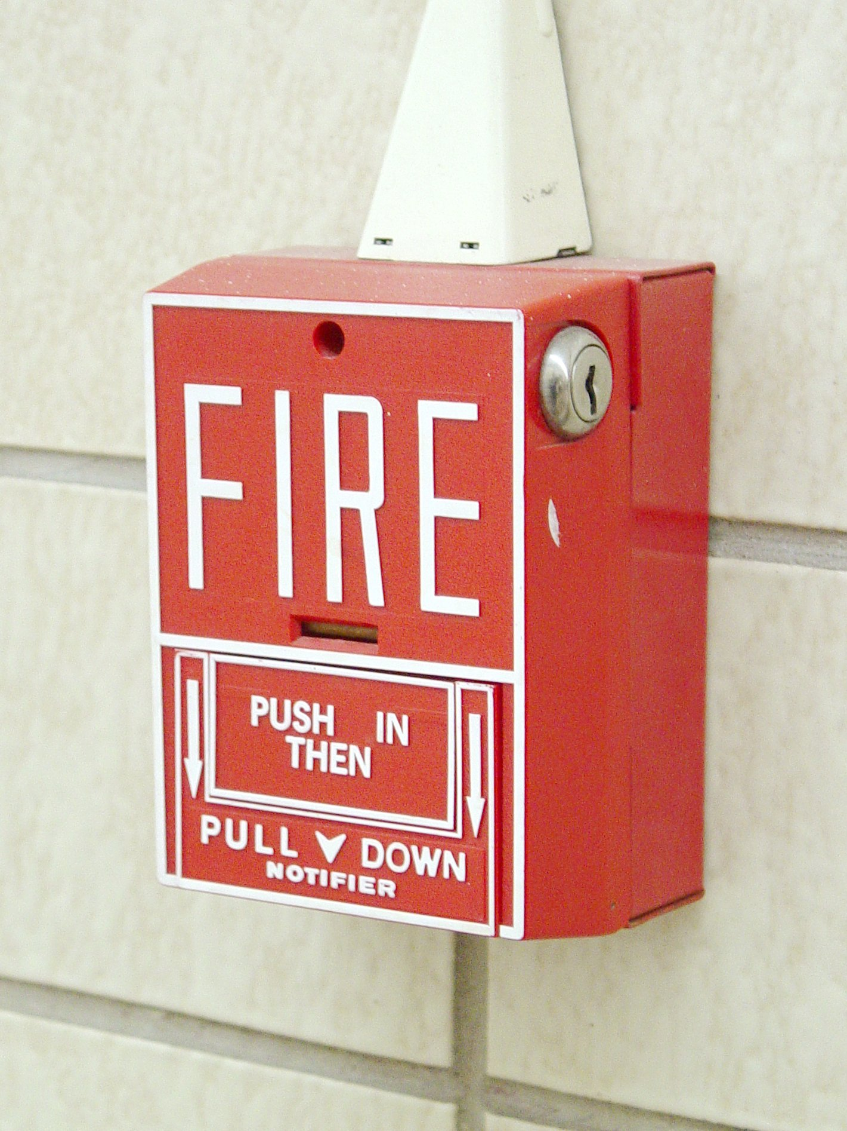
Linux needs to keep innovating
“No one has a guaranteed position in the technology industry.” -- Bill Gates, Pirates of Silicon Valley
“The only thing that can ever hurt Linux is Linux itself.” -- GKH, Linux Action Show
“Success is a self-correcting phenomenom.” -- Gary Hamel
Licensed under CC BY-SA 3.0 http://commons.wikimedia.org/wiki/File:Fire-lite-bg-10.jpg#mediaviewer/File:Fire-lite-bg-10.jpg

Slide 4
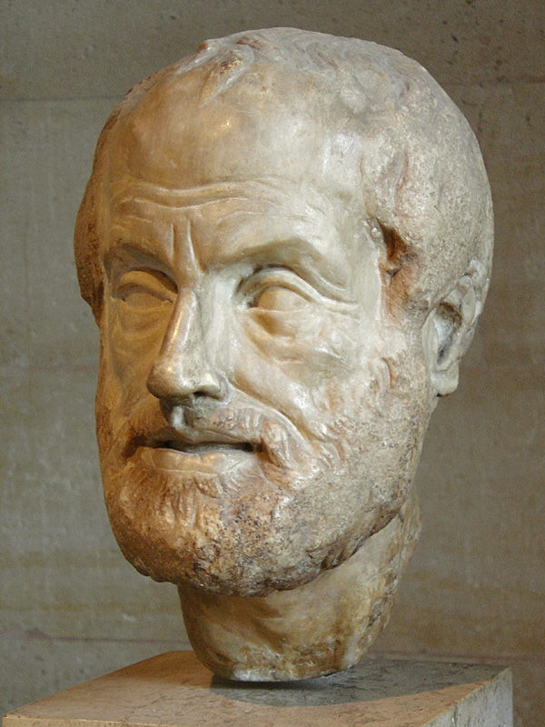
Philosophy of systemd
Extract duplicate functionality from daemons and move it to systemd core or kernel.
Replace /etc scripts with declarative config files.
Expose newer kernel APIs to userspace via a simple interface.

Slide 5
systemd is:
modular;
asynchronous and concurrent;
described by declarative sets of properties;
bundled with analysis tools and tests;
features a fully language-agnostic API.

Slide 6
One daemon to rule them all
xinetd: a daemon to lazily launch internet services when activity is detected on an AF_INET socket
systemd: a daemon to lazily launch any system service when activity is detected on an AF_UNIX socket (oversimplification)

Slide 7

Complexity arising from many similar small units

Slide 8
init.d scripts ⇒ systemd units
Unit's action and parameters: ExecStart=
Dependencies: Before=, After=, Requires=, Conflicts= and Wants=.
Default dependencies:
  Requires= and After= on basic.target;
  Conflicts= and Before= on shutdown.target.
Conditionals: ConditionPathExists, ConditionPathIsReadWrite!=
Types of unit files: service, socket, device, mount, scope, slice, automount, swap, target, path, timer, snapshot

Slide 9

sysVinit runlevels ≈ systemd targets
Targets are synchronization points.
Check /lib/systemd/system/runlevel?.target symlinks:
multi-user.target (runlevel 3 == text session)
graphical.target (runlevel 5 == graphical session)
Select boot-target :
  via /etc/systemd/system/default.target symlink;
  appending number or systemd.unit=<target> to bootargs.

Slide 10
plus: intuitively exposes kernel interfaces
Including Capabilities, Watchdog, Cgroups and kdbus ('coming attraction')
Kernel features configurable via simple ASCII options in unit files.
Encourages creation of system policies via unit templates.

Slide 11
systemd and cgroups
cgroups are a kernel-level mechanism for allocating resources: storage, memory, CPU and network.
slices are groups of daemons whose resources are managed jointly.
systemd scopes are resultant groups of user processes.
Can set BlockIOWeight, IOSchedulingPriority, OOMScoreAdjust, CPUShares, MemoryLimit …
Demo Example: limiting memory usage of Firefox.

Slide 12
systemd and security: granular encapsulationvia kernel's capabilities
CapabilityBoundingSet
PrivateTmp, PrivateDevices, PrivateNetwork
JoinNamespaces
ProtectSystem (/usr and /etc), ProtectHome
ReadOnlyDirectories, InaccessibleDirectories
systemd-nspawn: systemd's native containers
Demo Example: limiting privileges of root-initiated program

Slide 13
systemd and watchdogs
Support for soft or hard watchdogs
RuntimeWatchdogSec sets a timer for petting the dog
ShutdownWatchdogSec sets a timer to force reboot if shutdown hangs
Demo Example: systemd and softdog

Slide 14
resource utilization
systemd-211 in Poky includes 17 packages = 8 MB.
systemd-219 builds 90 MB of executables (not all needed).
minimal build = systemd, udevd and journald.
Memory (RSS) of fully featured build: ≈9 MB; minimum build ≈5 MB.
Features added/removed via './configure'.
Get rid of D-Bus, syslog and bash?

Slide 15
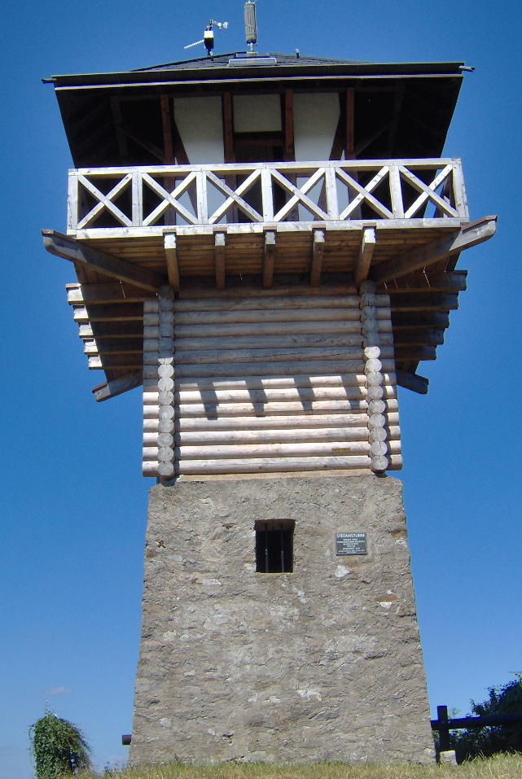
using the systemd journal
Easily pushed to a remote.
Can be cryptographically 'sealed'.
Configurable max size and rotation.
Log-reading tools are simple:
journalctl -xn
journalctl -p err
journalctl -u cron
journalctl -o json-pretty
systemctl status
systemctl is-failed bluetooth
systemctl --failed

Slide 16
Other embedded-relevant features
Support for read-only rootfs
Remote journaling via HTTP requests
Coredumpctl:
  read last core file
  read stack trace automatically written to journal
Timesyncd: lightweight network-time daemon
'systemctl snapshot' captures state to which the system can be restored

Slide 17

systemd prevents self-injury!
Test out new units by trying them:
  in /run
  in *.conf.d directory
  via bootargs
No need ever to modify files in /lib/systemd.
Services linked into basic.target.wants (≈runlevel 1) that won't work until graphical.target (runlevel 5) will start properly if their dependencies are correctly stated.

Slide 18

systemd and backwards compatibility

Slide 19
system updates
Ye Good Olde Days:
-- update kernel and modules
-- separately update root fs
Newfangled:
-- update kernel and modules
-- update device-tree
-- separately update root fs

Slide 20
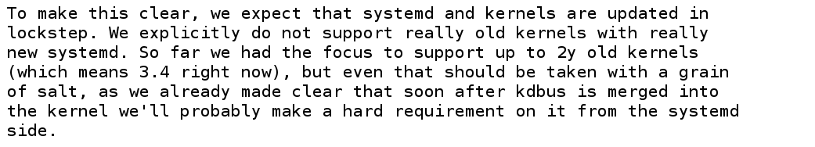

Slide 21
New system updates?
Old:
-- update kernel and modules
-- separately update root fs
New:
-- update kernel and modules
-- update device-tree?
-- separately update root fs
Newer:
-- update kernel and modules
-- update device-tree?
-- update systemd?
-- separately update root fs

Slide 22
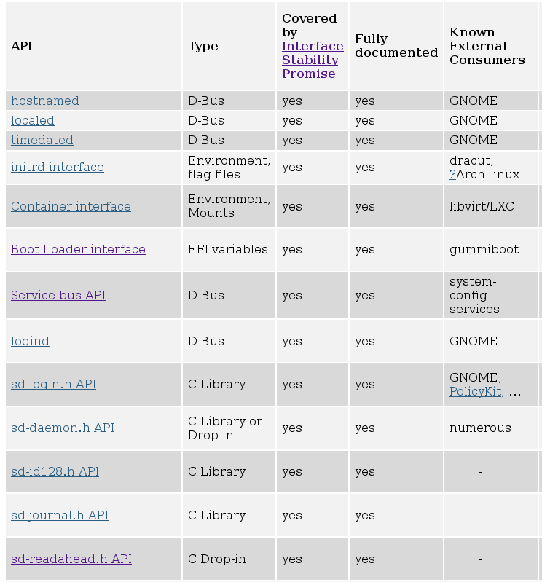
systemd's 'Interface Portability and Stability Chart'
Deprecated!

Slide 23

developing systemd
git clone git://anongit.freedesktop.org/systemd/systemd
systemd-devel list: submit patches or ask questions
Featureful utility library in src/shared/
#define streq(a,b) (strcmp((a),(b)) == 0)
#define strneq(a, b, n) (strncmp((a), (b), (n)) == 0)
#define strcaseeq(a,b) (strcasecmp((a),(b)) == 0)
#define strncaseeq(a, b, n) (strncasecmp((a), (b), (n)) == 0)
Complex autotools build system, many dependencies.
'Plumbing' dev tools in /lib/systemd, 'porcelain' tools in /bin

Slide 24
Summary
Systemd has:
  a superior design;
  tight integration with the Linux kernel;
  a vibrant developer community.
systemd is the less stable part of kernel's ABI.
Mostly things will 'just work'.
systemd exemplifies modernization Linux needs to stay competitive.

Slide 25

photo
courtesy
Jym
Dyer

Slide 26

Thanks
Vladimir Pantelic, Tom Gundersen, Lennart Poettering, Jeff Waugh, Ivan Shapovalov, Mantas Mikulènas, Stephanie Lockwood-Childs and Jon Stanley for corrections and advice.
Bill Ward, Jym Dyer and Janet Lafleur for use of their images.

Slide 27
Resources
Man pages are part of systemd git repo.
freedesktop.org: systemd mailing list archives and wiki
Poettering's 0pointer.de blog
➟At wayback machine: “Booting up” articles
Neil Brown series at LWN
➟Fedora's SysVinit to systemd cheatsheet
Poettering's 'What's new' talk from FOSDEM 2015
Josh Triplett's Debconf talk video
Linux Action Show interviews with Mark Shuttleworth and Lennart Poettering

Slide 28
Leftover Materials

Slide 29
Understanding dependencies
Try:
systemctl list-dependencies basic.target
systemctl list-dependencies –after tmp.mount

Slide 30
Understanding dependencies, p. 2
Try:
systemd-analyze dot rescue.target
systemd-analyze dot basic.target > basic.dot
dot -Tsvg basic.dot -o basic.svg
eog basic.svg (or view basic.svg with any web browser)

Slide 31

SysV already has a big service manager: bash
[user@localhost]$ ls -l /sbin/init
26k
[user@localhost]$ ls -lh /bin/bash
1008K
[user@localhost]$ ls -lh /lib/systemd/systemd
1.3M

Slide 33
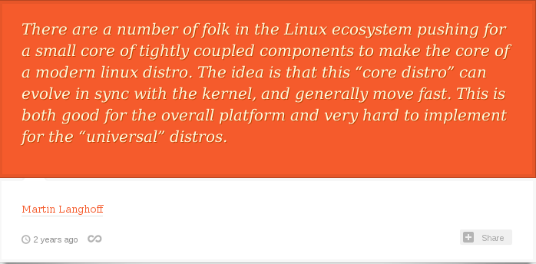
Greg K-H: “Tightly-coupled components”
Originally from https://lwn.net/Articles/494095/

Slide 34
[Socket activation demo with cups and ncat]

Slide 35
systemd and udev
udev is a kernel facility that handles device events.
  merged into the systemd project.
Rules are enabled by placement in /lib/udev/rules.d, unlike systemd unit enablement.
Rule loading is ordered by numeric filename prefix, like old sysVinit scripts.

Slide 36
udev is still old-school
Try:
ls /lib/udev/rules.d
cat /lib/udev/rules.d/99-systemd.rules

Slide 37
Hierarchy of unit files for system and user sessions
Organized into system and user units
/lib/systemd/system: systemd upstream defaults for system-wide services
/etc/systemd/system: local customizations by override and extension
/lib/systemd/user/: systemd's upstream defaults for per-user services
$HOME/.local/share/systemd/user/ for user-installed units
'drop-ins' are run-time extensions

Slide 38
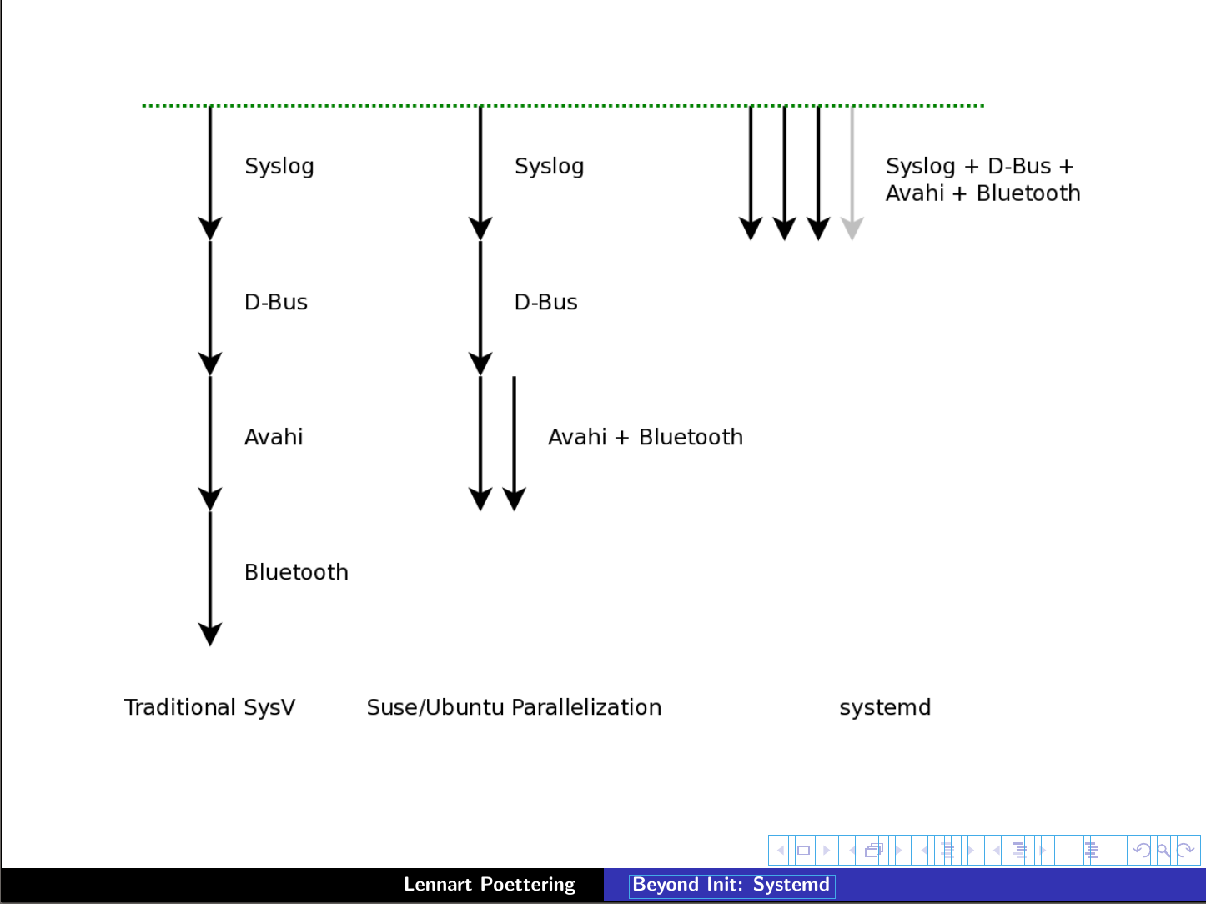
Serial
Linked list
Fully parallel
X
Upstart

Slide 39
Modularity can produce complexity
photo
courtesy
Bill
Ward

Slide 40

systemd and outside projects: CoreOS
networkd was initially contributed by CoreOS developers.
CoreOS's fleet “tool that presents your entire cluster as a single init system” is based on systemd.
  Spin up new containers due to events on sockets.
CoreOS devs are outside systemd inner circle.
systemd has many patches from Arch, Intel, Debian . . .

Slide 41
systemd in embedded systems
systemd is widely adopted in embedded systems because
  proper allocation of resources is critical;
  fastboot is required;
  customization of boot sequence is common.
Lack of backward compatibility for older kernels (due to firmware loading) is a pain point.
Embedded use cases are not always understood by systemd devs.

Slide 42
Try: 'systemctl isolate multi-user.target'
[warning: KILLS X11]
[runlevel demo with Fedora Qemu and Firefox]

Slide 43
systemd is easy to use
systemd utilities:
  Try: apropos systemd | grep ctl
All-ASCII configuration files: no hidden “registry”.
Customization is by overriding default files.
Many choices are controllable via symlinks.
Bash-completion by default.
Backwards compatibility with SysVinit

Slide 44

Override your defaults!
Replace a unit in /lib (upstream) by creating one of the same name in /etc (local changes).
Add services to boot by symlinking them into /etc/systemd/system/default.target.wants.
'mask' unit with link to /dev/null.
Best practice: do not change the files in /lib/systemd.
Read in-use unit with 'systemctl cat'.
photo courtesy
Jym Dyer

Slide 45
Extensions: drop-ins
Try: systemd-delta
Try: systemctl cat <list from 1st command>

Slide 46
Old way | New way | History
X11 manages graphics memory | Kernel's drm manages graphics memory | “Linux Graphics Drivers: an Introduction,” p. 26
static /dev, then devfs | udev
getrlimit, setrlimit | cgroups
KDE3 and GNOME2 | KDE4 and GNOME3 | KDE and GNOME
sysVinit | systemd | in progress
X11 client-server model | Wayland compositor

Slide 47
Crux of the problem: Dave Neary
“There is no freedesktop.org process for proposing standards, identifying those which are proposals and those which are de facto implemented, and perhaps more importantly, there is no process for building consensus around a specification . . .”
(comment regarding GNOME3)

Slide 48
systemd is . . .
the basis of Fedora, RHEL, CentOS, OpenSUSE, Ubuntu, Debian and much embedded.
praised by Jordan Hubbard of FreeBSD.
tightly integrated with Linux kernel cgroups.
the reference implementation for udev and for kdbus userspace access.

Slide 49
Customizing your installation
Replace a unit in /lib (upstream) by creating one of the same name in /etc (local changes).
Add services to boot by symlinking them into /etc/systemd/system/default.target.wants.
Best practice: do not change the files in /lib/systemd

Slide 50
Sequence of targets on a typical system
>$ ls -l /lib/systemd/system/default.target
/lib/systemd/system/default.target -> graphical.target
>$ cat /lib/systemd/system/graphical.target
After=multi-user.target
>$ cat /lib/systemd/system/multi-user.target
After=basic.target
>$ cat /lib/systemd/system/basic.target
After=sysinit.target sockets.target timers.target paths.target
slices.target

Slide 51
Example: set display manager
[user@localhost ~]$ ls -l `locate display-manager.service`
lrwxrwxrwx. 1 root root 35 Dec 11 2013 /etc/systemd/system/display-manager.service -> /usr/lib/systemd/system/gdm.service
[user@localhost ~]$ cat /usr/lib/systemd/system/gdm.service
[Unit]
Description=GNOME Display Manager
[ . . . ]
[Install]
Alias=display-manager.service
or
WantedBy=graphical.target

Slide 52
sysinit, sockets and multi-user are composite targets
>$ ls /lib/systemd/system/multi-user.target.wants/
dbus.service@ systemd-ask-password-wall.path@ systemd-
update-utmp-runlevel.service@ getty.target@
>$ ls /lib/systemd/system/sockets.target.wants:
dbus.socket@ systemd-shutdownd.socket@
systemd-initctl.socket@ systemd-udevd-control.socket@
>$ ls /lib/systemd/system/sysinit.target.wants:
cryptsetup.target@ systemd-journald.service@
debian-fixup.service@ systemd-journal-flush.service@
Symlinks replace lines of conditional code in SysVinit scripts.

Slide 53
Example: change the default target
[alison@localhost ~]$ ls /etc/systemd/system/default.target
/etc/systemd/system/default.target ->
/lib/systemd/system/graphical.target
[alison@localhost ~]$ sudo rm /etc/systemd/system/default.target
[alison@localhost ~]$ sudo ln -s /lib/systemd/system/multi-user.target
/etc/systemd/system/default.target
[alison@localhost ~]$ ~/bin/systemd-delta
[ . . . ]
[REDIRECTED] /etc/systemd/system/default.target →
/usr/lib/systemd/system/default.target

Slide 54
problems
systemd is modular, but:
  interopability with other SW may be inadequately tested.
Potentially rocky piecemeal transition by distros.
  e.g., Debian installer doesn't warn about a separate /usr partition.
Merciless deprecation of features (firmware loading, readahead . . . ).
Frequent releases, not particularly stable.

Slide 55
Taxonomy of systemd dependencies
Requires, RequiresOverridable, Requisite, RequisiteOverridable, Wants, BindsTo, PartOf, Conflicts, Before, After, OnFailure PropagateReloadsTo, ReloadPropagateFrom,

Slide 56
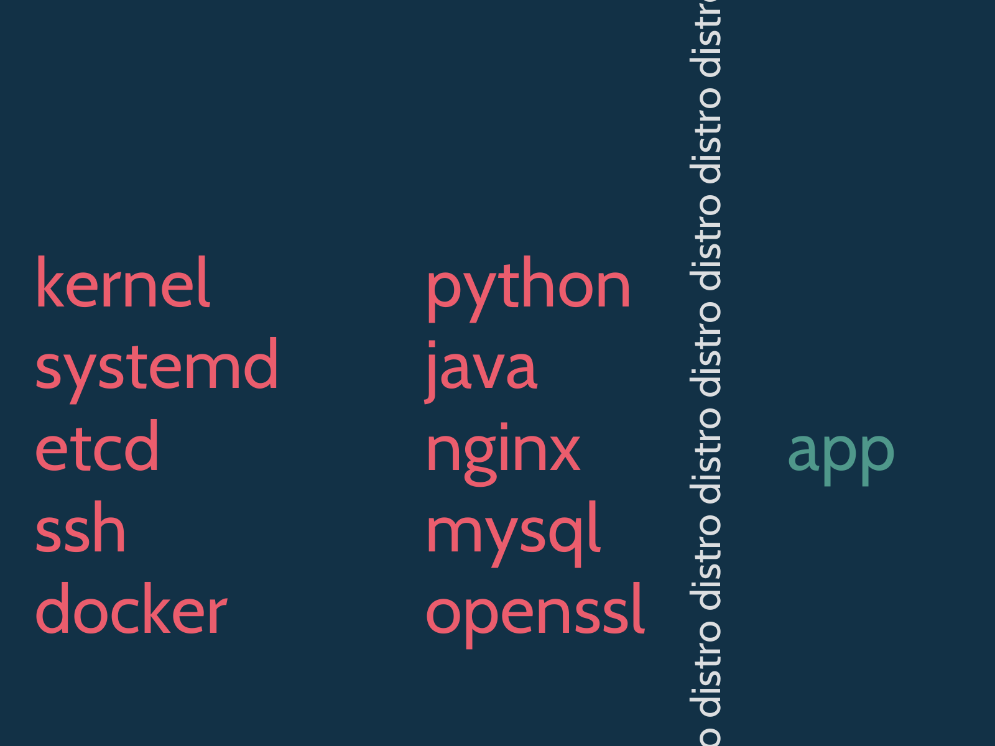
Brandon Philips at linux.conf.au

Slide 57
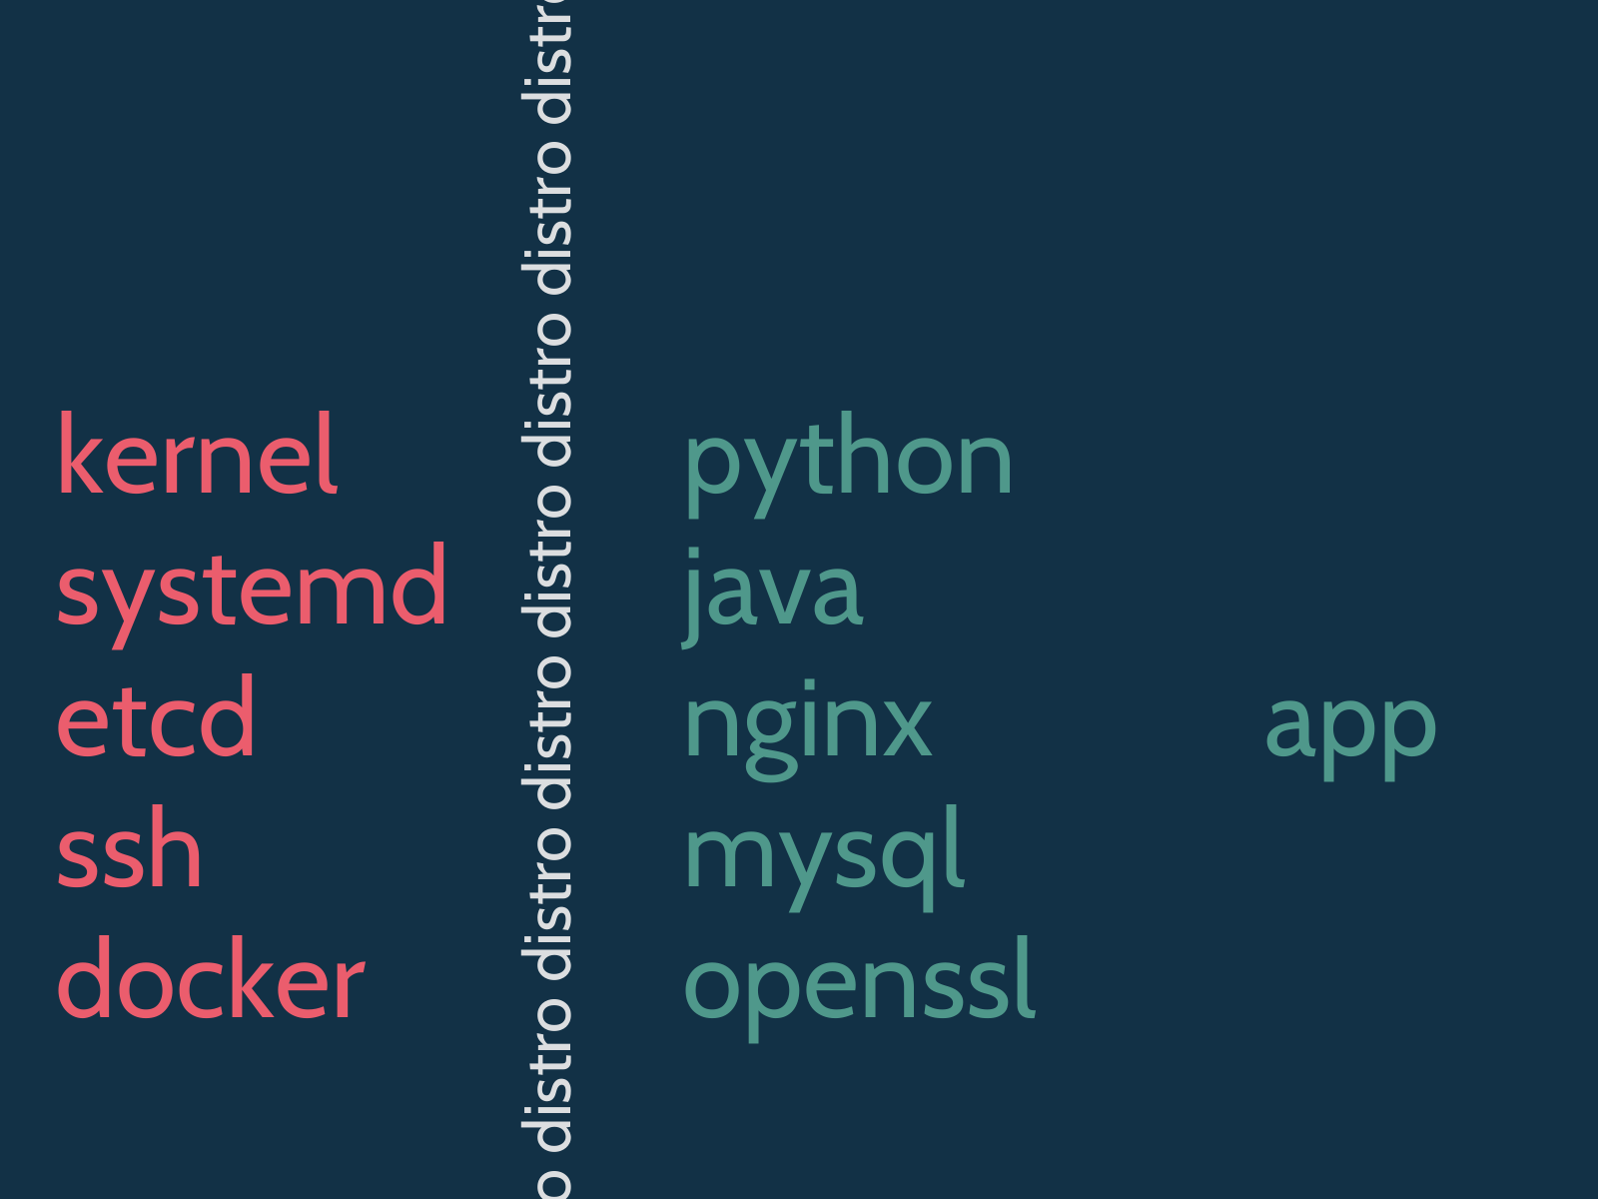
Brandon Philips at linux.conf.au

Slide 58

Design

