Slide 1
Automotive open source: opportunity and peril
Alison Chaiken
alison@she-devel.com
4/11/12
data fusion and mining opportunities
security problems and solutions
how to access vehicle-generated data
demos

Slide 2

Legacy View of “In-Vehicle Infotainment”
Do same stuff in car as at home: boring.

Slide 3
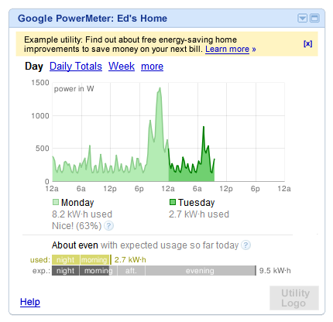
“Personal total environmental impact” tracking possible
by “mining” gas mileage data aggregated with other sources.

Slide 4
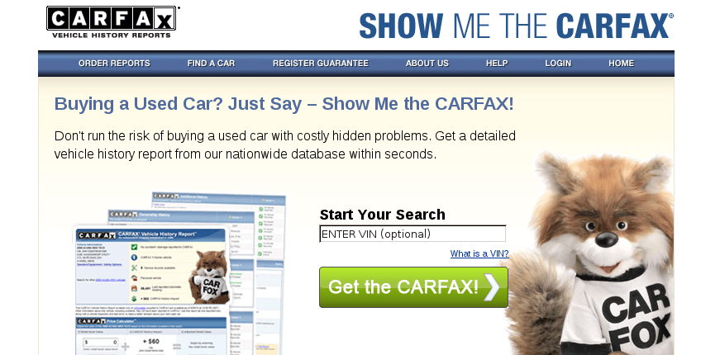
How about a driver-generated used-car report?
… if the report included a web-based verifiable summary
of real-time performance data?

Slide 5
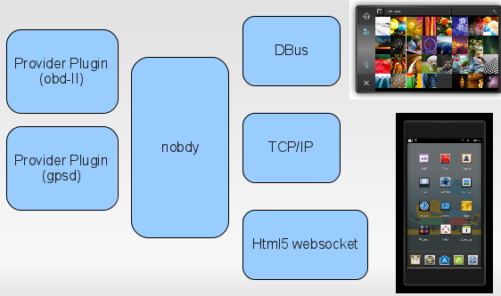
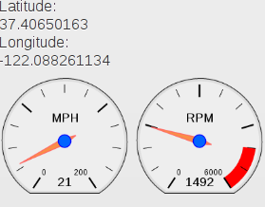
Example: publish your car's data to the WWW
http://openice.org/
Car's OBDII
connector
GPS
Remote
Browser
Plug-in framework with language-agnostic API.

Slide 6
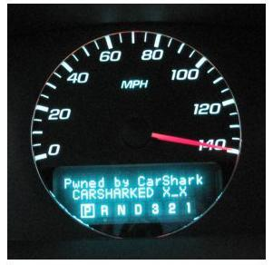
CAN bus is not ready for Internet age
UCSD, UWa, Rutgers: http://autosec.org/

Slide 7
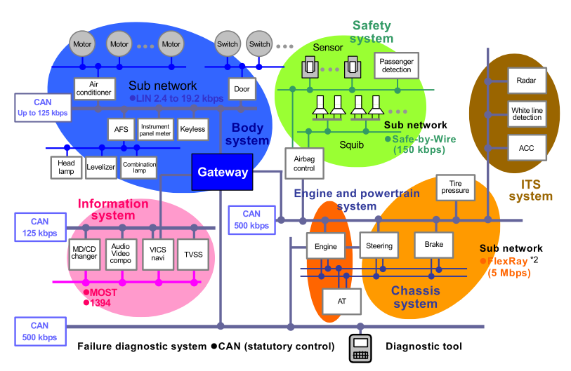
Automotive data buses have little security
Wireless!

Slide 8
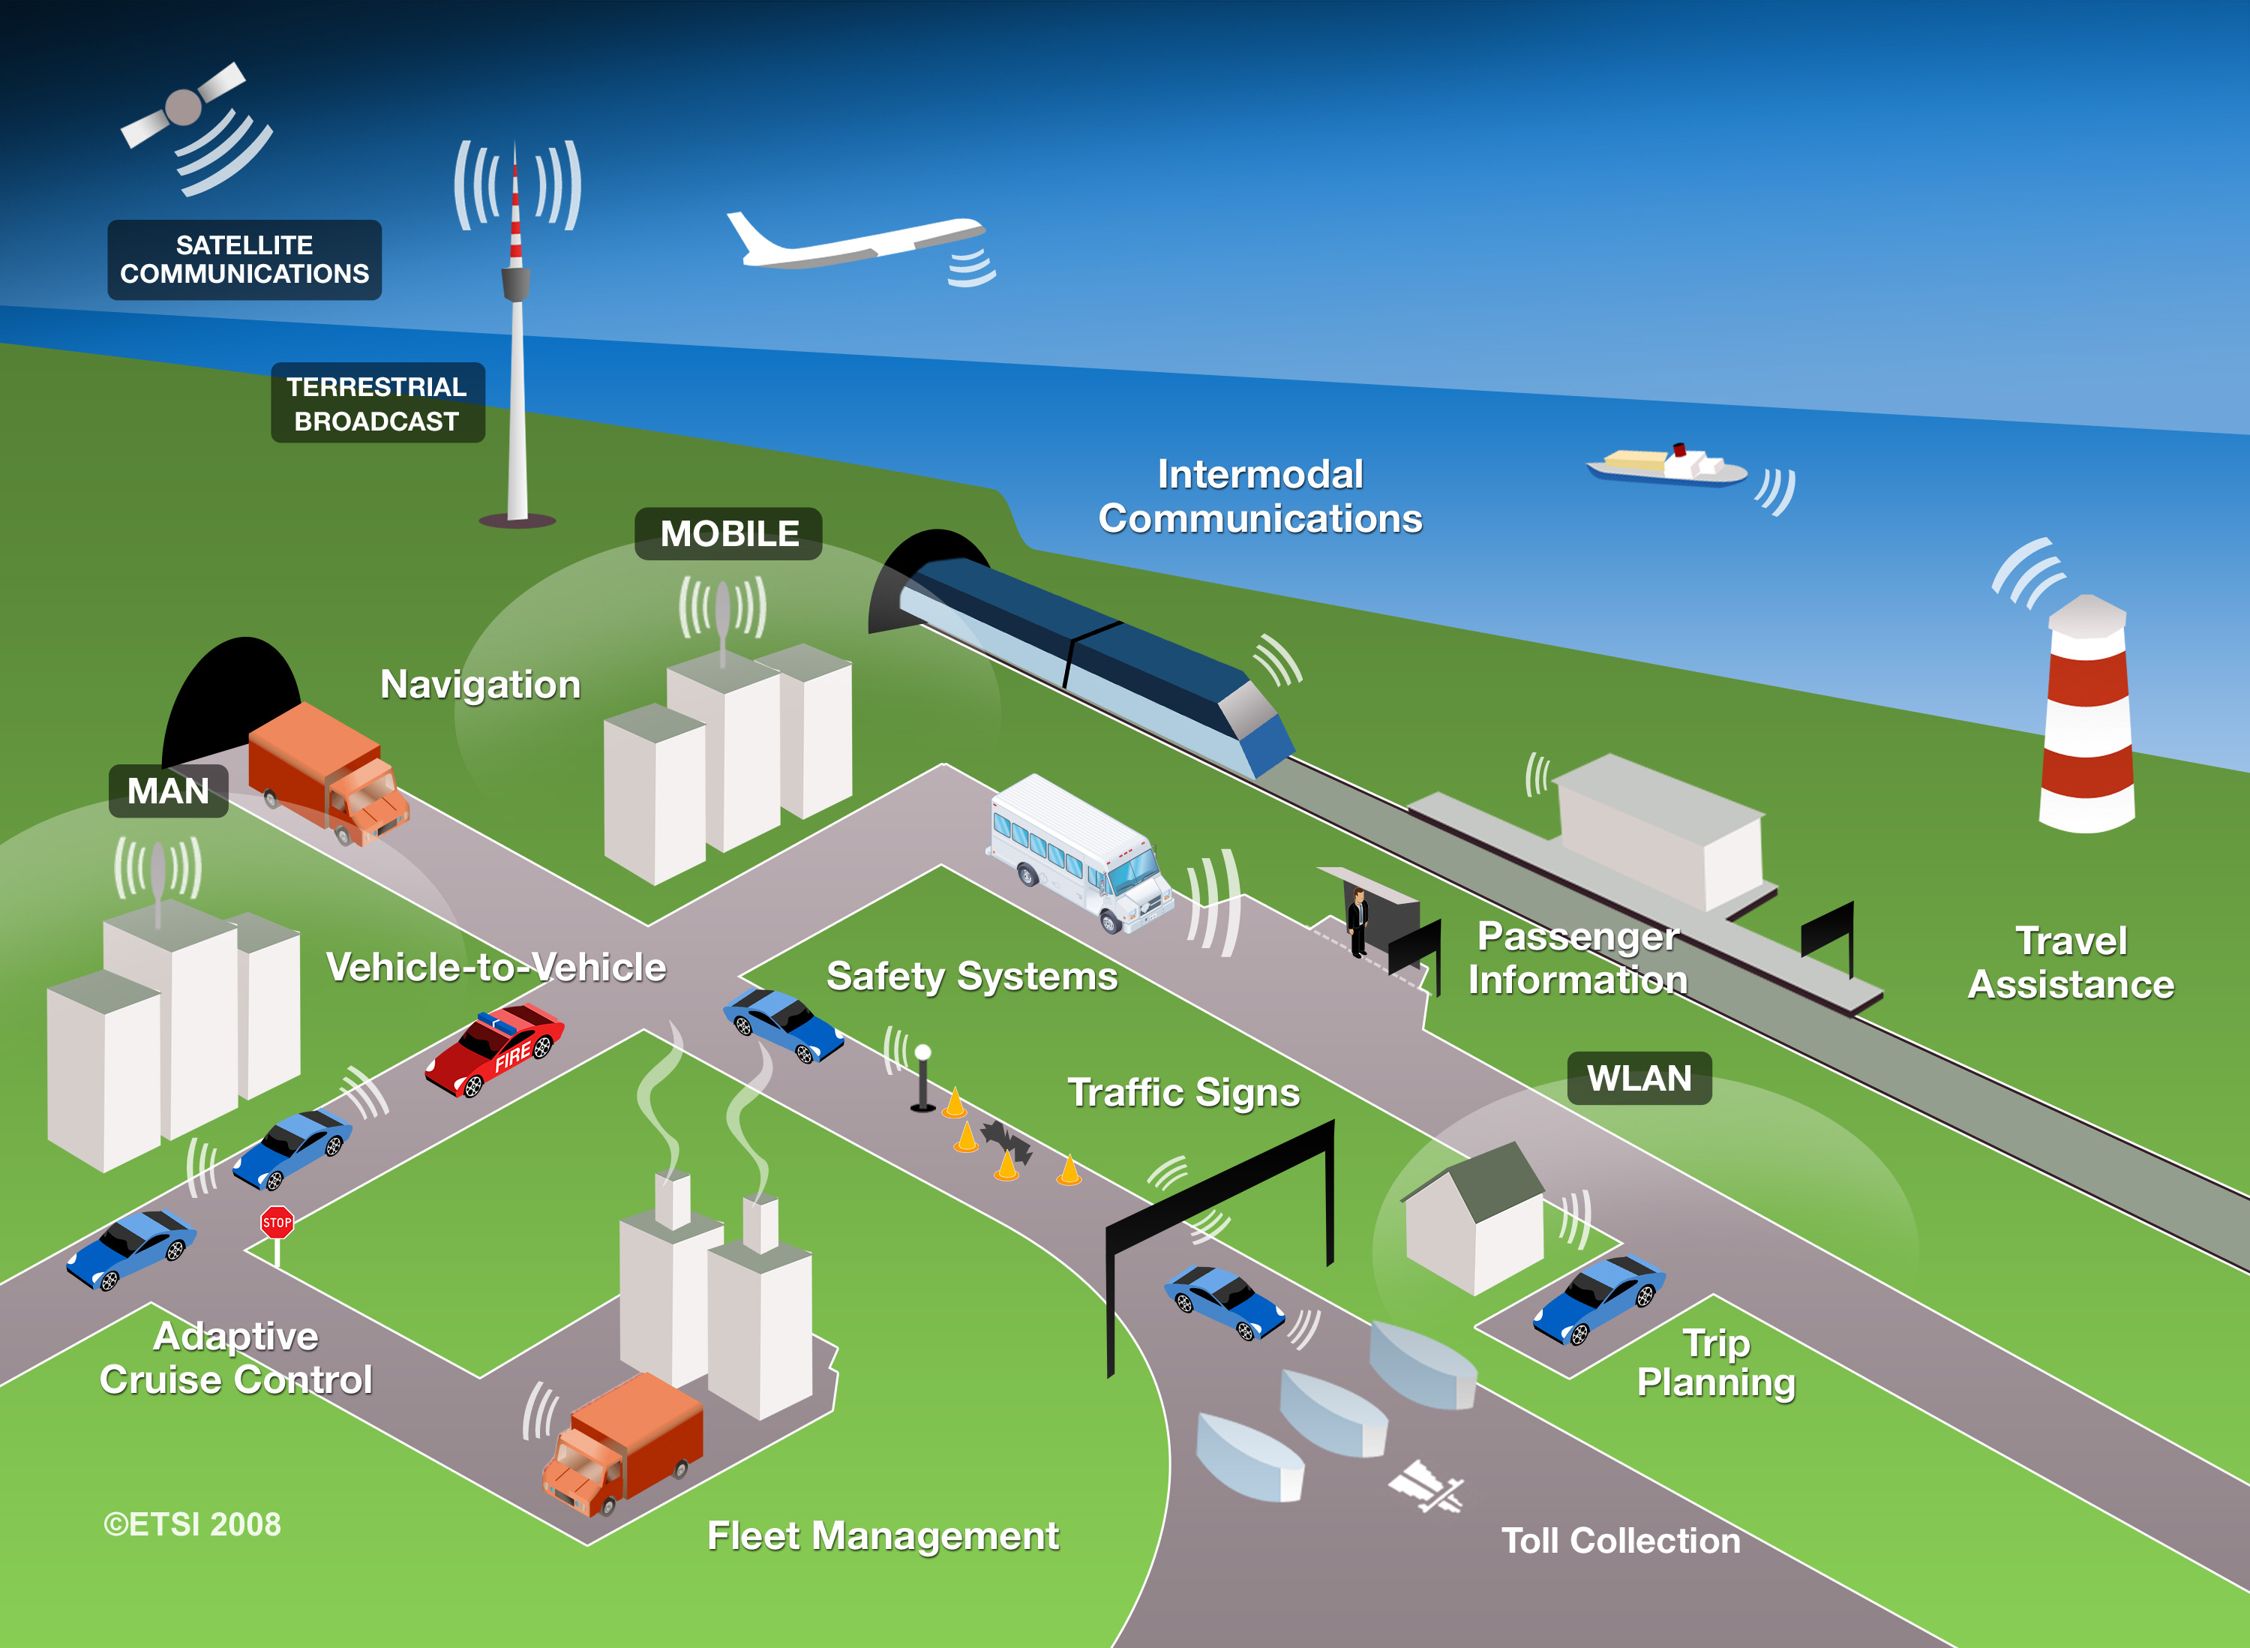
V2V and V2I: making use of real-time data
Courtesy ETSI.
Early-warning hazard alert system pilots already in U.S., Germany.

Slide 9
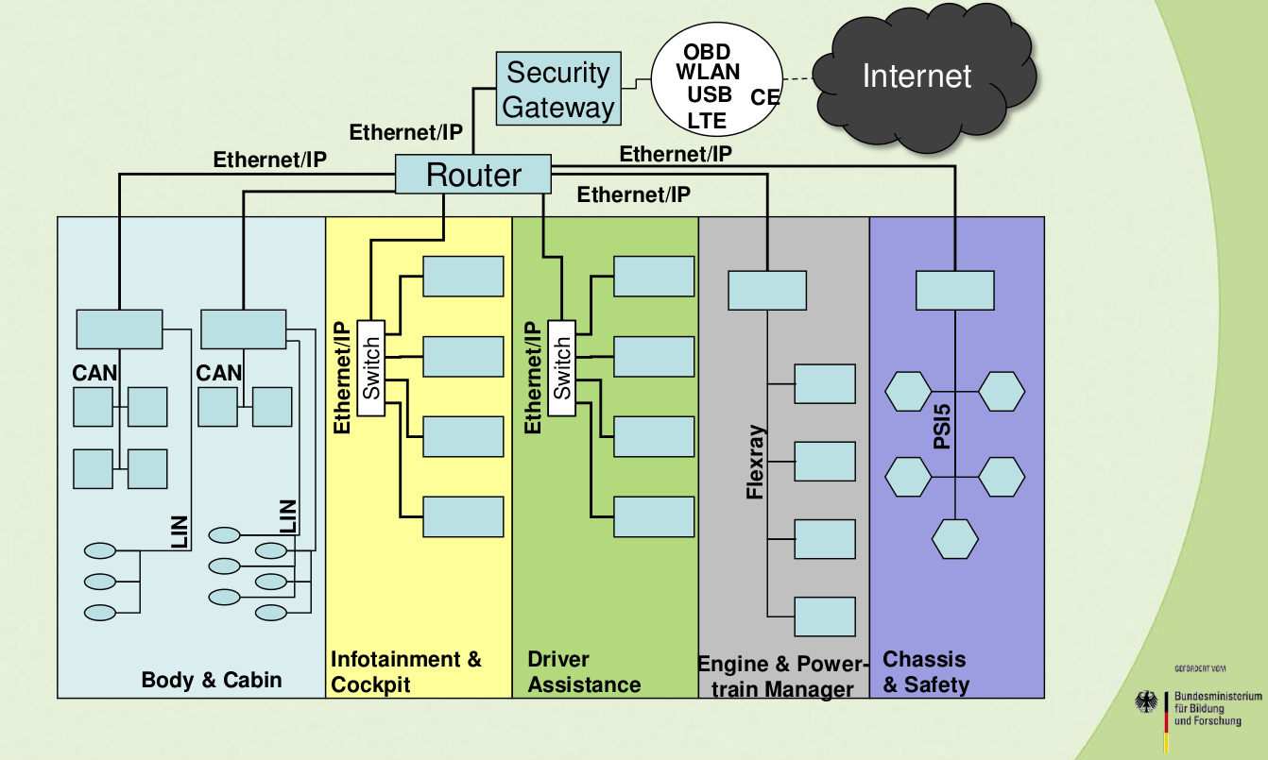
Expert security help is on the way
Source: Bless, Karlsuhe,
http://imara.inria.fr/ietf-its
NOT automotive “patch Tuesday” & anti-virus software!

Slide 10
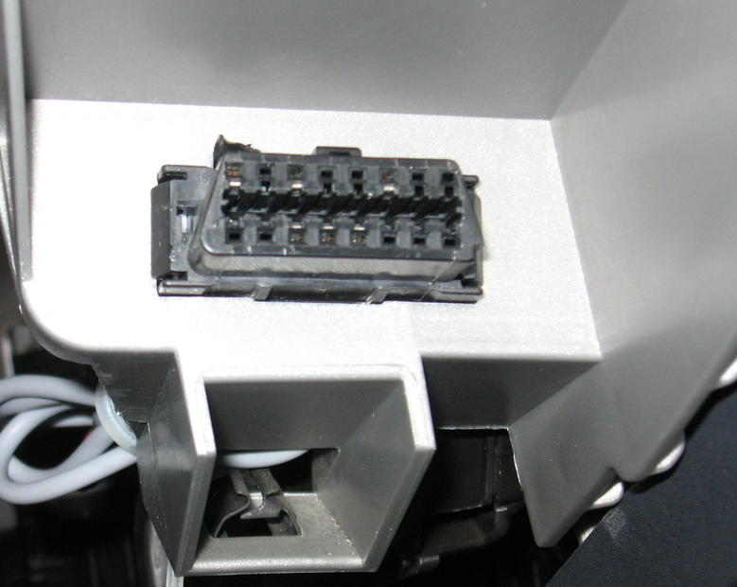
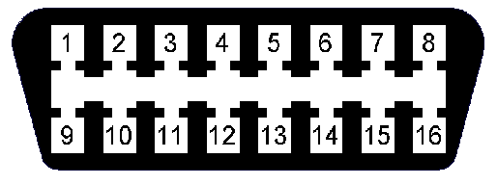
How to access a car's data
OBDII connector found in every
U.S. car since 1996.
COM
HS-CAN
LS-CAN
GND
Determine protocols in use
by examining populated pins.
2006 Mazda 3

Slide 11
How to select a scantool
Check which pins are populated in the OBDII connector of target car.
  Tells you which protocol(s) are supported.
Need only 4, 5, 6, 14 for OBDII (“smog test”).
Best choice for novice is USB ELM327:
  Cheaper (less than $50).
  Won't drain car battery and won't write to CAN data bus.
  Easier to connect than Bluetooth.

Slide 12
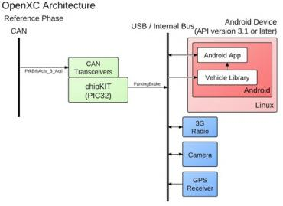
Ford's Android-Based OpenXC Platform

Slide 13
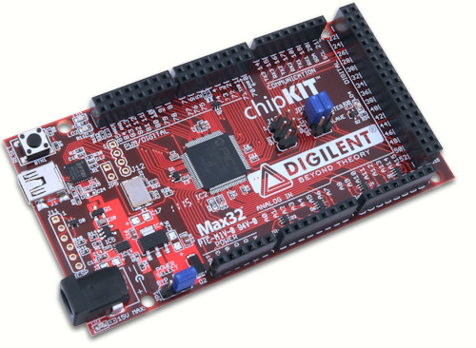
chipKIT Max32™ Prototyping Platform
32-bit MIPS processor, Arduino pin-compatible, open toolchain, two CAN controllers, $50

Slide 14
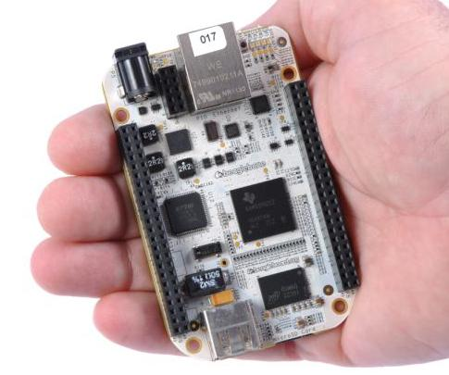
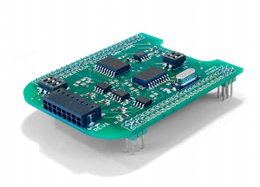
BeagleBone from TI
CAN “cape” for BeagleBone
Runs QCanObserver based on Qt
$89, widely available
€79, available via mail-order

Slide 15
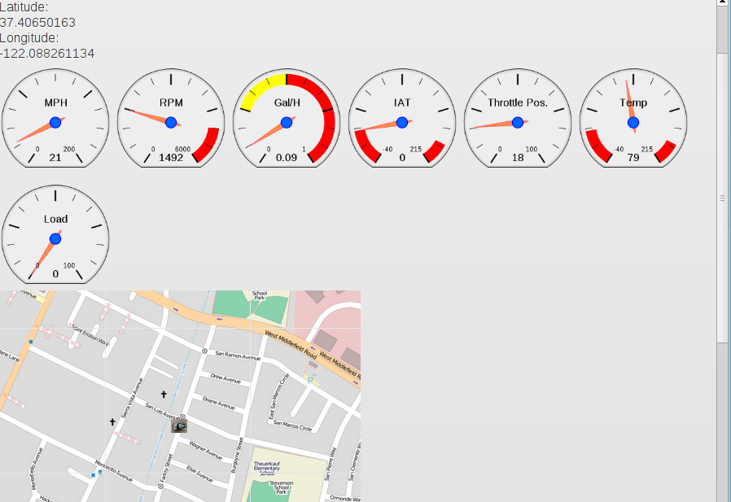
Demo 1: replay of prerecorded trip using nOBDy

Slide 16
Demo 2A: live data demo using nOBDy, OBDLink MX and EcuSim (lunchtime)
Demo 1
sqlite DB
from actual trip
EcuSim
HW CAN emulator
Demo 2A
Browser

Slide 17
Summary
Automotive software is rapidly evolving, both within and outside vehicle.
Serious security exploit may trigger a regulatory lock-down, killing innovation.
Opportunity right now for small businesses and individuals is tremendous.
Great time to get into the field!

Slide 18
Status of Automotive Open Source
Manufacturer | Confirmed Operating system
Fiat-Chrysler Blue&Me (500, Delta), Kia Uvo, BYD, Nissan Leaf | Microsoft Windows Embedded Automotive
Ford (all?) | MyTouch/Sync-Microsoft; OpenXC-Android
General Motors (new 2012 Cadillacs), Chevy Volt | MontaVista's GNU/Linux
Geely (China); Hawtai (China) | GNU/Linux: Moblin (MeeGo predecessor)
Renault R-Link | Android
Honda (Accord, Odyssey, Pilot), Audi, BMW (7-series and M models), Chrysler, Daewoo, GM (OnStar), Hyundai, Land Rover, Porsche, Saab (9-3) Renault (SM7) | QNX
Linux Foundation members: Toyota, Pelagicore, Symbio, Tieto.
Automotive Linux Summit 2011 presenters: Toyota, Nissan, BMW.
MeeGo Conference 2011 presenter: Nissan.
Volkswagen has a pilot using Maemo (Linux).

Slide 19
Demo 2B: live data demo using nOBDy, OBDLink MX and Mazda (evening)
OBDLink MX
scantool
Mazda 3
OBDII port
USGlobalSAT
USB GPS
Browser
Demo 2B

Slide 20
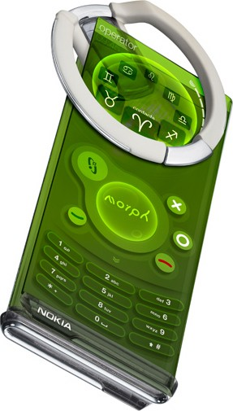
What do developers (and start-ups) really want?
Peer-group recognition:
– winning contest;
– “committer” or “maintainer.”
Limited-availability items:
– pre-release devices;
– prototypes;
– invitations to closed events;
– access to proprietary data.
Fun!
– games.
Money, like everybody else.
source: Engadget Mobile

Slide 21
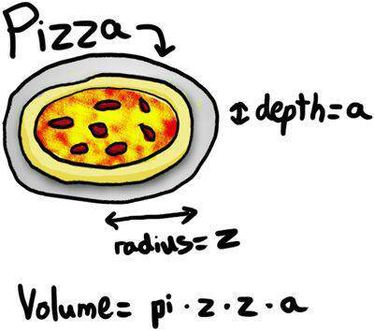
Fueling the Ecosystem: what do developers want?
Stereotype:
Free beer
Free food
Free t-shirts

Slide 22
How do we reach developers?
Exclusive events where pre-release or prototype hardware is distributed.
Exclusive events: pre-release API demos.
Exclusive access: (with NDA) proprietary data for mining.
Hackathons and coding contests with desirable prizes.
– Can be a “winner” t-shirt or an autographed book.
Foosball, video games, ping pong, Bawls, coffee are attractive.
Lowest barrier to entry: contests and summer students.

Slide 23
Why Right to Repair is important
Preserve owner-driver ability to read automotive data.
Forces of FUD will seize on an (inevitable) incident as an excuse to lock everything down.
A chance for software developers to communicate with technophobic home- and small-business mechanics.
National Act is stuck in a Congressional committee.
MA has 2012 ballot initiative.

Slide 24
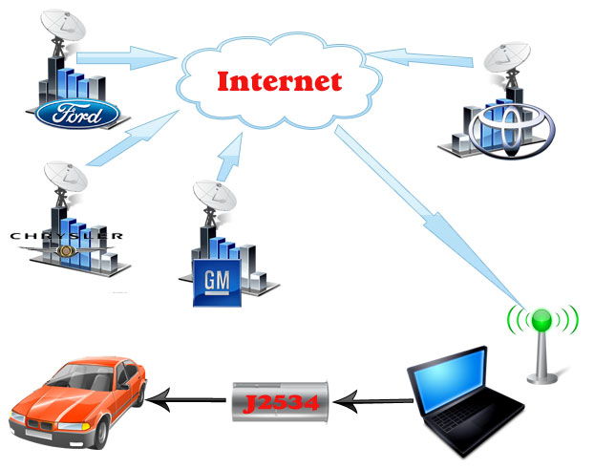
“Right to Repair” movement a natural ally of open source
Motor Vehicle Owners Right to Repair Act

Slide 25
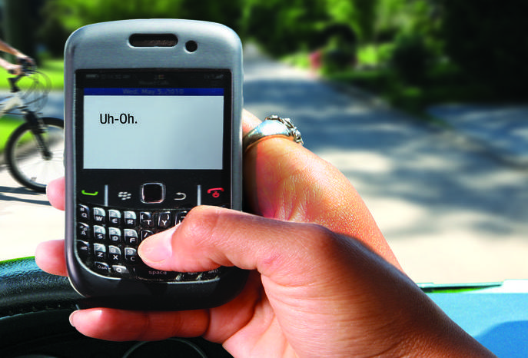
NHTSA moves to ban phone use in moving vehicles
source: distraction.gov
Prediction: touchscreen ban will be next.

Slide 26
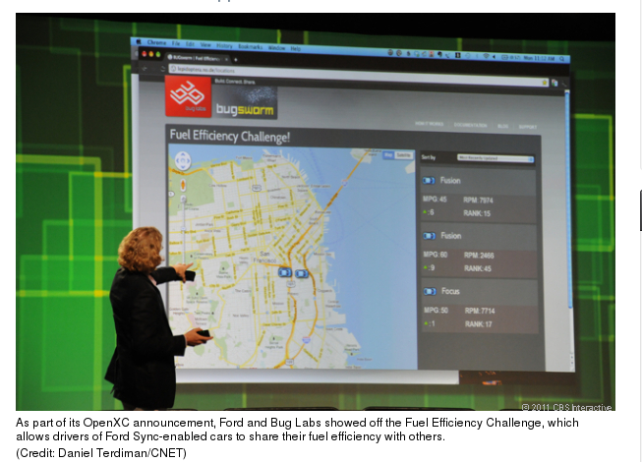
Ford's vehicle-data “Fuel Efficiency Challenge”
Vehicle data is provided by
Android- and Arduino-based “OpenXC Platform.”

Slide 27
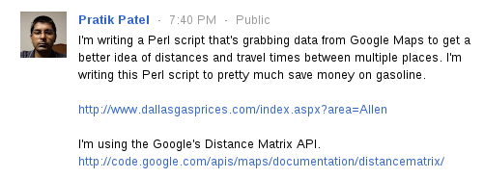
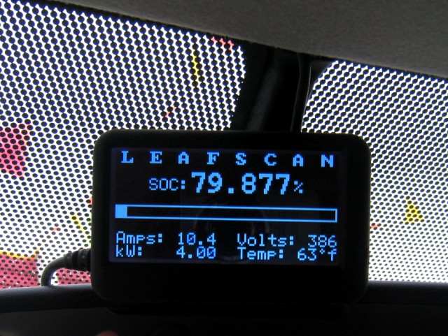
Small-biz and community contributions already
Data-
mining
Real-time
CAN-bus

