Slide 1
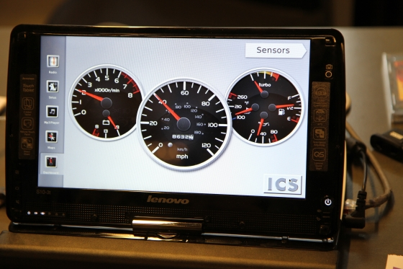
Automotive: new frontier for mobile Linux
Alison Chaiken
alchaiken@gmail.com
http://she-devel.com/

Slide 2

Visited Warren, MI in 1992-1994

Slide 3

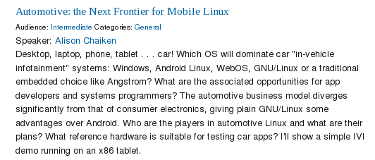
Tracking General Motors' Evolving Technical Interests

Slide 4
Outline
Evolving opportunities for IVI
HW platforms for IVI development
nOBDy, ExoPC and Pandaboard demos

Slide 5
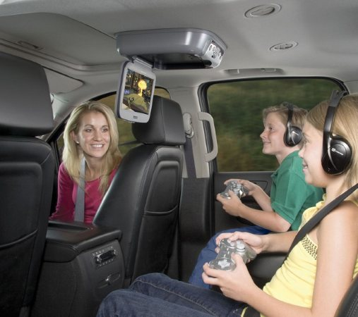
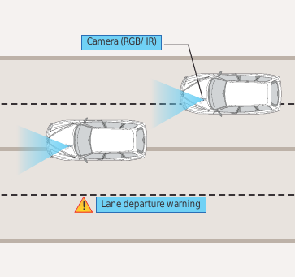
What is “in-vehicle infotainment”?
Courtesy Tata Consultancy Services
1st gen: available
2nd gen: pipeline

Slide 6
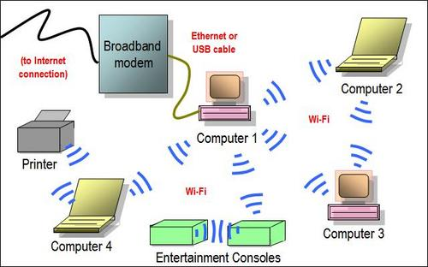
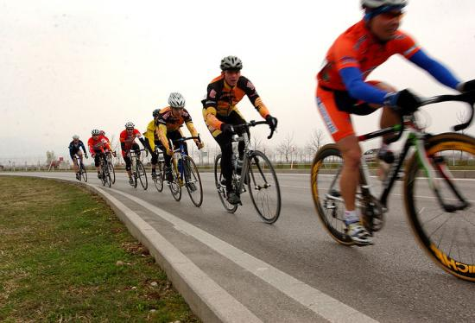
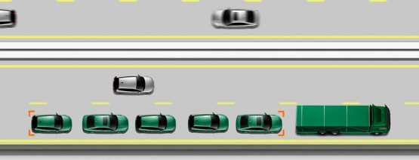
Opportunity: save energy through ad hoc networking
Use this . . .
to save energy . . .
with cars, too: 802.11p WAVE.

Slide 7
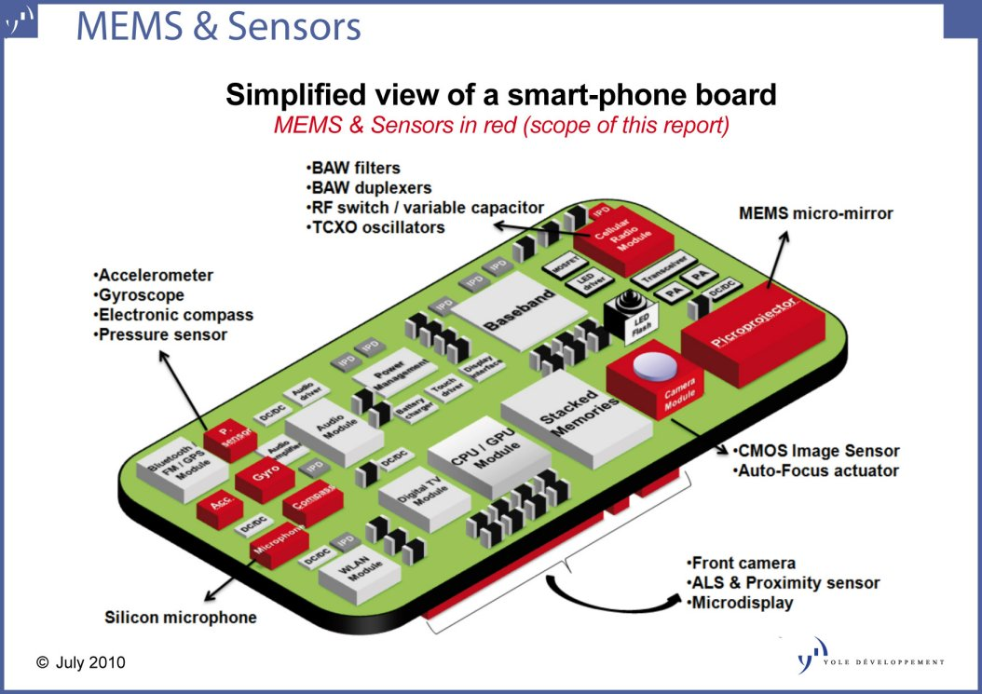
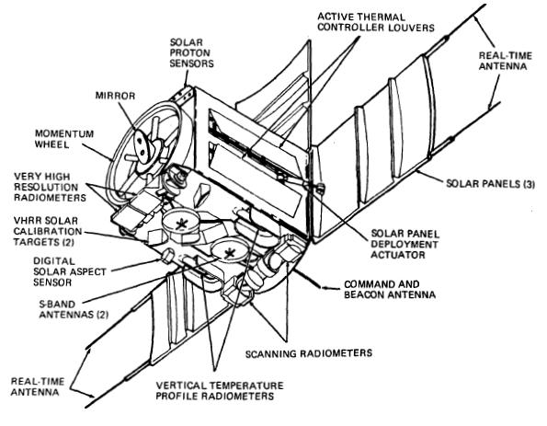
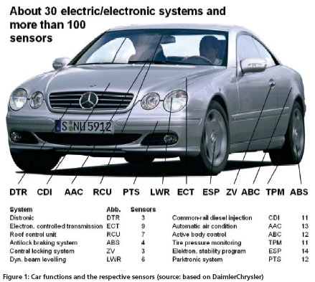
Opportunity: Mobile sensor platform data fusion/mining
Handset
Satellite

Slide 8
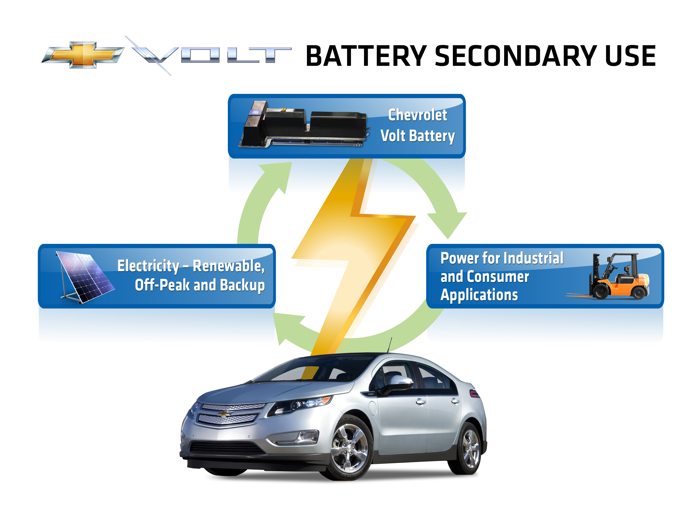
Familiar idea: car as load-levelling power storage

Slide 9
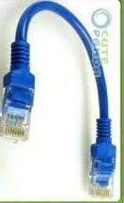
Extension: connected car can be main CPU for the home
COMPUTE POWER
Data backup
Media rendering
Thermostat
Hot water heater, furnace and computer in garage . . .

Slide 10

Extension: From “sneakernet” to “tirenet”
DATA STORAGE
Starbucks/Walmart
Sync rural home
Sync village business
Napster:iTunes::Wardriving:Download as a Service

Slide 11
“Adjacent” business opportunities
GM does not want to enter smart grid business.
  ABB does.
GM does not want to enter the home computer business.
  A lot of Sili Valley startups do.
GM does not want to enter the “tirenet” business.
  Chinese, Indian partners do.

Slide 12











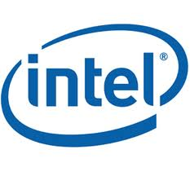




Bay Area IVI participants
New L.A. factory

Slide 13

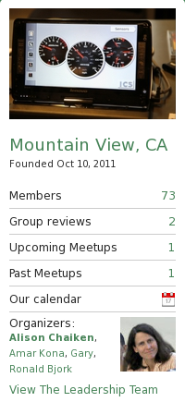

Slide 14
Challenges for IVI
Security in a multi-user, mobile, often unattended device
Safety: not “kill -9” but kill dead!
Novel hardware and architecture
Not a phone or desktop: little-understood UI/UX

Slide 15
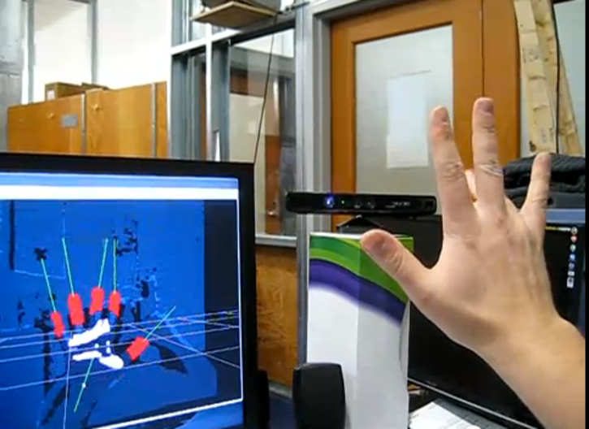
UI: What kind of controls?
Touchscreen, video gesture, joystick, voice, haptic?
Kinect piano: https://www.youtube.com/watch?v=kf3G-DXqt6Y

Slide 16
Novel architecture trades parts count for security
Front-seat RT audio
and video
incl. alarms
DSP
GPU
Atom or ARM SoC
running GNU/Linux
Encapsulated legacy system
Cortex-M
Sensor data R/O
16-bit MCU
running RTOS
In-dash GPCPU
MIPS with
OpenWRT
Atom or ARM
running Android
CAN and
MOST
buses
Control: R/W
Firewall
Backseat entertainment

Slide 17
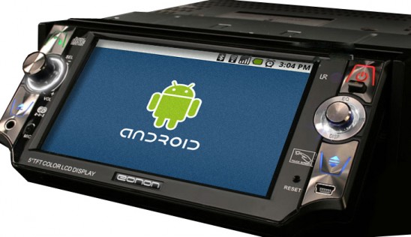
Maybe Android from Open Handset Alliance?
Inherently single user.
Text ads required for Android Market?
Open source, not open development.
Amazon and B&N more ready to deal?

Slide 18
2011 Linux Kernel Summit: no need to choose?
Many of the changes in the Android kernel have been blocked from merging into the mainline, but Android shipped it anyway, and it now has many millions of users. . . . how we should treat the Android code?
Linus took the microphone and stated that, simply, code that actually is used is the code that is actually worth something. The Android code is certainly being used . . . when code has millions of users, we have to say "yes" to it.
Abridged from https://lwn.net/Articles/464298/

Slide 19
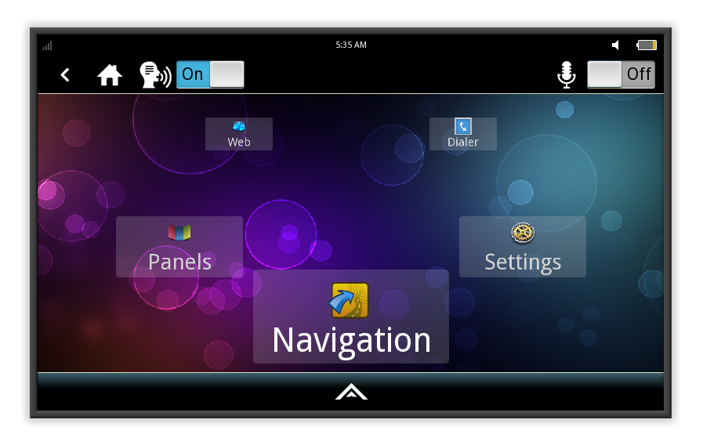
MeeGo IVI 1.2 Home Screen
Intel: Tizen-IVI will have large overlap with MeeGo.

Slide 20
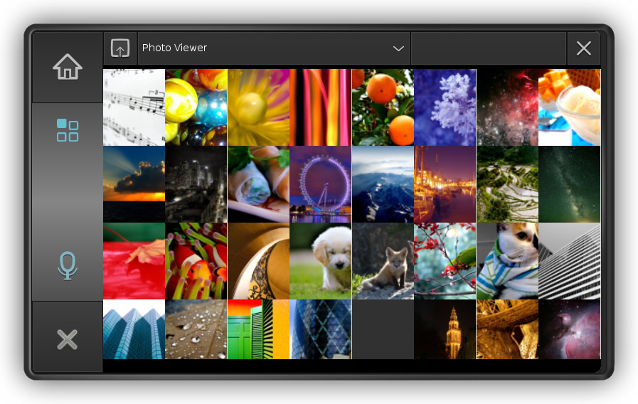
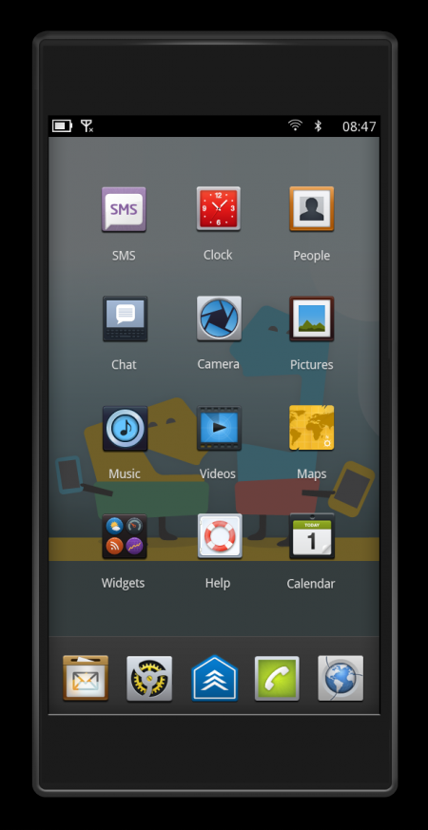
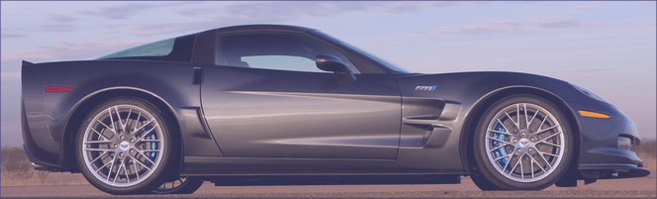
Tripzero: Handset/Tablet + meego ivi
In the near future...
DBus
nobdy
nobdy
Bluetooth
subscriber
plugin
Bluetooth
Provider
plugin
DBus
http://sf2011.meego.com/program/sessions/vehicle-communications-meego

Slide 21
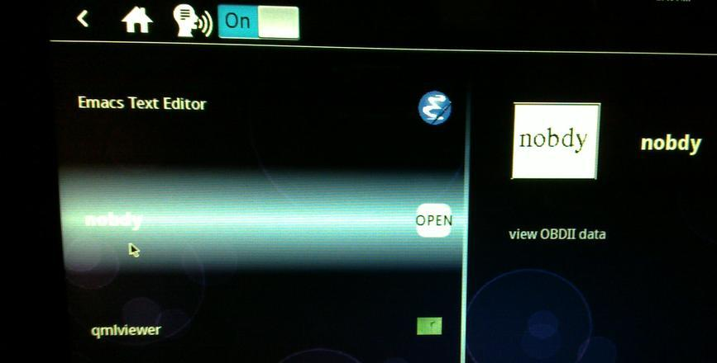
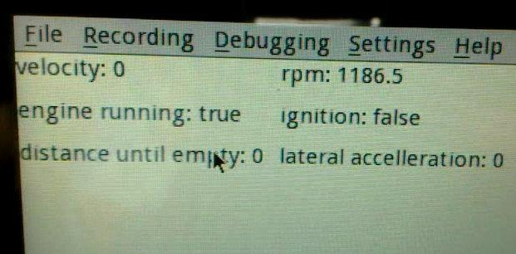
Nobdy on (unsupported) ExoPC Atom Slate and OMAP4 Pandaboard
Nobdy in scrollwheel menu
Live data stream via D-bus and qmlviewer

Slide 22
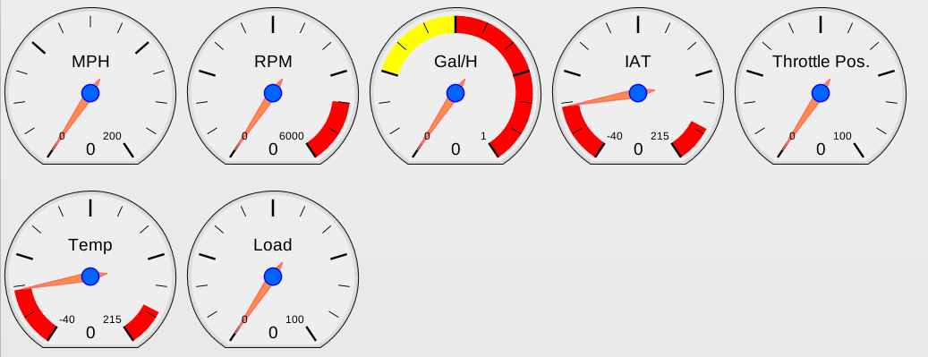
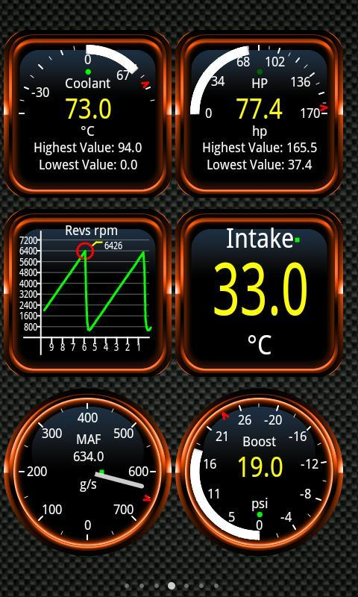
Linux OBDII Software
New nobdy Qjson UI from tripzero
Torque from Android Market
(not open source)
ICS IVI demo by Justin Noel

Slide 23
Goal: real-time mileage display for ICE vehicles
Real-time display in Prius:
  Is an important factor in its popularity;
  Illustrates the user empowerment of timely data
Real-time mileage is just the beginning of what data-mining can accomplish.
Killer app: “What's the cheapest gas within 1 mile of the freeway between me and an empty tank? Between me and my destination?”

Slide 24
Summary
Linux opportunities at all levels: HW, accessories, embedded, platform, apps, entrepreneurs and big companies.
Finding HW for development remains a problem: iKar PC? IMX53 Quickstart?
Many local companies and developers want to play.
Prediction: automotive is where Linux will show most growth.

Slide 25
Resources 1: Hardware platforms for IVI
ARM set-top box: Trimslice, $219 with Arch or MeeGo.
ARM board: FreeScale i.MX QuickStart, $149 w/ Ubuntu.
Atom/x86 slate: Ciara ExoPC Vibe, $699 w/ Windows.
Atom/x86 board: Intel Black Sands, $149 w/ reg, Android, Ubuntu or MeeGo.
ARM boards: T.I. BeagleBoard ($149), PandaBoard ($179), Ubuntu or Android.
Multiple displays and controls needed.
Touch, voice, video, joystick, haptic devices and drivers?
GPS dongles, CAN daughter cards . . .

Slide 26
Resources 2
IVI wiki: http://wiki.meego.com/In-vehicle
Official site: http://meego.com/downloads/releases/1.2/meego-v1.2-in-vehicle-infotainment-ivi
Mailing list archive: http://lists.meego.com/pipermail/meego-ivi
Mp3car.com
#linuxice and #meego-ivi IRC on freenode.net
nOBDy: wiki.openice.org/index.php?title=Nobdy
My notes and instructions
  on ExoPC: http://wiki.meego.com/MeeGo_IVI_on_ExoPC
  on Pandaboard: http://wiki.meego.com/Hardware-accelerated_graphics_on_Pandaboard_using_MeeGo

Slide 27
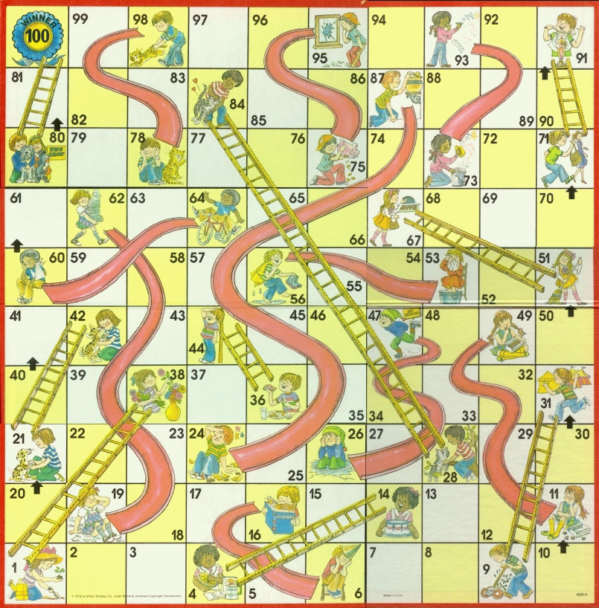
MeeGo Hardware Adaptation Process
Maybe not
that kernel
Update from
wrong repo
Use installer
defaults
Hand-craft
extlinux.conf
Multi-hour
“zypper up”

Slide 28
MeeGo-IVI on Atom and ARM Demo HW
No SW support for HW available to small-medium businesses.
Running IVI on ExoPC requires a mash-up of “Tablet Preview” and IVI UXes.
Meego-ivi repos support EMGD graphics only
  “zypper update” auto-overwrites drivers and X11 SO libraries.
Stopped work on ARM-based Pandaboard due to missing hardfp PowerVR driver.

Slide 29
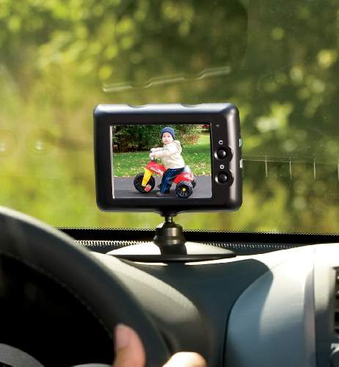
Hardware/Driver Challenge
CAN bus, MOST bus, wheel rotation sensors, oil level . . .
Not just RT audio, but RT video too!

Slide 30
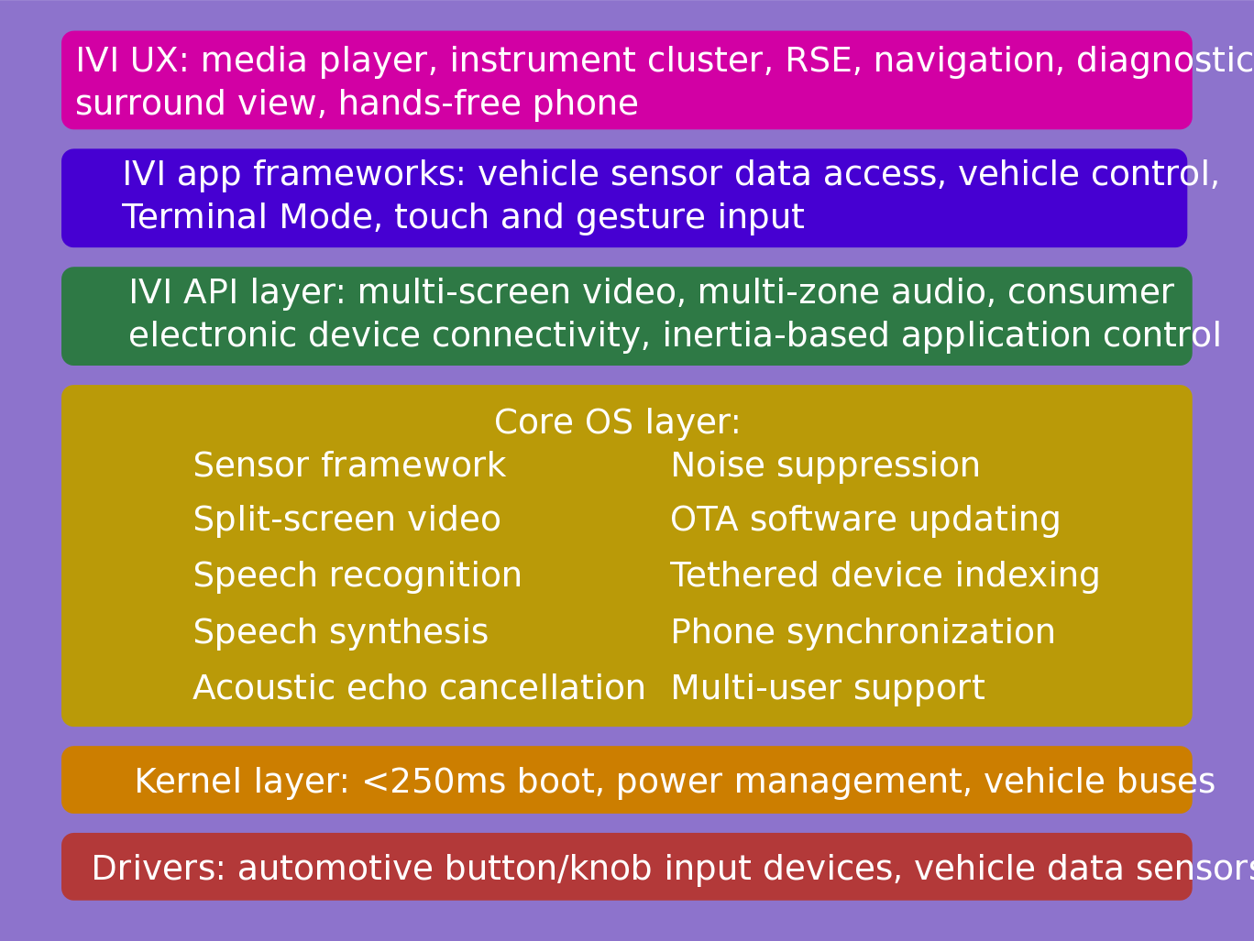
IVI UX Additional Features: MeeGo/Tizen
Courtesy
Nathan P. Willis,
http://tinyurl.com/3m4loer
Many automotive players, few public announcements.

Slide 31
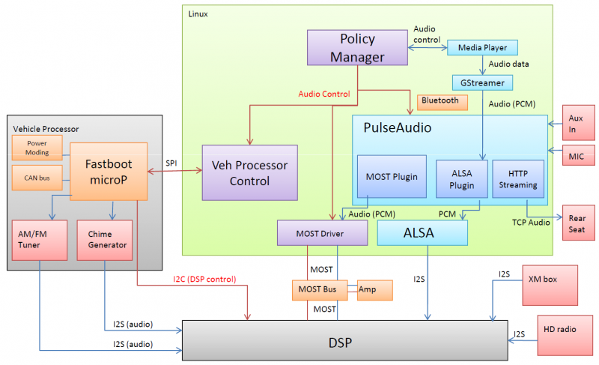
MeeGo IVI Audio Architecture
Courtesy Laci Jalics, Delphi.

Slide 32
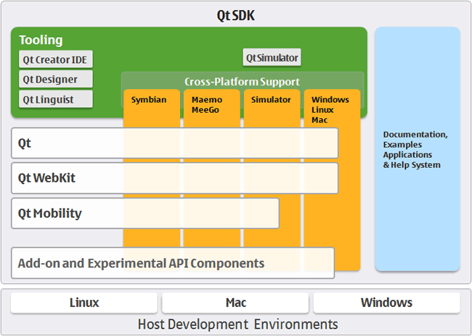
How about MeeGo?
MeeGo = lightweight GNU/Linux with a Qt face.

Slide 33
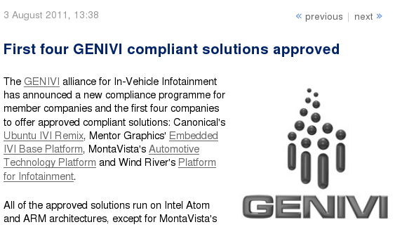
100-Member auto SW alliance endorses Linux
GENIVI is promulgating Linux standards for auto space.

Slide 34
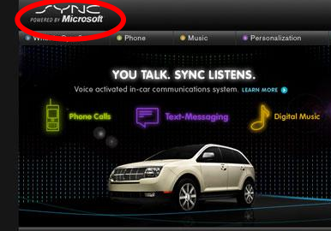
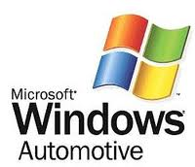
Security: Linux isn't ready either
Backseat kids changing nav system's destination . . .
mechanic at body shop installs malware.

Slide 35
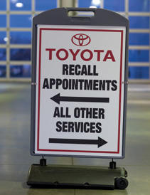
Safety:UI Design Space is Little Understood
What information does the driver need?
Prevent entertainment system from hogging resources (incl. Driver!).

