Slide 1
The next frontier: open source in the car
Alison Chaiken alison@she-devel.com slideshare.net/chaiken, wiki.openice.org
4/11/12
Who cares?
Status report
Opportunities for developers and businesses

Slide 2
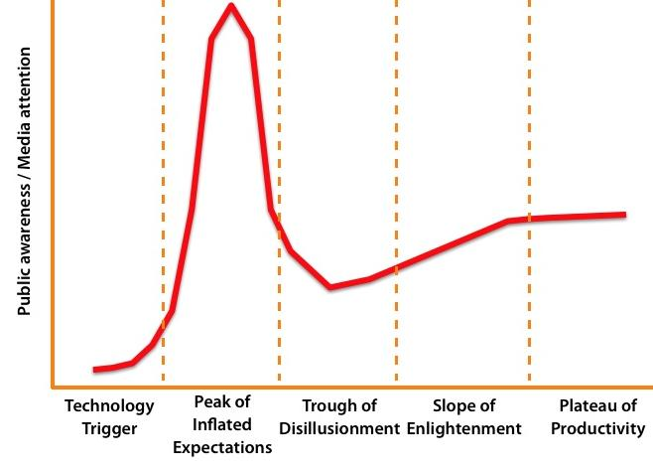

Gartner Hype Curve 2012
tablet
phone
connected
car
music
player
ebook
GPS
smart
meter
desktop,
laptop,
netbook

Slide 3
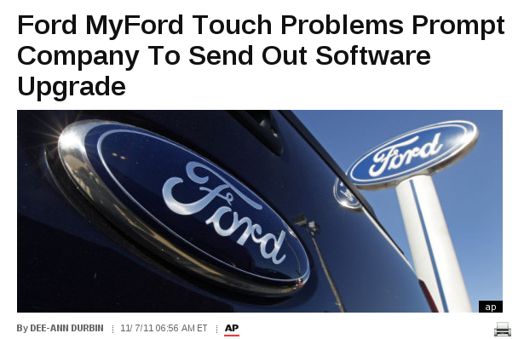
HuffPo: http://tinyurl.com/6m4afcl

Slide 4
Status of Automotive Open Source
Manufacturer | Confirmed Operating system
Fiat-Chrysler Blue&Me (500, Delta), Kia Uvo, BYD, Nissan Leaf | Microsoft Windows Embedded Automotive
Ford (all?) | MyTouch/Sync-Microsoft; OpenXC-Android
General Motors (new 2012 Cadillacs), Chevy Volt | MontaVista's GNU/Linux
Geely (China); Hawtai (China) | GNU/Linux: Moblin (MeeGo predecessor)
Renault R-Link, Roewe 350 | Android
Honda (Accord, Odyssey, Pilot), Audi, BMW (7-series and M models), Chrysler, Daewoo, GM (OnStar), Hyundai, Land Rover, Porsche, Saab (9-3) Renault (SM7) | QNX
Linux Foundation members: Toyota, Pelagicore, Symbio, Tieto.
Automotive Linux Summit 2011 presenters: Toyota, Nissan, BMW.
MeeGo Conference 2011 presenter: Nissan.
Volkswagen has a pilot using Maemo (Linux).

Slide 5
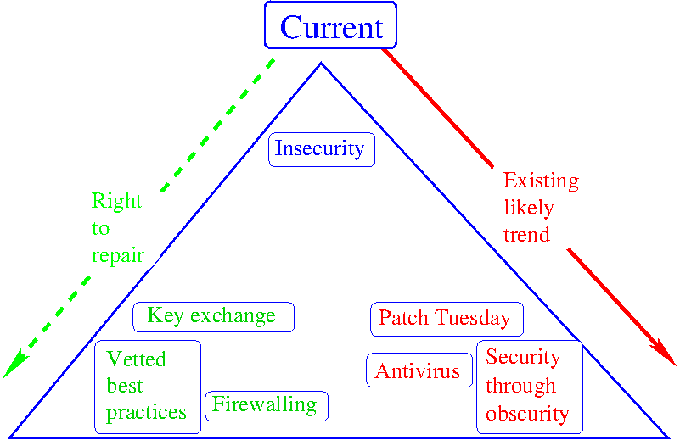

Slide 6
How to get involved
(or at least watch in an informed manner)
Write apps for automotive platforms.
Use cheap and readily available HW to interact with car.
Integrate automotive data with other sets and mine for new purposes.
Ask auto dealers, “What operating system does this model run?”
Tell your Congresscritter you support the “Right to Repair” Act.

Slide 7
Car manufacturer developer offerings
Renault R-Link (Android): no car available in U.S.
Ford's OpenXC Platform (Android and Arduino-compatible ChipKit32): launching May 2012.
General Motors Cadillac User Experience: 2Q 2012 launch promised.
Intel-Samsung (Tizen Linux with X11, HTML5) SDK: beta “preview”.
Ubuntu IVI Remix available for download now.

Slide 8
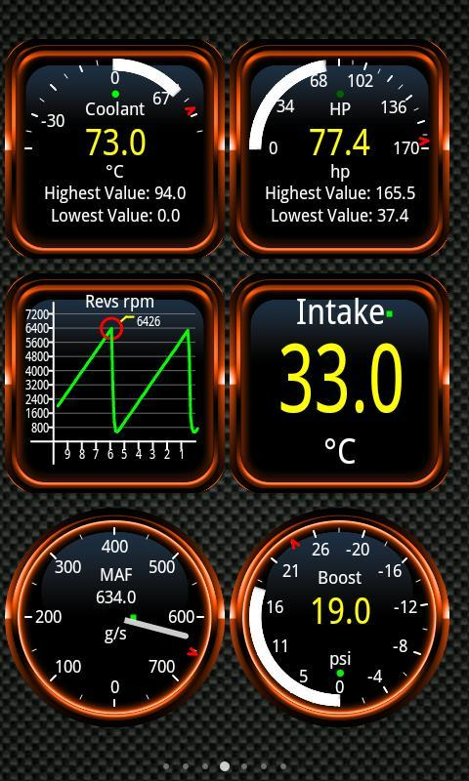
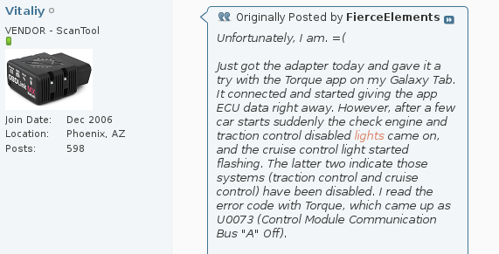
Proprietary “Torque” Android Market app and raw CAN
Source: very valuable mp3car.com forums
Pure OBDII completely safe!

Slide 9
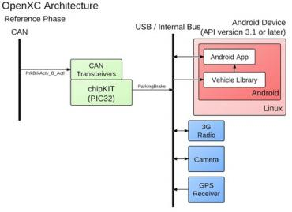
Ford's Android-Based OpenXC Platform
32-bit MIPS processor, Arduino pin-compatible, open toolchain, two CAN controllers, $50

Slide 10
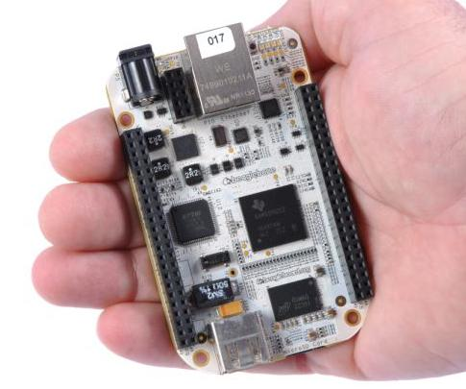
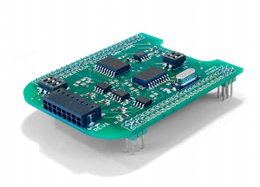
BeagleBone from TI
CAN “cape” for BeagleBone
Runs QCanObserver based on Qt
$89, widely available
€79, available via mail-order

Slide 11
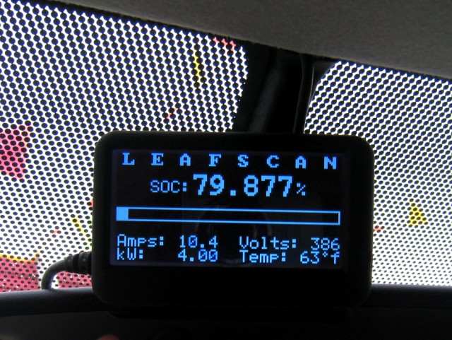
Quality community HW and SW already available
http://tinyurl.com/7wngdsj, http://tinyurl.com/7ttz24h

Slide 12
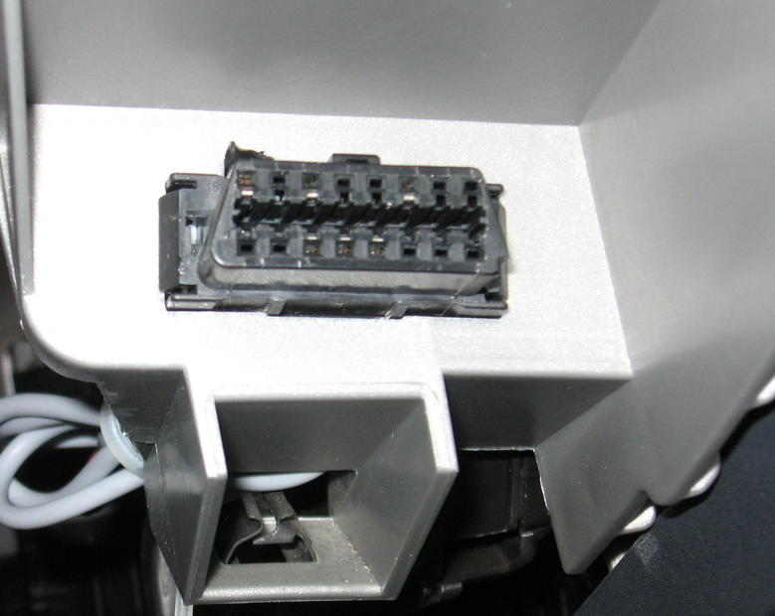
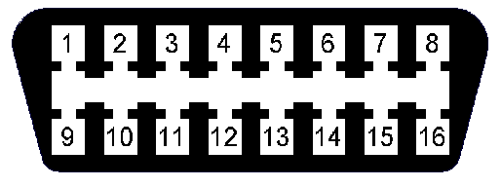
How to access a car's data
OBDII connector found in every
U.S. car since 1996.
COM
HS-CAN
LS-CAN
GND
Determine protocols in use
by examining populated pins.
2006 Mazda 3

Slide 13
How to select a scantool
Check which pins are populated in the OBDII connector of your car.
  Tells you which protocol(s) are supported.
Need only 4, 5, 6, 14 for OBDII.
Best choice for novice is USB ELM327:
  Cheaper (less than $50).
  Won't drain car battery and won't write to CAN.
  Easier to connect than Bluetooth.

Slide 14
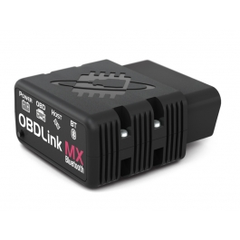
About the OBDLink MX
Power-user choice.
STN1110 controller (not ELM327), Bluetooth comms.
Support OBDII and non-standard CAN bus
  Typical “smog test” data plus
  Doors, lights, wipers, key, locks . . .
Reading OBDII is completely idiot-proof.
Writing to CAN allows remote door unlock, headlight checking . . . or “bricking” of car!

Slide 15
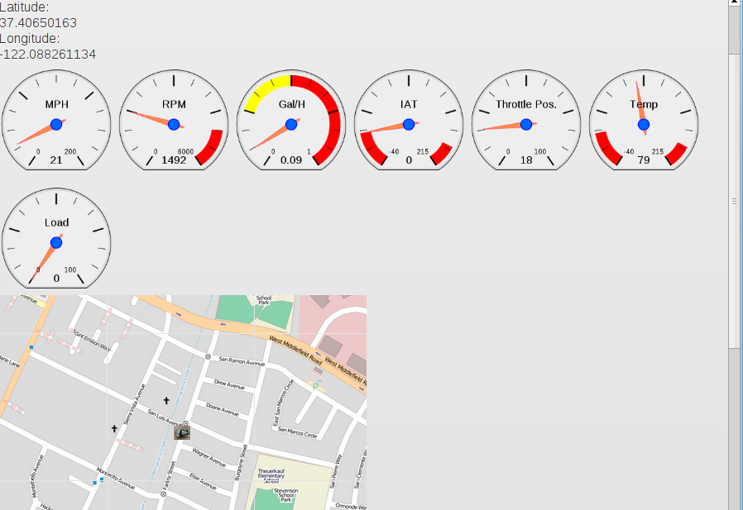
Demo 1: replay of prerecorded trip using nOBDy

Slide 16
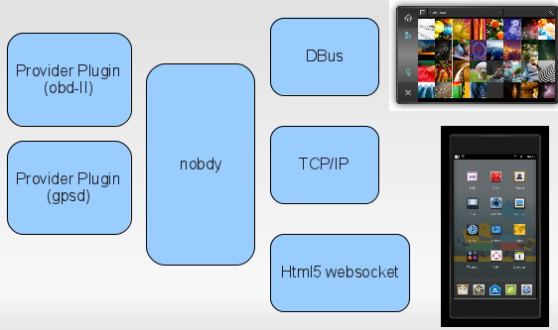
Demo 2A: live data demo using nOBDy, OBDLink MX and EcuSim (lunchtime)
Demo 1
sqlite DB
from actual trip
EcuSim
HW CAN emulator
Demo 2A
Browser

Slide 17
Demo 2B: live data demo using nOBDy, OBDLink MX and Mazda (evening)
OBDLink MX
scantool
Mazda 3
OBDII port
USGlobalSAT
USB GPS
Browser
Demo 2B

Slide 18
Summary
Automotive open source is at a tipping point
Opportunities to get involved as business, as hobby, as citizen
Inexpensive HW and open-source SW solutions abound
Join the party, or at least speak up for your rights!
Visit us at openice.org, #linuxice on freenode IRC or mp3car.com

Slide 19
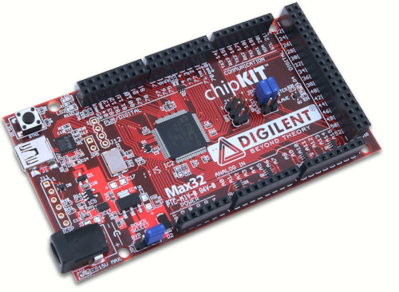
chipKIT Max32™ Prototyping Platform
32-bit MIPS processor, Arduino pin-compatible, open toolchain, two CAN controllers, $50

Slide 20
Our transportation system is
Dangerous
Hella annoying
Loud!!!
Time-wasting
Polluting
because until now individuals had little power to change it.
Goal: driver empowerment
Now: driver distraction
Goal: driver augmentation

