Slide 1
systemd, the next-generation Linux system manager
LISA15
Nov. 9, 2015
Alison Chaiken
alison@she-devel.com
Latest version with fixes at http://she-devel.com/LISA15/LISA15_systemd.pdf

Slide 2

Topics
Introduction: set up test environment.
Basic concepts and tools
Deeper dive into units, services and targets
Dependencies and service activation
Security and resource controls
Performance tuning and failure analysis
Stuart Chalmers

Slide 3
Key to examples
This font is for regular explanatory text and comments.
Blue font is for hyperlinks.
echo “green font for code snippets”
  Some are OK on localhost, others only in container or VM!

Slide 4
Quiz!
What is the most-deployed Linux init system, by number of devices?
  systemd;
  sysVinit;
  upstart;
  other.
systemd exits shortly after userspace comes up. (T/F)
systemd runs as
  one giant application;
  many threads of execution;
  a collection of processes;
  a virtual machine.

Slide 5
Quiz, p. 2
The license of systemd is:
  GPLv2;
  GPLv3;
  permissive;
  proprietary.
systemd runs on Linux as well as BSD and MacOS (T/F).
systemd's first distro release was:
  Fedora in 2011;
  Debian in 2014;
  RHEL in 2015.

Slide 6

Basic Concepts

Slide 7
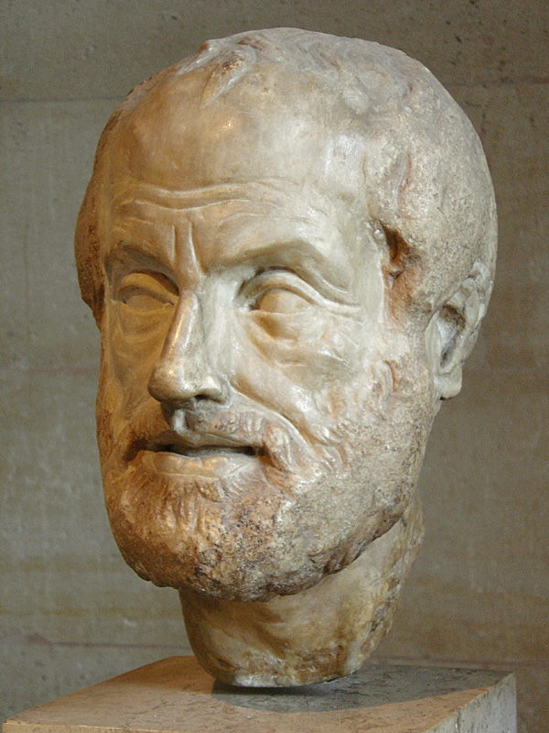
Philosophy of systemd
Extract duplicate functionality from daemons and move it to systemd core or kernel.
Replace init.d scripts with declarative config files.
Expose newer kernel APIs to userspace via a simple interface.
Control behavior of applications via unit files rather than with code changes.

Slide 8
systemd is:
modular;
asynchronous and concurrent;
described by declarative sets of properties;
bundled with analysis tools and tests;
features a fully language-agnostic API.

Slide 9
One daemon to rule them all
xinetd: a daemon to lazily launch internet services when activity is detected on an AF_INET socket
systemd: a daemon to lazily launch any system service when activity is detected on an AF_UNIX socket (oversimplification)

Slide 10

How to RTFM Most Effectively
Get the source:
git clone git@github.com:systemd/systemd.git
Provides a single grep-able directory with all man pages.
As a last resort, grep the source to find the origin of an error message.
The catch: must upload SSH key to github to clone from there.

Slide 11
Setup Test
Environment

Slide 12
Exercise 0: Install a container or VM in which to test systemd
Either:
boot up your favorite Linux container or VM;
or follow instructions to create a Debian or Fedora container;
or copy the Debian or Fedora container on the shared USB stick
or bring a device (e.g. RPi) on which to run Linux.
Any systemd installation >= 208 should work fine:
ps -p 1; systemctl --version

Slide 13
Configure container or VM for easy testing
Create a regular user (not root) and add to /etc/sudoers.
Add the user to the systemd-journal group.
If possible, install cups and nmap in the container/VM/device or on localhost.
If possible, install graphviz on localhost.

Slide 14
(optional) systemd-nspawn lightning course
systemd-nspawn manages systemd's native container type
Basically a namespaced chroot that reuses host's kernel.
Start console session for container:
  sudo systemd-nspawn -D </path/to/container/>
'Boot' the container:
  sudo systemd-nspawn -bD </path/to/container>
Monitor and control from host:
  machinectl list and machinectl status (not available in older versions)
  sudo machinectl reboot <container name>
  machinectl list-images

Slide 15
Preliminaries

Slide 16
Get started with systemctl and journalctl
addgroup $USER systemd-journal for access.
systemctl status; systemctl status ssh
journalctl -xn; journalctl -u ssh
systemctl --failed; journalctl -p err
sudo systemctl start cups (or restart)
systemctl show ntp
sudo systemctl poweroff or sudo systemctl reboot

Slide 17
Units and Services

Slide 18
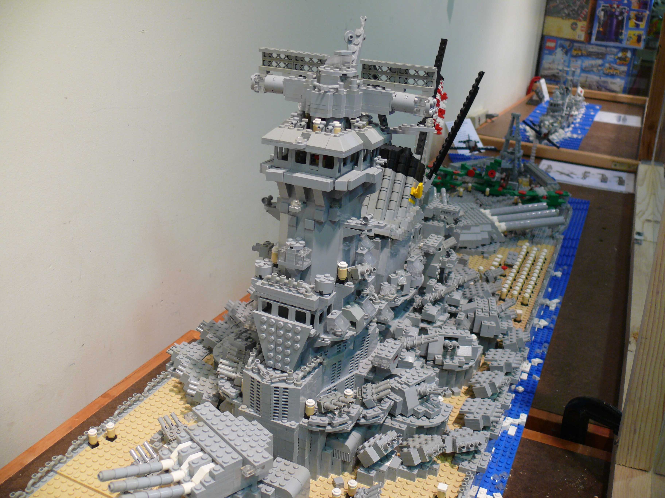
Complexity arising from many similar small units
Courtesy Bill Ward

Slide 19
init.d scripts ⇒⇒ systemd units
Unit's action and parameters: ExecStart=
Dependencies: Before=, After=, Requires=, Conflicts= and Wants=.
Default dependencies:
  Requires= and After= on basic.target;
  Conflicts= and Before= on shutdown.target.
Types of unit files: service, socket, device, mount, scope, slice, automount, swap, target, path, timer, snapshot
See 'man systemd.unit' or freedesktop.org

Slide 20
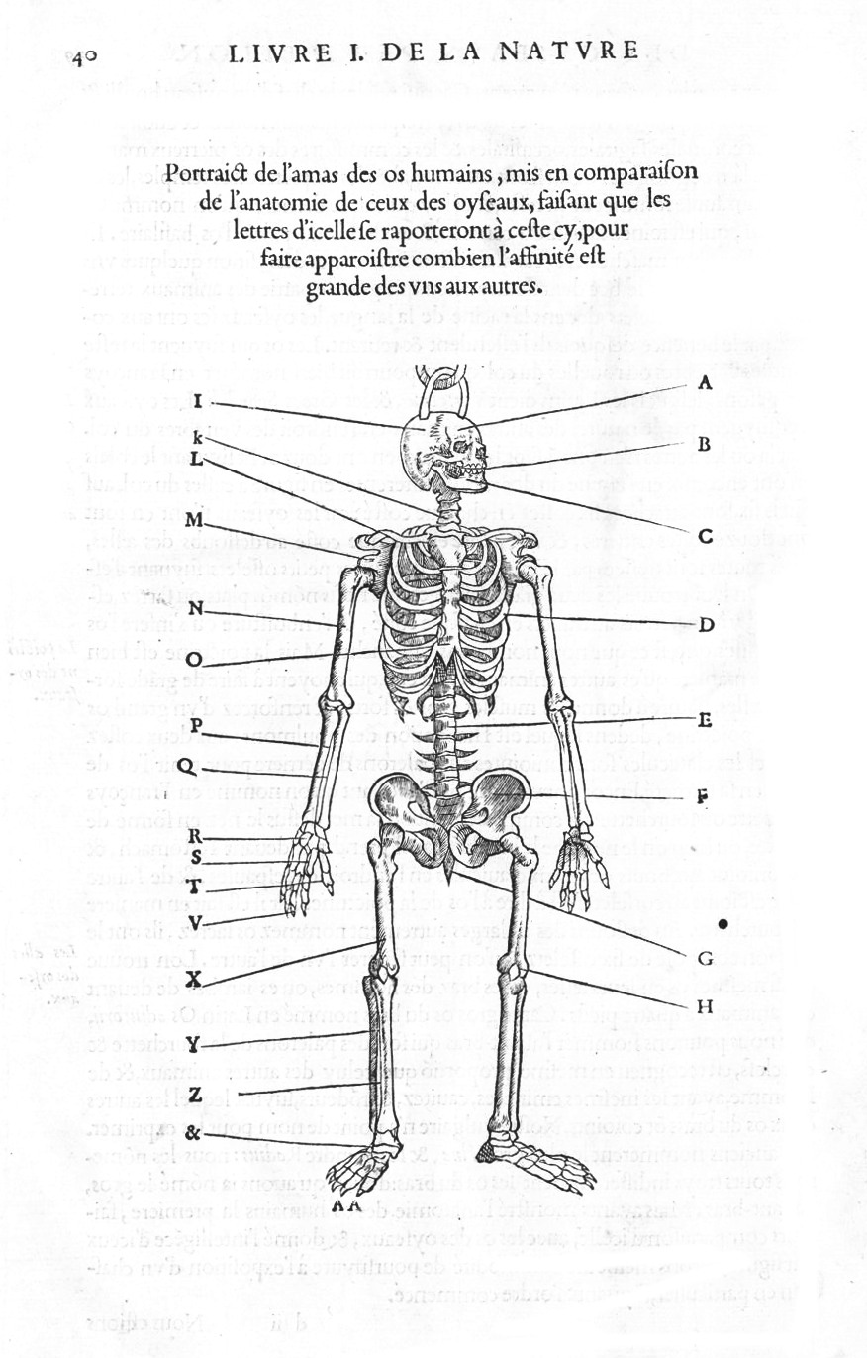
Anatomy of a Unit File
ExecStart can point to any executable, including a shell script.
Unit files typically include a [Unit] section and a [Service] section.
An [Install] section determines the target with which a unit is associated.
Try: systemctl cat ssh or systemctl show ssh

Slide 21
Precedence of unit files
/lib/systemd/system/: upstream defaults for system-wide services
/etc/systemd/system/: local customizations by override and extension
'drop-ins' are extension fragments akin to those in /etc/yum.repos.d/ or /etc/apt.conf.d/.
Try: systemd-delta

Slide 22
Exercise 1: create a HelloWorld service
Create HelloWorld.service in your container that prints “Hello World” into the systemd journal.
Situate it in the filesystem where systemd can find it.
Start the service using systemctl.
Check the status of your service. Where has “Hello, world” output appeared?

Slide 23
Solution: simple HelloWorld.service
With a text editor, create helloworld.sh:
  #!/bin/bash
  echo “Hello World!”
Copy the script into your container's filesystem:
  chmod +x helloworld.sh
  cp helloworld.sh /var/lib/machines/debian/usr/local/bin/
With a text editor, create HelloWorld.service:
  [Unit]
  Description=Hello World Service
  Documentation=
  [Service]
  ExecStart=/usr/local/bin/helloworld.sh
Copy the unit file into the container's filesystem:
  cp HelloWorld.service /var/lib/machines/debian/etc/systemd/system/
  (or, on your localhost, cp HelloWorld.service /etc/systemd/system/)
Boot the container, then load and run the unit:
  sudo systemd-nspawn -bD /var/lib/machines/debian
  [inside container] sudo systemctl start HelloWorld
  [inside container] systemctl status HelloWorld
  [inside container]journalctl -u HelloWorld

Slide 24
Targets
vs.
Runlevels

Slide 25

sysVinit runlevels ≈ systemd targets
Targets are synchronization points.
Check /lib/systemd/system/runlevel?.target symlinks:
multi-user.target (runlevel 3 == text session)
graphical.target (runlevel 5 == graphical session)
Select boot-target :
  via /etc/systemd/system/default.target symlink;
  by appending systemd.unit=<target> to bootargs.
Helpful diagram: “man 7 bootup”

Slide 26
Target Basics
Service S will be started as part of Target T iff S.service file is symlinked in the directory /etc/systemd/system/T.wants.
If S's unit file contains WantedBy=T, then
systemctl enable S
will create a symlink to S.service in /etc/systemd/system/T.wants
Similarly
systemctl disable S
removes the symlink.
To blacklist a service
systemctl mask S.service
'rm' or 'ln' can manage the services: there is no binary 'registry' DB.

Slide 27
Exercise 2: Make HelloWorld.service run at Boot
Modify HelloWorld.service.
Enable it.
Reboot and verify that the service is now started.
Disable the service, reboot and verify that service is not started.

Slide 28
Solution: make HelloWorld.Service run at boot
Append a “WantedBy” line to a new [Install] section in the unit:
[Install]
WantedBy=multi-user.target
Boot container and enable the unit:
sudo systemd-nspawn -bD /var/lib/machines/debian
[inside container] sudo systemctl enable HelloWorld
[inside container] ls /etc/systemd/system/multi-user.target.wants
Reboot and check status:
[inside container] sudo systemctl reboot
[inside container] systemctl status HelloWorld
Disable the service, reboot and check again:
[inside container] sudo systemctl disable HelloWorld [fails if the file is cp'ed, not ln'ed]
[inside container] sudo systemctl reboot
[inside container] systemctl status HelloWorld

Slide 29
systemd's dependencies

Slide 30
Demo: Generate ASCII Dependency Graphs
Examples:
systemctl list-dependencies basic.target
systemctl list-dependencies --after cups.socket
systemctl list-dependencies --before multi-user.target

Slide 31
Generate SVG Dependency Graph
Generate dependency metadata:
systemd-analyze dot basic.target > basic.dot
Generate graph image:
dot -Tsvg basic.dot -o basic.svg
View graph:
eog basic.svg (or view basic.svg with any web browser)
Note: dot is in graphviz package; eog is in eponymous one.

Slide 32
systemd bootup is ordered, but not deterministic
Services start other services they 'Want' or 'Require'.
Services stop if other services they 'Require' stop, but not if services they 'Want' stop.
'After' means 'start after another service starts'.
  Not 'start after another service is fully initialized' or finished.
  'Before' is similar.
To express more nuanced sequence, use Path, PID or Socket-based signalling. Examples:
  ConditionPathExists= in unit file listing /var/run/*.pid
  systemd-notify messages to socket
FAQ

Slide 33
Simple targets
vs.
runlevels

Slide 34

Not all targets are 'runlevels'
courtesy Pierre-Yves Beaudoin
FAQ
Targets can simply be collections of services all started at once.
A runlevel is a special target that is reached only when all wanted services reach completion.
RTFM: man systemd.special
New simple targets = new unit files + directories with symlinks.
New runlevels require new code.

Slide 35
FAQ: how do I create a new runlevel?
You don't want to.
  Doing so involves writing a bunch of C/C++ code.
Creating a new runlevel is possible.
  GENIVI automotive Linux project has done it.
  Code is available from
  git://git.projects.genivi.org/lifecycle/node-startup-controller.git
  Webcast slides and audio
  Use case: a LAN with many dumb no-OS MCUs.
Is your use case truly so different from those considered by freedesktop.org?

Slide 36
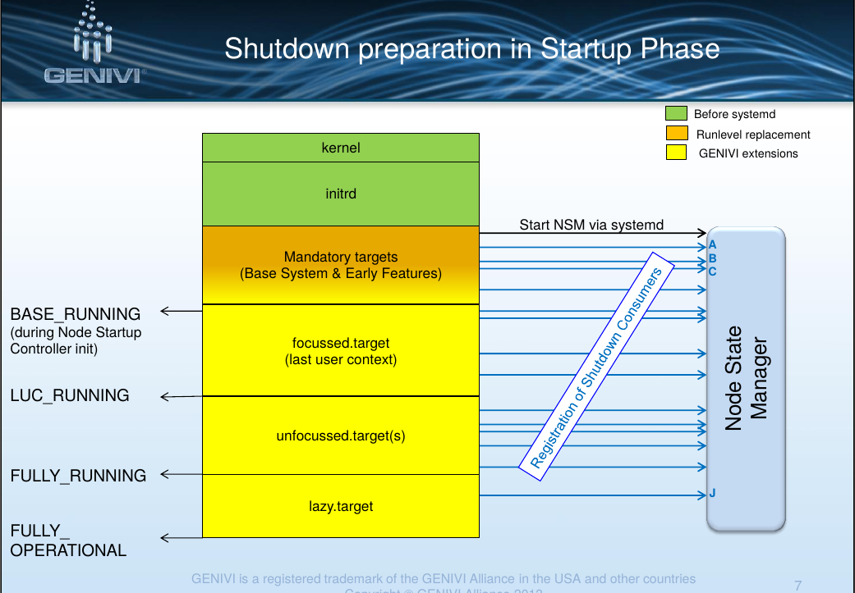
From GENIVI Lifecycle Management webcast slides; the source code

Slide 37
Unit file hierarchy
and precedence

Slide 38
system and user system instances
systemd's system instance manages singleton daemons that provide systemwide services;
systemd's user instance manages per-user services.
Try:
  systemctl --user status
Discuss: why does systemctl --user status fail?
Configuration files are in $HOME, not /etc/systemd.
User instance only runs if systemd is built with PAM feature:
systemctl --version | grep PAM

Slide 39
system and user units
Organized into system and user units.
/lib/systemd/system: systemd upstream's defaults for system-wide services
/usr/lib/systemd/user/: systemd upstream's defaults for per-user services
$HOME/.local/share/systemd/user/ for user-installed units
'drop-ins' are run-time extensions (man systemd.unit) for either user or system instances.

Slide 40
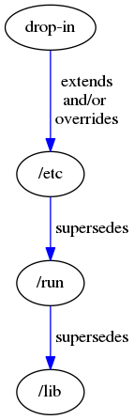
Precedence of system unit files
man systemd.unit
highest; optional;
static
in /etc/systemd/system/<unit-name>.d/foo.conf
alternatives that
produce the same result
optional;
static
in /etc/systemd/system/foo.service
optional;
dynamically generated
in /run/systemd/system/foo.service
lowest;
from upstream
in /lib/systemd/system/foo.service
Tip: create unit files for new services in /etc. Drop-ins are for override.

Slide 41
Exercise 3:Understanding unit file hierarchy
Display path and text of currently loaded unit file.
  systemctl cat systemd-logind
Copy the currently loaded unit to a position higher in
the unit-file hierarchy.
  sudo cp /lib/systemd/system/systemd-logind.service /etc/systemd/system
Try: systemctl cat systemd-logind
  Is the result what you expected? Why?
Another clue:
  systemd-delta

Slide 42
Unit file hierarchy puzzle: the answer
FAQ
sudo systemctl daemon-reload
systemctl cat systemd-logind
Clean-up. (Why is this important?)
  sudo rm /etc/systemd/system/systemd-logind.service
And repeat sudo systemctl daemon-reload

Slide 43
Understanding socket-based
activation

Slide 44
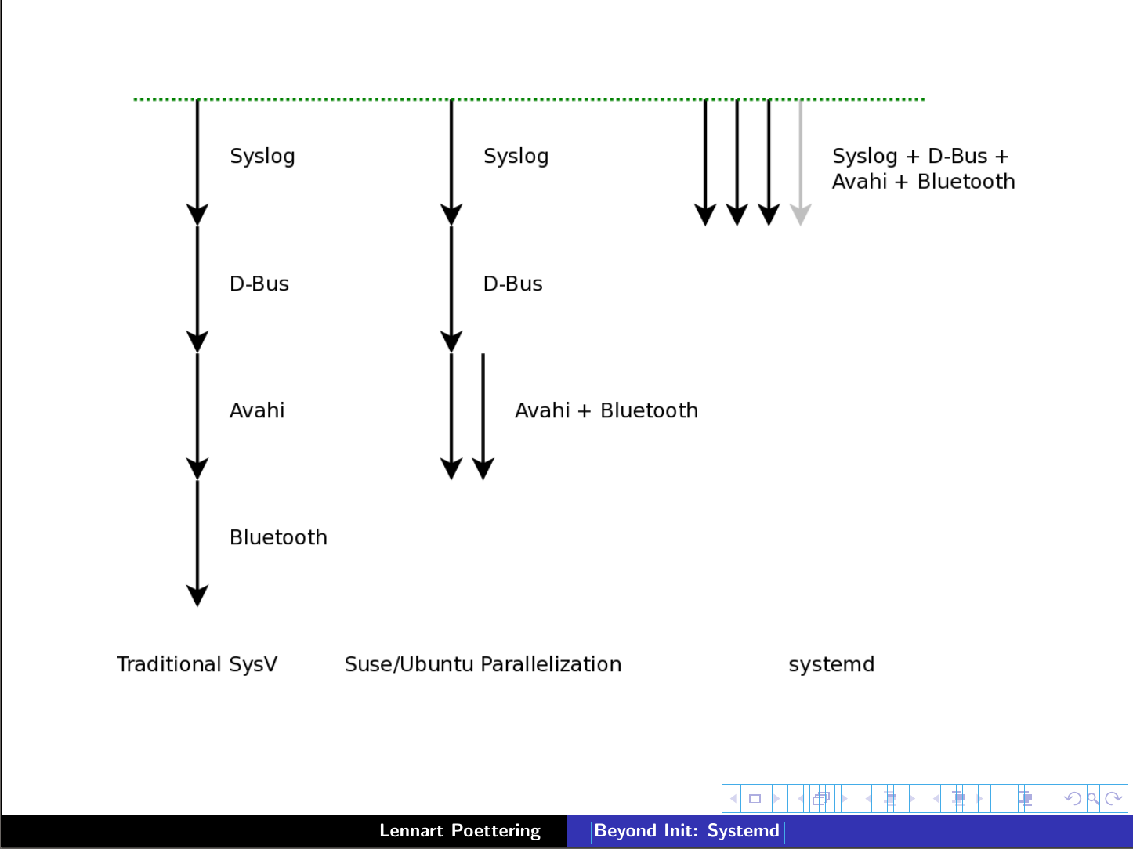
Socket-based activation is key to systemd's fast boot
Serial
Linked list
Fully parallel
and Upstart

Slide 45
Demo:control cups via socket-based activation
Check if cups is running and stop it:
systemctl status cups.service
sudo systemctl stop cups.service
systemctl status cups.service
What is cups.socket?
systemctl cat cups.socket
systemctl status cups.socket
What is the difference between /lib/systemd/system/cups.socket
and /var/run/cups/cups.sock?
cups.sock is a normal AF_UNIX socket, so
echo “HTTP POST” | ncat -U /var/run/cups/cups.socket
Now check cups.service:
systemctl status cups.service

Slide 46
Tune and control
your configuration
with systemd

Slide 47
systemd intuitively exposes kernel interfaces
Including Capabilities, Watchdog, Cgroups and kdbus ('coming attraction')
Kernel features are configurable via systemd's unit files.
Encourages creation of system-wide policies via unit templates.
man 7 capabilities

Slide 48
systemd and cgroups
cgroups were difficult to config prior to advent of systemd tools.
cgroups are a kernel-level mechanism for allocating resources: storage, memory, CPU and network.
slices are groups of services whose resources are managed jointly.
systemd scopes are resultant groups of processes.
Sysadmins can set BlockIOWeight, IOSchedulingPriority, OOMScoreAdjust, CPUShares, MemoryLimit, Nice …
Reference: kernel's documentation and 'man systemd.resource-control'

Slide 49
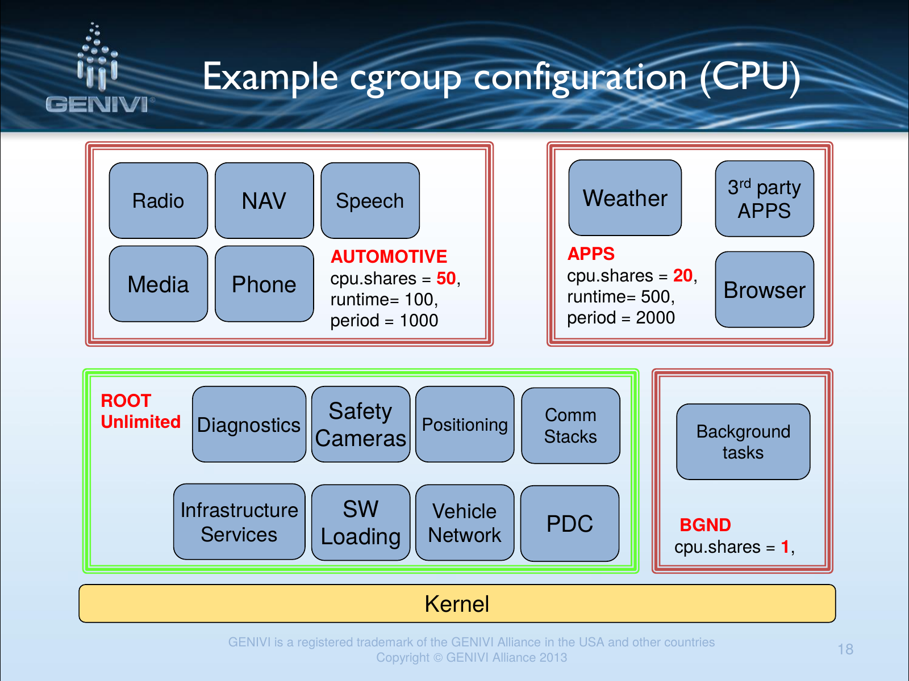
From GENIVI Lifecycle Management webcast slides (GENIVI automotive Linux consortium)

Slide 50
check cgroup configuration on your current system
systemd-cgls
systemd-cgtop
mount | grep cgroup shows which 'controllers' are available
NOTE:
  Which controllers are available depends on the kernel config:
  grep CGROUP /boot/config*
NOTE:
  unless "CPUAccounting=1", "MemoryAccounting=1" and "BlockIOAccounting=1" are enabled for the services in question, no resource accounting will be available for system services and the data shown by systemd-cgtop will be incomplete.

Slide 51
Exercise 4: set 'niceness' of Firefox
Create a service that starts Firefox with per-user settings in firefox.slice.
Set the 'niceness' of Firefox.
Check that the process runs at the 'niceness' you've set.
Hints:
  You may need to run 'xhost +localhost' on localhost.
  Possibly add 'Environment=DISPLAY=:0' to your unit file.
  man systemd.exec

Slide 52
Solution: nice Firefox
Create a firefox.service file in /usr/lib/systemd/user:
[Unit]
Description=Firefox web browser
[Service]
Environment=DISPLAY=:0
ExecStart=/usr/bin/firefox (might be /bin/firefox)
Nice=12
Slice=firefox.slice (optional but worth trying to see its effect)
systemctl --user start firefox
systemd-cgls
Employ ps or top to check 'niceness'.
Note that you now need
systemctl --user enable firefox
systemctl --user daemon-reload
journalctl –user-unit=firefox (not journalctl --user though)

Slide 53

systemd and security: granular encapsulationvia kernel's capabilities
CapabilityBoundingSet at boot; capability dropping possible
PrivateTmp, PrivateDevices, PrivateNetwork, JoinNamespaces
ProtectSystem (/usr and /etc), ProtectHome
ReadOnlyDirectories, InaccessibleDirectories
Set system-wide security policies via /etc/systemd/*conf files
References: LWN on “Inheriting capabilities” and man capabilities

Slide 54
Exercise 6: control file access of firefox.service
Add 'CapabilityBoundingSet=' to firefox.service and restart.
  Investigate with getpcaps, journalctl and systemctl. (getpcaps
  may not be in your default $PATH.)
Replace CapabilityBoundingSet directive with 'InaccessibleDirectories=/home'.
Move to /etc/systemd/system and restart.
  Try to read files in /home with the browser after starting it from 'sudo -i'.
  Explain the behavior.
Don't forget 'systemctl daemon-reload' and '--user'.

Slide 55
Solution: limiting Firefox's access
Starting firefox.service as jack, from /etc/systemd/user, with CapabilityBoundingSet=
  [jack@f22container ~]$ systemctl --user daemon-reload
  [jack@f22container ~]$ systemctl --user start firefox
  [jack@f22container ~]$ systemctl --user --failed
  UNIT LOAD ACTIVE SUB DESCRIPTION
  ● firefox.service loaded failed failed Firefox web browser
  [jack@f22container ~]$ journalctl --user -p err
  Sep 19 16:44:03 f22container systemd[300]: Failed at step CAPABILITIES spawning /bin/firefox: Operation not permitted

Slide 56
Solution: limiting Firefox's access
Starting firefox.service with sudo from /etc/systemd/system, without 'CapabilityBoundingSet=',
  bash-4.3# getpcaps `pidof firefox`
  Capabilities for `1923': = cap_chown,cap_dac_override,cap_dac_read_search,cap_fowner,cap_fsetid,cap_kill,cap_setgid,cap_setuid,cap_setpcap,cap_linux_immutable,cap_net_bind_service,cap_net_broadcast,cap_net_raw,cap_ipc_owner,cap_sys_chroot,cap_sys_ptrace,cap_sys_admin,cap_sys_boot,cap_sys_nice,cap_sys_resource,cap_sys_tty_config,cap_mknod,cap_lease,cap_audit_write,cap_audit_control,cap_setfcap+ep
With 'CapabilityBoundingSet=',
  bash-4.3# systemctl daemon-reload
  bash-4.3# getpcaps `pidof firefox`
  Capabilities for `2036': =
A bit simpler than SELinux!

Slide 57
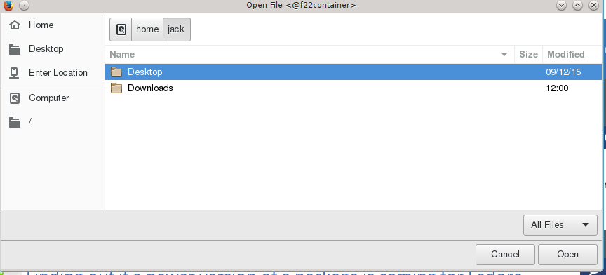
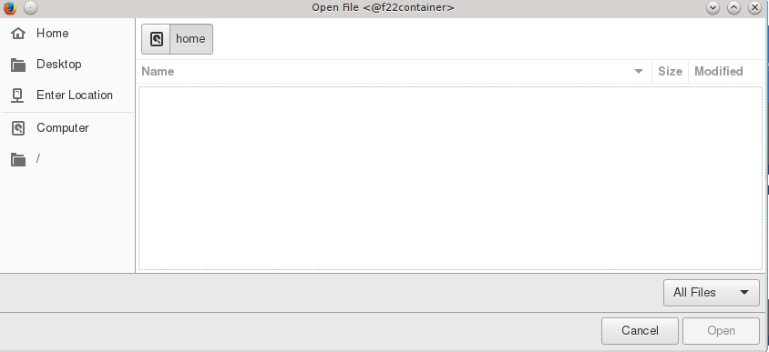
Solution: limit Firefox's access
Starting firefox.service as root from /etc/systemd/system and without 'InaccessibleDirectories=/home',
Starting firefox.service as root from /etc/systemd/system and with 'InaccessibleDirectories=/home',

Slide 58
systemd troubleshooting

Slide 59
ProTips!
When all else fails, consult the files in /etc/systemd/*.conf.
Dump all potential configuration items:
/lib/systemd/systemd --dump-configuration-items
Most useful man pages:
man systemd.exec
man systemd.unit
man systemd.service
Consult systemd mailing list archives and wiki.

Slide 60
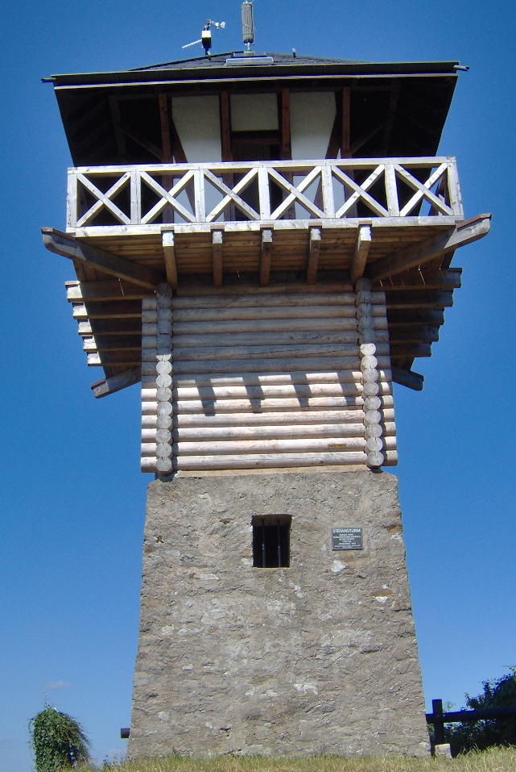
A bit more about the systemd journal
In binary format, but has a simple UI that beats 'grep' and 'awk'.
Is fully compatible with parallel syslog output.
Can push the journal to a remote via unit file configuration.
Can be automatically cryptographically signed.
Is, with udev, one of the required systemd components.

Slide 61

systemd prevents self-injury!
Test out new units by trying them:
  systemd-analyze verify <new unit>
  in /run
  in *.conf.d directory
  via bootargs
Do not ever modify files in /lib/systemd.
  Restore defaults by removing broken units with higher precedence.
Services linked into basic.target.wants (≈runlevel 1) that won't work until graphical.target (runlevel 5) will start properly if their dependencies are correctly stated.

Slide 62

systemd's watchdog timer support
Provides simple configuration of soft or hard watchdogs.
RuntimeWatchdogSec sets a timer for petting the dog.
ShutdownWatchdogSec sets a timer to force reboot if shutdown hangs.

Slide 63
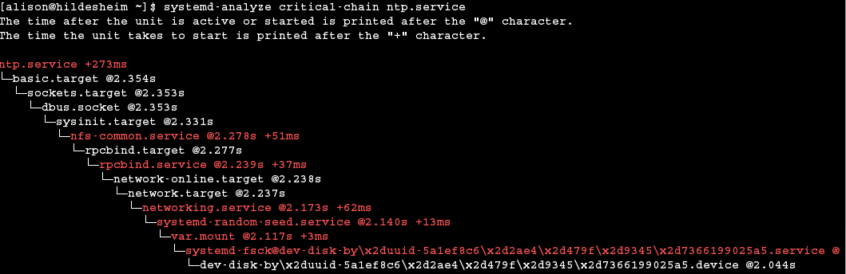
'systemd-analyze critical-chain':
Why did that unit take so long to start?
Note: ntp was started by SysVinit!!

Slide 64
Final quiz
T/F: systemd is best characterized as an init system.
Which of the following is not a recommended way to customize systemd?
  Edit /etc/systemd/*.conf files;
  Edit the files in /lib/systemd/system;
  Edit /etc/systemd/<unit-name.d>/*.conf files;
  Employ “systemctl enable” and “systemctl disable”.
Which of the following is not a real systemd component?
  systemd-nspawn, systemd-logind, packagectl, systemd-delta
Which of the following is true? The systemd journal:
  is incompatible with syslog;
  can be viewed with systemd-journalviewer or a browser;
  can be cryptographically signed automatically;
  is configured via an XML file.
T/F: systemd services are always started via socket-based activation.

Slide 65

Summary
systemd is easier to configure and customize than you fear.
Most users will not notice (or have not noticed).
There are real difficulties but
  systemd is still relatively new;
  system administration is complex.

Slide 66
Additional Resources
Man pages are part of systemd git repo.
freedesktop.org: systemd mailing list archives and wiki; Pöttering's blog
#systemd on Freenode IRC
➟At wayback machine: “Booting up” articles
systemd.conf YouTube channel and slides
Neil Brown series at LWN on 'systemd programming' (design of NFS units)
➟Fedora's SysVinit to systemd cheatsheet
LWN on “How Debian managed the systemd transition”
Linux Action Show interview with Lennart Poettering
“Who wrote systemd?” statistics
Jordan Hubbard of FreeBSD describes launchd porting plans (at 40 mins.)

Slide 67

Acknowledgements
https://commons.wikimedia.org/wiki/File:Pronam-mudra.png#/media/File:Pronam-mudra.png
twb and ohsix on #systemd on freenode IRC
Zbigniew Jędrzejewski-Szmek on systemd-devel
Kevin Dankwardt for help with organizing class
USENIX/LISA for invitation.

Slide 68
Course evaluation
The course was too introductory/too advanced.
The amount of lecture versus exercises was too high/too low.
The course content is relevant to my work: T/F.
I now understand systemd better: T/F.
I know how to find more information about systemd: T/F.
Email to alison@she-devel.com

Slide 69
system and user units derive from D-Bus
systemd cooperates with D-Bus to provide:
  singleton daemons that provide systemwide services;
  per-user services.
Try:
  busctl --system | head
  busctl --user | head
Same information is accessible via qdbus or gdbus.
Reference: “Control your Linux desktop with D-Bus”

Slide 70
Exercise: control firefox's memory utilization
The following works on systems where localhost's kernel is compiled with CONFIG_MEMCG=y.
  Don't forget that containers share the kernel with localhost.
Create a unit file that will start firefox.
Turn on memory accounting.
Check firefox's memory accounting via systemd-cgtop.
Add a MemoryLimit field to the unit file.
Restart your service and check the memory utilization again: top or ps -o slice,vsize,rss,%mem -C firefox.
Hints: you may need to run 'xhost +localhost' on localhost and add
'Environment=DISPLAY=:0' to your unit file.

Slide 71
Firefox and cgroups solution
firefox.service:
  [Unit]
  Description=Firefox web browser
  [Service]
  Environment=DISPLAY=:0
  ExecStart=/usr/bin/firefox (or /bin/firefox)
  MemoryAccounting=true
  MemoryLimit=10M
sudo mv firefox.service /etc/systemd/user
systemctl --user start firefox
systemd-cgtop and ps -o slice,vsize,rss,%mem -C firefox
Remove MemoryLimit and compare.

Slide 72
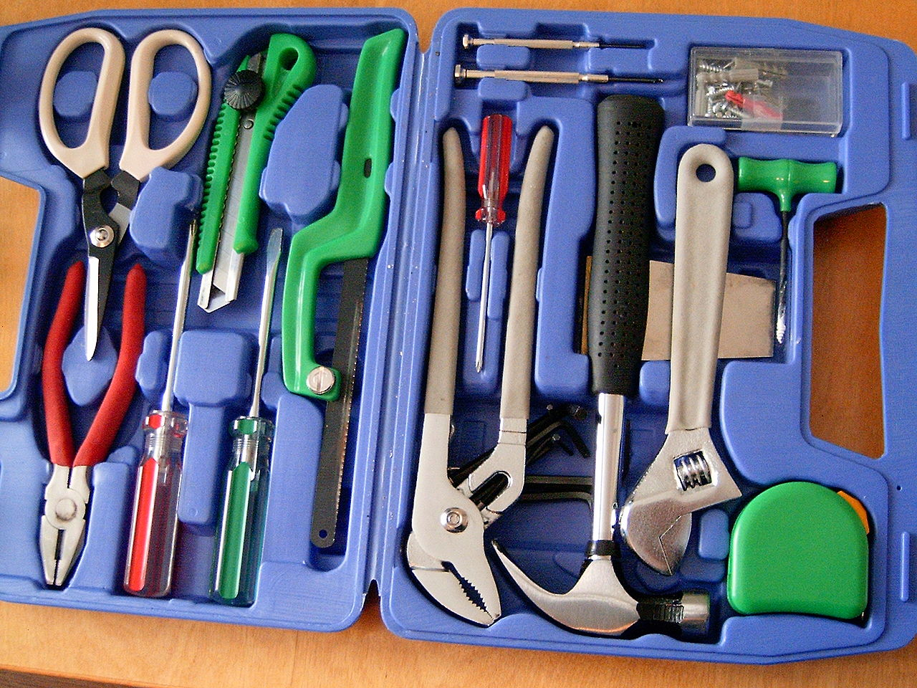
Taxonomy of systemd tools
Analogous to 'git'.
'Porcelain' generalized tools: 'ls /bin/*ctl'
  journalctl, systemctl, machinectl, busctl, loginctl, networkctl
  Man pages, useful in bash scripts.
'Plumbing' components: 'find /lib/systemd -executable -type f'
  A few lack man pages; try '--help'.
  Tools that are invoked by other tools.
  May be useful in testing.
Domain-specific: 'ls /usr/bin/systemd-*'
"20060513 toolbox" by Per Erik Strandberg sv:User:PER9000 - Own work.
Licensed under CC BY-SA 2.5 via Commons -
https://commons.wikimedia.org/wiki/File:20060513_toolbox.jpg#/media/File:20060513_toolbox.jpg

