Slide 1
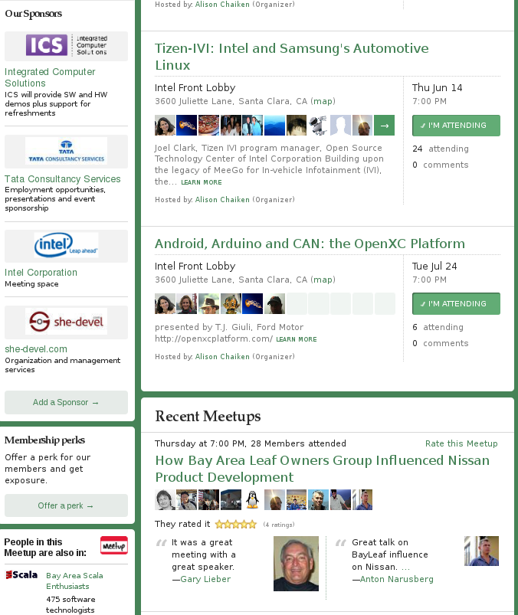

Silicon Valley Automotive Open Source Meetup http://www.meetup.com/Silicon-Valley-Automotive-Open-Source/
Completely
free!

Slide 2


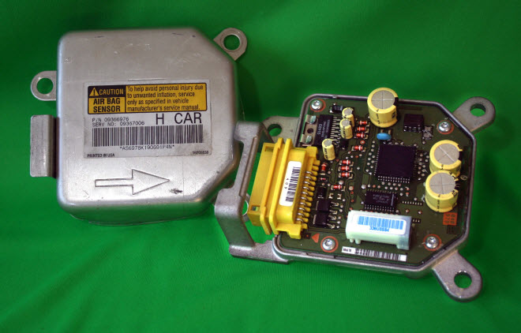
“no data are recorded by the (Event Data Recorder) EDR under normal driving conditions and no personal data . . . are recorded.”
Source: Insurance Institute for Highway Safety

Slide 3
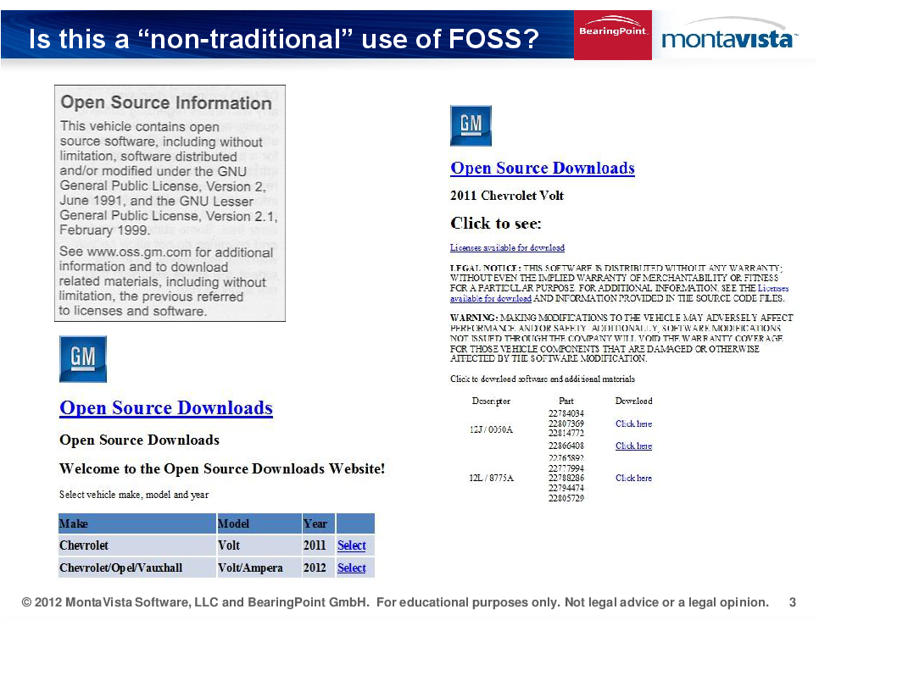

Slide 4
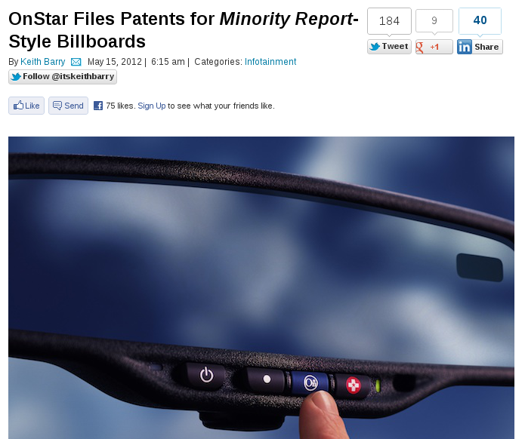

Slide 5
Status of Automotive Open Source
Manufacturer | Confirmed Operating system
Fiat-Chrysler Blue&Me (500, Delta), Kia Uvo, BYD, Nissan Leaf | Microsoft Windows Embedded Automotive
Ford (all?) | MyTouch/Sync-Microsoft; OpenXC-Android
General Motors (new 2012 Cadillacs), Chevy Volt | MontaVista's GNU/Linux
Geely (China); Hawtai (China) | GNU/Linux: Moblin (MeeGo predecessor)
Renault R-Link | Android
Honda (Accord, Odyssey, Pilot), Audi, BMW (7-series and M models), Chrysler, Daewoo, GM (OnStar), Hyundai, Land Rover, Porsche, Saab (9-3) Renault (SM7) | QNX
Linux Foundation members: Toyota, Pelagicore, Symbio, Tieto.
Automotive Linux Summit 2011 presenters: Toyota, Nissan, BMW.
MeeGo Conference 2011 presenter: Nissan.
Volkswagen has a pilot using Maemo (Linux).

Slide 6
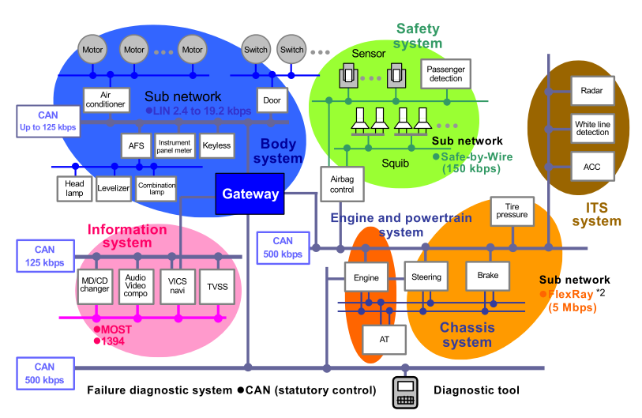
Automotive data buses have little security
Wireless!

Slide 7
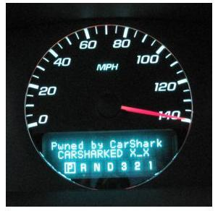
CAN bus is not ready for Internet age
UCSD, UWa, Rutgers: http://autosec.org/

Slide 8
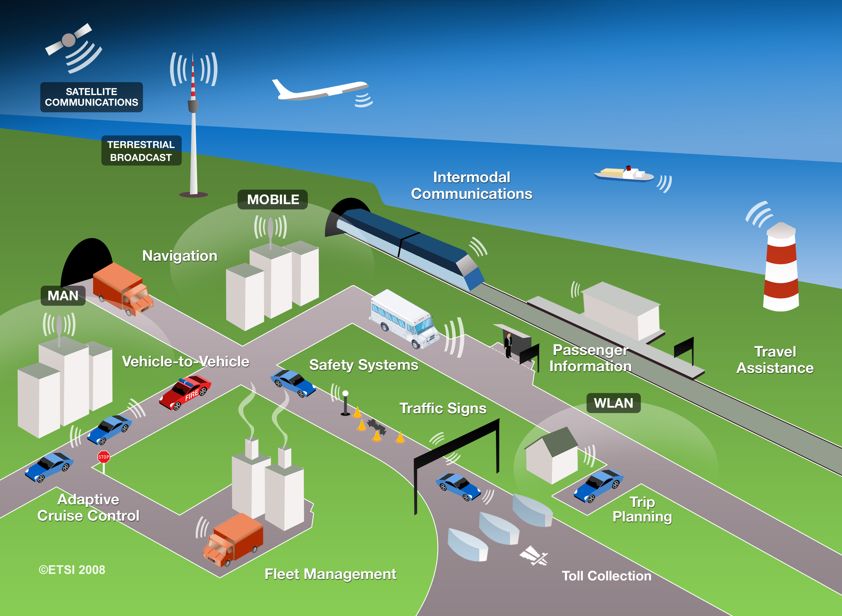
V2V and V2I: making use of real-time data
Courtesy ETSI.
Early-warning hazard alert system pilots already in U.S., Germany.

Slide 9
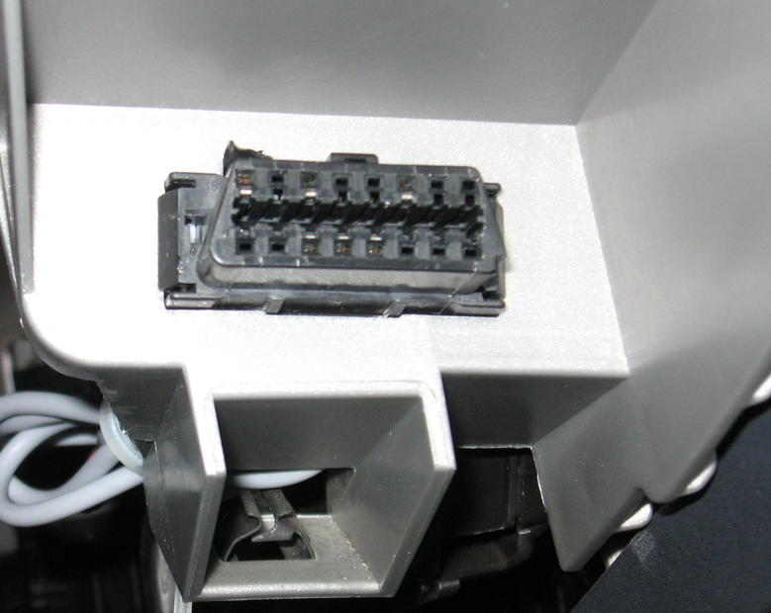
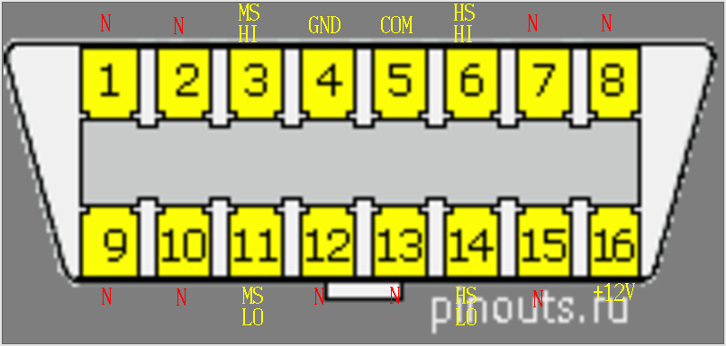
How to access a car's data: the connector
OBDII connector found in every
U.S. car since 1996.
Determine protocols in use
by examining populated pins.
2005 Mazda 3: http://tinyurl.com/6usk2hv

Slide 10
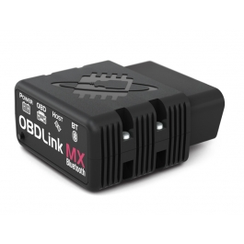
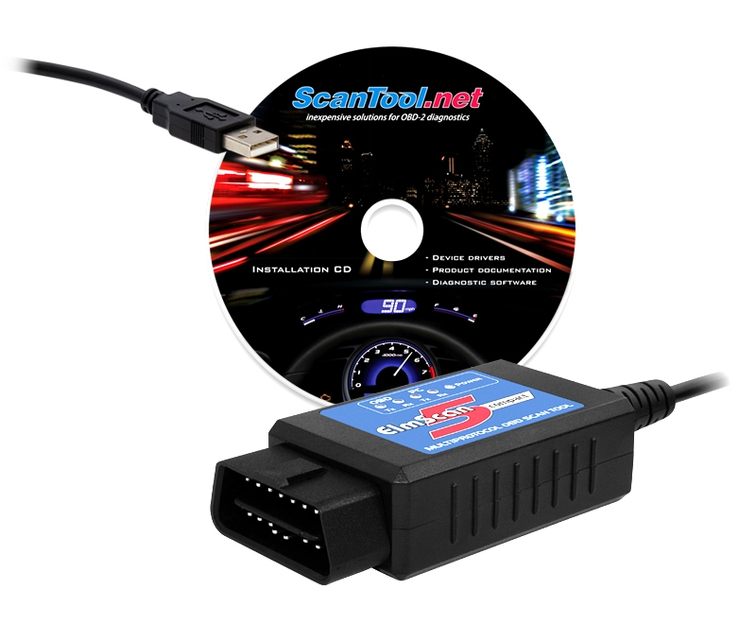
How to access a car's data: the scantool
Entry level: USB, limited protocol set,
read-only comms, $40
Experienced user: Bluetooth, expanded
protocols, some risk, $250
Scantool.net has great documentation and community support.

Slide 11
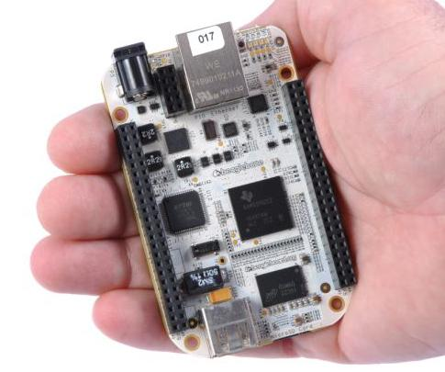
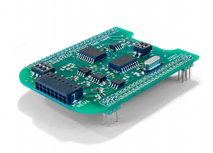
Roll your own scantool: BeagleBone from TI
CAN “cape” for BeagleBone
Runs QCanObserver based on Qt
$89, widely available
€79, available via mail-order

Slide 12
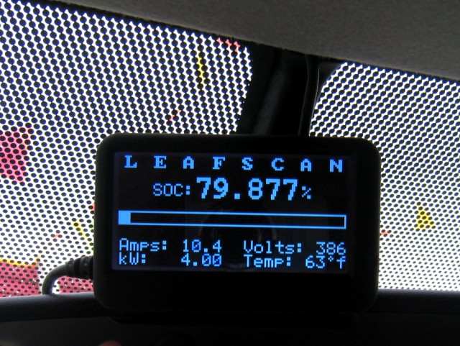
Scantool-based status display for Nissan Leaf
http://tinyurl.com/7wngdsj, http://tinyurl.com/7ttz24h

Slide 13
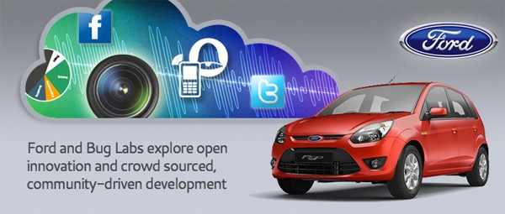
OpenXC Platform: Android/Arduino Scantool
http://openxcplatform.com/
Status: limited pre-release to selected developers

Slide 14
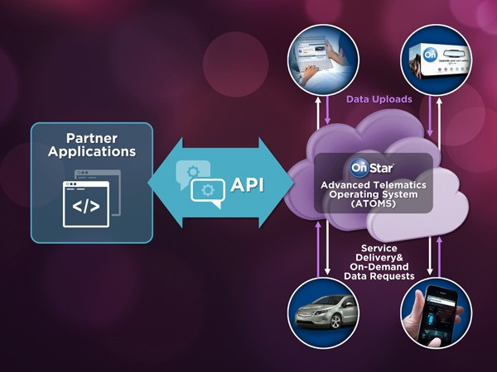
Cadillac User Experience based on MontaVista Linux
OnStar is
RIM's
QNX.
Status: SDK expected, Summer 2012

Slide 15
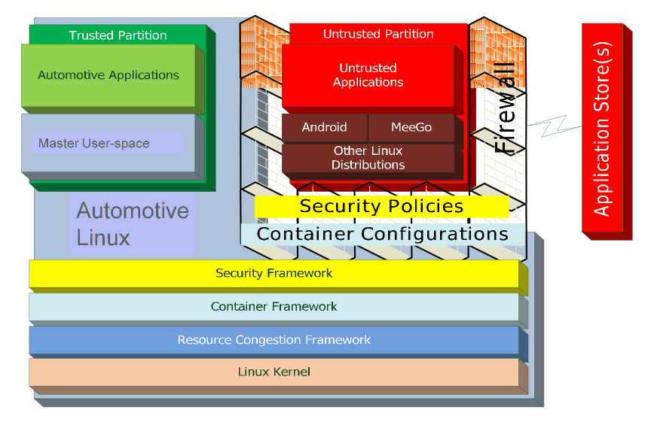
MontaVista's Automotive Linux stack
Courtesy Iisko Lappalainen, MontaVista, Embedded Linux Conf Europe 2011

Slide 16
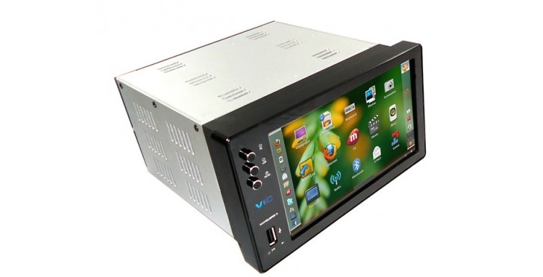
Ubuntu IVI Remix, released 12/2011
http://news.softpedia.com/news/Ubuntu-IVI-Remix-Beta-2-Officially-Released-242300.shtml
https://oem-share.canonical.com/share/ivi-remix/release-beta2-dec2011/

Slide 17
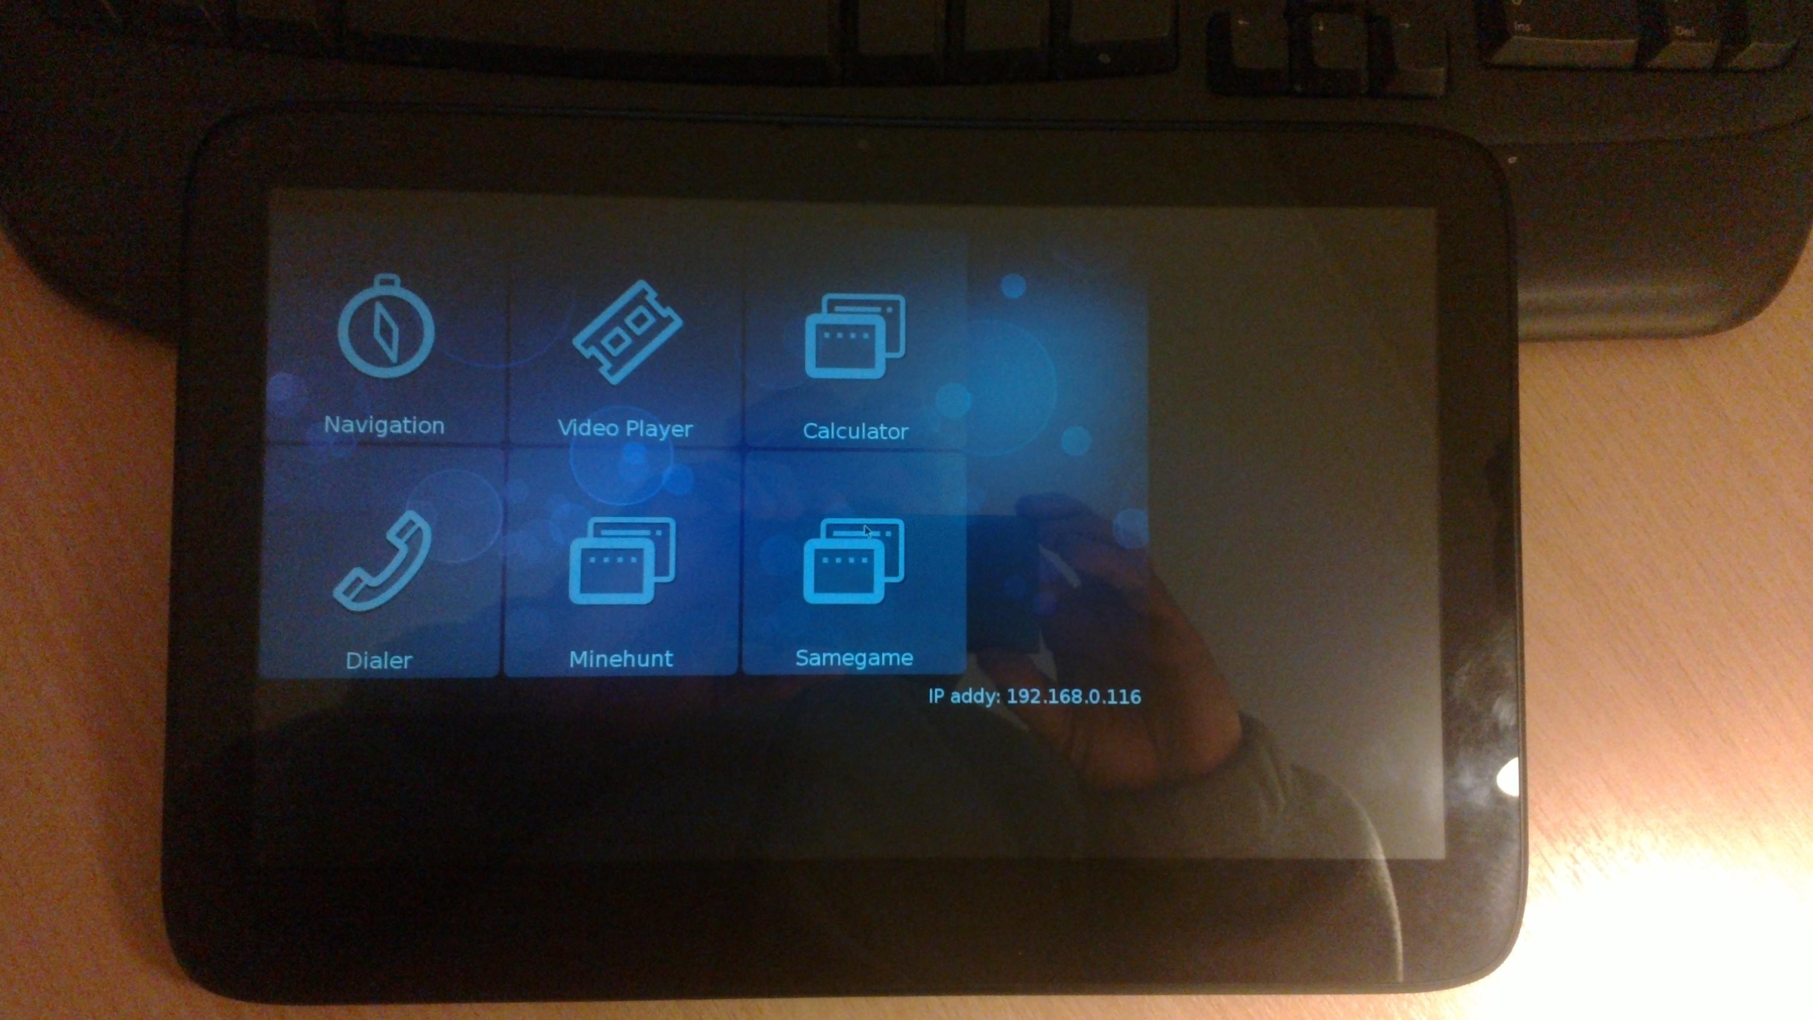
Tizen-IVI (Intel-Samsung) on Atom-based Slate
Intel-Samsung Automotive Linux for x86 and ARM

Slide 18


Dear Dr. Chaiken,
I thought you'd like to know that I'm once again a cosponsor of the Motor Vehicle Owners Right to Repair Act in the 112th Congress. . . . [it] requires vehicle manufacturers to provide the same service information to independent shops that they offer to their franchised dealers. . . . The Act has been referred to the House Committee on Energy and Commerce . . . Sincerely, Anna G. Eshoo

Slide 19
How to get involved: corporate-backed FLOSS
Tizen-IVI (Intel-Samsung): https://wiki.tizen.org/wiki/IVI
OpenXC (Android): http://openxcplatform.com/
Ubuntu IVI Remix: http://linux.softpedia.com/progDownload/Ubuntu-IVI-Remix-Download-78078.html
Renault R-Link (Android): http://www.renault.com/en/innovation/plaisir-et-confort/pages/r-link.aspx
Bosch-ETAS Busmaster (Windows): https://github.com/rbei-etas/busmaster

Slide 20



How to get involved: community projects
NOBDy wiki:
http://wiki.openice.org/index.php?title=Nobdy
OBDGPSLogger: http://icculus.org/obdgpslogger/
LibOBD:
http://libobd.wikia.com/wiki/Libobd_Wiki
OBDref: https://github.com/canurabus/obdref
Mp3car: http://www.mp3car.com/

Slide 21
OBDGPSLogger: Real-time Vehicle Diagnostics
http://icculus.org/obdgpslogger/

Slide 22
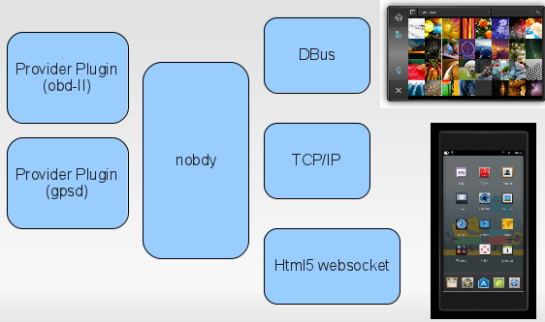
nOBDy is a plug-in framework akin to gstreamer or pulseaudio
Plugin
framework
subscriber or
provider
Provider Plugin
(obdsim)
Subscriber plugin

Slide 23
Features of nOBDy
Language-agnostic Websocket (TCP), Bluetooth and D-Bus API: use with python, Javascript or Java
Written using Qt (C++) toolkit and QML (Javascript-like Qt Modelling Language)
Browser interface based on JQuery Mobile
Provides communications interface to CAN (Controller Area Network) vehicle data bus
GPLv2, source on gitorious
Based on libobd, OBDGPSLogger, obdref and gpsd projects
Available as .deb and (soon) RPM packages

Slide 24
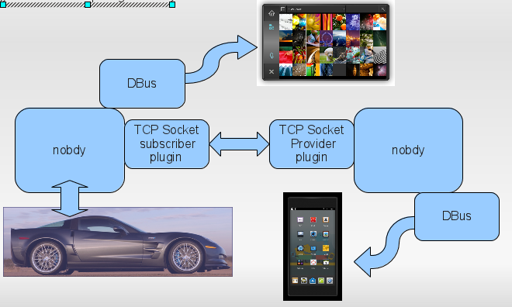
Use cases for nOBDy plug-in framework

Slide 25
nOBDy's stack
Your Qt, QML or Javascript application here!
nOBDy plugin framework
QML
JQuery
HTML5
Qt
OpenLayers
OBDGPSLogger
OpenStreetMap
gpsd
libobd
Linux kernel and device drivers
New plugins that talk TCP can be written in any language.

