Slide 1

MeeGo on Development Boards
Alison Chaiken
alchaiken@gmail.com
Nokia Mobility Solutions
5/24/2011

Slide 2
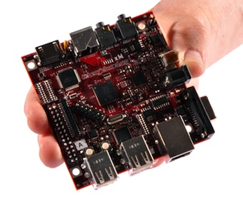
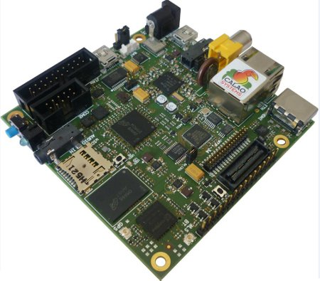
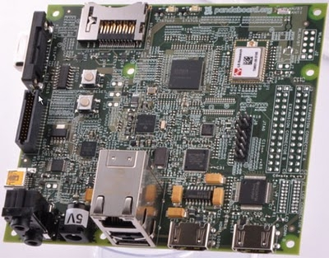
Notable Dev Boards in use by aMeeGos
BeagleBoard XM
X1 Cortex A8 with SGX530 GPU
Pandaboard
X2 Cortex A9 with SGX540 GPU
ST-Ericsson Snowball
X2 Cortex A9 with Mali GPU

Slide 3
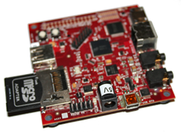
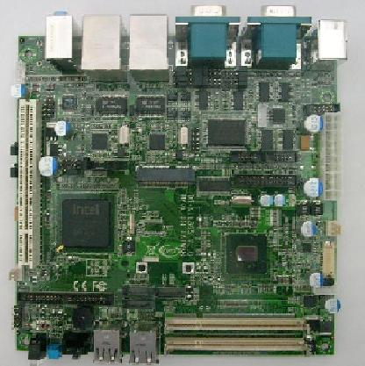
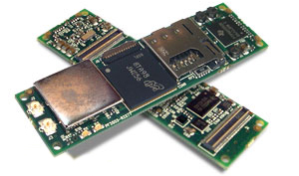
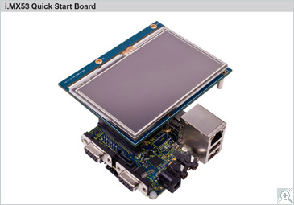
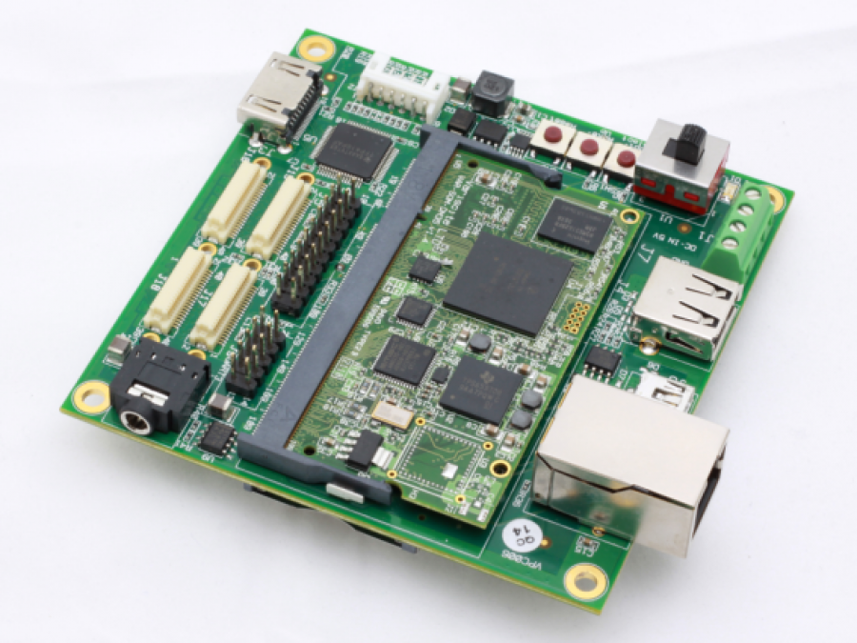
Prototyping possibilities
Gumstix Overo
X1 Cortex A8 with SGX530 GPU
Atom N450 Mini-ITX
Single core, “integrated graphics”
Freescale iMX53 QuickStart
X1 Cortex A8 1 GHz, SATA
Variscite AM35
X1 Cortex A8 600 MHz, CAN bus

Slide 4
Different approaches
TI has put a great deal of effort into development hardware but less into SDK
  No TI “app store”
Intel has put great effort into the MeeGo SDK
  AppUp online store accepts “components” as well as user-facing apps
Gumstix is explicitly aimed at prototypers
ST Ericsson, Freescale just getting started

Slide 5
Why does MeeGo care about dev boards?
Encourage interest in MeeGo platform
  Education and science markets
Enable startups and small businesses to develop prototypes of H/W products
Ease development of H/W-intensive S/W (using sensors)
Potential to create accessory market of MeeGo-compatible devices

Slide 6
Problems
Atom development boards are expensive ($1400) unless purchaser is part of “seed board” program ($149)
  Compatible tools (JTAG) also more expensive
MeeGo 1.2 ABI for ARM not backwards-compatible with 1.1 (softfp → hardfp break)
Device driver support spotty
Uneven toolchain support and documentation
Product lifetime and availability not always clear

Slide 7
Questions
Does MeeGo for
microcontrollers
make sense?
Who are the current
users and what are
their plans?
What features does MeeGo lack
to support H/W that startups
and small businesses need?
What features do existing
dev boards lack? What
accessories?
What relationship should
MeeGo have with Yocto, Linaro,
OpenEmbedded, Buildroot?

