Slide 1

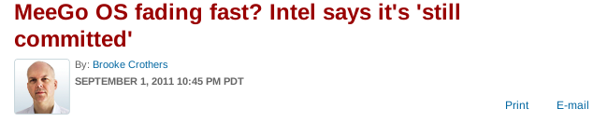
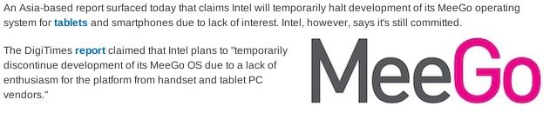


Slide 2
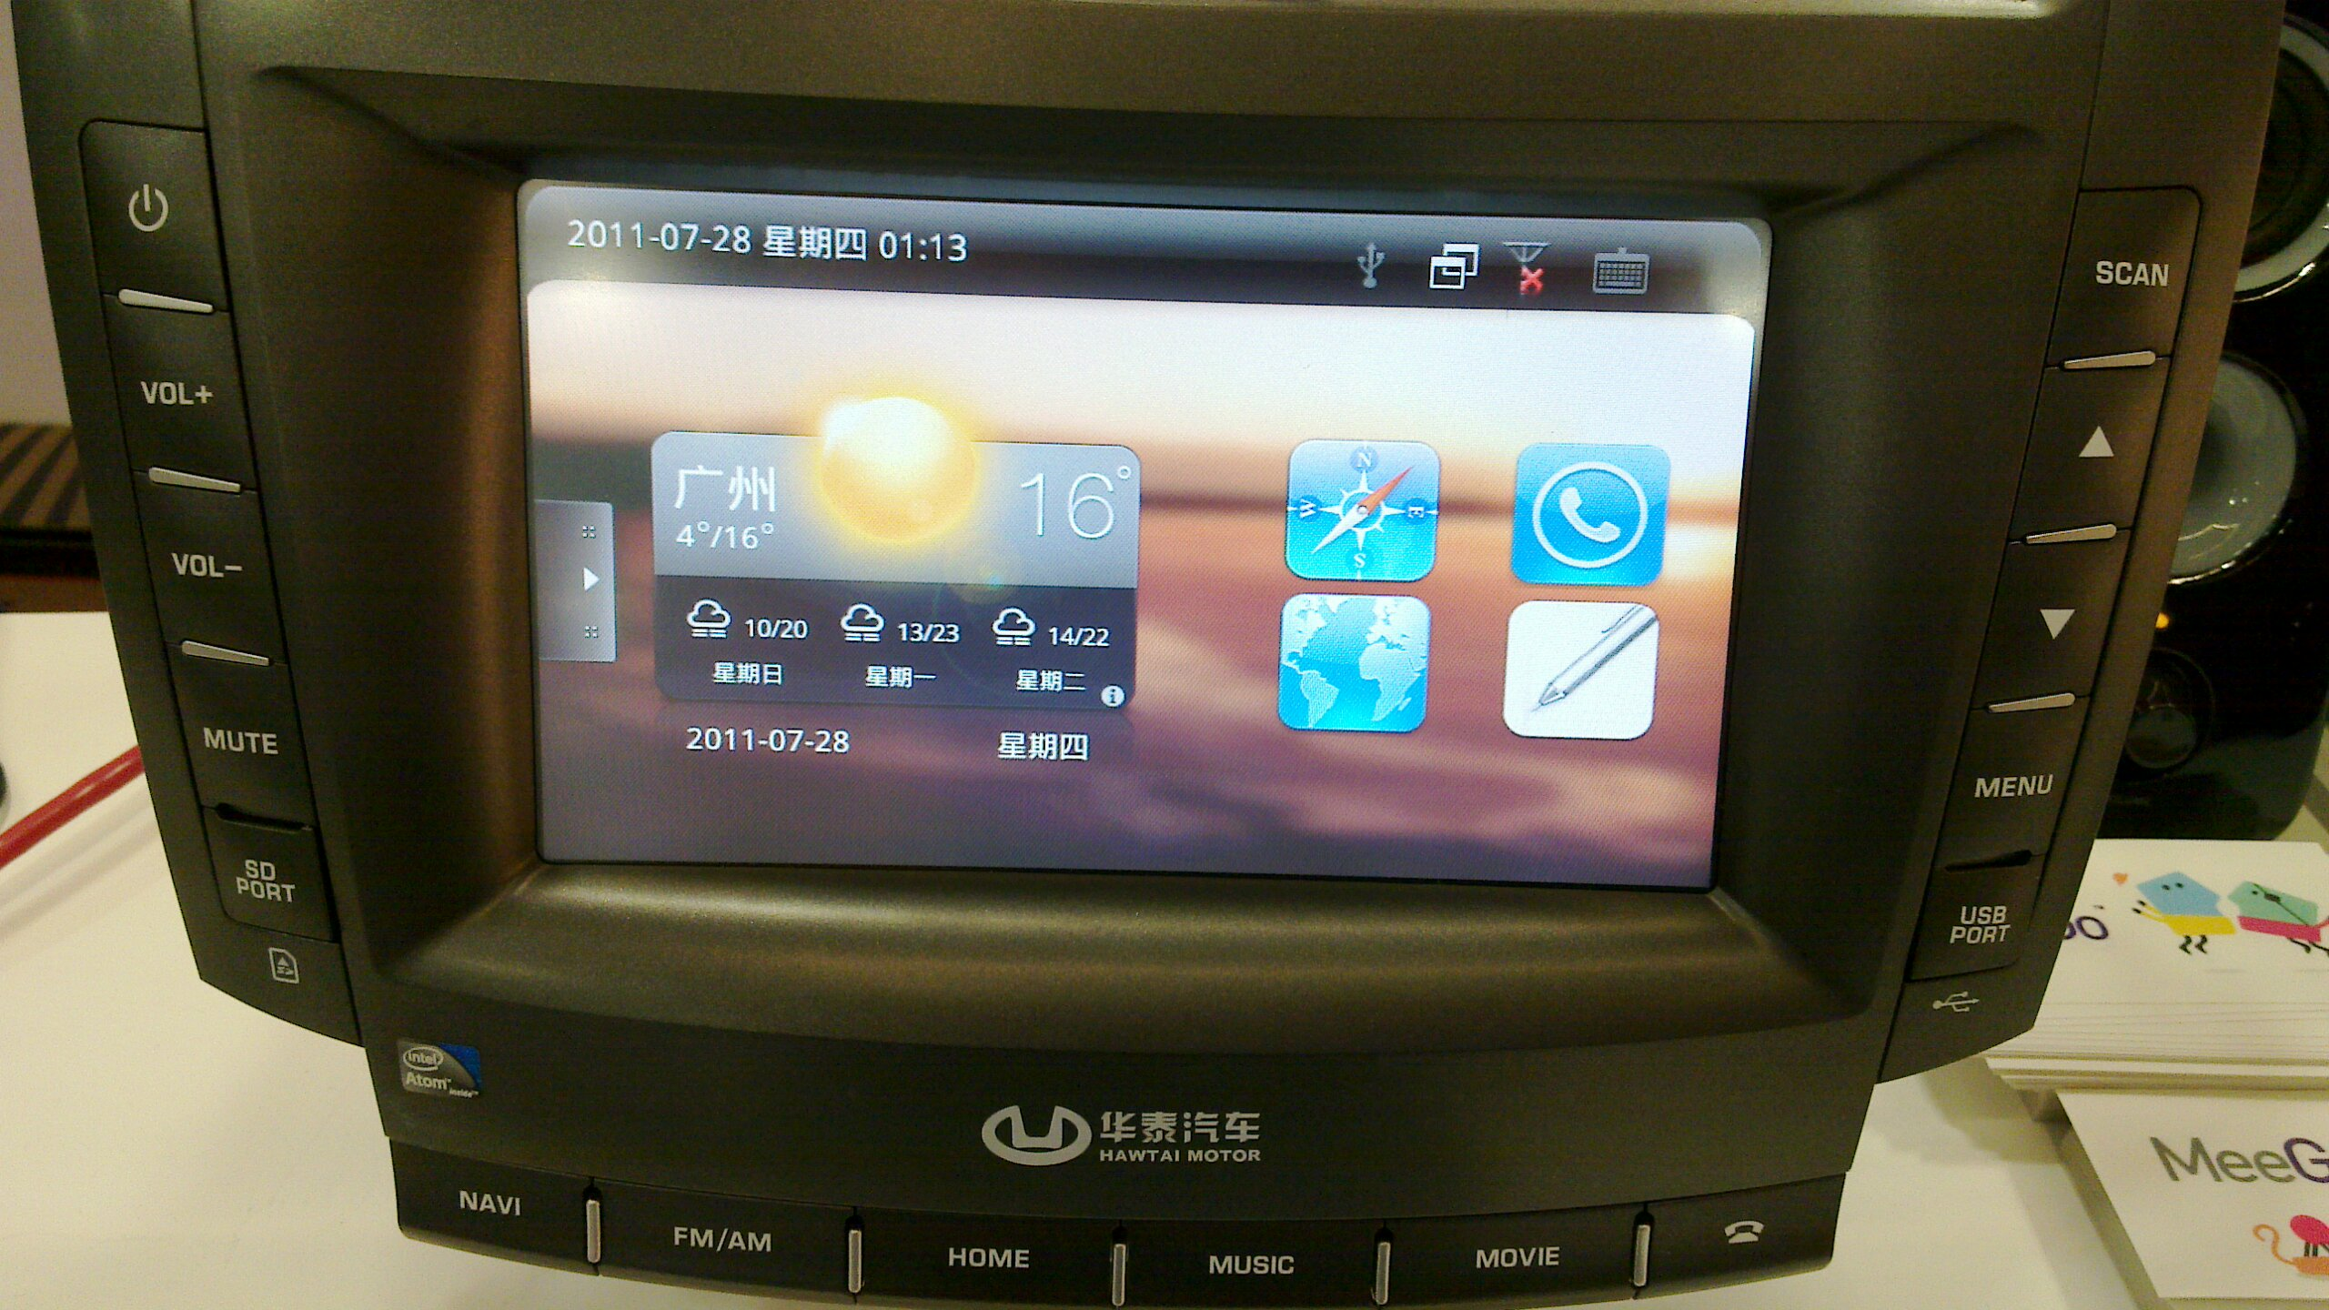
Automotive: next hot mobile platform for MeeGo
Alison Chaiken
alchaiken@gmail.com
http://she-devel.com/

Slide 3
Outline
Automotive software systems: IVI
The MeeGo IVI project
(lack of) hardware support for IVI
nobdy and ExoPC demos

Slide 4

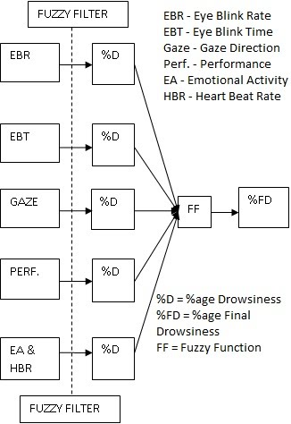
What is “in-vehicle infotainment”?
What “infotainment” calls to mind
What IVI could be

Slide 5
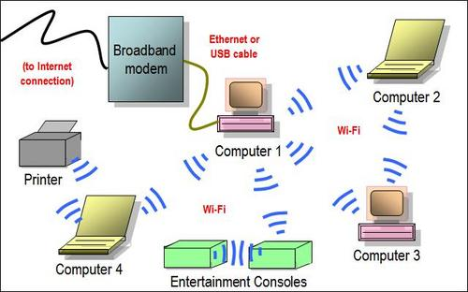

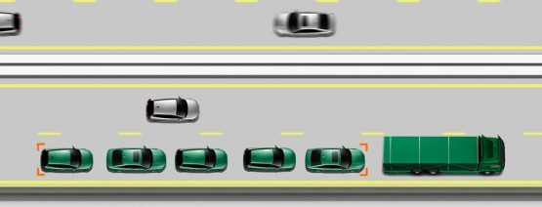
Ad hoc networking saves energy
Collision avoidance is key!

Slide 6
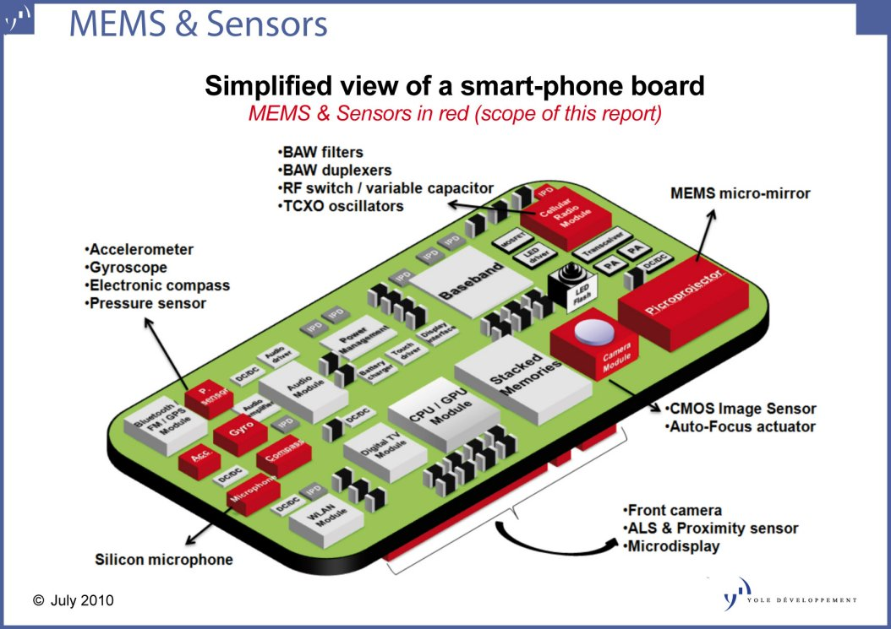
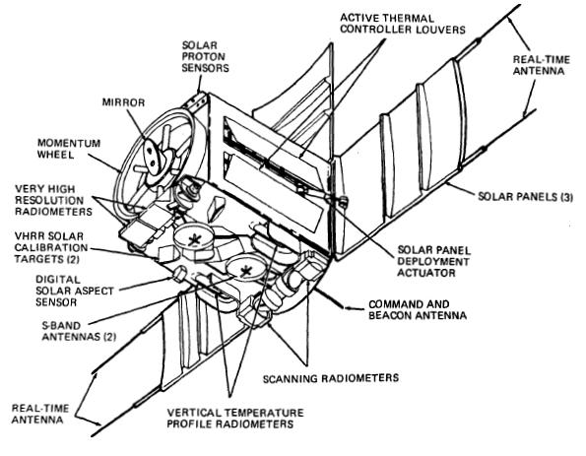
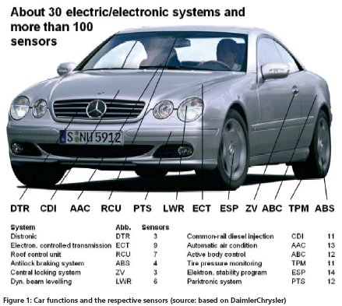
Mobile sensor platforms

Slide 7
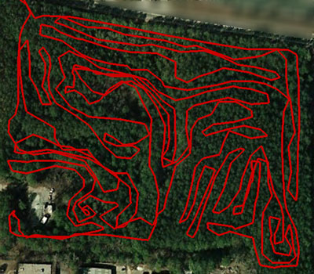
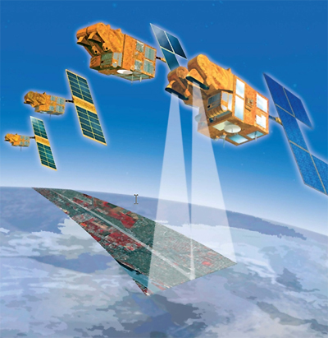
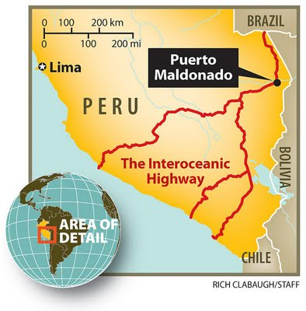
Mobile sensor data collection coverage
Sensor data fusion: way beyond real-time traffic!

Slide 8
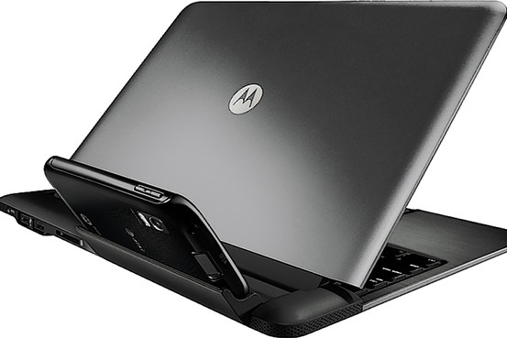
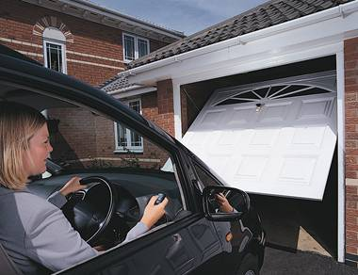
Inserting smarts into big dumb docking stations
Cars can tether and sync rural businesses and homes?

Slide 9
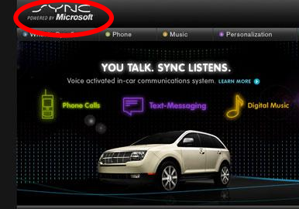
Challenges 1: security
Backseat kids changing nav system's destination . . .
mechanic at shop installs malware.

Slide 10
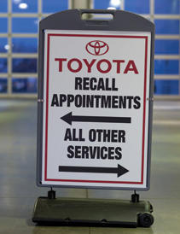
Challenges 2: safety
Driver must receive alarms but not modify many parameters.
Prevent malfunctioning systems from interfering with driving.

Slide 11
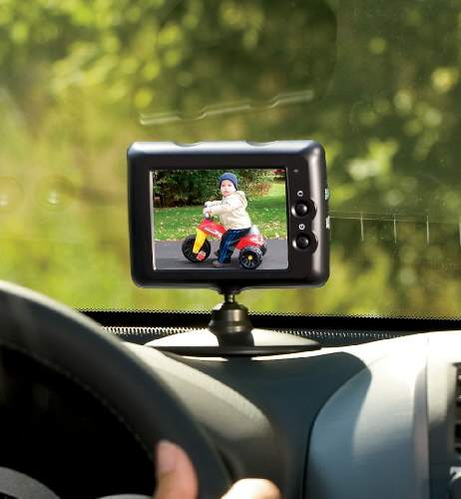
Challenges 3: HW needs
CAN bus, MOST bus, wheel rotation sensors, oil level . .
Not just RT audio, but RT video too!

Slide 12
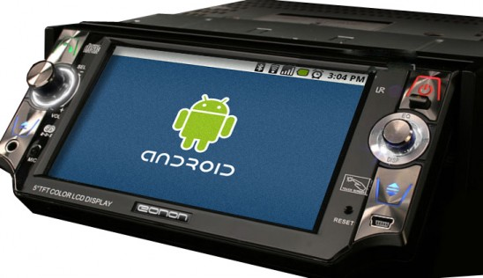
Maybe what we want is Android . . .
. . . from the Open Handset Alliance?

Slide 13
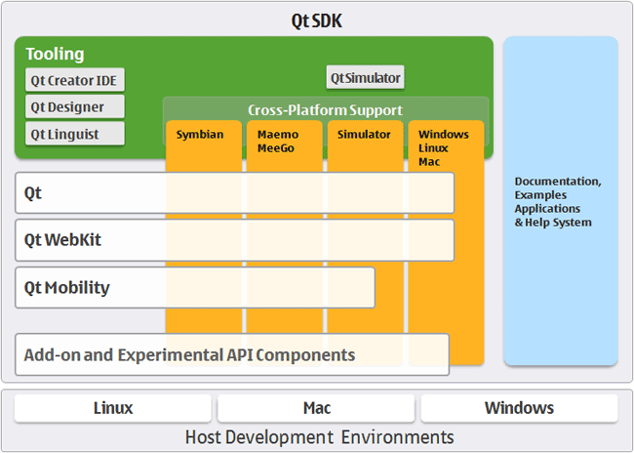
How about MeeGo?
MeeGo = lightweight GNU/Linux with a Qt face.

Slide 14
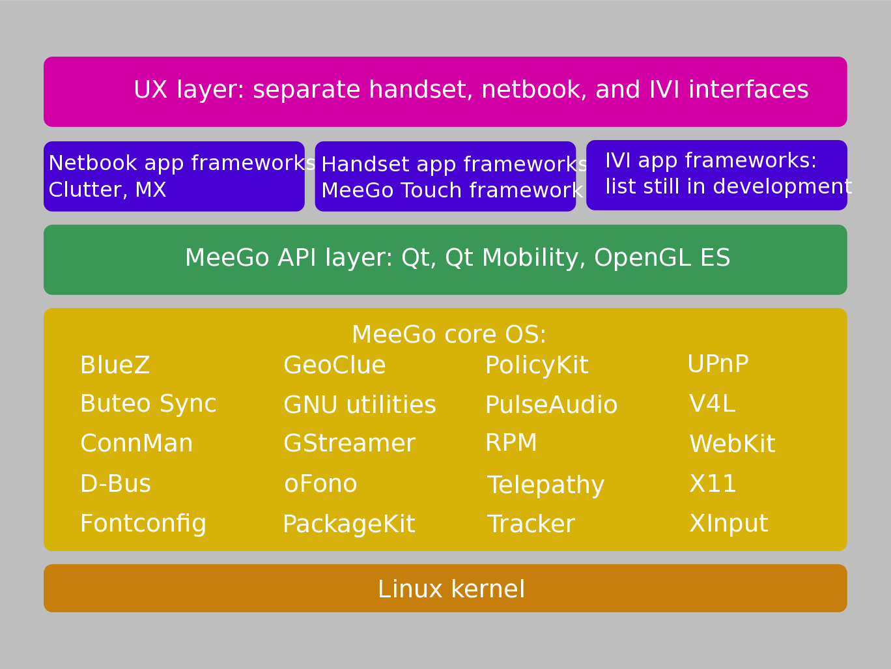
Why consider MeeGo?
Courtesy
Nathan P. Willis,
http://tinyurl.com/3m4loer
Closer to traditional GNU/Linux distro than Android.

Slide 15
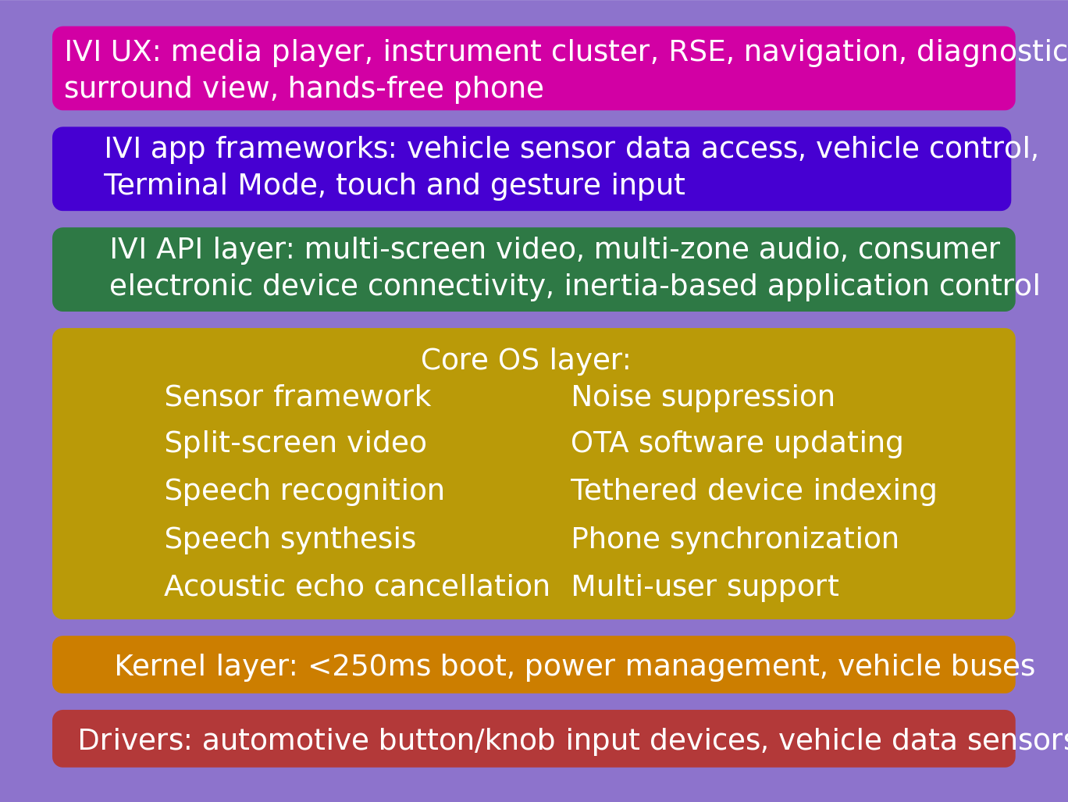
IVI UX Additional Features
Courtesy
Nathan P. Willis,
http://tinyurl.com/3m4loer
Many automotive players participating, few public announcements.

Slide 16
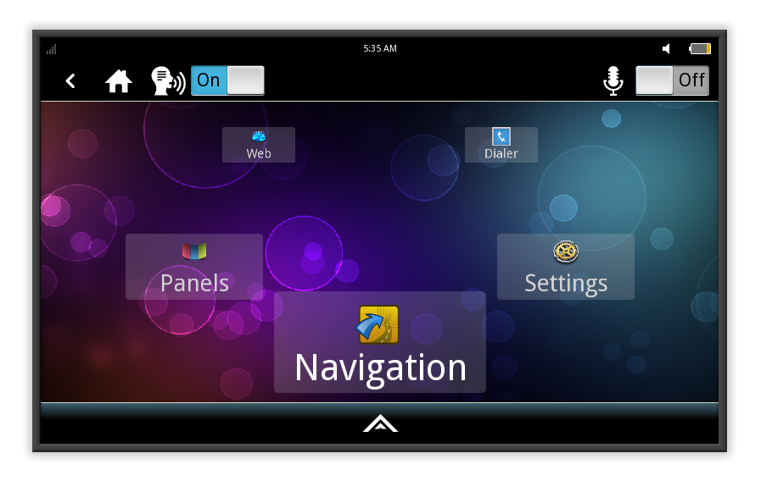
MeeGo IVI 1.2 Home Screen
Intended to be reskinned, not as a shipping product.

Slide 17
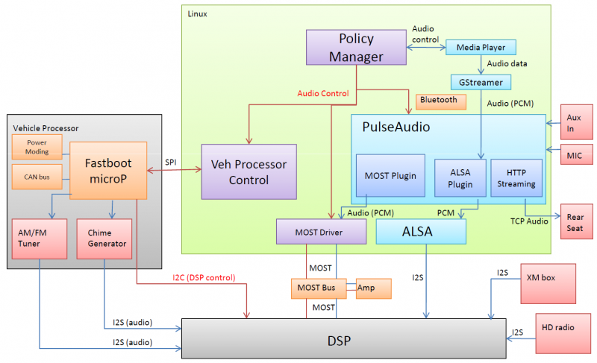
MeeGo IVI Audio Architecture
Courtesy Laci Jalics, Delphi.

Slide 18
What IVI reference hardware should devs use?
Despite ARM world domination, Atom still has a place in IVI.
Atom boards with CAN bus and GPS are very expensive.
Nice ARM boards (e.g. BeagleBoard) far cheaper.
Multiple display outputs preferable for IVI.
Touch and/or gesture interface likely.

Slide 19
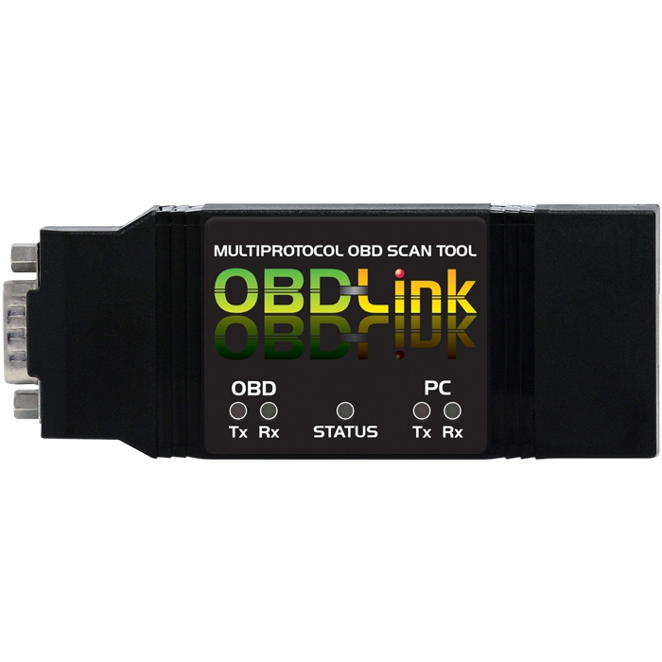
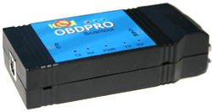
Tripzero: How do I test this in my car?
ELM compatible scantool
Any tablet/smartphone/laptop that runs meego
http://sf2011.meego.com/program/sessions/vehicle-communications-meego

Slide 20
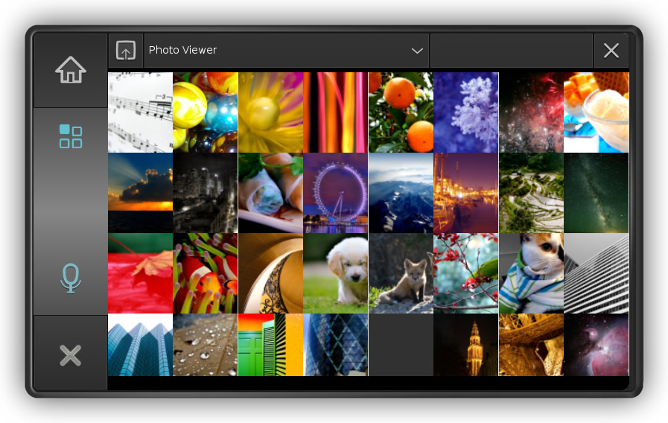
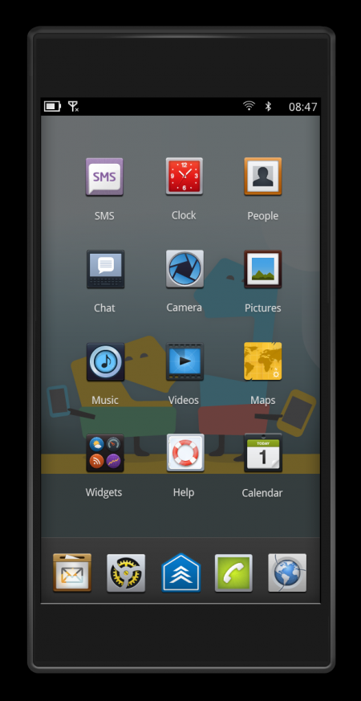
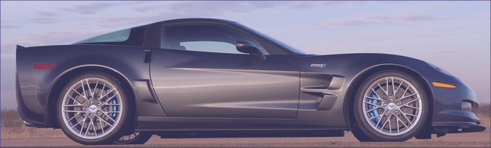
Tripzero: Handset/Tablet + meego ivi
In the near future...
DBus
nobdy
nobdy
Bluetooth
subscriber
plugin
Bluetooth
Provider
plugin
DBus
http://sf2011.meego.com/program/sessions/vehicle-communications-meego

Slide 21
Getting IVI & nobdy working on ExoPC and Pandaboard
Intel gave away heaps of Lenovo netbooks and ExoPC slates.
  NO subsequent software support.
Running IVI on slate requires a mash-up of “Tablet Preview” and IVI Uxes.
MeeGo 1.2 repositories support EMGD graphics only, while ExoPC has i915.
  “zypper update” auto-overwrites drivers and X11 SO libraries.
ExoPC camera and HDMI out are not working even with Windows pre-install.
Support from nobdy's tripzero is excellent!
Stopped work on Pandaboard with OMAP4430 processor (ARMv7) because of ABI break in MeeGo 1.2 and subsequent lack of HW accelerated graphics.

Slide 22
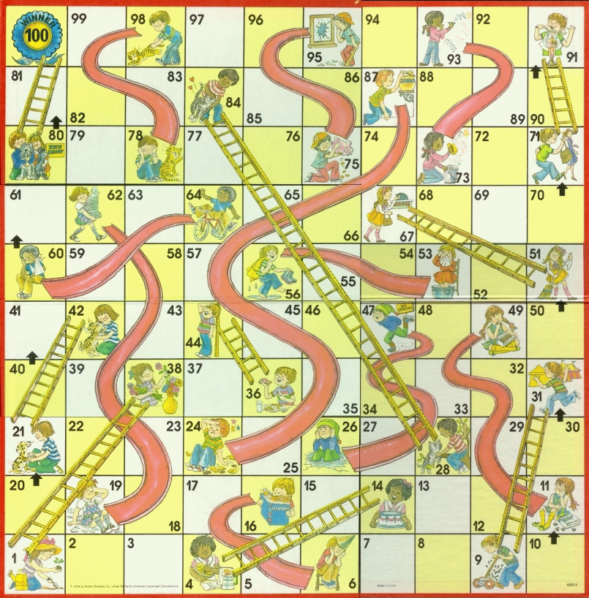
MeeGo Hardware Adaptation Process
Maybe not
that kernel
Update from
wrong repo
Use installer
defaults
Hand-craft
extlinux.conf
Multi-hour
“zypper up”

Slide 23
Summary
IVI is the part of MeeGo with the most traction.
Finding appropriate hardware to test and develop on remains problem.
Many companies are participating, some local to Bay Area.
Opportunities at all levels: HW, accessories, embedded, platform, apps, entrepreneurs and big companies

Slide 24
Resources
IVI wiki: http://wiki.meego.com/In-vehicle
Official site: http://meego.com/downloads/releases/1.2/meego-v1.2-in-vehicle-infotainment-ivi
Mailing list archive: http://lists.meego.com/pipermail/meego-ivi
Mp3car.com
#linuxice and #meego-ivi IRC on freenode.net
Nobdy: wiki.openice.org/index.php?title=Nobdy&oldid=4637 (current version is spam)
My notes and instructions
  on ExoPC: http://wiki.meego.com/MeeGo_IVI_on_ExoPC
  on Pandaboard: http://wiki.meego.com/Hardware-accelerated_graphics_on_Pandaboard_using_MeeGo

