Slide 1
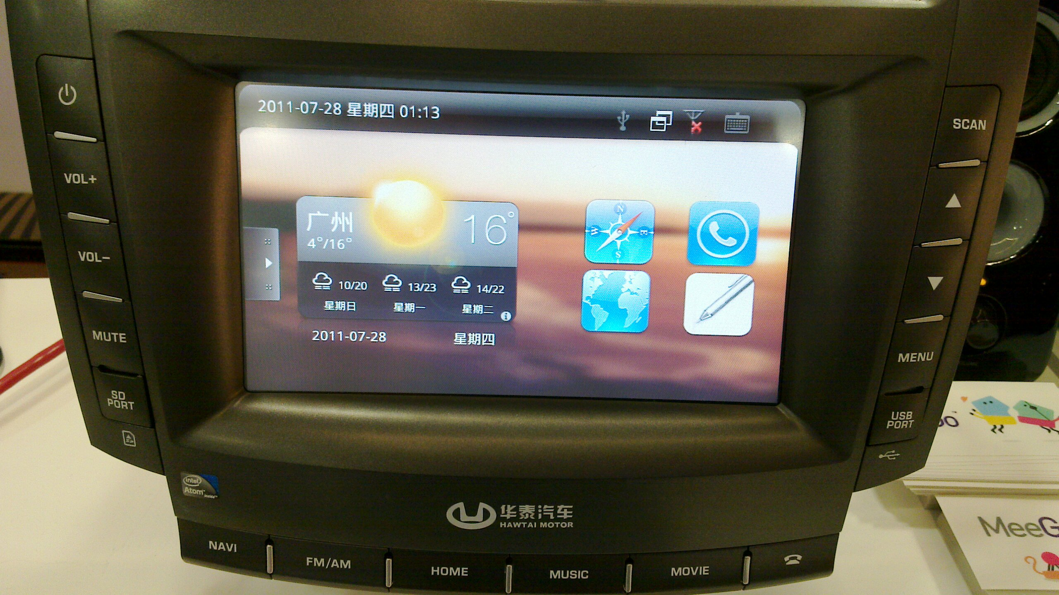
Automotive: next hot mobile platform for MeeGo
Alison Chaiken
alchaiken@gmail.com
http://she-devel.com/

Slide 2

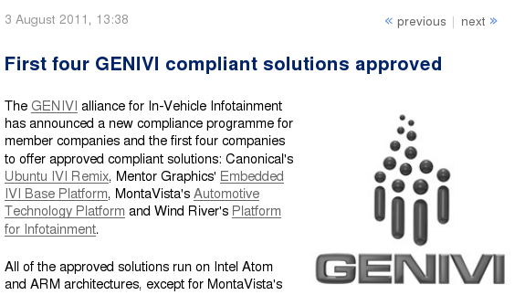
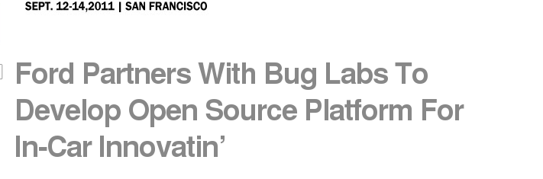

Slide 3
Outline
Automotive software systems: IVI
The MeeGo IVI project
(lack of) hardware support for IVI
nobdy and ExoPC demos

Slide 4

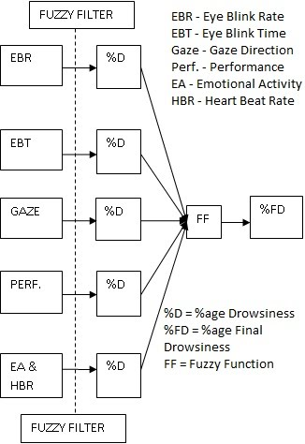
What is “in-vehicle infotainment”?
What “infotainment” calls to mind
What IVI could be

Slide 5
3 novel views of the auto
Module for ad hoc convoy
Mobile data collection platform
Giant portable CPU and battery

Slide 6
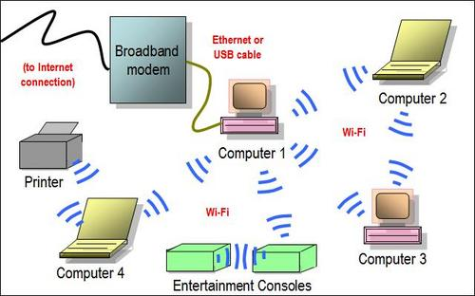
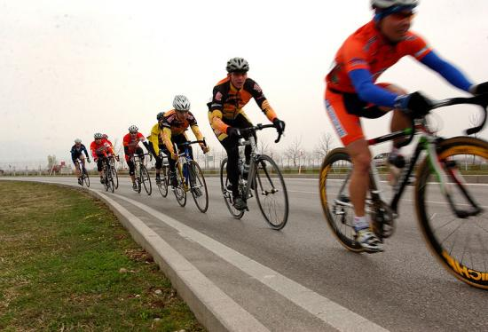
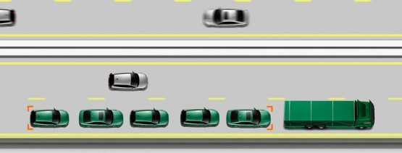
Ad hoc networking saves energy
Use this . . .
. . . to do this.

Slide 7
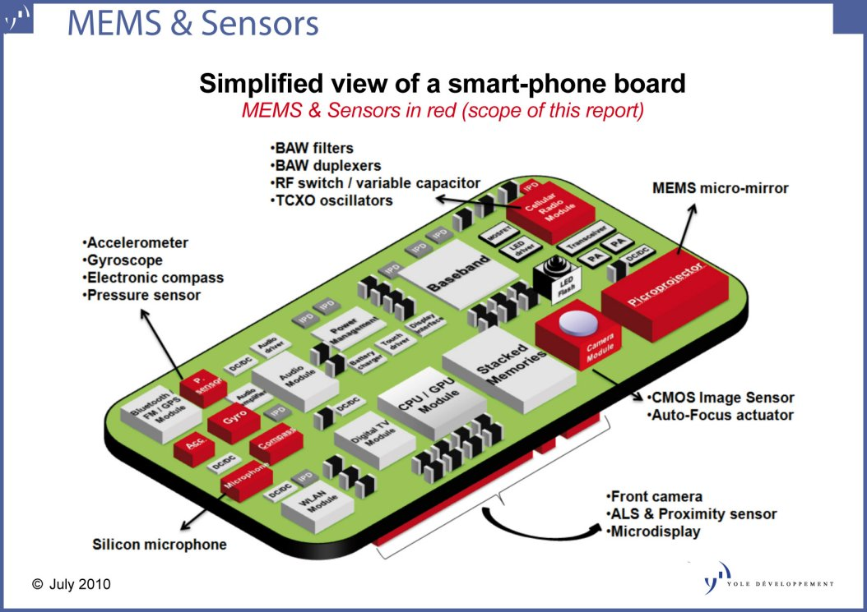
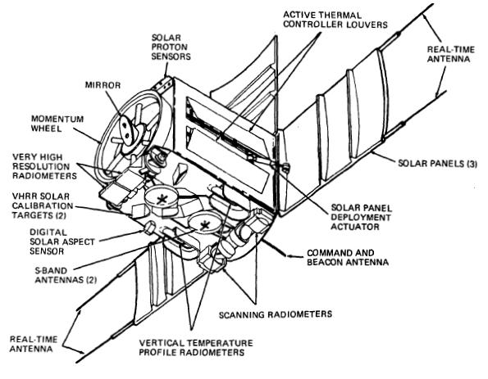
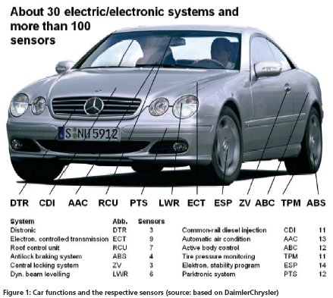
Mobile sensor platforms

Slide 8
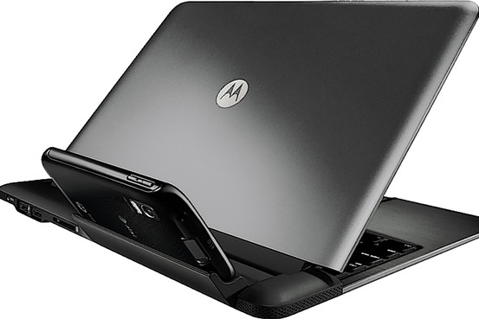
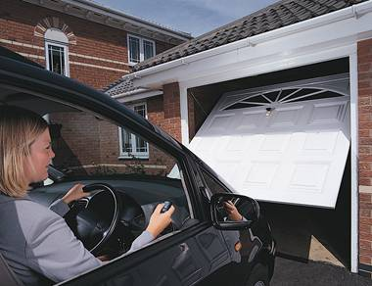
Inserting smarts into big dumb docking stations
Dock the Atrix . . .
. . . or dock the car?
Cars can tether and sync rural businesses and homes?

Slide 9
3 challenges for IVI
Security in a multiuser, mobile, often unattended device
Safety of a complex system with power to kill
Disparate collection of unique hardware

Slide 10
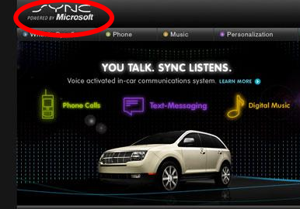
Challenges 1: security
Backseat kids changing nav system's destination . . .
mechanic at shop installs malware.

Slide 11
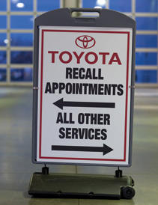
Challenges 2: safety
Driver must receive alarms but not modify many parameters.
Prevent malfunctioning systems from interfering with driving.

Slide 12
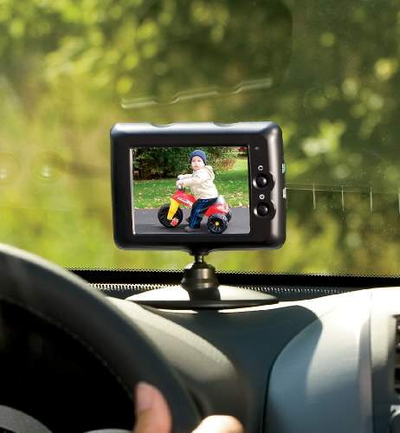
Challenges 3: HW needs
CAN bus, MOST bus, wheel rotation sensors, oil level . .
Not just RT audio, but RT video too!

Slide 13
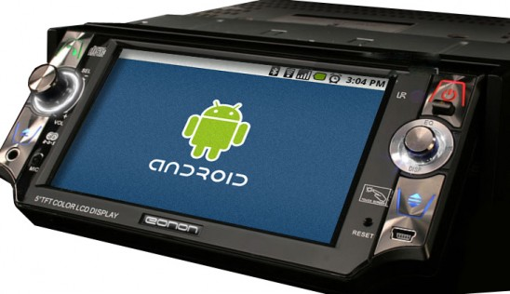
Maybe what we want is Android . . .
. . . from the Open Handset Alliance?

Slide 14
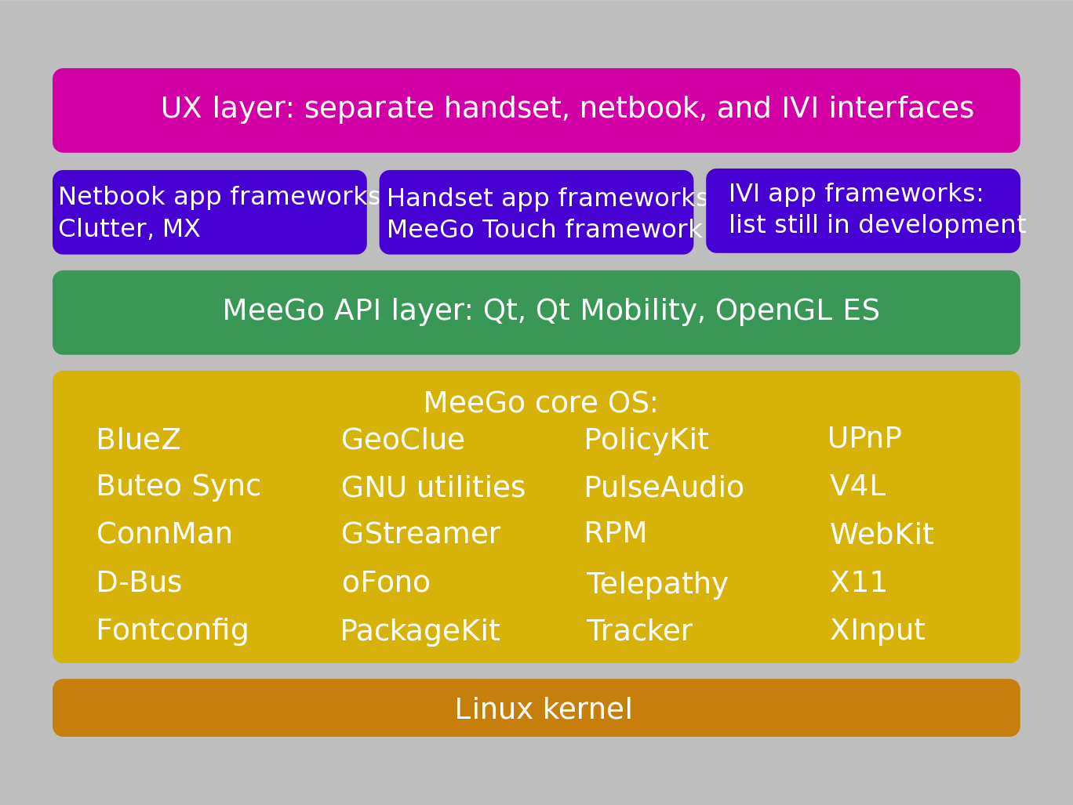
Why consider MeeGo?
Courtesy
Nathan P. Willis,
http://tinyurl.com/3m4loer
Closer to traditional GNU/Linux distro than Android.

Slide 15
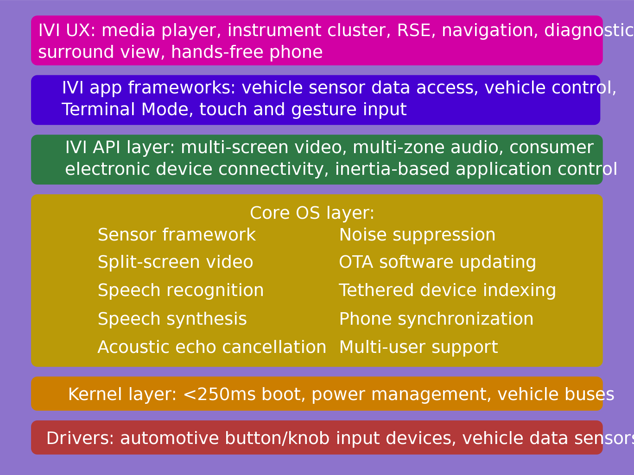
IVI UX Additional Features
Courtesy
Nathan P. Willis,
http://tinyurl.com/3m4loer
Many automotive players, few public announcements.

Slide 16
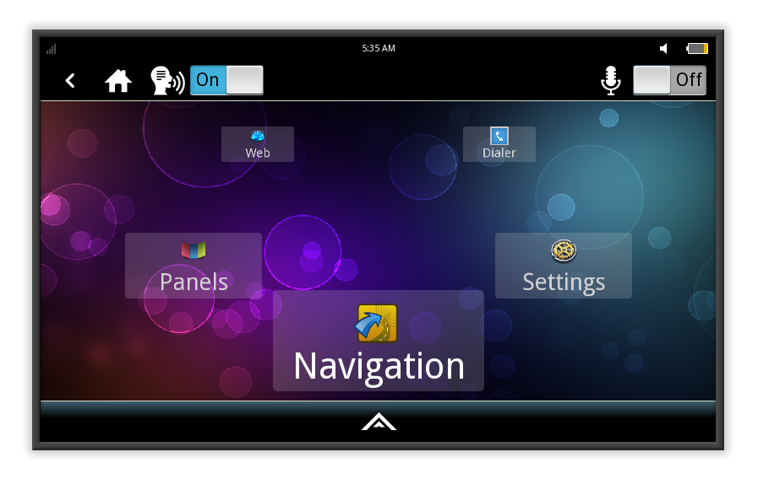
MeeGo IVI 1.2 Home Screen
Intended to be reskinned, not as a shipping product.

Slide 17
What IVI reference hardware should devs use?
ARM dominates mobile but Atom has a role in IVI.
Atom boards with CAN bus and GPS are very expensive: use dongles.
Nice ARM boards (e.g. BeagleBoard) far cheaper.
Multiple display outputs preferable for IVI.
Touch and/or gesture interface likely.

Slide 18
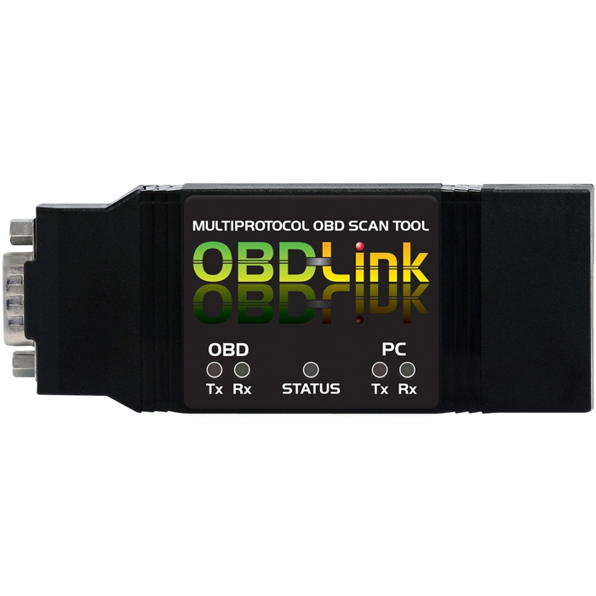
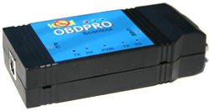
Tripzero: How do I test this in my car?
ELM compatible scantool
Any tablet/smartphone/laptop that runs meego
http://sf2011.meego.com/program/sessions/vehicle-communications-meego

Slide 19
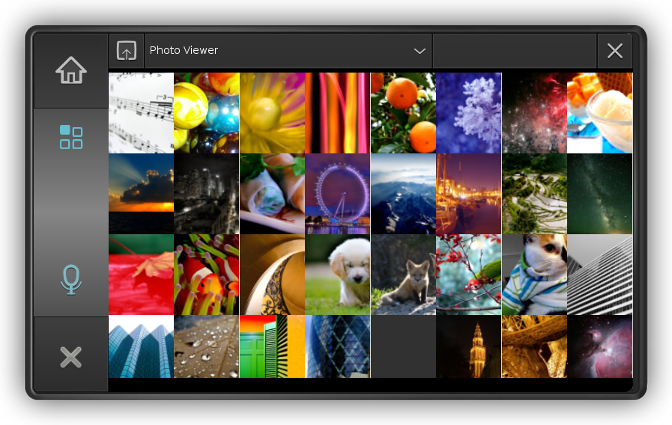
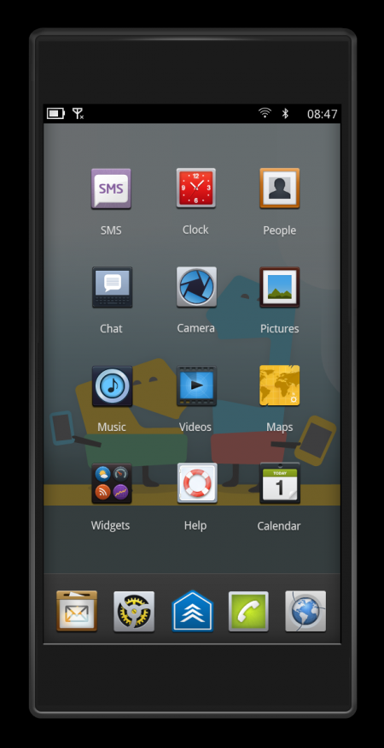
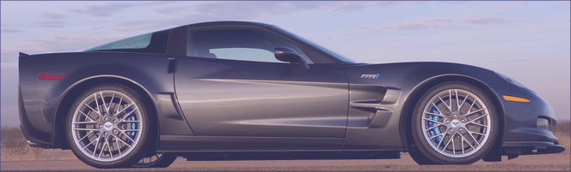
Tripzero: Handset/Tablet + meego ivi
In the near future...
DBus
nobdy
nobdy
Bluetooth
subscriber
plugin
Bluetooth
Provider
plugin
DBus
http://sf2011.meego.com/program/sessions/vehicle-communications-meego

Slide 20
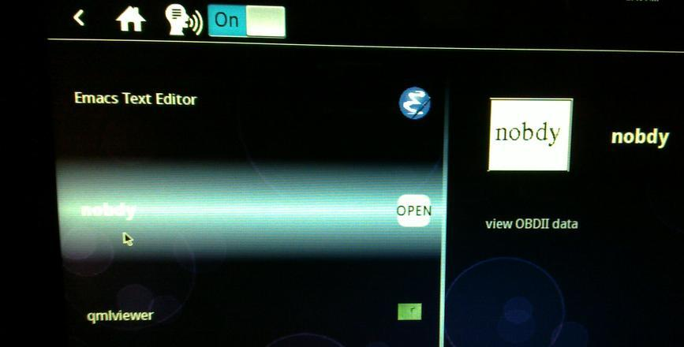
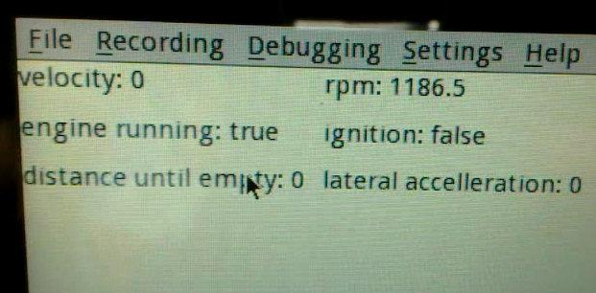
Nobdy on ExoPC
Nobdy in scrollwheel menu
Live data stream via D-bus and qmlviewer

Slide 21
Running MeeGo-IVI on ExoPC and Pandaboard
No SW support for HW available to small and medium businesses.
Running IVI on ExoPC requires a mash-up of “Tablet Preview” and IVI Uxes.
MeeGo 1.2 repositories support EMGD graphics only, while ExoPC has i915.
  “zypper update” auto-overwrites drivers and X11 SO libraries.
Stopped work on ARM-based Pandaboard due to missing graphics driver.

Slide 22
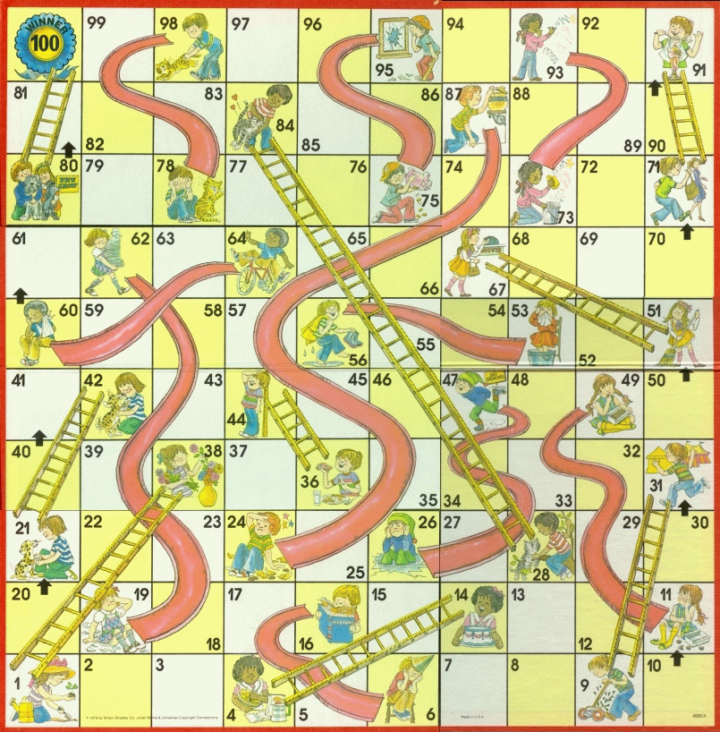
MeeGo Hardware Adaptation Process
Maybe not
that kernel
Update from
wrong repo
Use installer
defaults
Hand-craft
extlinux.conf
Multi-hour
“zypper up”

Slide 23
Summary
IVI is the part of MeeGo with the most traction.
Finding appropriate hardware for development remains a problem.
Many companies are participating, some local.
Opportunities at all levels: HW, accessories, embedded, platform, apps, entrepreneurs and big companies.

Slide 24
Resources
IVI wiki: http://wiki.meego.com/In-vehicle
Official site: http://meego.com/downloads/releases/1.2/meego-v1.2-in-vehicle-infotainment-ivi
Mailing list archive: http://lists.meego.com/pipermail/meego-ivi
Mp3car.com
#linuxice and #meego-ivi IRC on freenode.net
Nobdy: wiki.openice.org/index.php?title=Nobdy&oldid=4637 (current version is spam)
My notes and instructions
  on ExoPC: http://wiki.meego.com/MeeGo_IVI_on_ExoPC
  on Pandaboard: http://wiki.meego.com/Hardware-accelerated_graphics_on_Pandaboard_using_MeeGo

Slide 25
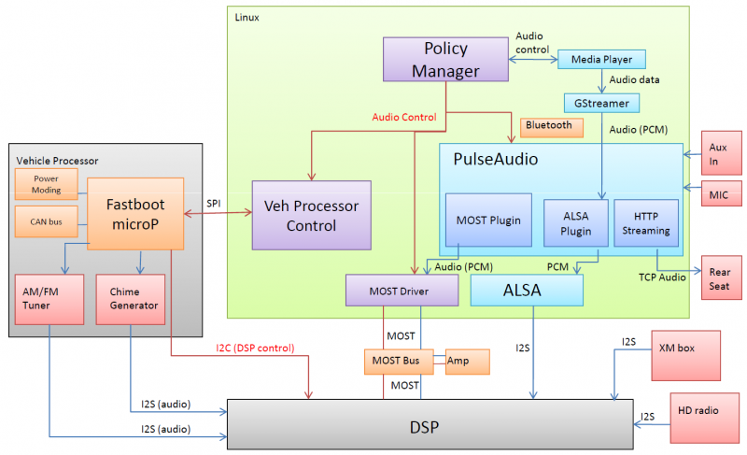
MeeGo IVI Audio Architecture
Courtesy Laci Jalics, Delphi.

Slide 26
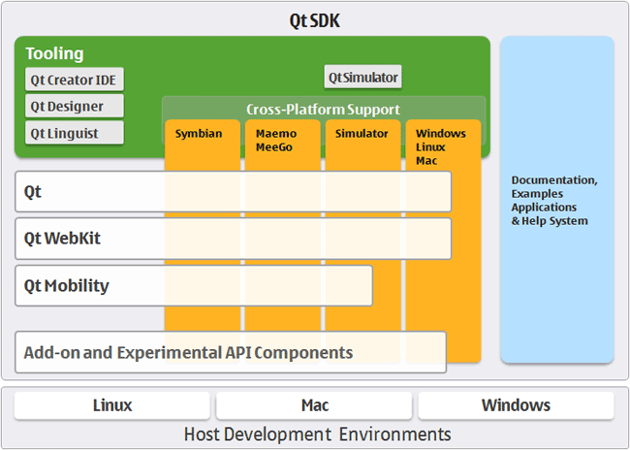
How about MeeGo?
MeeGo = lightweight GNU/Linux with a Qt face.

Slide 27

