Slide 1
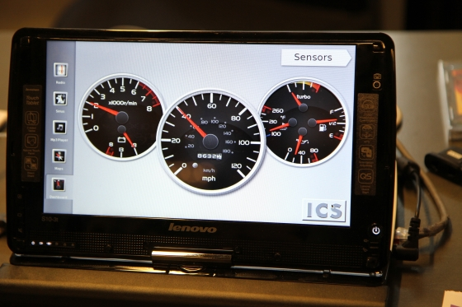
Automotive: new frontier for mobile Linux
ICS demos:
booths 24
and 67
Alison Chaiken
alchaiken@gmail.com
http://she-devel.com/

Slide 2
Contents
Why automotive Linux matters
What's different and what's hard
Automotive open-source project survey
Opportunities for developers and the community

Slide 3
Our transportation system is
Dangerous
Hella annoying
Loud!!!
Time-wasting
Polluting
because
individuals had little power to change it …
until NOW.

Slide 4
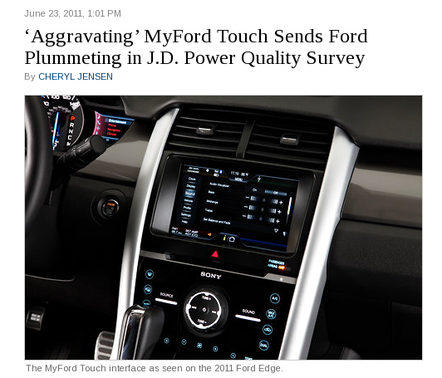
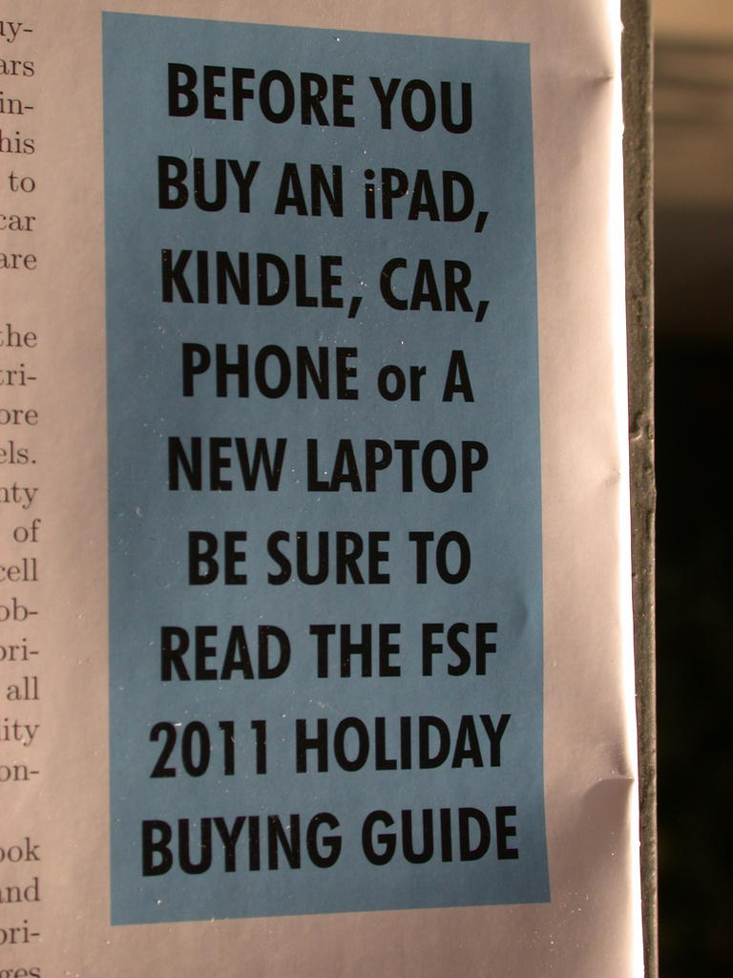
Exactly one political slide
New York Times, June 23 2011

Slide 5
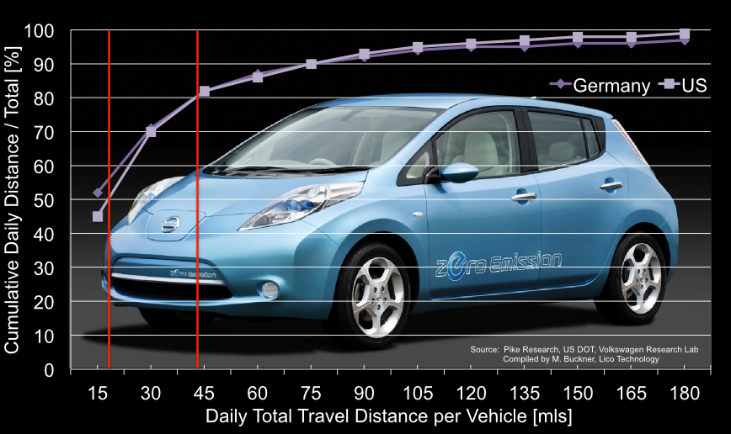
“Range anxiety”: a user perception problem
Let's help drivers better understand their needs.

Slide 6
Status of Automotive Linux
Manufacturer | Confirmed Operating system
Fiat-Chrysler Blue&Me (500, Delta), Kia Uvo | Microsoft Windows Embedded Automotive
Ford (all?) | MyTouch/Sync-Microsoft; OpenXC-Android
General Motors/Cadillac User Experience | MontaVista Linux
Geely (China); Hawtai (China) | Linux: Moblin (MeeGo-Tizen precursor)
Renault R-Link | Android
Honda (Accord, Odyssey, Pilot), Audi (A8L, Q5, A6), BMW (7-series and M models), Chrysler, Daewoo, GM (OnStar), Hyundai, Land Rover, Porsche, Saab (9-3) Renault (SM7) | QNX
Linux Foundation members: Toyota, Pelagicore, Symbio, Tieto
Automotive Linux Summit 2011 presenters: Toyota, Nissan, BMW
MeeGo Conference 2011 presenter: Nissan

Slide 8
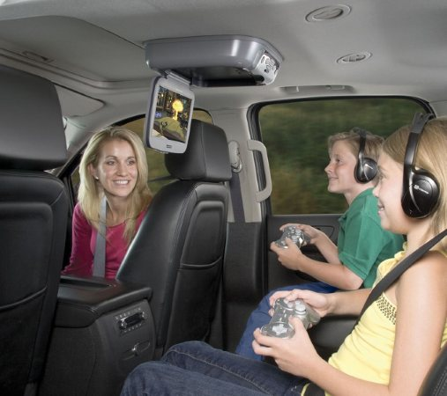
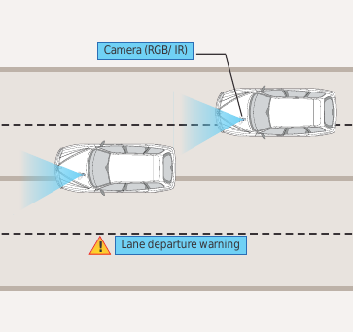
What is “in-vehicle infotainment”?
Courtesy Tata Consultancy Services
What “infotainment” calls to mind
What IVI could be

Slide 9
“Infotainment” 1st due to desire to monetize media sales
“91% of respondents said they would love to see a lane-change, blind-spot warning system …
83% said they would like in-vehicle technologies that would automatically call a tow truck …
Nearly ¾ said they'd like technology that would stop their car if the driver suffers a heart attack …
That’s about as far from Angry Birds as you can get.”
– Accenture survey data courtesy of GigaOm

Slide 10
Challenges for IVI
Little-understood UI/UX
Security: leave car in auto shop overnight
Novel sensors, data buses and architectures
Safety: not “kill -9” but kill dead!

Slide 11
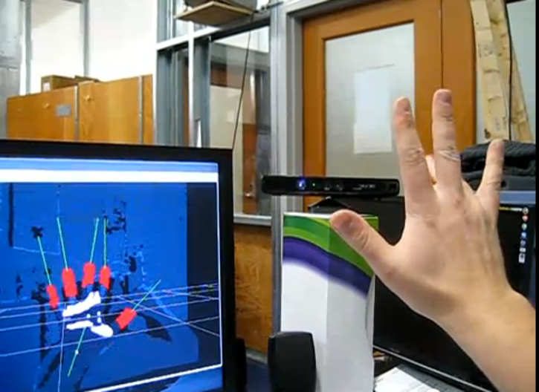
Car is laboratory for new controls and displays
New UIs will debut in cars and migrate to other form factors.
“Kinect piano”
Do we need a motion-sickness.css for passengers?

Slide 12
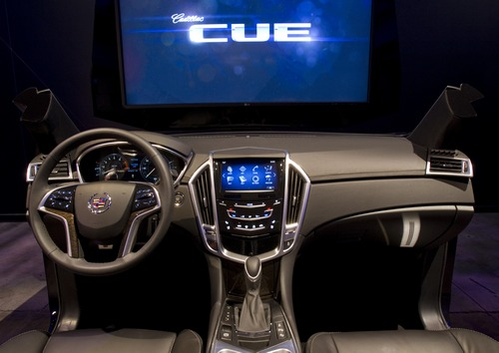
Cadillac User Experience: Linux by MontaVista
Status: limited developer pre-release, widely available Spring 2012

Slide 13
MontaVista's approach to security challenge
Seating
Position 1
Seating
Position 2
Seating
Position 3
OEM
Custom
Apps
Custom
Apps
Android Apps
HTML5
Apps
Android
MontaVista
Modii™
HTML5
Untrusted
Apps
GENIVI
Compliant
Stack
HAL
MV Linux Container
MV Linux Container
MV Linux Container
MontaVista Linux
SE Linux (NSA Security)
Multicore SoC (ARM, ATOM)
Excellent ELCE video by MontaVista: http://tinyurl.com/7emextu

Slide 14
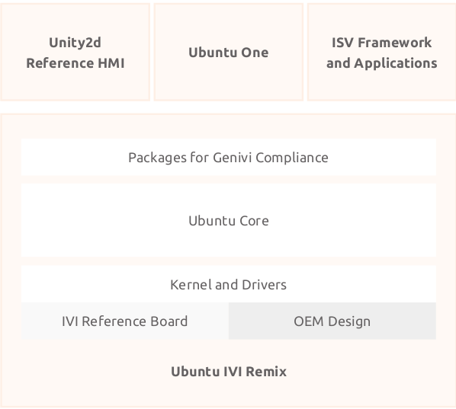
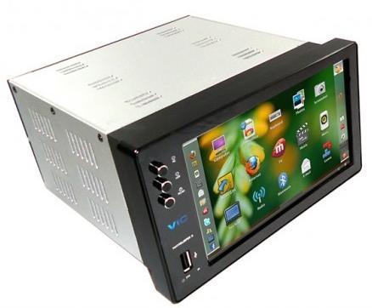
Ubuntu-IVI Remix
Generating a lot of vendor interest.

Slide 15
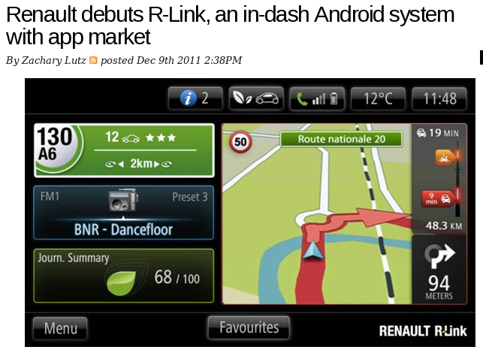
Renault's R-Link is first native Android
“application developers will progressively upgrade its content and offer more apps. They will be downloadable directly to the tablet inside the car or via 'My Renault' account thanks to the R-Link Store”
http://www.renault.com/en/innovation/plaisir-et-confort/pages/r-link.aspx

Slide 16
OBDGPSLogger Real-time Vehicle Diagnostics Capture Plot
Developer Chunky_Ks
(Gary Briggs)
will demo in Booth 48

Slide 17
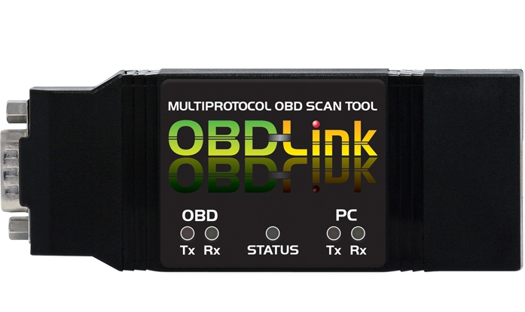
Tripzero: How do I test this in my car?
~$40 scantools access vehicle data and controls
nOBDy runs on any tablet/smartphone/laptop that supports Qt
http://sf2011.meego.com/program/sessions/vehicle-communications-meego

Slide 18
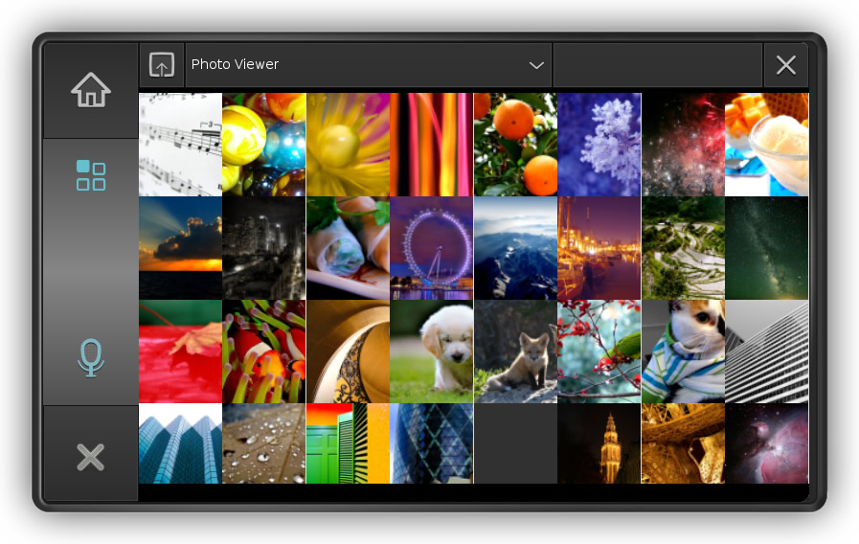
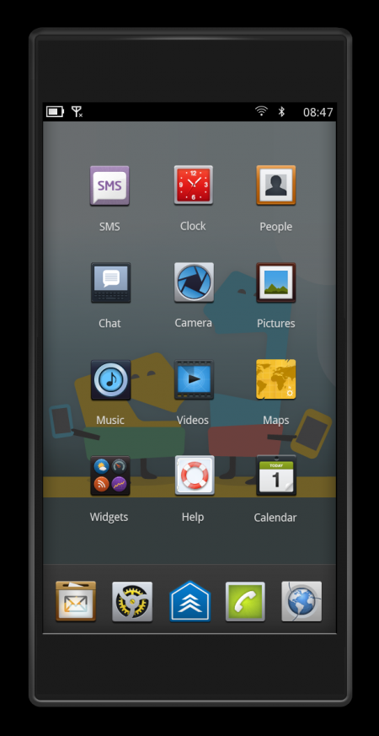
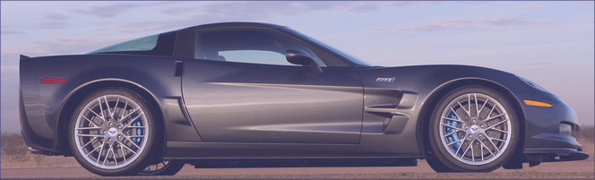
Tripzero: nOBDy is a GPL'ed plugin framework
Demo in Booth 48
DBus
nobdy
nobdy
Bluetooth
subscriber
plugin
Bluetooth
Provider
plugin
DBus
Docs: http://nobdy.wikia.com/wiki/Nobdy_Wiki

Slide 19
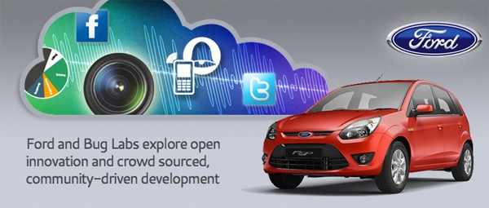
OpenXC project: AODPK (Android) CAN scanner
Status: limited developer pre-release

Slide 20
What can we contribute?
App that autosubmits your destination information from car nav system to casual carpooling website
“Where's the cheapest gas within a mile of the highway between here and where my tank will be empty?”
“Bump” pairing with friends' vehicles to enable proximity alerts
IRC, identica, diaspora, PGP integration

Slide 21
How to get involved
Work on an automotive or intelligent transport open source project
Develop for one of the car manufacturer's new app stores
Buy a car that runs Linux
Ask car dealers what OS the car runs, and say you would prefer Linux
“Linux Inside” bumper stickers? Penguin swallowing an MS logo?

Slide 22
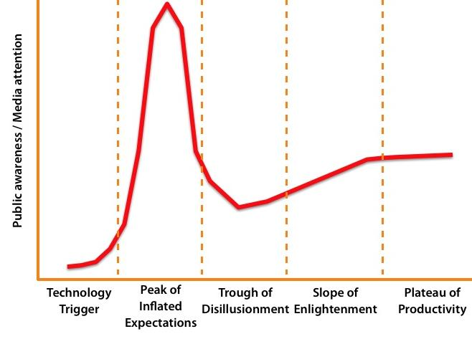
Summary: don't let this moment pass!
Opportunity to
create new
standards
You
are
here
X
Biz lock-in;
regulatory lock-down
Thanks to Intel and Texas Instruments for HW donations.

Slide 23

Trades parts count for security?
Front-seat RT audio
and video
incl. alarms
DSP
GPU
Atom or ARM SoC
running GNU/Linux
Encapsulated legacy system
Cortex-M
Sensor data R/O
16-bit MCU
running RTOS
In-dash GPCPU
MIPS with
OpenWRT
Atom or ARM
running Android
CAN and
MOST
buses
Control: R/W
Firewall
Backseat entertainment

Slide 24
Problem: what IVI HW should devs use?
ARM dominates, but Atom strong in IVI.
Atom HW with CAN bus and GPS is costly: use dongles.
ARM boards (e.g. BeagleBoard) cheaper.
Multiple displays and controls needed.
Touch, voice, video gesture, joystick?

Slide 25
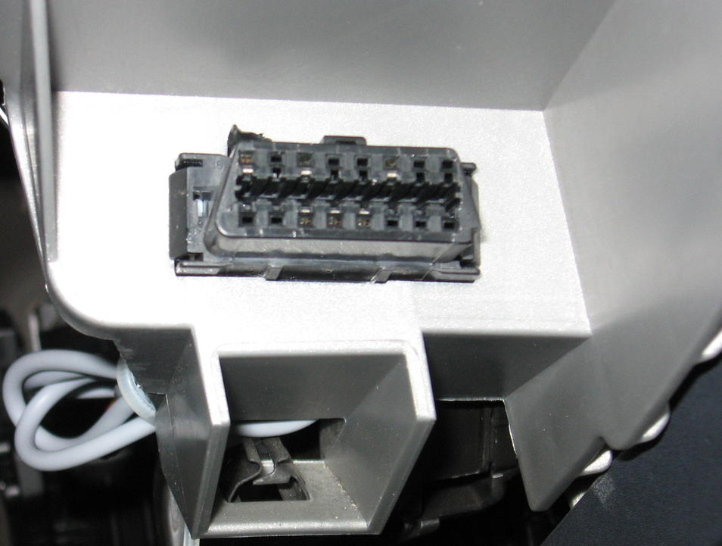
Smog check connector = access to vehicle sensors
OBD-II connector on left of steering wheel sees dozens of ECUs, sensors and controls via serial bus
GFDL

Slide 26
Features of nOBDy
Based on Qt toolkit and QML (Qt Modelling Language) – Booths 24 (Qt) and 67 (ICS)
TCP, Bluetooth, D-Bus support
Websocket/HTML5 browser interface based on JQuery Mobile
Provides communications interface to CAN (Controller Area Network) vehicle data bus
GPLv2, source on gitorious
Based on libobd, OBDGPSLogger and gpsd projects
Available as .deb and (soon) RPM packages

Slide 27
Features of nOBDy
Based on Qt toolkit and QML (Qt Modelling Language) – Booths 24 (Qt) and 67 (ICS)
TCP, Bluetooth, D-Bus support
Websocket/HTML5 browser interface based on JQuery Mobile
Provides communications interface to CAN (Controller Area Network) vehicle data bus
GPLv2, source on gitorious
Based on libobd, OBDGPSLogger and gpsd projects
Available as .deb and (soon) RPM packages

Slide 28
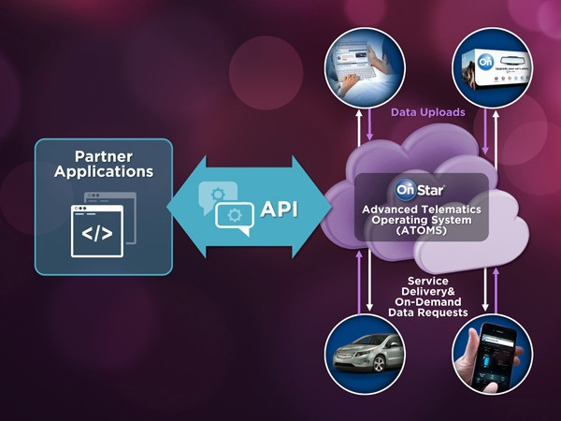
Cadillac User Experience based on MontaVista
Status: SDK expected, Spring 2012

Slide 29
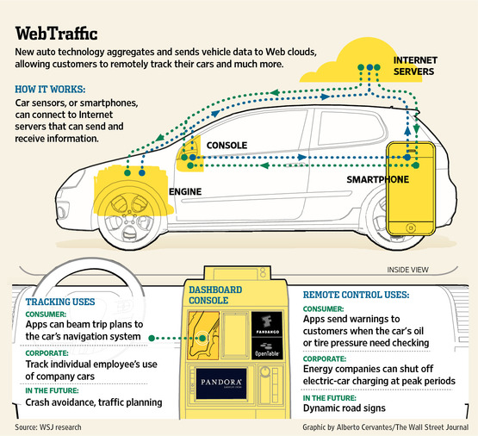
Back-end “cloud programming” in IVI

Slide 30
nOBDy's stack
Your Qt, QML or Javascript application here!
nOBDy plugin framework
QML
JQuery
HTML5
Qt
OpenLayers
OBDGPSLogger
OpenStreetMap
gpsd
libobd
Linux kernel and device drivers
New plugins that talk TCP can be written in any language.

Slide 31
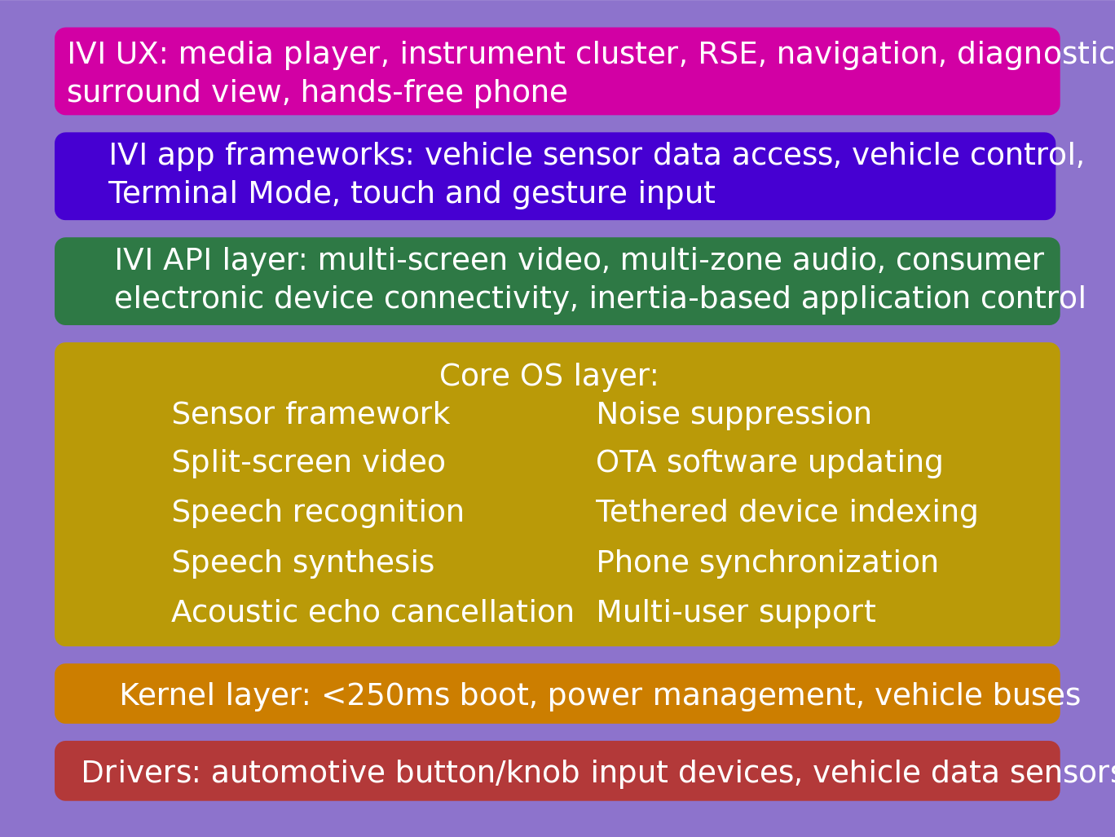
IVI UX Additional Features
Courtesy
Nathan P. Willis,
http://tinyurl.com/3m4loer

Slide 32



How to get involved: community projects
NOBDy wiki:
http://nobdy.wikia.com/wiki/Nobdy_Wiki
OBDGPSLogger: http://icculus.org/obdgpslogger/
LibOBD:
http://libobd.wikia.com/wiki/Libobd_Wiki
OBDref: https://github.com/canurabus/obdref
Mp3car: http://www.mp3car.com/

Slide 33
How to get involved: corporate-backed FLOSS
OpenXC: http://openxcplatform.com/
Ubuntu IVI Remix: http://linux.softpedia.com/progDownload/Ubuntu-IVI-Remix-Download-78078.html
Renault R-Link (Android): http://www.renault.com/en/innovation/plaisir-et-confort/pages/r-link.aspx
Bosch-ETAS Busmaster: https://github.com/rbei-etas/busmaster

Slide 34
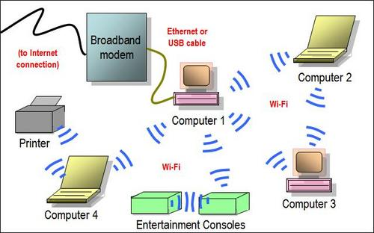
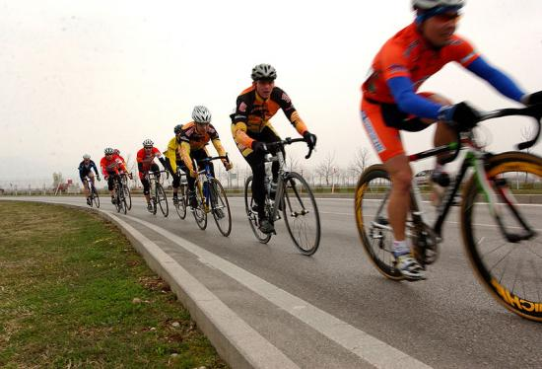
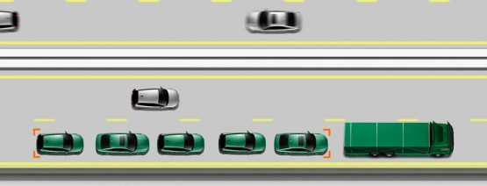
Opportunity: save energy through ad hoc networking
Use this . . .
to save energy . . .
with cars, too: 802.11p WAVE.

