Slide 1
systemd for developers
Alison Chaiken
alison@she-devel.com
http://she-devel.com
Feb. 21, 2015
Text in blue is hyperlinked.
On-the-fly audience exercises.

Slide 2
?
?
?
Quiz:
what is the most widely used
Linux init system?
?
?
?
?
?

Slide 3
Topics
Motivation
Design of systemd
Comparison with sysVinit
Integration of systemd with kernel features
Some tips for users and developers

Slide 4
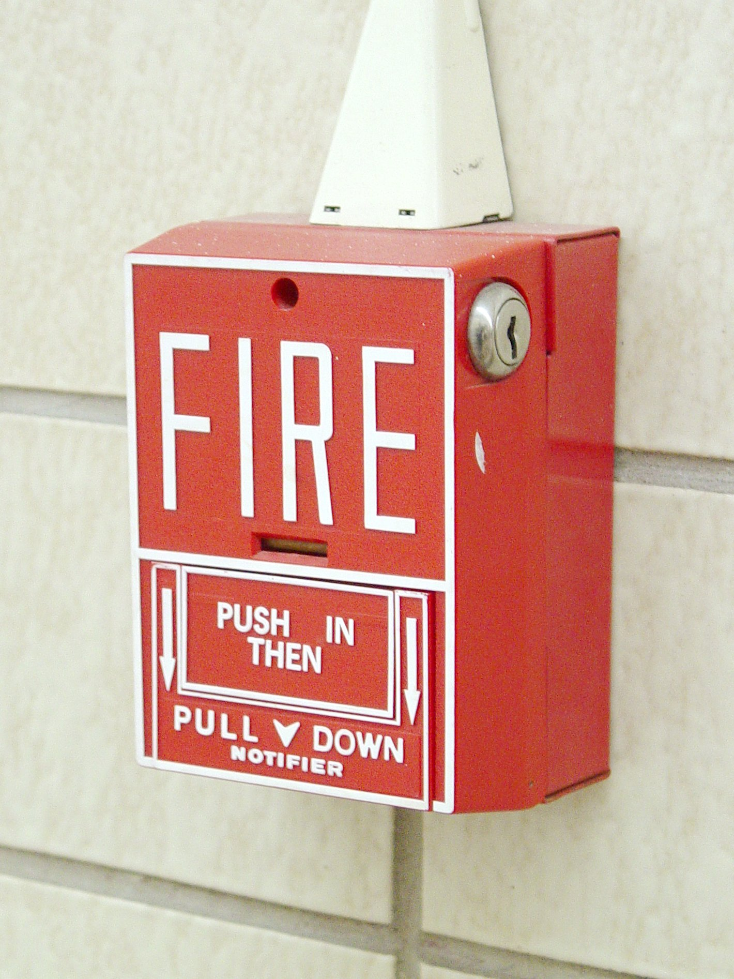
Linux needs to keep innovating
“No one has a guaranteed position in the technology industry.” -- Bill Gates, Pirates of Silicon Valley
“The only thing that can ever hurt Linux is Linux itself.” -- GKH, Linux Action Show
“Success is a self-correcting phenomenom.” -- Gary Hamel
Licensed under CC BY-SA 3.0 http://commons.wikimedia.org/wiki/File:Fire-lite-bg-10.jpg#mediaviewer/File:Fire-lite-bg-10.jpg

Slide 5

Design

Slide 6
Philosophy
Extract duplicate functionality from individual daemons and move it to the systemd core or the Linux kernel.
Replace /etc scripts with declarative configuration files in a standard format.

Slide 7
One daemon to rule them all
xinetd: a daemon to lazily launch internet services when activity is detected on an AF_INET socket
systemd: a daemon to lazily launch any system service when activity is detected on an AF_UNIX socket (oversimplification)

Slide 8
systemd is:
modular;
asynchronous and concurrent;
described by declarative sets of properties;
bundled with analysis tools and tests;
features a fully language-agnostic API.

Slide 9
sysVinit runlevels ≈ systemd targets
Targets are synchronization points for boot.
Check /lib/systemd/system/runlevel?.target symlinks:
multi-user.target.wants (runlevel 3 == text session)
graphical.target.wants (runlevel 5 == graphical session)
Select boot-target :
  via /etc/systemd/system/default.target symlink;
  appending number ('3' or '5') or systemd.unit=<target> to kernel cmdline;
Change current target with runlevel, telinit
  or systemctl isolate <something>.target

Slide 10
init.d scripts ⇒ systemd units
Unit's action and parameters: ExecStart=
Dependencies: Before=, After=, Requires=, Conflicts= and Wants=.
Default dependencies:
  Requires= and After= on basic.target;
  Conflicts= and Before= on shutdown.target.
Types of unit files: service, socket, device, mount, scope, slice, automount, swap, target, path, timer, snapshot

Slide 11
Understanding dependencies
Try:
systemctl list-dependencies basic.target
systemctl list-dependencies –after tmp.mount

Slide 12
Understanding dependencies, p. 2
Try:
systemd-analyze dot rescue.target
systemd-analyze dot basic.target > basic.dot
dot -Tsvg basic.dot -o basic.svg
eog basic.svg (or view basic.svg with any web browser)

Slide 13
Hierarchy of unit files for system and user sessions
Organized into system and user units
/lib/systemd/system: systemd upstream defaults for system-wide services
/etc/system/system: local customizations by override and extension
/lib/systemd/user/: systemd's upstream defaults for per-user services
$HOME/.local/share/systemd/user/ for user-installed units
'drop-ins' are run-time extensions

Slide 14
[system and user units: gnome-weather demo]

Slide 15
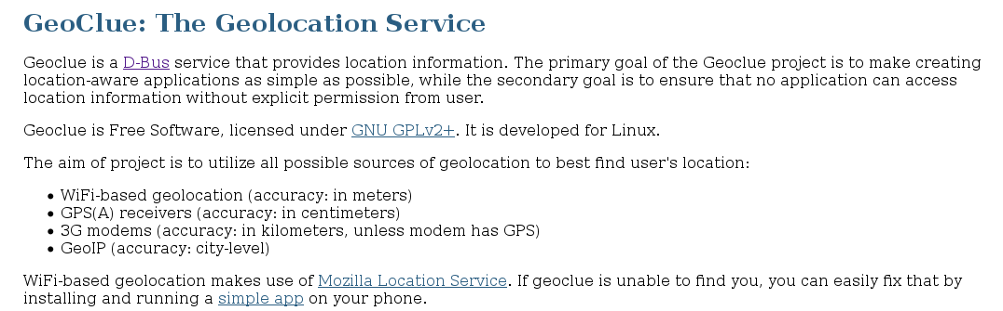

Slide 16

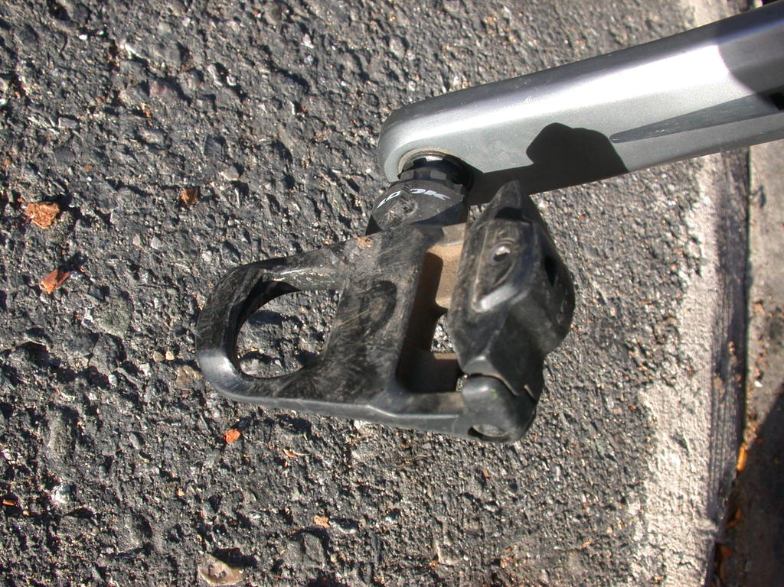
sysVinit
systemd
Comparison with sysVinit

Slide 17

SysV already has a big service manager: bash
[user@localhost]$ wc -l /sbin/init
64
[user@localhost]$ wc -l /bin/bash
4154
[user@localhost]$ wc -l /lib/systemd/systemd
5944

Slide 18
which services are started by sysVinit?
Try: 'ls/etc/init.d'

Slide 19
Which daemons started by systemd directly?
Try: 'ls /lib/systemd/system/*.service'
Try: 'systemctl list-sockets'

Slide 20

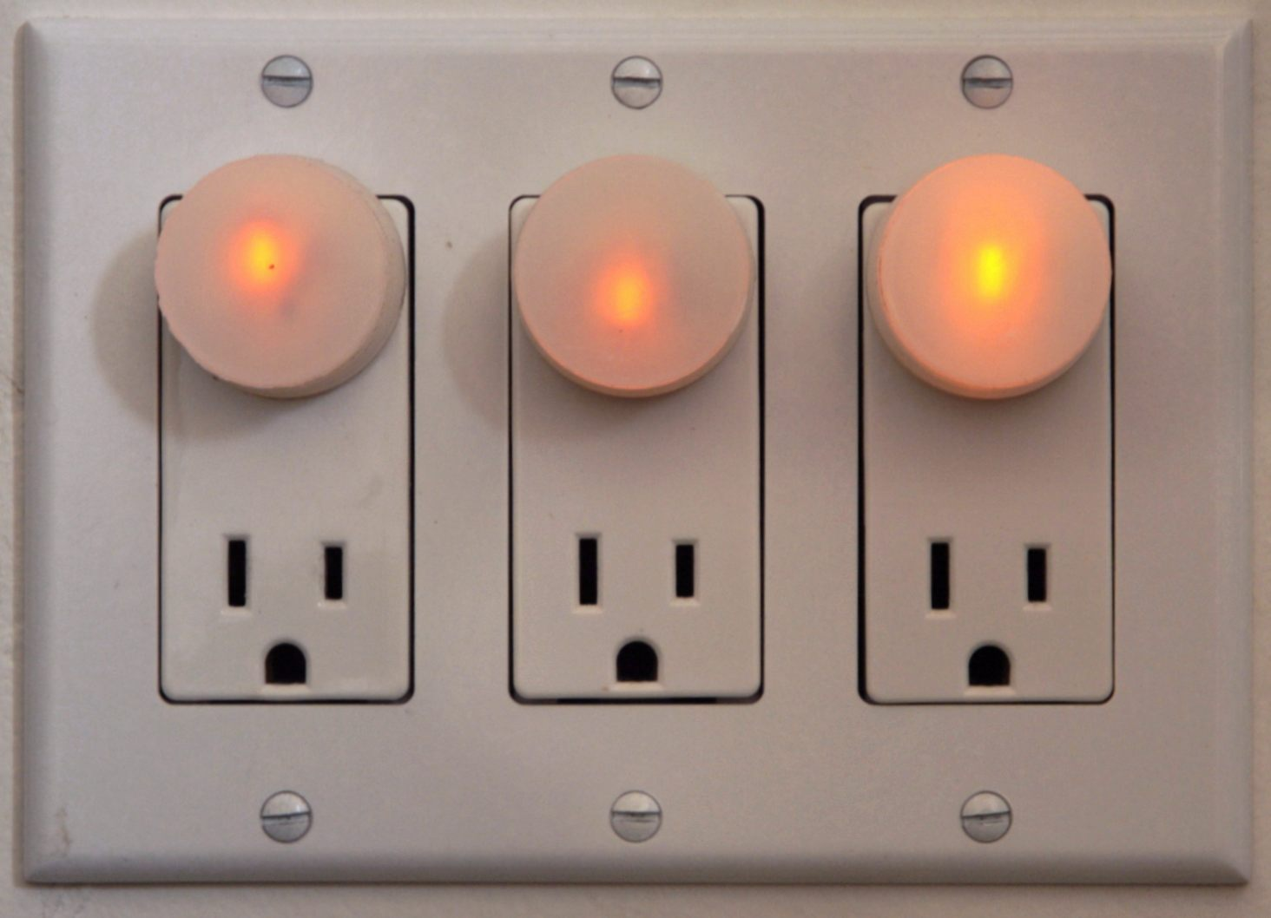
Major Differences with SysVInit
clean environment
socket-based activation

Slide 21
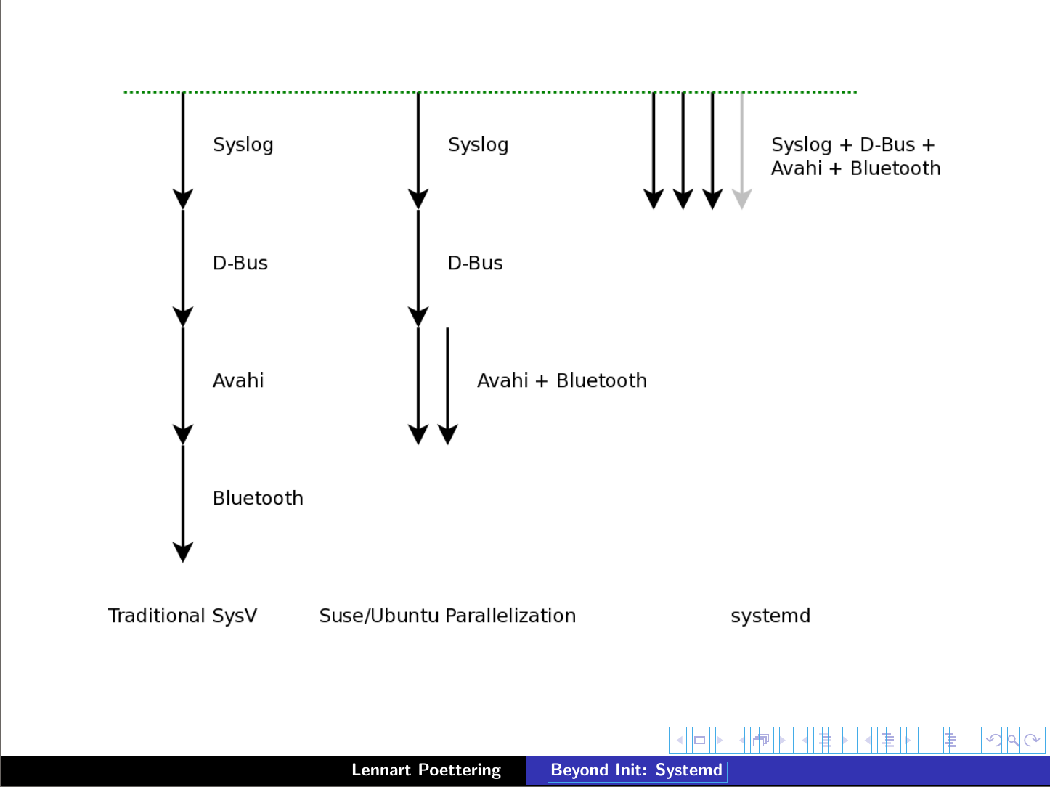
Serial
Linked list
Fully parallel
X
Upstart

Slide 22
[Socket activation demo with cups and ncat]

Slide 23
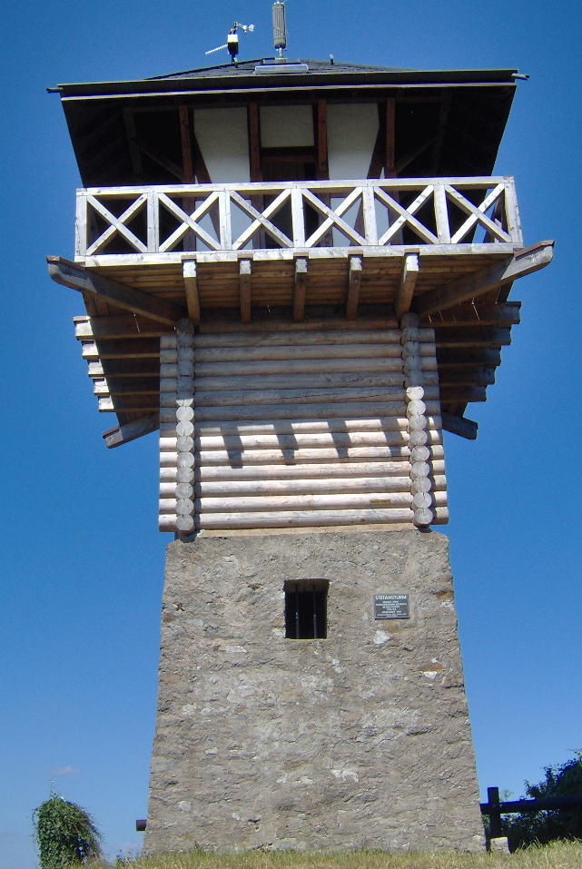
using the systemd journal
Run “addgroup $USER systemd-journal” for access.
Can be cryptographically signed.
Log-reading tools are simple:
Try: journalctl -xn
journalctl -p err
journalctl -u cron
journalctl --list-boots
systemctl status
systemctl is-failed bluetooth
systemctl --failed

Slide 24
integration of systemd with kernel features

Slide 25
systemd and cgroups
cgroups are a kernel-level mechanism for allocating resources like storage, memory, CPU and network
systemd slices are groups of daemons whose resources are managed jointly.
systemd scopes are similar groups of user processes.
Can set BlockIOWeight, IOSchedulingPriority, OOMScoreAdjust, CPUShares, MemoryLimit …
Try:
sudo systemd-cgls
sudo systemd-cgtop

Slide 26
systemd and udev
udev is a kernel facility that handles device events.
  merged into the systemd project.
Rules are enabled by placement in /lib/udev/rules.d, unlike systemd unit enablement.
Rule loading is ordered by numeric filename prefix, like old sysVinit scripts.

Slide 27
udev is still old-school
Try:
ls /lib/udev/rules.d
cat /lib/udev/rules.d/99-systemd.rules

Slide 28
systemd and security: granular encapsulationvia kernel's capabilities
PrivateTmp, PrivateDevices, PrivateNetwork
JoinNamespaces
ProtectSystem (/usr and /etc), ProtectHome
ReadOnlyDirectories, InaccessibleDirectories
systemd-nspawn: systemd's native containers
Easy configuration of kernel's capability properties

Slide 29
developing systemd
git clone git://anongit.freedesktop.org/systemd/systemd
systemd-devel list: submit patches or ask questions
Impressive and featureful utility library in src/shared/
#define streq(a,b) (strcmp((a),(b)) == 0)
#define strneq(a, b, n) (strncmp((a), (b), (n)) == 0)
#define strcaseeq(a,b) (strcasecmp((a),(b)) == 0)
#define strncaseeq(a, b, n) (strncasecmp((a), (b), (n)) == 0)
Complex but automated build system with many dependencies.
'Plumbing' dev tools in /lib/systemd, 'porcelain' tools in /bin
find /lib/systemd -executable -type f

Slide 30
Summary
Systemd has:
  a superior design;
  tight integration with the Linux kernel;
  a vibrant developer community.
Control has migrated away from distros toward kernel and freedesktop.org.
Most users will not notice.
systemd exemplifies the modernization Linux needs to stay relevant and competitive.

Slide 31
Resources
Man pages are part of systemd git repo.
freedesktop.org: systemd mailing list archives and wiki
At Poettering's 0pointer.de blog
➟At wayback machine: “Booting up” articles
Neil Brown series at LWN
➟Fedora's SysVinit to systemd cheatsheet
Steve Smethurst's Hacker Public Radio episode
Josh Triplett's Debconf talk video
Linux Action Show interviews with Mark Shuttleworth and Lennart Poettering

Slide 32

Thanks
Mentor Graphics for sending me to Germany to hack on systemd.
Vladimir Pantelic, Tom Gundersen and Lennart Poettering for corrections of an earlier version (without implied 'ack').
Ivan Shapovalov and Mantas Mikulènas for answering questions.
Bill Ward and Jym Dyer for use of their images.

Slide 33

photo
courtesy
Jym
Dyer

Slide 34
Leftover Materials

Slide 35
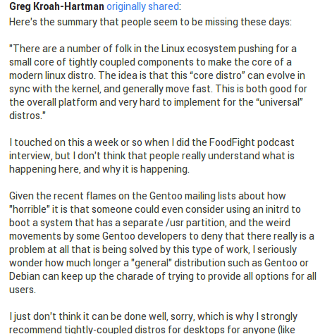
Greg K-H: “Tightly-coupled components”

Slide 36

Modularity can produce complexity
photo
courtesy
Bill
Ward

Slide 37

systemd and outside projects: CoreOS
networkd was initially contributed by CoreOS developers.
CoreOS's fleet “tool that presents your entire cluster as a single init system” is based on systemd.
  Spin up new containers due to events on sockets.
CoreOS devs are outside systemd inner circle.
systemd has many patches from Arch, Intel, Debian . . .

Slide 38
systemd in embedded systems
systemd is widely adopted in embedded systems because
  proper allocation of resources is critical;
  fastboot is required;
  customization of boot sequence is common.
Lack of backward compatibility for older kernels (due to firmware loading) is a pain point.
Embedded use cases are not always understood by systemd devs.

Slide 39
Try: 'systemctl isolate multi-user.target'
[warning: KILLS X11]
[runlevel demo with Fedora Qemu and Firefox]

Slide 40
systemd is easy to use
systemd utilities:
  Try: apropos systemd | grep ctl
All-ASCII configuration files: no hidden “registry”.
Customization is by overriding default files.
Many choices are controllable via symlinks.
Bash-completion by default.
Backwards compatibility with SysVinit

Slide 41

Override your defaults!
Replace a unit in /lib (upstream) by creating one of the same name in /etc (local changes).
Add services to boot by symlinking them into /etc/systemd/system/default.target.wants.
'mask' unit with link to /dev/null.
Best practice: do not change the files in /lib/systemd.
Read in-use unit with 'systemctl cat'.
photo courtesy
Jym Dyer

Slide 42
Extensions: drop-ins
Try: systemd-delta
Try: systemctl cat <list from 1st command>

Slide 43
Old way | New way | History
X11 manages graphics memory | Kernel's drm manages graphics memory | “Linux Graphics Drivers: an Introduction,” p. 26
static /dev, then devfs | udev
getrlimit, setrlimit | cgroups
KDE3 and GNOME2 | KDE4 and GNOME3 | KDE and GNOME
sysVinit | systemd | in progress
X11 client-server model | Wayland compositor

Slide 44
Crux of the problem: Dave Neary
“There is no freedesktop.org process for proposing standards, identifying those which are proposals and those which are de facto implemented, and perhaps more importantly, there is no process for building consensus around a specification . . .”
(comment regarding GNOME3)

Slide 45
systemd is . . .
the basis of Fedora, RHEL, CentOS, OpenSUSE, Ubuntu, Debian and much embedded.
praised by Jordan Hubbard of FreeBSD.
tightly integrated with Linux kernel cgroups.
the reference implementation for udev and for kdbus userspace access.

Slide 46
Customizing your installation
Replace a unit in /lib (upstream) by creating one of the same name in /etc (local changes).
Add services to boot by symlinking them into /etc/systemd/system/default.target.wants.
Best practice: do not change the files in /lib/systemd

Slide 47
Sequence of targets on a typical system
>$ ls -l /lib/systemd/system/default.target
/lib/systemd/system/default.target -> graphical.target
>$ cat /lib/systemd/system/graphical.target
After=multi-user.target
>$ cat /lib/systemd/system/multi-user.target
After=basic.target
>$ cat /lib/systemd/system/basic.target
After=sysinit.target sockets.target timers.target paths.target
slices.target

Slide 48
Example: set display manager
[user@localhost ~]$ ls -l `locate display-manager.service`
lrwxrwxrwx. 1 root root 35 Dec 11 2013 /etc/systemd/system/display-manager.service -> /usr/lib/systemd/system/gdm.service
[user@localhost ~]$ cat /usr/lib/systemd/system/gdm.service
[Unit]
Description=GNOME Display Manager
[ . . . ]
[Install]
Alias=display-manager.service
or
WantedBy=graphical.target

Slide 49
sysinit, sockets and multi-user are composite targets
>$ ls /lib/systemd/system/multi-user.target.wants/
dbus.service@ systemd-ask-password-wall.path@ systemd-
update-utmp-runlevel.service@ getty.target@
>$ ls /lib/systemd/system/sockets.target.wants:
dbus.socket@ systemd-shutdownd.socket@
systemd-initctl.socket@ systemd-udevd-control.socket@
>$ ls /lib/systemd/system/sysinit.target.wants:
cryptsetup.target@ systemd-journald.service@
debian-fixup.service@ systemd-journal-flush.service@
Symlinks replace lines of conditional code in SysVinit scripts.

Slide 50
Example: change the default target
[alison@localhost ~]$ ls /etc/systemd/system/default.target
/etc/systemd/system/default.target ->
/lib/systemd/system/graphical.target
[alison@localhost ~]$ sudo rm /etc/systemd/system/default.target
[alison@localhost ~]$ sudo ln -s /lib/systemd/system/multi-user.target
/etc/systemd/system/default.target
[alison@localhost ~]$ ~/bin/systemd-delta
[ . . . ]
[REDIRECTED] /etc/systemd/system/default.target →
/usr/lib/systemd/system/default.target

Slide 51
Misconceptions
systemd is more complex than sysVinit.
systemd is full of binary configuration files.
The system log is now unreadable! And liable to corruption!
{Fedora/GNOME/RedHat/Poettering} are trying to take over all of Linux.

Slide 52
problems
systemd is modular, but:
  interopability with other SW may be inadequately tested.
Potentially rocky piecemeal transition by distros.
  e.g., Debian installer doesn't warn about a separate /usr partition.
Merciless deprecation of features (firmware loading, readahead . . . ).
Frequent releases, not particularly stable.

Slide 53
Taxonomy of systemd dependencies
Requires, RequiresOverridable, Requisite, RequisiteOverridable, Wants, BindsTo, PartOf, Conflicts, Before, After, OnFailure PropagateReloadsTo, ReloadPropagateFrom,

