Slide 1
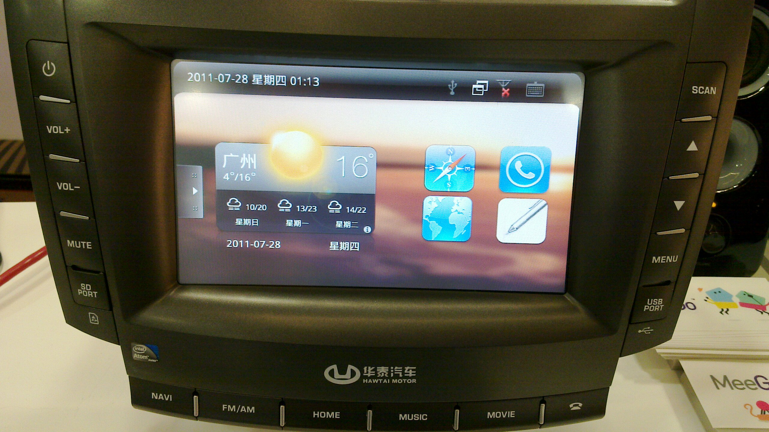
Automotive: next hot mobile platform
Alison Chaiken
alchaiken@gmail.com
http://she-devel.com/

Slide 2

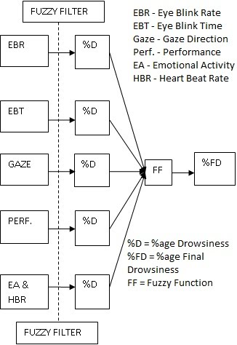
What is “in-vehicle infotainment”?
What “infotainment” calls to mind
What IVI could be

Slide 3
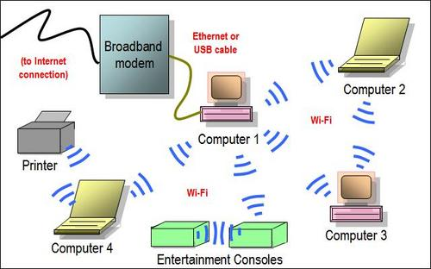

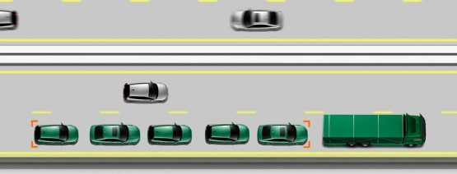
Ad hoc networking saves energy
Stress collision avoidance!

Slide 4
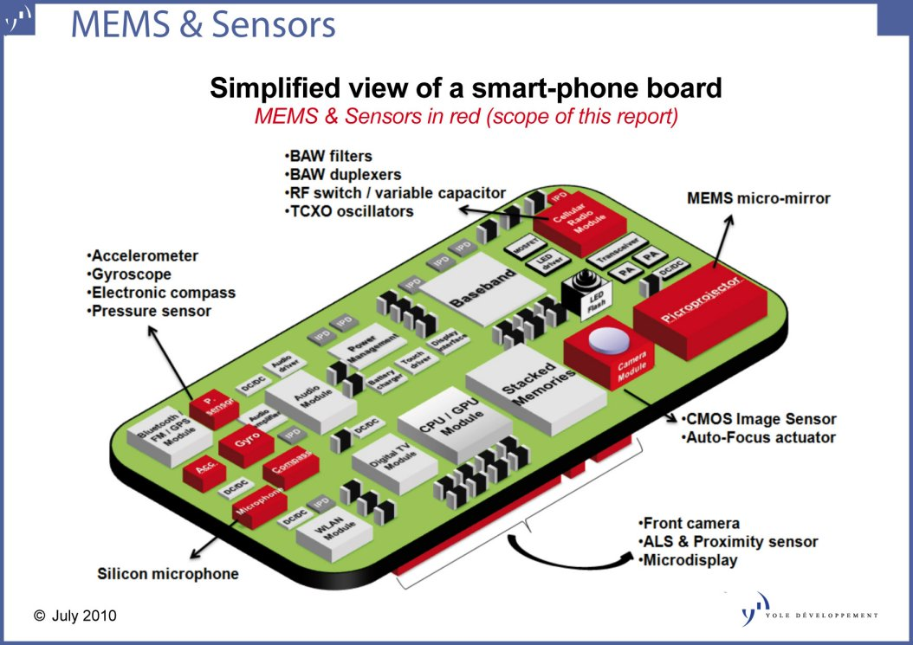
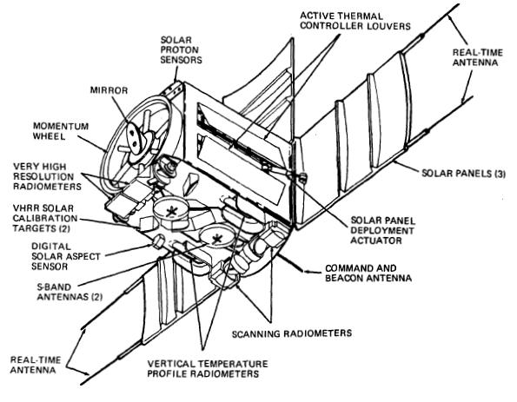
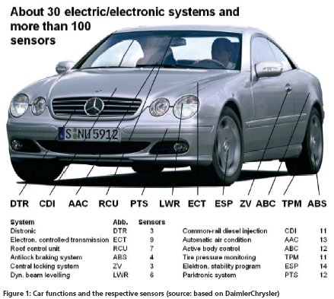
Mobile sensor platforms

Slide 5


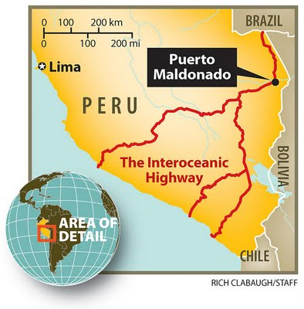
Mobile sensor data collection coverage
Sensor data fusion: way beyond real-time traffic!

Slide 6

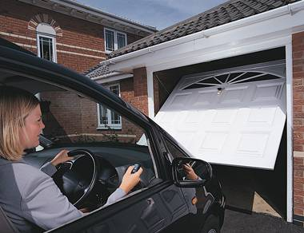
Inserting smarts into big dumb docking stations
Cars can tether and sync rural houses?

Slide 7
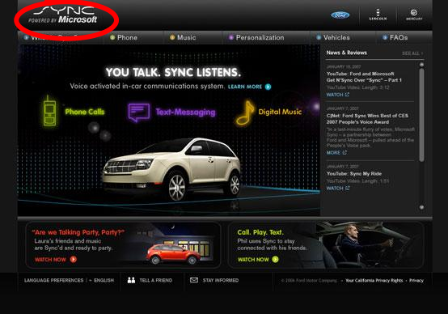
Special concerns for automotive: security
What is the right security model for auto use case?

Slide 8
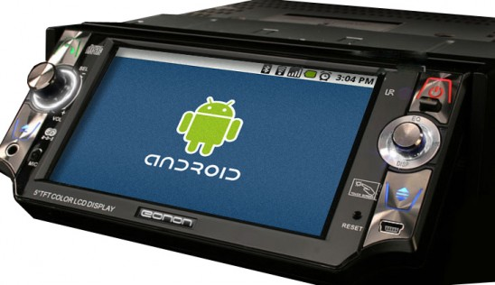
Is the platform we need Android . . .
. . . from the Open Handset Alliance?

Slide 9

Special concerns for automotive: safety
A highly regulated area, but lots of auto and insurance $.

Slide 10

Special concerns for automotive: real-time
Not just audio, but video too!

Slide 11
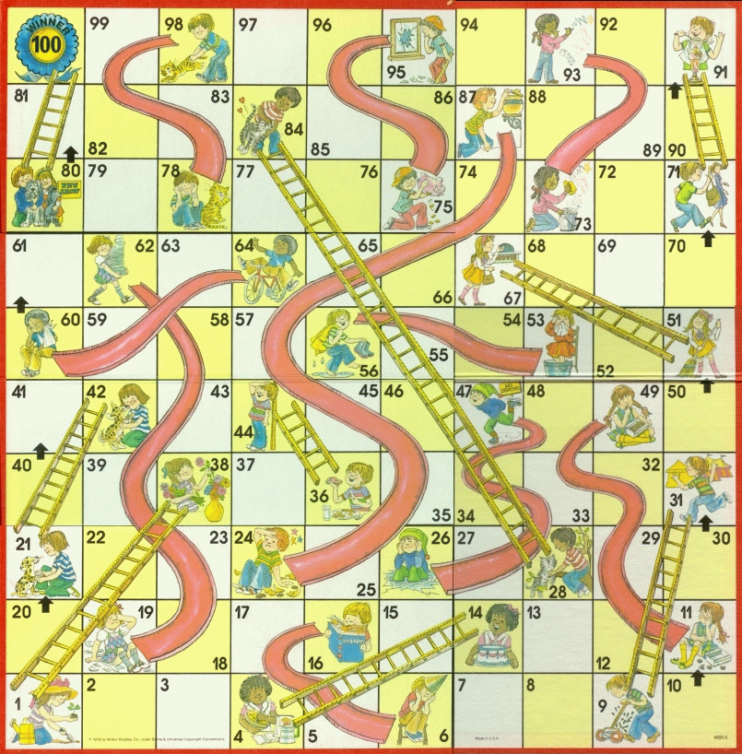
Hardware Adaptation Process
Maybe not
that kernel
Update from
wrong repo
Use installer
defaults
Hand-craft
boot-loader
Multi-hour
package update
Target platform: ExoPC Atom-based Slate running MeeGo

Slide 12
Advertisement: longer version with Demo
MeeGo Meet-up: Tuesday September 7, 7 PM here at HD
North Bay Linux Users Group, September 13
Code Camp, October 9

