Slide 1
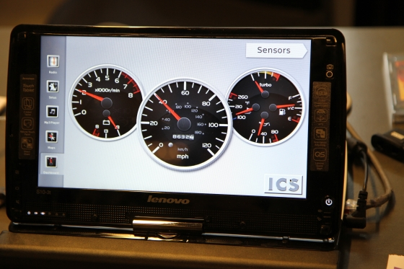

Our group's first sponsor

Slide 2
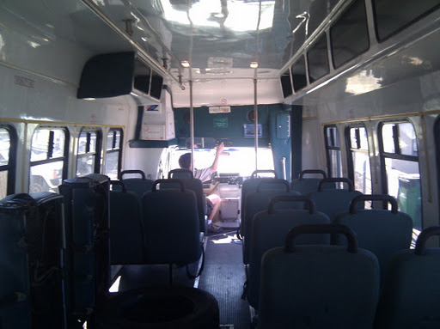
Advertisement: who wants to bus-pool to SCALE?
Katy's shuttle bus

Slide 3
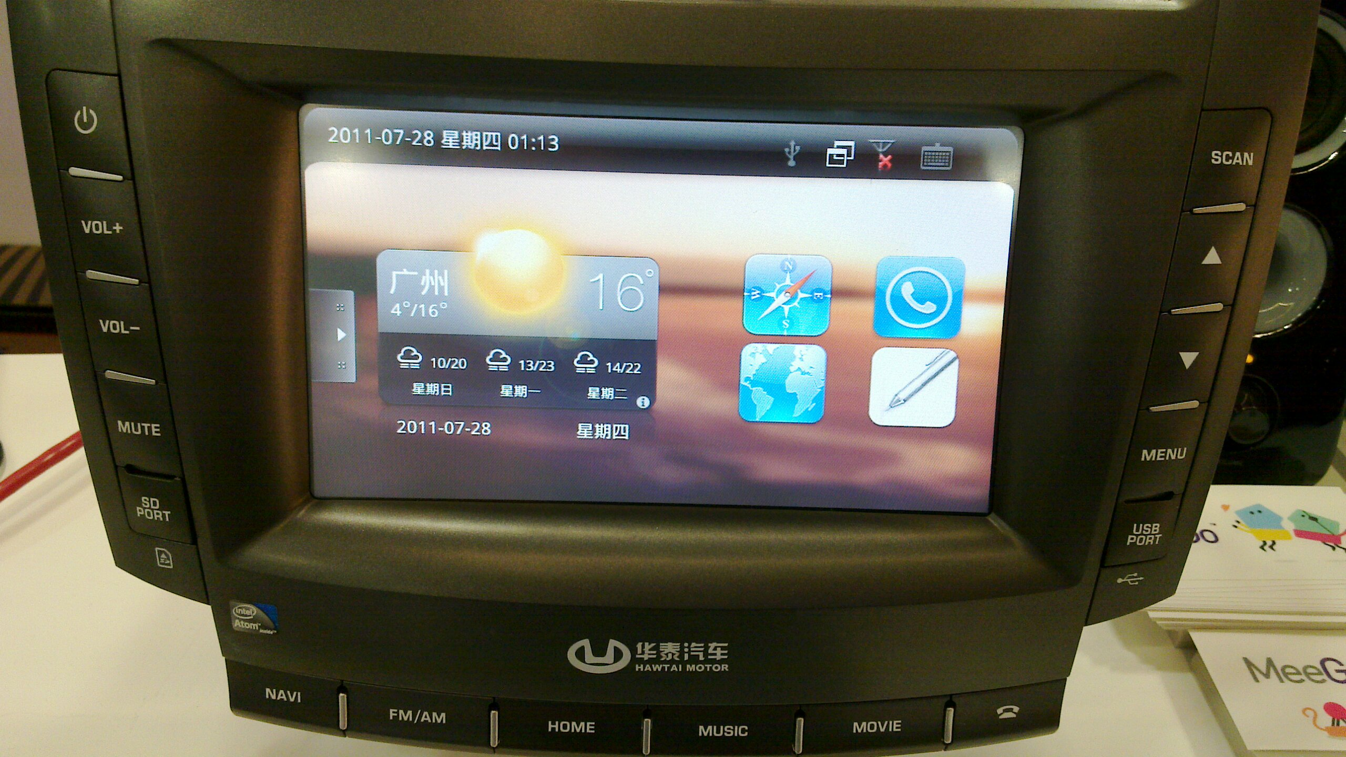
Automotive: new frontier for mobile Linux
Alison Chaiken
alchaiken@gmail.com
http://she-devel.com/

Slide 4
Outline
Automotive software systems: IVI
Major IVI projects and platforms
HW platforms for IVI development
nOBDy and ExoPC demos

Slide 5
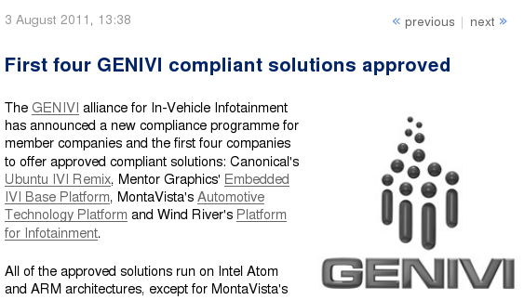
100-Member auto SW alliance endorses Linux
GENIVI is promulgating Linux standards for auto space.

Slide 6










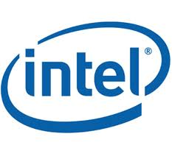




Bay Area IVI participants
New L.A. factory

Slide 7
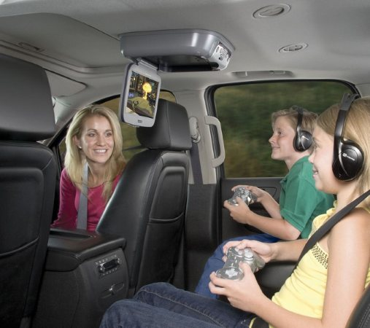
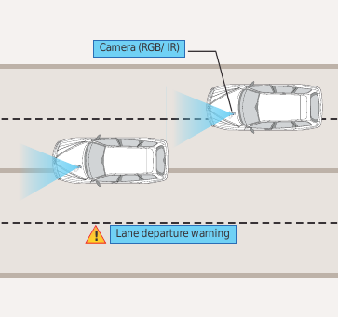
What is “in-vehicle infotainment”?
Courtesy Tata Consultancy Services
What “infotainment” calls to mind
What IVI could be

Slide 8
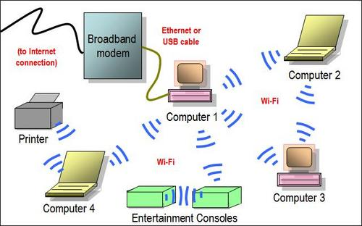
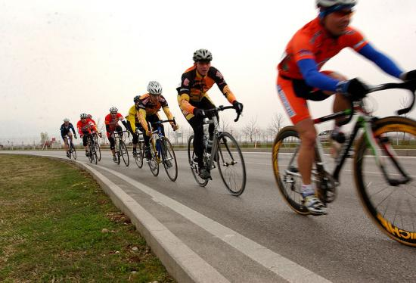
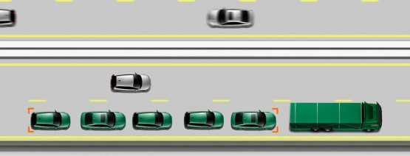
Opportunity: save energy through ad hoc networking
Use this . . .
to save energy . . .
with cars, too: 802.11p WAVE.

Slide 9
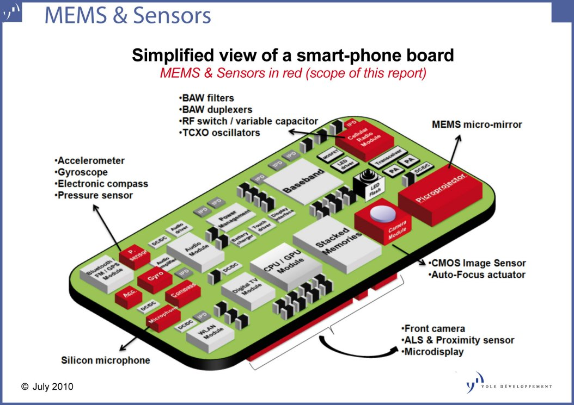
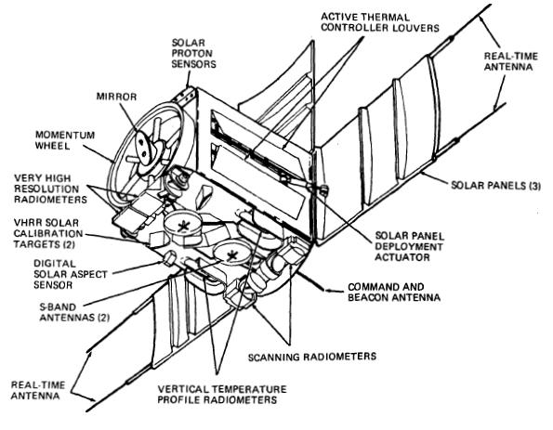
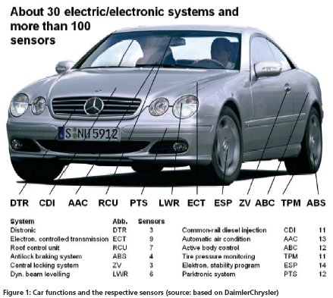
Opportunity: Mobile sensor platform data fusion/mining
Handset
Satellite

Slide 10
Challenges for IVI
Security in a multi-user, mobile, often unattended device
Safety: not “kill -9” but kill dead!
Novel hardware and architecture
Not a phone or desktop: little-understood UI/UX

Slide 11
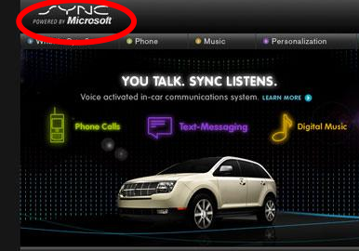
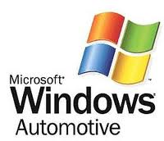
Security Challenge
Backseat kids changing nav system's destination . . .
mechanic at body shop installs malware.

Slide 12
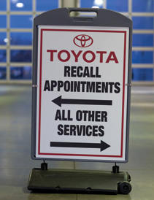
Safety Challenge
Driver gets alarms and has read-only access to many parameters.
Prevent entertainment system from hogging resources (incl. Driver!).

Slide 13
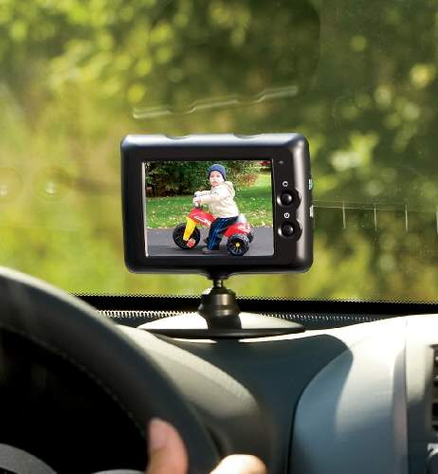
Hardware/Driver Challenge
CAN bus, MOST bus, wheel rotation sensors, oil level . . .
Not just RT audio, but RT video too!

Slide 14
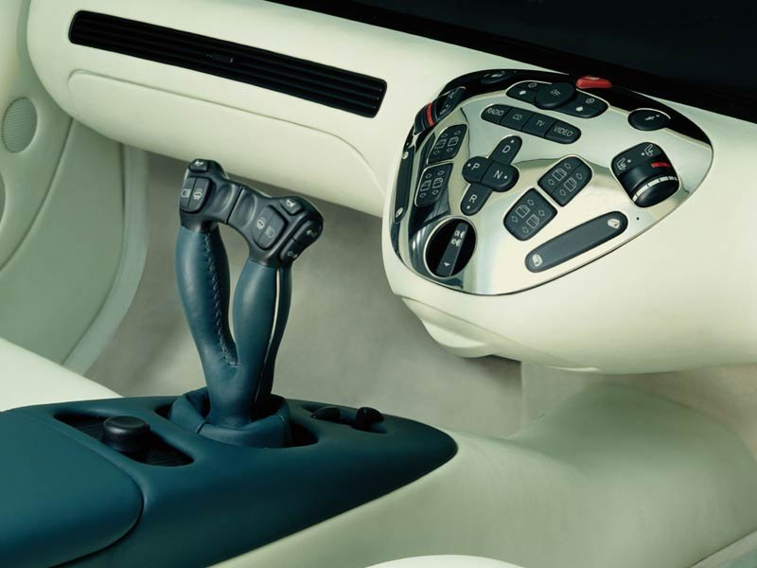
UI Challenge: What kind of controls?
Touchscreen, video gesture, joystick, voice, haptic?
http://funktion.catalystexhibit.com/2009/11/is-our-future-joystuck/

Slide 15

Novel architecture: my guess
Front-seat RT audio
and video
incl. alarms
DSP
GPU
Atom or ARM SoC
running GNU/Linux
Under-the-hood controller
Cortex-M
Sensor data R/O
16-bit MCU
running RTOS
In-dash GPCPU
Control: R/W
Atom or ARM
running Android
MIPS with
OpenWRT
CAN and
MOST
buses
Backseat entertainment
Firewall

Slide 16
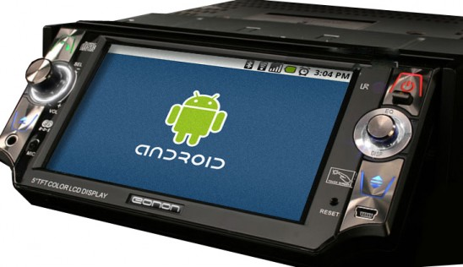
Maybe what we want is Android . . .
from the Open Handset Alliance?

Slide 17
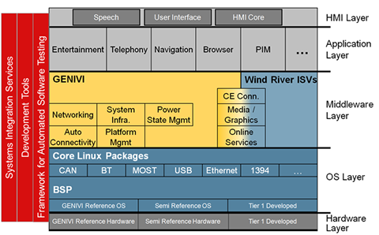
IVI Special Features: Wind River
A traditional GNU/Linux distro, unlike Android.

Slide 18
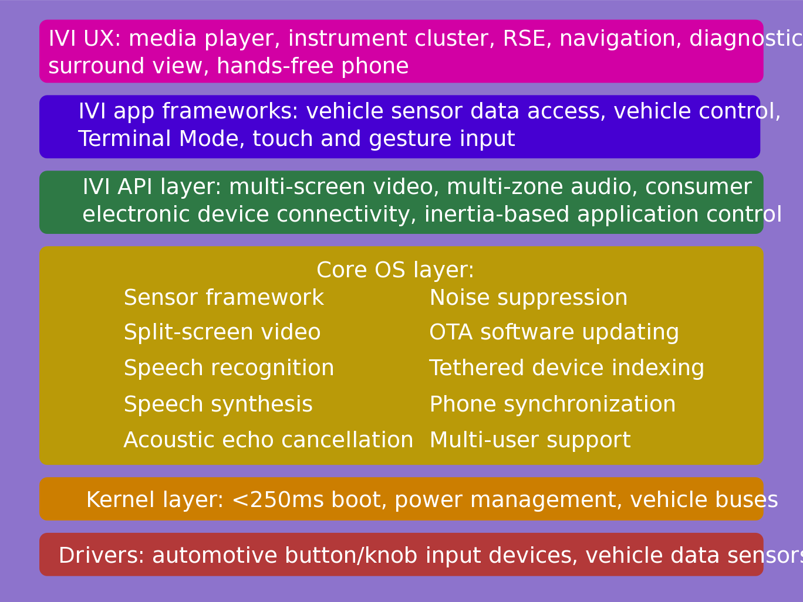
IVI UX Additional Features: MeeGo/Tizen
Courtesy
Nathan P. Willis,
http://tinyurl.com/3m4loer
Many automotive players, few public announcements.

Slide 19
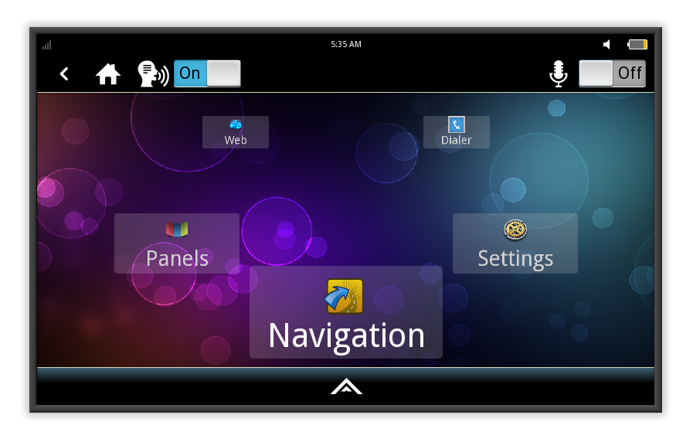
MeeGo IVI 1.2 Home Screen
Intended to be reskinned, not as a shipping product.

Slide 20
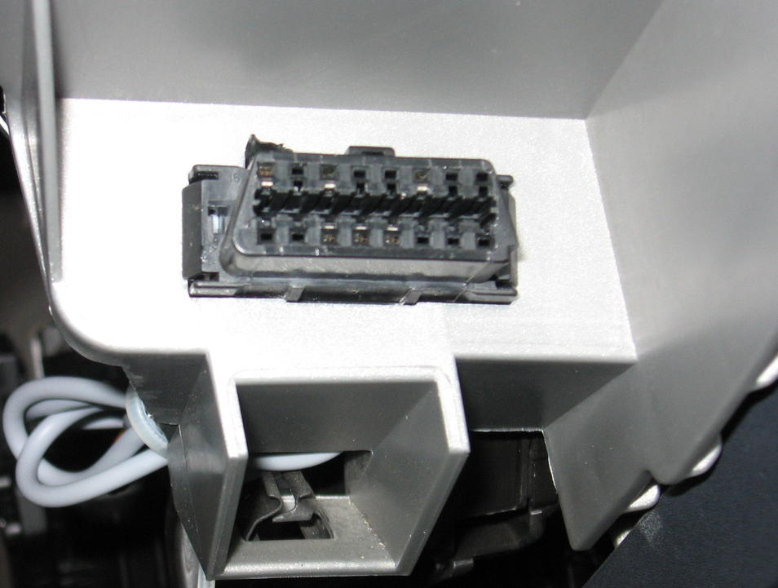
Example: tripzero's nobdy OBDII/CAN scanner
OBD-II connector on left
of steering wheel
Scan tool (USB to OBDII)
available from Amazon, etc.
about $35
GFDL

Slide 21
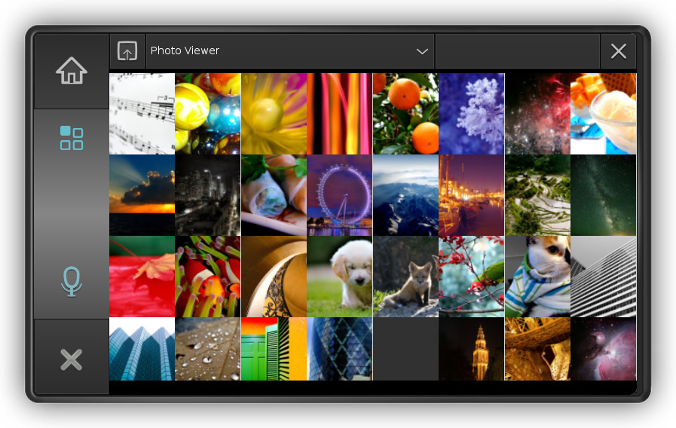
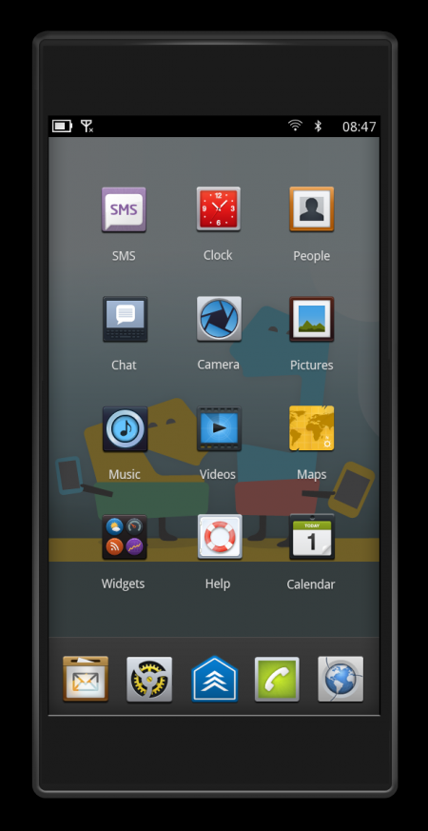
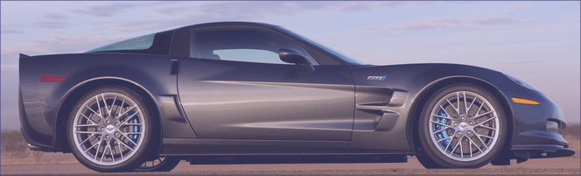
Tripzero: Handset/Tablet + meego ivi
In the near future...
DBus
nobdy
nobdy
Bluetooth
subscriber
plugin
Bluetooth
Provider
plugin
DBus
http://sf2011.meego.com/program/sessions/vehicle-communications-meego

Slide 22
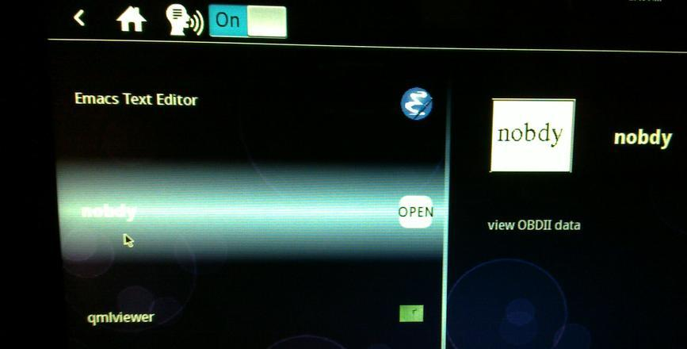
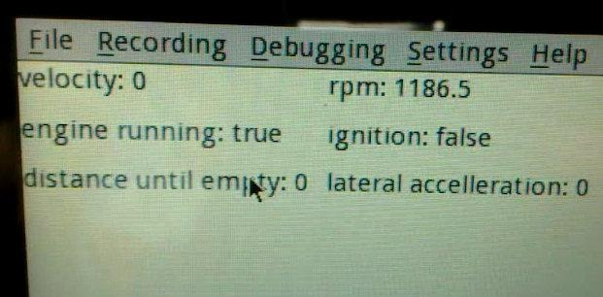
Nobdy on ExoPC
Nobdy in scrollwheel menu
Live data stream via D-bus and qmlviewer

Slide 23
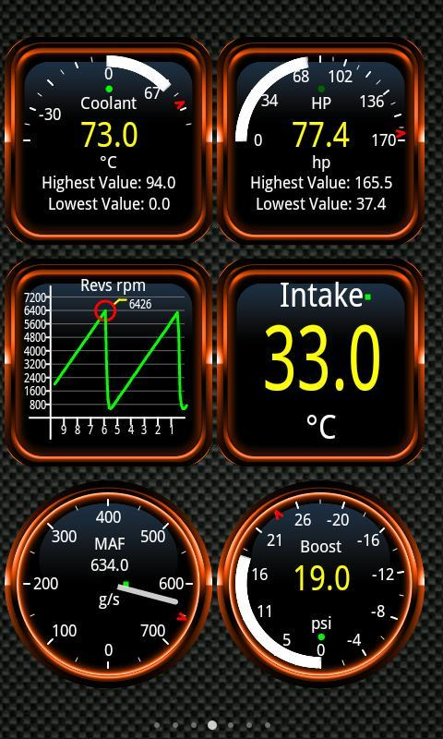
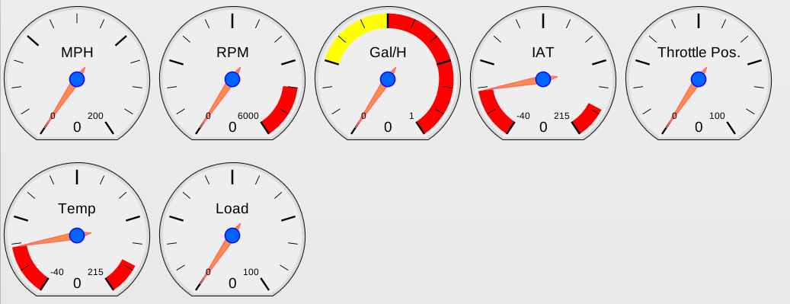
Linux OBDII Software
New nobdy Qjson UI from tripzero
Torque from Android Market
For open-source Qt UI, see ICS IVI demo by Justin Noel

Slide 24
Summary
Linux opportunities at all levels: HW, accessories, embedded, platform, apps, entrepreneurs and big companies.
Finding HW for development remains a problem.
Many local companies are participating =>> jobs.
Prediction: automotive is where Linux will show most growth.

Slide 25
Resources 1: Hardware platforms for IVI
ARM set-top box: Trimslice, $219 with Arch or MeeGo.
ARM board: FreeScale i.MX QuickStart, $149 w/ Ubuntu.
Atom/x86 slate: Ciara ExoPC Vibe, $699 w/ Windows.
Atom/x86 board: Intel Black Sands, $149 w/ reg, Android, Ubuntu or MeeGo.
ARM boards: T.I. BeagleBoard ($149), PandaBoard ($179), Ubuntu or Android.
Multiple displays and controls needed.
Touch, voice, video, joystick, haptic devices and drivers?
GPS dongles, CAN daughter cards . . .

Slide 26
Resources 2
IVI wiki: http://wiki.meego.com/In-vehicle
Official site: http://meego.com/downloads/releases/1.2/meego-v1.2-in-vehicle-infotainment-ivi
Mailing list archive: http://lists.meego.com/pipermail/meego-ivi
Mp3car.com
#linuxice and #meego-ivi IRC on freenode.net
nOBDy: wiki.openice.org/index.php?title=Nobdy
My notes and instructions
  on ExoPC: http://wiki.meego.com/MeeGo_IVI_on_ExoPC
  on Pandaboard: http://wiki.meego.com/Hardware-accelerated_graphics_on_Pandaboard_using_MeeGo

Slide 27
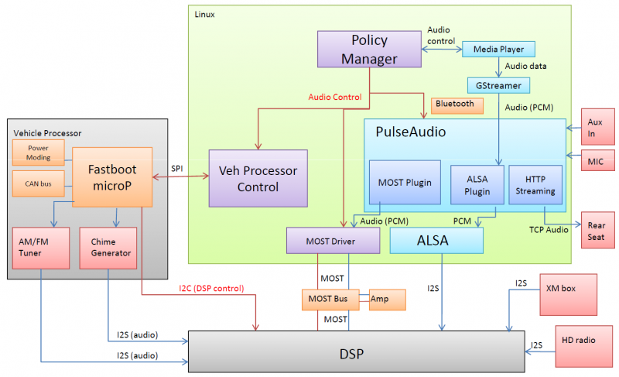
MeeGo IVI Audio Architecture
Courtesy Laci Jalics, Delphi.

Slide 28
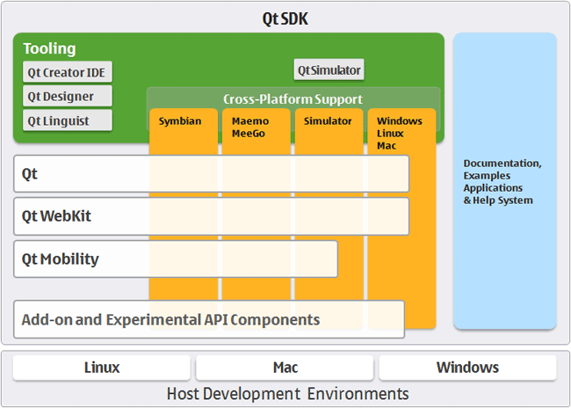
How about MeeGo?
MeeGo = lightweight GNU/Linux with a Qt face.

Slide 29
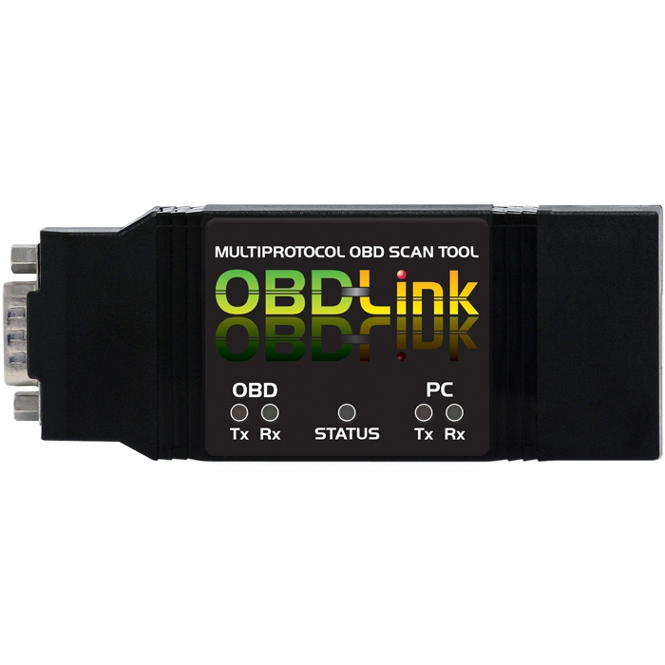
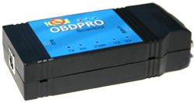
Tripzero: How do I test this in my car?
Elm-compatible scantool
Any tablet/smartphone/laptop that runs meego
http://sf2011.meego.com/program/sessions/vehicle-communications-meego

Slide 30
MeeGo-IVI on Atom and ARM Demo HW
No SW support for HW available to small-medium businesses.
Running IVI on ExoPC requires a mash-up of “Tablet Preview” and IVI UXes.
Meego-ivi repos support EMGD graphics only
  “zypper update” auto-overwrites drivers and X11 SO libraries.
Stopped work on ARM-based Pandaboard due to missing graphics driver.

Slide 31
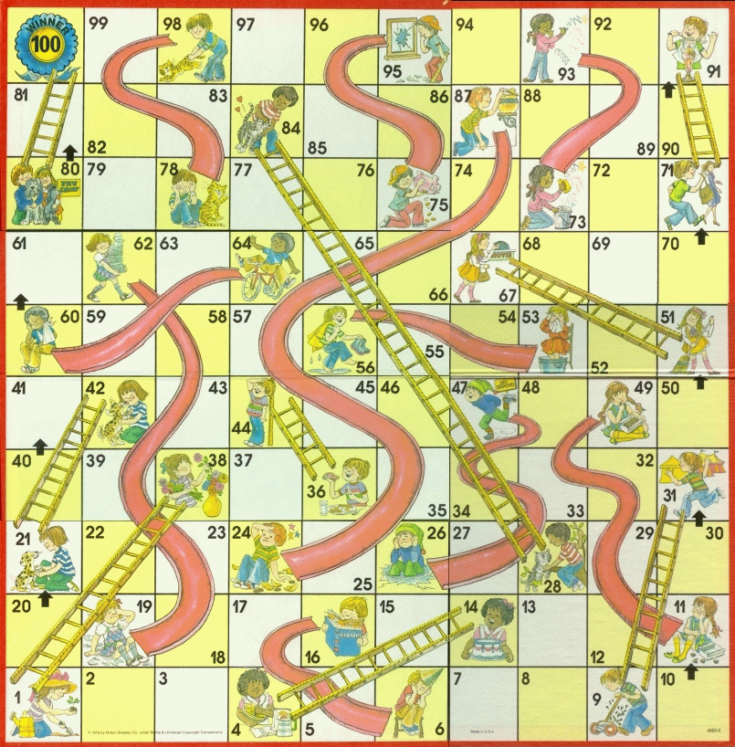
MeeGo Hardware Adaptation Process
Maybe not
that kernel
Update from
wrong repo
Use installer
defaults
Hand-craft
extlinux.conf
Multi-hour
“zypper up”

Slide 32
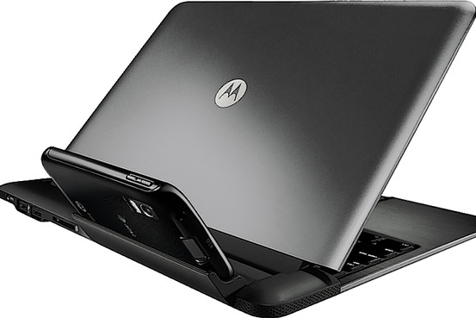
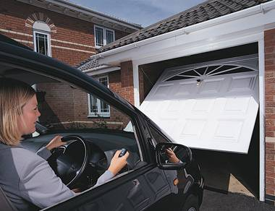
Inserting smarts into big dumb docking stations
Dock the Atrix . . .
. . . or dock the car?
Cars can tether and sync rural businesses and homes?

