Slide 1
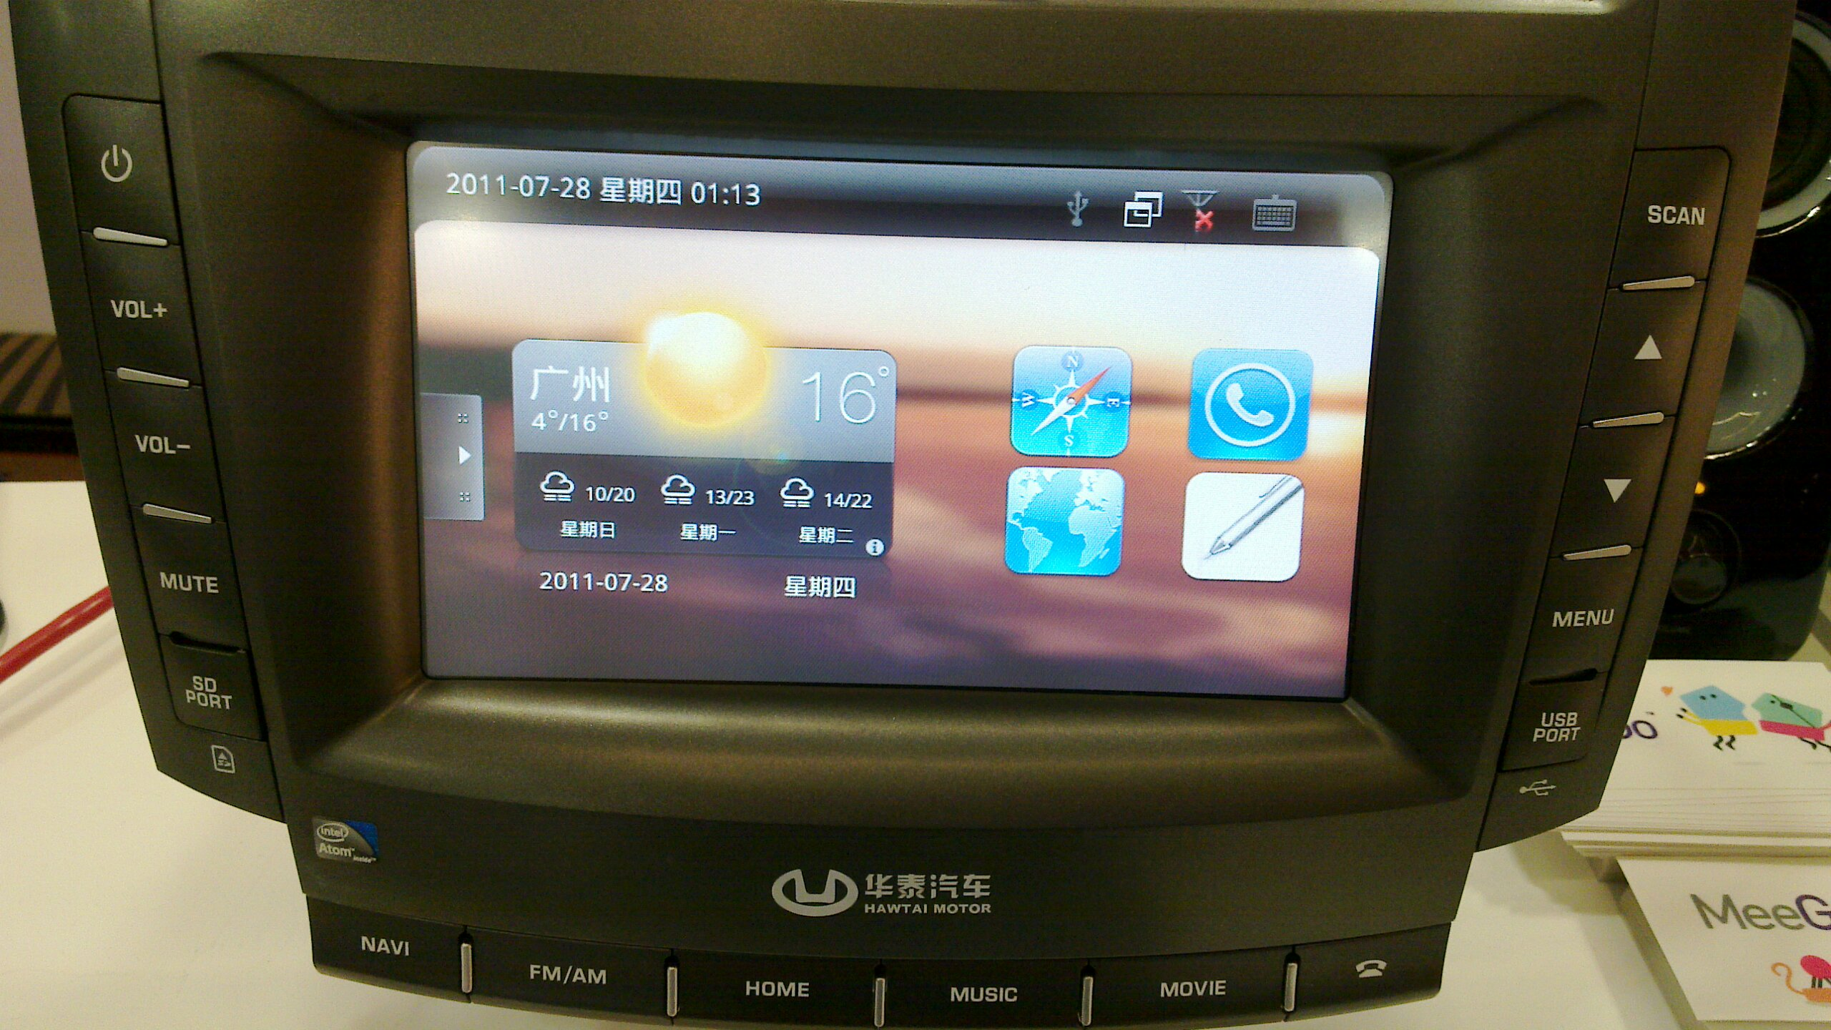
Automotive: new frontier for mobile Linux
Alison Chaiken
alchaiken@gmail.com
http://she-devel.com/

Slide 2
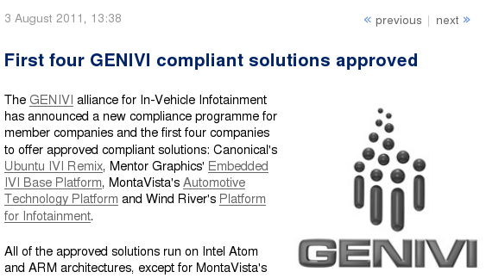
100-Member auto SW alliance endorses Linux
http://www.h-online.com/open/news/item/First-four-GENIVI-compliant-solutions-approved-1317701.html

Slide 3
Outline
Automotive software systems: IVI
Major IVI projects and platforms
(lack of) HW support for IVI development
nOBDy and ExoPC demos

Slide 4

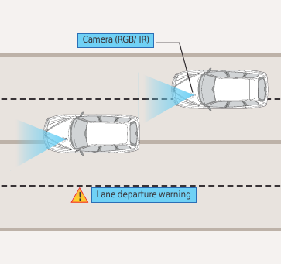
What is “in-vehicle infotainment”?
Courtesy Tata Consultancy Services
What “infotainment” calls to mind
What IVI could be

Slide 5













Bay Area IVI participants
New L.A. factory

Slide 6
3 potential novel auto apps
Saving fuel with ad hoc convoys

Slide 7
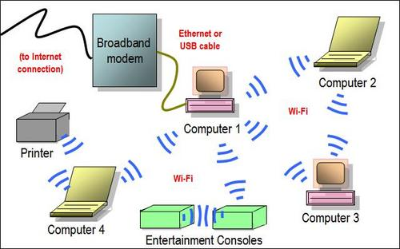

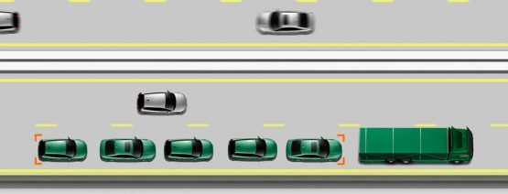
Ad hoc networking saves energy
Use this . . .
to save energy . . .
with cars, too: 802.11p WAVE.

Slide 8
3 potential novel auto apps
Saving fuel with ad hoc convoys
Car as mobile data collection platform

Slide 9
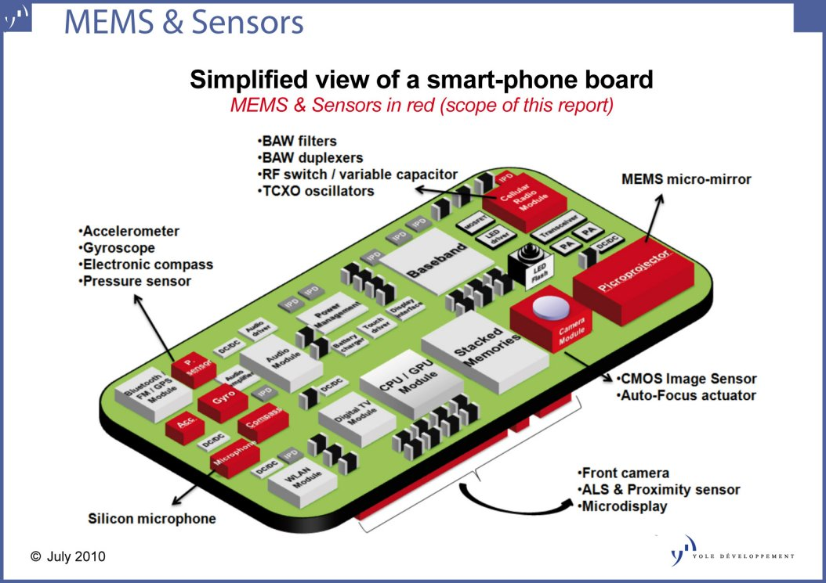
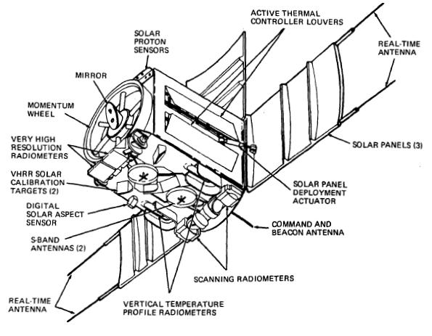
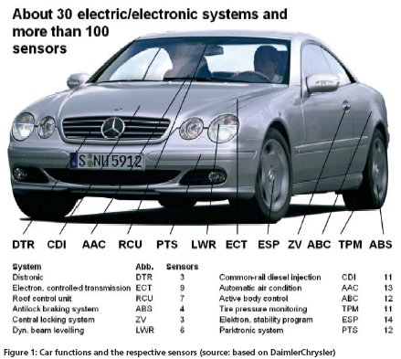
Mobile sensor platforms

Slide 10
3 potential novel auto apps
Saving fuel with ad hoc convoys
Car as mobile data collection platform
Car as giant portable CPU and battery

Slide 11
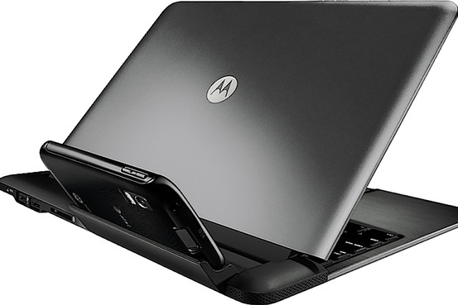
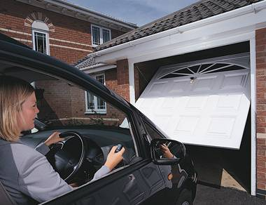
Inserting smarts into big dumb docking stations
Dock the Atrix . . .
. . . or dock the car?
Cars can tether and sync rural businesses and homes?

Slide 12
4 challenges for IVI
Security in a multi-user, mobile, often unattended device

Slide 13
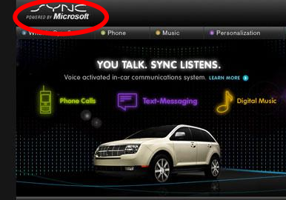

Challenge 1: security
Backseat kids changing nav system's destination . . .
mechanic at body shop installs malware.

Slide 14
4 challenges for IVI
Security in a multi-user, mobile, often unattended device
Safety: not “kill -9” but kill dead!

Slide 15
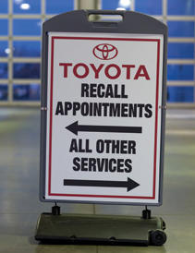
Challenge 2: safety
Driver gets alarms and has read-only access to many parameters.
Prevent entertainment system from hogging resources (incl. Driver!).

Slide 16
4 challenges for IVI
Security in a multi-user, mobile, often unattended device
Safety of a complex system with power to kill
Unique HW: device drivers!?

Slide 17
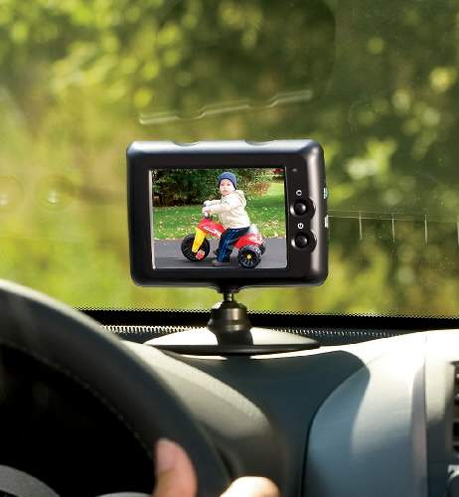
Challenge 3: HW needs
CAN bus, MOST bus, wheel rotation sensors, oil level . .
Not just RT audio, but RT video too!

Slide 18
4 challenges for IVI
Security in a multi-user, mobile, often unattended device
Safety: not “kill -9” but kill dead!
Unique hardware: device drivers?!
Not a phone or desktop: little-understood UI/UX

Slide 19
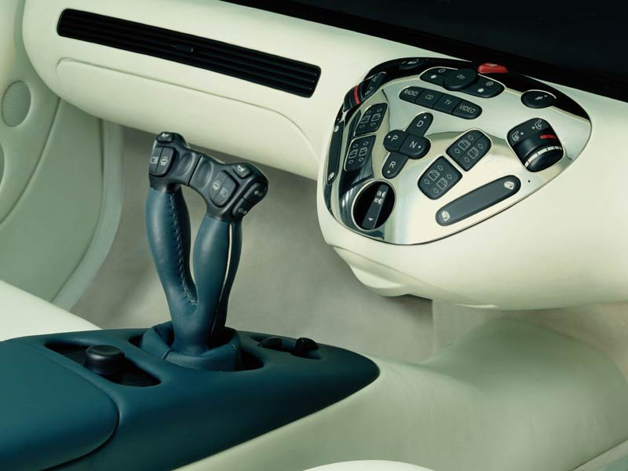
Game-like Controls, Real Cars?
Touchscreen, video gesture, joystick, voice, haptic?
http://funktion.catalystexhibit.com/2009/11/is-our-future-joystuck/

Slide 20
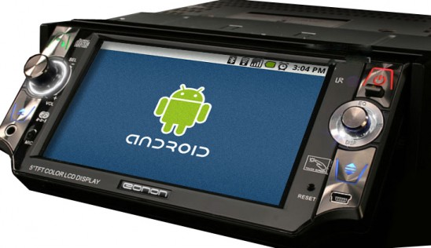
Maybe what we want is Android . . .
from the Open Handset Alliance?

Slide 21
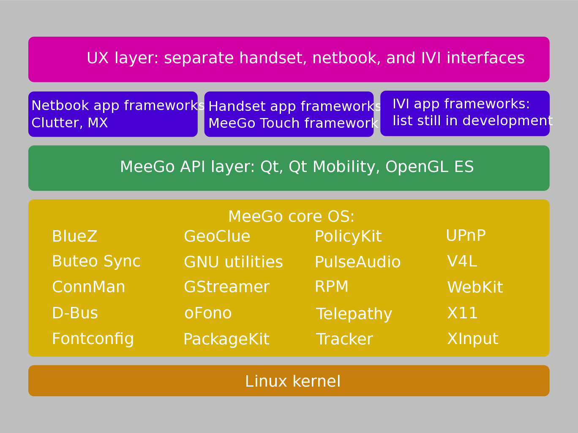
Why consider MeeGo? (or Tizen)?
Courtesy
Nathan P. Willis,
http://tinyurl.com/3m4loer
Closer to traditional GNU/Linux distro than Android.

Slide 22
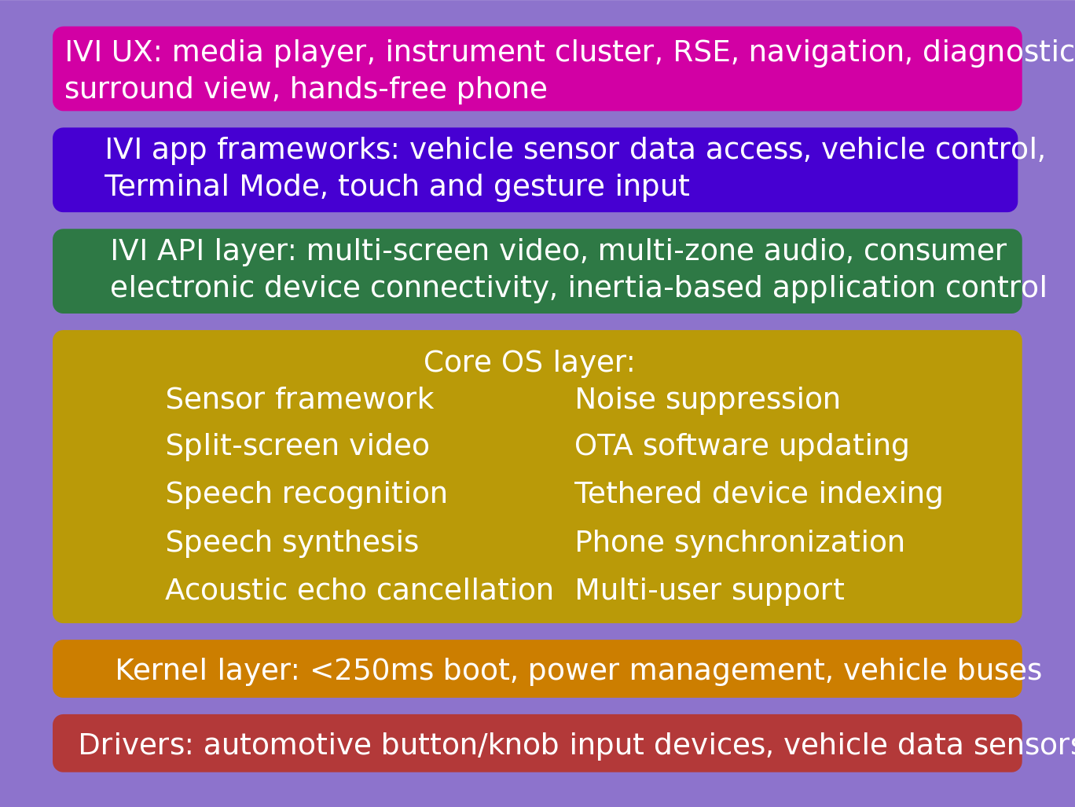
IVI UX Additional Features
Courtesy
Nathan P. Willis,
http://tinyurl.com/3m4loer
Many automotive players, few public announcements.

Slide 23
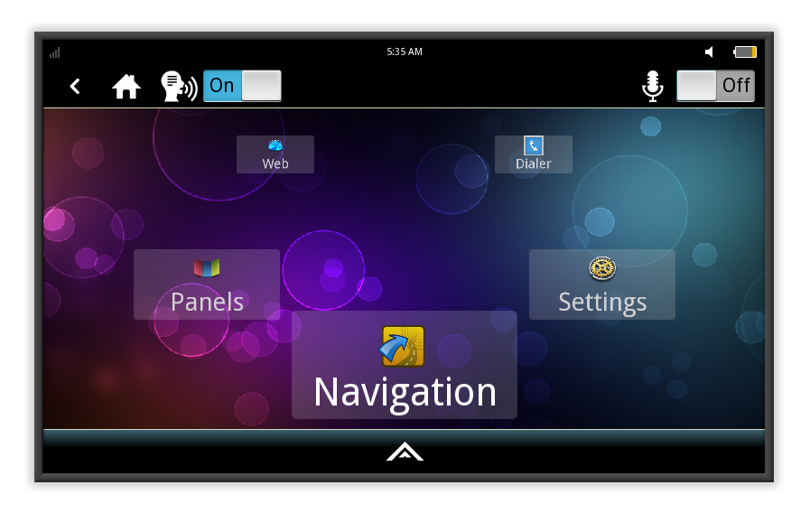
MeeGo IVI 1.2 Home Screen
Intended to be reskinned, not as a shipping product.

Slide 24
Problem: what HW platform should IVI devs use?
ARM set-top box: Trimslice, $219 with Arch or MeeGo.
ARM board: FreeScale i.MX QuickStart, $149 w/ Ubuntu.
Atom/x86 slate: Ciara ExoPC Vibe, $699 w/ Windows.
ARM boards: T.I. BeagleBoard ($149), PandaBoard ($179), Ubuntu.
Multiple displays and controls needed.
Touch, voice, video, joystick, haptic devices and drivers?
GPS dongles, CAN daughter cards . . .

Slide 25
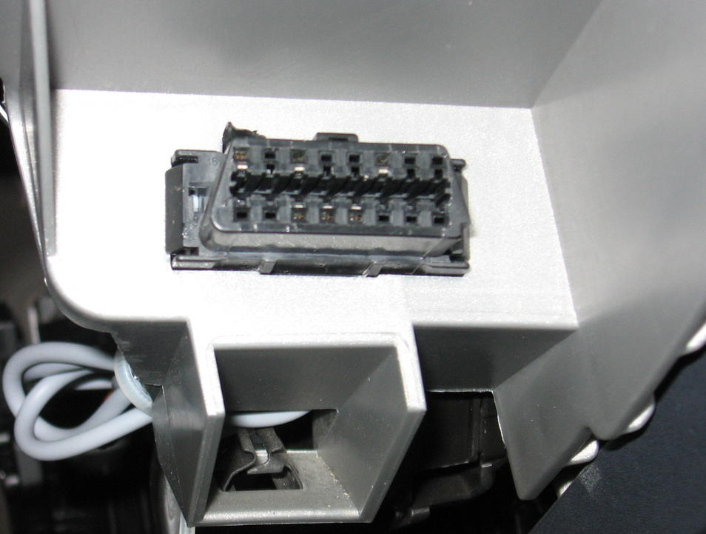
Example: tripzero's nobdy OBDII/CAN scanner
OBD-II connector on left
of steering wheel
GFDL

Slide 26
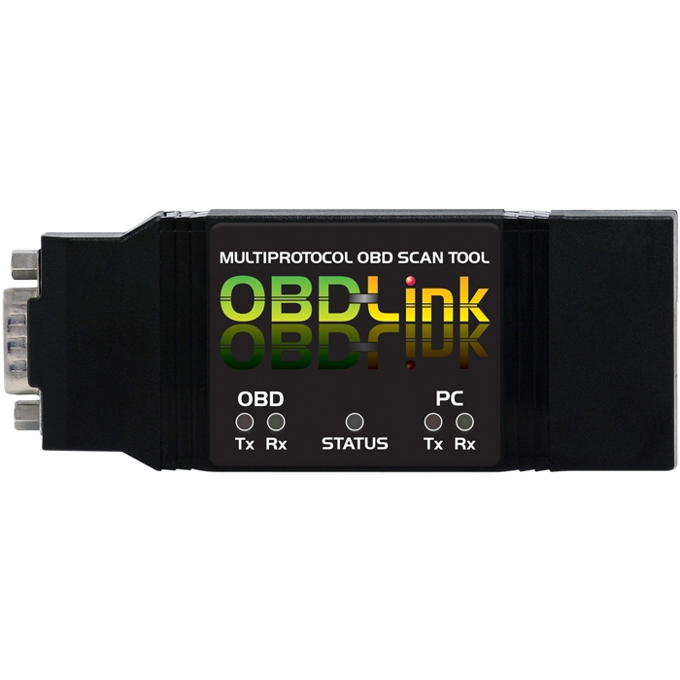
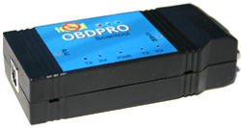
Tripzero: How do I test this in my car?
Elm-compatible scantool
Any tablet/smartphone/laptop that runs meego
http://sf2011.meego.com/program/sessions/vehicle-communications-meego

Slide 27
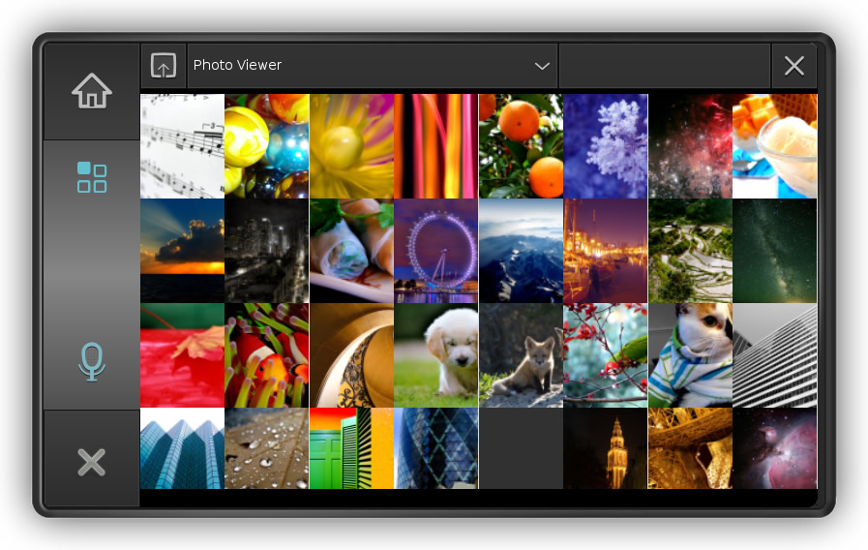
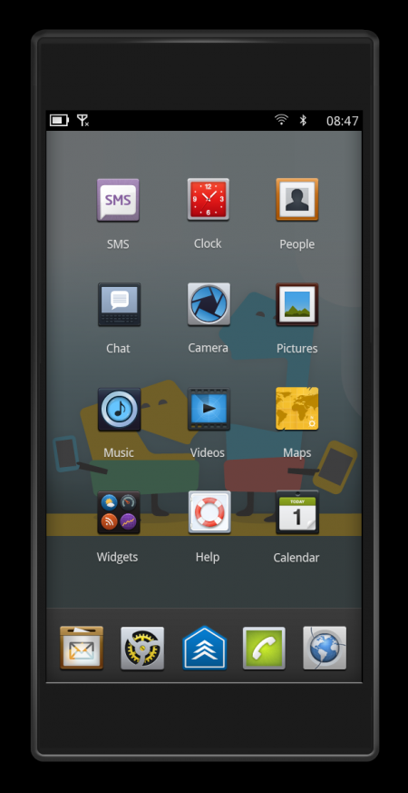
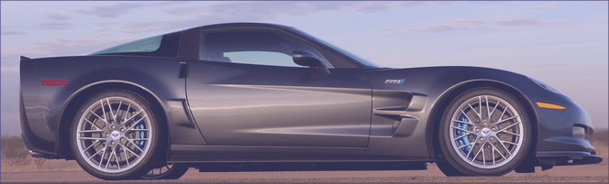
Tripzero: Handset/Tablet + meego ivi
In the near future...
DBus
nobdy
nobdy
Bluetooth
subscriber
plugin
Bluetooth
Provider
plugin
DBus
http://sf2011.meego.com/program/sessions/vehicle-communications-meego

Slide 28
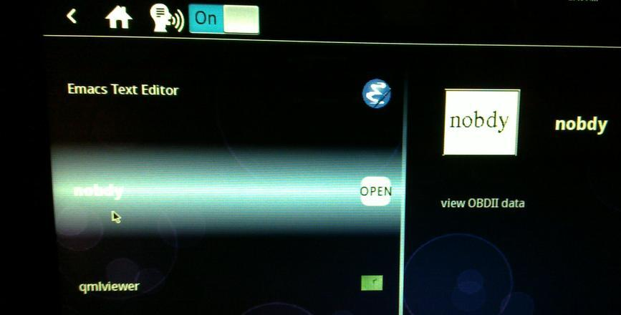
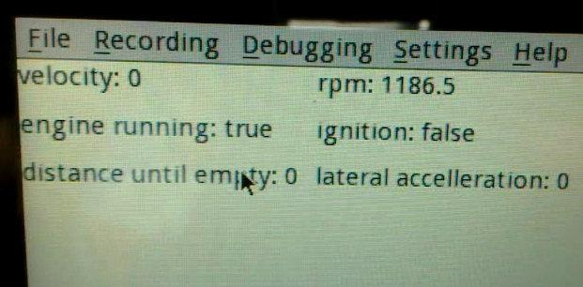
Nobdy on ExoPC
Nobdy in scrollwheel menu
Live data stream via D-bus and qmlviewer

Slide 29
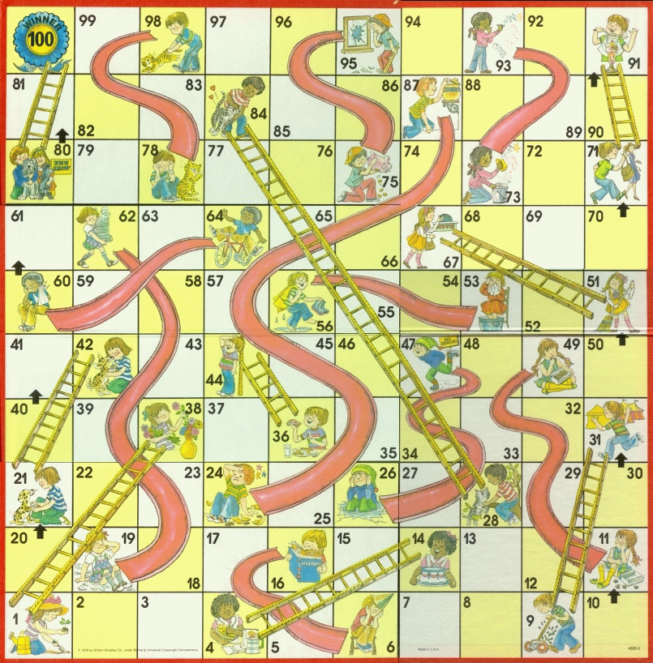
MeeGo Hardware Adaptation Process
Maybe not
that kernel
Update from
wrong repo
Use installer
defaults
Hand-craft
extlinux.conf
Multi-hour
“zypper up”

Slide 30
Summary
Linux opportunities at all levels: HW, accessories, embedded, platform, apps, entrepreneurs and big companies.
Finding HW for development remains a problem.
Many local companies are participating.
Prediction: automotive is where Linux will show most growth.

Slide 31
Resources
IVI wiki: http://wiki.meego.com/In-vehicle
Official site: http://meego.com/downloads/releases/1.2/meego-v1.2-in-vehicle-infotainment-ivi
Mailing list archive: http://lists.meego.com/pipermail/meego-ivi
Mp3car.com
#linuxice and #meego-ivi IRC on freenode.net
Nobdy: wiki.openice.org/index.php?title=Nobdy&oldid=4637 (current version is spam)
My notes and instructions
  on ExoPC: http://wiki.meego.com/MeeGo_IVI_on_ExoPC
  on Pandaboard: http://wiki.meego.com/Hardware-accelerated_graphics_on_Pandaboard_using_MeeGo

Slide 32
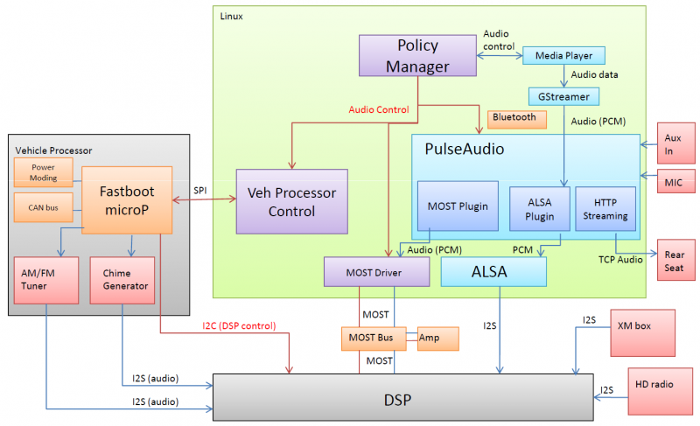
MeeGo IVI Audio Architecture
Courtesy Laci Jalics, Delphi.

Slide 33
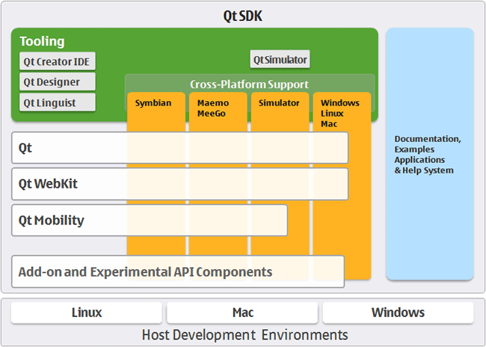
How about MeeGo?
MeeGo = lightweight GNU/Linux with a Qt face.

Slide 34
MeeGo-IVI on Atom and ARM Demo HW
No SW support for HW available to small-medium businesses.
Running IVI on ExoPC requires a mash-up of “Tablet Preview” and IVI UXes.
Meego-ivi repos support EMGD graphics only
  “zypper update” auto-overwrites drivers and X11 SO libraries.
Stopped work on ARM-based Pandaboard due to missing graphics driver.

Slide 35

