Slide 1
The “Telematics Horizon”
V2V and V2I Networking
Alison Chaiken
Embedded Software Division
October 25, 2013
alison_chaiken@mentor.com

Slide 2
Telematics horizon: the reach of sensor awareness of a “connected car”
compared to
line of sight for an unconnected one.
Origin: Daimler, per Dr. Christian Weiß

Slide 3
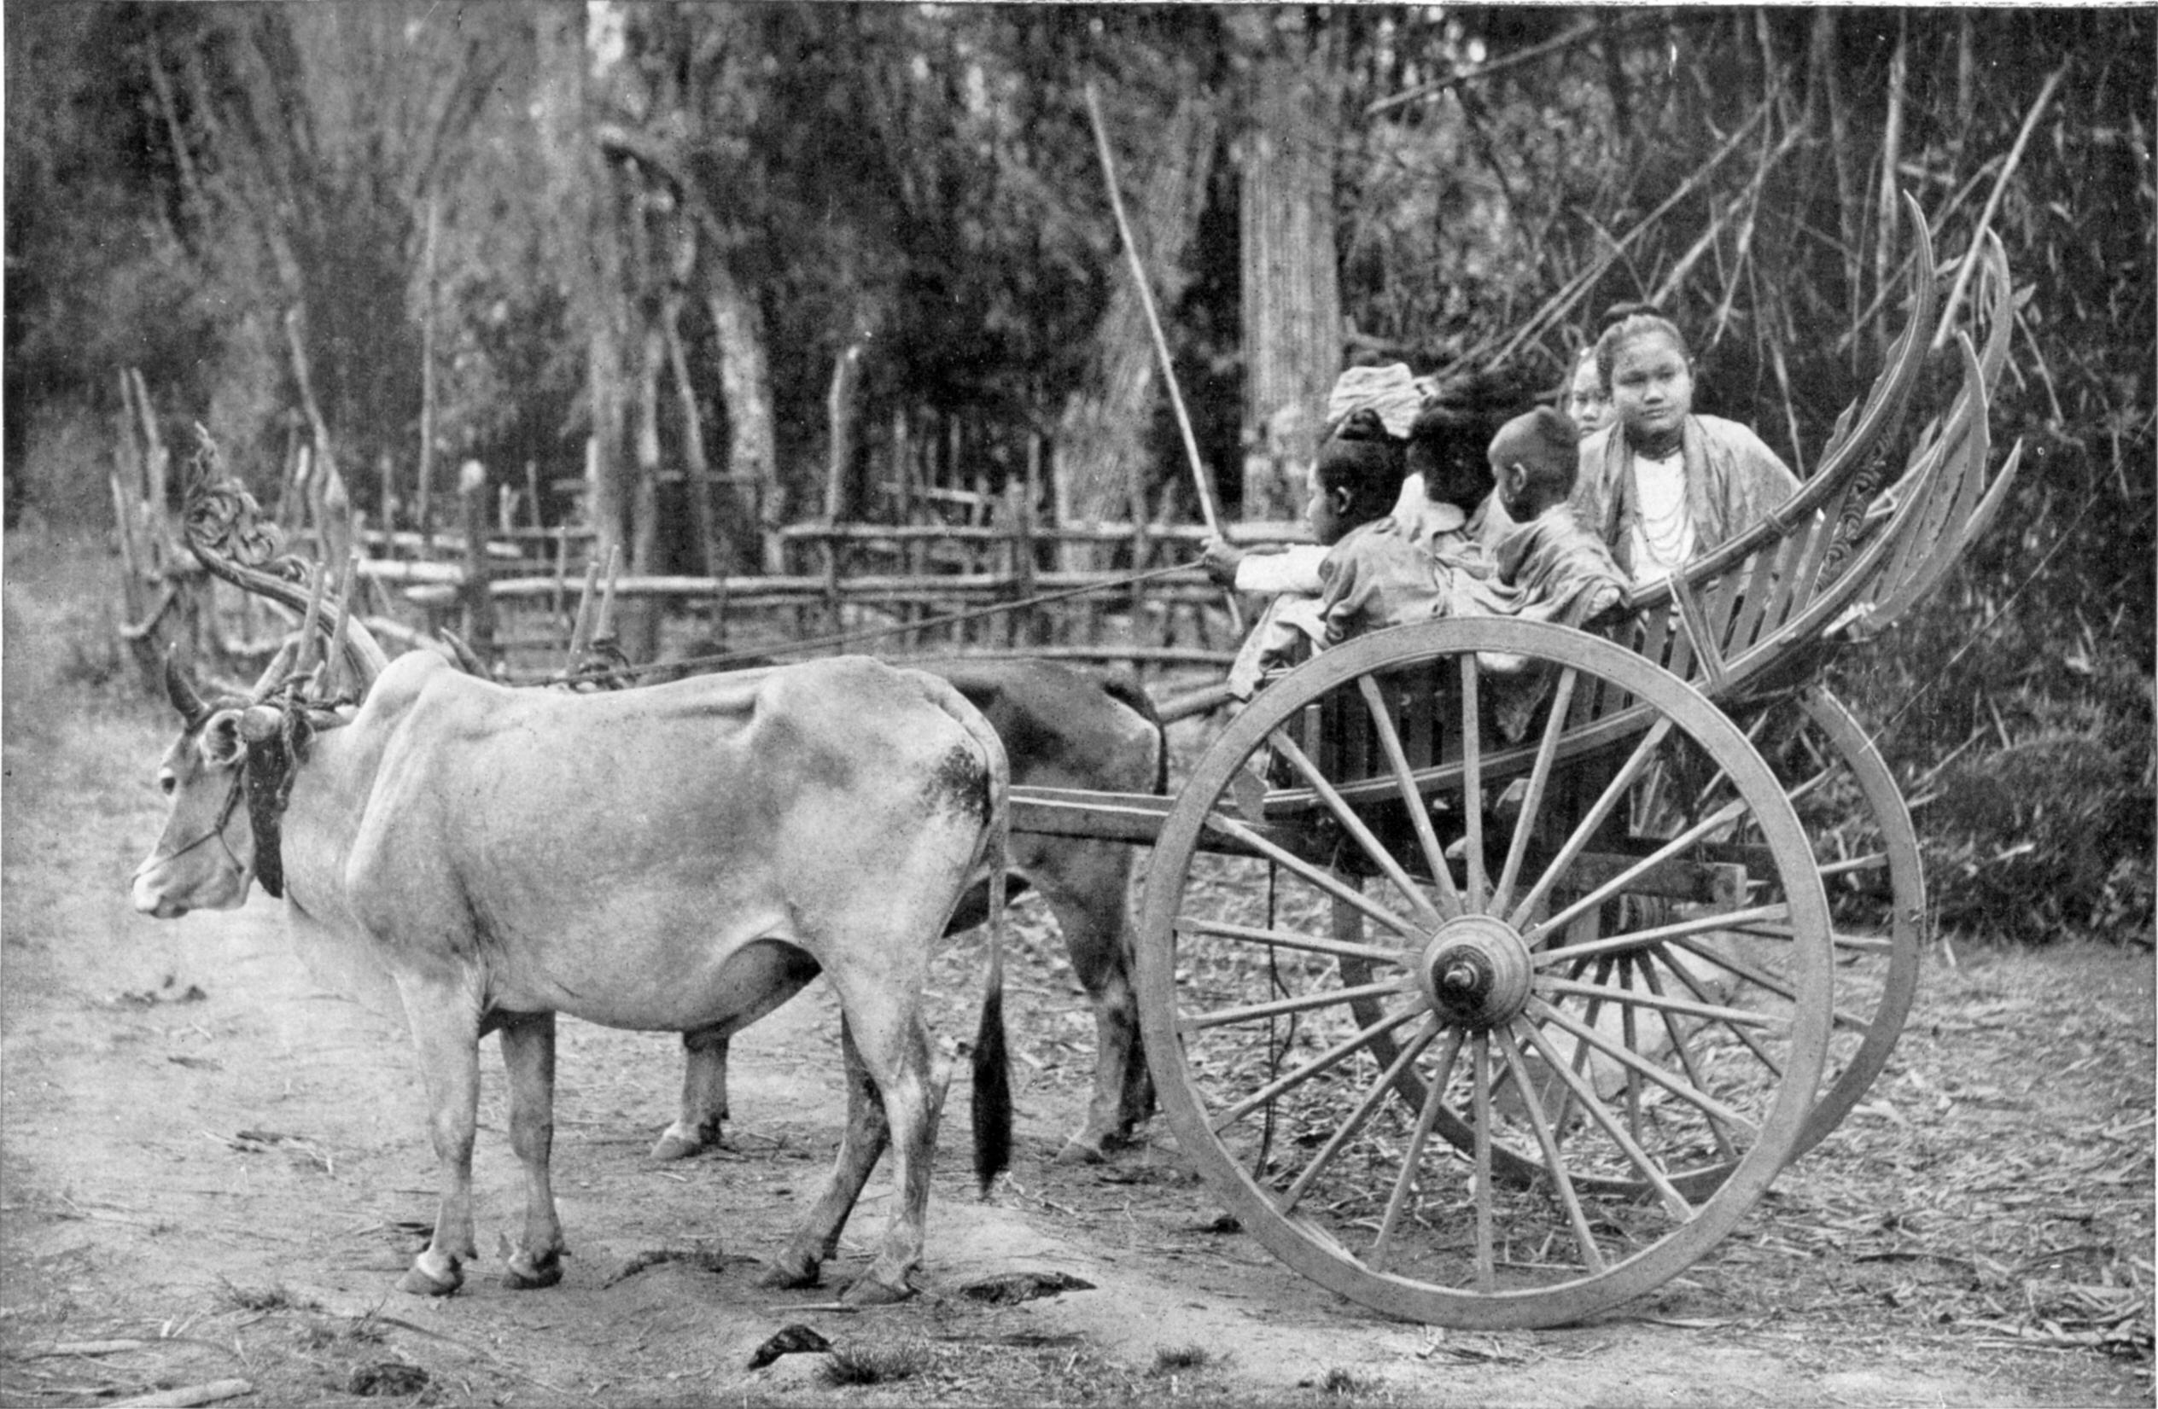
Goal: increase safety and reduce accidents
First semi-autonomous vehicles (H/T Greg Dibb, Nissan)

Slide 4
Agenda
Introducing vehicle-to-infrastructure (V2I) and vehicle-to-vehicle (V2V)
V2X hardware and protocol stacks
Safety Pilot and simTD pilots
Security and GeoNetworking (Q&A)
Future prospects

Slide 5
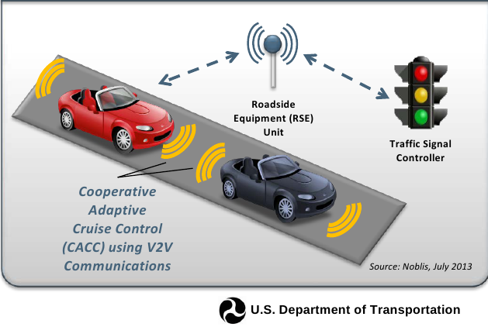
“Killer App”: Green-light optimal speed advisory
GLOSA will allow drivers to set optimal green-signal speed.

Slide 6

What hardware will
automotive internets use?
IEEE-802.11p
(= ITS-G5)

Slide 7
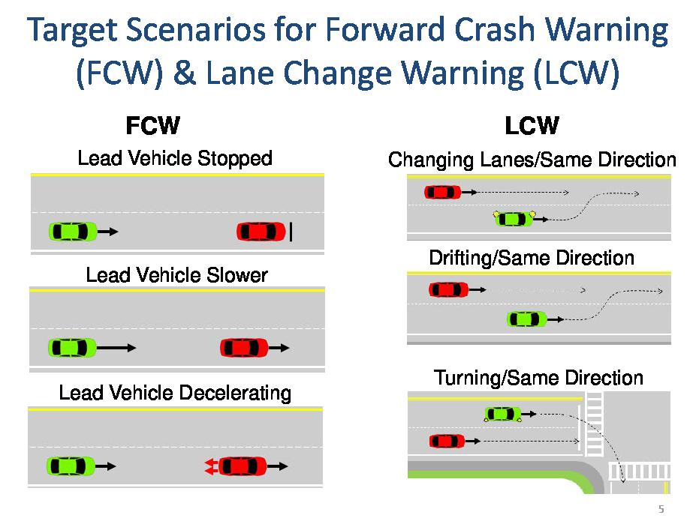
Why V2V needs low latency
Source: J. Harding, Connected Vehicle Public Meeting

Slide 8




802.11p vs. LTE vs. Satellite and FM
802.11p is the only low-latency safety channel.
LTE has the largest install base and is industry-funded.
Terrestrial and satellite radio will carry vehicular data:
3G (UMTS) already employed in simTD.
Telcos are investing heavily in automotive.
+

Slide 9
802.11p (WAVE) vs. other Comms Modes
Lower-overhead protocol for safety messages.
No access point (AP) and no basic service set (BSS)
  Too much delay for moving vehicles.
  Lower latency than 802.11a/b/g/n, LTE or satellite.
Message priorities 0-7.
Half-width channels; always ad hoc.
Up to 33 dBm (~1 km) in E.U. and 44 dBm in U.S.
No upstream Linux driver.

Slide 10
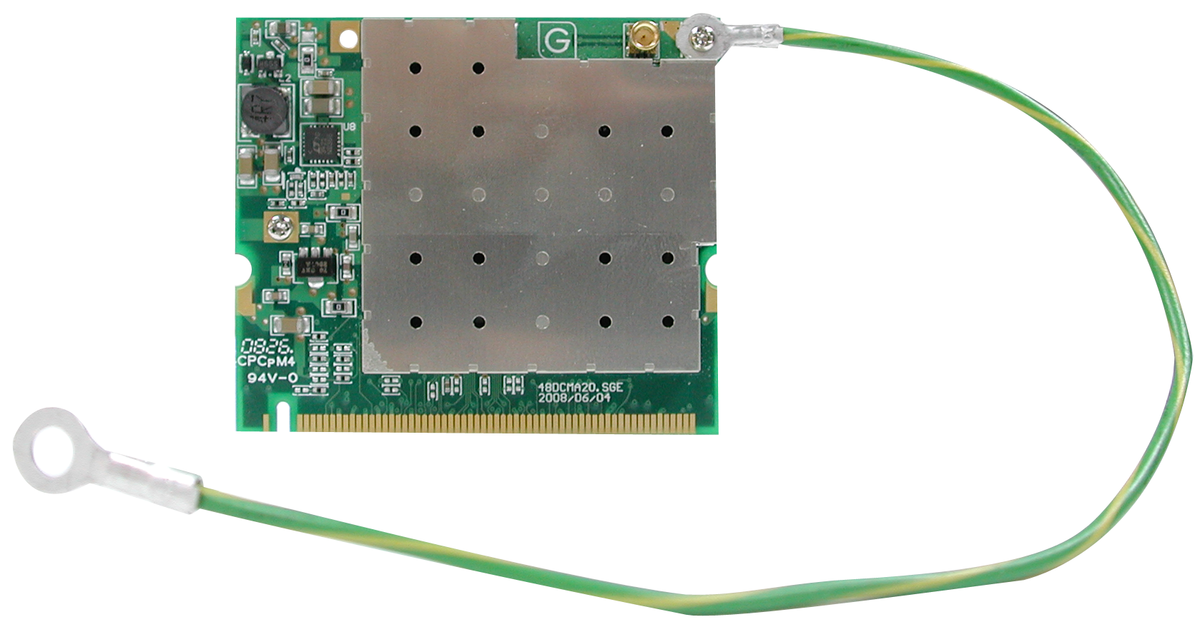
Manufacturers of 802.11p radios
NEC
Cisco/Cohda Wireless
Commsignia (BSD-based)
Denso
Delphi
Savari
Kapsch
Siemens
UNEX
AutoTalks
Arada
DGE
Componentality
UNEX DCMA-86P2 miniPCI
SafetyPilot
collected by Alexandru Petrescu, cea.fr

Slide 11
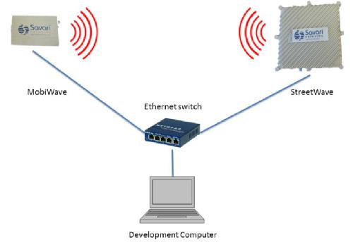
Products are all OpenWRT-based routers?
In-vehicle
Roadside
802.11p chipsets
made by Atheros, Ralink,
Cohda/NXP
Image: “IntelliDrive Technology based Yellow Onset ® Decision Assistance System for Trucks”, Sharma et al.

Slide 12
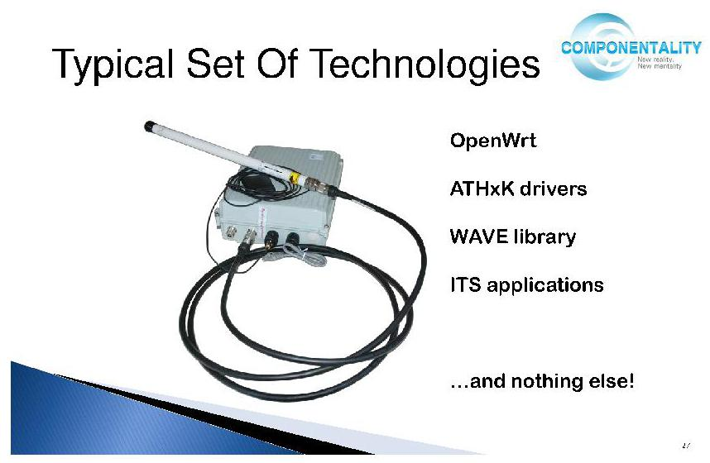
Componentality: open-source 802.11p stack: the bluez of DSRC?
Source: “Using Open Source Solutions for V2V and V2I Communications,”
Automotive Grade Linux webinar

Slide 13
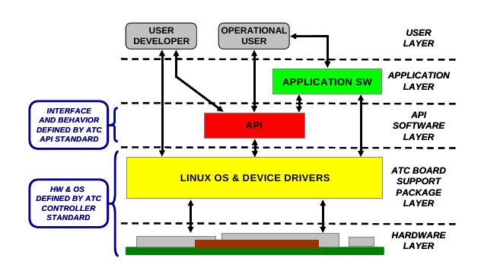
Linux in V2I:
Advanced Transportation Controller (ATC)
Applications: GLOSA; Traffic Surveillance; Ramp Meter;
Dynamic Message Signs; Weather monitor; Weigh stations;
Rail intersections; Lane usage controls; Roadworks warning . . .
Source: Institute for Traffic Engineers

Slide 14
Recently completed field trials:
Safety Pilot and simTD

Slide 15
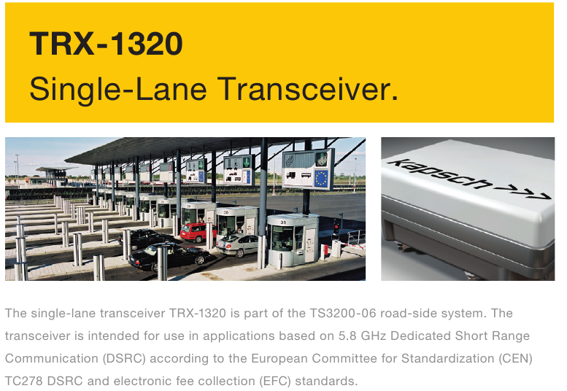
CEN DSRC in Europe = electronic tolling
(Comité Européen de Normalisation)

Slide 16
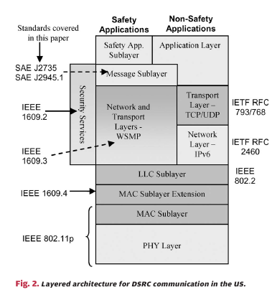
U.S. DSRC: safety protocol
Two stacks:
safety stack
does not use
TCP/UDP or IP
J.B. Kenney, Proc. IEEE 99, 1162 (2011).

Slide 17
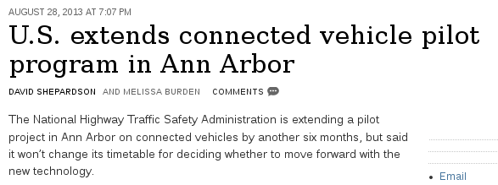
Safety Pilot trial in Ann Arbor MI
Originally 8/2012-8/2013, but extended.
2800 cars, trucks and buses from 7 automakers.
64 embedded systems, 300 aftermarke, rest transmit-only.
NHTSA decision late 2013.
  “Notice of Proposed Rule Making” likely late 2014
V2V only so far.

Slide 18
E.U.'s Safe Intelligent Mobility—Test Area Germany
(simTD) Pilot
Opel; Audi; BMW; Daimler; Ford; VW; Bosch; Conti; Deutsche Telekom, plus govs and unis.
120 vehicles and 3 motorcycles plus RSUs.
Data collection 2012-6/2013, 41K hrs and 1.65M km.
2015: ‘Cooperative ITS Corridor Rotterdam - Frankfurt am Main - Vienna’
  Features “Roadworks Warning” and “Detection of Traffic Conditions”.

Slide 19
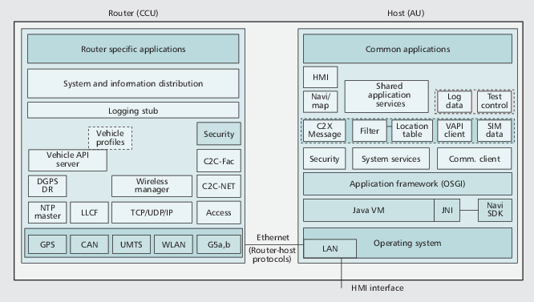
simTD's “vehicle stations”
Linux router + Windows XP Host
Ref.: H. Stübing et al., IEEE Comm. 148 (2010).

Slide 20
Dual protocol stacks of simTD
Based on ETSI ITS G5 plus GeoNetworking.
Management
Applications
Transport
Network
Physical Communication Technologies
From Automotive Internetworking, courtesy M. Bechler, BMW.

Slide 21
Internet Engineering Task Force (IETF) work on Geonetworking and ITS
3 draft standards in preparation
  Geonetworking (submitted)
  'Scenarios and Requirements for IP in Intelligent Transportation Systems' (submitted)
  IPv6 over 802.11p (particular GENIVI interest)
  V2X (with MANET working group of IETF?)
Info: https://www.ietf.org/mailman/listinfo/its
chief organizer: Alex Petrescu of CEA
in contact with GENIVI Networking Expert Group

Slide 22
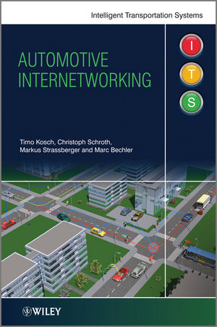
Resources
simTD and Safety Pilot
ITSSv6, CALM, ETSI, ISO C-ITS
SAE, IEEE, ISO, IETF, FCC, NHTSA standards
IETF-ITS mailing list
Componentality's FlexRoad
Automotive Grade Linux
Telematics News, Wired Autopia
slideshare.net/chaiken

Slide 23
Acknowledgements
(for corrections, not endorsements)
Alex Petrescu, CEA
Ravi Puvvala, Savari Networks
Greg Larson, CalTrans
Rex Buddenberg, consultant, former NPS
Georgios Karagiannis, Univ. Twente
Christie Dudley, Santa Clara Univ.
John Kenney, Toyota InfoTech Center
Konstantin Khait, Componentality
Timo Kosch and Marc Bechler, BMW
Andreas Festag, TU Dresden
Special thanks to Sarah Newman and Kevin Dankwardt

Slide 24
Conclusions
Safety Pilot and simTD trials indicate gov't and OEM commitment.
1st EU trial centers on V2I; US one V2V.
EU vs. U.S.: compatible spectrum, but slightly different protocols.
IETF-ITS and Componentality seek participants.
HW is expensive and lacks Linux support.
Anticipated US decision will raise awareness.

Slide 25
Extra slides follow

Slide 26

Special cases
Transit-service vehicles
Emergency responders
Over-the-air software updates
Agricultural equipment
Fleet vehicles
Rental cars
… and many more.

Slide 27
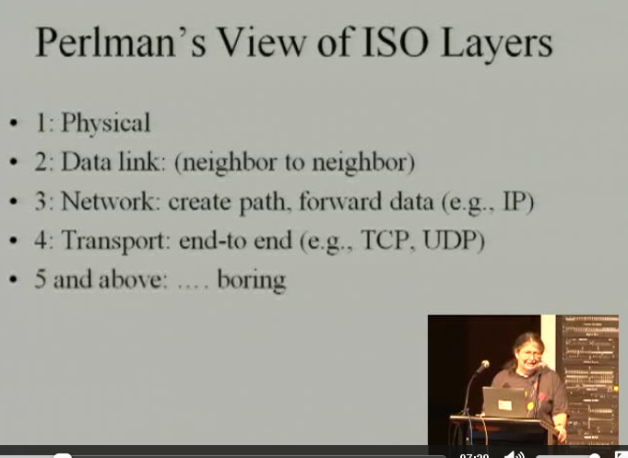
Warning: not about streaming media or web browsers

Slide 28

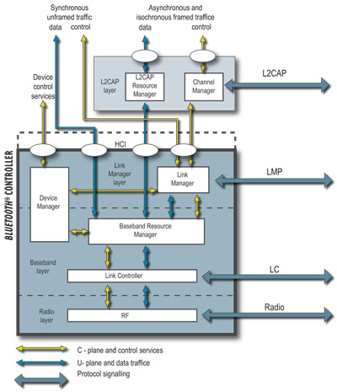
Or proprietary IEEE-1609 stacks akin to Bluetooth?
vs.

Slide 29
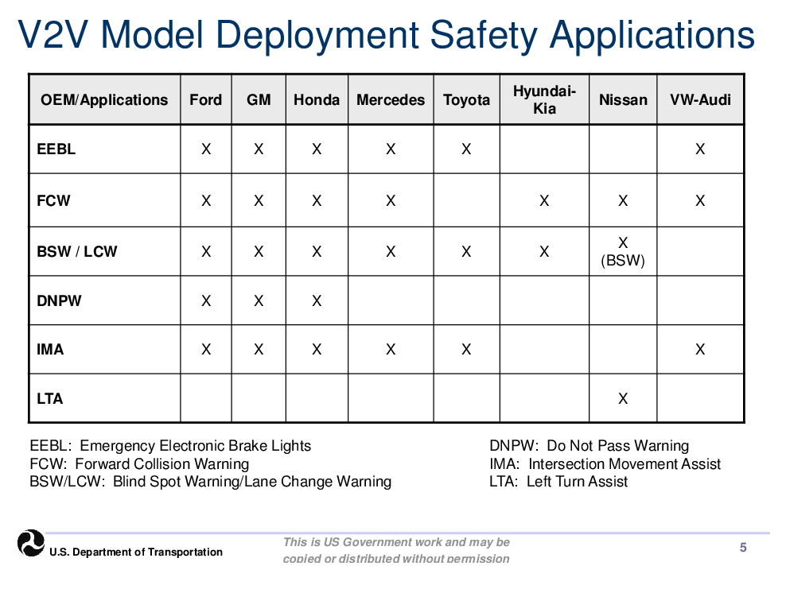
Source: M. Lukuc, Connected Vehicle Public Meeting

Slide 30
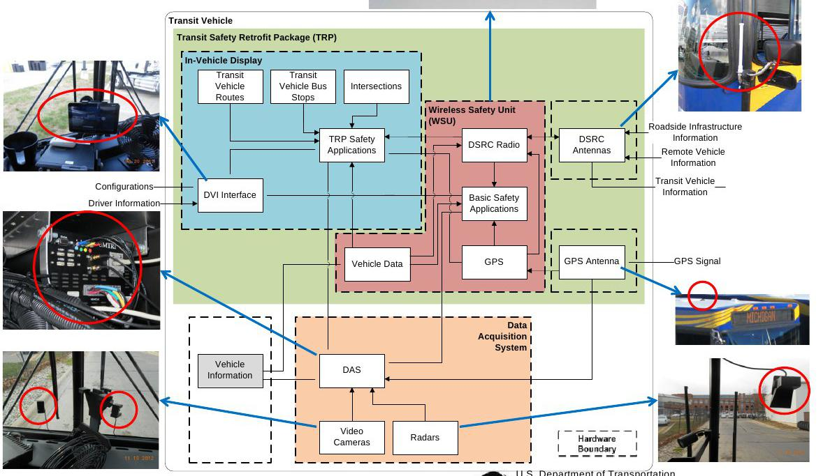
Safety Pilot's transit vehicle system
Source: S. Mortensen, Connected Vehicle Public Meeting

Slide 31
Glossary
Common to EU and US:
  Vehicle-to-vehicle (V2V)
  Vehicle-to-infrastructure (V2I)
  Wireless Access Vehicular Environment = IEEE-802.11p = ITS-G5
  WAVE Short Message Protocol (WSMP)
Different:
  On Board Unit (US) = ITS Vehicle Station (EU) = OBE
  Road Side Unit (US) = ITS Roadside Station (EU) = RSE
  Basic Safety Message (US) = Cooperative Awareness Message (EU)
  Dedicated Short Range Communication (DSRC)

Slide 32
Participating standards bodies
Intl: ISO, SAE, IEEE, IETF, ITU, ITE, TPEG
EU: ETSI, CEN, C2C Consortium, Ofcom
US: FHWA, NHTSA, FCC, ASTM, V2C3
Japan: ARIB
Indian and Chinese activity
~5.9 GHz dedicated spectrum in both U.S and EU
Analog TV “whitespace” in Britain (via BT) and dedicated spectrum in Japan

Slide 33
IETF ITS Standards History (courtesy A. Petrescu)
Network Mobility (NEMO) Working Group (2003)
Mobile Ad Hoc Network and NEMO: MANEMO BoF (2007)
In-Vehicle Routing Requirements in Low Power and Lossy Networks (I-D 2008)
Automotive Industry Requirements for NEMO Route Optimization (I-D 2009)
Transport Protocol for Decentralized Probe Applications for Vehicles (I-D 2010)
Best Current Practice for IP-based In-Vehicle Emergency Calls (I-D 2010)
Traffic safety applications requirements (I-D 2010)
ITSsv6, geocasting, DLEP protocol – informal meeting (2012)
Potential topics of work: IPv6-straight-over-80211p, direct V2V and Geonetworking – bar BoF ITS (2013)

Slide 34
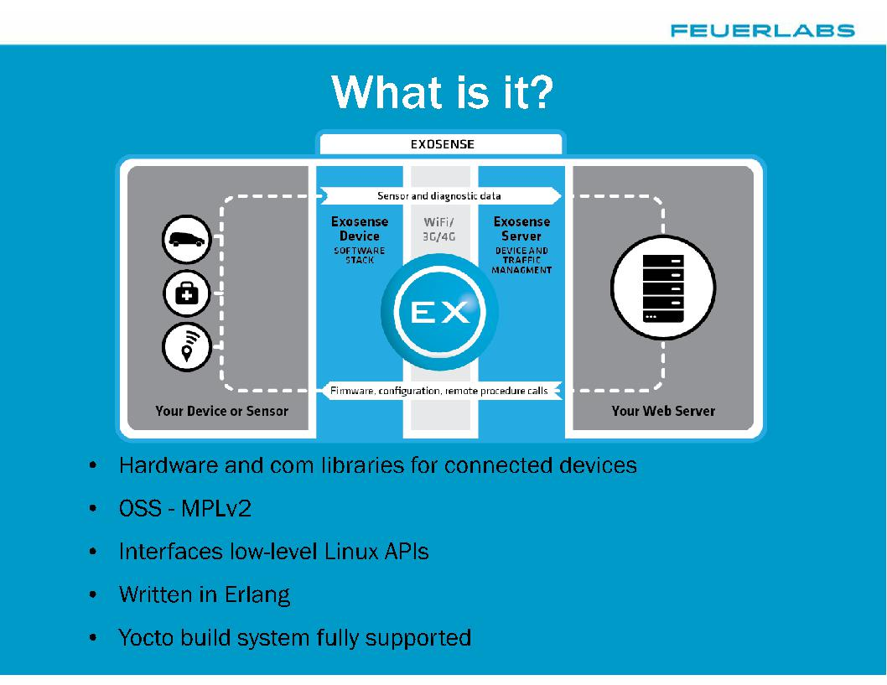
Feuer Labs' Exosense

Slide 35
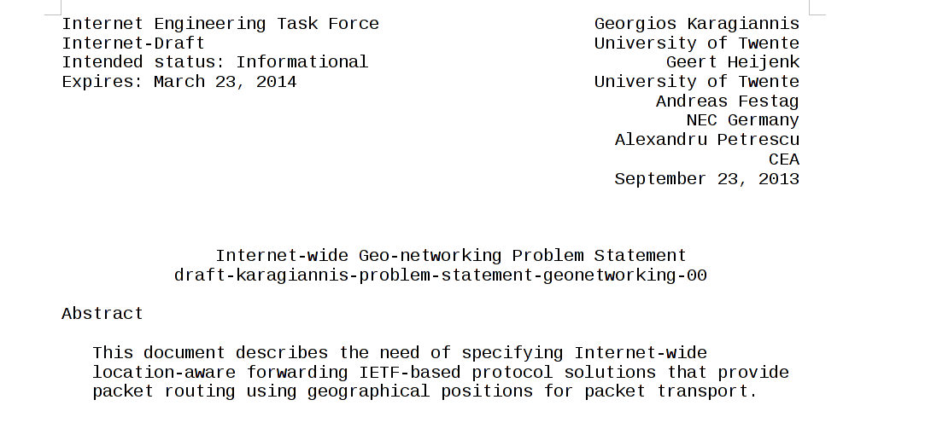

Slide 36
Safety Pilot participants
Roadside:
Arada, Kapsch, ITRI,.Cohda/Cisco, Savari
In-vehicle:
AutoTalks, Cohda, Denso, DGE, ITRI, Savari, Arada
Aftermarket Safety Devices:
Cohda/Delphi, Cohda/Visteon , Denso, Kapsch
Automakers:
GM, Ford, Toyota, Honda, VW, Daimler, Hyundai and Nissan

Slide 37
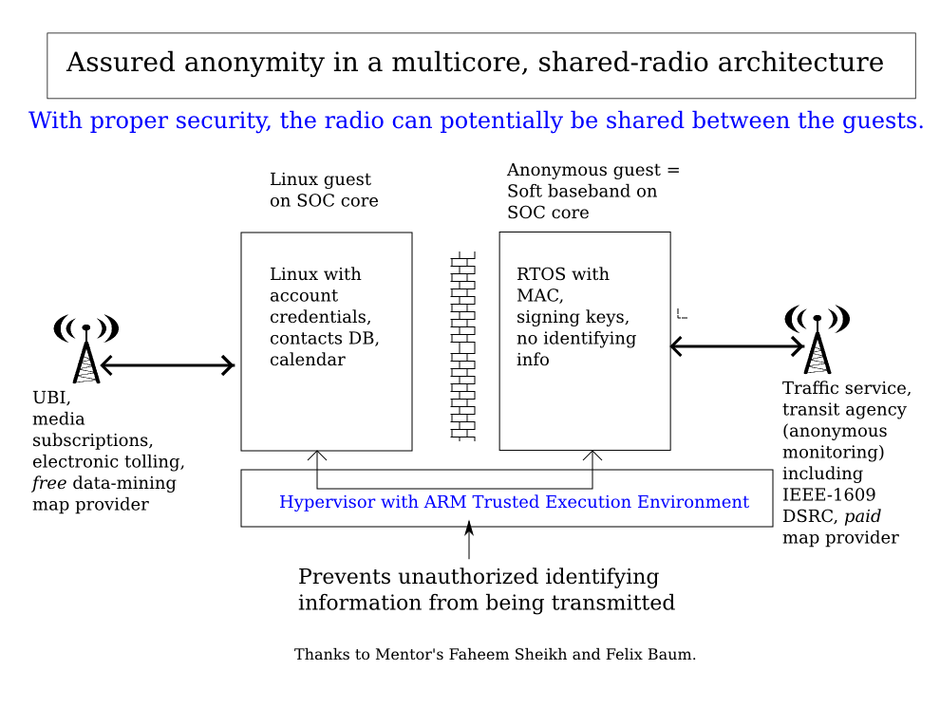

Slide 38
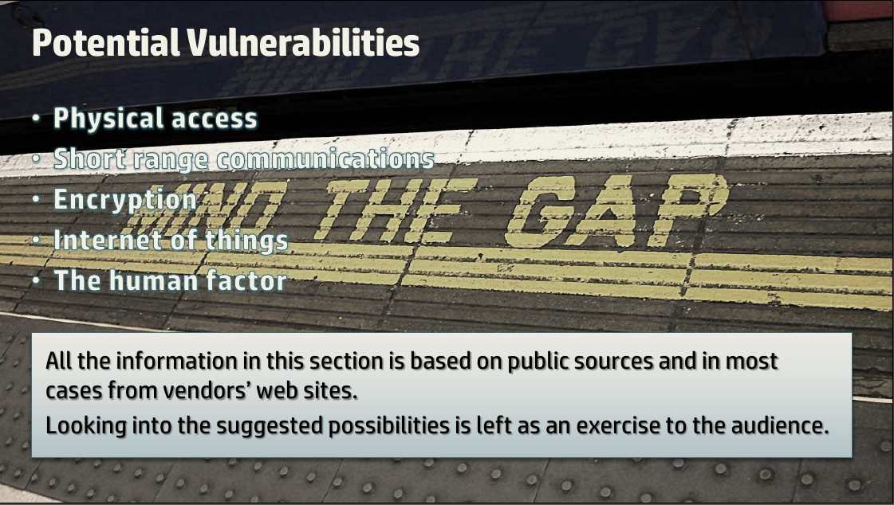
Ofer Shezaf, “Who can hack a[n EV] plug?”

Slide 39
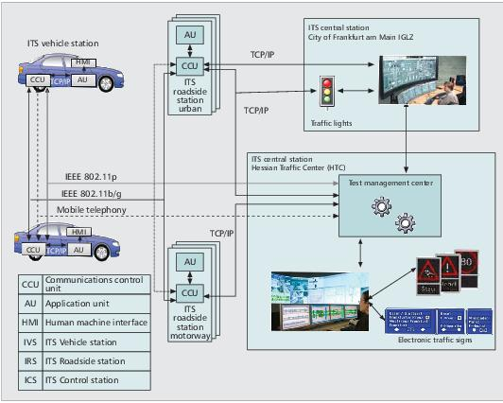
Architecture of simTD
Unlike SafetyPilot, includes Central Station and emphasizes V2I.

Slide 40
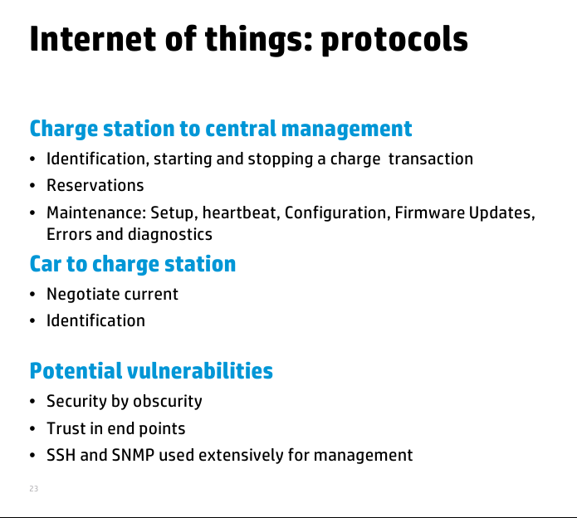
Ofer Shezaf, “Who can hack a[n EV] plug?”

