Slide 1
The “Telematics Horizon”
V2V and V2I Networking
Alison Chaiken
Embedded Software Division
October 25, 2013
alison_chaiken@mentor.com

Slide 2
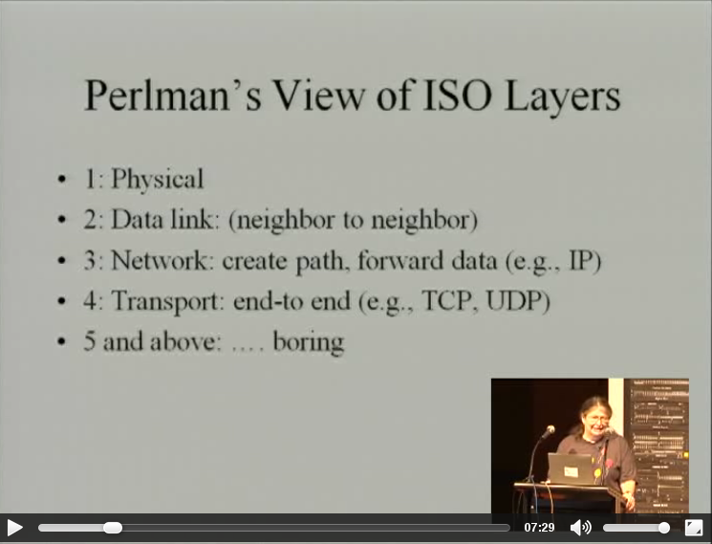
Warning: not about streaming media or web browsers

Slide 3
Agenda
Introducing vehicle-to-infrastructure (V2I) and vehicle-to-vehicle (V2V)
V2X protocol stacks around the world
A few notable pilot projects
Security
Future prospects

Slide 4
Glossary
On Board Unit (OBU) = ITS Vehicle Station (IVS)
Road Side Unit (RSU) = ITS Roadside Station (IRS)
Vehicle-to-vehicle (V2V)
Vehicle-to-infrastructure (V2I)
Geocast
Geounicast
Geoanycast
Base Station Set (BSS)
Outside the context of a BSS (OCB)
802.11p
Wireless Short Message Protocol (WSMP)
Wireless Access Vehicular Environment (WAVE, IEEE-802.11p)
Dedicated Short Range Communication (DSRC)

Slide 5


802.11p vs. LTE vs. Satellite Radio
802.11p is the only low-latency safety channel
LTE has the largest install base and is industry-funded
Satellite radio providers want to carry vehicular data
3G (UMTS) already employed in simTD.

Slide 6
Participating standards bodies
Europe: ETSI, CEN, C2C Consortium
International: ISO, SAE, IEEE, IETF, ITU
U.S.: FHWA, NHTSA, FCC, ASTM
Japan: Association of Radio Industries and Businesses (ARIB)
Indian and Chinese activity as well
~5.9 GHz dedicated spectrum in U.S and EU;
700 MHz “whitespace” in Japan

Slide 7
Manufacturers of 802.11p radios
NEC (Tier 1)
NXP/Cohda Wireless (radio OEM)
Cisco/Cohda Wireless
Commsignia (BSD-based)
Denso (Tier 1)
Delphi
Savari
Kapsch
Siemens
ITRI
AutoTalks
Arada
DGE
collected by Alexandru Petrescu, cea.fr

Slide 8
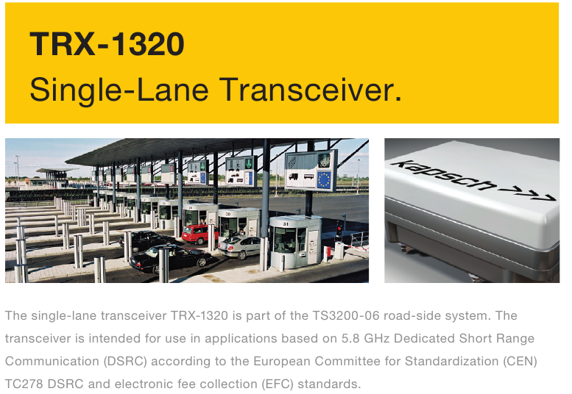
CEN DSRC in Europe = electronic tolling
(Comité Européen de Normalisation)

Slide 9
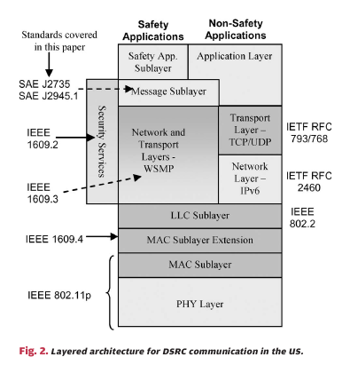
U.S. DSRC: safety application in same spectrum
Safety stack
does not use
TCP/UDP or IP!
J.B. Kenney, Proc. IEEE 99, 1162 (2011).

Slide 10
Differences in 802.11p (WAVE) versus other WiFi
A lower-overhead standard intended for low-latency safety messages
Much lower latency than LTE or satellite
No access point (AP) and no base station set (OCB)
AP association and BSS formation won't work for moving vehicles
Narrower channels
Range similar to other WiFi
No upstream Linux kernel driver
Thanks to John Kenney, Toyota InfoTech Center

Slide 11
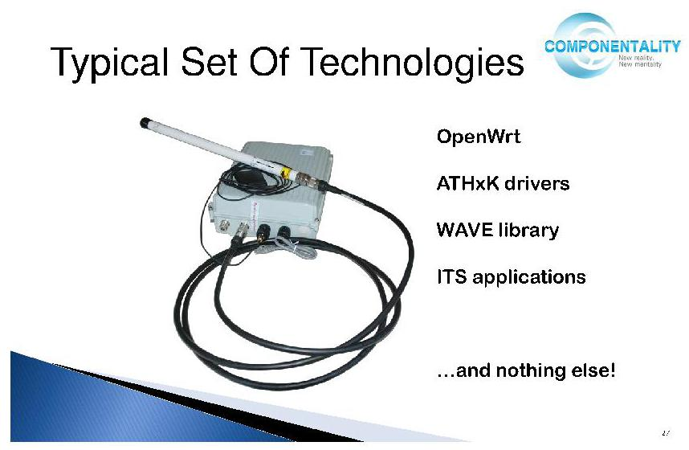
Componentality: Linux 802.11p stack
OpenWRT is the actively developed Linux variant designed for wireless routers, works on MIPS, ARM, x86.
Source: “Using Open Source Solutions for V2Vand V2I Communications,”
Automotive Grade Linux webinar

Slide 12
WAVE, WSMP (IEEE-1609) and ETSI CALM FAST
Basic safety message (BSM) sent via WSMP several times a second (10/s in Safety Pilot)

Slide 13
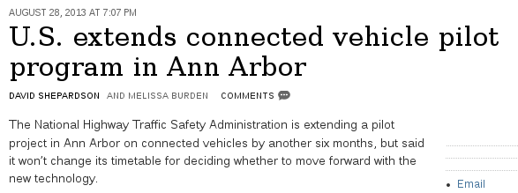
Safety Pilot trial in Ann Arbor MI
Originally 8/2012-8/2013, but extended
2800 cars, trucks and buses
300 embedded systems, 64 aftermarket and rest transmit-only
National Highway Transportation Safety Administration Decision late 2013
NHTSA “Notice of Proposed Rule Making” likely late 2014

Slide 14
E.U.'s Safe Intelligent Mobility—Test Area Germany
(simTD) Pilot
Partners: Opel; Audi; BMW; Daimler; Ford; VW; Bosch; Conti; Deutsche Telekom, plus governments and universities
120 identically equiped vehicles and 3 motorcycles plus RSUs/IRSs
41K hours and 1.65M km
Anonymous, encrypted data transmission
Began 2012, wrapped up data collection 6/2013
Most successful functions: Electronic Brake Light, the Intersection and Cross Traffic Assistant and Traffic Sign Assistant/Warning.
First introduction: Roadworks Warning and Detection of Traffic Conditions
2015: ‘Cooperative ITS Corridor Rotterdam - Frankfurt am Main - Vienna’

Slide 15
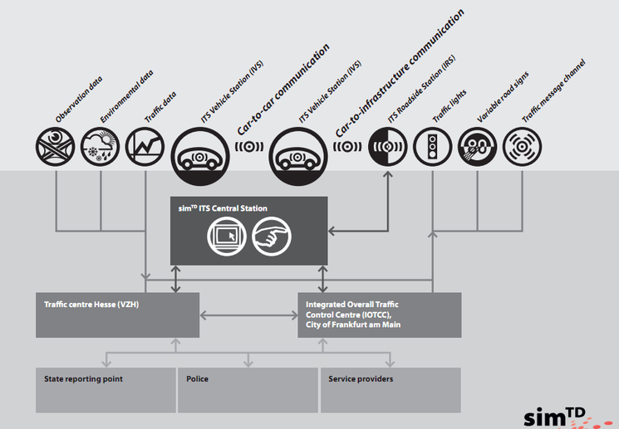
Architecture of simTD

Slide 16
IETF ITS Standards History (courtesy A. Petrescu)
Network Mobility (NEMO) Working Group (2003)
Mobile Ad Hoc Network and NEMO: MANEMO BoF (2007)
In-Vehicle Routing Requirements in Low Power and Lossy Networks (I-D 2008)
Automotive Industry Requirements for NEMO Route Optimization (I-D 2009)
Transport Protocol for Decentralized Probe Applications for Vehicles (I-D 2010)
Best Current Practice for IP-based In-Vehicle Emergency Calls (I-D 2010)
Traffic safety applications requirements (I-D 2010)
ITSsv6, geocasting, DLEP protocol – informal meeting (2012)
Potential topics of work: IPv6-straight-over-80211p, direct V2V and Geonetworking – bar BoF ITS (2013)

Slide 17
Internet Engineering Task Force (IETF) work on ITS
3 RFCs in preparation
  Geonetworking (submitted)
  IPv6 over 802.11p (particular GENIVI interest)
  V2X (MANET working group of IETF?)
Info: https://www.ietf.org/mailman/listinfo/its
Alexandru Petrescu
in contact with GENIVI Networking Expert Group

Slide 18
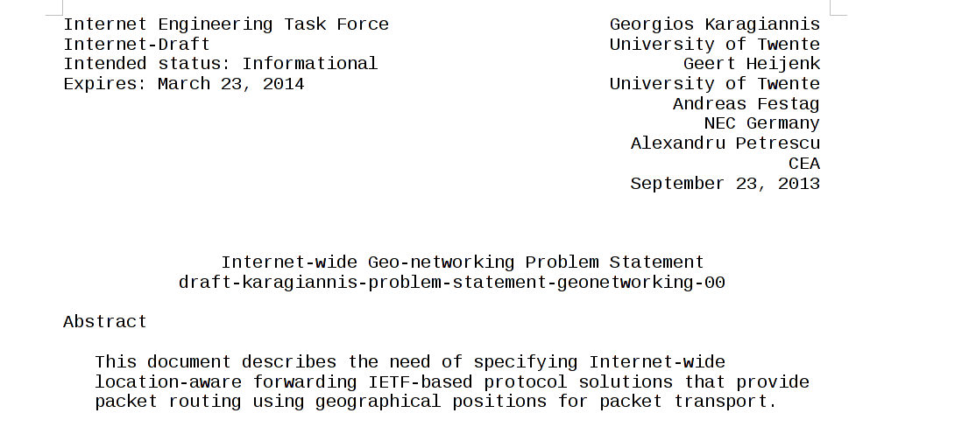

Slide 19
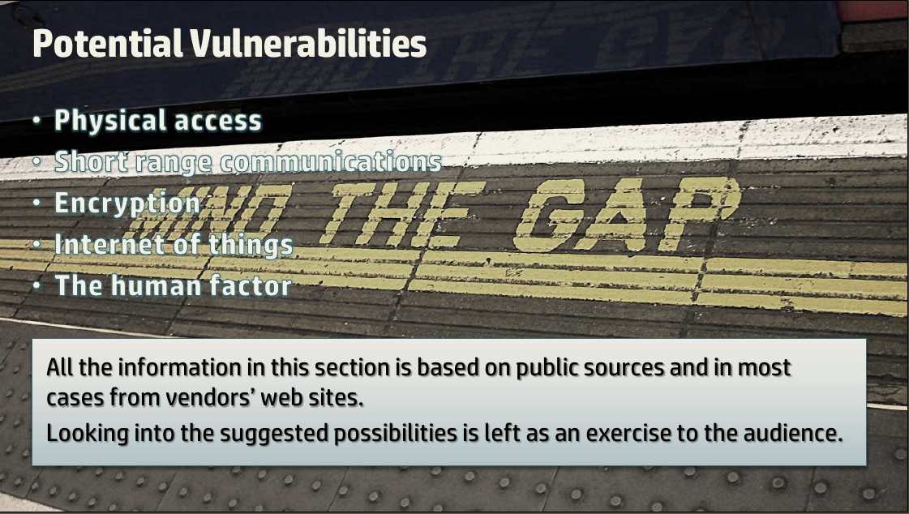
Ofer Shezaf, “Who can hack a[n EV] plug?”

Slide 20
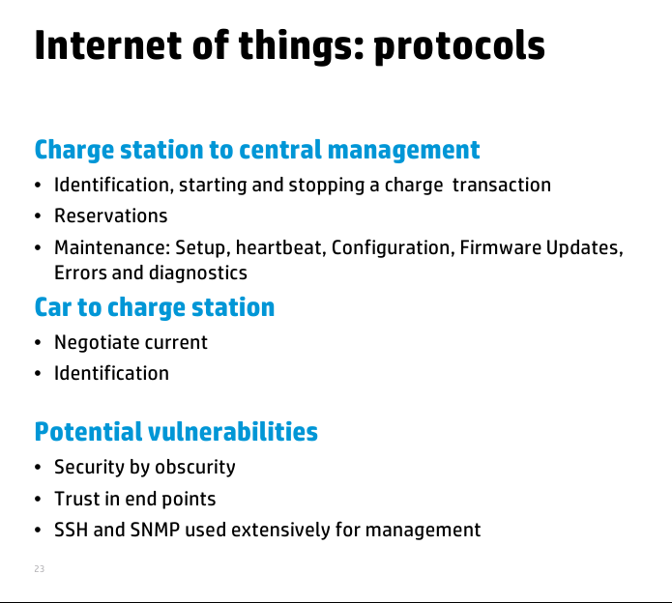
Ofer Shezaf, “Who can hack a[n EV] plug?”

Slide 21
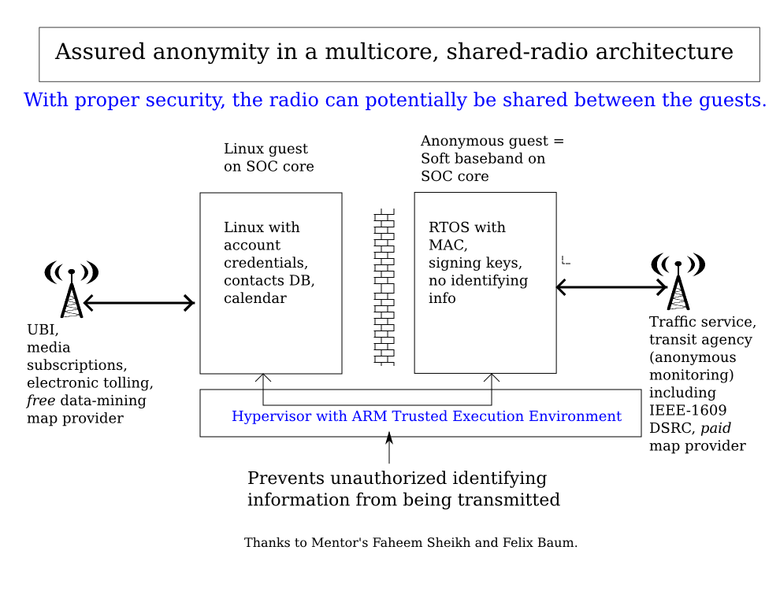

Slide 22
Special cases
Emergency responders
Space suits

Slide 23
Resources

Slide 24
Acknowledgements

Slide 25
Conclusions

Slide 26
Extra slides follow

Slide 27
Feuer Labs' Exosense

Slide 28
Safety Pilot participants
Roadside:
Arada, Kapsch, ITRI,.Cohda/Cisco, Savari
In-vehicle:
AutoTalks, Cohda, Denso, DGE, ITRI, Savari, Arada
Aftermarket Safety Devices:
Cohda/Delphi, Cohda/Visteon , Denso, Kapsch
Automakers:
GM, Ford, Toyota, Honda, VW, Daimler, Hyundai and Nissan

