Slide 1
Technology, Business and Regulation
of the “Connected Car”
Alison Chaiken
Mentor Embedded Software
alison_chaiken@mentor.com
John Kenney
Toyota InfoTechnology Center
jkenney@us.toyota-itc.com‎

Slide 2
Agenda
Alison:
Connected vehicle safety and traffic management
Connection modalities: LTE, 802.11p, SMS, satellite . . .
John:
V2X Protocols and spectrum
Security and scalability
Alison:
European and U.S. pilot projects
Available HW and SW
Immediate prospects

Slide 3
V2X Terminology
Vehicle-to-vehicle (V2V)
Vehicle-to-infrastructure (V2I)
On Board Unit (US) = ITS Vehicle Station (EU)
Road Side Unit (US) = ITS Roadside Station (EU)
Dedicated Short Range Communication (DSRC)
= automated tolling in E.U.
but
safety messages in U.S.

Slide 4
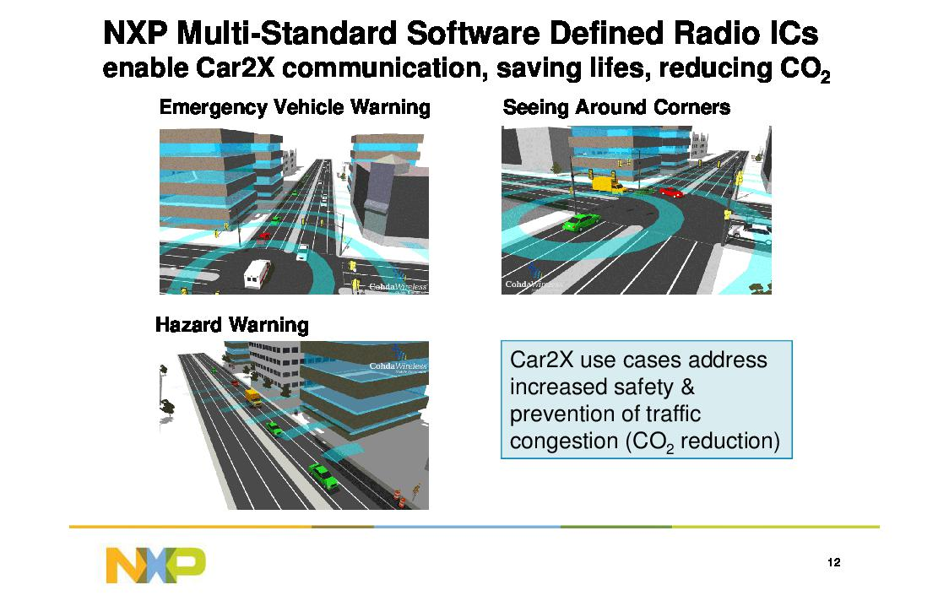

Slide 5
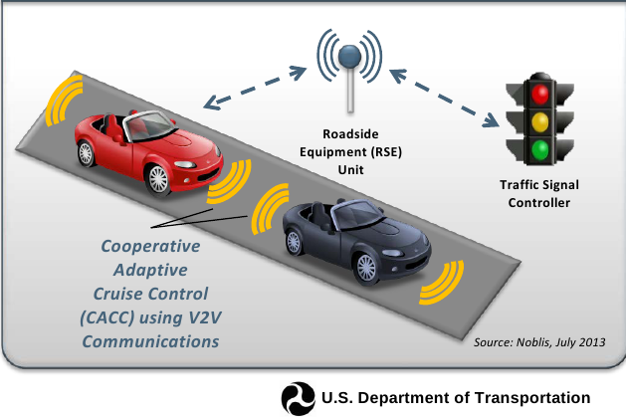
“Killer App”: Green-light optimal speed advisory
GLOSA will allow drivers to set optimal green-signal speed.

Slide 6




802.11p vs. LTE vs. Satellite and FM
802.11p is the only low-latency safety channel.
LTE has the largest install base and is industry-funded.
Terrestrial and satellite radio, data-over-voice, SMS also:
3G (UMTS) already employed in simTD (Germany) and Smart In-Car (Netherlands).
Telcos are investing heavily in automotive.
+

Slide 7
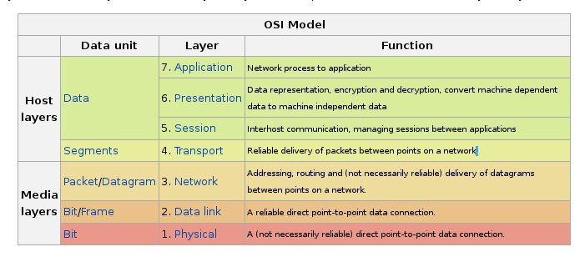
Automotive networking needs new protocols in every layer

Slide 8

John:
V2X protocols and spectrum
Security and scalability

Slide 9
DSRC Standards Overview
Necessary for interoperability
Most standards fairly mature
^{DSRC Security (IEEE 1609.2)}
2009
^{Messages (SAE J2735)}
Min. Perf. Req. (SAE J2945)
^{Non-safety applications}
Draft
^{DSRC WSMP}
^{Service Advertisement}
^{(IEEE 1609.3)}
^{TCP/UDP}
^{IPv6}
2013
2010
2010
^{DSRC Upper-MAC (IEEE 1609.4)}
^{DSRC PHY+MAC (IEEE 802.11p)}
2010
See: J. Kenney, “DSRC Standards in the United States”, Proc. IEEE, July 2011, Vol. 99, No. 7, pp. 1162-1182

Slide 10
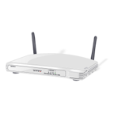


Comparison 802.11p with AP LAN
Access
Point
Access
Point
Access
Point
Step 1
Authentication
Step 2
Association
Step 3
Data Exchange
Communication is “Outside the Context of a Basic Service Set” (or OCB, i.e. truly ad hoc)
Avoiding setup delay is critical for high mobility “Wireless Access in Vehicular Environments” (WAVE)
802.11p
Immediate
Data Exchange

Slide 11
DSRC Network & Transport Layers (1609.3)
Two choices in US
WAVE Short Message Protocol (WSMP)
  Lightweight compared to Internet protocols (5 byte header)
  No routing
  Adequate for many DSRC applications
IPv6 + TCP/UDP
Note: In Europe a “Geo-Networking” protocol is being defined

Slide 12
1609.2 Security Services
Two primary functions:
1. Authentication – Shows sender is authorized, and that data not altered
2. Encryption – keeps data secret (need for this limited)
Both use “elliptic curve” cryptographic algorithms
Note: Privacy is key element of V2X security
  1609.2 supports pseudonymous certificates – not linked to car
  Identifiers (certificates, MAC, etc.) changed every few minutes

Slide 13
SAE J2735 Basic Safety Message (BSM)
Item
Time
3D Position
Position Accuracy
Speed
Heading
Steering Wheel Angle
Acceleration
Brake Status
Vehicle Size
Event Flags
Path History
Path Prediction
Other optional fields
Not included in every BSM
BSM is broadcast by each vehicle several times per second over a few hundred meters

Slide 14
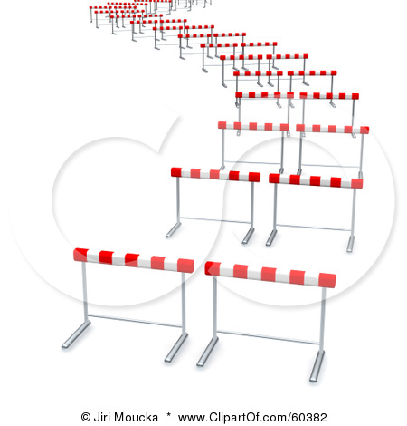
We’ve come a long way
2013
apps
interoperability
privacy
Technical
Policy
channelization
interference
Business
Governance
standards
spectrum
1999

Slide 15

Still to go … near term
Scalability
Scalability
Deployment
Positioning
Security

Slide 16
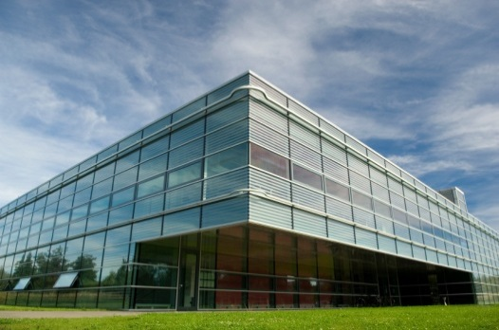
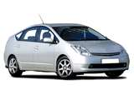
Security Infrastructure
Can I trust you?
Get/Renew credentials?
Detect misbehavior?
CA Internally segregated to prevent insider attack
Example misbehavior: BSM with valid signature reports fictitious car.
New Certificates
Certificate
Revocation Lists
Certificate
Authority (CA)
Misbehavior
Reports
What medium?

Slide 17
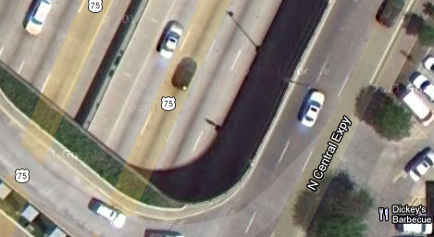
Positioning
Relative Distance?
Which
Lane?
Where in Lane?
Which Road?

Slide 18
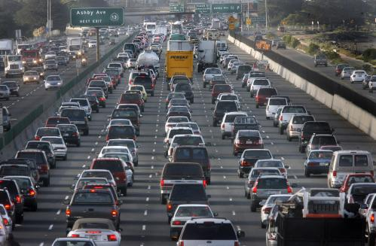
Scalability
Basic question: will all this still work here?

Slide 19
Aspects of Scalability
Processing resource
  Collision threat assessment
  Per-message Security
Wireless Channel resource
Security Infrastructure
Hard to throw money at this one

Slide 20
US DSRC Spectrum: Seven 10 MHz channels
5.850 GHz
5.925 GHz
CH
175
CH
181
20
MHz
20
MHz
CH
172
CH
174
CH
176
CH
178
CH
180
CH
182
CH
184
5 MHz
Reserved
Service
Service
Service
Control
Service
Service
Service
10
MHz
10
MHz
10
MHz
10
MHz
10
MHz
10
MHz
10
MHz
Ch. 172:
Collision Avoidance Safety
Ch. 184: Public Safety
Ch. 178:
Control Channel
WAVE Service Advertisements are broadcast here, indicating how to access services on other “Service Channels”

Slide 21
Potential new Wi-Fi channels in 5 GHz band
Currently available channels
New channels
IEEE channel #
36
40
44
48
52
56
60
64
68
72
76
80
84
88
92
96
100
104
108
112
116
120
124
128
132
136
140
144
149
153
157
161
165
169
173
177
181
20 MHz
40 MHz
80 MHz
160 MHz
UNII-1
UNII-2A
NEW
UNII-2C
UNII-3
NEW
5250
MHz
5350
MHz
UNII-2B
5470
MHz
5725
MHz
5825
MHz
UNII-4
5925
MHz
802.11n introduced 40 MHz channels
802.11ac introducing 80 MHz and 160 MHz channels
UNI-2 (A, B, C): radar is primary, Dynamic Frequency Selection (DFS) is required by Wi-Fi

Slide 22
Spectrum Sharing Timeline
Key steps:
  Identify sharing technology candidate(s)
  Test rigorously
NTIA 5 GHz report: support sharing, note risks (Jan.)
NPRM 13-49 comments due (May)
President: Make 500 MHz new spectrum available by 2020
New law requires:
FCC and NTIA to act on 5.3 GHz
NTIA to study 5.9 GHz (Feb.)
IEEE 802.11 forms tech. Tiger Team (Aug.)
US House Hearing (Nov.)
2010
2011
2012
2013
2014
2015
Global mobile data volume more than doubles for 4th year in a row
Pres. Council Advisors Science & Tech (PCAST) calls for 1000 MHz shared use pilot projects (July)
Auto group met with FCC and White House Science Office (Sept.)
FCC NPRM 13-49:
Share 5.3 and 5.9,
Simplify 5 GHz rules (Feb.)
NPRM 13-49 reply comments due (July)
FCC = Federal Communications Commission
NTIA = National Telecommunications and Information Administration

Slide 23
“Detect-and-vacate” concept
Key is to avoid colliding with or delaying DSRC packets
Wi-Fi devices already avoid overlapping transmissions via a “listen-then-talk” protocol
  Carrier Sense Multiple Access/Collision Avoidance (CSMA/CA)
Wi-Fi can detect DSRC device in area via similar function that looks for 10 MHz DSRC packet “signature”
Before sending anywhere in 5.9 GHz band, listen for DSRC in all 7 channels
  If no DSRC detected, ok to operate WLAN
  If DSRC detected, keep out of the band for [TBD] time
  For more information see: https://mentor.ieee.org/802.11/dcn/13/11-13-0994-00-0reg-proposal-for-u-nii-4-devices.docx
See: J. Lansford, J. Kenney, and P. Ecclesine, “Coexistence of Unlicensed Devices with DSRC Systems in the 5.9 GHz ITS Band,” IEEE VNC 2013

Slide 24
Available V2X Hardware and Software

Slide 25
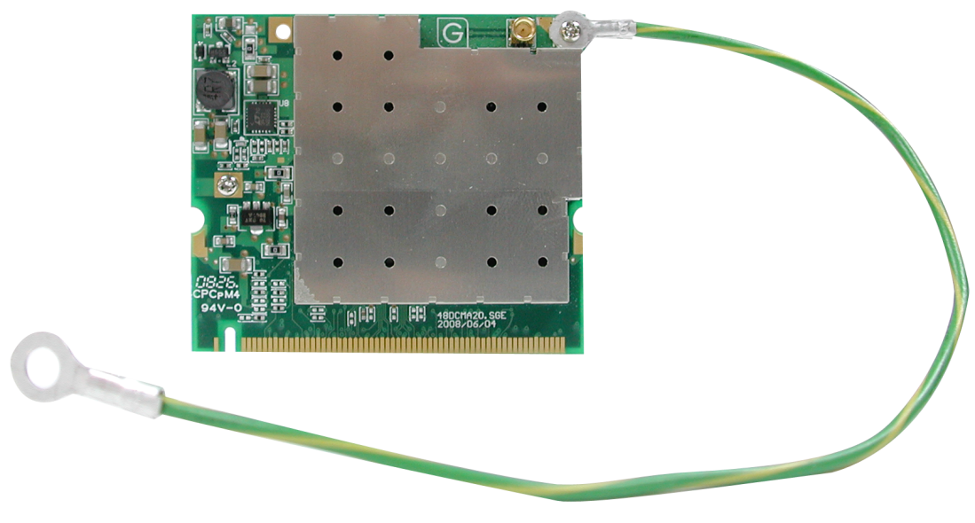
Manufacturers of 802.11p radios
NEC
NXP/Cohda
Cisco/Cohda Wireless
Commsignia (BSD-based)
Denso
Delphi
Savari
Kapsch
Siemens
UNEX
AutoTalks
Arada
DGE
Componentality
Broadcom
UNEX DCMA-86P2 miniPCI
collected by Alexandru Petrescu, cea.fr

Slide 26
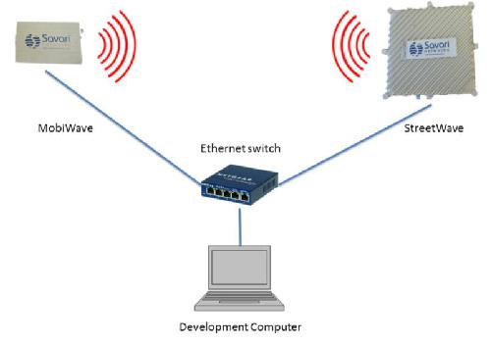
RSUs and OBUs are mostly OpenWRT (Linux) routers
In-vehicle
Roadside
802.11p chipsets
made by Atheros, Ralink,
Cohda/NXP
Image: “IntelliDrive Technology based Yellow Onset ® Decision Assistance System for Trucks”, Sharma et al.

Slide 27
Recently completed field trials:
Safety Pilot
simTD
Smart In-Car

Slide 28
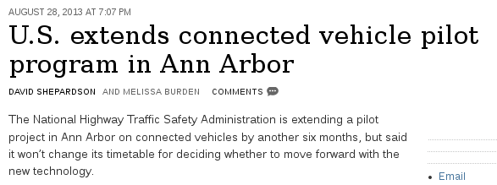
Safety Pilot V2V trial in Ann Arbor MI
Originally 8/2012-8/2013, but extended.
2800 cars, trucks and buses from 7 automakers.
64 embedded systems, 300 aftermarke, rest transmit-only.
NHTSA decision expected in December 2013.
  “Notice of Proposed Rule Making” likely late 2014

Slide 29
E.U.'s Safe Intelligent Mobility—Test Area Germany
(simTD) Pilot
Emphasizes V2I.
Opel; Audi; BMW; Daimler; Ford; VW; Bosch; Conti; Deutsche Telekom, plus govs and unis.
120 vehicles and 3 motorcycles plus RSUs.
Data collection 2012-6/2013, 41K hrs and 1.65M km.
2015: ‘Cooperative ITS Corridor Rotterdam - Frankfurt am Main - Vienna’
  Features “Roadworks Warning” and “Detection of Traffic Conditions”.

Slide 30
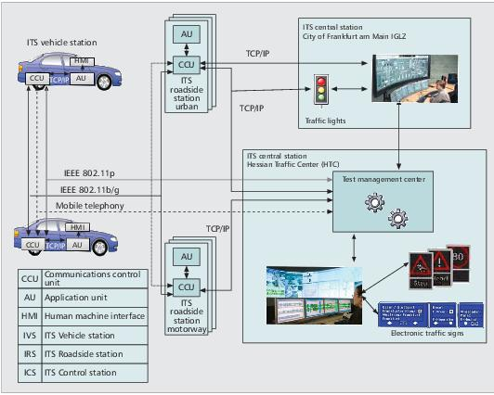
Architecture of simTD
Unlike SafetyPilot, includes Central Station and emphasizes V2I.

Slide 31
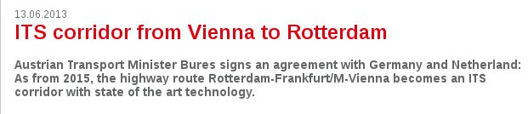
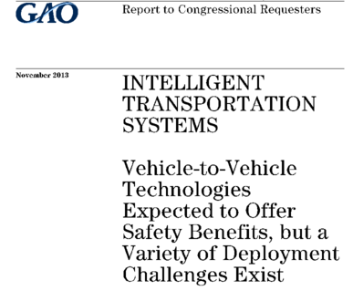
Near Future

Slide 32
Conclusions
V2X is a key enabler of vehicle autonomy.
Enormous potential to improve safety and optimize traffic flow.
Burgeoning opportunities for HW, SW, backhaul, analytics . . .
Extensive government investment in EU and U.S.
Now is a great time to get involved.

Slide 33
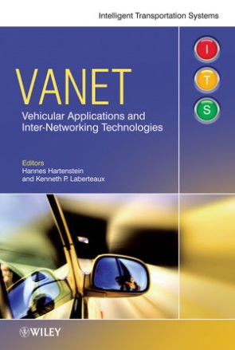
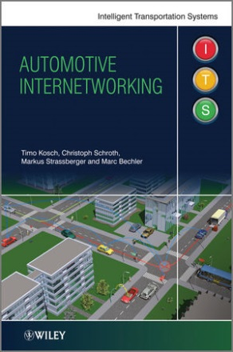
Resources
simTD, Safety Pilot, Smart In-Car
ITSSv6, CALM, ETSI, ISO C-ITS
SAE, IEEE, ISO, IETF, FCC, NHTSA standards
IETF-ITS mailing list
Componentality's FlexRoad and Drivity
Automotive Grade Linux
Telematics News
Wired Autopia
slideshare.net/chaiken

Slide 34
Extras

Slide 35
SAE Standards
J2735 Message Set Dictionary
  Defines 15 messages and constituent data elements
  Key messages:
    Basic Safety Message (V2V safety)
    Signal Phase and Timing
    MAP
J2945 Minimum Performance Requirements (MPR)
  Not yet published – expected 2015
  Example content for Basic Safety Message:
    Message frequency and transmit power
    Accuracy of sensor data in message (e.g. position, velocity)
Typically sent by roadside unit at intersection

Slide 36
DSRC Spectrum Sharing
Wi-Fi has been a tremendous success
US Government supports allowing Wi-Fi to share spectrum in new bands with “primary users” (e.g. radar, satellite)
US FCC considering allowing Wi-Fi to share 5.9 GHz DSRC band
  Issued “Notice of Proposed Rule Making” Feb. 2013
  Requested comments from stakeholders
IEEE 802.11 “Tiger Team” considering technical sharing solutions
  “Detect-and-vacate” option
  “Re-channelize and share packet by packet” option
Auto industry wants to ensure no “Harmful Interference” from Wi-Fi. Not yet clear if a solution exists.
Any candidate solution will require rigorous testing

Slide 37
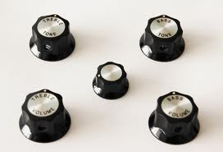
Safety Channel Scalability
Message Rate
Transmit Power
Lots of control knobs
Can be used in combination or alone
Can be responsive to different stimuli
Data Rate
Packet Length
Sensitivity Control
Reasons why we emphasize message rate:
Predictable impact independent of topology
Maintain connectivity at distances of interest
Fine grained control
Large dynamic range (no obvious minimum)
Toyota ITC’s LIMERIC algorithm is under investigation in US and EU
See: G. Bansal, J. Kenney, and C. Rohrs, “LIMERIC: A Linear Adaptive Message Rate Control Algorithm for DSRC Congestion Control, “IEEE Trans Vehicular Technology, Vol. 62, Issue 9, pp. 4182-4197, November 2013

Slide 38
DSRC Standards Overview
Necessary for interoperability
Most standards fairly mature
^{DSRC Security (IEEE 1609.2)}
Message Dictionary (SAE J2735)
Min. Perf. Req. (SAE J2945)
^{Non-safety applications}
^{DSRC WSMP}
^{Service Advertisement}
^{(IEEE 1609.3)}
^{TCP/UDP}
^{IPv6}
^{DSRC Upper-MAC (IEEE 1609.4)}
^{DSRC PHY+MAC (IEEE 802.11p)}
See: J. Kenney, “DSRC Standards in the United States”, Proc. IEEE, July 2011, Vol. 99, No. 7, pp. 1162-1182

Slide 39
IEEE 1609.4: Multi-Channel Operation
Objective: Multiplex one radio effectively among multiple channels
Approach: use time division
Optional: Not used for safety channel in US
Sync period
100 msec
Sync period
100 msec
Control
Channel
Interval
(advertise)
Service
Channel Interval
(access service)
Control
Channel Interval (advertise)
Service
Channel Interval
(access service)
50 msec
50 msec
time

Slide 40
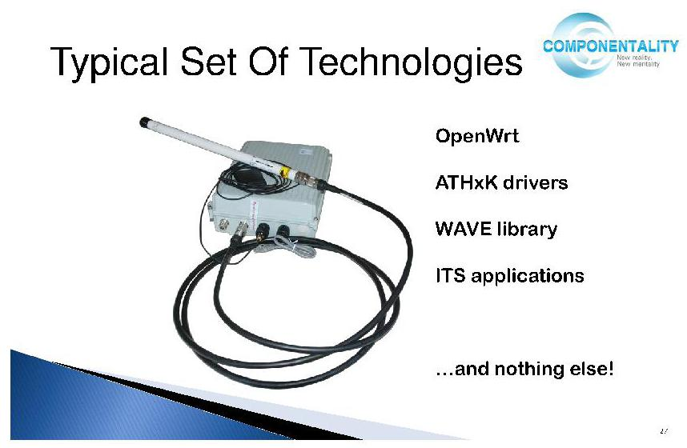
Componentality: open-source 802.11p stack:
the bluez of DSRC?
Source: “Using Open Source Solutions for V2V and V2I Communications,”
Automotive Grade Linux webinar

Slide 41
802.11p (WAVE) vs. other Comms Modes
Lower-overhead protocol for safety messages.
No access point (AP) and no basic service set (BSS)
  Too much delay for moving vehicles.
  Lower latency than 802.11a/b/g/n, LTE or satellite.
Message priorities 0-7.
Half-width channels; always ad hoc.
Up to 33 dBm (~1 km) in E.U. and 44 dBm in U.S.
No upstream Linux driver.

Slide 42
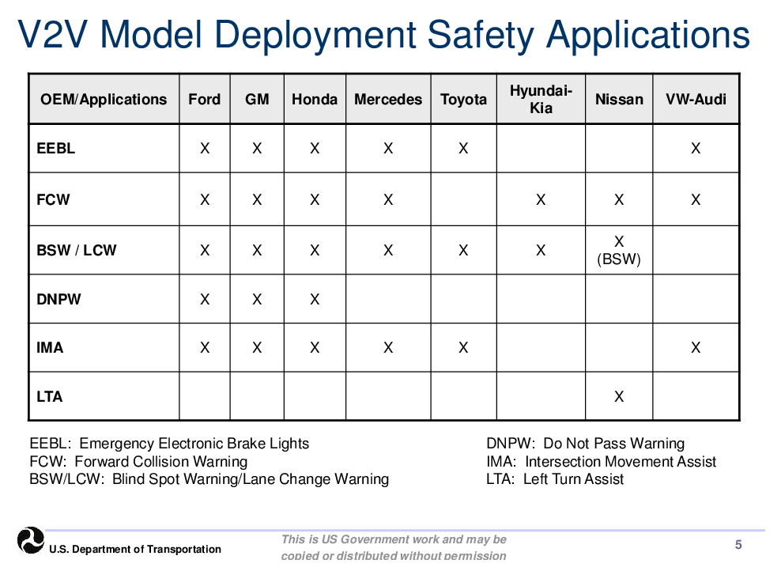
Source: M. Lukuc, Connected Vehicle Public Meeting

Slide 43
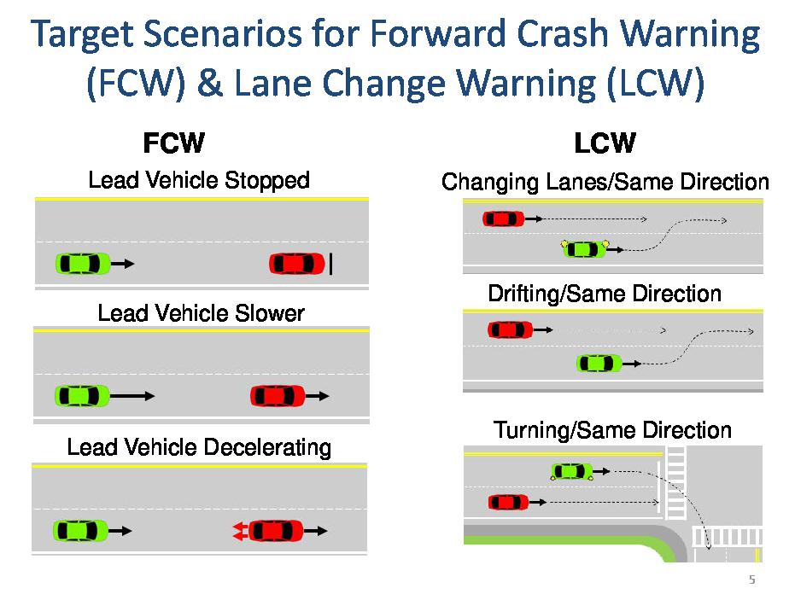
Why V2V needs low latency
Source: J. Harding, Connected Vehicle Public Meeting

Slide 44
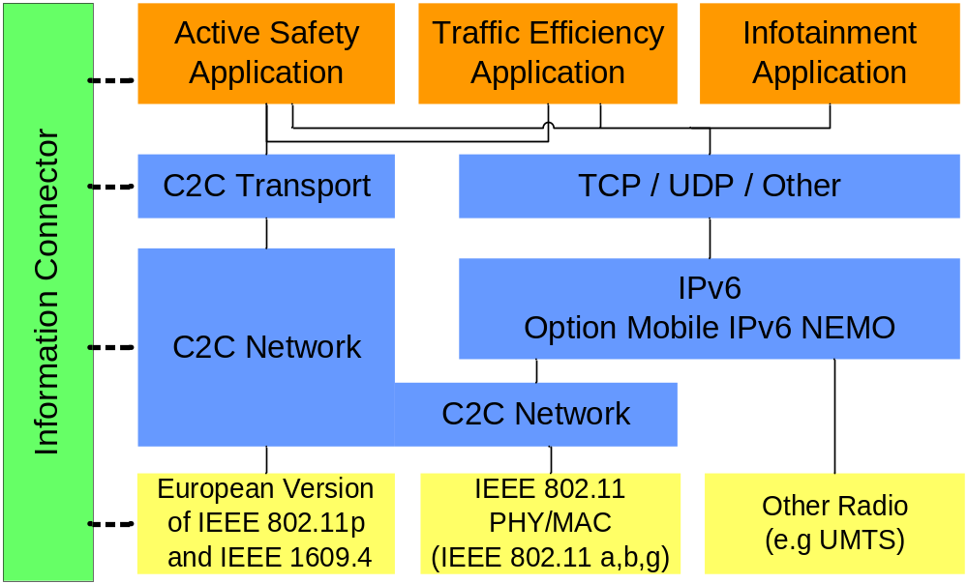
Dual protocol stacks of simTD
Based on ETSI ITS G5 plus GeoNetworking.
Management
Applications
Transport
Network
Physical Communication Technologies
From Automotive Internetworking, courtesy M. Bechler, BMW.

Slide 45
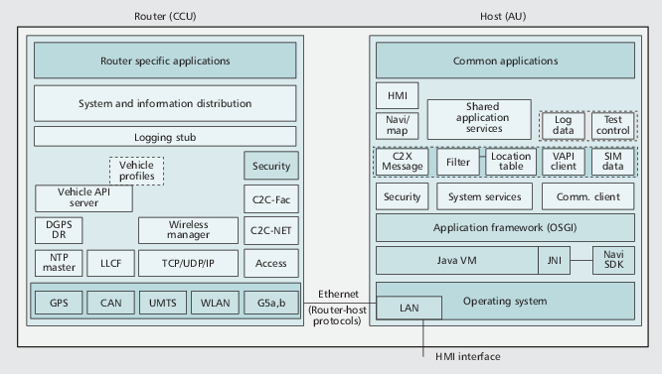
simTD's “vehicle stations”
Linux router + Windows XP Host
Ref.: H. Stübing et al., IEEE Comm. 148 (2010).

Slide 46
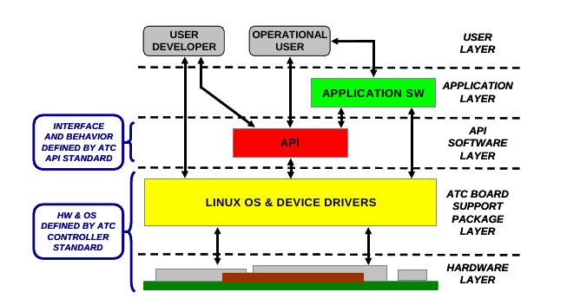
Linux in V2I:
Advanced Transportation Controller (ATC)
Applications: GLOSA; Traffic Surveillance; Ramp Meter;
Dynamic Message Signs; Weather monitor; Weigh stations;
Rail intersections; Lane usage controls; Roadworks warning . . .
Source: Institute for Traffic Engineers

Slide 47
Internet Engineering Task Force (IETF) work on Geonetworking and ITS
3 draft standards in preparation
  Geonetworking (submitted)
  'Scenarios and Requirements for IP in Intelligent Transportation Systems' (submitted)
  IPv6 over 802.11p (particular GENIVI interest)
  V2X (with MANET working group of IETF?)
Info: https://www.ietf.org/mailman/listinfo/its
chief organizer: Alex Petrescu of CEA
in contact with GENIVI Networking Expert Group

Slide 48

Special cases
Transit-service vehicles
Emergency responders
Over-the-air software updates
Agricultural equipment
Fleet vehicles
Rental cars
… and many more.

Slide 49
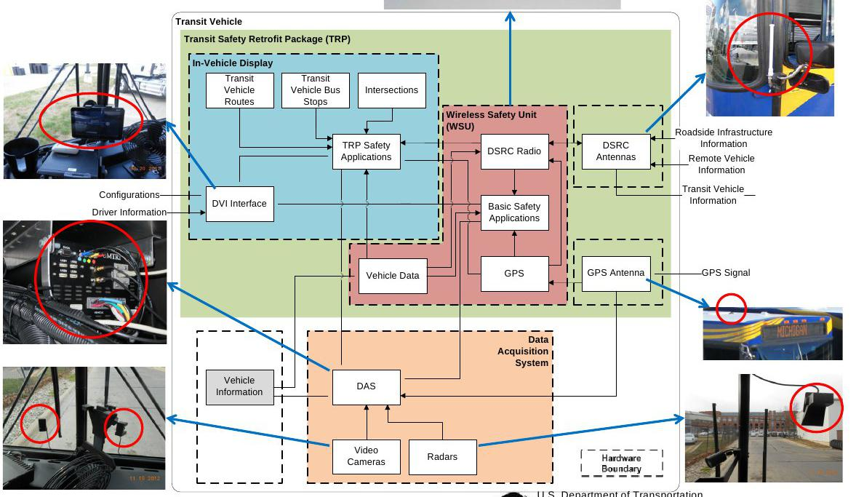
Safety Pilot's transit vehicle system
Source: S. Mortensen, Connected Vehicle Public Meeting

Slide 50
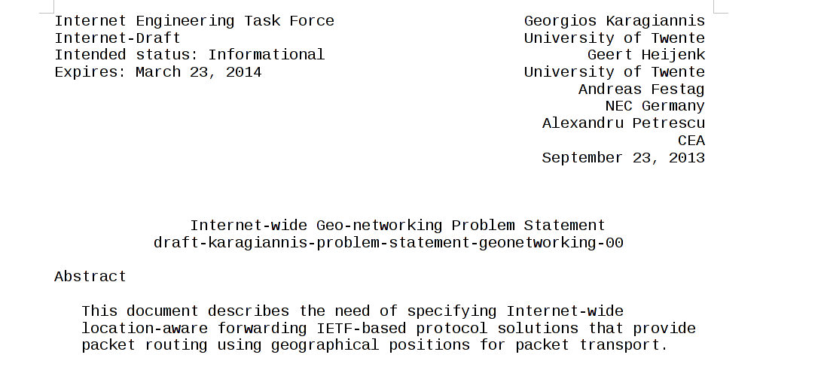

Slide 51
Safety Pilot participants
Roadside:
Arada, Kapsch, ITRI,.Cohda/Cisco, Savari
In-vehicle:
AutoTalks, Cohda, Denso, DGE, ITRI, Savari, Arada
Aftermarket Safety Devices:
Cohda/Delphi, Cohda/Visteon , Denso, Kapsch
Automakers:
GM, Ford, Toyota, Honda, VW, Daimler, Hyundai and Nissan

Slide 52


Resources
ITSSv6
CALM
SAE, IEEE, ISO, IETF, FCC, NHTSA standards
simTD
Safety Pilot
Smart In-Car
ETSI, ISO C-ITS
Automotive Grade Linux
IETF-ITS mailing list
Componentality's FlexRoad and Drivity
Telematics News
Wired Autopia
slideshare.net/chaiken
https://project.inria.fr/itssv6/users/
https://www.ietf.org/mailman/listinfo/its
http://calm.its-standards.info/
http://componentality.com/
http://componentality.com/flexroad/
http://componentality.com/drivity/
http://simtd.de/
http://telematicsnews.info/
http://wired.com/autopia/
http://www.its.dot.gov/presentations.htm
http://slideshare.net/chaiken
http://www.ertico.com/smart-in-car-trial-car-data-real-time-accessible-to-improve-traffic-flow-and-increase-traffic-safety/
http://www.etsi.org/index.php/technologies-clusters/technologies/intelligent-transport
http://www.linuxfoundation.org/collaborate/workgroups/automotive-grade-linux

