Slide 1
systemd: the modern init system you will learn to love
Alison Chaiken
alison@she-devel.com
http://she-devel.com
Jan. 7, 2015
Text in blue is hyperlinked.
On-the-fly audience exercises.

Slide 2
Topics
Motivation
Concepts
Usage
Controversy
Special topics (cgroups, udev, CoreOS)

Slide 3
Quiz:
what is the most widely used
Linux init system?

Slide 4
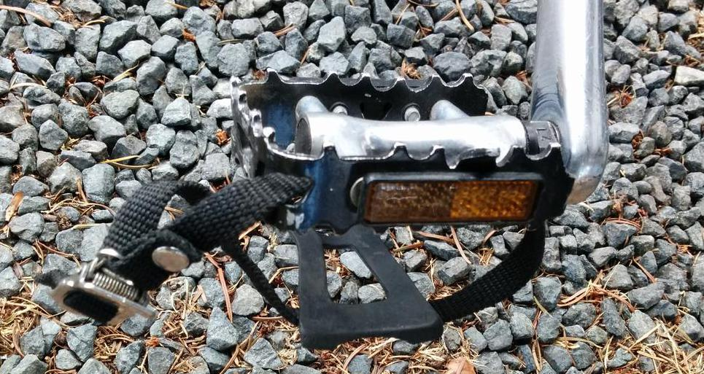
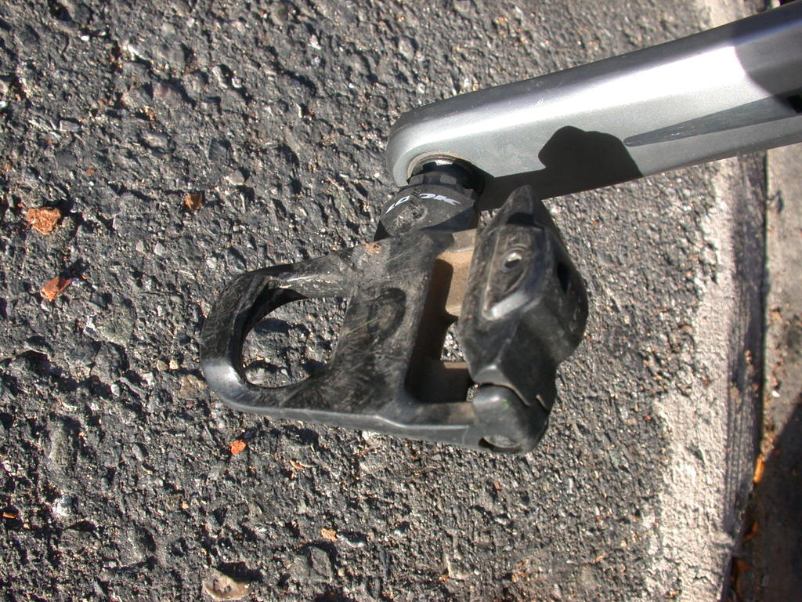
Aversion to change
sysVinit
systemd
Never go back!

Slide 5
systemd is . . .
already the basis of Fedora, RHEL, CentOS, OpenSUSE and much embedded.
soon to be the basis of Debian and Ubuntu.
praised by Jordan Hubbard of FreeBSD.
after OpenStack and Docker, the most discussed new Linux feature.

Slide 6
Concepts

Slide 7
systemd is:
modular;
asynchronous and concurrent;
described by declarative sets of properties;
bundled with analysis tools and tests;
features a fully language-agnostic API.

Slide 8
Philosophy
Extract duplicate functionality from individual daemons and move it to the systemd core or the Linux kernel.
Replace /etc scripts with declarative configuration files.

Slide 9
One daemon to rule them all
xinetd: a daemon to lazily launch internet services when activity is detected on an AF_INET socket
systemd: a daemon to lazily launch any system service when activity is detected on an AF_UNIX socket (oversimplification)

Slide 10
which services are started by sysVinit?
Try: 'ls/etc/init.d'

Slide 11
Which daemons started by systemd directly?
Try: 'ls /lib/systemd/system/*.service'
Try: 'systemctl list-sockets'

Slide 12
Side-by-side comparison
[user@localhost]$ wc /etc/rc5.d/S16rsyslog
126 380 2796 /etc/rc5.d/S16rsyslog
[user@localhost]$ wc /lib/systemd/system/rsyslog.service
15 16 290 /lib/systemd/system/rsyslog.service
[user@localhost]$ wc /bin/bash
4154 25489 1029624 /bin/bash
[user@localhost]$ wc /lib/systemd/systemd
5944 33609 1309072 /lib/systemd/systemd

Slide 13

Modularity can produce complexity
photo
courtesy
Bill
Ward

Slide 14


Major Differences with SysVInit
clean environment
socket-based activation

Slide 15
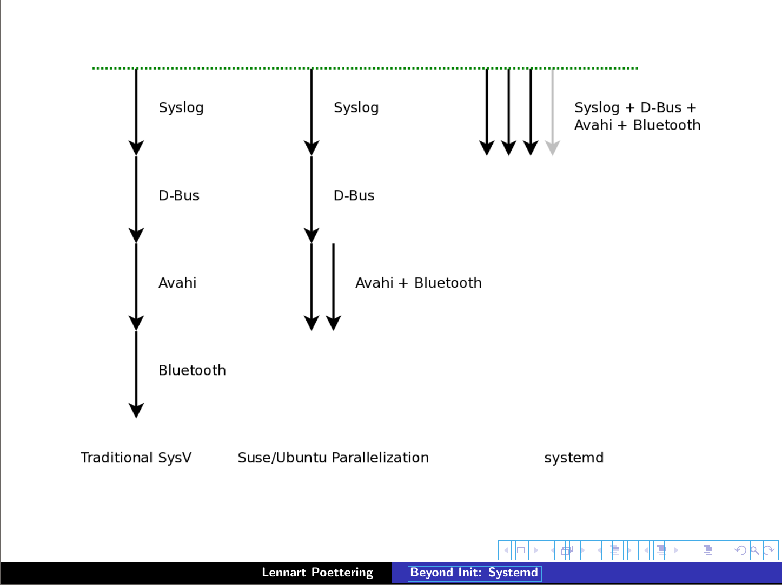
Serial
Linked list
Fully parallel
X
Upstart

Slide 16
[Socket activation demo with cups and ncat]

Slide 17
init.d scripts ⇒ systemd units
Unit's action and parameters: ExecStart=
Dependencies: Before=, After=, Requires=, Conflicts= and Wants=.
Default dependencies:
  Requires= and After= on basic.target;
  Conflicts= and Before= on shutdown.target.
Types of unit files: service, socket, device, mount, scope, slice, automount, swap, target, path, timer, snapshot

Slide 18
Sequence of targets on a typical system
>$ ls -l /lib/systemd/system/default.target
/lib/systemd/system/default.target -> graphical.target
>$ cat /lib/systemd/system/graphical.target
After=multi-user.target
>$ cat /lib/systemd/system/multi-user.target
After=basic.target
>$ cat /lib/systemd/system/basic.target
After=sysinit.target sockets.target timers.target paths.target
slices.target

Slide 19
Try: 'systemctl isolate multi-user.target'
[warning: KILLS X11]
[runlevel demo with Fedora Qemu and Firefox]

Slide 20
Understanding dependencies
Try:
systemctl list-dependencies basic.target
systemctl list-dependencies –after tmp.mount

Slide 21
Usage

Slide 22
systemd is easy to use
systemd utilities:
  Try: apropos systemd | grep ctl
All-ASCII configuration files: no hidden “registry”.
Customization is by overriding default files.
Many choices are controllable via symlinks.
Bash-completion by default.
Backwards compatibility with SysVinit

Slide 23
Hierarchy of unit files for system and user sessions
/lib/systemd/system: systemd upstream defaults
/etc/system/system: local customizations by override and extension
/usr/lib/systemd/user/: distro's unit files for user sessions
$HOME/.local/share/systemd/user/ for user-installed units
'drop-ins' are run-time extensions

Slide 24

Override your defaults!
Replace a unit in /lib (upstream) by creating one of the same name in /etc (local changes).
Add services to boot by symlinking them into /etc/systemd/system/default.target.wants.
'mask' unit with link to /dev/null.
Best practice: do not change the files in /lib/systemd.
Read in-use unit with 'systemctl cat'.
photo courtesy
Jym Dyer

Slide 25
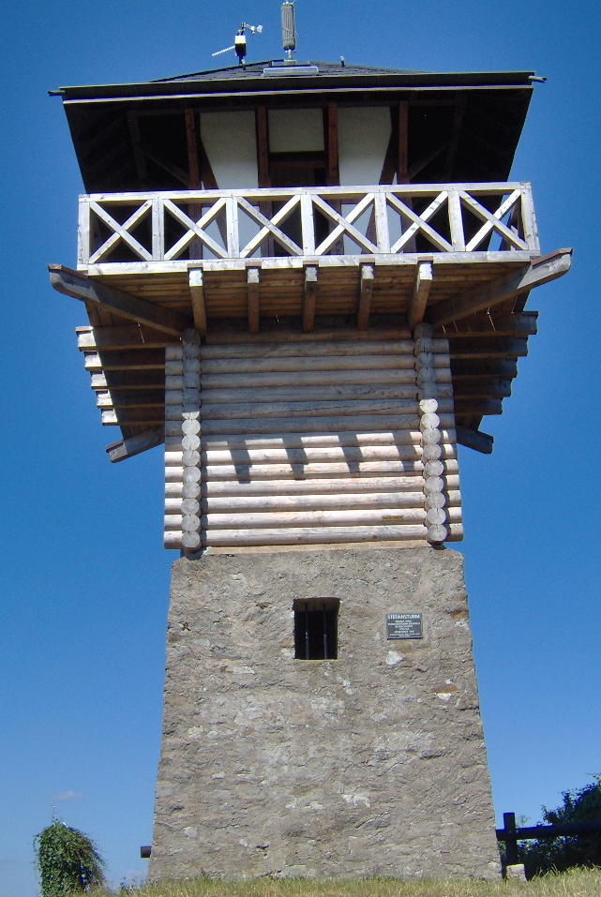
using the systemd journal
Binary format is (rightfully) controversial.
Run “addgroup $USER systemd-journal” for access.
Log-reading tools are simple:
  journalctl -xn
  journalctl -p err
  journalctl /usr/sbin/cron
  systemctl status
  systemctl is-failed bluetooth
  systemctl --failed

Slide 26
Controversy

Slide 27
Old way | New way | History
X11 manages graphics memory | Kernel's drm manages graphics memory | “Linux Graphics Drivers: an Introduction,” p. 26
static /dev, then devfs | udev | “udev and devfs: the final word”
getrlimit, setrlimit | cgroups | “On the history of process grouping”
KDE3 and GNOME2 | KDE4 and GNOME3 | KDE and GNOME
sysVinit | systemd | in progress
X11 client-server model | Wayland compositor | “The Wayland Situation”

Slide 28
Crux of the problem: Dave Neary
“There is no freedesktop.org process for proposing standards, identifying those which are proposals and those which are de facto implemented, and perhaps more importantly, there is no process for building consensus around a specification . . .”
(comment regarding GNOME3)

Slide 29
Summary
Systemd has:
  a superior design;
  tight integration with the Linux kernel;
  a vibrant developer community.
Rants against systemd are largely FUD.
Control over userspace has migrated:
  away from distros;
  toward kernel and freedesktop.org.
Most users will not notice.
The transition from X11 to Wayland will break more.

Slide 30

Thanks
Mentor Graphics for sending me to Germany to hack on systemd.
Kevin Dankwardt for teaching me about LWN and cscope.
Vladimir Pantelic, Tom Gundersen and Lennart Poettering for corrections (without implied 'ack').
Bill Ward and Jym Dyer for use of their images.

Slide 31

photo
courtesy
Jym
Dyer

Slide 32
Resources
Man pages are part of systemd git repo.
freedesktop.org: systemd mailing list archives and wiki
At Poettering's 0pointer.de blog
➟At wayback machine: “Booting up” articles
Neil Brown series at LWN
Fedora's SysVinit to systemd cheatsheet
Steve Smethurst's Hacker Public Radio episode
Josh Triplett's Debconf talk video
Carla Schroeder's linux.com tutorial

Slide 33
Special topics

Slide 34
tight integration: systemd and cgroups
cgroups are a kernel-level mechanism for allocating resources like storage, memory, CPU and network
Userspace configures cgroups through cgroupfs
[user@localhost]$ sudo mount | grep cgroup
cgroup on /sys/fs/cgroup/cpuset type cgroup
cgroup on /sys/fs/cgroup/net_cls,net_prio type cgroup
cgroup on /sys/fs/cgroup/blkio type cgroup
[ . . . ]
BSDs do not have cgroups.
Demo: sudo systemd-cgls; sudo systemd-cgtop

Slide 35
tight integration: systemd and udev
udev is a daemon that handles kernel events related to changes in device status.
udev was (controversially) merged into the systemd project.
Like cgroups, udev is tightly integrated into the Linux kernel.
Related imminent improvement: kdbus

Slide 36
systemd and security: granular encapsulation
PrivateTmp, PrivateDevices, PrivateNetwork
JoinNamespaces
ProtectSystem (/usr and /etc), ProtectHome
ReadOnlyDirectories, InaccessibleDirectories
systemd-nspawn: systemd's native containers
Easy configuration of kernel's capability properties

Slide 37
systemd in embedded systems
systemd is widely adopted in embedded systems because
  proper allocation of resources is critical;
  fastboot is required;
  customization of boot sequence is common.
Lack of backward compatibility for older kernels (due to firmware loading) is a pain point.
Embedded use cases are not always understood by systemd devs.

Slide 38

systemd and outside projects: CoreOS
networkd was initially contributed by CoreOS developers.
CoreOS's fleet “tool that presents your entire cluster as a single init system” is based on systemd.
  Spin up new containers due to events on sockets.
CoreOS devs are outside systemd inner circle.
systemd has many patches from Arch, Intel, Debian . . .

Slide 39
developing systemd
git clone git://anongit.freedesktop.org/systemd/systemd
systemd-devel list: submit patches or ask questions
Impressive and featureful utility library in src/shared/
#define streq(a,b) (strcmp((a),(b)) == 0)
#define strneq(a, b, n) (strncmp((a), (b), (n)) == 0)
#define strcaseeq(a,b) (strcasecmp((a),(b)) == 0)
#define strncaseeq(a, b, n) (strncasecmp((a), (b), (n)) == 0)
Complex but automated build system with many dependencies.
'Plumbing' dev tools in /lib/systemd, 'porcelain' tools in /bin
find /lib/systemd -executable -type f

Slide 40
Leftover Materials

Slide 41
sysVinit runlevels ≈ systemd targets
Check /lib/systemd/system/runlevel?.target symlinks:
multi-user.target.wants (runlevel 3 == text session)
graphical.target.wants (runlevel 5 == graphical session)
Select boot-target :
  via /etc/systemd/system/default.target symlink;
  appending number ('3' or '5') or systemd.unit=<target> to kernel cmdline;
Change current target by
  using runlevel (or telinit) command;
  or systemctl isolate multi-user.target

Slide 42
Extensions: drop-ins
Try: systemd-delta
Try: systemctl cat <list from 1st command>

Slide 43
Customizing your installation
Replace a unit in /lib (upstream) by creating one of the same name in /etc (local changes).
Add services to boot by symlinking them into /etc/systemd/system/default.target.wants.
Best practice: do not change the files in /lib/systemd

Slide 44
Example: set display manager
[user@localhost ~]$ ls -l `locate display-manager.service`
lrwxrwxrwx. 1 root root 35 Dec 11 2013 /etc/systemd/system/display-manager.service -> /usr/lib/systemd/system/gdm.service
[user@localhost ~]$ cat /usr/lib/systemd/system/gdm.service
[Unit]
Description=GNOME Display Manager
[ . . . ]
[Install]
Alias=display-manager.service
or
WantedBy=graphical.target

Slide 45
sysinit, sockets and multi-user are composite targets
>$ ls /lib/systemd/system/multi-user.target.wants/
dbus.service@ systemd-ask-password-wall.path@ systemd-
update-utmp-runlevel.service@ getty.target@
>$ ls /lib/systemd/system/sockets.target.wants:
dbus.socket@ systemd-shutdownd.socket@
systemd-initctl.socket@ systemd-udevd-control.socket@
>$ ls /lib/systemd/system/sysinit.target.wants:
cryptsetup.target@ systemd-journald.service@
debian-fixup.service@ systemd-journal-flush.service@
Symlinks replace lines of conditional code in SysVinit scripts.

Slide 46
Example: change the default target
[alison@localhost ~]$ ls /etc/systemd/system/default.target
/etc/systemd/system/default.target ->
/lib/systemd/system/graphical.target
[alison@localhost ~]$ sudo rm /etc/systemd/system/default.target
[alison@localhost ~]$ sudo ln -s /lib/systemd/system/multi-user.target
/etc/systemd/system/default.target
[alison@localhost ~]$ ~/bin/systemd-delta
[ . . . ]
[REDIRECTED] /etc/systemd/system/default.target →
/usr/lib/systemd/system/default.target

Slide 47
Misconceptions
systemd is more complex than sysVinit.
systemd is full of binary configuration files.
The system log is now unreadable! And liable to corruption!
{Fedora/GNOME/RedHat/Poettering} are trying to take over all of Linux.

Slide 48
problems
systemd is modular, but:
  interopability with other SW may be inadequately tested.
Potentially rocky piecemeal transition by distros.
  e.g., Debian installer doesn't warn about a separate /usr partition.
Merciless deprecation of features (firmware loading, readahead . . . ).
Frequent releases, not particularly stable.

Slide 49
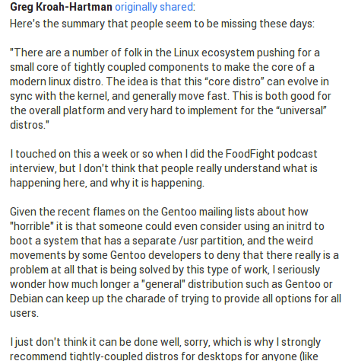
Greg K-H: “Tightly-coupled components”

Slide 50
Taxonomy of systemd dependencies
Requires, RequiresOverridable, Requisite, RequisiteOverridable, Wants, BindsTo, PartOf, Conflicts, Before, After, OnFailure PropagateReloadsTo, ReloadPropagateFrom,

