Slide 1
Alison Chaiken
C++ Meetup Group, 2025
alison@she-devel.com
Code: https://github.com/chaiken/condvar
Slides: http://she-devel.com/Chaiken_RoboticsAndThreads.pdf
Blue text indicates hyperlinks.

Slide 2
Agenda
Safety-critical applications and concurrency
How priority inheritance works
A 15-year-old bug in libpthread
Impact on std::condition_variable and std::atomic
An alternate condition variable implementation
How to fix C++?
Conclusions

Slide 3

Realtime OSes

Slide 4


RTOSes in Latency-Critical Applications

Slide 5
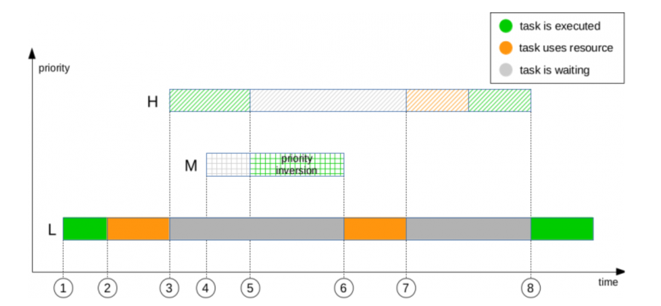
Priority inversion occurs when L-prio thread holds a lock that H-prio thread needs
Hi-prio needs
lock
Priority
Lo-prio takes
lock
Time

Slide 6
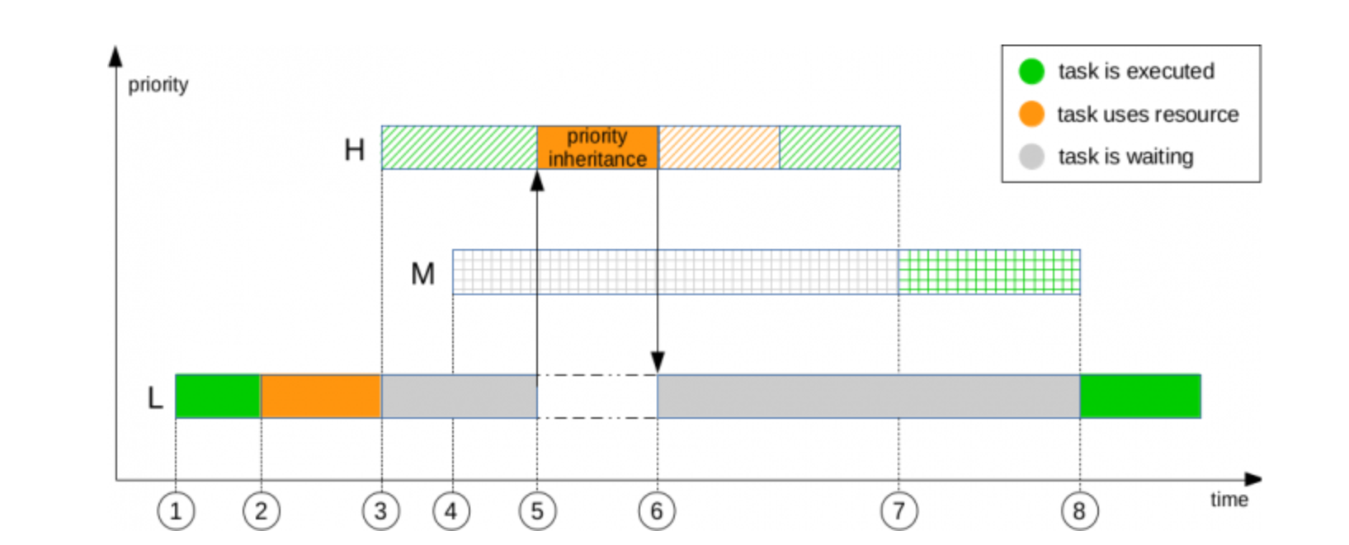
Priority Inheritance in Realtime Kernel Boosts the L-prio thread temporarily
Hi-prio needs
lock
Priority
Lo-prio takes
lock
Time
Vital for userspace tasks as well as kernel!

Slide 7
Fedor Pikus, “A Spinlock Implementation”
#include <atomic>
#include <time.h>
class spinlock {
public:
spinlock() : flag_(0) {}
void lock() {
static const timespec ns = {0 /*seconds*/, 1 /*ns*/};
for (int i = 0; flag_.load(std::memory_order_relaxed) || FAST
flag_.exchange(1, std::memory_order_acquire)); SLOWER
i++) {
if (i == 8) { i = 0; nanosleep(&ns, NULL); } YIELD TO THREAD WITH LOCK
}
}
void unlock() { flag_.store(0, std::memory_order_release); }
private:
std::atomic<unsigned int> flag_;
}

Slide 8
pthreads and condition variables

Slide 9
C++ Condition Variables
void do_something_for_a_while(std::deque &q,
std::mutex &protect_q,
std::condition_variable &q_changed)
{
std::unique_lock lock(protect_q);
auto const expire = system_clock::now() +
std::chrono::seconds(5);
while (system_clock::now() < expire) {
if (q_changed.wait_until(lock, expire, [&q]
{ return !.empty(); })) {
do_something(q);
return;
}
}
throw std::runtime_error("Timed out");
}

Slide 10
POSIX Condition Variables and Spurious Wakeups
Q.: Where can the following go wrong?
{
pthread_mutex_lock(m);
condition = true;
pthread_cond_signal(cond);
pthread_mutex_unlock(m);
}
A1.: The signaled thread may see that the mutex is locked.

Slide 11
POSIX Condition Variables and Spurious Wakeups
Q.: Where can the following go wrong?
{
pthread_mutex_lock(m);
condition = true;
pthread_cond_signal(cond);
pthread_mutex_unlock(m);
}
A0.: A third thread can grab the mutex before the signaled thread.

Slide 12
POSIX Condition Variables and Spurious Wakeups
Q.: Where can the following go wrong?
{
pthread_mutex_lock(m);
condition = true;
pthread_cond_signal(cond);
pthread_mutex_unlock(m);
}
A2.: There may be an ABA problem with the condition variable.

Slide 13
Even further under the hood: futexes
Inside pthread_cond_signal.c:
if (do_futex_wake)
futex_wake (cond->__data.__g_signals + g1, 1, private);
Inside pthread_mutex_lock.c:
futex_wait ((unsigned int *) &mutex->__data.__lock, oldval,
PTHREAD_ROBUST_MUTEX_PSHARED (mutex));
First int* param of futex syscalls is the “futex word”.

Slide 14
Servers 1, Robots 0

Slide 15
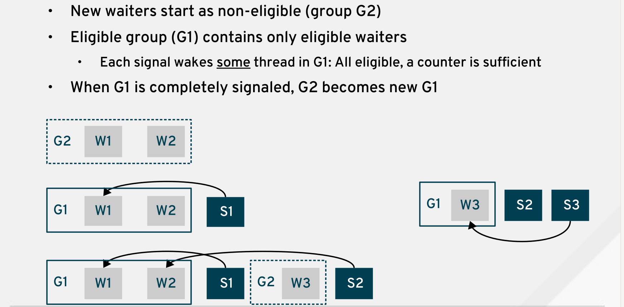
POSIX Notion of Eligible Waiters

Slide 16
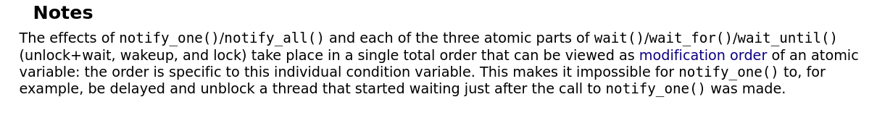
std::condition_variable and futexes

Slide 17
The futex word is already full
#define FUTEX_TID_MASK 0x3FFF FFFF (30 bits)
#define FUTEX_WAITERS 0x8000 0000
#define FUTEX_OWNER_DIED 0x4000 0000

Slide 18

Priority Inheritance makes Conflicting Demands
Realtime scheduler requires all locks to have an owner.
Priority inheritance means that the kernel and userspace must exchange info that won't fit in 32-bit “futex word.”
Consequently, an ABI break is needed:
  either 64-bit pthread_cond_t (the “futex word”),
or
  an additional function parameter.
https://tinyurl.com/3dxz5869

Slide 19
Fix Requires an ABI Break
Either:
futex() syscall must take an additional argument;
-or-
the “futex word” must change from 32- to 64-bit.

Slide 20
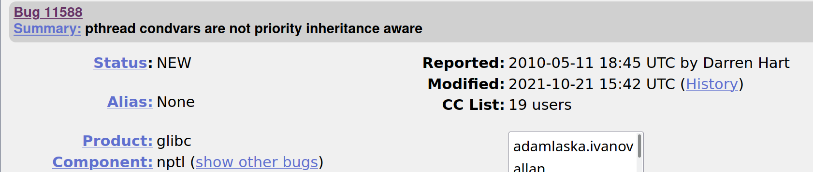
Problem: glibc threads do not support PI
Bug report posted in 2010; still “NEW” in 2025.

Slide 21
Robotics projects need a different condvar implementation: librtpi
int pthread_cond_signal(pthread_cond_t *cond);
int pthread_cond_broadcast(pthread_cond_t *cond);
int pi_cond_signal(pi_cond_t *cond, pi_mutex_t *mutex);
int pi_cond_broadcast(pi_cond_t *cond, pi_mutex_t *mutex);

Slide 22
C++ Atomics (C++20)

Slide 23

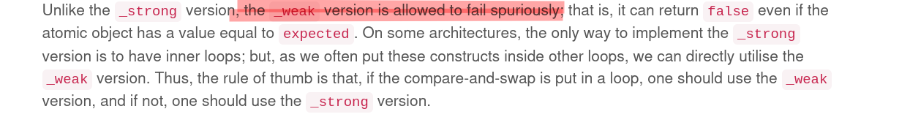

Slide 24
std::atomic<bool> locked_flag = false;
void incrementer(std::size_t &op1, std::size_t &op2) {
for (std::size_t i = 0; i < CYCLES; ++i) {
while (locked_flag.exchange(true, std::memory_order_acquire)) {
locked_flag.wait(true, std::memory_order_relaxed);
}
op1++;
op2 = op1;
locked_flag.store(false, std::memory_order_release);
locked_flag.notify_one();
}
}

Slide 25
Watching what atomic.notify() does
(code stolen from Teodorescu)
std::atomic<bool> locked_flag = false;
void incrementer(std::size_t &op1, std::size_t &op2) {
for (std::size_t i = 0; i < CYCLES; ++i) {
while (locked_flag.exchange(true, std::memory_order_acquire)) {
locked_flag.wait(true, std::memory_order_relaxed);
}
op1++; op2 = op1;
locked_flag.store(false, std::memory_order_release);
locked_flag.notify_one();
}
}
$ sudo strace -vf ./atomic-stack_lib_test | grep futex
futex(0x7f1977c6273c, FUTEX_WAKE_PRIVATE, 2147483647) = 0
[pid 265158] futex(0x55f2121afd80, FUTEX_WAKE, 2147483647) = 0
[pid 265156] futex(0x7f1977800990, FUTEX_WAIT_BITSET|FUTEX_CLOCK_REALTIME, 265157, NULL, FUTEX_BITSET_MATCH_ANY) = 0

Slide 26
A way forward

Slide 27
In the spirit of
template<typename T, allocator= std::allocator>
class container;
why not
template<threadlib=std::pthread>
class condition_variable;
template<threadlib=std::pthread>
class mutex;
?

Slide 28
Conclusions

Slide 29
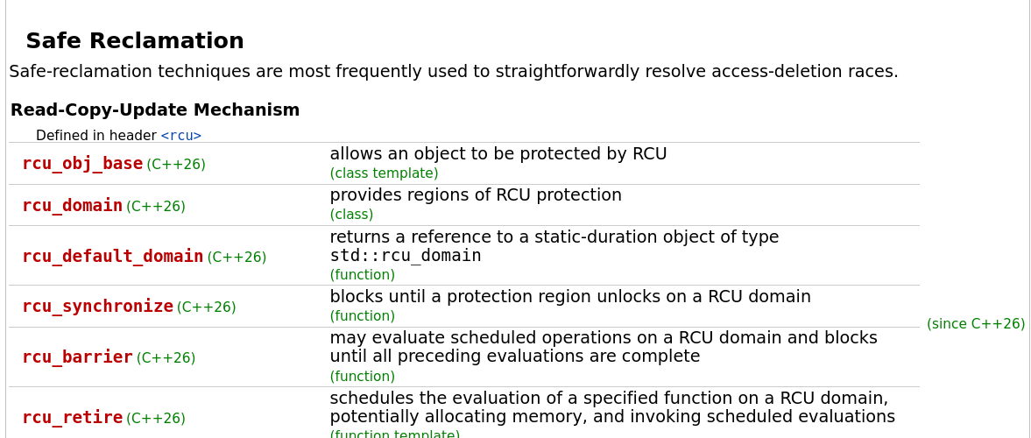
Preview of Coming Attractions

Slide 30
References
librtpi, maintained by Gratian Crisan (National Instruments)
librtpi: Conditional Variables for Real-Time Applications, Gratian Crisan, 2020
Pthread Condvars: Posix Compliance and the PI gap, Torvald Riegel (Redhat) and Darren Hart (VMWare), 2016
In an Atomic World, Lucian Radu Teodorescu (Garmin), 2024
Basics of Futexes, Eli Bendersky

