Slide 1
AT and beam dynamics course
Tuesday, March 27, 2012
ESRF
B. Nash

Slide 2
Morning session
Objectives
Getting set up: download and compile code, set path
Components of a storage ring and how they are represented. Track a particle through an element. Read in ESRF lattice.
Linear dynamics. Transfer matrix. Symplecticity. Lattice functions. Tunes.
Non-linear dynamics. Dynamic aperture.
If time: add an insertion device via a kick map. Compute tune shift.

Slide 3
Afternoon Session
Equilibrium emittance and OhmiEnvelope
Load model machines for different days with different coupling corrections.
Compute vertical emittance
Plot coupling angle

Slide 4
Getting AT software ready
Log in to rnice
log in to oar cluster
oarsub -I -l nodes=1/core=3 -p "mem>4000 and cpu_vendor='INTEL '"
start Matlab
Set proxy settings in .subversion/servers file:
[global]
http-proxy-exceptions = *.esrf.fr, localhost
http-proxy-host = proxy2.esrf.fr
http-proxy-port = 3128
Download software:
svn co https://atcollab.svn.sourceforge.net/svnroot/atcollab atcollab

Slide 5
Setting up in Matlab
Go to Set Path under File menu
Select: Add with Subfolders:
choose:
~/atcollab/trunk
In Matlab, type:
atmexall
This should compile all the c files into mex files that can be called from Matlab.
That should be it!

Slide 6
Additional files for this course
create a folder called atcourse
add it to your path
copy files from ~nash/atcourse to your atcourse folder.

Slide 7
How to store a high energy electron
Accelerate to high energy (E=6.04 GeV for ESRF) in linac and booster, then inject into ring.
Use dipole magnets to create circular trajectory.
Use quadrupoles to confine the beam transversely.
Use sextupoles to fix chromatic aberration caused by the quadrupoles.
Use an RF cavity to replenish energy and confine longitudinally.

Slide 8
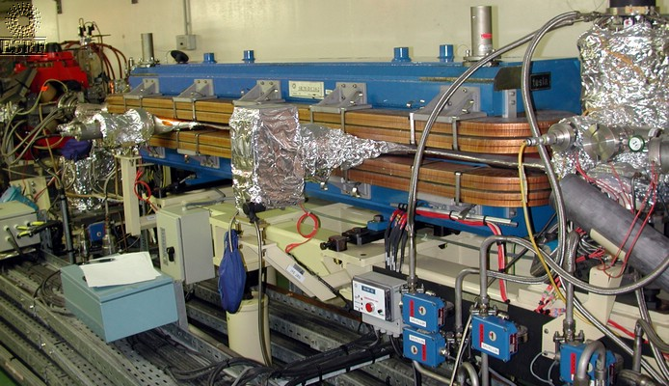
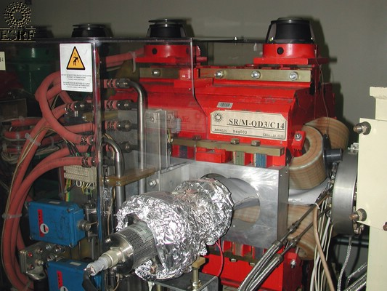
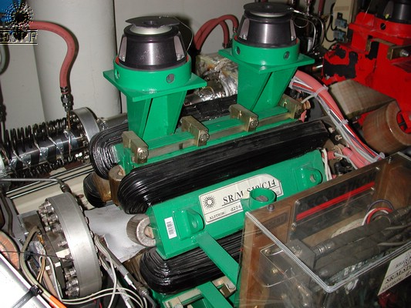
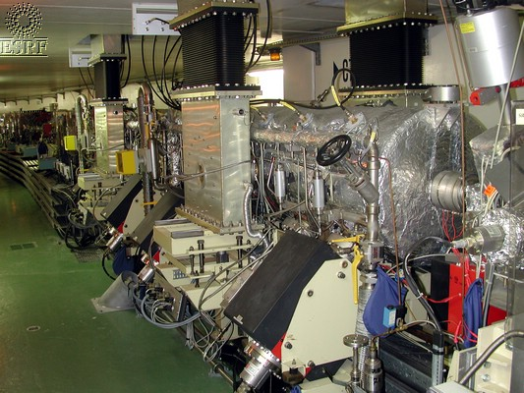
Components needed to store electrons
dipole
quadrupole
sextupole
RF cavity

Slide 9
Load the ESRF lattice
>> load esrf.mat
This is a cell structure with 1648 elements
>> esrf{1}
>> esrf{10}
ans =
FamName: 'S6'
Length: 0.4000
PolynomB: [0 0 -4.1054]
PolynomA: [0 0 0]
MaxOrder: 2
NumIntSteps: 10
PassMethod: 'StrMPoleSymplectic4Pass'
BetaCode: 'SX'
Energy: 6.0400e+09
ans =
FamName: 'SDHI'
Length: 3.0526
PassMethod: 'DriftPass'
BetaCode: 'SD'
Energy: 6.0400e+09
>> findcells(esrf,'FamName',‘S6')
ans=…

Slide 10


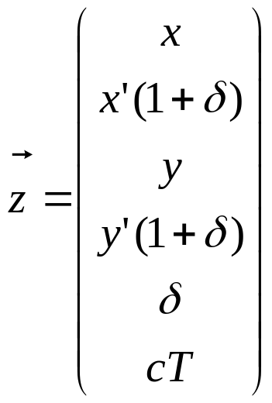

Electrons move through elements
6-D phase space for
Electron or ‘ray’ entering
Plane at element

Slide 11
Integrators
EAperturePass.c
IdTablePass.c
IdentityPass.c
Matrix66Pass.c
QuadLinearPass.c
SolenoidLinearPass.c
StrMPoleSymplectic4Pass.c
WiggLinearPass.c
AT has the following integrators:
AperturePass.c
BendLinearPass.c
BndMPoleSymplectic4E2Pass.c
BndMPoleSymplectic4E2RadPass.c
BndMPoleSymplectic4Pass.c
BndMPoleSymplectic4RadPass.c
CavityPass.c
CorrectorPass.c
DriftPass.c
In-coming phase-space
point
element
Calling syntax:
>>StrMPoleSymplectic4Pass(QF2,[.001 0 0 0 0 0]')

Slide 12
Drift space
The simplest example is the electron just passing through empty space.
path length effect
note this is non-linear!

Slide 13
Bend
L, theta, theta_i, theta_f
rho=L/theta
>> esrf{14}
ans =
FamName: 'B1H'
Length: 2.1573
BendingAngle: 0.0923
EntranceAngle: 0.0491
ExitAngle: 0.0432
PassMethod: 'BndMPoleSymplectic4E2Pass'
K: 0
PolynomA: [0 0 0]
PolynomB: [0 0 0]
MaxOrder: 2
NumIntSteps: 10
BetaCode: 'DI'
FringeInt: 0
FullGap: 0
Energy: 6.0400e+09
>> esrf{15}
ans =
FamName: 'B1S'
Length: 0.2927
BendingAngle: 0.0059
EntranceAngle: -0.0432
ExitAngle: 0.0491
PassMethod: 'BndMPoleSymplectic4E2Pass'
K: 0
PolynomA: [0 0 0]
PolynomB: [0 0 0]
MaxOrder: 2
NumIntSteps: 10
BetaCode: 'DI'
FringeInt: 0
FullGap: 0
Energy: 6.0400e+09
hard bend
soft bend

Slide 14
Cavity
>> esrf{end}
ans =
FamName: 'CAV'
Length: 0
PassMethod: 'IdentityPass'
Voltage: 562500
Frequency: 3.5220e+08
HarmNumber: 992
BetaCode: 'CA'
Energy: 6.0400e+09
cavity turned off in model
by default
>> findcells(esrf,'FamName','CAV')
ans =
Columns 1 through 9
103 206 309 412 515 618 721 824 927
Columns 10 through 16
1030 1133 1236 1339 1442 1545 1648
cavity in long
straights: distributed
model. Note reduced
RF voltage to give total
correct value.

Slide 15
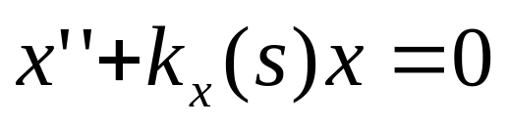
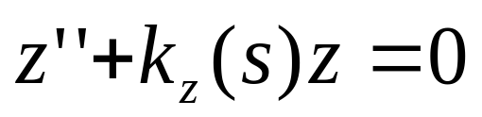
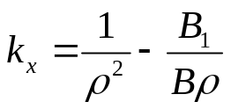
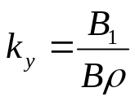
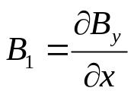

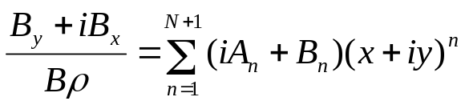
Linear Optics: Quadrupole
quad
(Hill’s equation)
>>QF2=esrf{6}
QF2
FamName: 'QF2'
Length: 0.9434
K: 0.3910
PassMethod:'StrMPoleSymplectic4Pass'
PolynomA: [0 0 0]
PolynomB: [0 0.3910 0]
MaxOrder: 2
NumIntSteps: 10
=20.15 for 6.04 GeV, ESRF
Multipole expansion

Slide 16
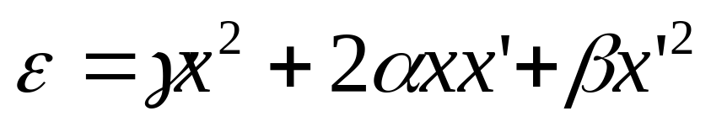
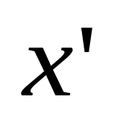




Harmonic oscillator in phase space
Twiss Parameters
measuring the position
over time, it will oscillate
invariant with position!
turn 1
turn 2
slope:
turn 3
tune is defined by
number of oscillations about closed
orbit over 1 turn
This is at one position in the ring.

Slide 17
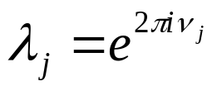
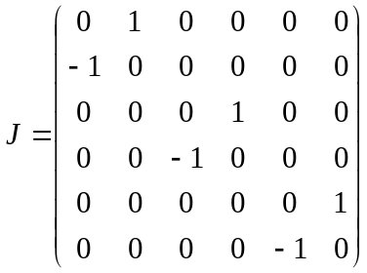

Linear Dynamics, continued
All this can found from one-turn map matrix.
>>M=findm66(esrf)
In uncoupled case, beta functions from eigenvectors of M
Tunes from eigenvalues
>> eigs(M)
Find tunes!
This matrix satisfies a property called symplecticity:
Verify this property for ESRF lattice.

Slide 18
Compute the lattice functions around the ring: atlinopt function
>>[lindata,tunes,xsi]=atlinopt(esrf,0,1:length(esrf)+1);
The fields of lindata:
SPos
Dispersion
B
beta
mu
A
alpha
C
gamma
>> tunes
tunes =
0.4396 0.3901
nx=36,
ny=14
ElemIndex
>>xsi
xsi =
2.6599 5.2293
M44

Slide 19
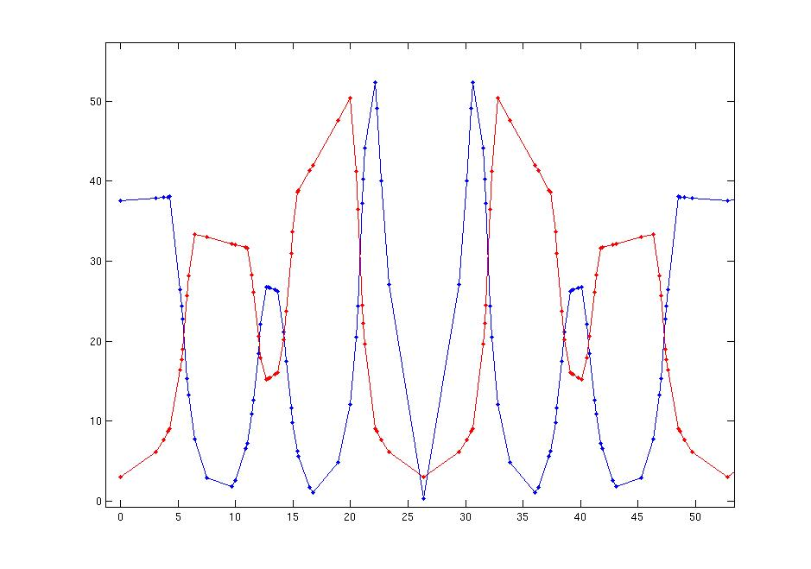
Plotting the results of atlinopt
because the result is an array of arrays, one needs to use the cat
function to pull out the individual fields.
>>beta = cat(1,lindata.beta);
>>betax= beta(:,1);
>>betay=beta(:,2);
>>disp = cat(2,lindata.Dispersion);
>>dispx=disp(1,:);
small inconsistency in the array
orientation!
use ‘hold on’ so that
later plots don’t replace
earlier
>>spos=cat(1,lindata.SPos)
>>plot(spos,betax,'.-b',spos,betay,'.-r')
Note that there are 32 super-periods,
and a total circumference of 844.39 m.
Each cell is 26.38 m long. Note mirror
symmetry of adjacent cells.
S (m)

Slide 20
Add Radiation
>>[esrfrad,radindex,cavindex]=atradon(esrf);
What changed?
Check symplecticity condition for esrfrad.

Slide 21
Sextupole element
>>S6 = esrf{10}
S6 =
FamName: 'S6'
Length: 0.4000
PolynomB: [0 0 -4.1054]
PolynomA: [0 0 0]
MaxOrder: 2
NumIntSteps: 10
PassMethod: 'StrMPoleSymplectic4Pass'
BetaCode: 'SX'
Energy: 6.0400e+09
Note that the element here
comes directly from the PolynomB.
From multipole expansion, work out the
form for the magnetic field for the
sextupole.

Slide 22
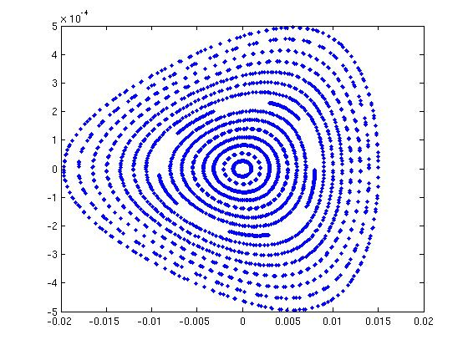
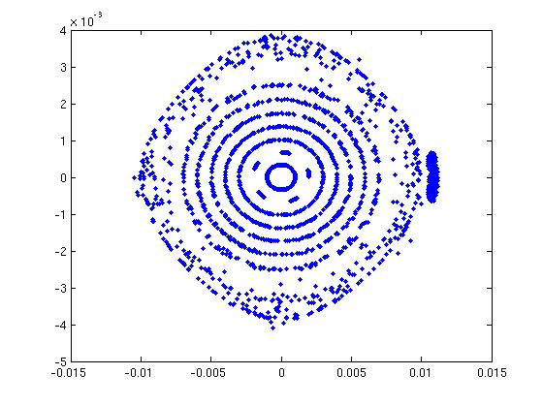
Non-linear dynamics
Sextupoles result in non-linear dynamics. Many new phenomena arise.
Motion can now be unstable at large amplitudes.
Motion is chaotic. Accurate tracking for large number of turns: need to be sophisticated in tracking algorithm. Symplectic integrators.
x’(rad)
y’(rad)
x(m)
y(m)
>> z0=[0.001 0 0 0 0 0]'*(1:15);
>> zf=ringpass(esrf,z0,200);
>> plot(zf(1,:),zf(2,:),'.b')
>> z0=[0 0 0.001 0 0 0]'*(1:15);
>> zf=ringpass(esrf,z0,100);
>> plot(zf(3,:),zf(4,:),'.b')

Slide 23
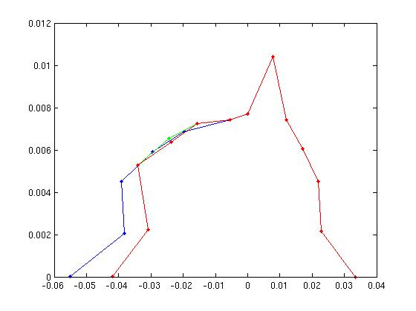
Non-linear dynamics continued
Compute dynamic aperture for ESRF lattice using atdynap function:
Vary the number of tracking turns and see how the dynamic aperture varies.
Change the value of a sextupole setting:
esrf{10}.PolynomB=[0 0 -2], and recompute dynamic aperture.
y (m)
>>[xm100,ym100]=atdynap(esrf,100)
>>[xm200,ym200]=atdynap(esrf,200)
>>[xm300,ym300]=atdynap(esrf,300)
>>[xm400,ym400]=atdynap(esrf,400)
>>plot(xm100,ym100,'.-b',xm200,ym200,'.-g',xm300,ym300,'.-r',xm400,ym400,'.-y')
X (m)

Slide 24
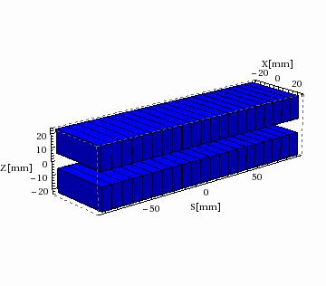
Modelling Undulator impact on beam
1.6 m undulator B_max= 0.76 T, lam= 35 mm.
Model in Radia. U35.mat contains this kick map in a Matlab variable.
>> U35elem=atidtable('U35',1,'U35.mat',6.04,'IDTablePass')
U35elem =
FamName: 'U35'
Nslice: 1
MaxOrder: 3
NumIntSteps: 10
R1: [6x6 double]
R2: [6x6 double]
T1: [0 0 0 0 0 0]
T2: [0 0 0 0 0 0]
PassMethod: 'IDTablePass'
Length: 1.6000
NumX: 81
NumY: 21
xtable: [1x81 double]
ytable: [1x21 double]
xkick: [21x81 double]
ykick: [21x81 double]
xkick1: [21x81 double]
ykick1: [21x81 double]
PolynomA: [0 0 0 0]
PolynomB: [0 0 0 0]

Slide 25
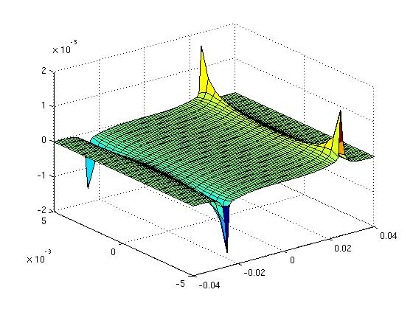
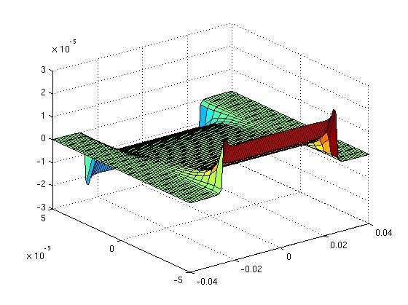
Plot the kick maps
>> xtable=U35elem.xtable;
>> ytable=U35elem.ytable;
>>xkick = U35elem.xkick;
>> surf(xtable,ytable,xkick)
>> ykick = U35elem.ykick;
>> surf(xtable,ytable,xkick)
>> surf(xtable,ytable,ykick)
horizontal kick
vertical kick

Slide 26

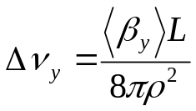
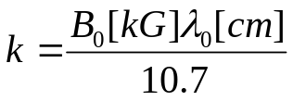


Find the tune shift and DA impact from this ID
Add the U35 to the ring:
>>esrf_U35=add_ID(esrf,U35elem)
For B=0.76 T
Compute the new tunes.
Compute the new dynamic aperture.
Try decreasing the energy when creating the element to give a stronger effect.

Slide 27
Afternoon

Slide 28
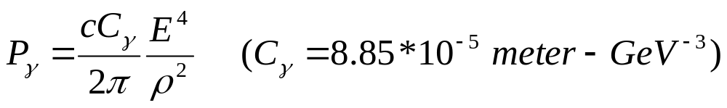
Equilibrium Emittance
We saw that with radiation, the linear motion is not symplectic. It is damped. If you run enough turns, all particles go to 0. Is this the truth?
There’s another effect. The radiated energy has quantum fluccuations. This causes a diffusion effect. Causes a change in second moments of beam size.

Slide 29
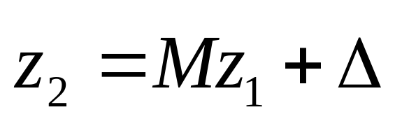
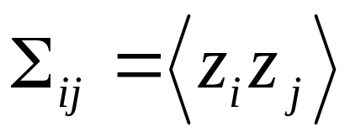
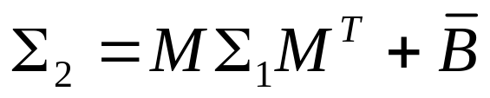
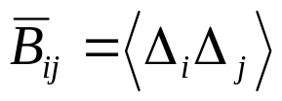
Second moments with Radiation
Mathematically, we write:
One turn map,
with radiation damping
Deterministic (reversible)
Random fluccuation
From quantum effect.
Average (first moment) is zero, non-zero second moment.
Define
Then,
Average over ensemble.

Slide 30
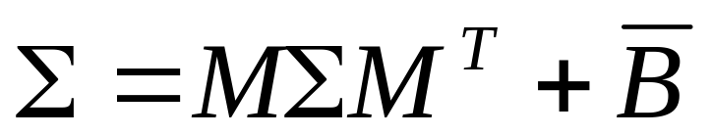
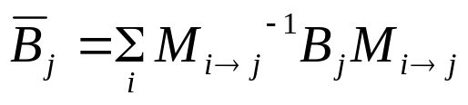
Equilibrium beam
Equilibrium if:
findm66(esrfrad)
findmpoleraddiffmatrix(B1Hrad,[0 0 0 0 0 0]’)
(esrfrad{14})
This is all combined together in
>>[env, rmsdp, rmsbl] = ohmienvelope(esrfrad,radindex,1:length(esrfrad)+1)
energy spread
bunch length

Slide 31
Envelope structure
ENVELOPE is a structure with fields
Sigma - [SIGMA(1); SIGMA(2)] - RMS size [m] along
the principal axis of a tilted ellips
Assuming normal distribution exp(-(Z^2)/(2*SIGMA))
Tilt - Tilt angle of the XY ellips [rad]
Positive Tilt corresponds to Corkscrew (right)
rotatiom of XY plane around s-axis
R - 6-by-6 equilibrium envelope matrix R
env =
1x1649 struct array with fields:
Sigma
Tilt
R
OhmiEnvelope computation
included in atx function
lindata=atx(esrf,0);
tilt=cat(1,lindata.tilt)*360/(2*pi); //Convert to degrees.
spos=findspos(esrf,1:length(esrf));
tiltdat=[spos tilt];
plot(spos,tilt)

Slide 32
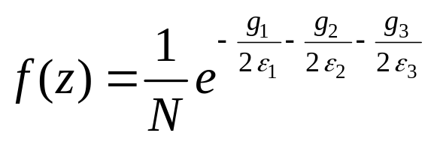
Connection to Emittances
To a good approximation, one can also write the Gaussian
beam distribution in the form
In the uncoupled case, the g’s are the Courant-Snyder invariants.
The eps’s are the emittances.

Slide 33
Vertical emittance from coupling
Try to add a skew quadrupole component
to create non-zero vertical emittance.
Plot beam sizes around ring.

Slide 34
Real errors
Measure a response matrix.
Apply corrections.
AT lattices are a part of this process.
Find esrf08Nov2011.mat and
esrf27Sept2011.mat
In the atcourse folder.
Compute the vertical emittance, and beam sizes around ring for these two machines. Plot coupling angle and compare for the two.

