Slide 1

Note: The data and information in this document is reflective of a hypothetical situation and client. This document is to be used for KPMG Virtual Internship purposes only.
Sprocket Central Pty Ltd
Data analytics approach
[Data analytics Division] - [Engagement Manager], [Senior Consultant], [Chaima]

Slide 2
Note: The data and information in this document is reflective of a hypothetical situation and client. This document is to be used for KPMG Virtual Internship purposes only.
Agenda
Introduction
Data Exploration
Model Development
Interpretation

Slide 3
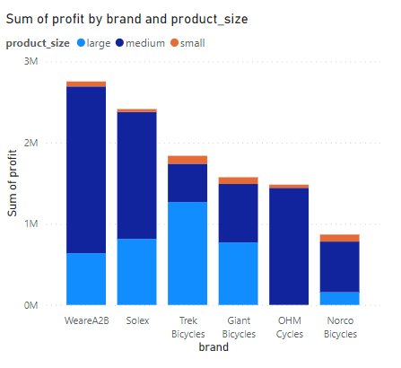
Note: The data and information in this document is reflective of a hypothetical situation and client. This document is to be used for KPMG Virtual Internship purposes only.
Introduction
Products analysis:
WeareA2B and Solex are the most two profitable brands
The most sold size is medium and then large and then small

Slide 4
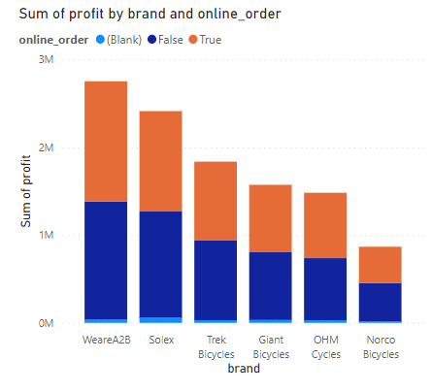
Note: The data and information in this document is reflective of a hypothetical situation and client. This document is to be used for KPMG Virtual Internship purposes only.
Introduction
The order mode feature is uniformly distributed among the brands

Slide 5
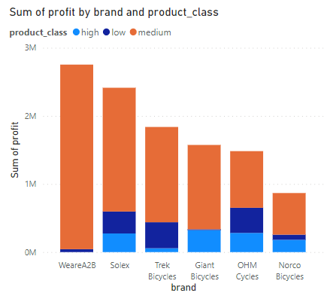
Note: The data and information in this document is reflective of a hypothetical situation and client. This document is to be used for KPMG Virtual Internship purposes only.
Introduction
The products most sold class is medium

Slide 6
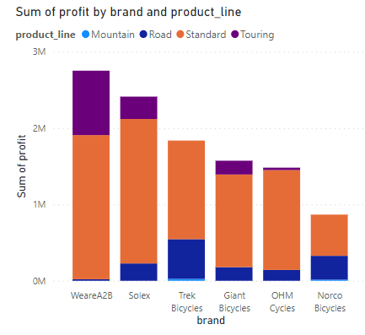
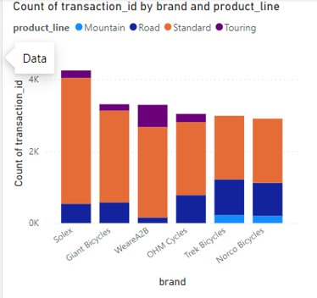
Note: The data and information in this document is reflective of a hypothetical situation and client. This document is to be used for KPMG Virtual Internship purposes only.
Introduction
The products most sold line is standard
The most sold and the most profitable brands are different.

Slide 7
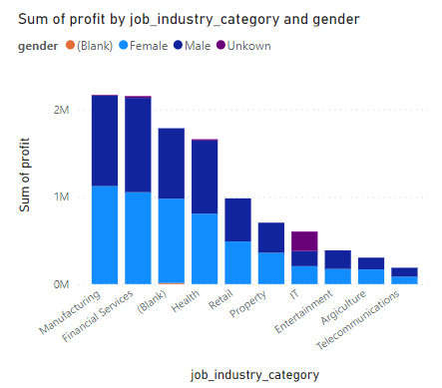
Note: The data and information in this document is reflective of a hypothetical situation and client. This document is to be used for KPMG Virtual Internship purposes only.
Data Exploration
Most customers work in the following job industry categories:
The gender is not a feature that affects the profit

Slide 8
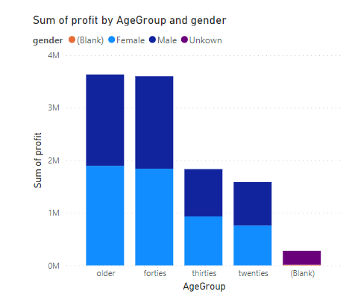
Note: The data and information in this document is reflective of a hypothetical situation and client. This document is to be used for KPMG Virtual Internship purposes only.
Data Exploration
2/3 of the customers are 40 years old or older

Slide 9
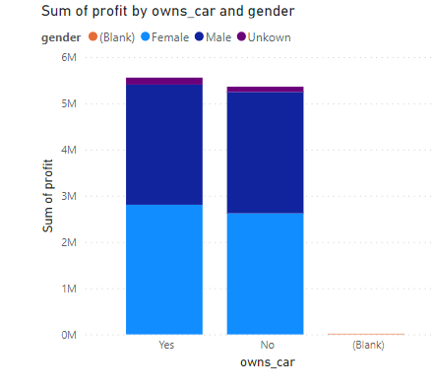
Note: The data and information in this document is reflective of a hypothetical situation and client. This document is to be used for KPMG Virtual Internship purposes only.
Data Exploration
Owning a car is not a feature that affects the profit

Slide 10
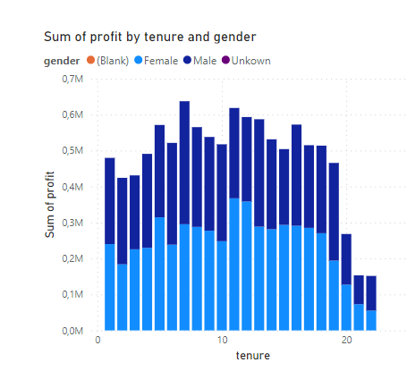
Note: The data and information in this document is reflective of a hypothetical situation and client. This document is to be used for KPMG Virtual Internship purposes only.
Data Exploration
Tenure is not a feature that affects the profit

Slide 11
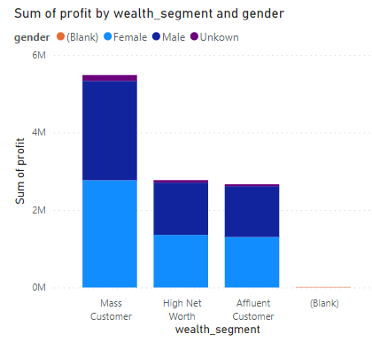
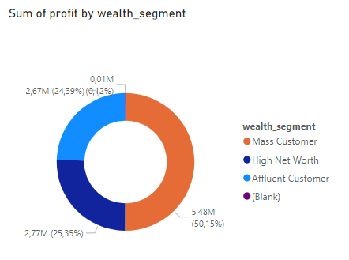
Note: The data and information in this document is reflective of a hypothetical situation and client. This document is to be used for KPMG Virtual Internship purposes only.
Data Exploration
50% of the costumers are in the "Mass Costumer" category

Slide 12
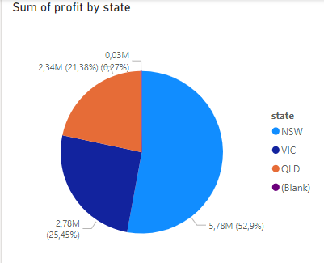
Note: The data and information in this document is reflective of a hypothetical situation and client. This document is to be used for KPMG Virtual Internship purposes only.
Data Exploration
More than 50% of the customers are from NSW

Slide 13
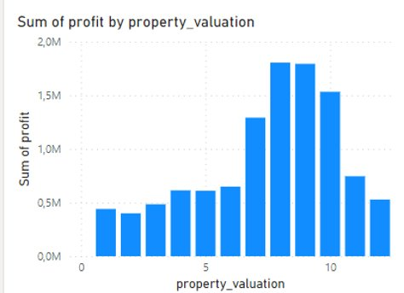
Note: The data and information in this document is reflective of a hypothetical situation and client. This document is to be used for KPMG Virtual Internship purposes only.
Data Exploration
The most frequent property valuations among the customers are 8 and 9

Slide 14
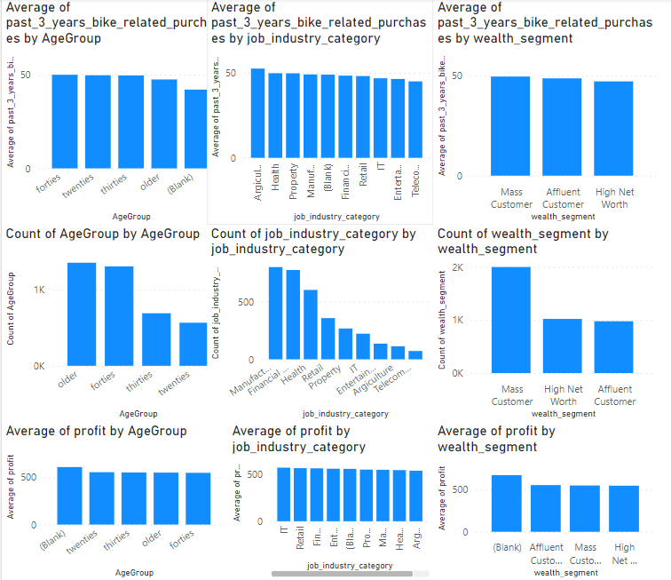
Note: The data and information in this document is reflective of a hypothetical situation and client. This document is to be used for KPMG Virtual Internship purposes only.
Model Development
There are three factors that affect the profit:
1- the number of articles bought by each customer in a category (buying behaviors of each customer category)
2- the size of each customer category
3-the profit per unit of each sold product

Slide 15
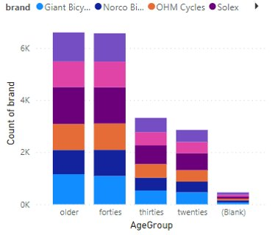
Note: The data and information in this document is reflective of a hypothetical situation and client. This document is to be used for KPMG Virtual Internship purposes only.
Model Development
The most sold and the most profitable brands are different. But this is not due to the difference of the buying behavior among the different customer categories.

Slide 16
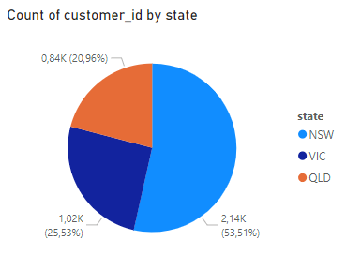
Note: The data and information in this document is reflective of a hypothetical situation and client. This document is to be used for KPMG Virtual Internship purposes only.
Interpretation
Results of the analysis:
The analysis of the data set shows that the customer buying behaviors of each category is the same in average: same average profit and same average number of purchased articles over the three last years. Therefore the only factor remaining is:
--> the size of the customer category
High value customers:
1- age: > 40
2-job industry category: manufacturing – financial services – health
3- wealth segment: mass customer
4- state: NSW
The filterd 'New_Customer' dataset contains 108 High value customer

