Slide 1


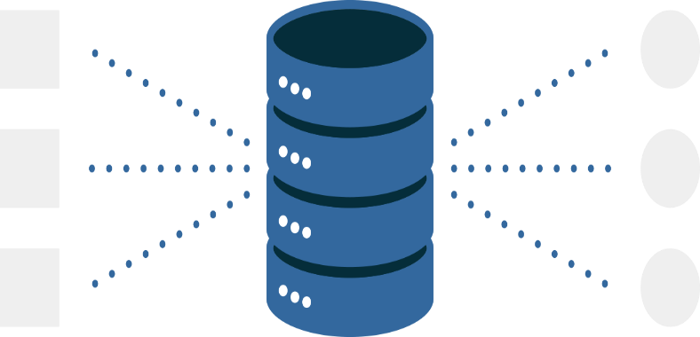




Database
ML Model
WebService
Training Data
Serialize
Deserialize
Rest API
Inputs
Outputs
home_team: ‘Tunisie’
avag_team: ‘Maroc’
home_rank: 37
avag_rank: 42
Draw: 42%
Lose: 17%
Win: 41%
Notebook
Website

