Slide 1


Lecture 3: Deep Q-Learning
Dr. MALKI Abdelhamid @: a.malki@esi-sba.dz
Ecole Supérieure d’Informatique de Sidi Bel Abbes (ESI-SBA) 2024/2025
Module IASD: Advanced Deep Learning (DRL)

Slide 2
What is Q-Learning? recap
Q-Learning is an algorithm we use to train our Q-Function, an action-value function that determines the value of being at a particular state and taking a specific action at that state.
Q-function is encoded by a Q-table, a table where each cell corresponds to a state-action pair value.
The problem is that Q-Learning is a tabular method. This becomes a problem if the states and actions spaces are not small enough to be represented efficiently by arrays and tables.
Q-Learning worked well with small state space environments like:
FrozenLake, we had 16 states.
Taxi-v3, we had 500 states.

Slide 3
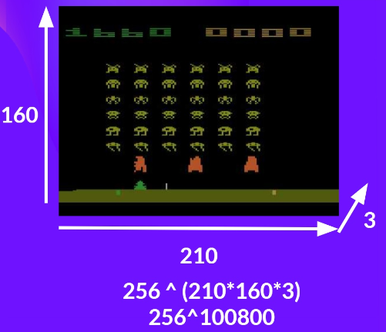
From Q-Learning to Deep Q-Learning
Atari environments have an state space with a shape of (210, 160, 3)*.
For each pixel, the value can go from 0 to 255.
➔ 256^{210×160×3}=256¹⁰⁰⁸⁰⁰ possible states

Slide 4
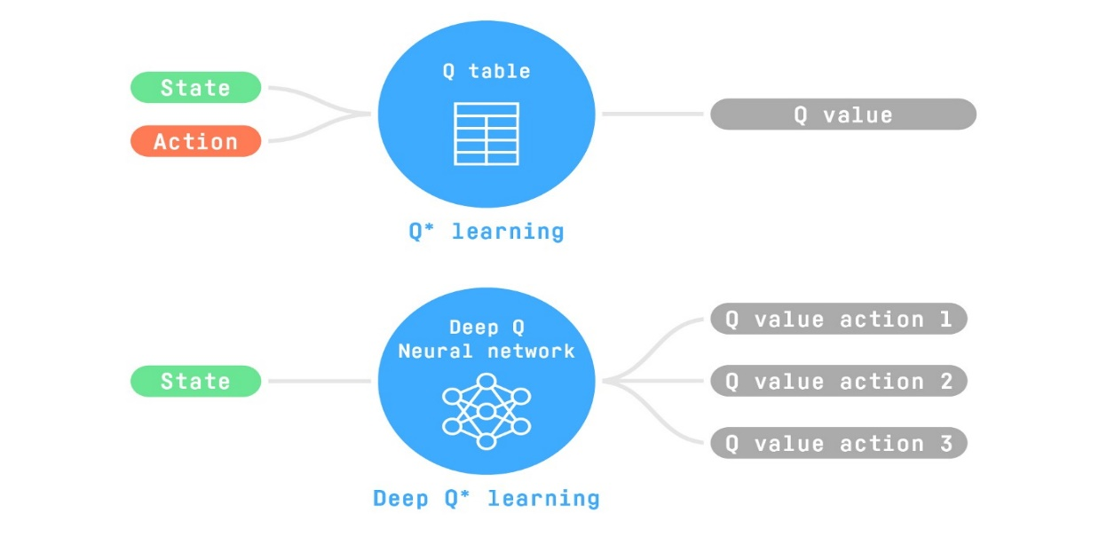

From Q-Learning to Deep Q-Learning
When the state space is gigantic, creating and updating a Q-table for that environment would not be efficient.
In this case, the best idea is to approximate the Q-values using a parametrized Q-function Q(s, a, $θ$​)$≈$ Q*​(s,a) .
This neural network will approximate, given a state, the different Q-values for each possible action at that state.

Slide 5
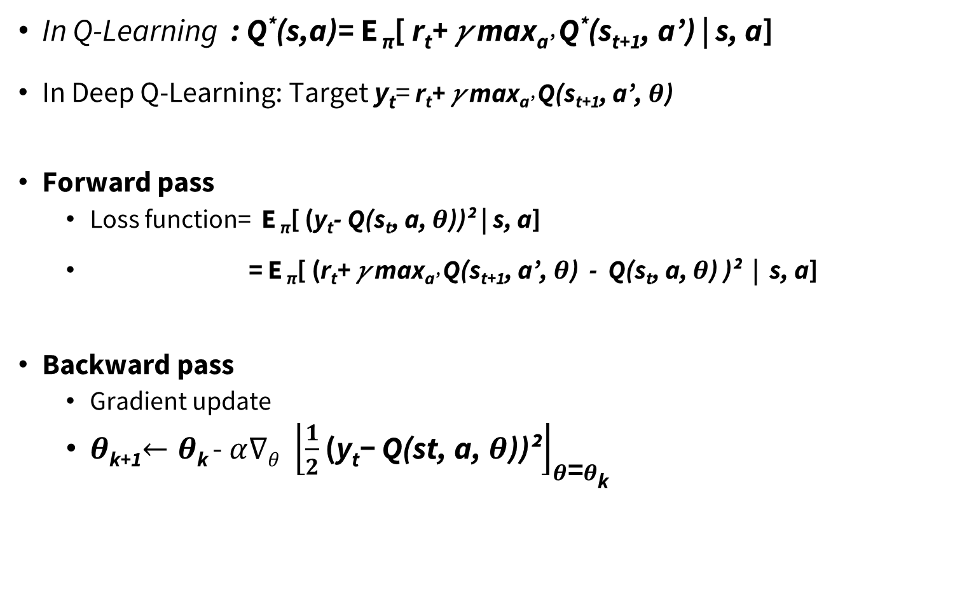
Deep Q-Learning algo
In Q-Learning : Q*(s,a)= E _{π}[ r_{t}+ 𝛾 max_{a’} Q*(s_{t+1}, a’) | s, a]
In Deep Q-Learning: Target y_{t}= r_{t}+ 𝛾 max_{a’} Q(s_{t+1}, a’, $θ$)
Forward pass
Loss function= E _{π}[ (y_{t}- Q(s_{t}, a, $θ$​))² | s, a]
= E _{π}[ (r_{t}+ 𝛾 max_{a’} Q(s_{t+1}, a’, $θ$) - Q(s_{t}, a, $θ$) )² | s, a]
Backward pass
Gradient update
$θ$_{k+1}$←$ $θ$_{k} - ${α∇θ \left\lfloor \frac{1}{2}\text{(}\text{y}\text{t}\text{− }\text{Q}\text{(}\text{st}\text{, }\text{a}\text{,} θ\text{))²}\right\rfloor }_{θ\text{=}θ\text{k}}$
target
prediction

Slide 6
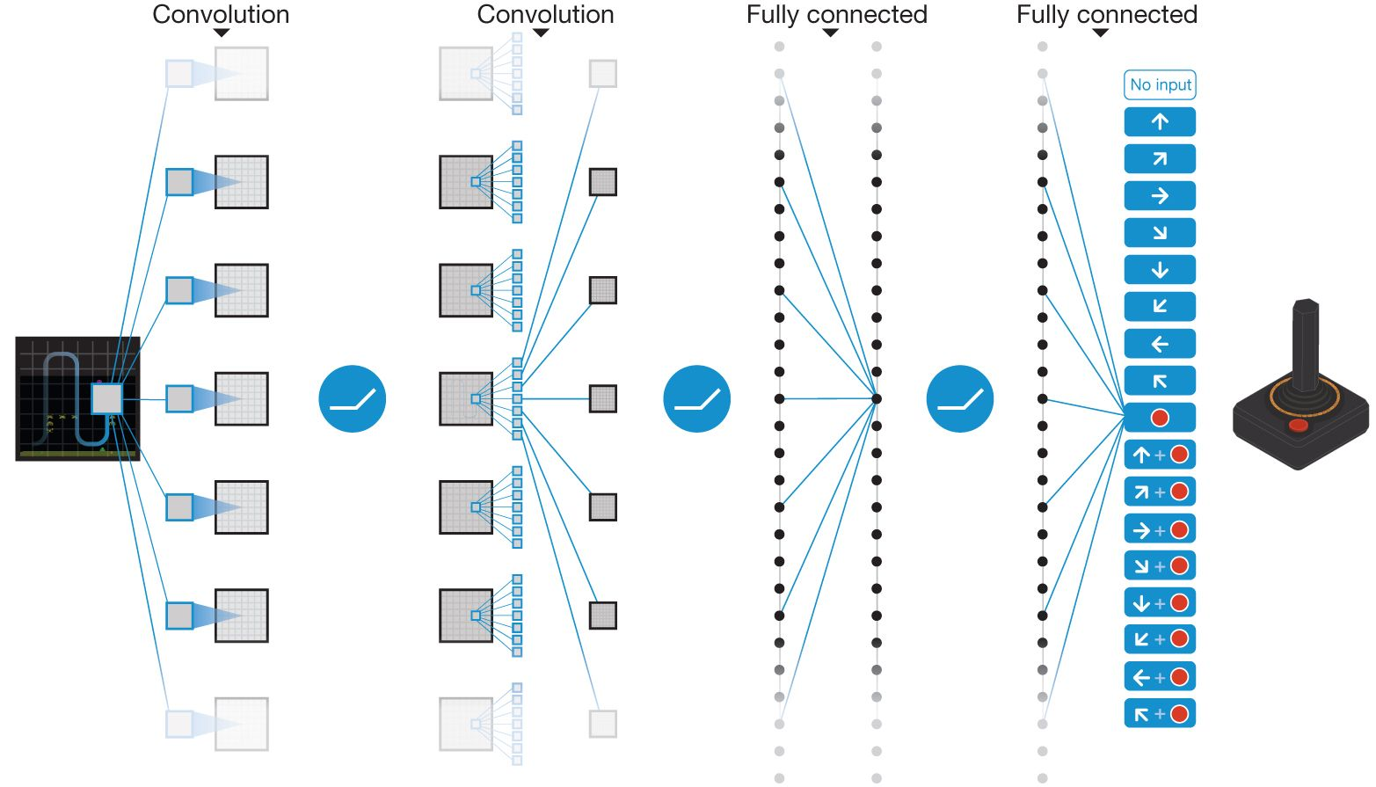
Deep Q-Learning training algo
(Mnih et Al. 2015)
https://storage.googleapis.com/deepmind-media/dqn/DQNNaturePaper.pdf

Slide 7
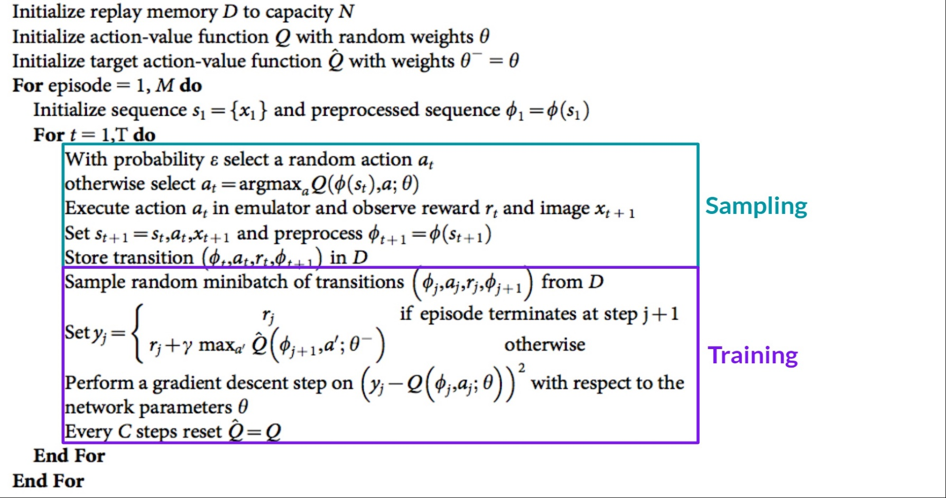
Deep Q-Learning training algo
(Mnih et Al. 2015)
Sampling: we perform actions and store the observed experience tuples in a replay memory.
Training: Select a small batch of tuples randomly and learn from this batch using a gradient descent update step.

Slide 8
Deep Q-Learning training algo
Deep Q-Learning training might suffer from instability, mainly because of combining:
a non-linear Q-value function (Neural Network)
and bootstrapping (when we update targets with existing estimates and not an actual complete return).
To stabilize the training, three different solutions are possibles:
Experience Replay to make more efficient use of experiences.
Fixed Q-Target to stabilize the training.
Double Deep Q-Learning, to handle the problem of the Over-Estimation of Q-values.

Slide 9
DQN algo: Experience Replay
Learning from batches of consecutive samples is problematic:
Samples are correlated => inefficient learning
Forgetting previous experiences
Address these problems using experience replay
Continually update a replay memory table of transitions (s_{t}, a_{t}, r_{t}, s_{t+1})
Train Q-network on random minibatches of transitions from the replay memory, instead of consecutive samples
This allows the agent to learn from the same previous experiences multiple times.
Avoid forgetting previous experiences and reduce the correlation between experiences.

Slide 10
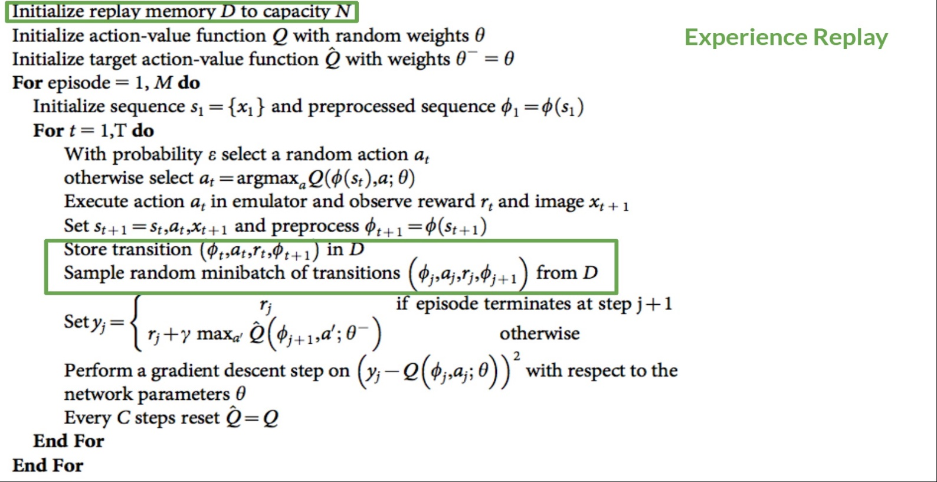
DQN algo: Experience Replay

Slide 11
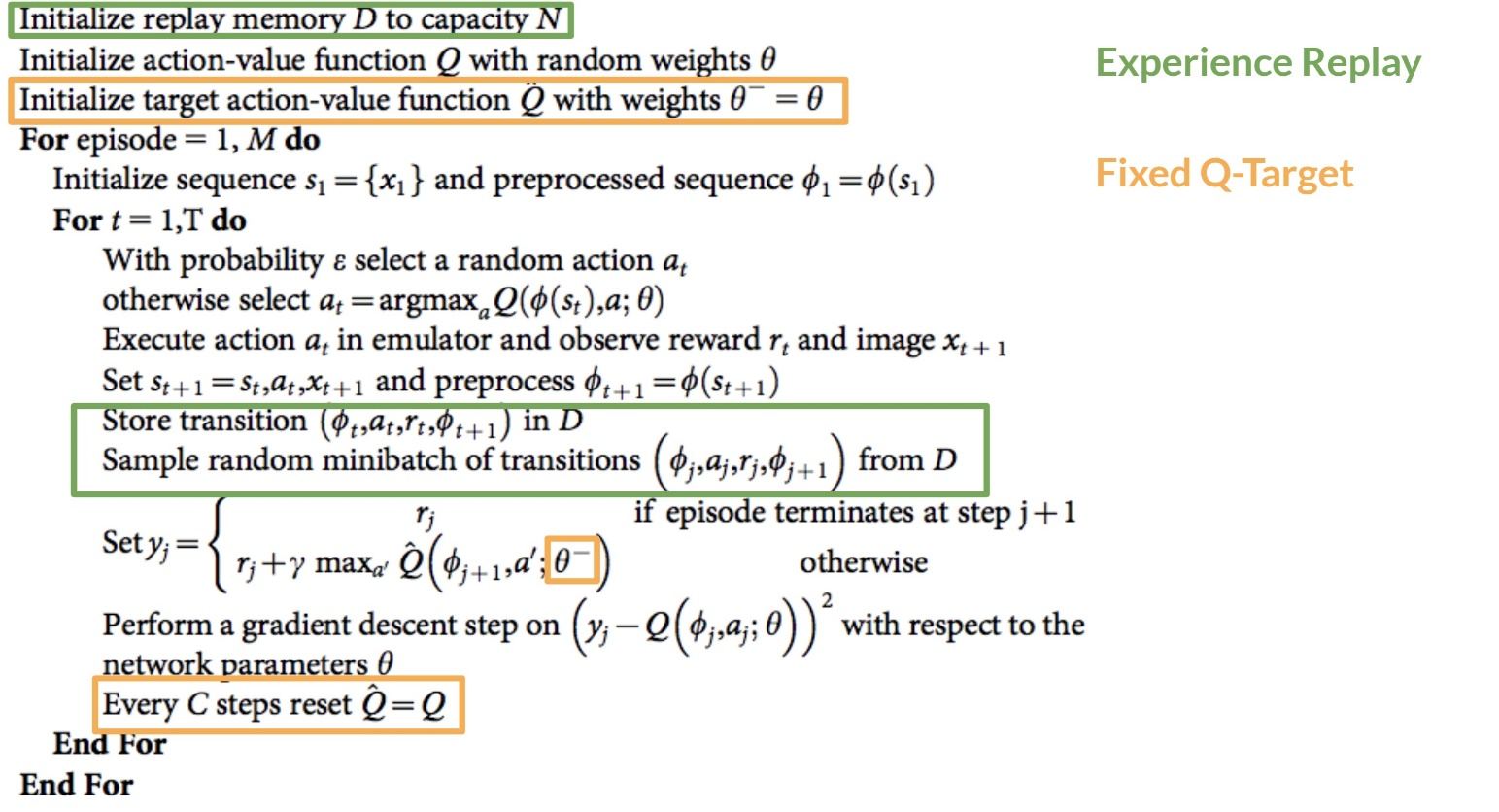

DQN algo: Fixed Target Network
To stable the training process we need two separate networks:
Use the online Q-network $Q$ for action selection ➔ Q(s_{t}, a, $θ$)
Use a separate target-network $\hat{Q}$with fixed parameters $θ^{−}$ for estimating the Target ➔ y_{t}=r_{t}+ 𝛾 max_{a’} Q (s_{t+1}, a’, $θ^{−}$)
$θ^{− }$ of $\hat{Q}$ is updated to $θ$ of $Q$ only each C.

Slide 12
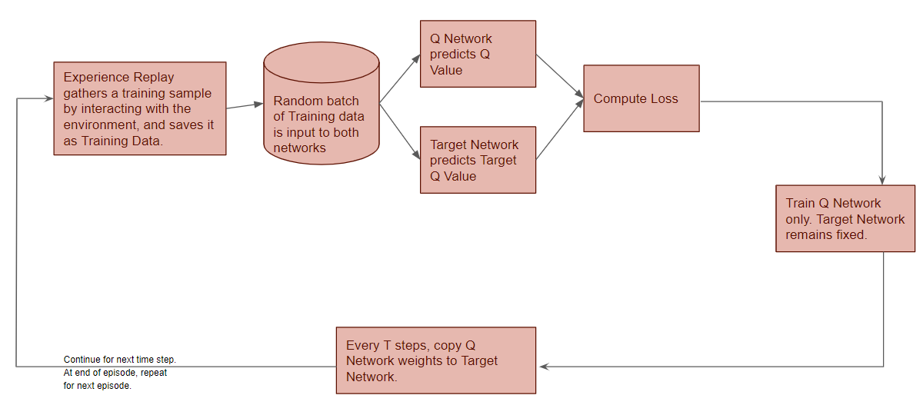
Deep Q-Learning training algo

Slide 13
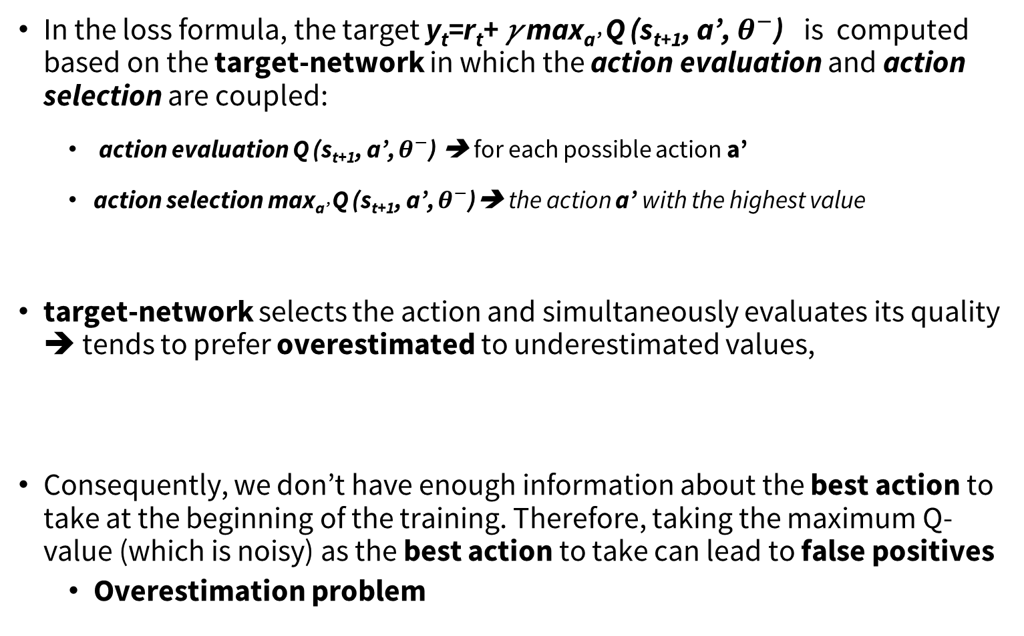
DQN algo: Double DQN
In the loss formula, the target y_{t}=r_{t}+ 𝛾 max_{a’} Q (s_{t+1}, a’, $θ^{−}$) is computed based on the target-network in which the action evaluation and action selection are coupled:
action evaluation Q (s_{t+1}, a’, $θ^{−}$) ➔ for each possible action a’
action selection max_{a’} Q (s_{t+1}, a’, $θ^{−}$)➔ the action a’ with the highest value
target-network selects the action and simultaneously evaluates its quality ➔ tends to prefer overestimated to underestimated values,
Consequently, we don’t have enough information about the best action to take at the beginning of the training. Therefore, taking the maximum Q-value (which is noisy) as the best action to take can lead to false positives
Overestimation problem

Slide 14
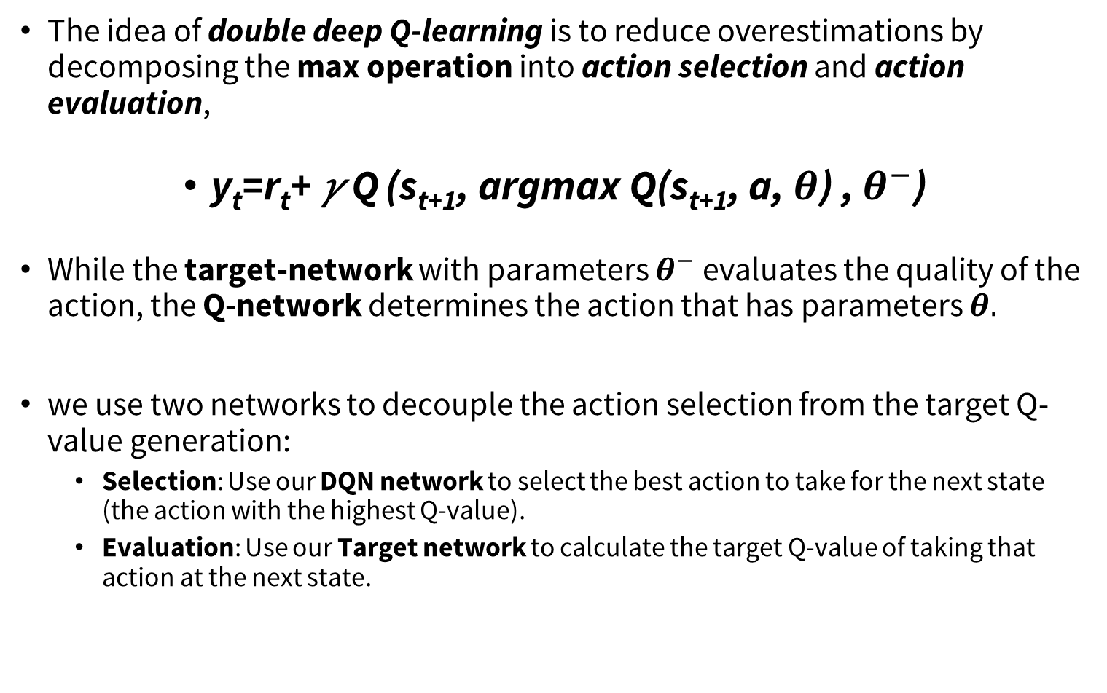
DQN algo: Double DQN
The idea of double deep Q-learning is to reduce overestimations by decomposing the max operation into action selection and action evaluation,
y_{t}=r_{t}+ 𝛾 Q (s_{t+1}, argmax Q(s_{t+1}, a, $θ$) , $θ^{−}$)
While the target-network with parameters $θ^{−}$evaluates the quality of the action, the Q-network determines the action that has parameters $θ.$
we use two networks to decouple the action selection from the target Q-value generation:
Selection: Use our DQN network to select the best action to take for the next state (the action with the highest Q-value).
Evaluation: Use our Target network to calculate the target Q-value of taking that action at the next state.

Slide 15
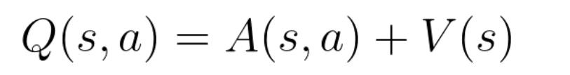
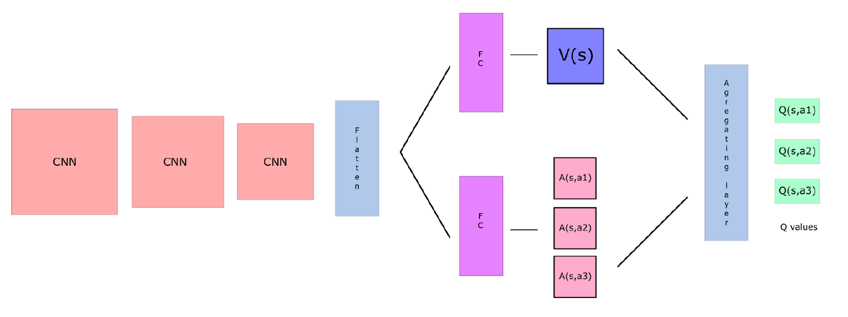
Dueling DQN (DDQN)
Decompose Q(s,a)
V(s) : the value of being at that state
A(s,a ): the advantage of taking action a in state s versus all other possible actions at that state
Use two streams:
one that estimates the state value V(s)
one that estimates the advantage for each action A(s,a)
Useful for states where action choice does not affect Q( s,a)

Slide 16
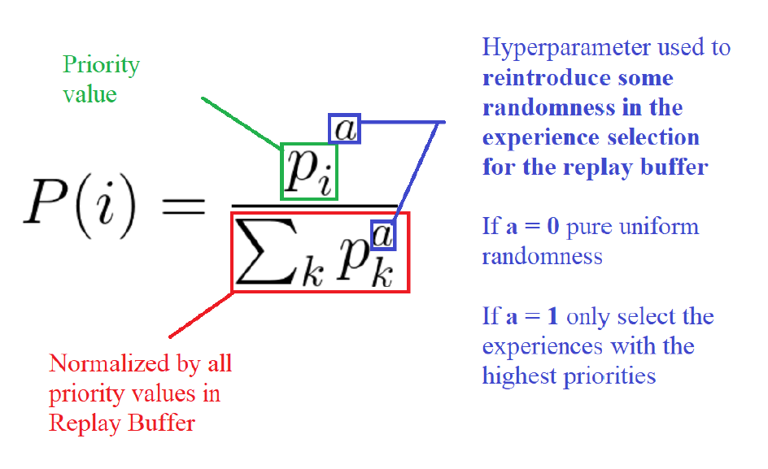
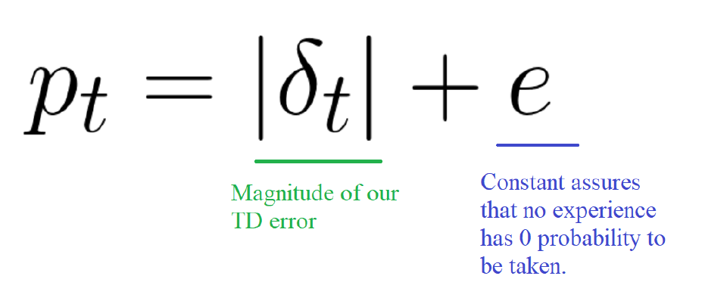
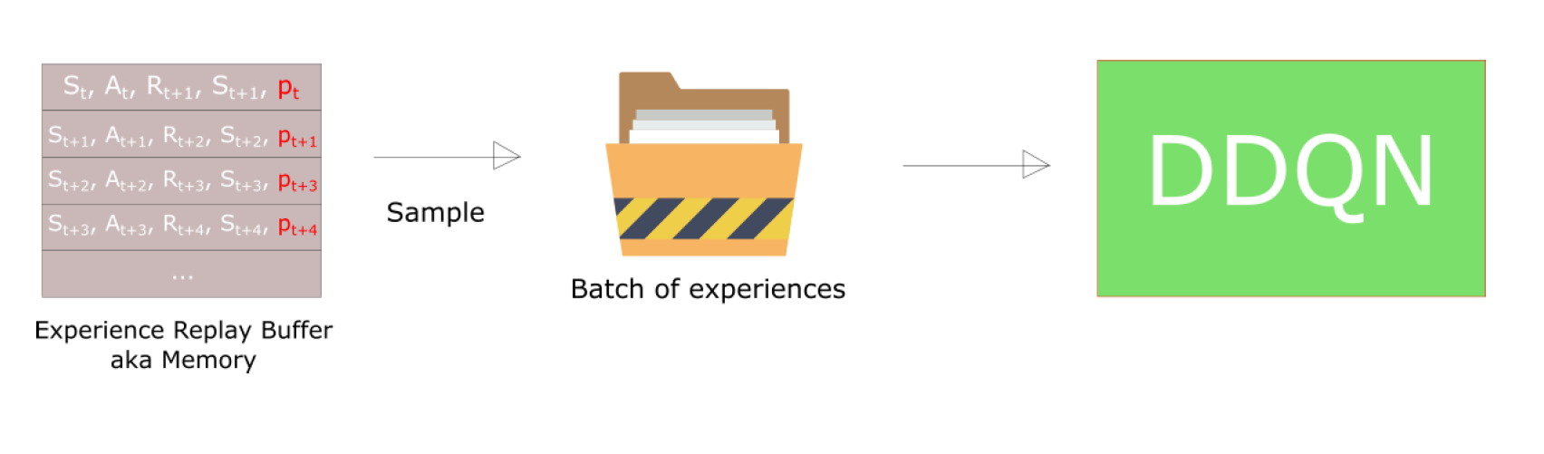
Prioritized Experience Replay
Sample experiences based on impact not frequency of occurrence

Slide 17
REF
https://huggingface.co/learn/deep-rl-course/
https://deep-reinforcement-learning.net/
Slides for the course Reinforcement Learning (Master Computer Science 2022 at Leiden University)
https://dac.lip6.fr/master/rladl/
Slides for the course Reinforcement Learning and advanced Deep Learning (Master Data Science Paris – DAC – SU 2023)
https://deeplearning.mit.edu
Introduction to Deep Reinforcement Learning

