Slide 1


Lecture 4: Policy Gradient
Dr. MALKI Abdelhamid @: a.malki@esi-sba.dz
Ecole Supérieure d’Informatique de Sidi Bel Abbes (ESI-SBA) 2024/2025
Module IASD: Advanced Deep Learning (DRL)

Slide 2
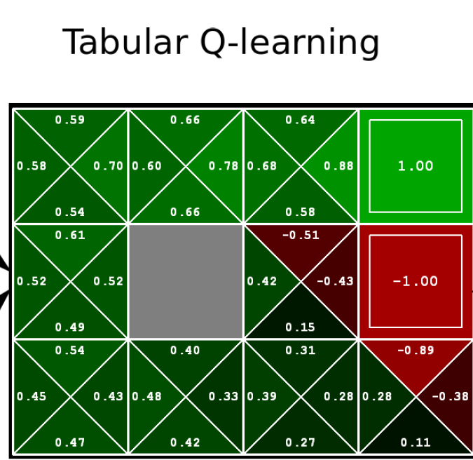
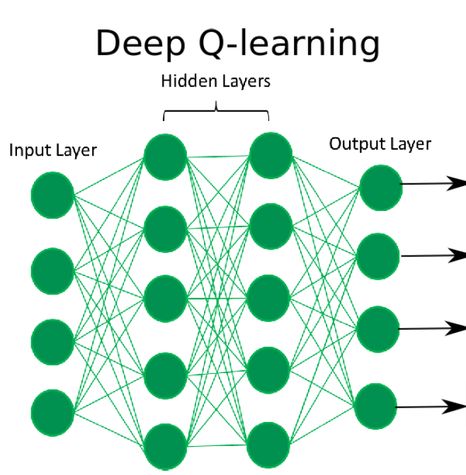


Introduction: value-based
In value Based method, we approximated parametric value functions, where a policy can be generated from these values
Greedy➔ select the action with the highest value given a state
$$a={argmax}_{a}Q(s,a)$$
$$a={argmax}_{a}\hat{Q}(s,a|θ)$$
action a1
state s
action a2
state s
action a
action a3
action a4

Slide 3
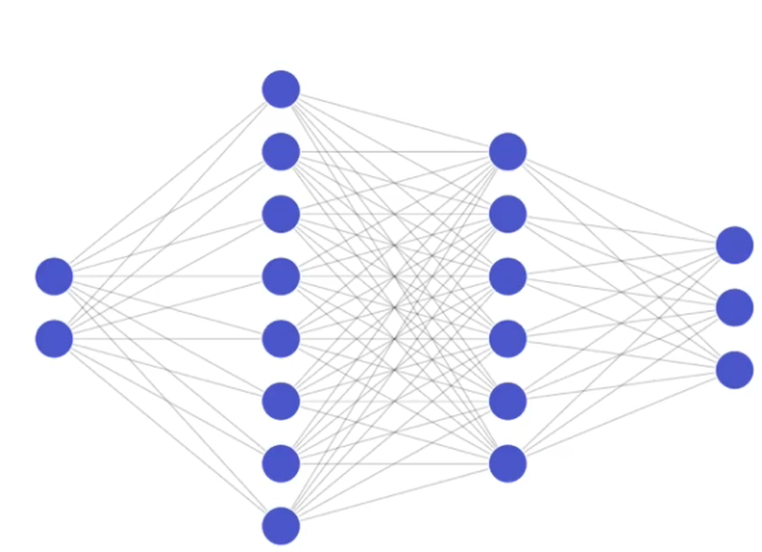
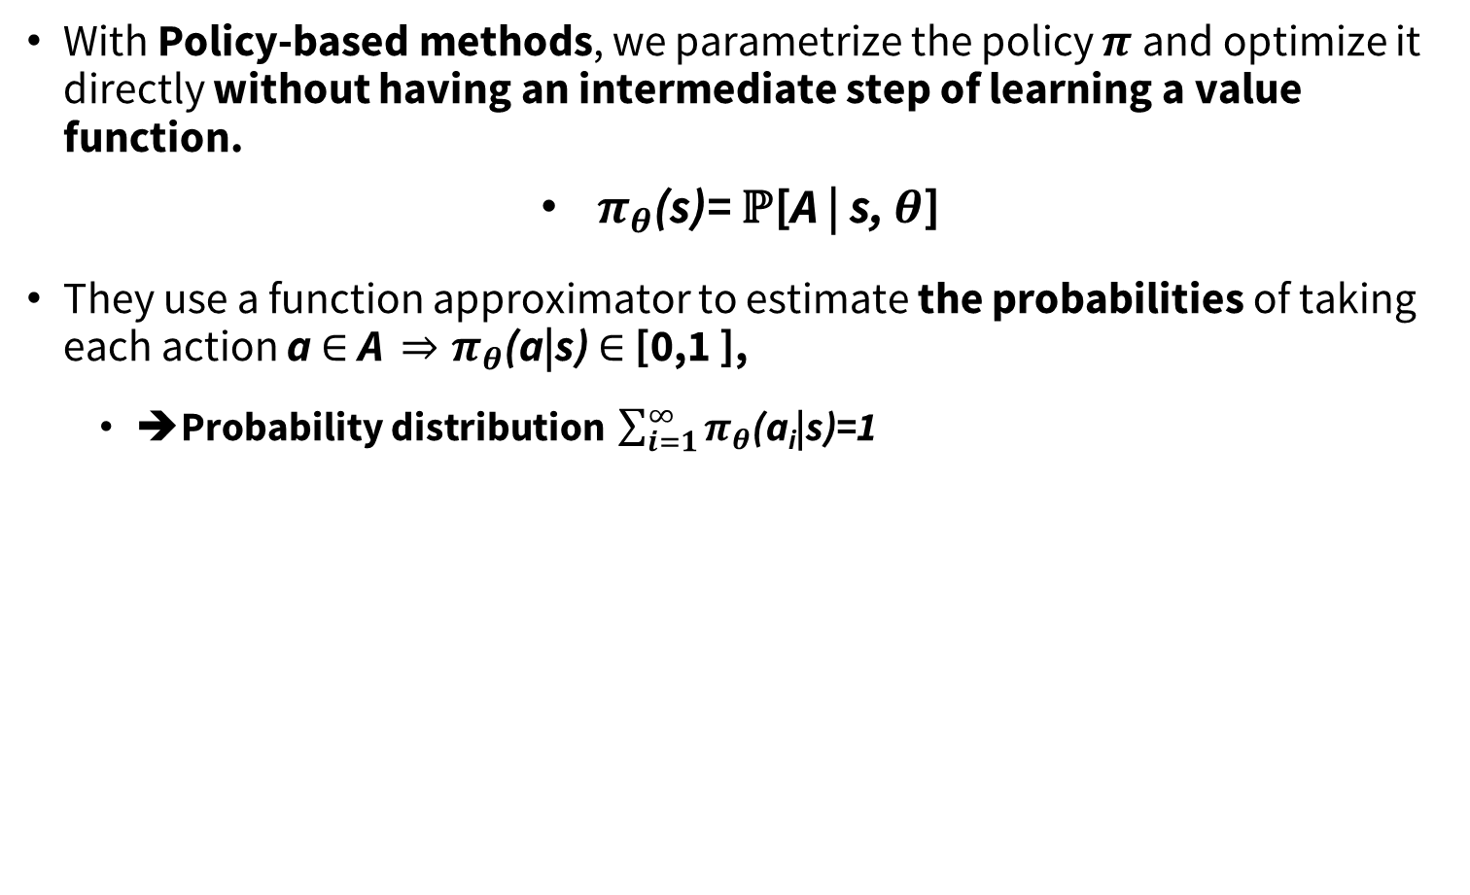

Introduction: Policy-based
With Policy-based methods, we parametrize the policy $π$and optimize it directly without having an intermediate step of learning a value function.
$π_{θ}$(s)= $\text{ℙ}\text{[}\text{A}\text{ | }\text{s}\text{, }θ\text{]}$
They use a function approximator to estimate the probabilities of taking each action a $∈$A $⇒π_{θ}$(a|s) $∈$ [0,1 ],
➔Probability distribution $\sum_{i=1}^{∞}{π_{θ}\text{(}\text{a}\text{i}\text{|}\text{s}\text{)}}$=1
The neural network is the Policy
Output:
$π_{θ}$(s)=$\left[\begin{matrix}\text{p}\text{(}\text{a}\text{1}\text{)} \\ \text{p}\text{(}\text{a}\text{2}\text{)} \\ \text{p}\text{(}\text{a}\text{3}\text{)}\end{matrix}\right]$
Input:
S=[s₁, s₂]

Slide 4
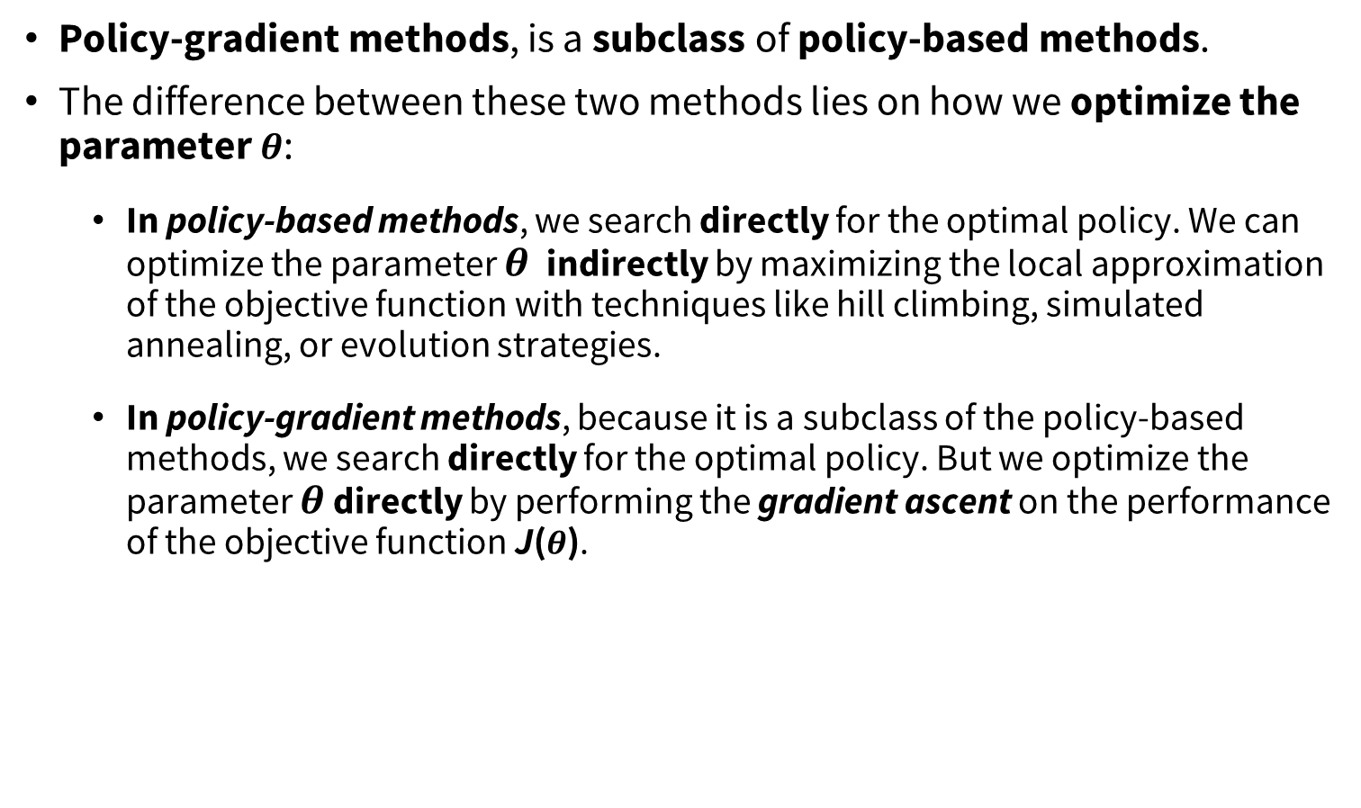
policy-based vs policy-gradient methods
Policy-gradient methods, is a subclass of policy-based methods.
The difference between these two methods lies on how we optimize the parameter $θ$:
In policy-based methods, we search directly for the optimal policy. We can optimize the parameter $θ$ indirectly by maximizing the local approximation of the objective function with techniques like hill climbing, simulated annealing, or evolution strategies.
In policy-gradient methods, because it is a subclass of the policy-based methods, we search directly for the optimal policy. But we optimize the parameter $θ$ directly by performing the gradient ascent on the performance of the objective function J($θ$).

Slide 5
Advantages
True objective and the simplicity of integration:
We can estimate the policy directly without storing additional data (action values).
Easy extended to high-dimensional or continuous action spaces
Sometimes policies are simple while values and models are complex
E.g., complicated dynamics, but optimal policy is always “move forward”

Slide 6
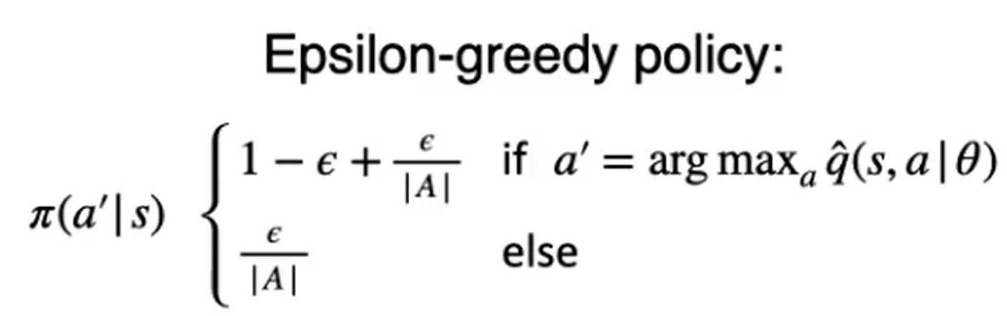
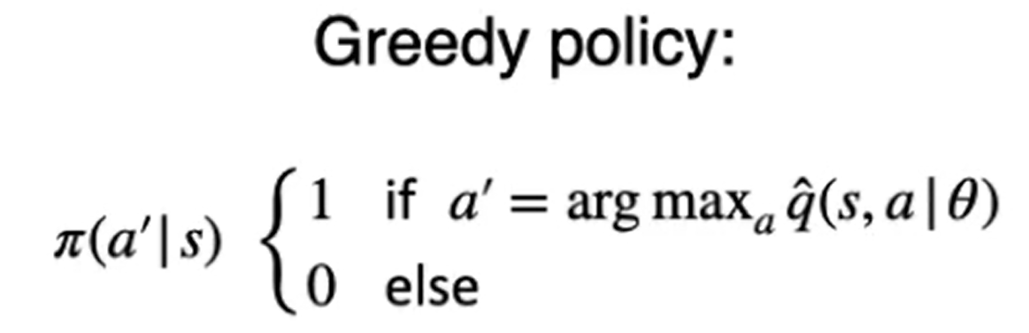
Advantages
Policy-gradient methods can easily learn stochastic policies
Value-based methods are deterministic and cannot represent stochastic policies in a simple way:

Slide 7
Stochastic policies
Why could we need stochastic policies?
In MDPs, there is always an optimal deterministic policy
But, most problems are not fully observable
This is the common case, especially with function approximation
The optimal policy may then be stochastic
Provides some ‘exploration’ during learning

Slide 8
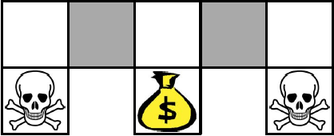
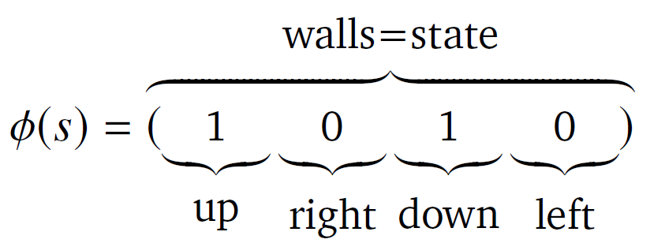
deterministic vs stochastic policy
The grey states look the same
Consider features:
Compare deterministic and stochastic policies

Slide 9
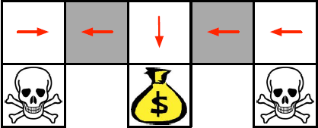
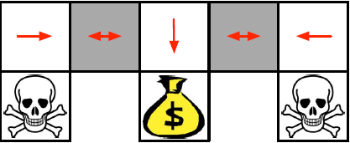

deterministic vs stochastic policy
Under a deterministic policy, the policy will either always move right when in a grey state or always move left.
➔ Either way, it can get stuck and never reach the money
Under a value-based Reinforcement learning algorithm, we learn a quasi-deterministic policy (“greedy epsilon strategy”). Consequently, our agent can spend a lot of time before reaching the goal.
On the other hand, an optimal stochastic policy will randomly move left or right in grey states. Consequently, it will not be stuck and will reach the goal state in a few steps with a high probability

Slide 10
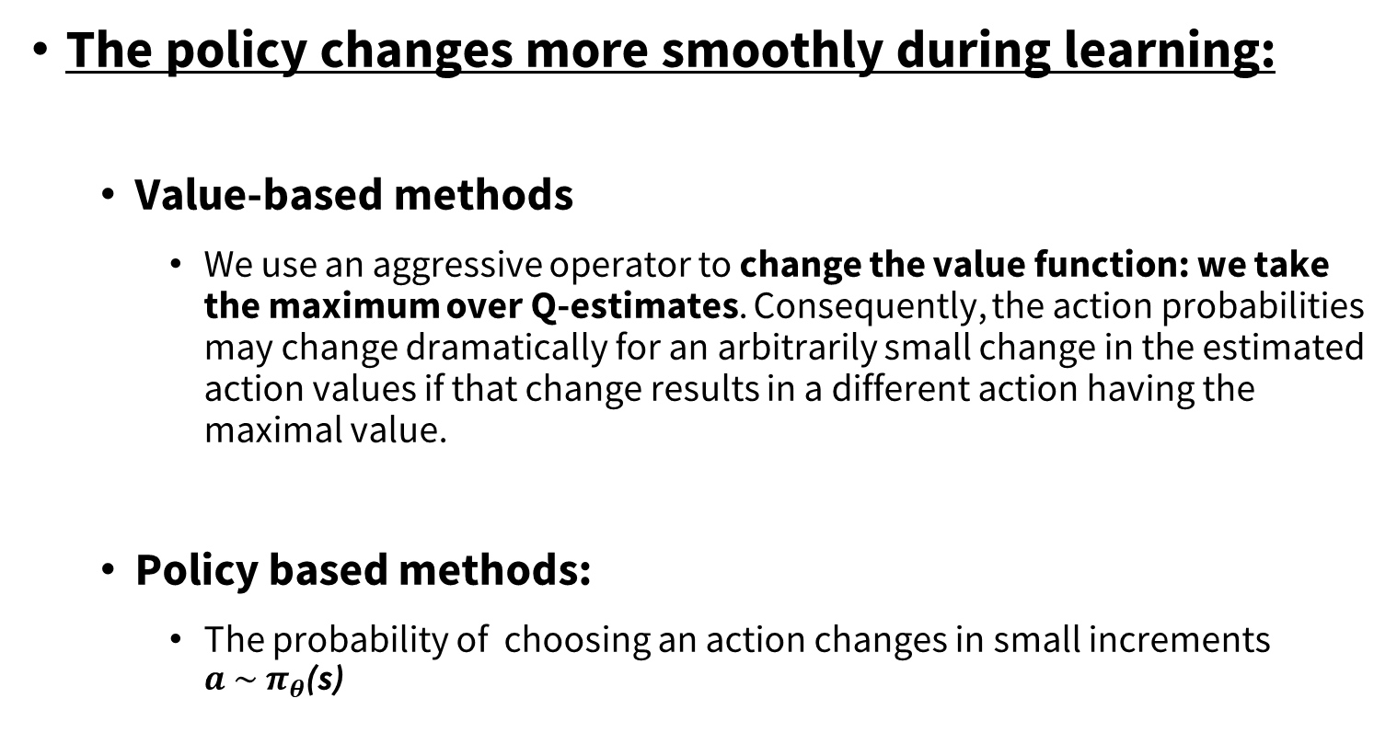
Advantages
The policy changes more smoothly during learning:
Value-based methods
We use an aggressive operator to change the value function: we take the maximum over Q-estimates. Consequently, the action probabilities may change dramatically for an arbitrarily small change in the estimated action values if that change results in a different action having the maximal value.
Policy based methods:
The probability of choosing an action changes in small increments ${a \sim π}_{θ}$(s)

Slide 11
Disadvantages:
Frequently, policy-gradient methods converges to a local maximum(suboptimal solutions ) instead of a global optimum.
In some cases, the initial policy can be in a region of the policy space that traps the algorithm in a local optimum
Policy-gradient goes slower, step by step: it can take longer to train (inefficient).
Policy-gradient can have high variance

Slide 12
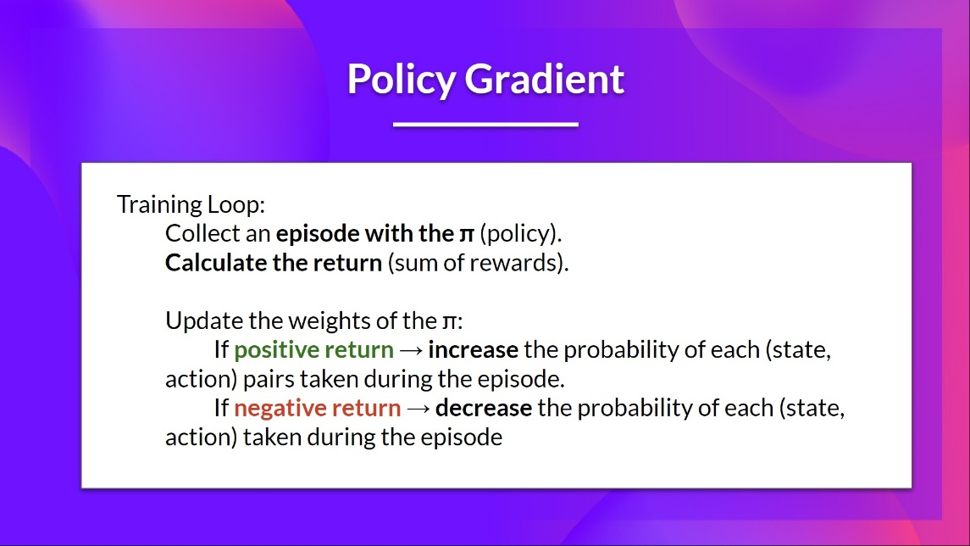

Policy Objective Function
We have our stochastic policy π which has a parameter $θ$. This π, given a state, outputs a probability distribution of actions.
$π_{θ}$(s)= $\text{ℙ}\text{[}\text{A}\text{ | }\text{s}\text{, }θ\text{]}$
Where $π_{θ}$(a_{t}|s_{t}) is the probability of the agent selecting action a_{t}​ from state s_{t}​ given our policy π.
But how do we know if our policy is good? We need to have a way to measure it. To know that, we define a score/objective function called $J(θ)$

Slide 13
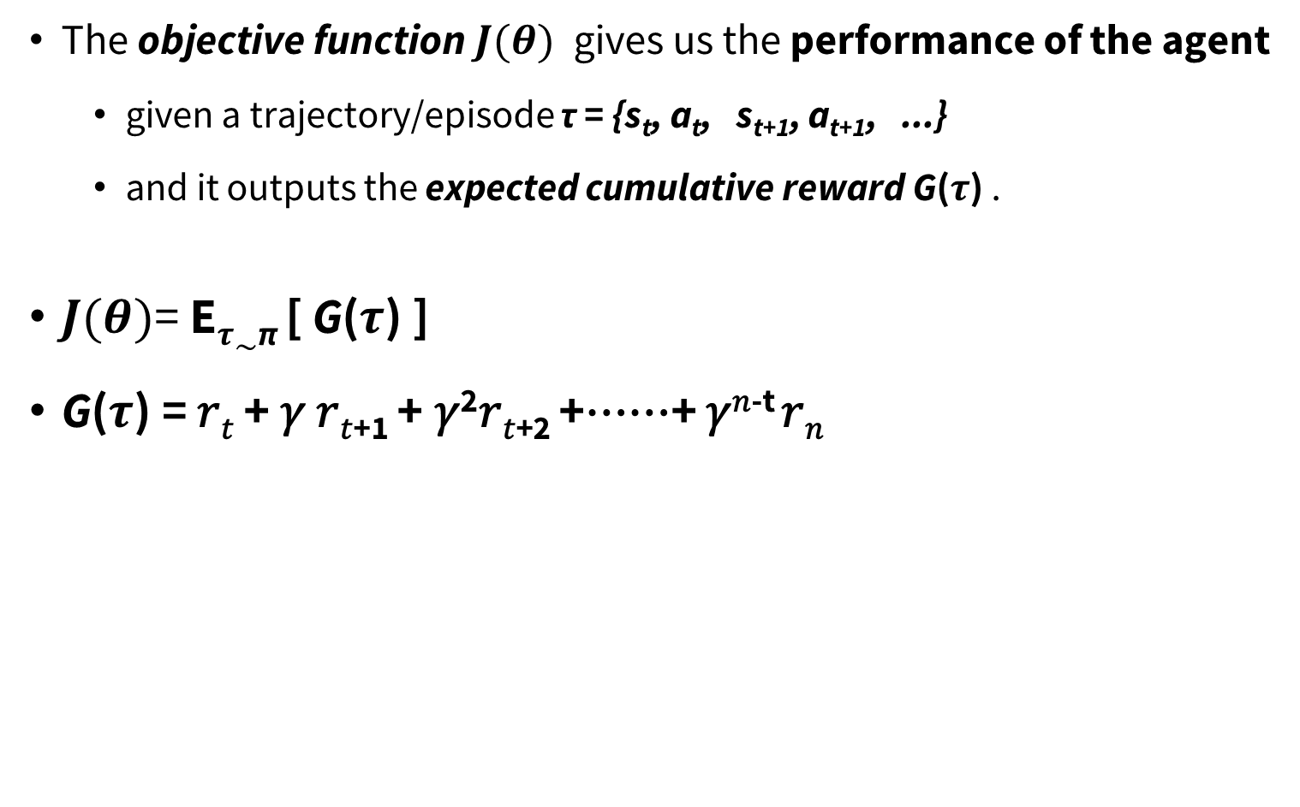
Policy Objective Function
The objective function $J(θ)$ gives us the performance of the agent
given a trajectory/episode τ = {s_{t}, a_{t}, s_{t+1}, a_{t+1}, ...}
and it outputs the expected cumulative reward G($τ$) .
$J(θ)$= E$τ\sim$_{π} [ G($τ$) ]
G($τ$) = 𝑟_{𝑡} + 𝛾 𝑟_{𝑡+1} + 𝛾²𝑟_{𝑡+2} +⋯⋯+ 𝛾^{𝑛-t} 𝑟_{𝑛}

Slide 14
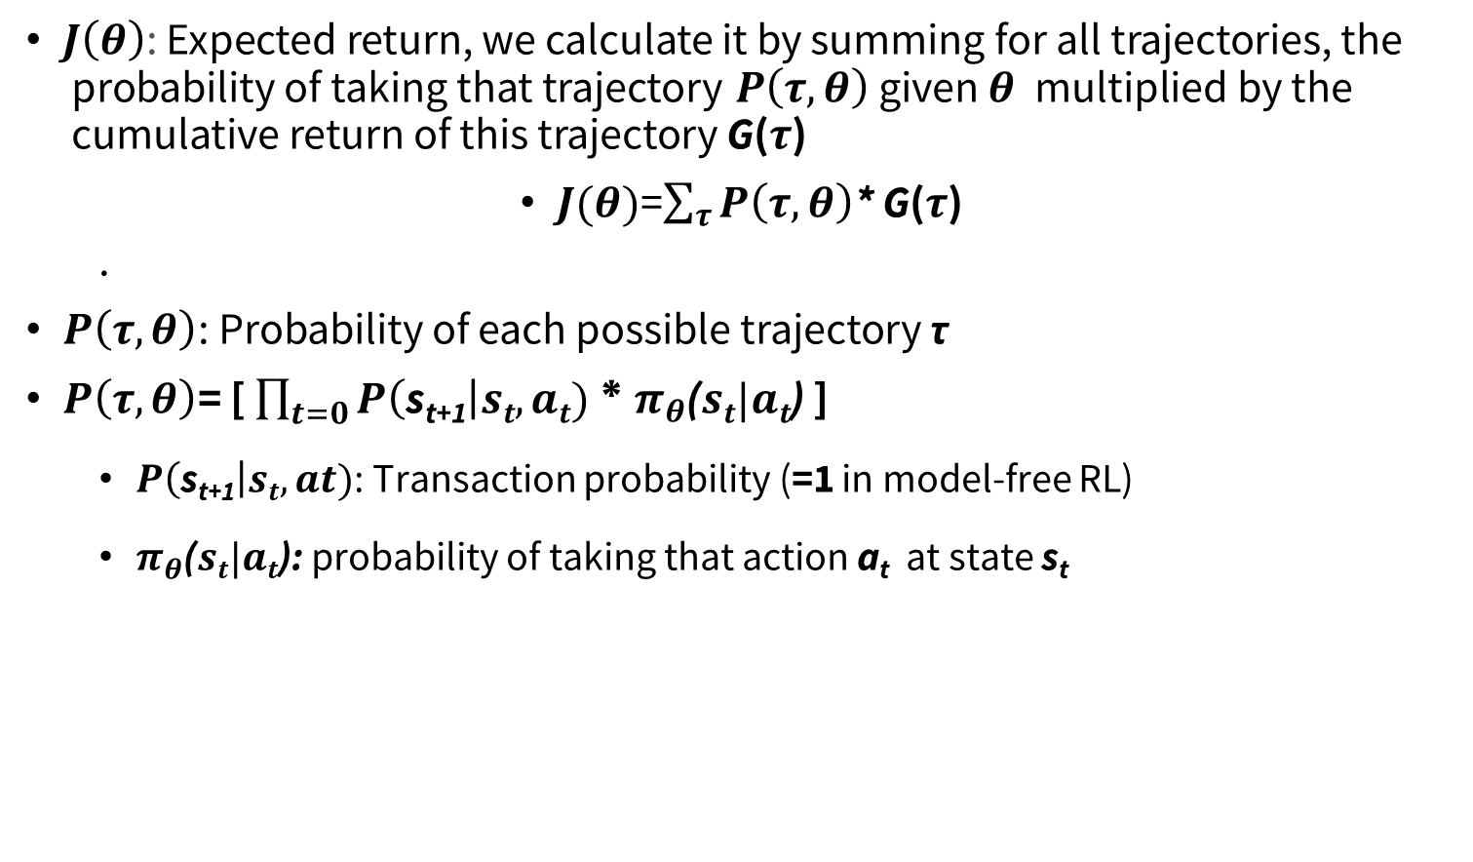
Policy Objective Function
$J\left(θ\right)\text{: }\text{Expected} \text{return}\text{, }\text{we} \text{calculate} \text{it} \text{by} \text{summing} \text{for} \text{all} \text{trajectories}\text{, }\text{the} \text{probability} \text{of} \text{taking} \text{that} \text{trajectory} P\left(τ,θ\right) \text{given} θ \text{multiplied} \text{by} \text{the} \text{cumulative} \text{return} \text{of} \text{this} \text{trajectory} \text{G}\text{(}τ\text{)}$
$J(θ)$=$\sum_{τ}{P\left(τ,θ\right)}$* G($τ$)
.
$P\left(τ,θ\right)$: $\text{Probability} \text{of} \text{each} \text{possible} \text{trajectory} \text{τ}$
$P\left(τ,θ\right)$= [ $\prod_{t=0}{P\left(\text{s}\text{t}\text{+}\text{1}\right|st,at)}$ * $π_{θ}$($st|at$) ]
$P\left(\text{s}\text{t}\text{+}\text{1}\right|st,at)$: Transaction probability (=1 in model-free RL)
$π_{θ}$($st|at$): probability of taking that action a_{t} at state s_{t}

Slide 15
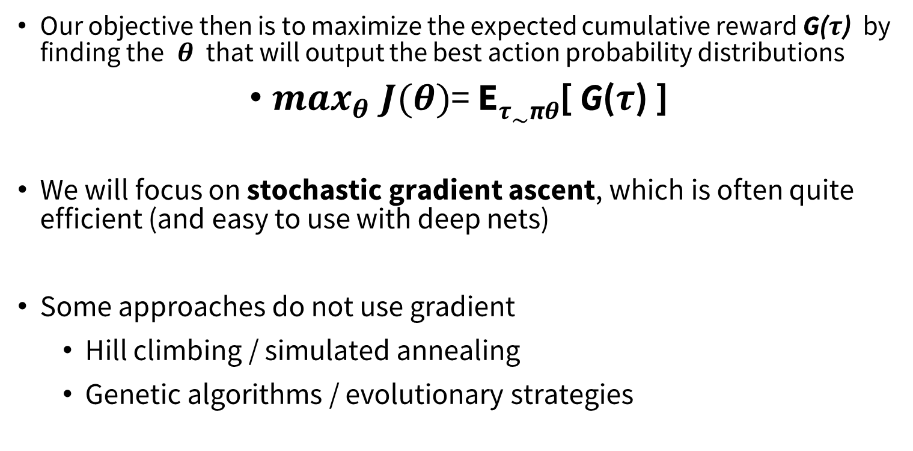
Policy Optimization
Our objective then is to maximize the expected cumulative reward G($τ$) by finding the $θ$ that will output the best action probability distributions
$\max_{θ}$ $J(θ)$= E$τ\sim$_{π}$θ$[ G($τ$) ]
We will focus on stochastic gradient ascent, which is often quite efficient (and easy to use with deep nets)
Some approaches do not use gradient
Hill climbing / simulated annealing
Genetic algorithms / evolutionary strategies

Slide 16
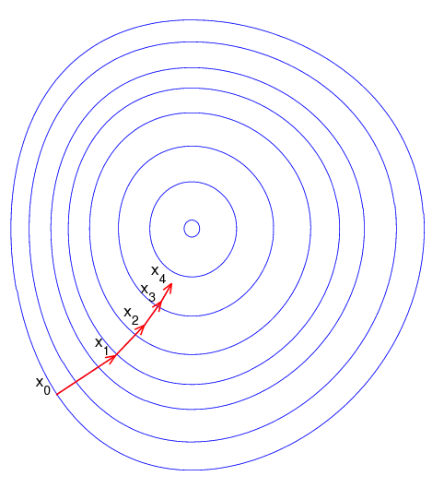
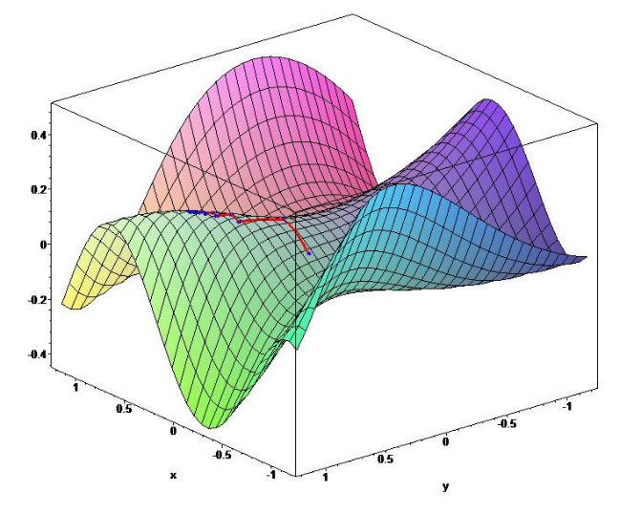

Policy Gradient
Idea: ascent the gradient of the objetive $J(θ)$
$∆θ=α∇_{θ} J(θ)$
$θ ←θ+α∇_{θ} J(θ)$
Where${ ∇}_{θ}J(θ)$ is the policy gradient
And $α$ is a step-size parameter
Stochastic policies help ensure $J(θ)$ is smooth

Slide 17
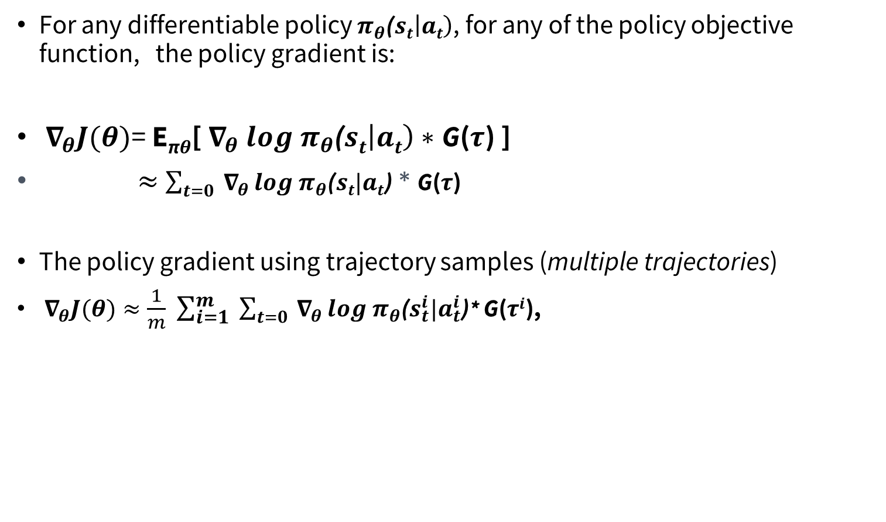
Policy Gradient Theorem
For any differentiable policy $π_{θ}\text{(}st\left|at\right)$, for any of the policy objective function, the policy gradient is:
${ ∇}_{θ}J(θ)$= E_{π}$θ$[${ ∇}_{θ} log π_{θ}\text{(}st\left|at\right)∗$G($τ$) ]
$≈$ $\sum_{t=0}{{ ∇}_{θ }log π_{θ}\text{(}st|at\text{)}}$ * G($τ$)
The policy gradient using trajectory samples (multiple trajectories)
${ ∇}_{θ}J(θ)≈\frac{1}{m} \sum_{i=1}^{m}{ \sum_{t=0}{{ ∇}_{θ }log{ π}_{θ}\text{(}s_{t}^{i}|a_{t}^{i}\text{)}}}$* G($τi$),

Slide 18
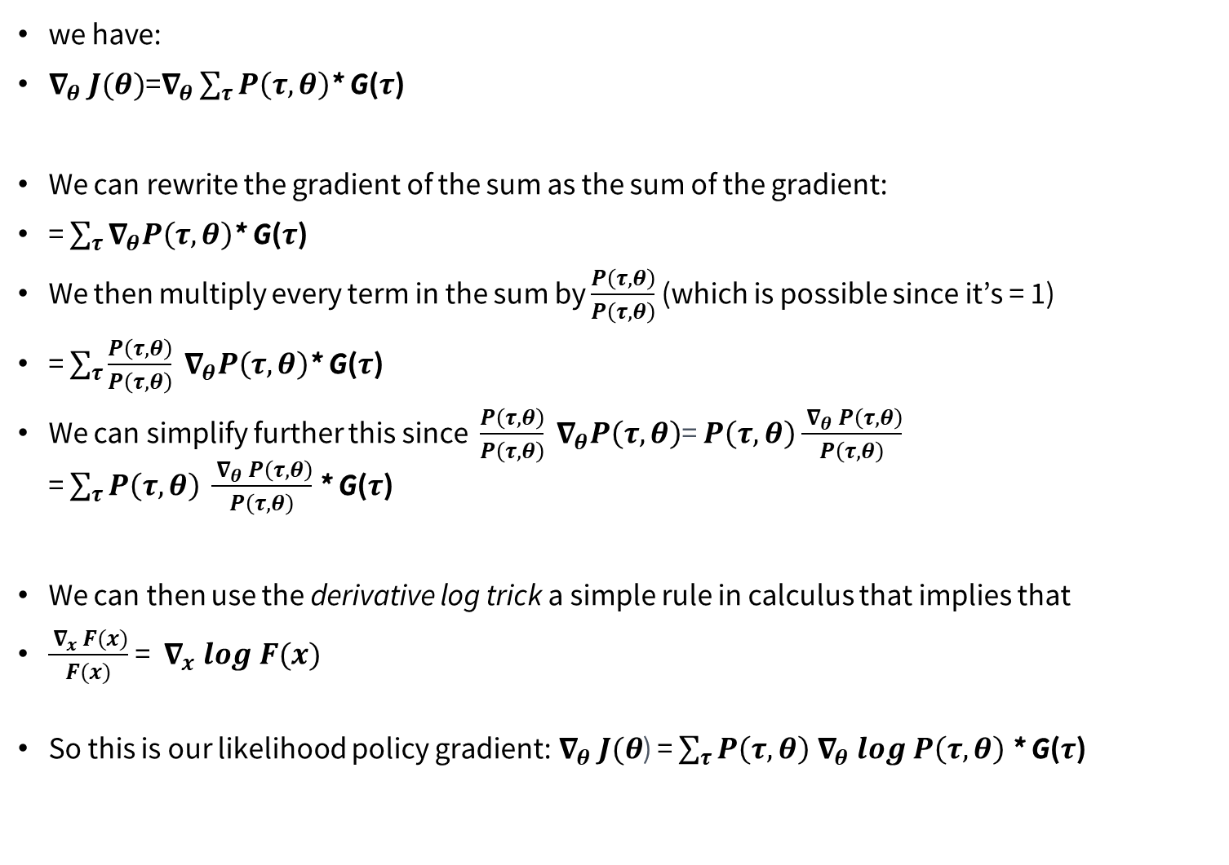
Policy Gradient Theorem : proof
$\text{we} \text{have}\text{:}$
$∇_{θ} J(θ)$=$∇_{θ}\sum_{τ}{P\left(τ,θ\right)}$* G($τ$)
We can rewrite the gradient of the sum as the sum of the gradient:
= $\sum_{τ}{∇_{θ}P\left(τ,θ\right)}$* G($τ$)
We then multiply every term in the sum by $\frac{P\left(τ,θ\right)}{P\left(τ,θ\right)}$ ​(which is possible since it’s = 1)
= $\sum_{τ}{{\frac{P\left(τ,θ\right)}{P\left(τ,θ\right)} ∇}_{θ}P\left(τ,θ\right)}$* G($τ$)
We can simplify further this since $\frac{P\left(τ,θ\right)}{P\left(τ,θ\right)}{ ∇}_{θ}P\left(τ,θ\right)$= $P\left(τ,θ\right)$ $\frac{{ ∇}_{θ} P\left(τ,θ\right)}{P\left(τ,θ\right)}$ = $\sum_{τ}{P\left(τ,θ\right) \frac{{ ∇}_{θ} P\left(τ,θ\right)}{P\left(τ,θ\right)}}$ * G($τ$)
We can then use the derivative log trick a simple rule in calculus that implies that
$\frac{{ ∇}_{x} F(x)}{F(x)}$ = ${ ∇}_{x} log F(x)$
So this is our likelihood policy gradient:$∇_{θ} J(θ$) = $\sum_{τ}{P\left(τ,θ\right){ ∇}_{θ} log P\left(τ,θ\right)}$ * G($τ$)

Slide 19
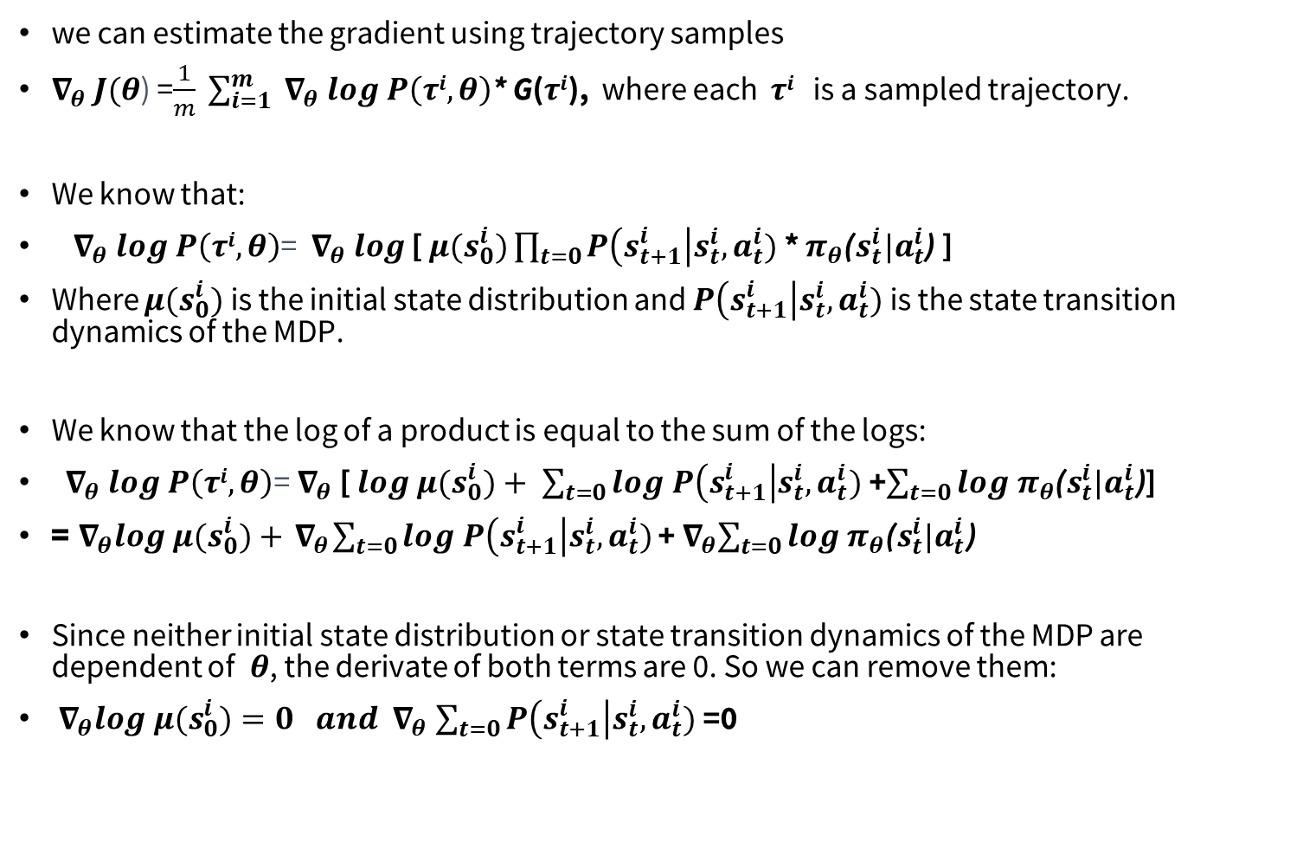
Policy Gradient Theorem : proof
we can estimate the gradient using trajectory samples
$∇_{θ} J(θ$) =$\frac{1}{m} \sum_{i=1}^{m}{{ ∇}_{θ} log P\left(τi,θ\right)}$* G($τi$), where each $τi$ is a sampled trajectory.
We know that:
${ ∇}_{θ} log P\left(τi,θ\right)$= ${ ∇}_{θ} log$ [ $μ(s_{0}^{i})\prod_{t=0}{P\left(s_{t+1}^{i}\right|s_{t}^{i},a_{t}^{i})}$ * $π_{θ}$($s_{t}^{i}|a_{t}^{i}$) ]
Where $μ(s_{0}^{i})$ is the initial state distribution and $P\left(s_{t+1}^{i}\right|s_{t}^{i},a_{t}^{i})$ is the state transition dynamics of the MDP.
We know that the log of a product is equal to the sum of the logs:
${ ∇}_{θ} log P\left(τi,θ\right)$=${ ∇}_{θ}$[ $log μ(s_{0}^{i})+ \sum_{t=0}{log P\left(s_{t+1}^{i}\right|s_{t}^{i},a_{t}^{i})}$ +$\sum_{t=0}{log{ π}_{θ}\text{(}s_{t}^{i}|a_{t}^{i}\text{)}}$]
=${ ∇}_{θ}log μ(s_{0}^{i})+{ ∇}_{θ}\sum_{t=0}{log P\left(s_{t+1}^{i}\right|s_{t}^{i},a_{t}^{i})}$ +${ ∇}_{θ}\sum_{t=0}{log π_{θ}\text{(}s_{t}^{i}|a_{t}^{i}\text{)}}$
Since neither initial state distribution or state transition dynamics of the MDP are dependent of $θ$, the derivate of both terms are 0. So we can remove them:
${ ∇}_{θ}log μ(s_{0}^{i}){=0 and ∇}_{θ}\sum_{t=0}{P\left(s_{t+1}^{i}\right|s_{t}^{i},a_{t}^{i})}$ =0

Slide 20

Policy Gradient Theorem : proof
We can rewrite the gradient of the sum as the sum of gradients:
${ ∇}_{θ} log P\left(τi,θ\right)$=$\sum_{t=0}{{ ∇}_{θ} log{ π}_{θ}\text{(}s_{t}^{i}|a_{t}^{i}\text{)}}$
So, the final formula for estimating the policy gradient is:
$∇_{θ} J(θ$) = $\frac{1}{m} \sum_{i=1}^{m}{ \sum_{t=0}{{ ∇}_{θ }log π_{θ}\text{(}s_{t}^{i}|a_{t}^{i}\text{)}}}$* G($τi$),

Slide 21


Reinforce algorithm
The Reinforce algorithm, also called Monte-Carlo policy-gradient, is a policy-gradient algorithm that uses an estimated return from an entire episode to update the policy parameter $θ$:
Algorithm REINFORCE
Initialize $θ$ arbitrarily
For episode in 1..N do
Use the policy $π_{θ}$ to collet a trajectory $τ$ = {s₀, a₀, r₀ ,…, s_{t}, a_{t}, r_{t}, ...}
For t from T-1 to 0:
G$t$=$\sum_{k=t}^{T−1}{{ y}^{k−t}}$ r_{k}
Estimate the gradient$∇_{θ}J(θ$)= $\sum_{t=0}^{T−1}{{ ∇}_{θ}log{ π}_{θ}\text{(}st|at\text{)}}$ * G$t$
Optimize $π_{θ}$using the gradient $∇_{θ}J(θ$)
Update the weights of the policy: $θ ←θ+α∇_{θ} J(θ)$
1:
2:
3:
4:
5:
6:
7:
8:

Slide 22
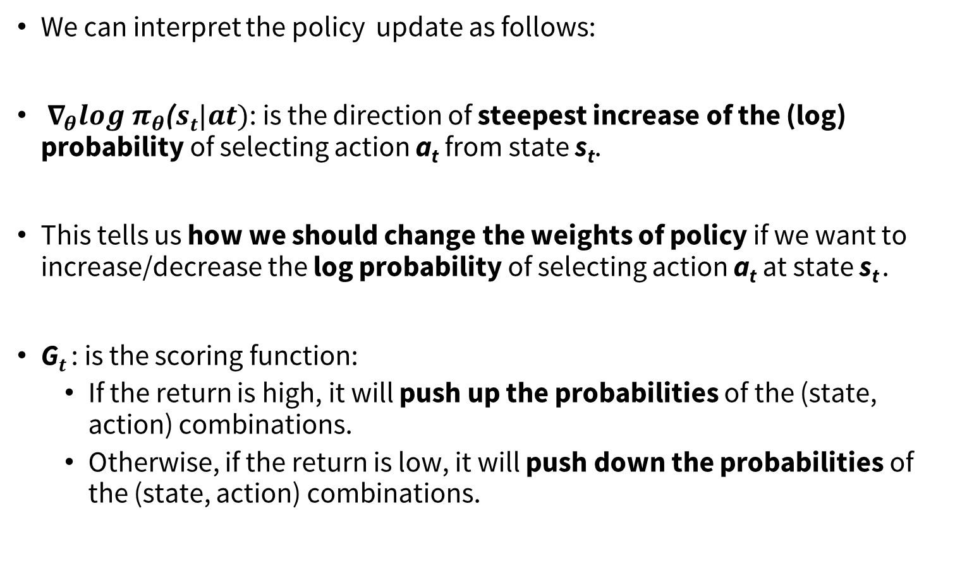
Reinforce algorithm
We can interpret the policy update as follows:
${ ∇}_{θ}log{ π}_{θ}\text{(}st|at)$: is the direction of steepest increase of the (log) probability of selecting action a_{t} from state s_{t}.
This tells us how we should change the weights of policy if we want to increase/decrease the log probability of selecting action a_{t} at state s_{t} ​.
G$t$: is the scoring function:
If the return is high, it will push up the probabilities of the (state, action) combinations.
Otherwise, if the return is low, it will push down the probabilities of the (state, action) combinations.

Slide 23
REF
https://huggingface.co/learn/deep-rl-course/
https://deep-reinforcement-learning.net/
Slides for the course Reinforcement Learning (Master Computer Science 2022 at Leiden University)
https://www.udacity.com/course/deep-reinforcement-learning-nanodegree--nd893
Udacity: The Deep Reinforcement Learning Nanodegree
https://www.deepmind.com/learning-resources/reinforcement-learning-lecture-series-2021
Lecture 9: Policy Gradients and Actor Critics

