Slide 1


Lecture 6: Proximal Policy Optimization PPO [Schulman et al, 2017]
Dr. MALKI Abdelhamid @: a.malki@esi-sba.dz
Ecole Supérieure d’Informatique de Sidi Bel Abbes (ESI-SBA) 2024/2025
Module IASD: Advanced Deep Learning (DRL)

Slide 2
Introduction
The Advantage Actor Critic (A2C) is a hybrid architecture combining value-based and policy-based methods that helps to stabilize the training by reducing the variance with:
An Actor that controls how our agent behaves (policy-based method).
A Critic that measures how good the action taken is (value-based method).

Slide 3
The intuition behind PPO
We want to avoid having too large of a policy update.
The idea with Proximal Policy Optimization (PPO) is that we want to improve the training stability of the policy by limiting the change you make to the policy at each training epoch
we update the policy conservatively.
Measure how much the current policy changed compared to the former on,
For two reasons:
We know empirically that smaller policy updates during training are more likely to converge to an optimal solution.
A too-big step in a policy update can result in falling “off the cliff” (getting a bad policy) and taking a long time or even having no possibility to recover.

Slide 4
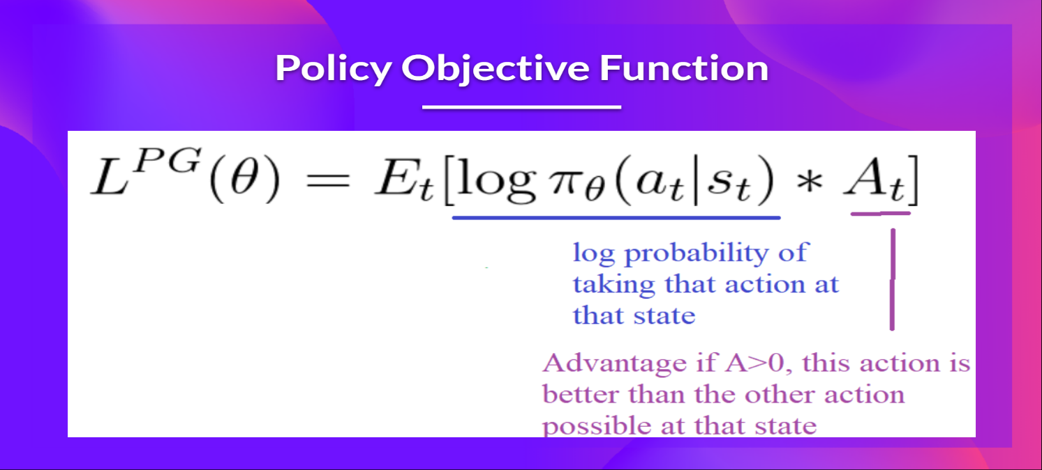
Clipped Surrogate Objective Function
The Policy Objective Function
The idea was that by taking a gradient ascent step on this function, we would push our agent to take actions that lead to higher rewards and avoid harmful actions.
However, the problem comes from the step size:
Too small, the training process was too slow
Too high, there was too much variability in the training

Slide 5
Clipped Surrogate Objective Function
With PPO, the idea is to constrain our policy update with a new objective function called the Clipped surrogate objective function that will constrain the policy change in a small range using a clip.
This new function is designed to avoid destructively large weights updates :

Slide 6
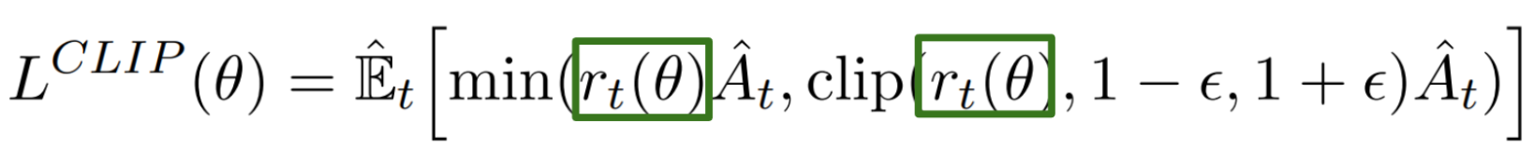
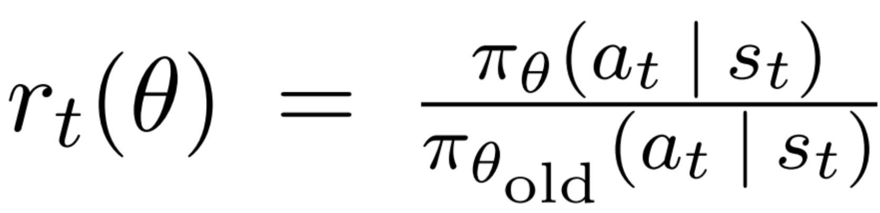

Ratio Function
Ratio Function: is the probability of taking action a_{t}​ at state s_{t​} in the current policy, divided by the same for the previous policy.
Estimate the divergence between old and current policy.
r_{t}​($θ$) denotes the probability ratio between the current and old policy:
If r_{t}​($θ$) >1, the action a_{t}​ at state s_{t} is more likely in the current policy than the old policy.
If r_{t}​($θ$) is between 0 and 1, the action is less likely for the current policy than for the old one.

Slide 7
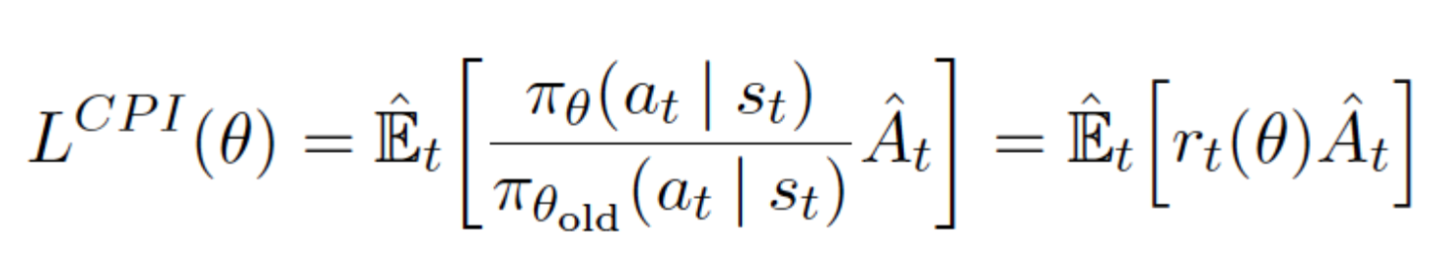
unclipped part
This ratio can replace the log probability we use in the policy objective function. This gives us the left part of the new objective function
multiplying the ratio by the advantage.
However, without a constraint, if the action taken is much more probable in our current policy than in our former, this would lead to a significant policy gradient step and, therefore, an excessive policy update.
Consequently, we need to constrain this objective function by penalizing changes that lead to a ratio far away from 1 (in the paper, the ratio can only vary from 0.8 to 1.2).

Slide 8
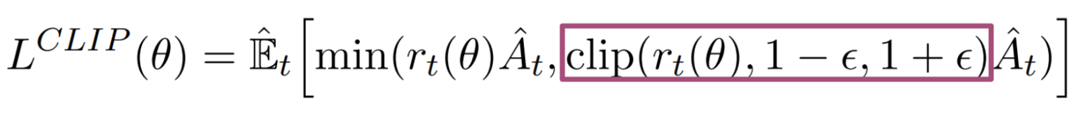
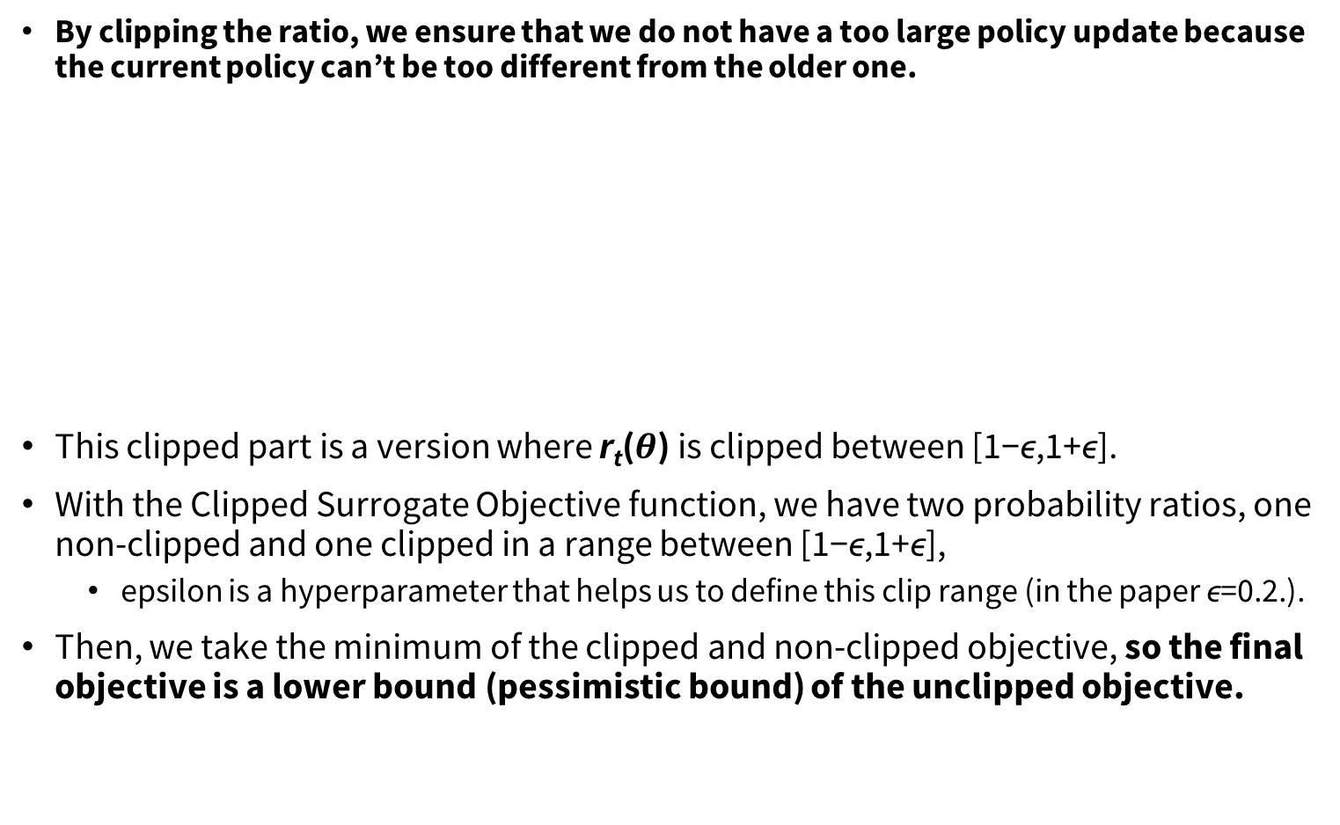
clipped part
By clipping the ratio, we ensure that we do not have a too large policy update because the current policy can’t be too different from the older one.
This clipped part is a version where r_{t}​($θ$) is clipped between [1−ϵ,1+ϵ].
With the Clipped Surrogate Objective function, we have two probability ratios, one non-clipped and one clipped in a range between [1−ϵ,1+ϵ],
epsilon is a hyperparameter that helps us to define this clip range (in the paper ϵ=0.2.).
Then, we take the minimum of the clipped and non-clipped objective, so the final objective is a lower bound (pessimistic bound) of the unclipped objective.

Slide 9
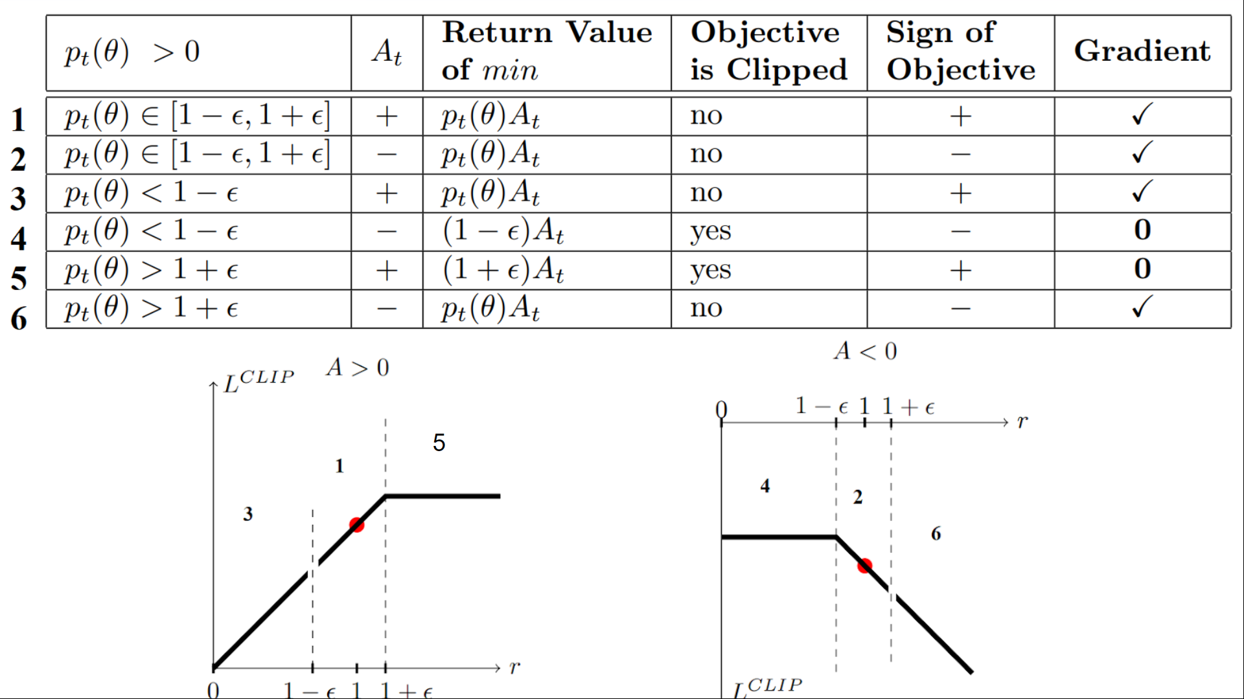
Visualize the Clipped Surrogate Objective Function
Table from "Towards Delivering a Coherent Self-Contained Explanation of Proximal Policy Optimization" by Daniel Bick

Slide 10
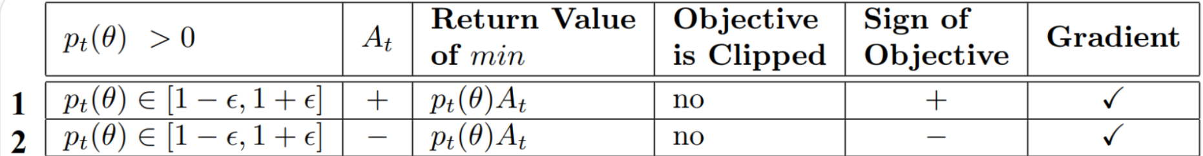
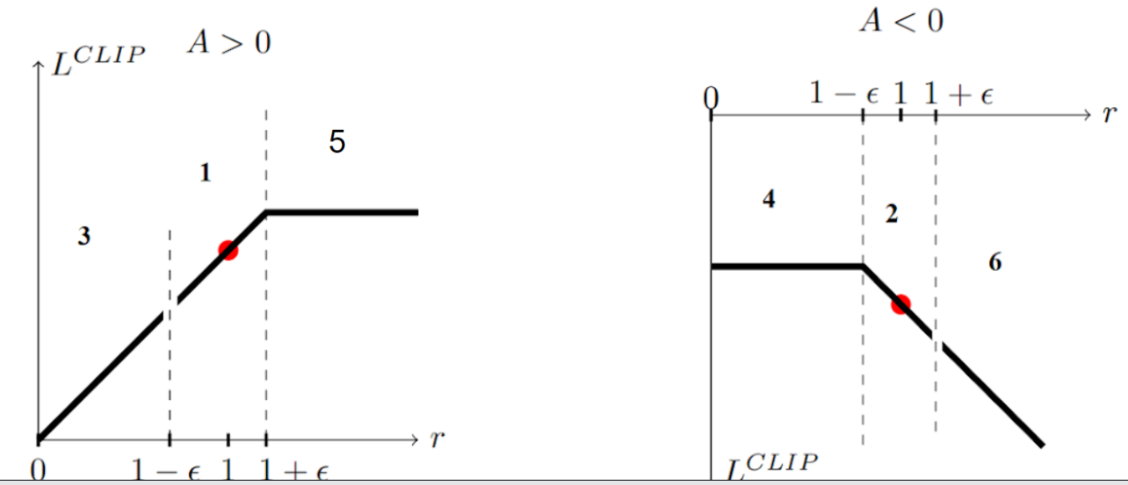
Visualize the Clipped Surrogate Objective Function
Case 1 and 2: the ratio is between the range
the clipping does not apply since the ratio is between the range [1−ϵ,1+ϵ]
In situation 1, we have a positive advantage: the action is better than the average of all the actions in that state. Therefore, we should encourage our current policy to increase the probability of taking that action in that state.
In situation 2, we have a negative advantage: the action is worse than the average of all actions at that state. Therefore, we should discourage our current policy from taking that action in that state.

Slide 11
Visualize the Clipped Surrogate Objective Function
Case 3 and 4: the ratio is below the range
If the probability ratio is lower than[1−ϵ], the probability of taking that action at that state is much lower than with the old policy.
If, like in situation 3, the advantage estimate is positive (A>0), then you want to increase the probability of taking that action at that state.
But if, like situation 4, the advantage estimate is negative, we don’t want to decrease further the probability of taking that action at that state. Therefore, the gradient is = 0, so we don’t update our weights.

Slide 12
Visualize the Clipped Surrogate Objective Function
Case 5 and 6: the ratio is above the range
If the probability ratio is higher than [1+ϵ], the probability of taking that action at that state in the current policy is much higher than in the former policy.
If, like in situation 5, the advantage is positive, we don’t want to get too greedy. We already have a higher probability of taking that action at that state than the former policy. Therefore, the gradient is = 0, so we don’t update our weights.
If, like in situation 6, the advantage is negative, we want to decrease the probability of taking that action at that state.

Slide 13
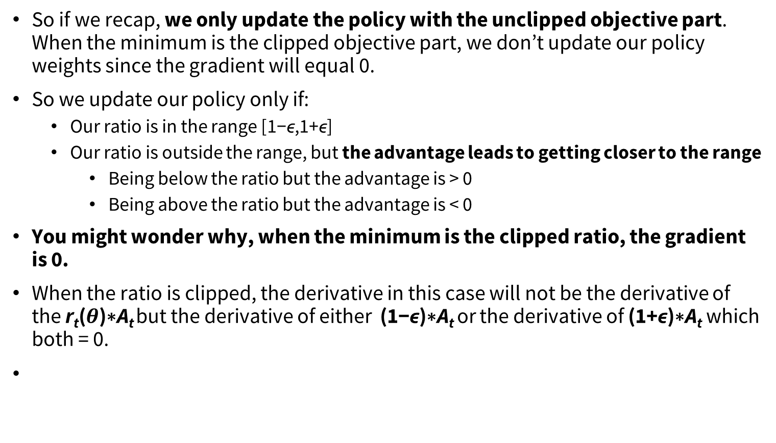
Visualize the Clipped Surrogate Objective Function
So if we recap, we only update the policy with the unclipped objective part. When the minimum is the clipped objective part, we don’t update our policy weights since the gradient will equal 0.
So we update our policy only if:
Our ratio is in the range [1−ϵ,1+ϵ]
Our ratio is outside the range, but the advantage leads to getting closer to the range
Being below the ratio but the advantage is > 0
Being above the ratio but the advantage is < 0
You might wonder why, when the minimum is the clipped ratio, the gradient is 0.
When the ratio is clipped, the derivative in this case will not be the derivative of the r_{t}​($θ$)∗A​_{t} but the derivative of either (1−ϵ)∗A_{t​} or the derivative of (1+ϵ)∗A_{t}​ which both = 0.

Slide 14
Continuous actions
Pure value-based RL can be non-trivial to extend to continuous action spaces
When directly updating the policy parameters, continuous actions are easier
Most Policy-based algorithms can be used for discrete and continuous actions
Note: exploration in high-dimensional continuous spaces can be challenging

Slide 15

Continuous actions
In the context of continuous action spaces, it's common to use a normal (Gaussian) probability distribution to represent the policy of the actor.
The actor outputs the mean and standard deviation of the distribution, and the actual action is then sampled from this distribution.
π(a∣s) is the probability of taking action a given state s,
μ is the mean of the distribution (output by the actor network),
σ is the standard deviation of the distribution

Slide 16
REF
https://huggingface.co/learn/deep-rl-course/
https://deep-reinforcement-learning.net/
Slides for the course Reinforcement Learning (Master Computer Science 2022 at Leiden University)
https://www.udacity.com/course/deep-reinforcement-learning-nanodegree--nd893
Udacity: The Deep Reinforcement Learning Nanodegree
https://www.deepmind.com/learning-resources/reinforcement-learning-lecture-series-2021
Lecture 9: Policy Gradients and Actor Critics

