Slide 1


Lecture 5: Actor critic
Dr. MALKI Abdelhamid @: a.malki@esi-sba.dz
Ecole Supérieure d’Informatique de Sidi Bel Abbes (ESI-SBA) 2024/2025
Module IASD: Advanced Deep Learning (DRL)

Slide 2
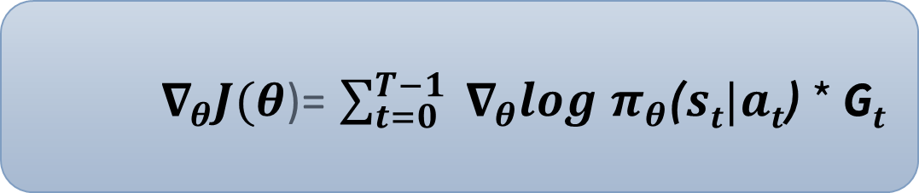
The Problem of Variance in Reinforce
In Reinforce, we want to increase the probability of actions in a trajectory proportionally to how high the return is.
If the return is high, we will push up the probabilities of the (state, action) combinations.
Otherwise, if the return is low, it will push down the probabilities of the (state, action) combinations.
This return G_{τ} is calculated using a Monte-Carlo sampling. We collect a trajectory and calculate the discounted return, and use this score to increase or decrease the probability of every action taken in that trajectory.
If the return is good, all actions will be “reinforced” by increasing their likelihood of being taken.
$∇_{θ}J(θ$)= $\sum_{t=0}^{T−1}{{ ∇}_{θ}log{ π}_{θ}\text{(}st|at\text{)}}$ * G$t$

Slide 3
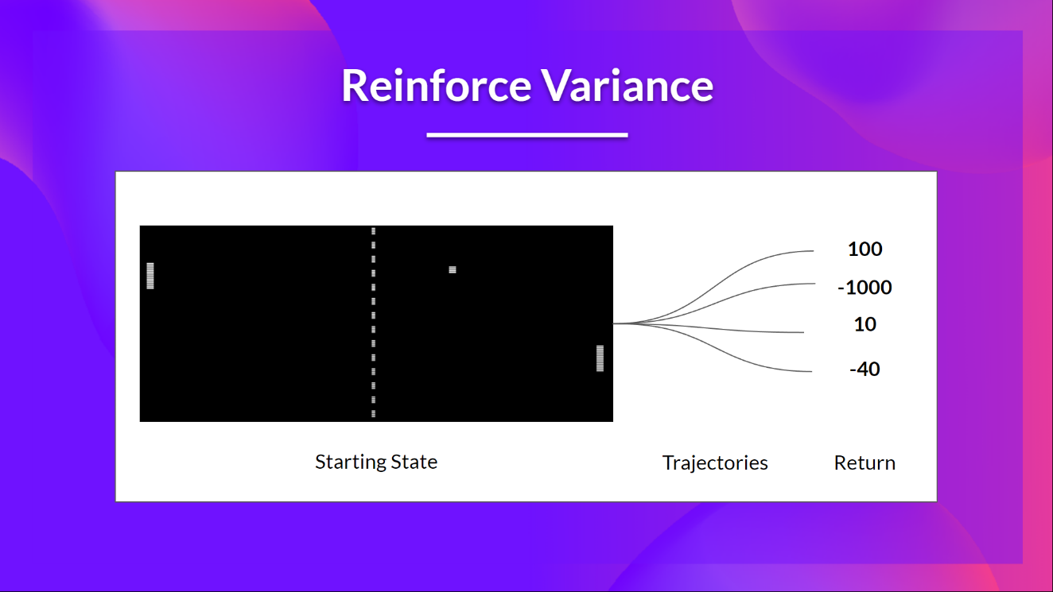
The Problem of Variance in Reinforce
Given the stochasticity of the environment (random events during an episode) and stochasticity of the policy, trajectories can lead to different returns, which can lead to high variance.
Consequently, the same starting state can lead to very different returns. Because of this, the return starting at the same state can vary significantly across episodes.

Slide 4
The Problem of Variance in Reinforce
The solution is to mitigate the variance by using a large number of trajectories, hoping that the variance introduced in any one trajectory will be reduced in aggregate and provide a “true” estimation of the return.
However, increasing the batch size significantly reduces sample efficiency. So we need to find additional mechanisms to reduce the variance

Slide 5
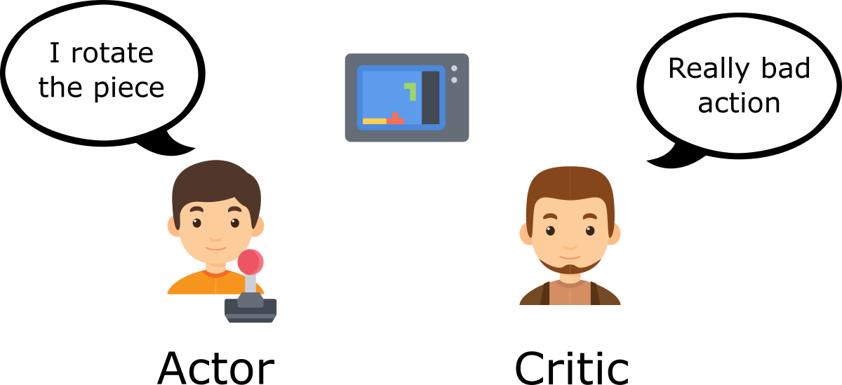
Actor-Critic (A2C)
The solution to reducing the variance of the Reinforce algorithm and training our agent faster and better is to use a combination of Policy-Based and Value-Based methods:
Actor-Critic method.
To understand the Actor-Critic, imagine you’re playing a video game. You can play with a friend that will provide you with some feedback. You’re the Actor and your friend is the Critic

Slide 6

Actor-Critic (A2C)
with Actor-Critic methods, there are two function approximations (two neural networks):
Actor, a policy function parameterized by theta: $π_{θ}$(s)
Critic, a value function parameterized by w: Q_{w}​(s,a)

Slide 7
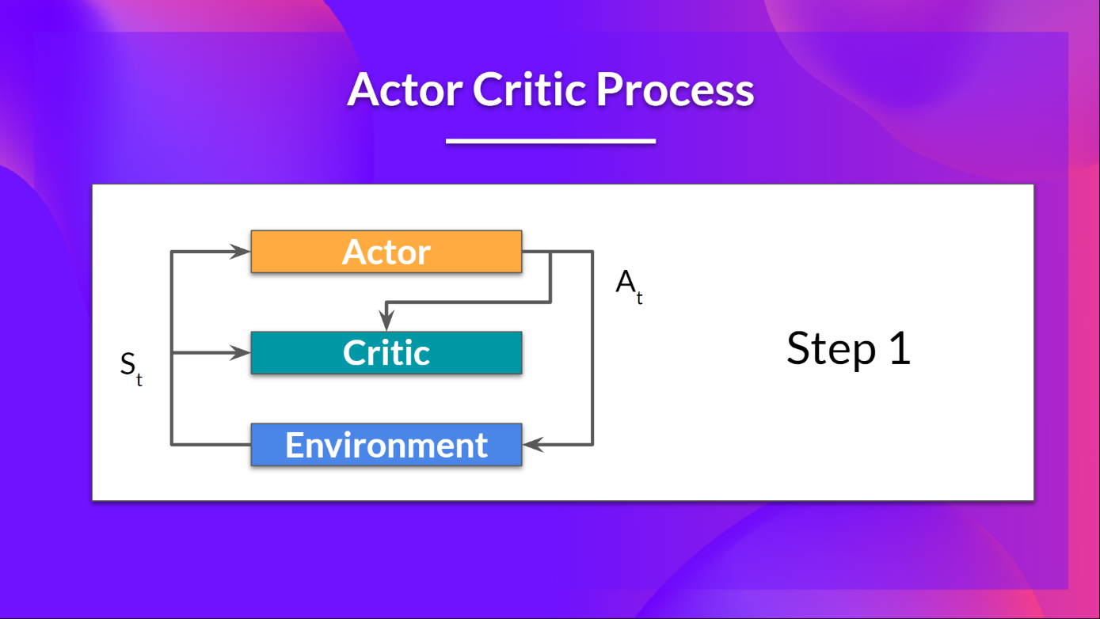

Actor-Critic (A2C)
At each timestep, t, we get the current state S_{t}​ from the environment and pass it as input through our Actor and Critic.
Our Policy $π_{θ}$(s) takes the state and outputs an action A_{t}​.

Slide 8
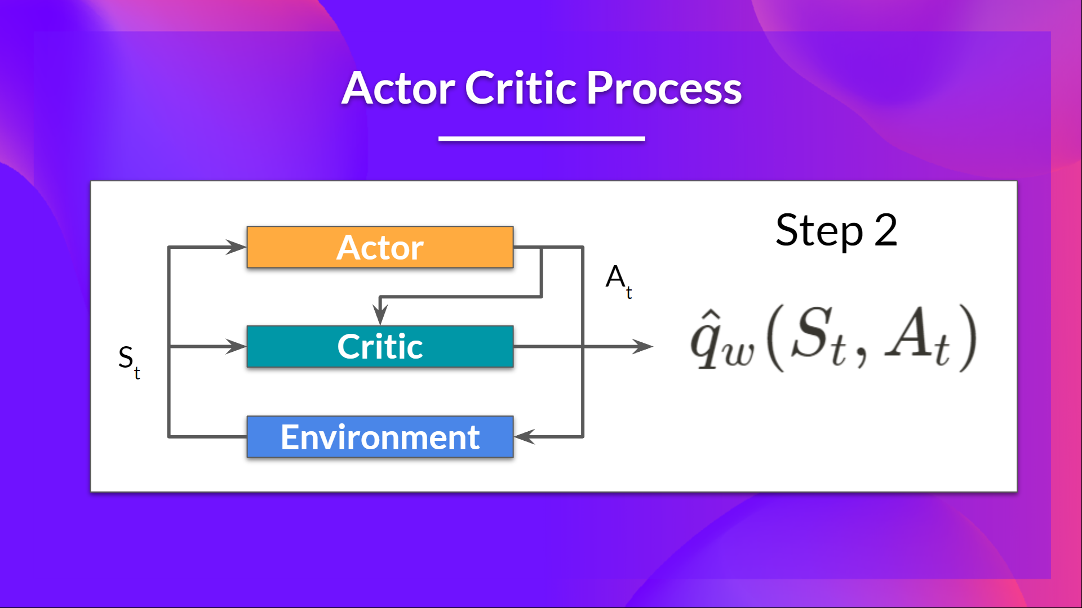
Actor-Critic (A2C)
The Critic takes that action also as input and, using S_{t}​ and A_{t}​, computes the value of taking that action at that state: the Q-value.

Slide 9
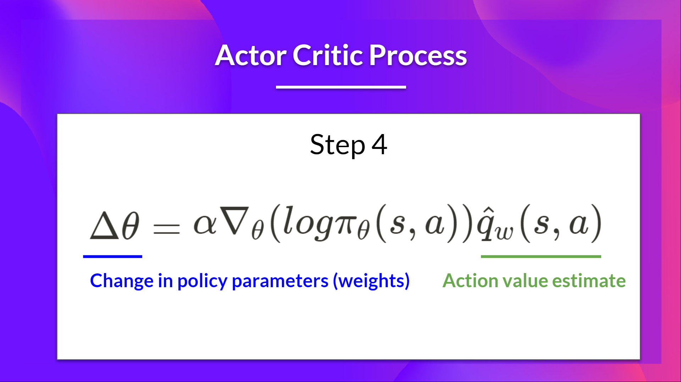
Actor-Critic (A2C)
The Actor updates its policy parameters using the Q-value.

Slide 10
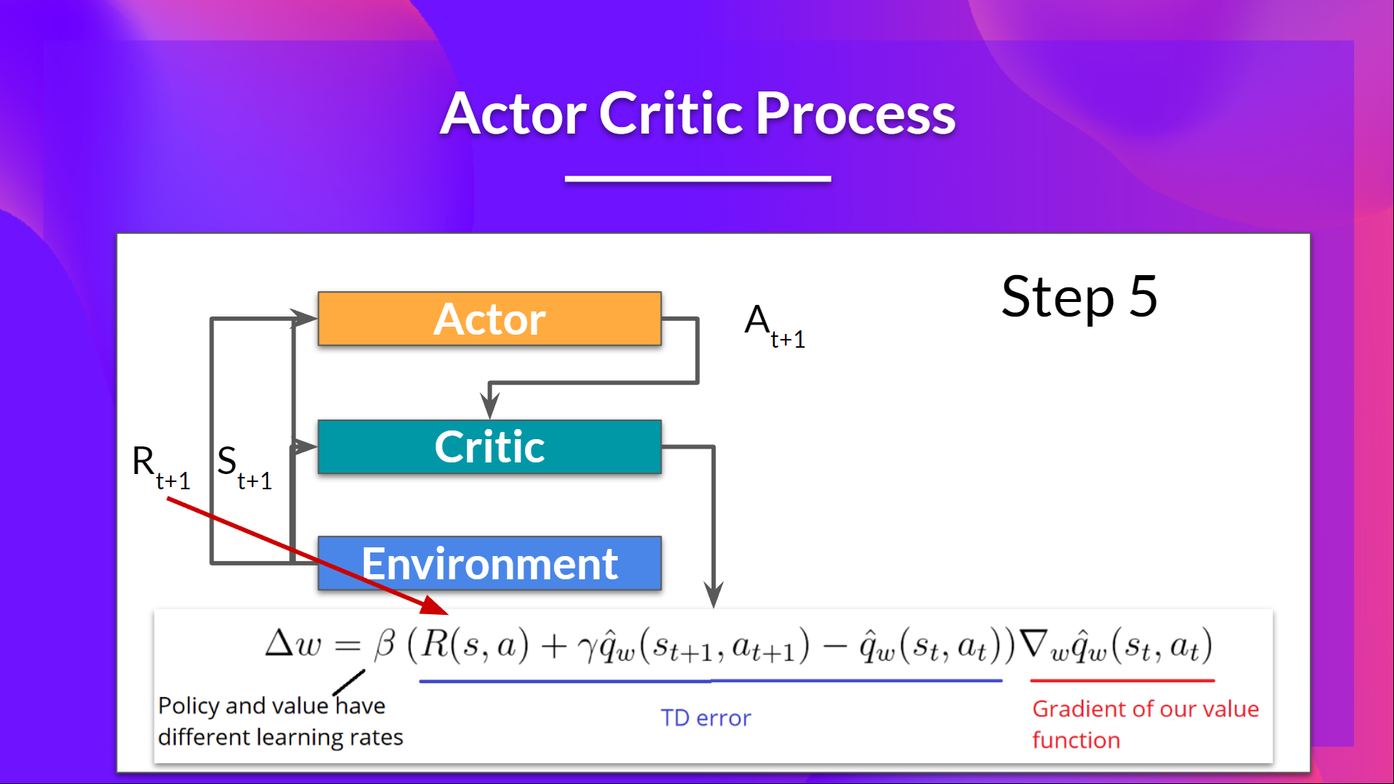
Actor-Critic (A2C)
the Actor produces the next action to take at A_{t+1}​ given the new state S_{t+1}​.
The Critic then updates its value parameters.

Slide 11
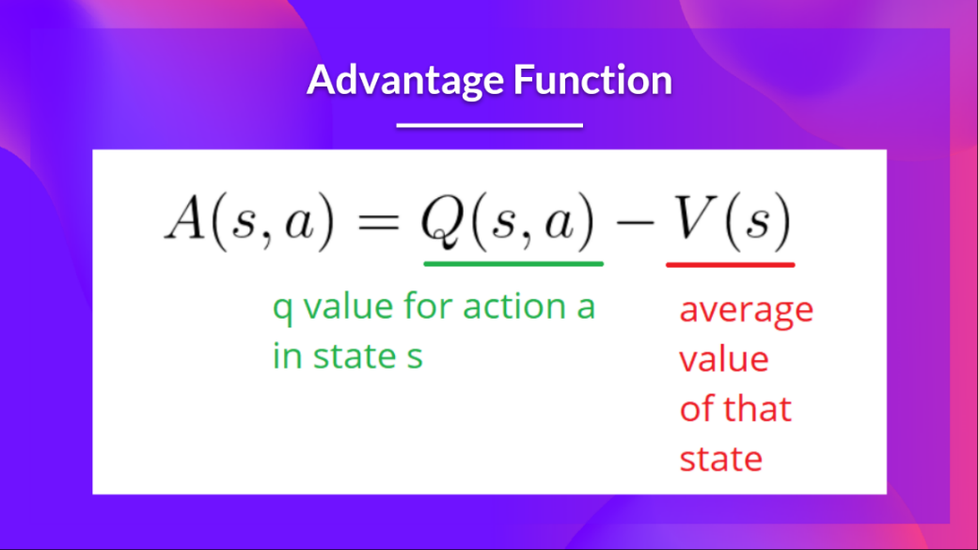
Adding Advantage in Actor-Critic (A2C)
We can stabilize learning further by using the Advantage function as Critic instead of the Action value function.
The idea is that the Advantage function calculates the relative advantage of an action compared to the others possible at a state:
how taking that action at a state is better compared to the average value of the state.
It’s subtracting the mean value of the state from the state action pair:

Slide 12
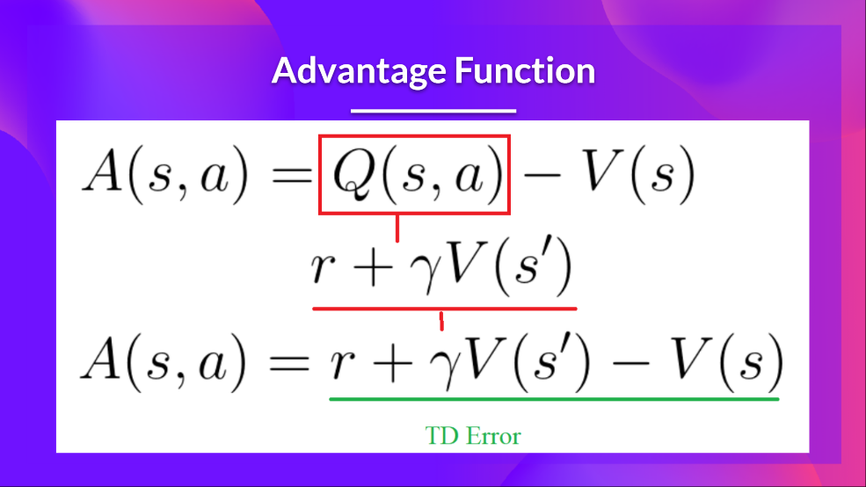
Adding Advantage in Actor-Critic (A2C)
In other words, this function calculates the extra reward we get if we take this action at that state compared to the mean reward we get at that state.
The extra reward is what’s beyond the expected value of that state.
If A(s,a) > 0: our gradient is pushed towards reinforcing this action..
If A(s,a) < 0 (our action does worse than the average value of that state), our gradient is pushed to avoid this action.
The problem with implementing this advantage function is that it requires two value functions — Q(s,a) and V(s).
Fortunately, we can use the TD error as a good estimator of the advantage function.

Slide 13
REF
https://huggingface.co/learn/deep-rl-course/
https://deep-reinforcement-learning.net/
Slides for the course Reinforcement Learning (Master Computer Science 2022 at Leiden University)
https://www.udacity.com/course/deep-reinforcement-learning-nanodegree--nd893
Udacity: The Deep Reinforcement Learning Nanodegree
https://www.deepmind.com/learning-resources/reinforcement-learning-lecture-series-2021
Lecture 9: Policy Gradients and Actor Critics

