Slide 1
New Gen port

Slide 2
Agenda
1
Objective
2
Scope Project
2
2
3
Timeline

Slide 3
Objective
Change Using Data Gen Port from AS400 to MSSQL
2. Schedule Gen Port can set up by user in any day.
3. User can predictive number of contract for next due.
4. Change set up workforce from import excel in AS400 to New Gen Port System and user can set up team , campaign , collector more flexibility.
5. User can choose pattern for generate raw file.

Slide 4
Scope Of Project
Port
Management
Workforce
Management
Filter
Management
Gen Port
Management
*** Improve Filter

Slide 5
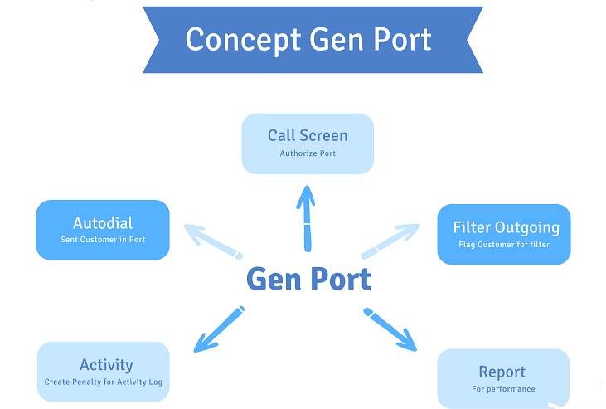

Slide 6



Gen Port Process
Work Force Manage
Filter Management
(Filter Outgoing)
Raw File
Enterprise DB
Call Screen
OA
Update Build
AS400
LG System
Raw File
Report
Start Build
Autodial

Slide 7
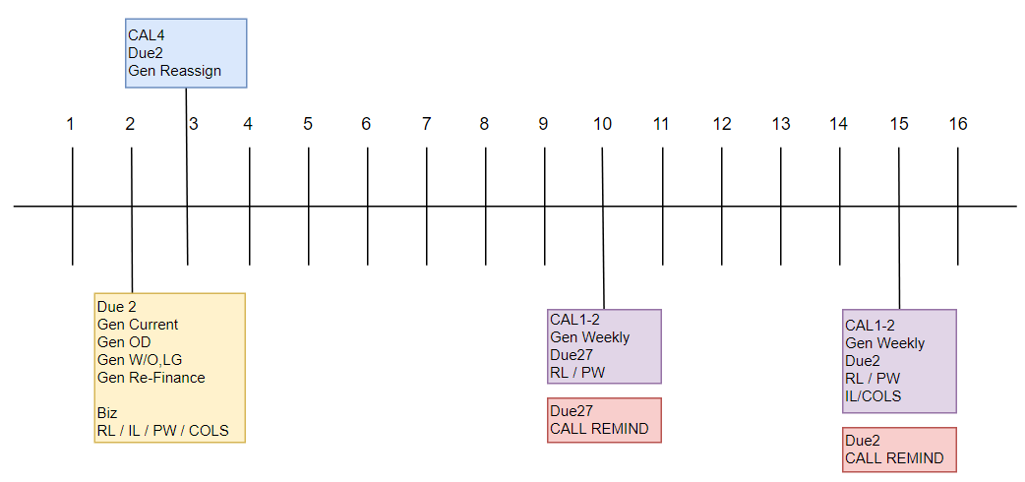
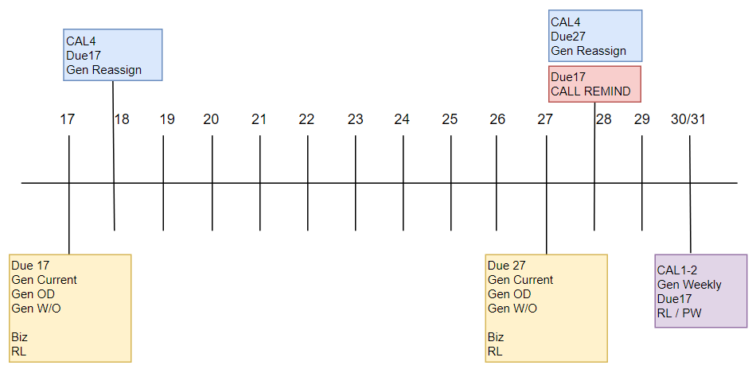
Gen Port Schedule (Existing)

Slide 8

Gen Port Process
Existing
AS400
Raw File
Autodial
New
MSSQL
Raw File
Autodial

Slide 9
Port Management
Normal
OD
Conditions
Conditions
Call Remind
Refinance
Skip Due
Current
W/O
Conditions
Conditions
First Due
COLS
LG
New Port 1
New Port 2

Slide 10
Port condition
Condition 1
Condition 1
Remind
W/O
Condition 2
Condition 2
Condition 3
Condition 3
Condition 1
Condition 1
OD
New Port 1
Condition 2
Condition 2
Condition 3
Condition 3

Slide 11

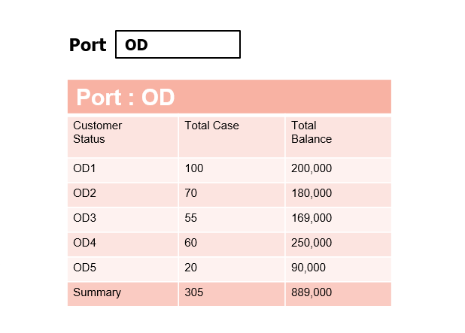
Port Preview

Slide 12
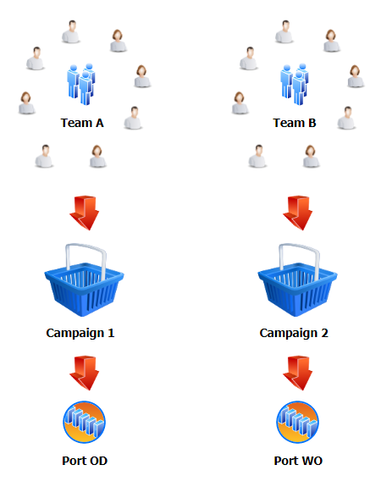
Workforce Management
Set Collector and Team
Set Campaign
Assign Campaign

Slide 13
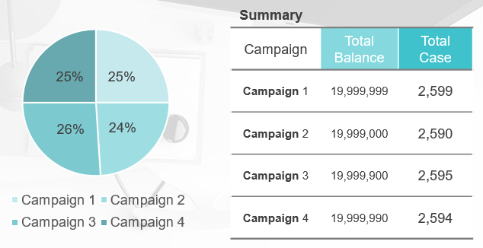
Gen Port Management
Contract distribution
Pattern 1
Pattern 2
Pattern 3
Pattern 4
Total Balance
Average Balance
Case
Manual
Preview Gen port

Slide 14



ALM
Raw File
C1R02T1S1.raw
C1R02T1S2.raw
C1R02T1S3.raw
C1R02T1S4.raw
Contact List
Service
C1R02T1_A
ALM_C1R02T1_S1
C1R02T1_B
ALM_C1R02T1_S2
C1R02T1
Strategy
Filter
C1R02T1_C
ALM_C1R02T1_S3
C1R02T1_D
ALM_C1R02T1_S4

Slide 15
Filter Management
Filter Group 1
Filter Group 4
Person Code = CU (NOTE DB) AND
Balance > 1000 (Enterprise DB)
Filter Group 2
Filter Group 5
Last Contact Date (ALM) AND
Tel Type (Enterprise DB)
Filter Group 3
Filter Group 6
Age > 30 (Enterprise DB) AND
Result Code = PP (NOTE DB) AND
Balance > 1000 (Enterprise DB)
Autodial
ALM+UIP
Raw File
Filter Group

Slide 16
Filter Group
CAL2
CAL4
CAL1
CAL3
Result Code
Note Date
Receive Date
Action Code
Person Code
Result Code
Note Date
Campaign Code
New WO Date
Reassign Date
Existing WO Date
Action Code
Person Code
Result Code
Note Date
Person Code
Result Code
Note Date
Campaign Code

Slide 17
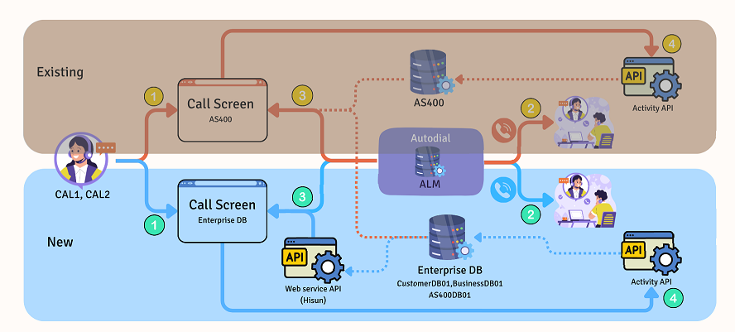
Call Screen System

Slide 18
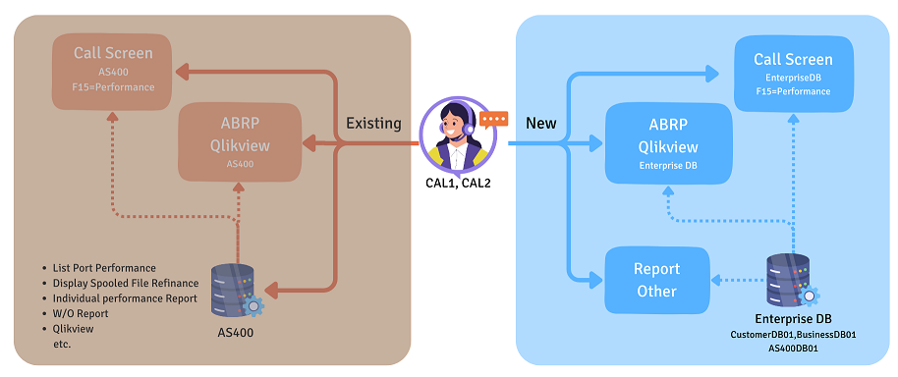
Report

Slide 19
Timeline
Call Center 1-2
Go Lives : New Gen Port System | 10/01/2024
Go Lives : Log In Call Screen | 17/01/2024
Go Lives : Port COLS | UAT
Go Lives : Port Due27 | UAT
Go Lives : Port Due17 | UAT
Go Lives : Port Due2 (RL+IL+PW) | UAT

Slide 20
Timeline
Call Center 3
Go Lives : New Gen Port System | 10/01/2024
Go Lives : Log In Call Screen | 17/01/2024
Go Lives : Port Due27 | UAT
Go Lives : Port Due17 | UAT
Go Lives : Port Due2 | UAT
Go Lives : Individual Performance Report | UAT

Slide 21
Thank you

