Slide 1



Hibernate – Query API
Session
17
Chaim Turkel
Ido Barash

Slide 2


Query API
Hibernate Query Language (HQL)
Run-time queries
Named queries
Criteria API
Filters and Where conditions
Ordering
Locking

Slide 3

Hibernate Query Language
Hibernate manages all our DB hits.
It’s Session exposes a very useful API for actions like persisting, merging and deleting.
But a fundamental idea of working with a DB is retrieving the persisted data.
The DB understands SQL for querying, which is a great language for tabular formed data.
When using Hibernate, we work with objects (not tables), therefor we need an object-based query language.

Slide 4
Hibernate Query Language
HQL - Hibernate Query Language
HQL is based on SQL’s commonly used syntax.
HQL is object-based. Instead of using tables and columns, it uses objects and properties.
Supports inheritance.
Supports containment.
One HQL query can be executed by Hibernate engine as several SQL queries.

Slide 5
Hibernate Query Language
Simple HQL: Lets take this entities for examples: @Entity
@Table(name = "developers_general")
@Inheritance(strategy = InheritanceType.JOINED)
public abstract class AbstractDeveloper {
@Id
@Column(name = "employee_id")
@GeneratedValue(strategy = GenerationType.IDENTITY)
protected Integer id;
@Column(name = "first_Name")
protected String firstName;
@Column(name = "last_Name")
protected String lastName;
protected Double salary;
@OneToMany
@JoinColumn(name = "employee", referencedColumnName = "employee_id")
protected Set<Phone> phones;

Slide 6
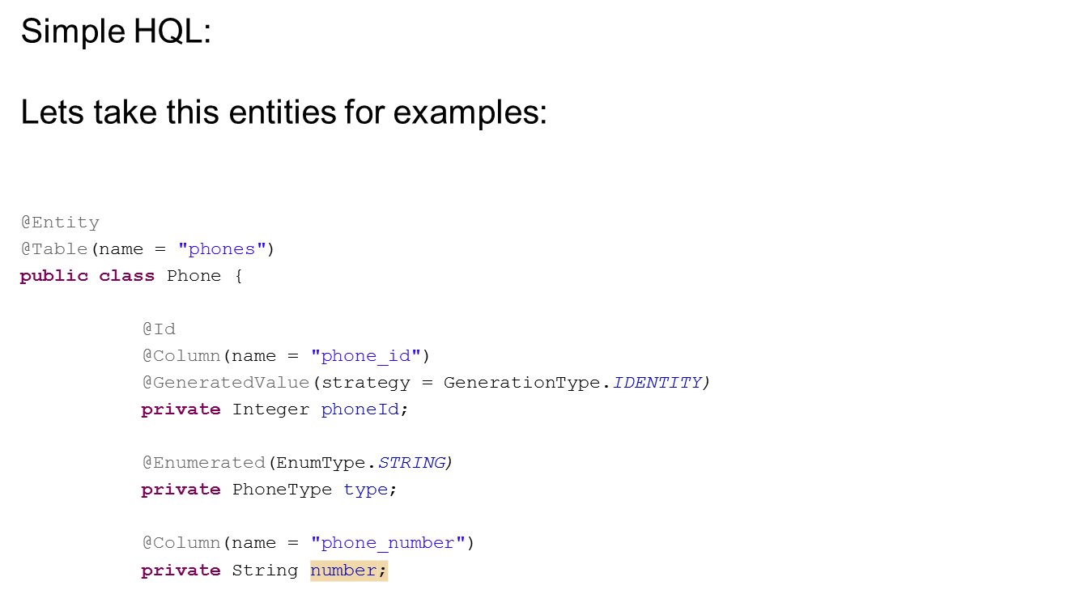
Hibernate Query Language

Slide 7
Hibernate Query Language
Simple HQL: Retrieve all phones: SELECT p FROM Phone p

Slide 8
Hibernate Query Language
Simple HQL: Retrieve all phones: SELECT p FROM Phone p
Reference Class Phone Not table name

Slide 9
Hibernate Query Language
Simple HQL: Retrieve all phones: SELECT p FROM Phone p Hibernate will execute: SELECT * FROM PHONES Hibernate will hit the DB, retrieve the record set and assemble the entities on it’s own. It will return a List<Phone>

Slide 10
Hibernate Query Language
Simple HQL: Retrieve all home phones:

Slide 11
Hibernate Query Language
Simple HQL: Retrieve all home phones: SELECT p FROM Phone p WHERE p.type LIKE ‘HOME’ Hibernate will execute: SELECT * FROM phones p WHERE p.type LIKE ‘HOME’

Slide 12
Hibernate Query Language
HQL returns object/s:
SELECT p FROM Phone p
If we retrieve data from one table only, we can drop the SELECT statement.
FROM Phone p

Slide 13
Hibernate Query Language
But what if we want to return only the phone number ?
SELECT p.number FROM Phone p
We still return an object.

Slide 14
Hibernate Query Language
Complicated HQL: Retrieve all home phones of a specific developer (id 5):

Slide 15
Hibernate Query Language
Complicated HQL: Retrieve all home phones of a specific developer (id 5): SELECT p FROM Phone p

Slide 16
Hibernate Query Language
Complicated HQL: Retrieve all home phones of a specific developer (id 5): SELECT p FROM Phone p WHERE p…. ?

Slide 17
Hibernate Query Language
Complicated HQL: Retrieve all home phones of a specific developer (id 5): SELECT p FROM Phone p WHERE p…. ?
@Entity
@Table(name = "phones")
public class Phone {
@Id
@Column(name = "phone_id")
@GeneratedValue(…)
private Integer phoneId;
@Enumerated(EnumType.STRING)
private PhoneType type;
@Column(name = "phone_number")
private String number; }

Slide 18
Hibernate Query Language
Complicated HQL: Retrieve all home phones of a specific developer (id 5): SELECT p FROM Phone p WHERE p…. ?
@Entity
@Table(name = "phones")
public class Phone {
@Id
@Column(name = "phone_id")
@GeneratedValue(…)
private Integer phoneId;
@Enumerated(EnumType.STRING)
private PhoneType type;
@Column(name = "phone_number")
private String number; }
No join property in the class!

Slide 19
Hibernate Query Language
Complicated HQL: Retrieve all home phones of a specific developer (id 5): SELECT p FROM Phone p WHERE p…. ?
In fact, the class has no reference to the containing developer…
@Entity
@Table(name = "phones")
public class Phone {
@Id
@Column(name = "phone_id")
@GeneratedValue(…)
private Integer phoneId;
@Enumerated(EnumType.STRING)
private PhoneType type;
@Column(name = "phone_number")
private String number; }
No join property in the class!

Slide 20
Hibernate Query Language
Complicated HQL: Retrieve all home phones of a specific developer (id 5): In SQL we would have done it like this: SELECT * FROM PHONES p WHERE p.employee = 5

Slide 21
Hibernate Query Language
Complicated HQL: Retrieve all home phones of a specific developer (id 5): In SQL we would have done it like this: SELECT * FROM PHONES p WHERE p.employee = 5 In HQL we must go through the objects hierarchy and retrieve the phones through the containing developer:

Slide 22
Hibernate Query Language
Complicated HQL: Retrieve all home phones of a specific developer (id 5): In SQL we would have done it like this: SELECT * FROM PHONES p WHERE p.employee = 5 In HQL we must go through the objects hierarchy and retrieve the phones through the containing developer: SELECT dev.phones FROM AbstractDeveloper dev WHERE dev.id = 5 AND dev.phones.type LIKE ‘HOME’

Slide 23
Hibernate Query Language
Complicated HQL: Retrieve all home phones of a specific developer (id 5): Lets review this HQL statement:
SELECT dev.phones FROM AbstractDeveloper dev WHERE dev.id = 5 AND dev.phones.type LIKE ‘HOME’

Slide 24
Hibernate Query Language
Complicated HQL: Retrieve all home phones of a specific developer (id 5): Lets review this HQL statement:
SELECT dev.phones FROM AbstractDeveloper dev WHERE dev.id = 5 AND dev.phones.type LIKE ‘HOME’
We retrieve the phones using the containing developer

Slide 25
Hibernate Query Language
Complicated HQL: Retrieve all home phones of a specific developer (id 5): Another way to do this:
SELECT p FROM AbstractDeveloper dev JOIN dev.phones p WHERE dev.id = 5 AND p.type LIKE ‘HOME’

Slide 26
Hibernate Query Language
Let's recall what is Lazy loading:
There are two ways to handle relations:
EAGER: Hibernate will always retrieve the contained entity or collection.
LAZY: Hibernate will not retrieve the contained entity or collection unless:
It was explicitly asked to do so in the query.
The property was accessed during the current transaction.
@OneToMany(fetch = FetchType.LAZY)
@JoinColumn(name = "EMP_ID", referencedColumnName = "OWNER_ID")
private List<Phone> phones;

Slide 27
Hibernate Query Language
Lazy loading: Retrieve all developers SELECT p FROM AbstractDeveloper dev
Hibernate will retrieve only developers (phones will be null).
If we want to fetch lazy property: SELECT p FROM AbstractDeveloper dev LEFT JOIN FETCH dev.phones p

Slide 28
Hibernate Query Language
HQL also supports SQL aggregations:
Count()
Min() / Max()
Sum()
Avg()
SELECT MIN(a.balance), MAX(a.balance), AVG(a.balance) FROM Account a
HQL also supports SQL GROUP BY and HAVING
HQL also supports UPDATE, DELETE and INSERT INTO statements

Slide 29
Hibernate Query Language
What if we want to retrieve partial object:
We need to create a new class which mirrors the returned data.
We must provide a parameters constructor for Hibernate to invoke.
public class DeveloperDto {
private String firstName;
private String lastName;
public DeveloperDto(String firstName, String lastName) {
this.firstName = firstName;
this.lastName = lastName;
} }

Slide 30
Hibernate Query Language
What if we want to retrieve partial object:
Now we can tell Hibernate to create a new instance of the mirror object:
SELECT NEW com.training.model.DevelopersDto( dev.firstName, dev.lastName) FROM AbstractDeveloper dev WHERE dev.id = 5 AND dev.phones.type LIKE ‘HOME’
1

Slide 31
Runtime queries:
We can use the Hibernate Session to generate and run a query in runtime:

Slide 32
Runtime queries:
We can use the Hibernate Session to generate and run a query in runtime:
String hql = “ SELECT p " +
“ FROM AbstractDeveloper dev " +
“ LEFT JOIN FETCH dev.phones p " +
“ WHERE p.type LIKE 'HOME'";
Query query = session.createQuery(hql);
List<Phone> phones = query.list();
String hql = “ SELECT dev " +
“ FROM AbstractDeveloper dev " +
“ WHERE dev.id = 6 ";
Query query = session.createQuery(hql);
AbstractDeveloper dev = (AbstractDeveloper) query.uniqueResult();

Slide 33
Runtime queries:
Queries support parameters:
Ordered parameters
String hql = "SELECT dev " +
"FROM AbstractDeveloper dev " +
"WHERE dev.id = ? AND dev.firstName LIKE ?" ;
Query query = session.createQuery(hql);
query.setParameter(0, 6);
query.setParameter(1, "Hezi");
AbstractDeveloper dev = (AbstractDeveloper) query.uniqueResult();

Slide 34
Runtime queries:
Queries support parameters:
Named parameters
String hql = "SELECT dev " +
"FROM AbstractDeveloper dev " +
"WHERE dev.id = :developerId AND dev.firstName LIKE :developerName" ;
Query query = session.createQuery(hql);
query.setParameter(developerName, "Hezi");
query.setParameter(developerId, 6);
AbstractDeveloper dev = (AbstractDeveloper) query.uniqueResult();

Slide 35
Runtime queries:
Exercise:
Create test class and inject SessionFactorty.
Generate on your own 5 developers (Java, JS, CPP)
Persist the developers
Retrieve all Java developers from the DB

Slide 36
Runtime queries:
Exercise1: Solution
@Test
public void testExercise1() {
List<AbstractDeveloper> developers = new ArrayList<AbstractDeveloper>();
developers.add(DeveloperFactory.getDeveloper(JavaDeveloper.class));
developers.add(DeveloperFactory.getDeveloper(JavaDeveloper.class));
developers.add(DeveloperFactory.getDeveloper(CppDeveloper.class));
developers.add(DeveloperFactory.getDeveloper(JsDeveloper.class));
developers.add(DeveloperFactory.getDeveloper(JavaDeveloper.class));
Session session = sessionFactory.openSession();
for (AbstractDeveloper developer : developers) {
session.save(developer);
}
session.close();
session = sessionFactory.openSession();
String hql = "SELECT dev FROM JavaDeveloper dev";
Query query = session.createQuery(hql);
List<AbstractDeveloper> persistedJavaDeveloper = query.list();
session.close();
Assert.assertNotNull(persistedJavaDeveloper);
Assert.assertEquals(persistedJavaDeveloper.size(), 3);
}

Slide 37
Runtime queries:
Exercise 2:
Create test class and inject SessionFactorty.
Generate Developer(add to it 2 phones).
Set the phones property in developers to be LAZY.
Save the Developer and the phones
Retrieve the developer without it’s phones.
Retrieve the Developer with all it’s phones in one query.

Slide 38
Runtime queries:
Exercise 2: Solution @Test public void testExercise2() {
AbstractDeveloper developer = DeveloperFactory.getDeveloper(JavaDeveloper.class);
Set<Phone> phones = new HashSet<Phone>();
phones.add(new Phone(PhoneType.MOBILE, "054-3333333"));
phones.add(new Phone(PhoneType.HOME, "03-3333333"));
developer.setPhones(phones);
Session session = sessionFactory.openSession();
Integer devId = (Integer) session.save(developer);
for (Phone phone : phones) {
session.save(phone);
}
session.close();
session = sessionFactory.openSession(); String hql = "SELECT dev " +
“ FROM AbstractDeveloper dev LEFT JOIN FETCH dev.phones" +
“ Where dev.id = :developer_id " ;
Query query = session.createQuery(hql);
query.setParameter("developer_id", devId);
AbstractDeveloper persistedDeveloper = (AbstractDeveloper) query.uniqueResult();
-- Asserts --

Slide 39
Runtime queries:
Exercise:
Create a new DTO class (developer name, address List<phones>)
Generate data for several developers
Retrieve this DTO for a specific developer

Slide 40
Named queries:
Runtime queries means that the query object is created every time when it is asked for.
These queries can not be validated on deployment time for correctness.
These queries are scattered all over the code – this might make it difficult to maintain.
Hibernate also supports pre-compiled static named queries.

Slide 41
Named queries:
Named queries are HQL statements that have been prepared from advanced.
They are compiled and validated during the session factory initialization process (deployment time).
They are easier to maintain since they are usually written in one place.

Slide 42
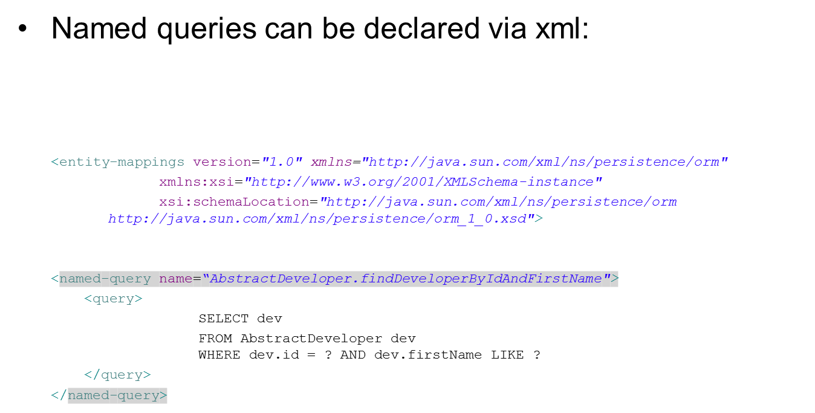
Named queries:

Slide 43
Named queries:
Named queries can be declared via xml: Than we can use the getNamedQuery of Hibernate session API.
Query query = session.getNamedQuery( "AbstractDeveloper.findDeveloperByIdAndFirstName").
query.setParameter(0, 6);
query.setParameter(1, "Hezi");
AbstractDeveloper dev = (AbstractDeveloper) query.uniqueResult();

Slide 44
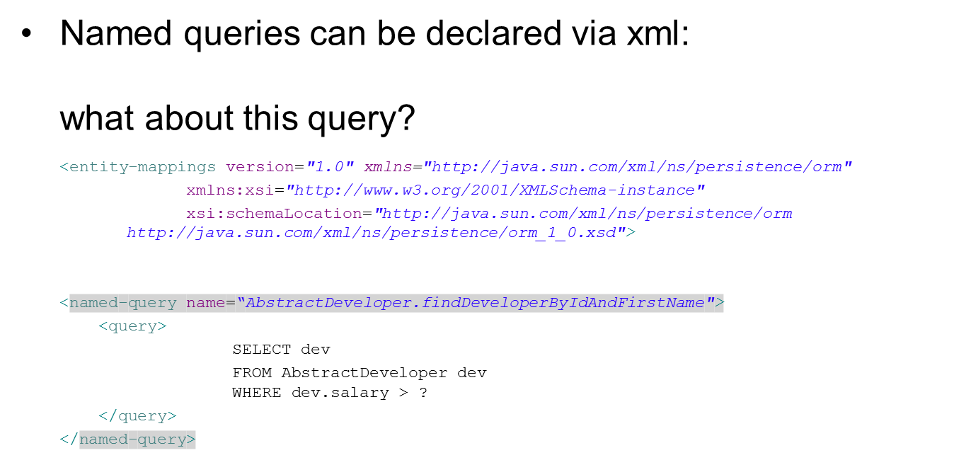
Named queries:

Slide 45
Named queries:
This is a reserved XML character

Slide 46
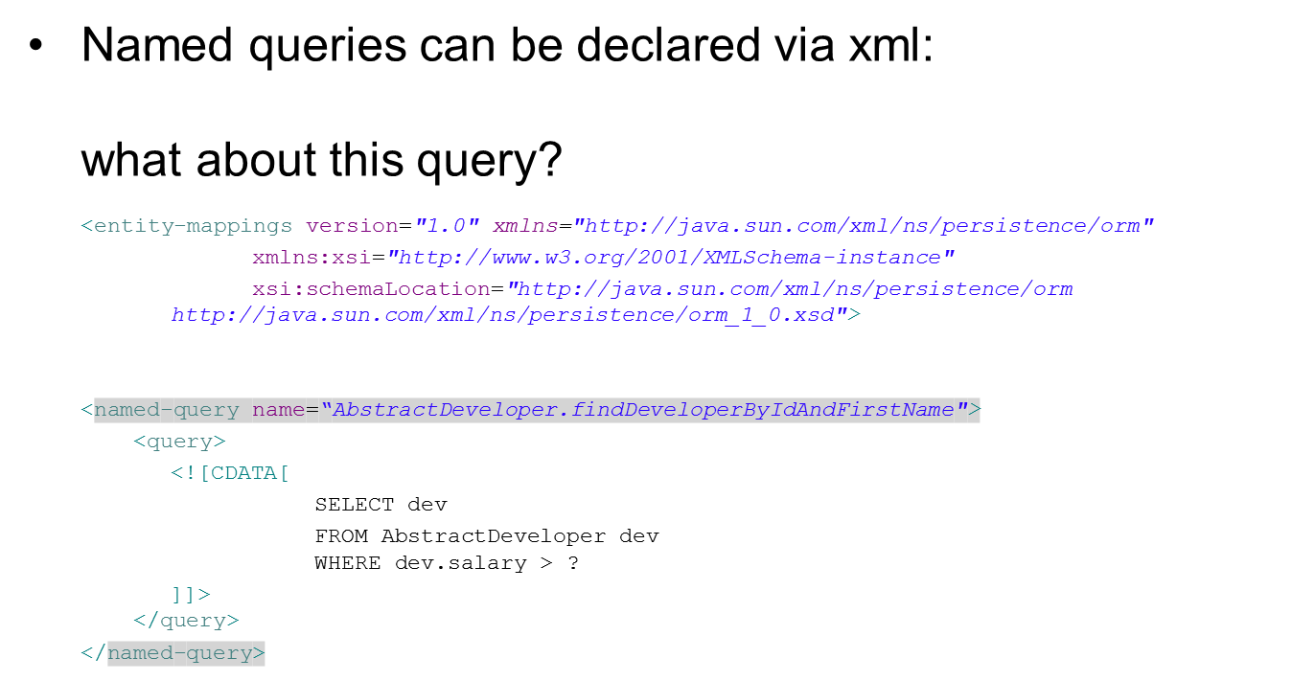
Named queries:

Slide 47
Named queries:
Named queries can also be declared via annotations:
@NamedQueries( {
@NamedQuery(
name = "AbstractDeveloper.findDeveloperByIdAndFirstName",
query = "SELECT dev FROM AbstractDeveloper dev WHERE dev.salary > ?") })
public abstract class AbstractDeveloper {

Slide 48
Named queries:
Named queries can also be declared via annotations:
@NamedQueries( {
@NamedQuery(
name = "AbstractDeveloper.findDeveloperByIdAndFirstName",
query = "SELECT dev FROM AbstractDeveloper dev WHERE dev.salary > ?") })
public abstract class AbstractDeveloper {
In this case, XMLs are more convenient.

Slide 49
Named queries:
Exercise: Convert the last two queries to named queries (using XML file).

Slide 50
Criteria API:
Another way to query the DB is using the criteria API.
The criteria API allows us to build a query without a ‘SQL like’ language.
Basically we create a special criteria object, associate it with an entity and add restrictions.

Slide 51
Criteria API:
Another way to query the DB is using the criteria API.
The criteria API allows us to build a query without a ‘SQL like’ language.
Basically we create a special criteria object, associate it with an entity and add restrictions.
Criteria criteria = session.createCriteria(AbstractDeveloper.class);
List<AbstractDeveloper> result = criteria.list();

Slide 52
Criteria API:
Another way to query the DB is using the criteria API.
The criteria API allows us to build a query without a ‘SQL like’ language.
Basically we create a special criteria object, associate it with an entity and add restrictions.
Criteria criteria = session.createCriteria(AbstractDeveloper.class);
List<AbstractDeveloper> result = criteria.list();
This will retrieve all the AbstractDevelopers from the DB.

Slide 53
Criteria API:
Now, lets add restrictions:
AbstractDeveloper id = 5
Criteria criteria = session.createCriteria(AbstractDeveloper.class);
criteria.add(Restrictions.eq("id", 5));
AbstractDeveloper result = (AbstractDeveloper) criteria.uniqueResult();

Slide 54
Criteria API:
Now, lets add restrictions:
AbstractDeveloper id = 5
Criteria criteria = session.createCriteria(AbstractDeveloper.class);
criteria.add(Restrictions.eq("id", 5));
AbstractDeveloper result = (AbstractDeveloper) criteria.uniqueResult();
We use the Restriction class static method to create restrictions that will be translated to where statements.

Slide 55
Criteria API:
Now, lets add restrictions:
AbstractDeveloper id = 5
AbstractDeveloper salary between 10k and 20k

Slide 56
Criteria API:
Now, lets add restrictions:
AbstractDeveloper id = 5
AbstractDeveloper salary between 10k and 20k
AbstractDeveloper name start with Hezi
Criteria criteria = session.createCriteria(AbstractDeveloper.class);
criteria.add(Restrictions.eq("id", 5));
criteria.add(Restrictions.between("salary", 10000, 20000));
criteria.add(Restrictions.like("firstName", "Hezi%"))
AbstractDeveloper result = (AbstractDeveloper) criteria.uniqueResult();

Slide 57
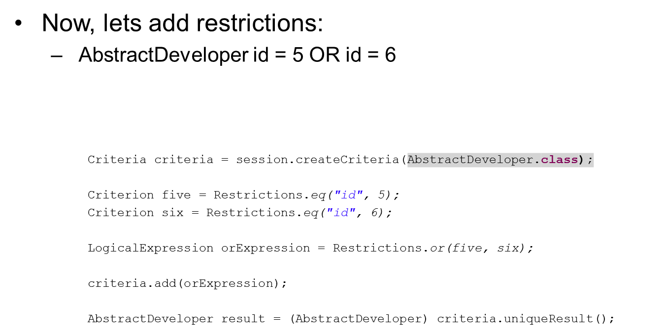
Criteria API:

Slide 58
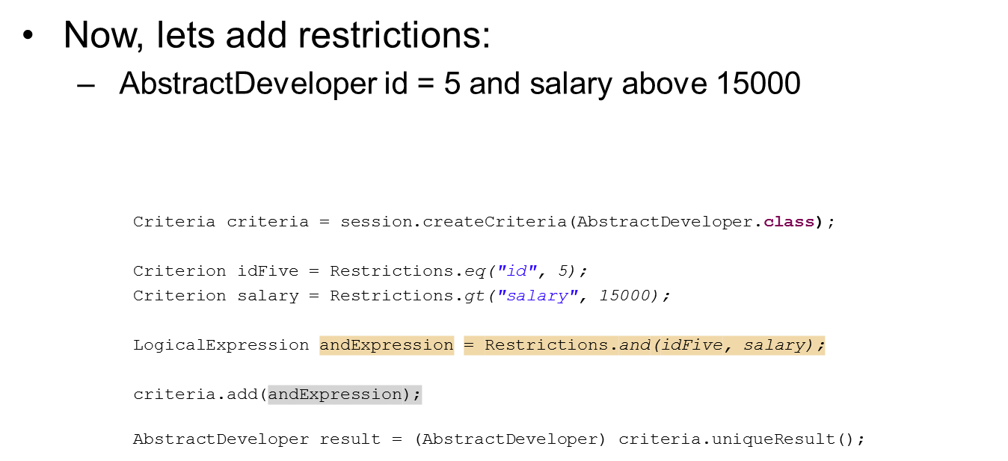
Criteria API:

Slide 59
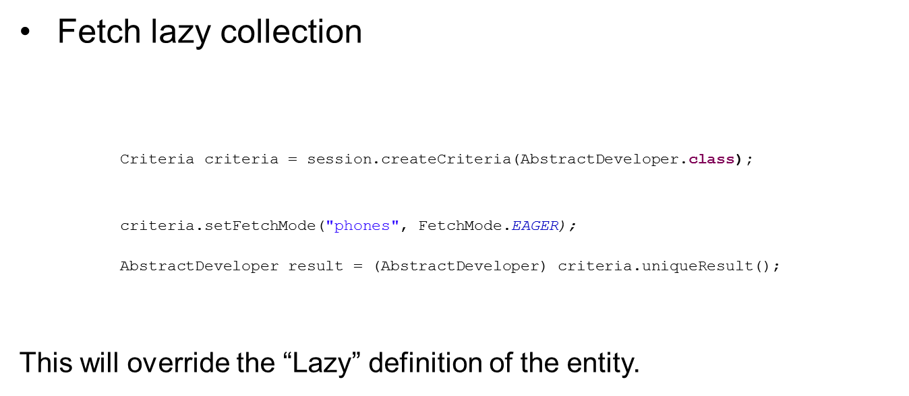
Criteria API:

Slide 60
Criteria API:
Exercise:
Convert the last two queries to Criteria queries.

Slide 61
Filters and Where conditions
Hibernate ONLY!
Sometimes there are WHERE statements that are similar to every query for the same object.
For example: phone type is HOME
date_x < effevtive date <= date_Y
We can add the same where statement in every query regarding this entity.
Or we could use pre-declared @Where and @Filter.

Slide 62
Filters and Where conditions
Hibernate ONLY!
@where states a fixed where condition:
@Entity
@Table(name = "developers_general")
public abstract class AbstractDeveloper {
@Id
@Column(name = "employee_id")
@GeneratedValue(strategy = GenerationType.IDENTITY)
protected Integer id;
. . .
@OneToMany @JoinColumn(name = "employee", referencedColumnName = "employee_id")
@Where(clause = "type LIKE 'HOME'")
protected Set<Phone> phones;
}

Slide 63
Filters and Where conditions
Hibernate ONLY!
@where states a fixed where condition:
@Entity
@Table(name = "developers_general")
public abstract class AbstractDeveloper {
@Id
@Column(name = "employee_id")
@GeneratedValue(strategy = GenerationType.IDENTITY)
protected Integer id;
. . .
@OneToMany @JoinColumn(name = "employee", referencedColumnName = "employee_id")
@Where(clause = "type LIKE 'HOME'")
protected Set<Phone> phones;
}
Hibernate will add the “ AND type LIKE ‘HOME’ ” to the query that will be generated in order to fetch the inner phones list.

Slide 64
Filters and Where conditions
Hibernate ONLY!
@Filter states dynamic where clause

Slide 65
Filters and Where conditions
Hibernate ONLY!
@Filter states dynamic where clause
This means that they are basically pre-declared where conditions that can use parameters.

Slide 66
Filters and Where conditions
Hibernate ONLY!
@Filter states dynamic where clause
This means that they are basically pre-declared where conditions that can use parameters.
They must be defined on the Type itself:

Slide 67
Filters and Where conditions
Hibernate ONLY!
@Filter states dynamic where clause
This means that they are basically pre-declared where conditions that can use parameters.
They must be defined on the Type itself:
@FilterDef(
Name = “effec_date_filter”,
parameters = { @ParamDef(name = "date", type = "date") },
defaultCondition = "opening_effec_date <= :date AND closing_effec_date > :date")
public abstract class AbstractDeveloper {

Slide 68
Filters and Where conditions
Hibernate ONLY!
@Filter states dynamic where clause
Filters must be associated with a property:

Slide 69
Filters and Where conditions
Hibernate ONLY!
@Filter states dynamic where clause
Filters must be associated with a property:
public abstract class AbstractDeveloper {
@Id
@Column(name = "employee_id")
@GeneratedValue(strategy = GenerationType.IDENTITY)
protected Integer id;
. . .
@OneToMany @JoinColumn(name = "employee", referencedColumnName = "employee_id")
@Filter(name = “effective_date_filter")
protected Set<Phone> phones;
}

Slide 70
Filters and Where conditions
Hibernate ONLY!
@Filter states dynamic where clause
Filters must be explicitly activated and deactivated in query level:

Slide 71
Filters and Where conditions
Hibernate ONLY!
@Filter states dynamic where clause
Filters must be explicitly activated and deactivated in query level:
Query query = session.createQuery("SELECT dev FROM AbstractDeveloper");
List<AbstractDeveloper> result = query.list();

Slide 72
Filters and Where conditions
Hibernate ONLY!
@Filter states dynamic where clause
Filters must be explicitly activated and deactivated in query level:
session.enableFilter("effective_date_filter");
Query query = session.createQuery("SELECT dev FROM AbstractDeveloper");
List<AbstractDeveloper> result = query.list();
session.disableFilter("effective_date_filter");
Hibernate will add the filter’s clause to the inner query which fetches the phones – if activated.

Slide 73
Sorting
Let’s say we have a reference to a list of phones:
@OneToMany
@JoinColumn(name = "employee", referencedColumnName = "employee_id")
protected Set<Phone> phones;
But now, we would like to have the phones list sorted.

Slide 74
Sorting
Let’s say we have a reference to a list of phones:
@OneToMany
@JoinColumn(name = "employee", referencedColumnName = "employee_id")
protected Set<Phone> phones;
But now, we would like to have the phones list sorted.
Hibernate offers 3 ways to do it:

Slide 75
Sorting
Let’s say we have a reference to a list of phones:
@OneToMany
@JoinColumn(name = "employee", referencedColumnName = "employee_id")
protected Set<Phone> phones;
But now, we would like to have the phones list sorted.
Hibernate offers 3 ways to do it:
Add Order By to the HQL.
Use @OrderBy annotation
Use @Sort annotations(Hibernate only)

Slide 76
Sorting
HQL order by
We simply add an ORDER BY statement to the query.

Slide 77
Sorting
HQL order by
We simply add an ORDER BY statement to the query. SELECT dev.phones FROM AbstractDeveloper dev WHERE dev.id = 5 ORDER BY dev.phones.id

Slide 78
Sorting
HQL order by
We simply add an ORDER BY statement to the query. SELECT dev.phones FROM AbstractDeveloper dev WHERE dev.id = 5 ORDER BY dev.phones.id
This way is very good from performance point of view, especially if we use named queries.
This way is “query – oriented”, the list must be ordered in all queries.

Slide 79
Sorting
@OrderBy @OneToMany
@JoinColumn(name = "employee", referencedColumnName = "employee_id")
protected Set<Phone> phones;

Slide 80
Sorting
@OrderBy @OneToMany
@JoinColumn(name = "employee", referencedColumnName = "employee_id")
@OrderBy(“id") protected Set<Phone> phones;
Hibernate will add ORDER BY statement each time the inner list is selected.
This is also available in JPA.

Slide 81
Sorting
@Sort
The @Sort way works differently.
ORDER BY statement won’t be added to the query.
Instead, Hibernate will get the data from the DB as is, and then it will perform sorting operation, on it’s own.

Slide 82
Sorting
@Sort
The @Sort way works differently.
ORDER BY statement won’t be added to the query.
Instead, Hibernate will get the data from the DB as is, and then it will perform sorting operation, on it’s own.
This requires use of SortedSet (and not List or normal Set).
We must provide Hibernate with a way to decide the order:
Natural: The collected object must implement Comparable .
Comparator: Provide Comparator object.

Slide 83
Sorting
@Sort
@OneToMany(cascade = CascadeType.ALL)
@JoinColumn(name = "employee", referencedColumnName = "employee_id")
@Sort(type = SortType.NATURAL)
protected SortedSet<Phone> phones;
@Entity
@Table(name = "phones")
public class Phone implements Comparable<Phone>{
. . .
@Override
public int compareTo(Phone o) {
return this.getPhoneId() - o.getPhoneId();
}
}

Slide 84
Sorting
@Sort
@OneToMany(cascade = CascadeType.ALL)
@JoinColumn(name = "employee", referencedColumnName = "employee_id")
@Sort(type = SortType.COMPARATOR, comparator = PhoneComparator.class)
protected SortedSet<Phone> phones;
public class PhoneComparator implements Comparator<Phone> {
@Override
public int compare(Phone o1, Phone o2) {
return o1.getPhoneId() - o2.getPhoneId();
}
{

Slide 85


THANK YOU
Ido Barash
Email: ido.barash@tikalk.com

