Slide 1



Java basics
Session
5
Chaim Turkel
Ido Barash

Slide 2


Last session
Generics

Slide 3
Java basics - 5
Reflection API
Annotations
Design patterns

Slide 4

Reflection API
Reflection is an ability to examine and modify the structure and behavior of objects at runtime, without knowing names and types.
We can:
Examine an object’s type, super-types, implemented interfaces and fields at runtime.
Construct an object for a class at runtime
Invoke methods at runtime
Reflection API contains several methods and types to use this features

Slide 5

Reflection API
All methods of a class:
All fields of a class:
Get the “firstName” field:
Create new Instance of Sample class:

Slide 6
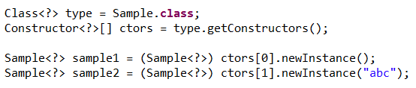

Reflection API
Create instance using constructor
Check if method is private or static:

Slide 7
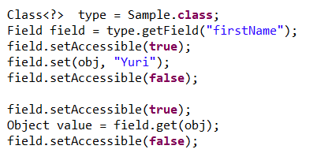
Reflection API
Get and set private field:
Get method Generic type:

Slide 8
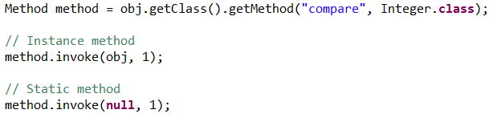

Reflection API
Invoke a method:
Iterate over an array

Slide 9
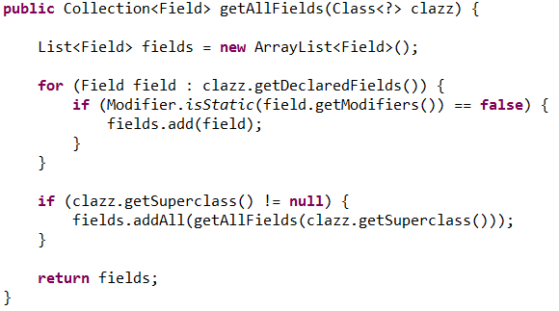
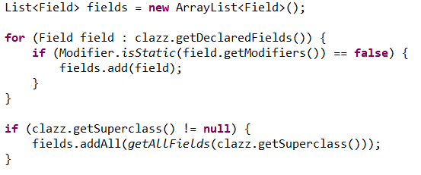
Reflection API
Get all fields (or methods)
GetFields – returns only public fields (including super fields)
GetDeclaredFields – returns all fields but not super fields.

Slide 10
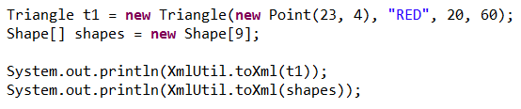
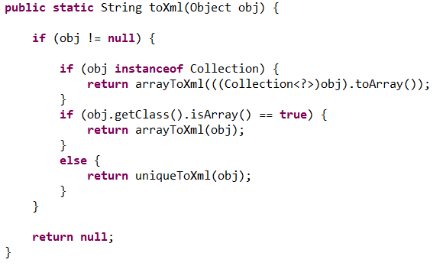
Reflection API
Example: Object to XML (no attributes):

Slide 11
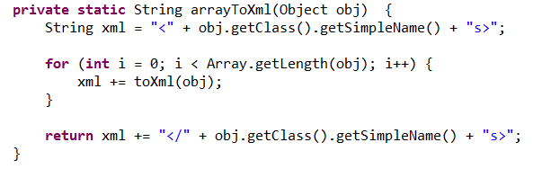
Reflection API
Object to XML (no attributes):

Slide 12
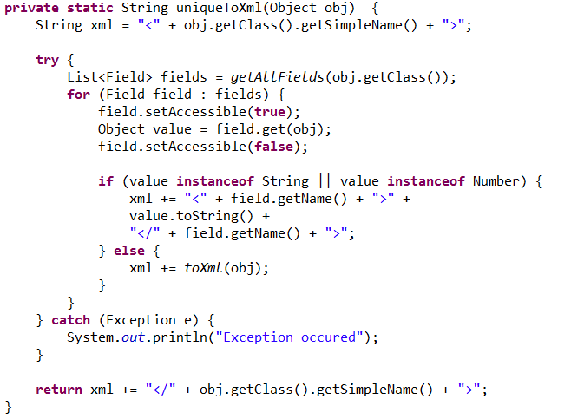
Reflection API
Object to XML (no attributes):

Slide 13
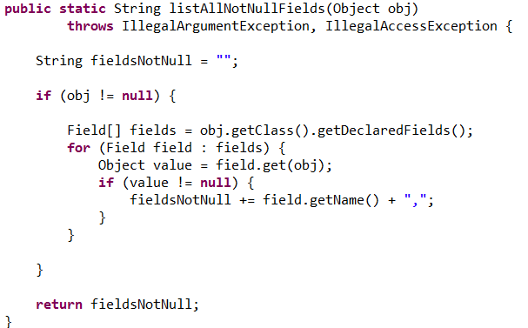
Reflection API
Exercise: Write a static method which gets an Object and returns a String of the names of all not null fields.

Slide 14
Reflection API
Exercise: Write a static method which gets an Object and returns a String of the names of all not null fields.

Slide 15
Reflection API
What are Reflection API’s pros?

Slide 16
Reflection API
What are Reflection API’s pros?
Handle general behavior regardless of types.
Flexibility

Slide 17
Reflection API
What are Reflection API’s pros?
Handle general behavior regardless of types.
Flexibility
What are Reflection API’s cons?

Slide 18
Reflection API
What are Reflection API’s pros?
Handle general behavior regardless of types.
Flexibility
What are Reflection API’s cons?
Performance. This is a very expensive API.
Encapsulation violation. Access private fields easily.
Lost of compile-time check.
Lots of messed-up and ugly code.

Slide 19
Annotations
Annotations are meta-data on the program embedded in the program.
Annotations can be parsed during run-time or on development time.
Annotations are used to hold meta-data on the class, method or field for further use somewhere in the program.
Annotations has no direct effect on the code they annotate.
We can use as many annotations as we want.

Slide 20
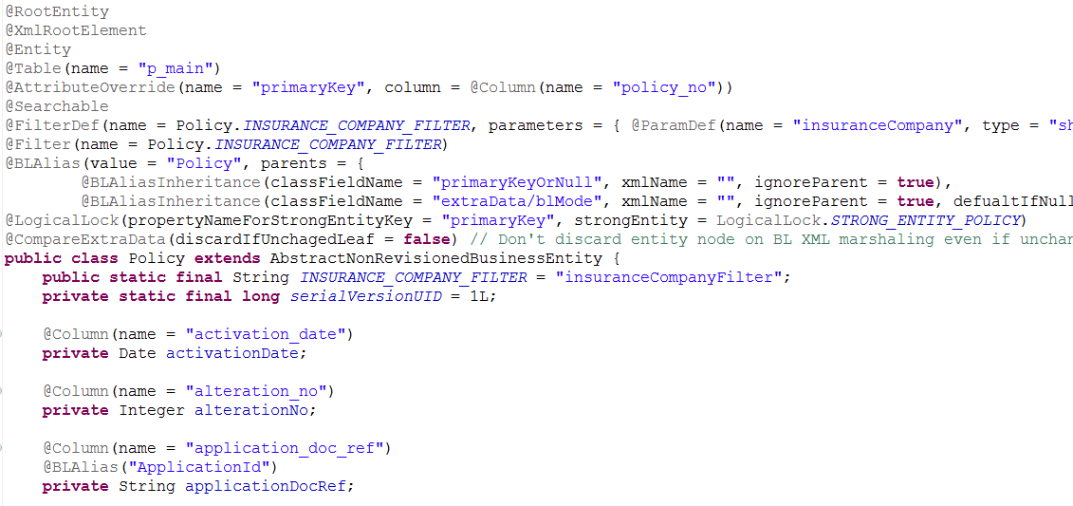
Annotations

Slide 21


Annotations
@override :
Development time annotation.
Makes sure that a method that the developer intended to override is actually exists in a super type or implemented interface. If not, compilation error.
@XmlElement
Runtime annotation
Provides meta-data regarding how this member should be translated to XML.

Slide 22
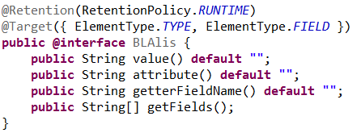
Annotations
Create a custom annotation @interface
Declare Retention : Runtime or source time
Declare Target : Field, Class , Method, Parameter, Constructor
Declare data.

Slide 23
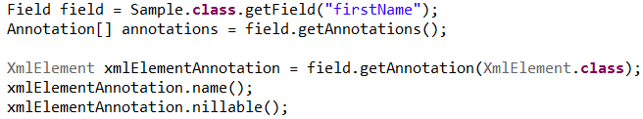
Annotations
Runtime annotations are very useful by Reflection API
We can search for meta-data of a field or a class at runtime very easily:

Slide 24
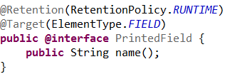
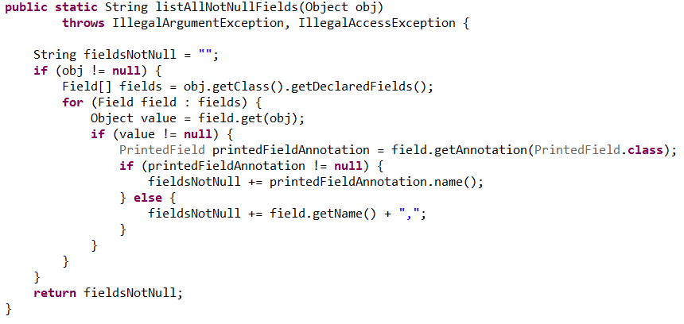
Annotations
Exercise: Use last exercise as a base. Add an annotation to change the way the field name is printed.

Slide 25
Annotations
Exercise: Use last exercise as a base. Add an annotation to change the way the field name is printed.

Slide 26
Design patterns
Best practices used by experienced software developers.
Solutions to problems developers face during development.
Solutions that were obtained by trial and error for a long time.
There are many design patterns we will explore only:
composite
Factory
Singleton
Proxy / Delegation proxy

Slide 27
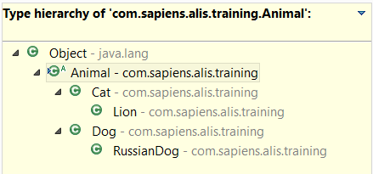
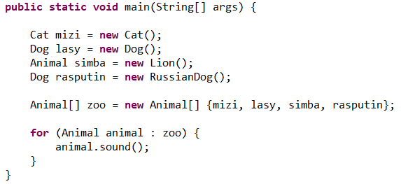
Design patterns
Composite: You already used it

Slide 28
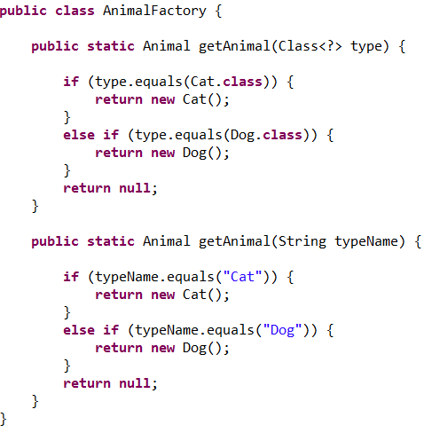
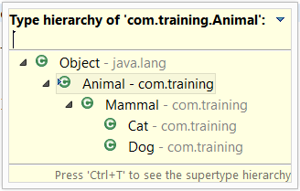
Design patterns
Factory: create an object

Slide 29
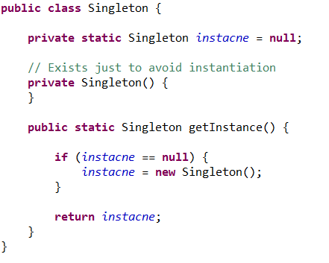
Design patterns
Singleton: one instance only.

Slide 30
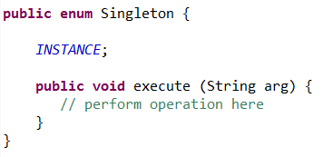
Design patterns
Singleton: More elegant way – The enum way

Slide 31

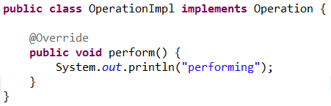
Design patterns
Proxy: A wrapper class that wraps the actual object and adds functionality without changing the object’s code. For example: Logger – add time of entrance and exit to an interface method:

Slide 32
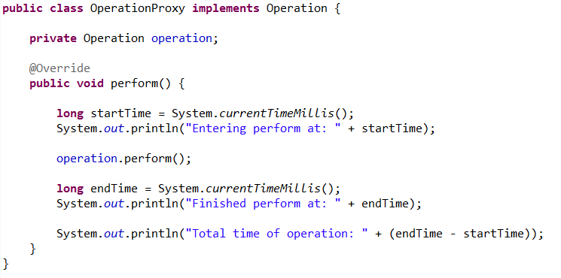
Design patterns
The proxy class implements the same interface, but in it’s own implementation, it add functionality and call the actual object’s operation.

Slide 33
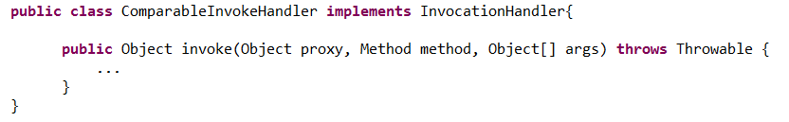
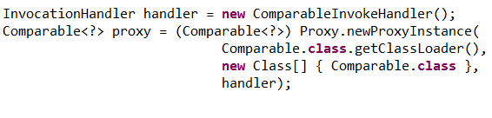
Design patterns
Delegation proxy – Creating proxies dynamically using reflection.

Slide 34
Design patterns
Exercise: Create JSON serializer using Reflection API. Get an object and return JSON string. * Object can be a single object. * Object can be a List or a Set or an Array. * Don’t handle Maps. * Don’t forget that nulls should be serialized as “null”. * Numbers should not be wrapped with “ “.

Slide 35
Overview
Reflection API
Annotations
Design patterns

Slide 36


THANK YOU
Ido Barash
Email: ido.barash@tikalk.com

